Slide 1
The Other Alex
Alex Shellum, Alex Malott, Aaron Thompson
Devin Kadillak, Lucas Wilson

Slide 2
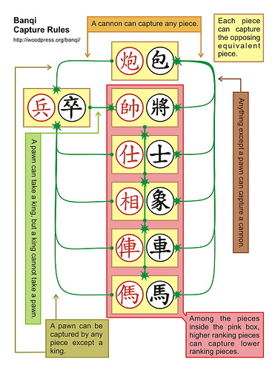
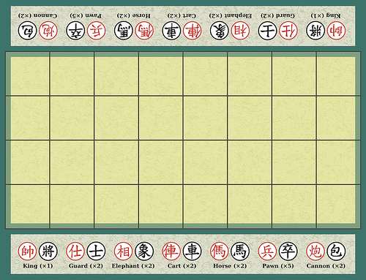
Banqi Capture Rules

Slide 3
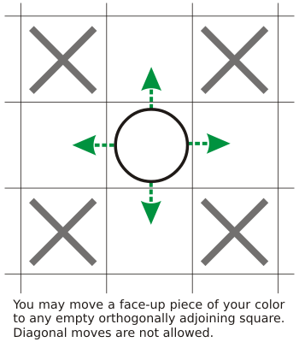
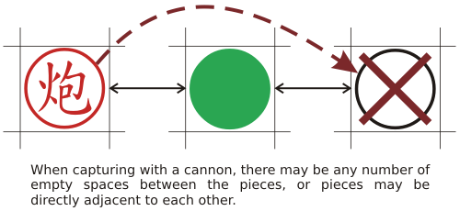
Banqi Movement

Slide 4
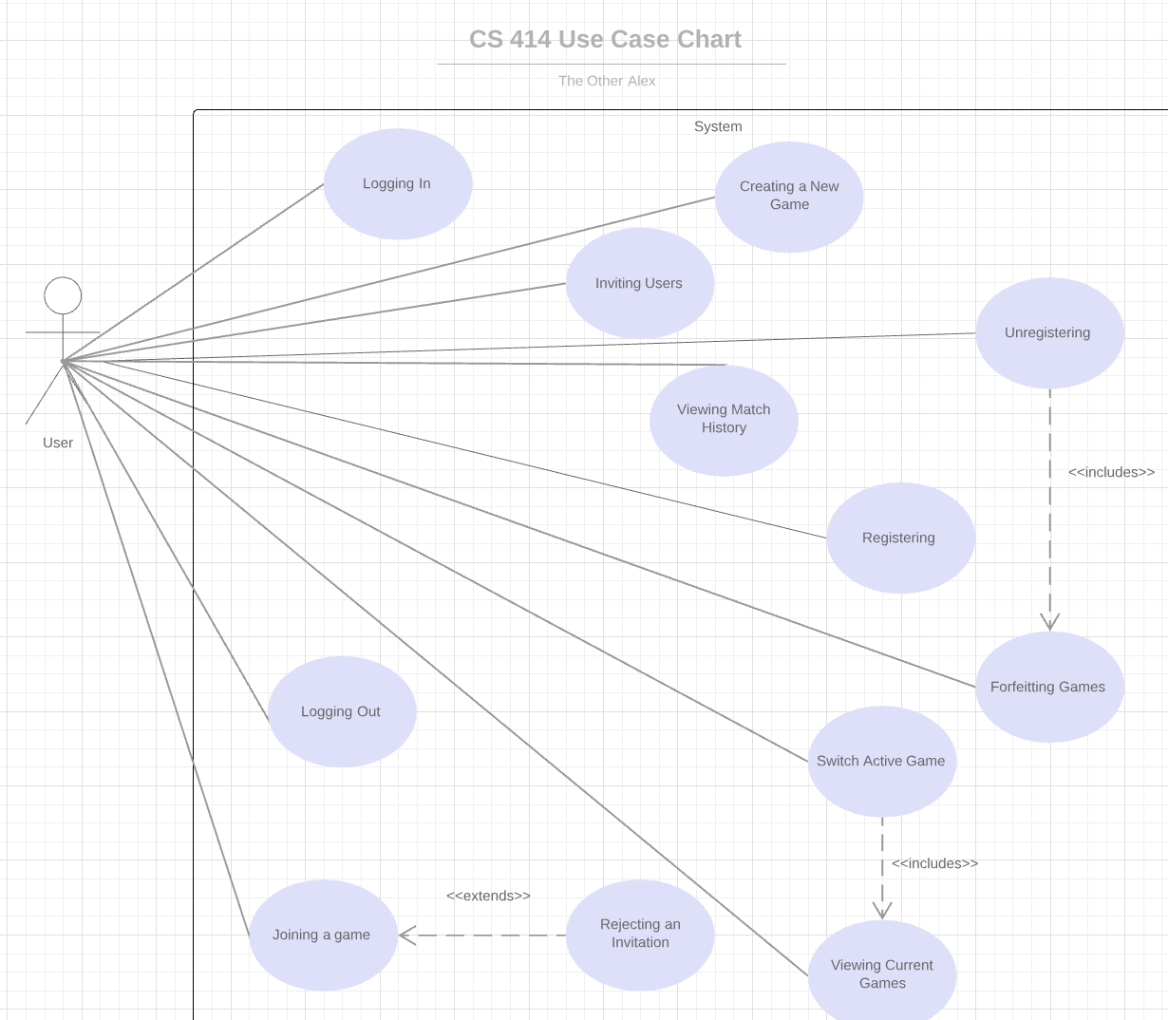
Use Case Document
Use case id: | EU-4
Use case name: | Joining a game
Overview: | The first invited player to accept an invite joins the game.
Type: | Primary
Actors: | User {Initiator} {Primary}
Pre-conditions: | EU-3
Main Flow: | 1) The invited user receives invitation. 2) The invited user accepts invitation. 3) The system checks validity of invitation and finds it valid. 4) The invited user joins the game.
Alternative flows: | 3a) Invalid invitation. 3a1) The system checks validity of invitation and finds it invalid. 3a2) The system notifies the user about the invalidity of the invitation and removes it from the invited player dashboard. 3a3) Use case ends.
Post-conditions: | The invited player joins user’s game.

Slide 5
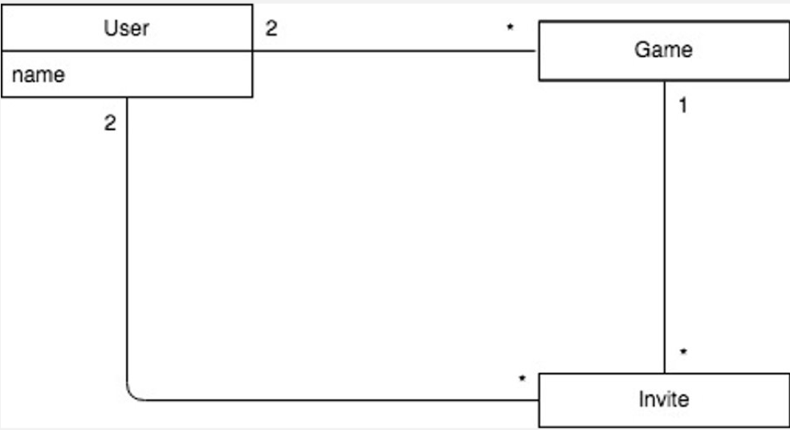
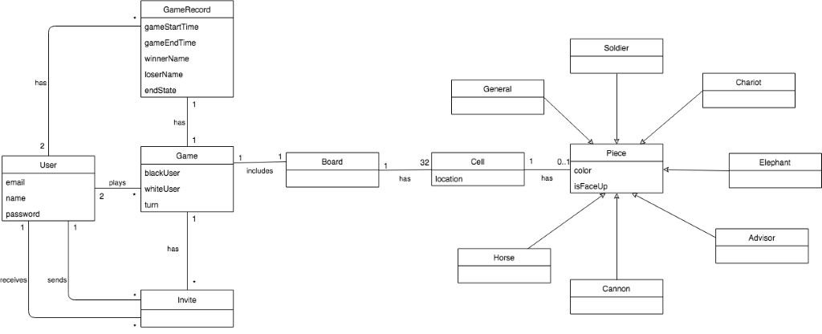
Domain Model
Old and busted
Revised

Slide 6
Design Document: Package Diagram

Slide 7
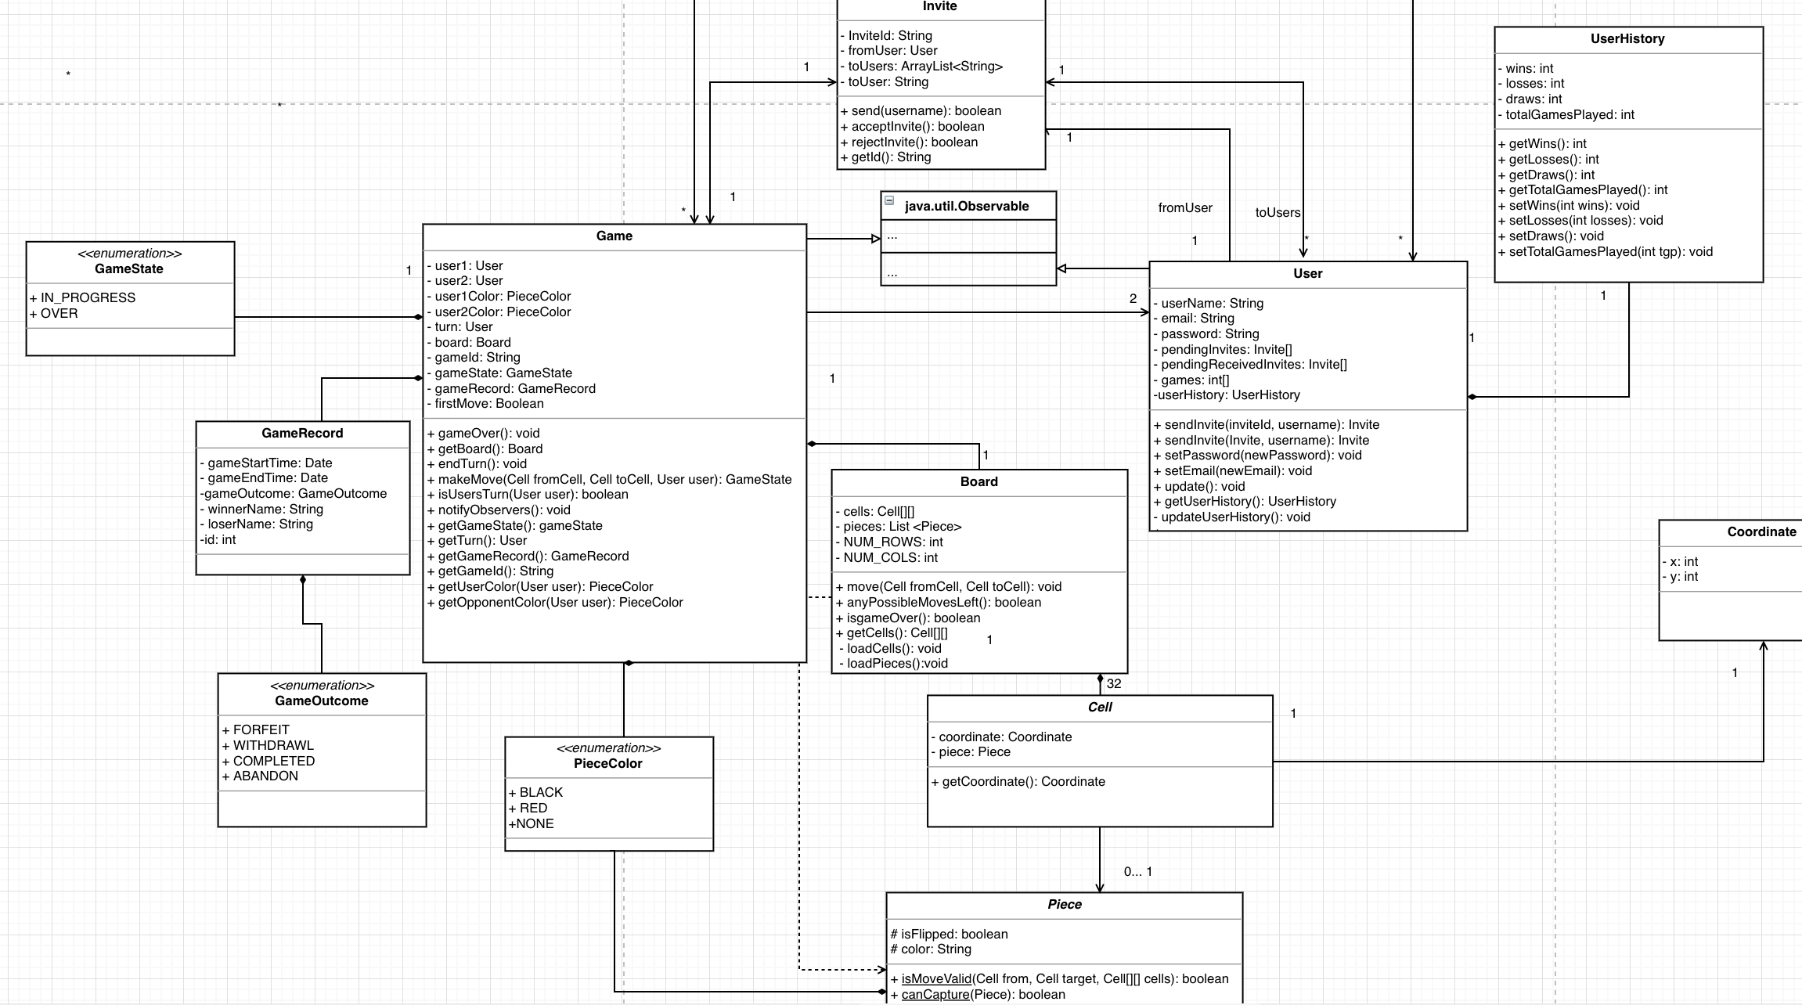
Design Document: Design Class Diagram

Slide 8
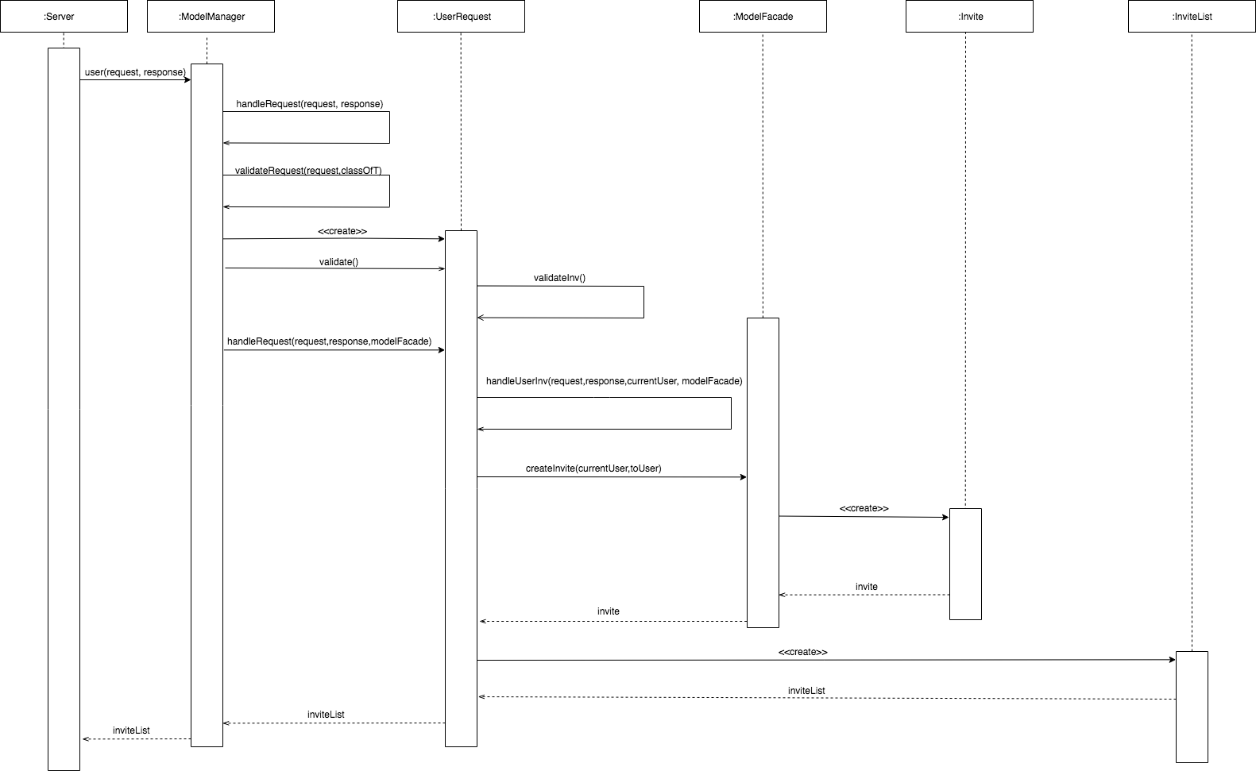
Sequence Diagram For Creating an Invite

Slide 9
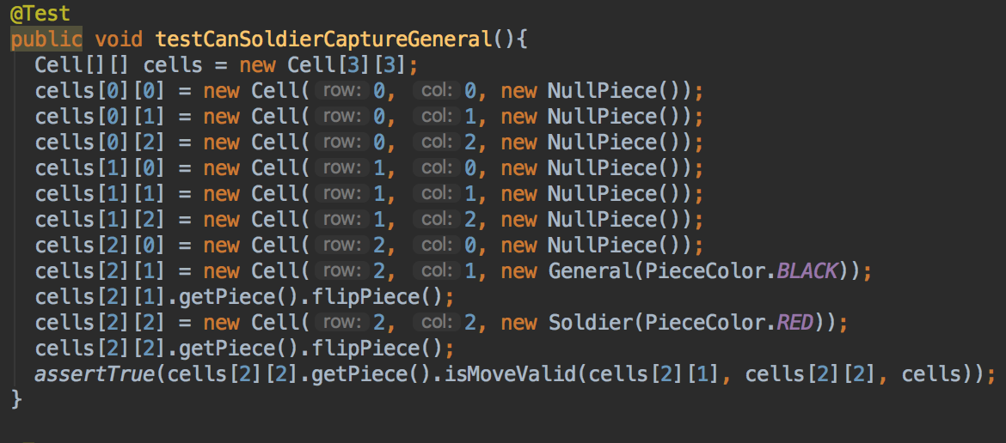
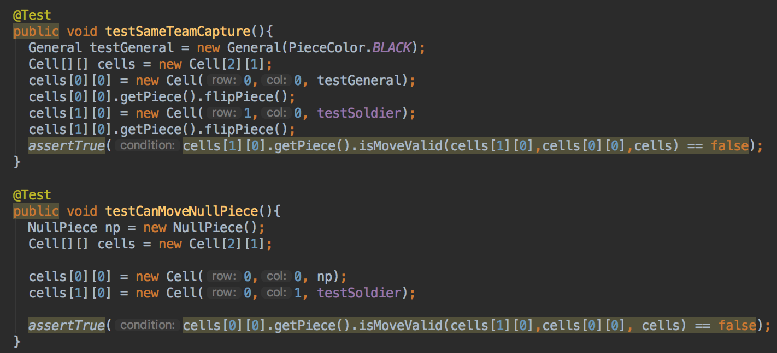
Unit Testing
Testing corner cases
Testing basic functionality

Slide 10
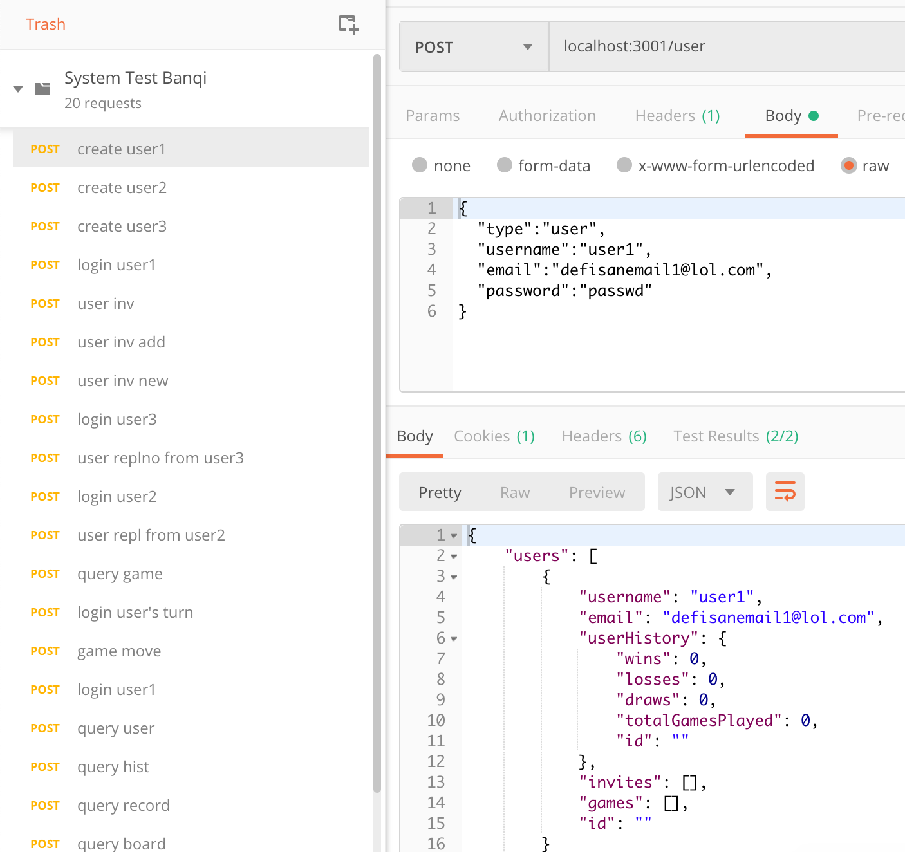
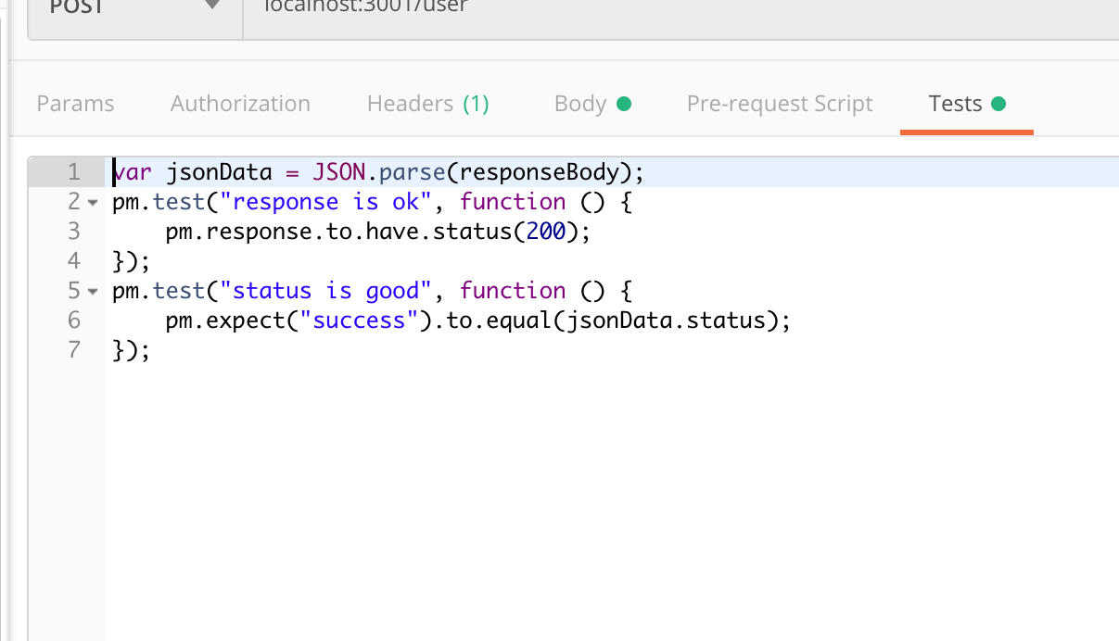
System Testing

Slide 11
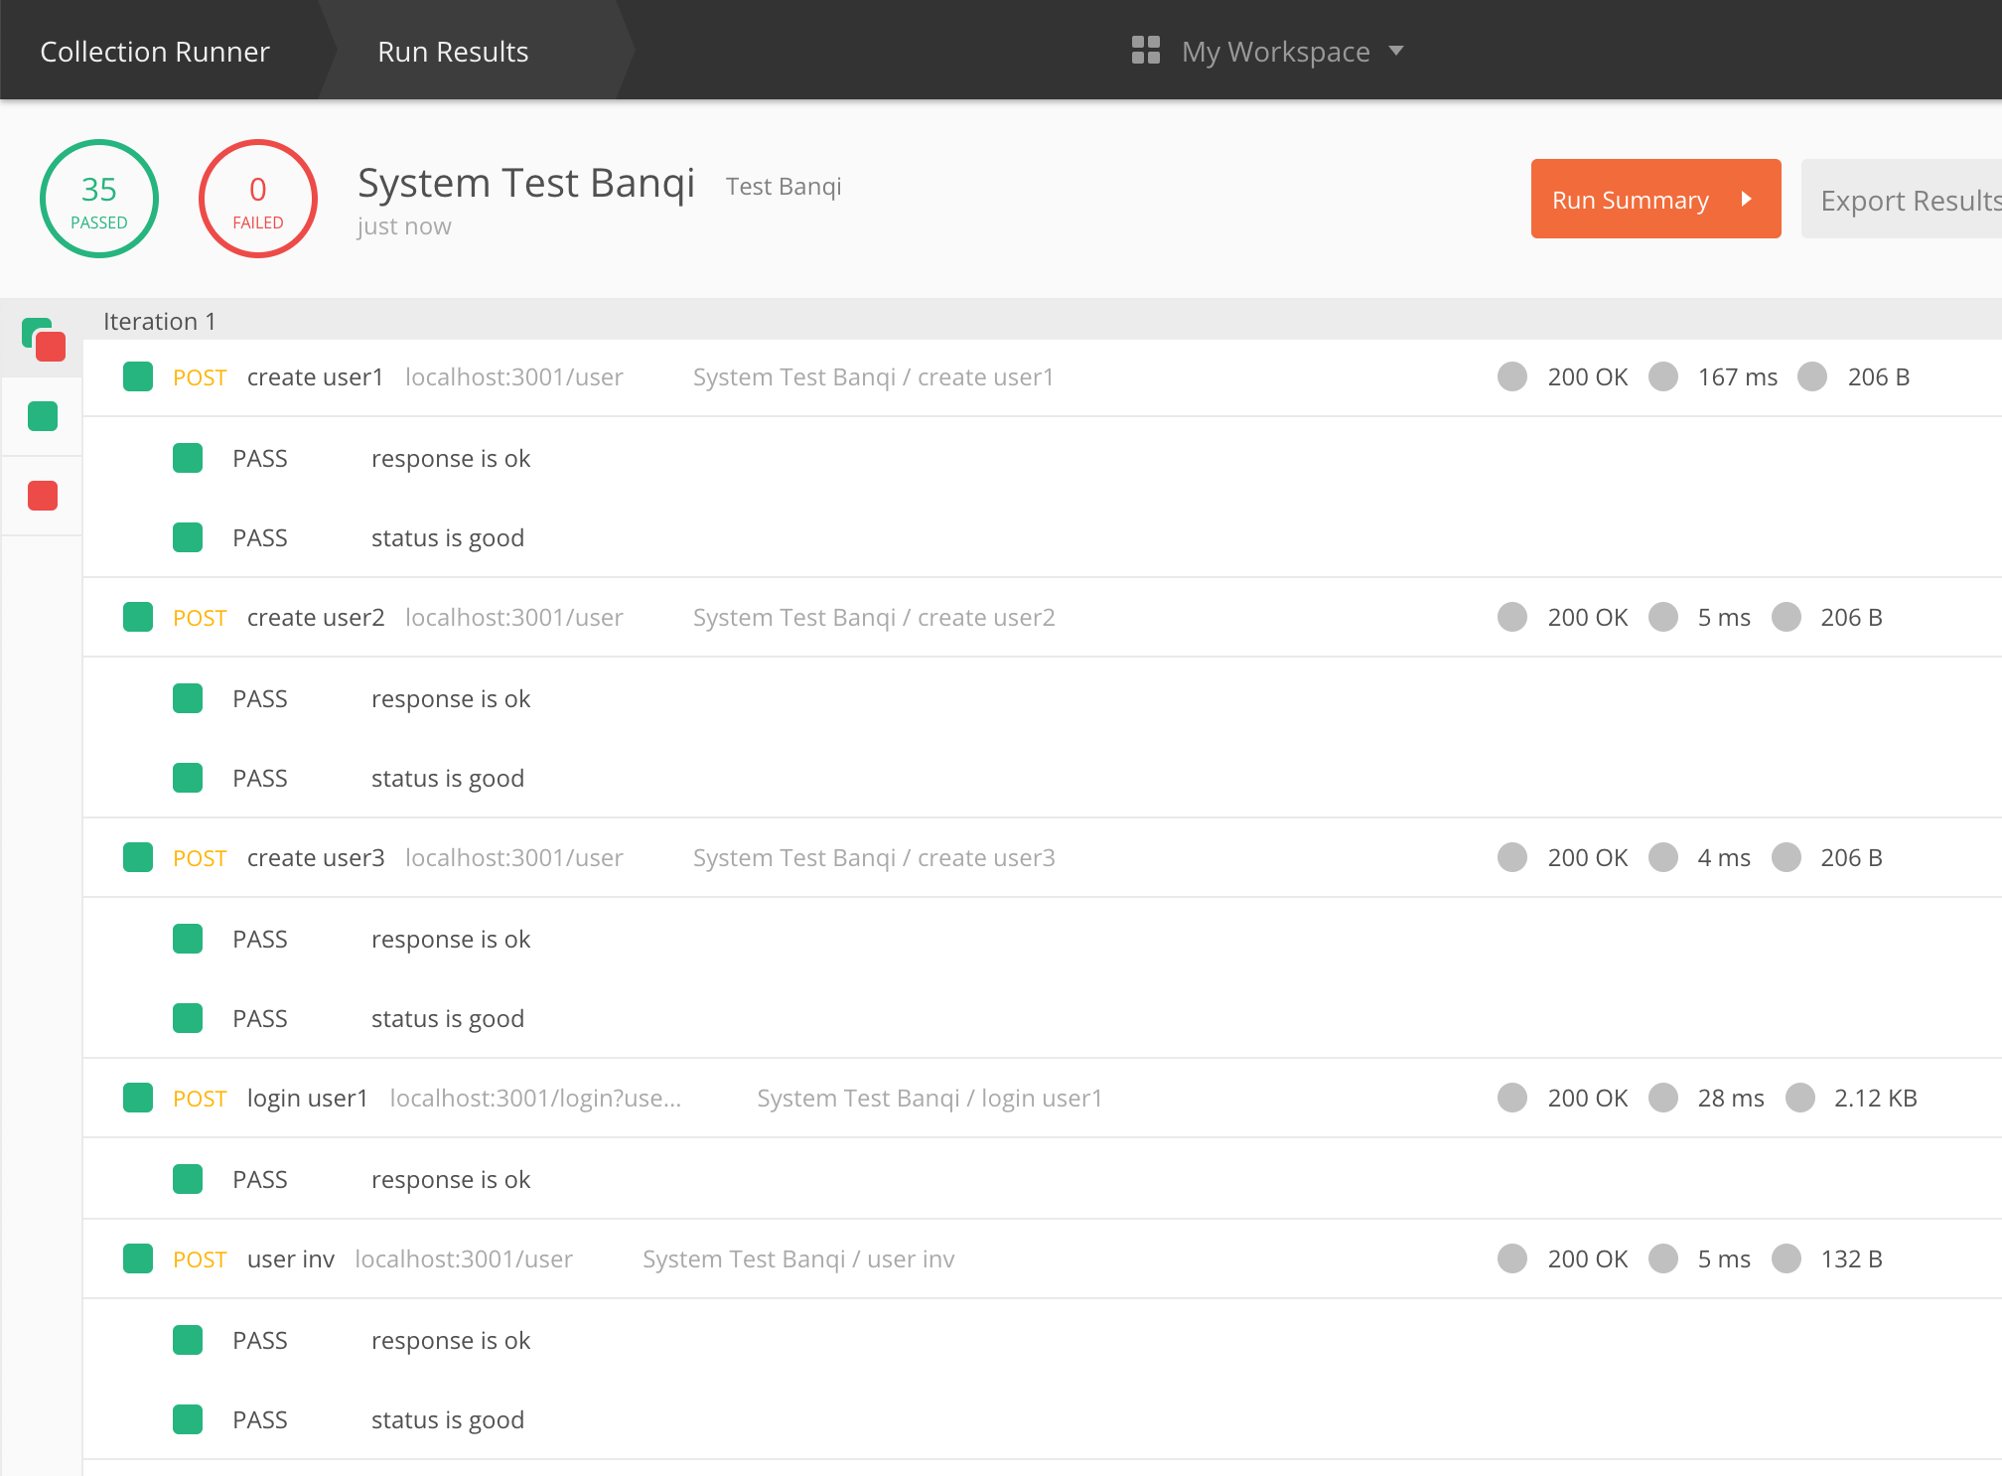
System Testing

Slide 12
Refactoring

Slide 13
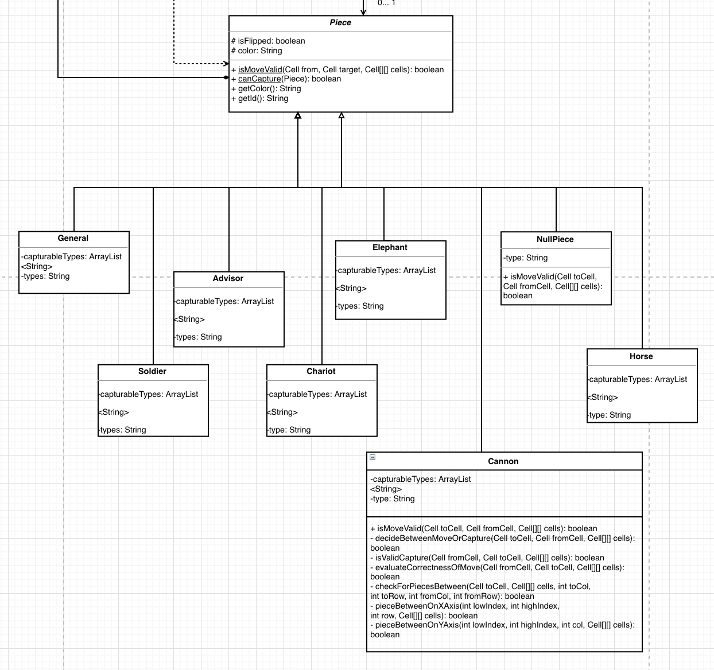
GRASP Pattern: Polymorphism

Slide 14
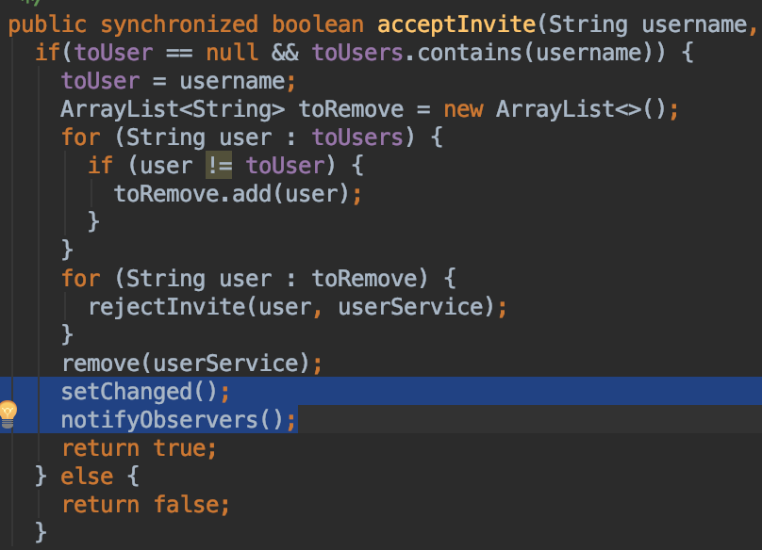
Pattern: Observer Pattern Subject

Slide 15
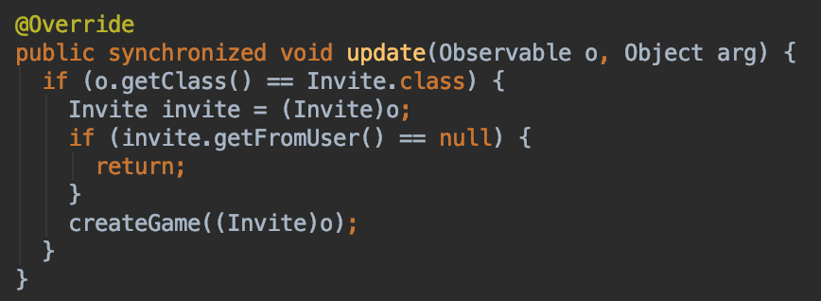
Pattern: Observer Pattern Observer

Slide 16
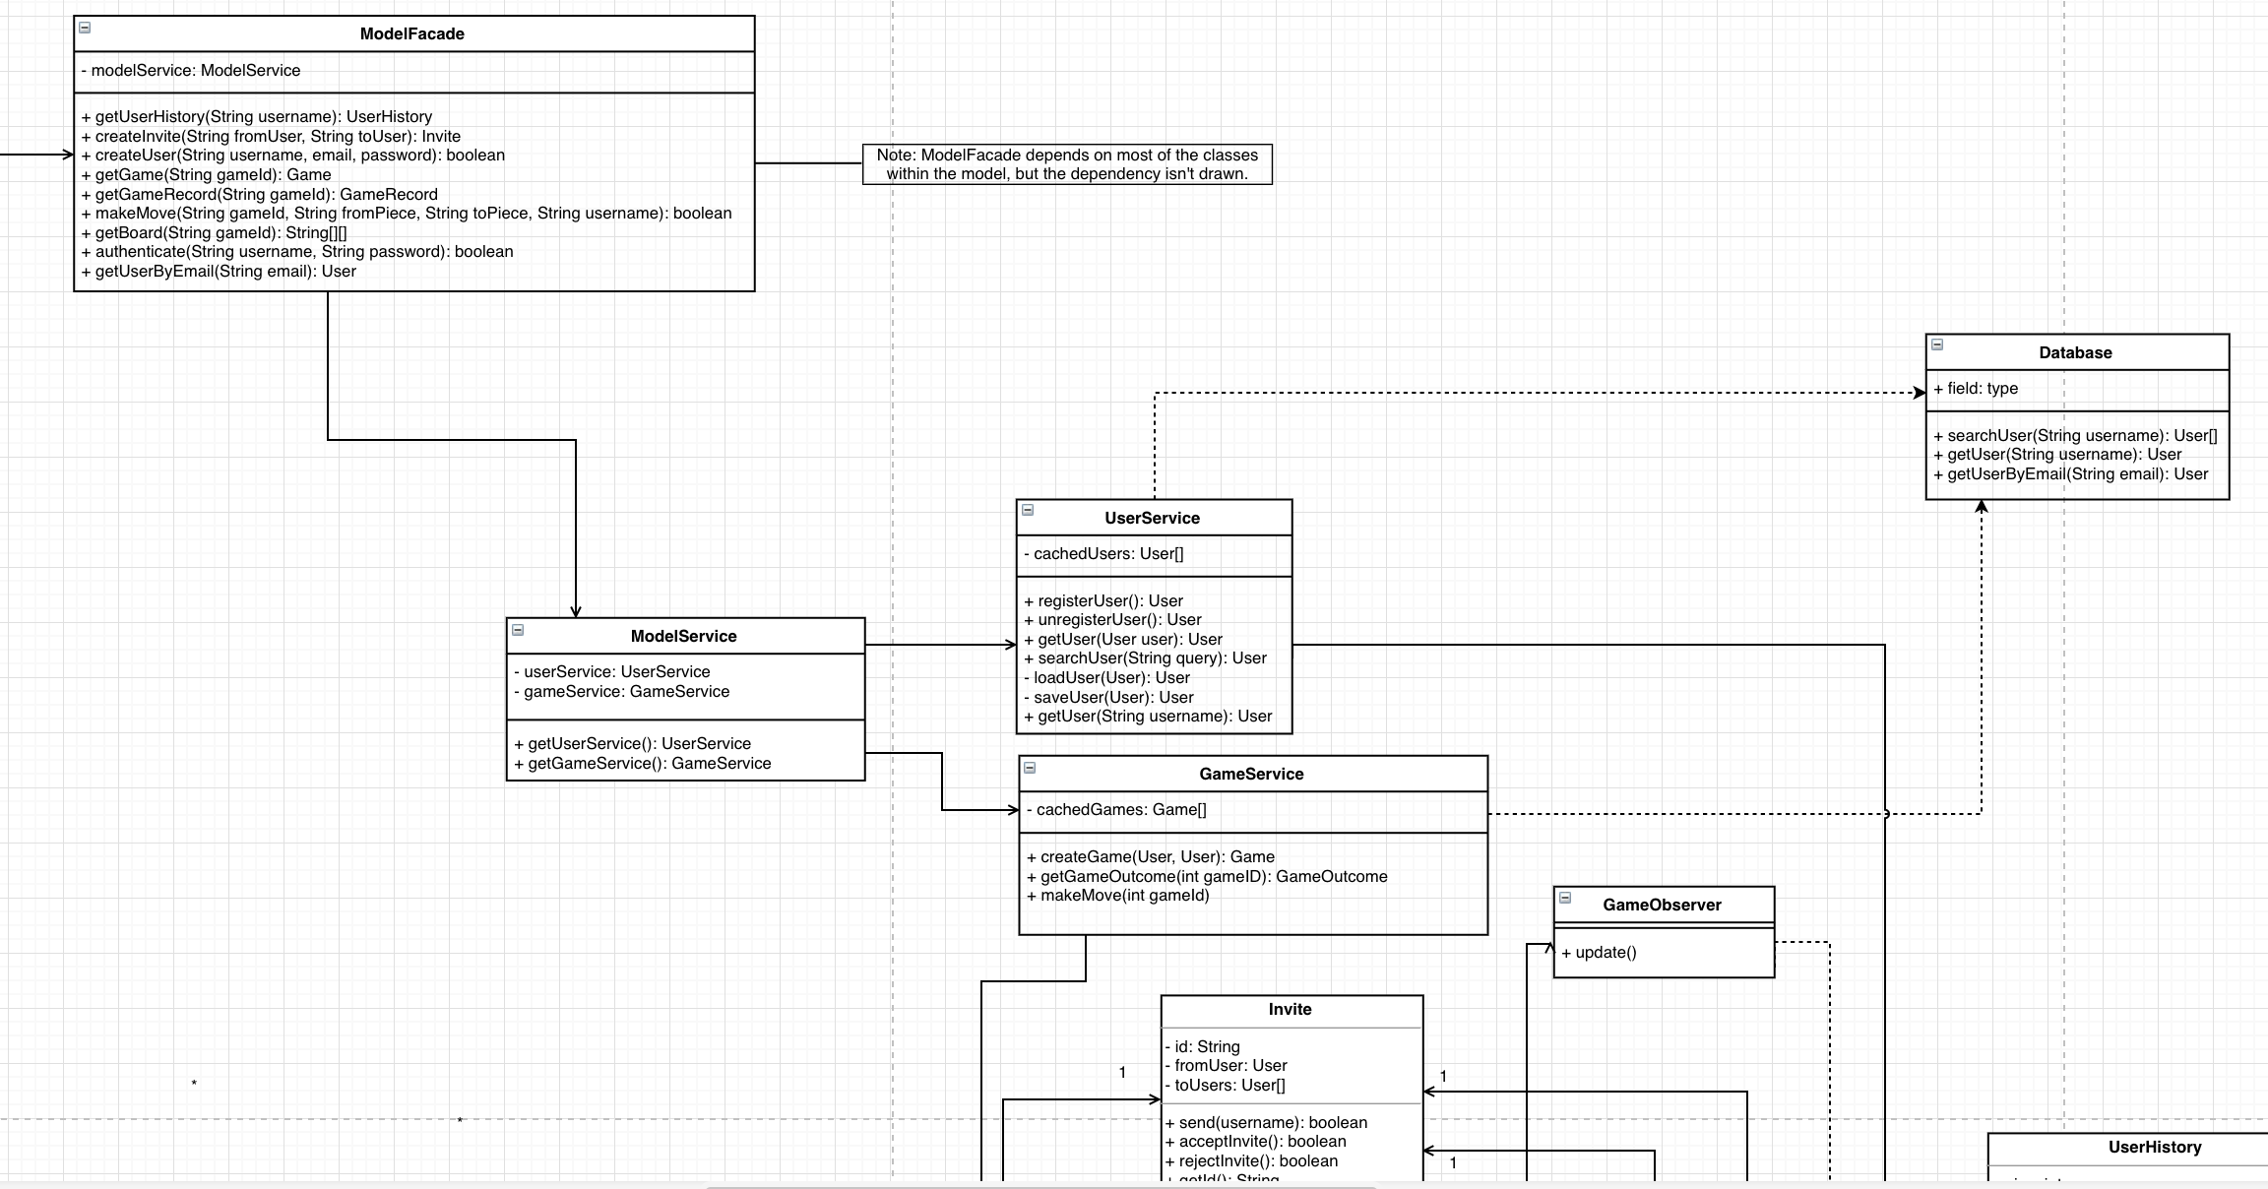
Pattern: Facade Controller

Slide 17
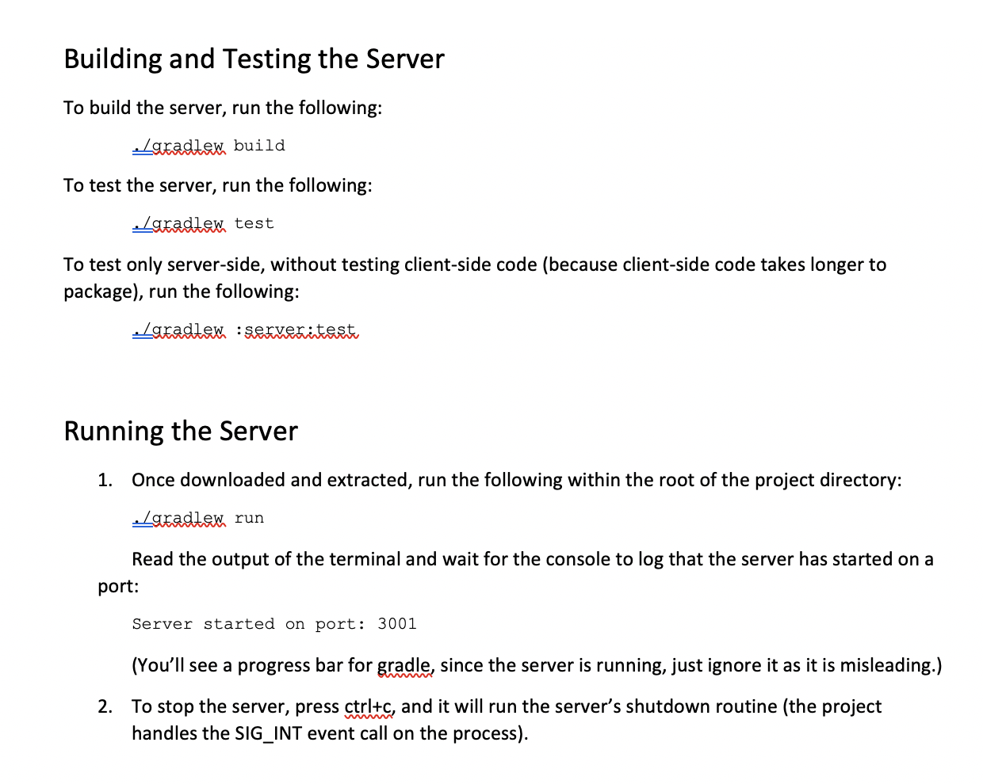
Development Manual

Slide 18
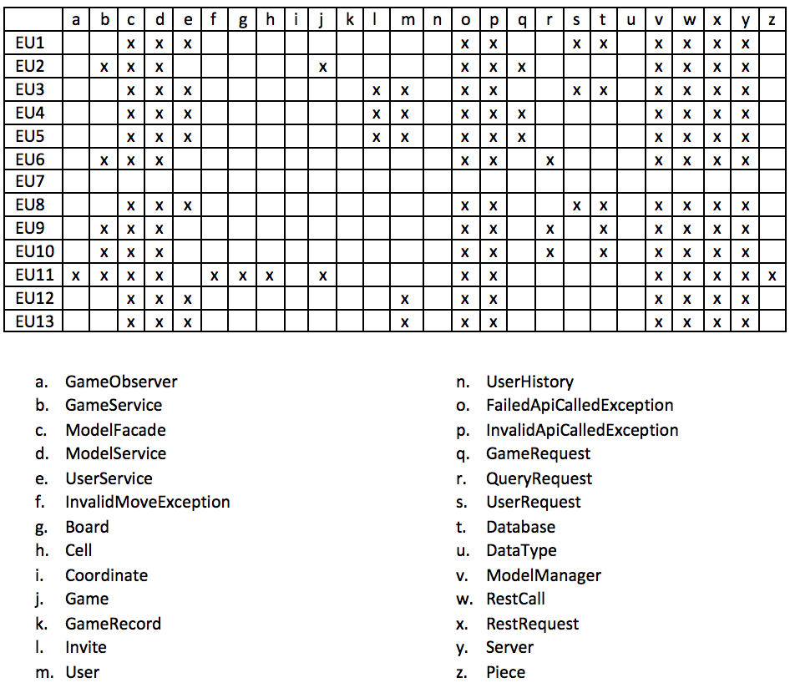
Traceability Link Matrix
EU1: Registering
EU2: Creating a game
EU3: Inviting Users
EU4: Joining a game
EU5: Rejecting Invitation
EU6: Switch active game
EU7: Forfeiting a game
EU8: Unregistering
EU9: Viewing match history
EU10: Viewing Active Games
EU11: Moving
EU12: Logging In
EU13: Logging out

