Slide 1
CS480x: Final Project Process Book
Jason Dykstra, Colby Frechette, Shannon Truong
March 2021

Slide 2
THIS SLIDE WILL DISPLAY THE FINAL PRODUCT ON OUR WEBSITE AND A DESCIPTION OF WHAT WE DID

Slide 3
Overview, Motivation, objectives
Overview
This project aims to present various aspects of WPI finances and compare these figures across a span of 11 fiscal years from 2009-2020.
Motivation
Our team was interested in creating a visualization of the WPI financial reports and how they progressively change year to year. We were interested in seeing what WPI was spending their money on, their assets, and how this has evolved over the given timeframe. Additionally, we think that this dataset would be fun, interesting , and relatable to WPI students if we presented the information visually and would peak their interest rather than in a fiscal year report.
Goals/Objectives
The objectives for this project include the following:
Process and extract data from fiscal year reports including various interesting categories to present
Find and accurately produce effective graphs and charts to convey information to the user
Create an effective visualization from the scraped dataset presented in the WPI fiscal year reports.
*The final objective encompasses the all of the project goals/objectives*

Slide 4
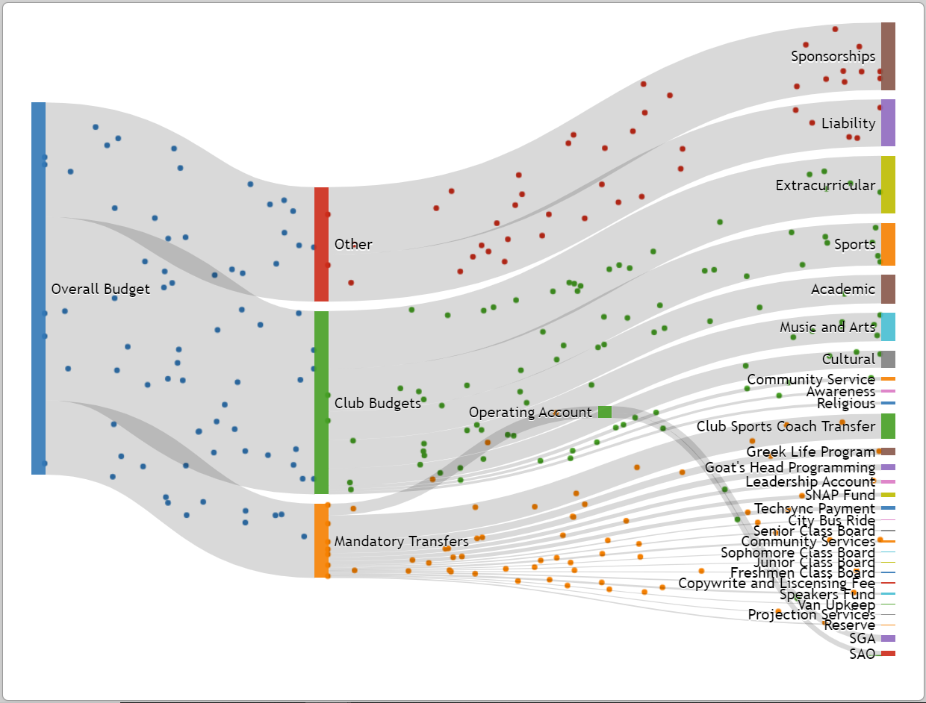
Related Works and Inspirations
https://sgaviz.cs.wpi.edu/
A recent WPI MQP also had a similar project goal. Their project focused more specifically on where the WPI student life fee is being used as handled by the Student Government Association (SGA) which primarily manages club budgets. Our project focuses on a broader budget encompassing WPI assets and where those funds are being allocated for the university as a whole
We initially caught interest in learning about the allocation of WPI funds from a news article revealing Robert Foisie’s gift of a golf course in Florida contributing to WPI’s owned real estate which is reported in their assets.

Slide 5
Data
Data Source
https://www.wpi.edu/offices/controller
For every fiscal year from 2009-2020, WPI publishes a report and financial statement outlining expenses and revenue collected for each year. It further goes into detail of the allocation of funds for categories which we will select a variety to include in the visualization.
Data Collection
For every report published, there is a uniform format. This made our data scraping much easier. We performed this data scraping manually as the datasets we were viewing were small enough. Using a spreadsheet, we were able to go in and select only the categories that seemed interesting to include in the visualization. We first all decided on gathering data regarding total liabilities and assets for every fiscal year. To add on, additional categories that we plan on analyzing include: Student Services, Sponsored Research (operating expenses), Tuition and Fees, Net Student Loans Receivable, and Real Estate (with assets). These figures were represented in thousands. The figures were recorded for every fiscal year FY09-FY20.
Unintended Problems and Notes
During our data collection, in some cases we ran into some issues in which there were some discrepancies between the data. In the fiscal year reports, each year reports the current year as well as providing figures from the previous years. We encountered some discrepancies between the number for some categories as we were data scraping.

Slide 6
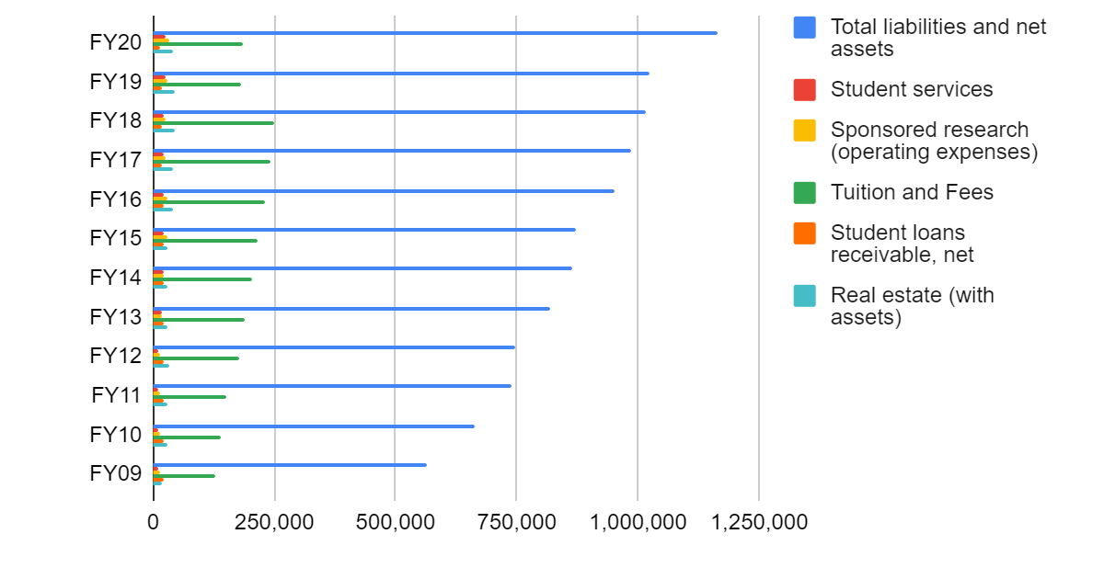
Data Analysis
Since the dataset that we have chosen for this visualization were simple and small, we were able to glance at the spreadsheets and quickly understand the overall trend of the data. At first glance, viewing the total liabilities and net assets data points, we can see that due to inflation and the university growth in the past decade, this number has increased over the span of the timeframe of our data. This is shown and graphed in the figure below from our collected data in a spreadsheet. We see that the Tuition and fees category fluctuates with a steady increase from FY09 to FY18 but drops and is constant at FY19-FY20 so far. There may be a reason for this drop in this dataset and one can infer that due to COVID-19, this may have played a role in affecting the revenue the university collects in tuition and fees.

Slide 7
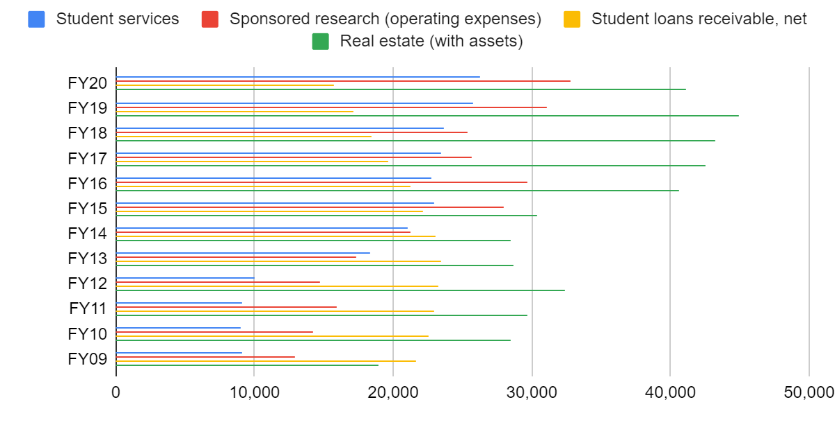
Data Analysis Continued…
Using the same tool, we can continue to go in and visualize the remaining categories we were initially interested in. As a general trend, we see that for student services, sponsored research, and real estate, there is a general upward trend. The amount of money allocation increases with each fiscal year. Consequently, the net student loans receivable category has a rough bell shape from FY09-FY20. This may be due to other factors as well.
By graphing the data collected, we were able to have an expected outcome of the trends in our dataset. While nothing is descriptive and very detailed in these initial visualization generation, it gives us a rough estimate of what to expect and gives us an initial idea of an accurate presentation of our data for when we go to create a visual.

Slide 8
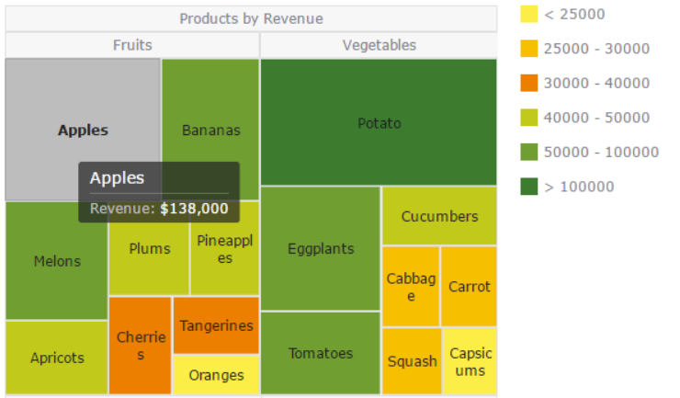
Design Evolution
After looking at various visualizations presenting data on financial reports, we saw that many creators utilized an interactive animated visualization to show the cash flow and allocation of funds from a source to the groups. This visualization style is called a Sankey diagram which was presented in the Related Works section.
Similarly, as shown above, we considered utilizing a tree map to display various data sets from different fiscal years in order to compare. We wanted to use tree maps to convey what percentage of the budget is allocated to the various categories as mentioned before. As seen in the figure above, the size of the cells can help relay this data to the viewer. This may allow the viewer to perceive the data more clearly.

