Slide 1
CS480x: Final Project Process Book
Jason Dykstra, Colby Frechette, Shannon Truong
March 2021

Slide 2

WPI financial evolution through the years….
WPI students pay thousands of dollars in tuition yearly but where does all the money go? We use data visualizations of WPI’s University Audited Financial Statements for each fiscal year to visually compare differences in where WPI gets its money, and how it spends it.

Slide 3
Overview, Motivation, objectives
Overview
This project aims to present various aspects of WPI finances and compare these figures across a span of 11 fiscal years from 2009-2020.
Motivation
Our team was interested in creating a visualization of the WPI financial reports and how they progressively change year to year. We were interested in seeing what WPI was spending their money on, their assets, and how this has evolved over the given timeframe. Additionally, we think that this dataset would be fun, interesting , and relatable to WPI students if we presented the information visually and would peak their interest rather than in a fiscal year report.
Goals/Objectives
The objectives for this project include the following:
Process and extract data from fiscal year reports including various interesting categories to present
Find and accurately produce effective graphs and charts to convey information to the user
Create an effective visualization from the scraped dataset presented in the WPI fiscal year reports.
*The final objective encompasses the all of the project goals/objectives*

Slide 4
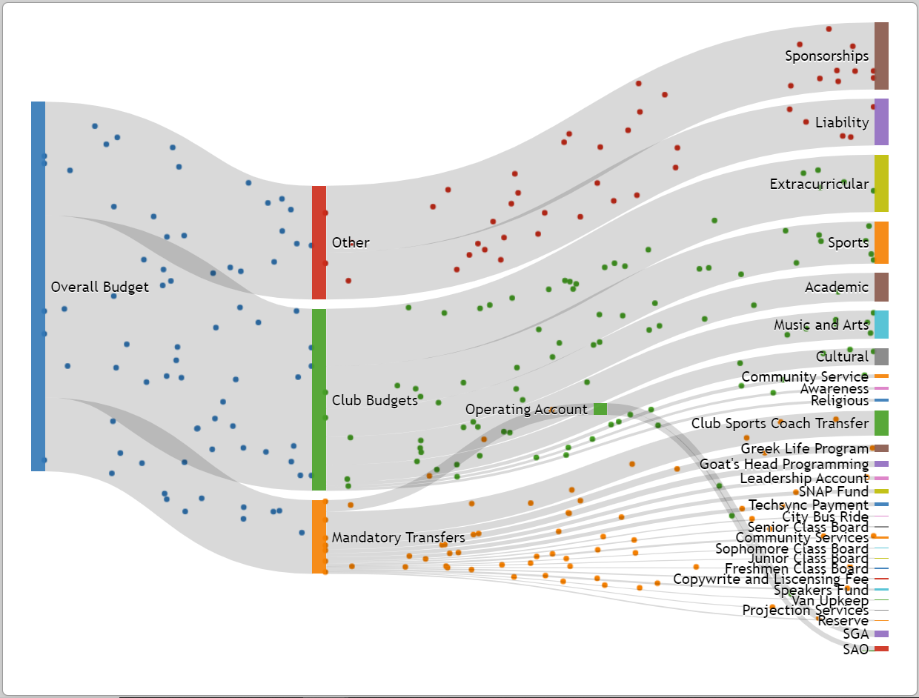
Related Works and Inspirations
https://sgaviz.cs.wpi.edu/
A recent WPI MQP also had a similar project goal. Their project focused more specifically on where the WPI student life fee is being used as handled by the Student Government Association (SGA) which primarily manages club budgets. Our project focuses on a broader budget encompassing WPI assets and where those funds are being allocated for the university as a whole
We initially caught interest in learning about the allocation of WPI funds from a news article revealing Robert Foisie’s gift of a golf course in Florida contributing to WPI’s owned real estate which is reported in their assets.

Slide 5
Questions
What affected the rise of total liabilities and net assets?
How does student tuition affect the total liabilities and net assets?
How has WPI spent the money it has earned on students? (i.e., sponsored research, student services, student loans)
Our primary question for investigation and what interested our team initially to explore this data set was the figure presenting the total liabilities and net assets (TLNA). This figure seemed to have increased throughout the years, as seen visually and numerically. Initially, our hypothesis for this rise was based on the idea that tuition increase among other factors such as increase in student enrollment, were the cause.
With our hypothesis, we developed a second question to explore this notion that the primary income for WPI was tuition increase. As mentioned, and analyzed later, this was not the case.
Our third question then targets the use of the increase in TLNA. Since there is a clear increase in this figure, our team decided to analyze where the money was being spent and how the money was benefitting the students at WPI.

Slide 6
Data
Data Source
https://www.wpi.edu/offices/controller
For every fiscal year from 2009-2020, WPI publishes a report and financial statement outlining expenses and revenue collected for each year. It further goes into detail of the allocation of funds for categories which we will select a variety to include in the visualization.
https://public.tableau.com/profile/wpi.institutional.research#!/vizhome/Enrollment_15718046316670/Enrollment
To continue, we also utilized an online source on tableau that presents data regarding the enrollment of students during over the years. The source presents demographics, majors, and more information on the number of students enrolled per year.
Data Collection
For every report published, there is a uniform format. This made our data scraping much easier. We performed this data scraping manually as the datasets we were viewing were small enough. Using a spreadsheet, we were able to go in and select only the categories that seemed interesting to include in the visualization. We first all decided on gathering data regarding total liabilities and assets for every fiscal year. To add on, additional categories that we plan on analyzing include: Student Services, Sponsored Research (operating expenses), Tuition and Fees, Net Student Loans Receivable, and Real Estate (with assets). These figures were represented in thousands. The figures were recorded for every fiscal year FY09-FY20.
Unintended Problems and Notes
During our data collection, in some cases we ran into some issues in which there were some discrepancies between the data. In the fiscal year reports, each year reports the current year as well as providing figures from the previous years. We encountered some discrepancies between the number for some categories as we were data scraping.

Slide 7
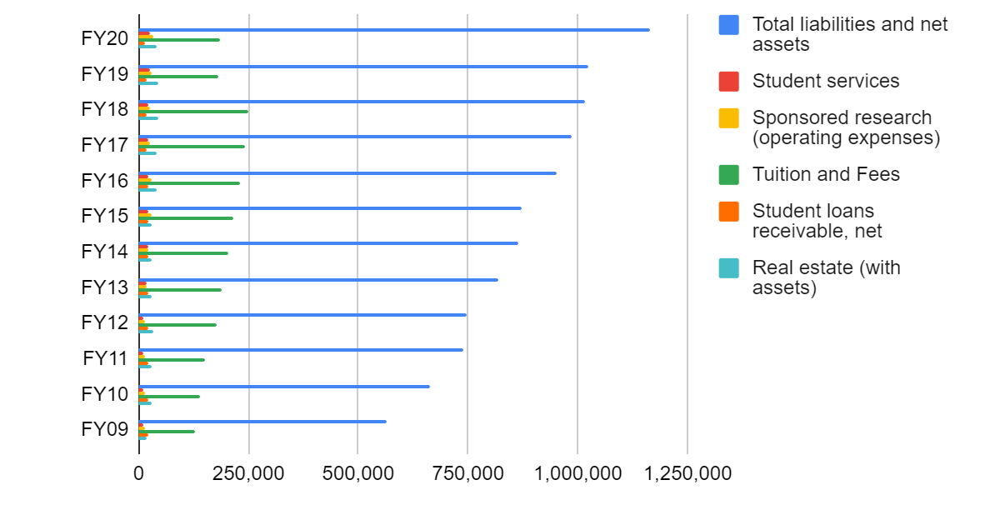
Initial Data Analysis
Since the dataset that we have chosen for this visualization were simple and small, we were able to glance at the spreadsheets and quickly understand the overall trend of the data. At first glance, viewing the total liabilities and net assets data points, we can see that due to inflation and the university growth in the past decade, this number has increased over the span of the timeframe of our data. This is shown and graphed in the figure below from our collected data in a spreadsheet. We see that the tuition and fees category fluctuates with a steady increase from FY09 to FY18 but drops and is constant at FY19-FY20 so far. There may be a reason for this drop in this dataset and one can infer that due to COVID-19, this may have played a role in affecting the revenue the university collects in tuition and fees.

Slide 8
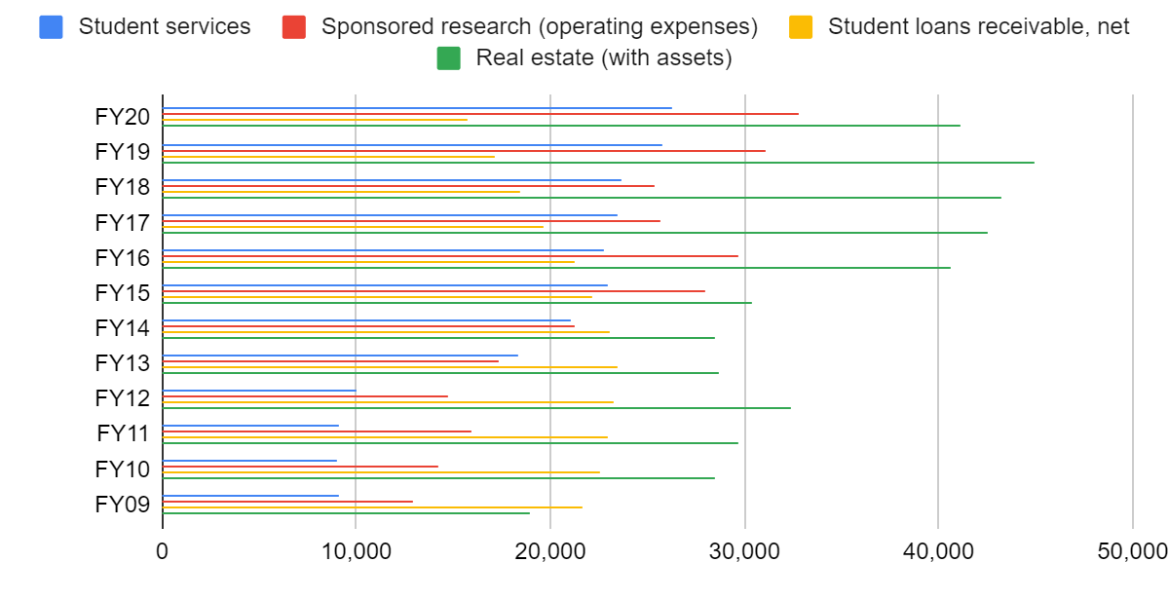
Initial Data Analysis Continued…
Using the same tool, we can continue to go in and visualize the remaining categories we were initially interested in. As a general trend, we see that for student services, sponsored research, and real estate, there is a general upward trend. The amount of money allocation increases with each fiscal year. Consequently, the net student loans receivable category has a rough bell shape from FY09-FY20. This may be due to other factors as well.
By graphing the data collected, we were able to have an expected outcome of the trends in our dataset. While nothing is descriptive and very detailed in these initial visualization generation, it gives us a rough estimate of what to expect and gives us an initial idea of an accurate presentation of our data for when we go to create a visual.

Slide 9
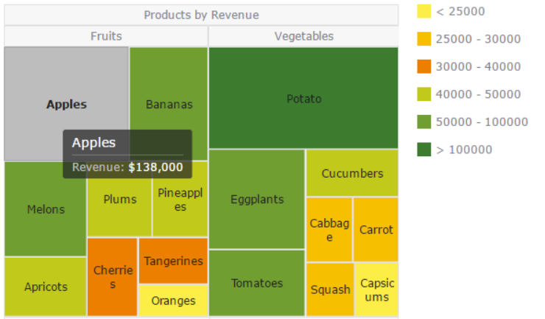
Design Evolution
After looking at various visualizations presenting data on financial reports, we saw that many creators utilized an interactive animated visualization to show the cash flow and allocation of funds from a source to the groups. This visualization style is called a Sankey diagram which was presented in the Related Works section.
Similarly, as shown above, we considered utilizing a tree map to display various data sets from different fiscal years in order to compare. We wanted to use tree maps to convey what percentage of the budget is allocated to the various categories as mentioned before. As seen in the figure above, the size of the cells can help relay this data to the viewer. This may allow the viewer to perceive the data more clearly.

Slide 10
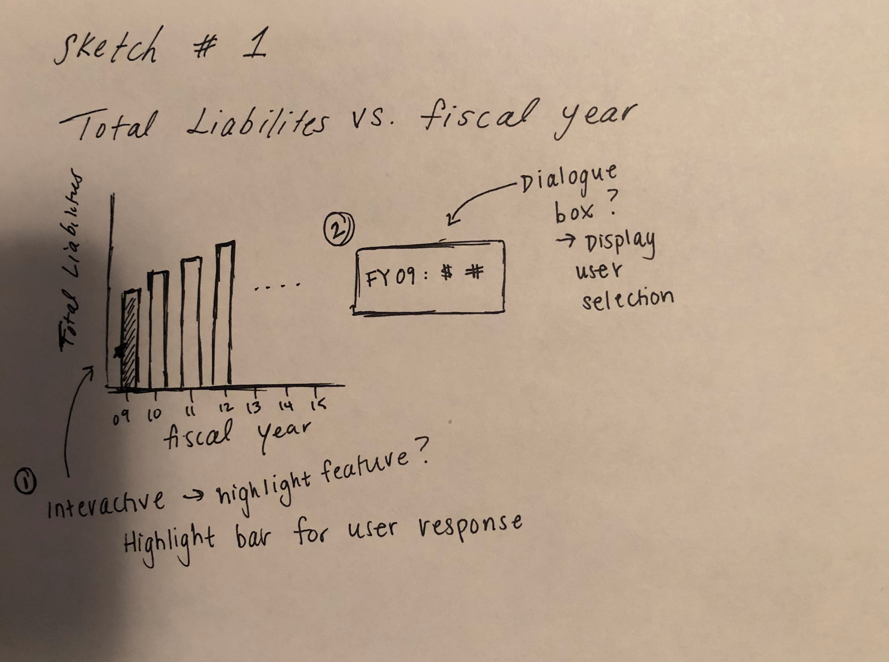
While we did consider utilizing tree maps, we ultimately decided to visualize the financials of WPI using bars. As noted in the Cleveland and McGill graphical perception experiment, graphical position alignment was the most effective in conveying results and data to the user. Due to the informative nature of our dataset, we decided that this was the best option to represent the dataset. We planned on creating an interactive graph as shown below to allow the user a hovering capability to display more detailed results contained in the dataset.
Design wise, we chose to stick with bold colors primarily with blue and red (green when needed another option). With the hovering capability, by increasing the saturation and brightness of the blue color, we were able to visually show the user their selection and highlight the bar in a more prominent blue. This design was repeated for following interactive bar charts in our project.

Slide 11
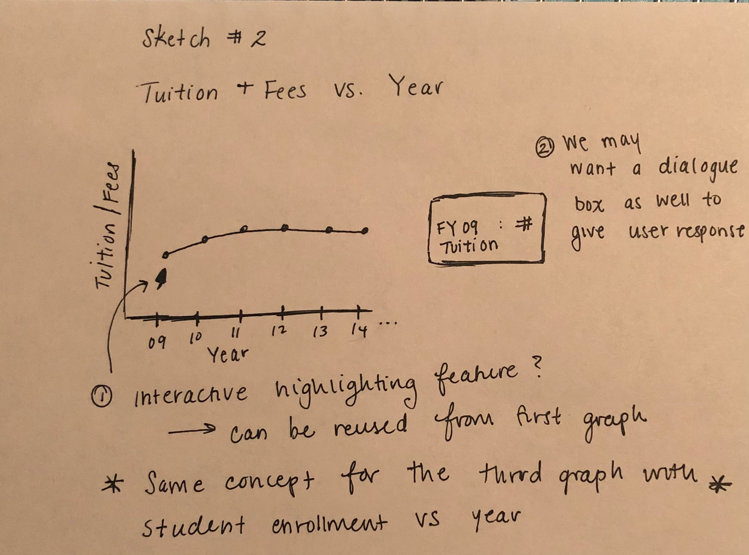
Our next two proposed visualization was aimed towards analyzing the tuition/fees and student enrollment at WPI. Since the two graphs are similar in style and format, we ultimately decided to combine the two graphs in order to reduce the redundancy.

Slide 12
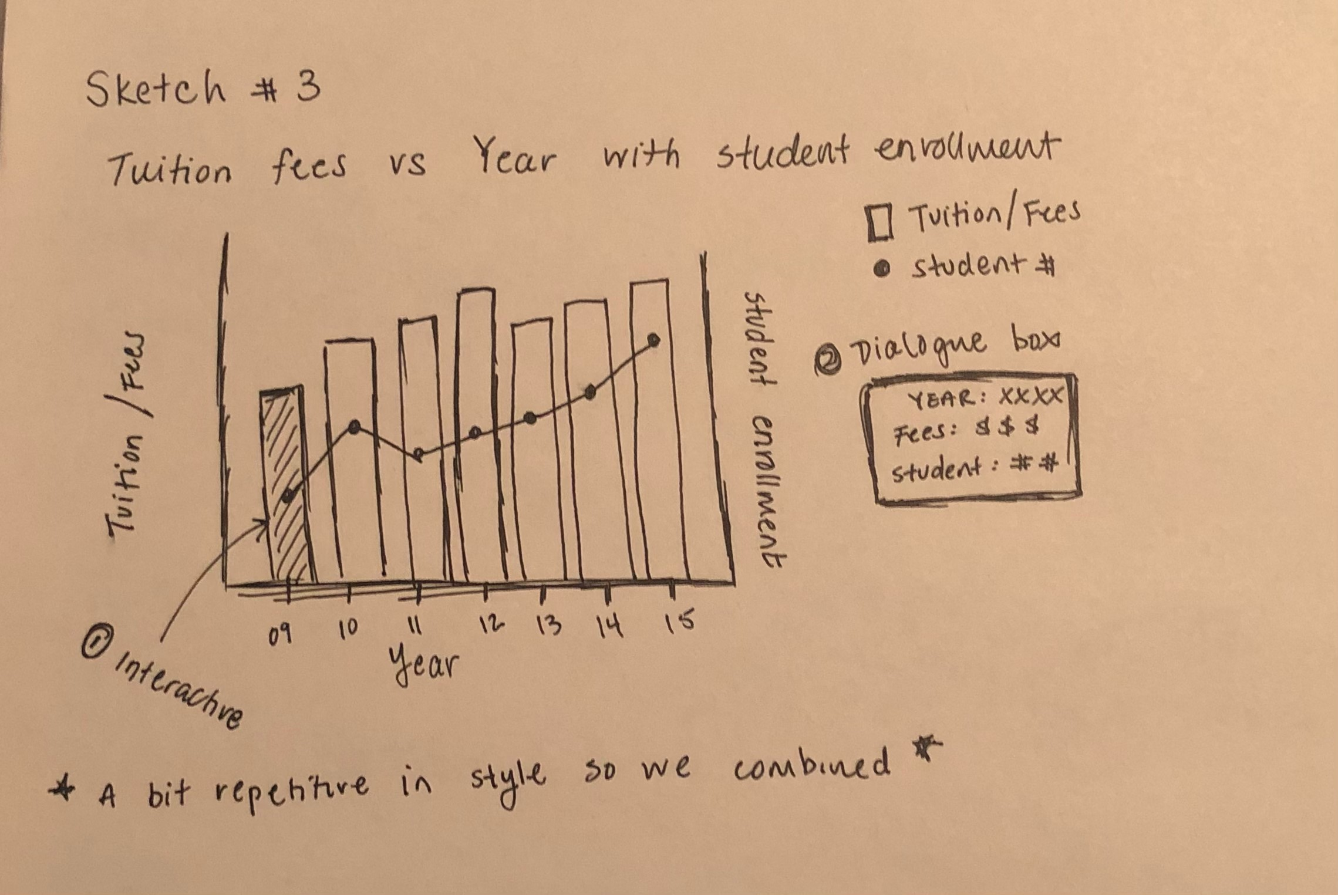
Our design of the combined graph displaying tuition/fees and student enrollment per year initially began with the proposal of layering two lines as shown in the previous sketch. Utilization the bar and layering the line charts atop the bars allow the user to perceive the data and highlight the two differing graphs atop one another more effectively. Since we are utilizing the two y-axis on both sides of the graph, we determined that the design of this visualization may be confusing therefore to decrease ambiguity we designed this with two different types of charts.
As mentioned previously in the explanation for the color of the bar charts, the muted blue color when not highlighted allowed for higher contrast with a chosen bright red line indicating the two different datasets we are presenting.

Slide 13
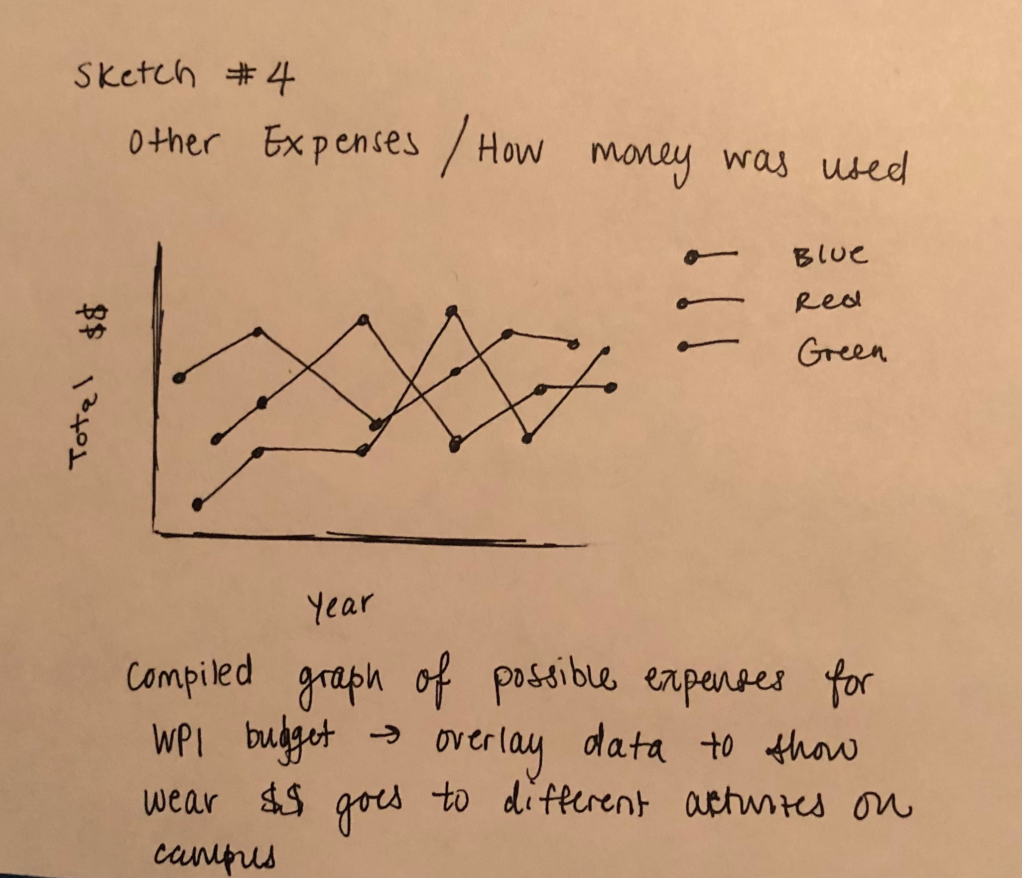
Finally, our design of for targeting the expenses of WPI and their usage of money was done in a line chart. Since the datasets and categories we have decided to present are of the same magnitude in importance and no clear distinction in grouping of data was necessary, we decided to graph and visualize the sponsored research, student services, and student loans receivable data each with their own line on the graph. We did this style of graphical formatting in order to convey the difference in usage of funds by WPI.
The design aspect of the lines and colors chosen were distinct (red, blue, and green) to show the difference in data each line represented.

Slide 14
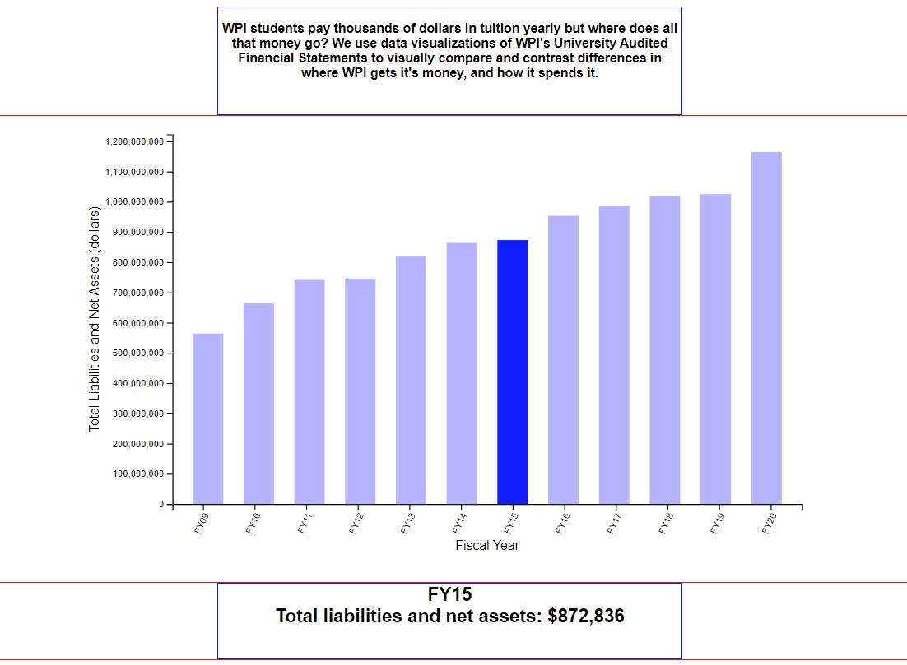
Implementation
A screenshot showing the general overall data with a user selection of a bar and detailed description of what the data represents.

Slide 15
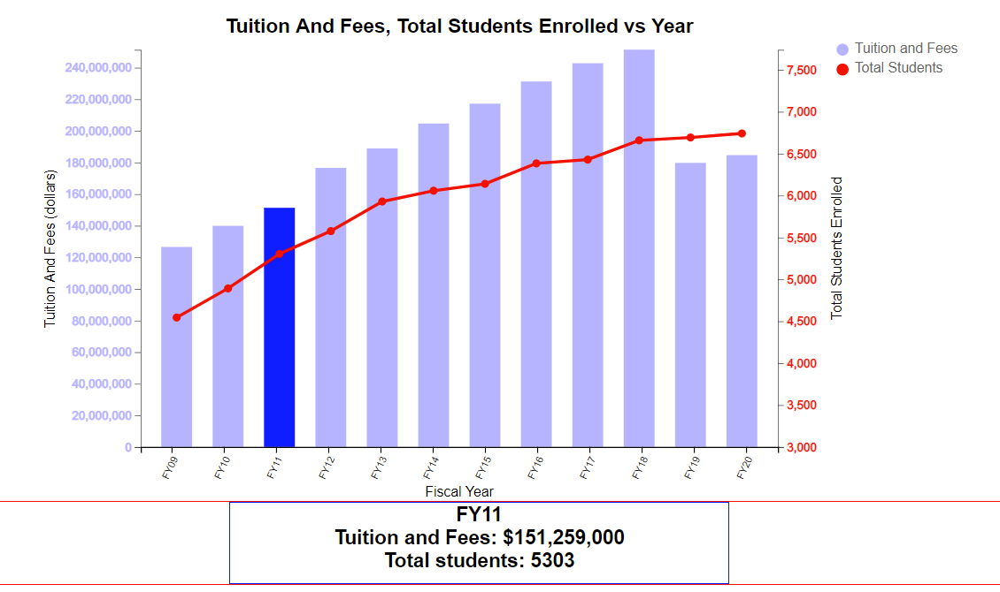
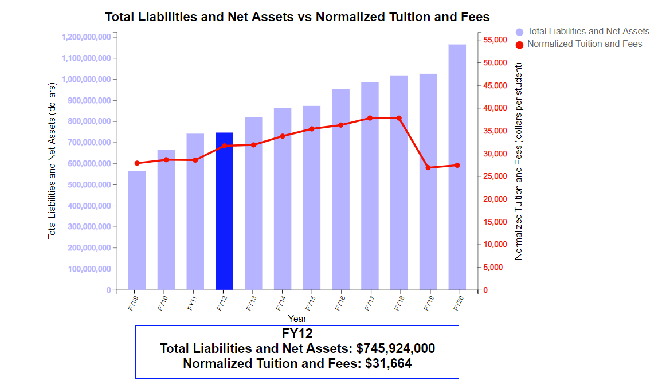
A screenshot showing an overlay of a line chart representing the total student enrollment on top of a chart indicating the tuition and fees for a year. Here it indicated the user selection with a detailed description of both datasets
A similar graph implantation with different datasets where we graph total liabilities and net assets along with the normalized tuition and fees for a given year.

Slide 16
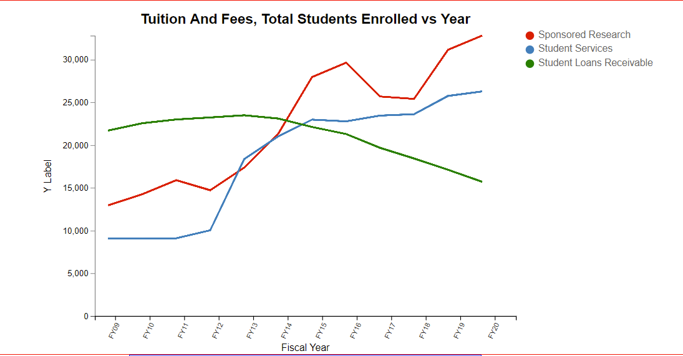
A screenshot showing the different line charts with a corresponding legend indicating the varying categories of what each line represents.

Slide 17
Data Evaluation
Total Liabilities and Net Assets Over 10 Years: 2009-2020
In our first general bar plot, we have charted the total liabilities and net assets of WPI for every fiscal year in which they were reported. As shown, WPI’s net assets have recently surpassed 1.1 billion dollar, over double what they were just 10 years ago, in 2009. This poses the questions: Where did all this money come from?
Tuition/Fees and Student Enrollment yearly
While it may seem as though increasing tuition and student population increase may have caused this influx of assets to WPI, our findings have uncovered otherwise. While both tuition increase and student population increase have steadily risen, we wonder how this may have affected WPI’s assets.
As you can see in the plots charting the tuition/fees and total student enrollment, WPI’s increase in assets is not solely from the amount of money students pay, it must be coming from elsewhere. This is due to WPI’s not-for-profit business model, which may be comforting to some. However, this does not answer the questions of, where does all our money go?
Money Usage On Students
While we only investigated a couple categories where funds were allocated for student focused opportunities such as sponsored research, student services, and student loans receivable, while the net assets for WPI has doubled, in the research and student services category, the allocation of funds were also doubled over the past 10 years. The amount of money WPI allocates to student services are directly reflective of their increase in assets.

Slide 18
Conclusion

