Slide 1
2016.10.05
CS 482 Lab Session Interactive Computer Graphics

Slide 2
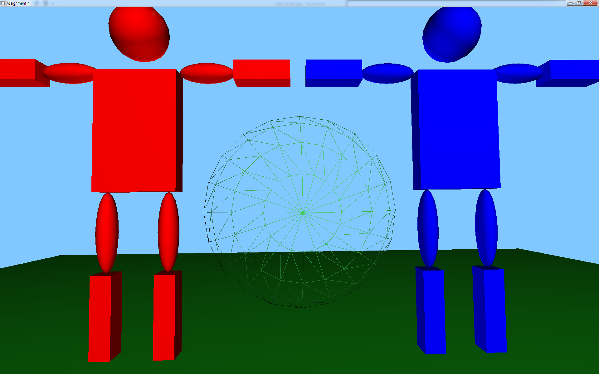
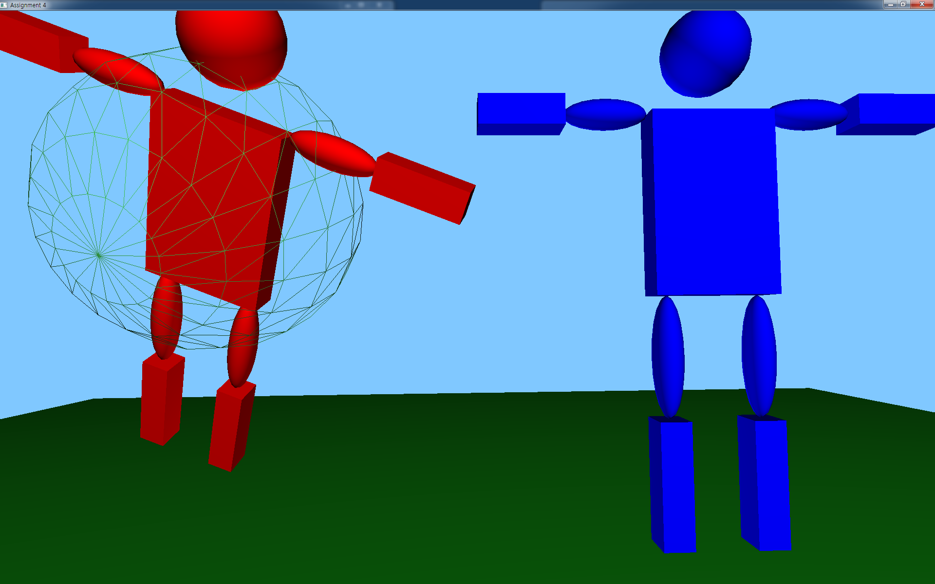
Goals
Scene graph
Build a structure for dealing with objects in a smart way
Picking
Implement user manipulation code
Note that you have to read the description file (pdf) and the detailed description in the code thoroughly

Slide 3
Preliminaries
You would be better to get familiar with the following concepts to complete this assignment:
Class
Vector
There are many classes and functions in this homework, so please read the description (pdf and code) in advance, and start to do some coding.

Slide 4
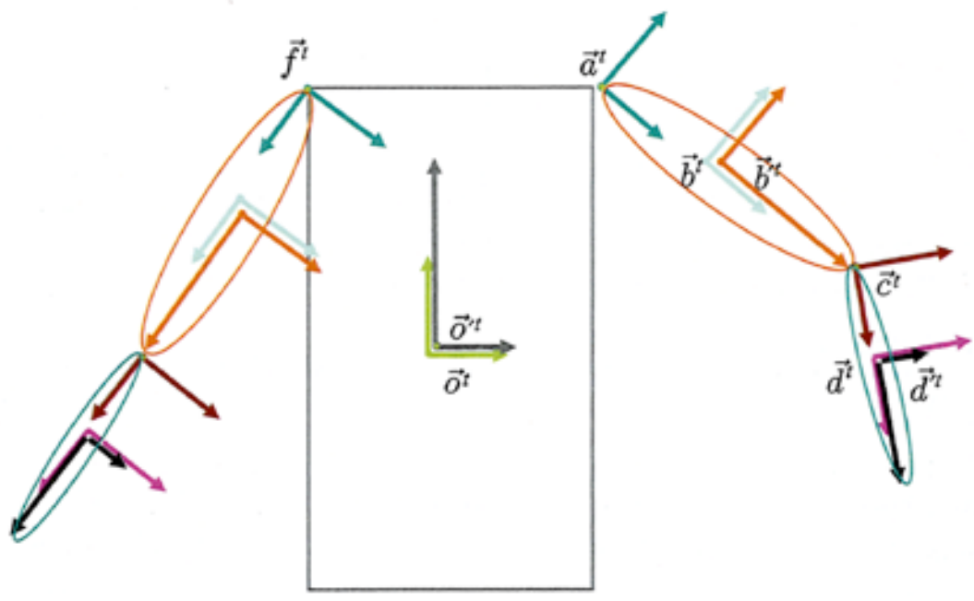
Scene graph
If we move the body of the robot, the connected components should be modified automatically.

Slide 5
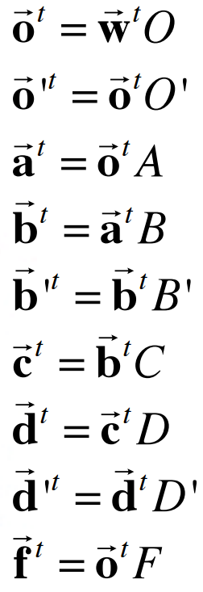
Scene graph
In order to build it, we describe an object frame with the previous object frame, not the world frame.

Slide 6
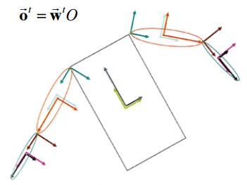
Scene graph
Other parts would be changed following the scene graph when we modify the object frame .

Slide 7
Scene graph
Tree
Parent and child: objects and sub-objects
Nodes (refer to the pdf file)
Transform nodes
RBT with respect to its parent frame
Shape nodes
Geometry to be drawn

Slide 8
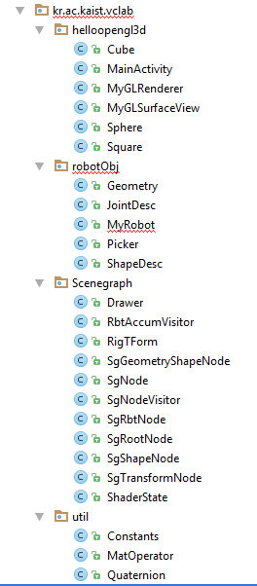
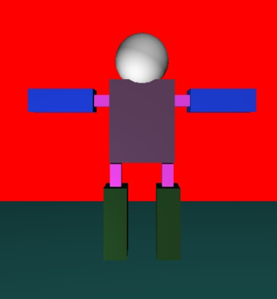
SEARCHING
“//problem” comment and fill out the blanks on skeleton code
Finally, you should construct your own Robot

