Slide 1
Instant Radiosity for Real-Time Global Illumination
Rohith Chandran
Vivek Reddy
CIS 565: GPU Programming and Architecture
Final Project, Fall 2013
University of Pennsylvania

Slide 2
Instant Radiosity
Theory introduced by Alexander Keller in 1997.
Idea is to trace many light rays through the scene, intersecting it with scene objects.
Create point lights (called Virtual Point Lights (VPLs)) at every intersection point.
Use actual lights along with Virtual Point Lights for shading.
Combined with deferred shading, this has become a viable option for real-time GI.

Slide 3
Our implementation
We use the compute shader to trace rays from the light to spawn VPLs in the scene.
Use the forward shader to render the scene, iterating over each of the point lights (virtual and actual), sum up the contributions of all the lights to obtain the final image.
Shadow maps to support shadowing due to the actual light source.

Slide 4
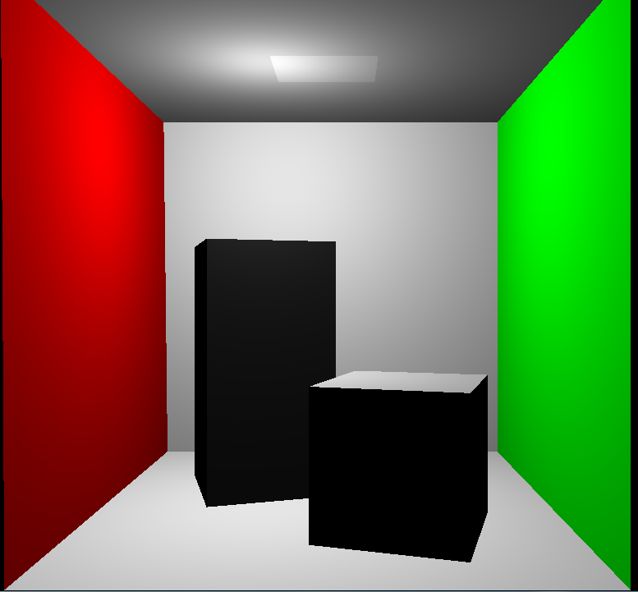
Screenshots

Slide 5
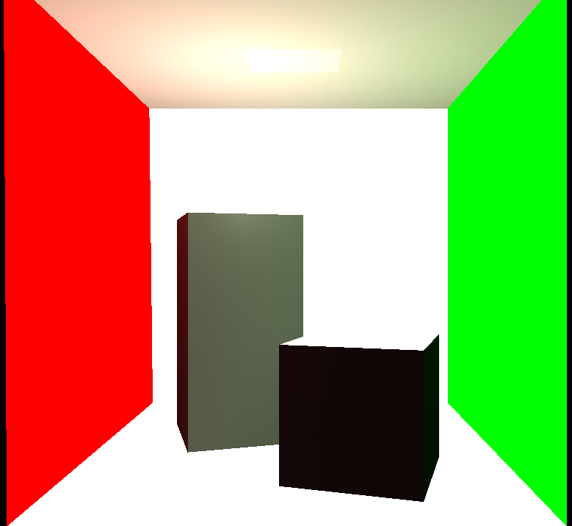
Screenshots

Slide 6

Screenshots

Slide 7

Screenshots

Slide 8
Demo
http://www.youtube.com/watch?v=U2VEdSv-wUI

Slide 9
Implementation issues and difficulties (a.k.a. Reality Bites)
Byte alignment issues in Shader Storage Buffer
Compute Shaders returned invalid results
Shadow mapping works in deferred rendering path, but not in forward rendering
Even though both paths are using the exact same code and texture !
Couldn’t read in depth values, required in Forward+
Tiled Forward Rendering was implemented, but the output is not as expected
Tiling of lights was validated from the host-side, but the fragment shader isn’t seeing any lights in its tile.

Slide 10
Extensions/Future work
Forward+/Tiled forward
Tiled deferred
Support for texturing

Slide 11
Where are we with regard to these extensions
We have implemented both Forward+/Tiled forward, but are being held back by bugs.
Tiled deferred and support for texturing need to be done.

