Slide 1
JUKED
Design Presentation
Francisco Rovelo, Laura Phillips, John Mills, Noah Patton, M Rahman

Slide 2
Problem Definition
Most parties have one dj that is the dictator of the music.
Juked gives power to the people allowing for guests to control the music.
Let the guests search, pick, and choose songs to be played at the party.
Allows for upvotes to move a song up in the queue and be played sooner.
Allows for downvotes to remove a song entirely, rendering that one guy who plays barbie girl over and over powerless.

Slide 3
Updated Scope
The scope has been degraded to simply a Spotify implementation.
However, for modularity we have considered using platform objects (i.e., Spotify Object)
This object will contain all necessary methods and classes for that object.
Spotify Song URL
Spotify Song URI
Spotify Wrapper Functions
This was done for the purpose of time. If we have time to implement other services, it will be easier to add this way.

Slide 4
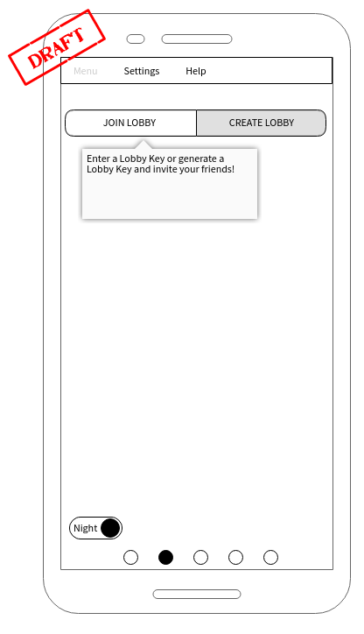
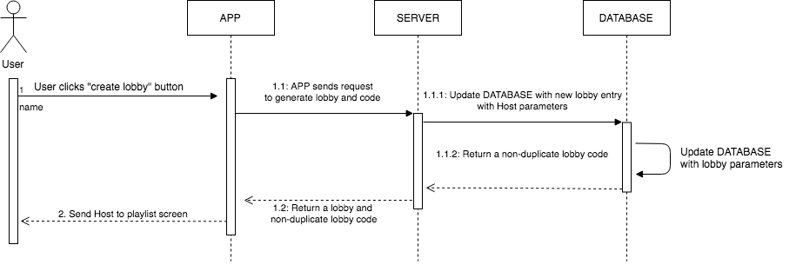
Host Creates A Lobby
The host will click “Create Lobby” which in turn sends a request to create a lobby/playlist and return the lobby as well as a unique lobby entry code.
Notes:
Fran: This is going to add an entry into the database that contains all the users/deviceIDs that are associated with the lobby

Slide 5
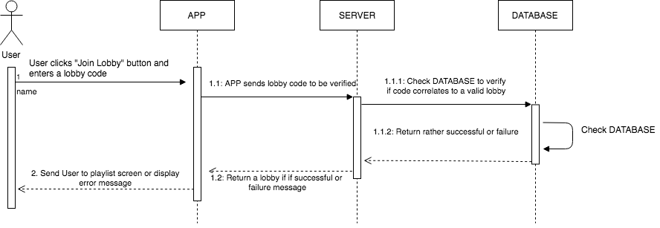
User Joins A Lobby
When a User attempts to join a lobby, they will enter a code which is sent to the DATABASE for validation. If such a lobby exist, it returns success and sends the user to the lobby. Otherwise, error message.
Notes:
Fran: f

Slide 6
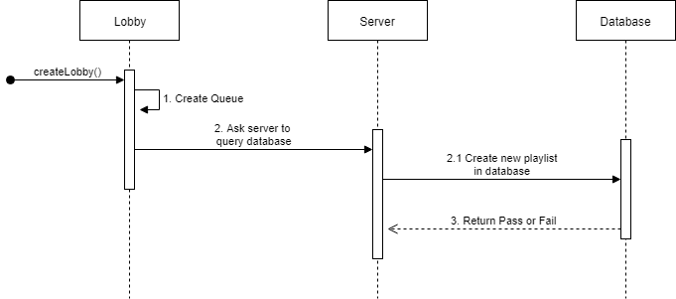
Creation of Playlist
When a new lobby is created, a playlist is automatically created. An ArrayList is created in the program, then the server queries the database. A new playlist table will then be created.
Notes:
John

Slide 7
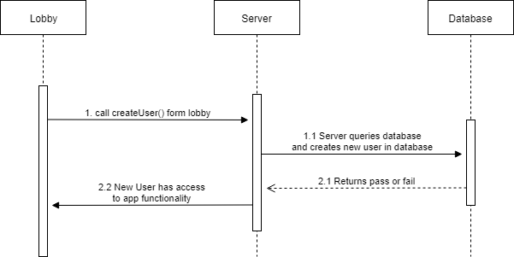
Creation of User
A user object is created when a user joins a lobby. The method createUser is sent to the server with all of the information that is input from join lobby. The server queries the database and adds the new user.
Notes:
John

Slide 8
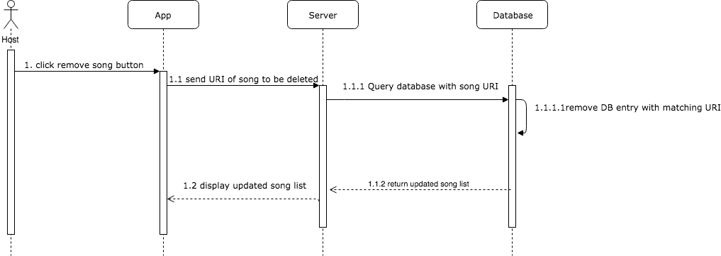
Host Removes a Song
When a Host removes a song from the queue, the app will contact the server, and the server will contact the database with the song identifier. The database will remove the song from the table of queued songs, and the updated queue will be returned and displayed to the app screen
Notes:
Laura

Slide 9
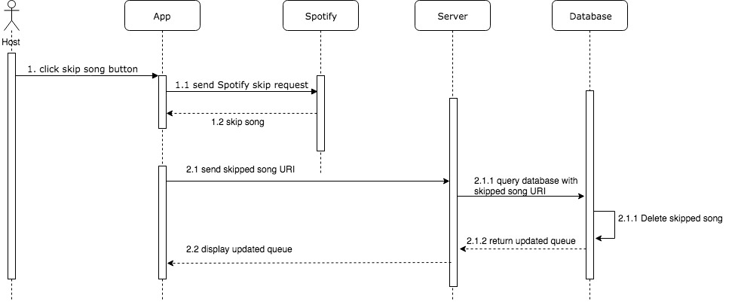
Host Skips a Song
If the host wants to skip the song that is currently playing, the app will contact the Spotify to skip to the next song. The app will then contact the server with the skipped song’s identifier. The database entry matching the skipped song will be deleted, and the updated queue will be displayed
Notes:
Laura

Slide 10
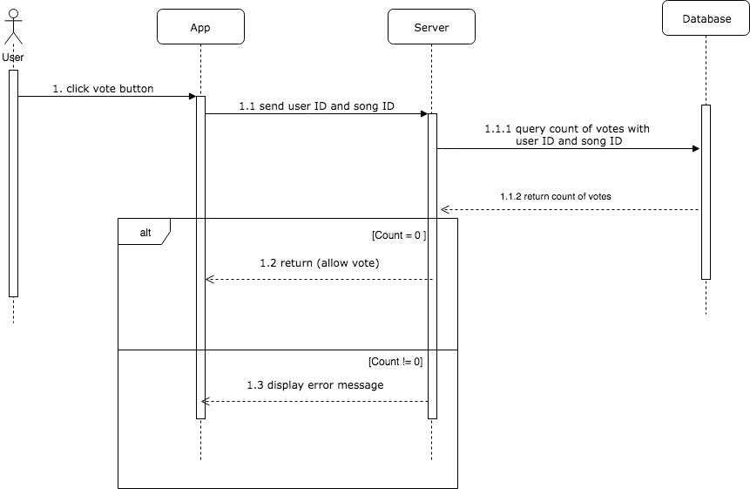
Check If User Has Voted
When a user tries to vote on a song, the app will send the user’s ID and the song ID to the server, which will contact the database. If there is a vote matching the user AND song ID, then an error message is displayed. Otherwise, the vote is allowed.
Notes:
Laura

Slide 11
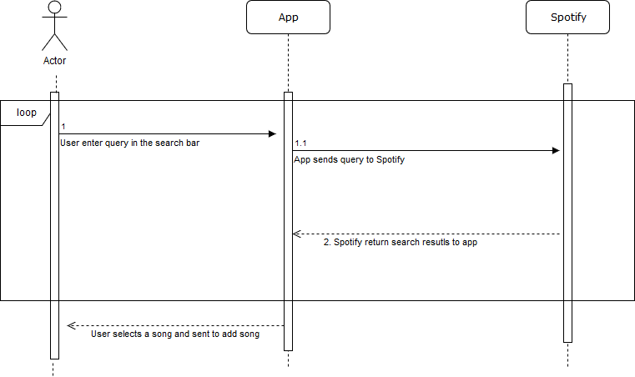
Search for a song
When user search for a song, the passes the query to spotify, returns the result to app. User than have option to choose, discard or redo.
Notes:
Mo

Slide 12
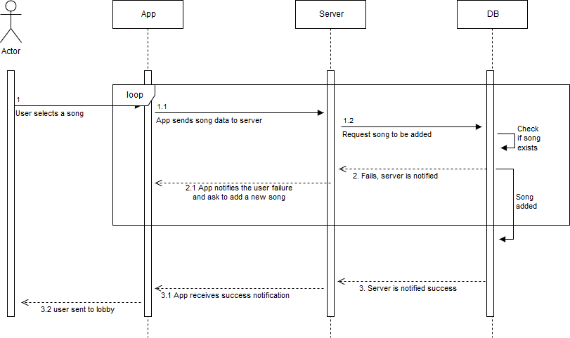
Add a song
User selects a song, the database gets updated and user is sent to lobby or requested to select another song.
Notes:
Mo

Slide 13
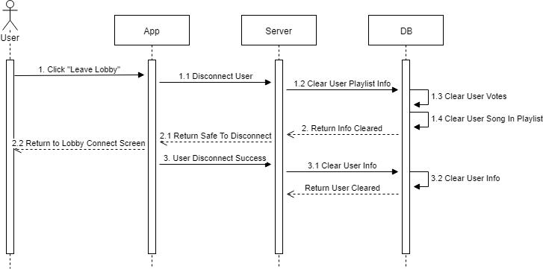
Leave Lobby
When user clicks leave lobby, the app passes the request to the server, which queries the database, then returns to the server to disconnect the app before fully clearing the database.
Notes:
Mo

Slide 14
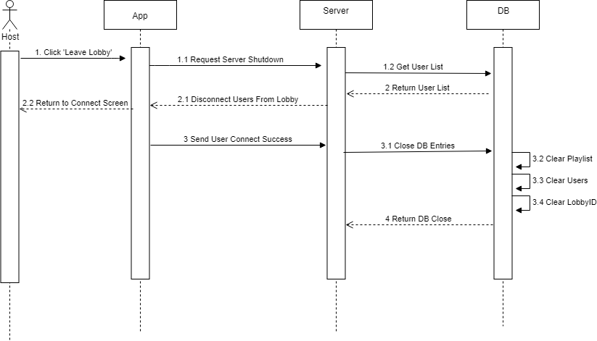
Close Lobby
When host clicks leave lobby, the app passes the request to the server, which gathers user list from DB to disconnect users from lobby and then close/clear the DB entries.
Notes:
Mo

Slide 15
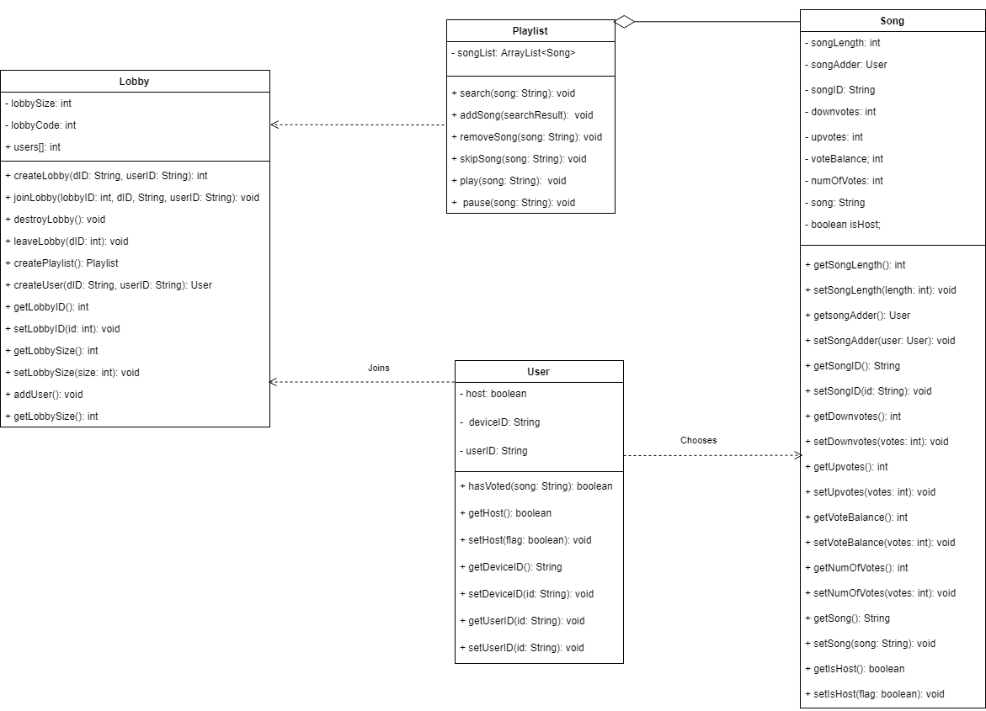
Class Diagram

Slide 16
Present Priority
Best to have less option but better performance- just focus on Spotify, with the options open for SoundCloud and Youtube in the future.
Get a working app, then each member picks an area to smooth out the rough edges.
A little bit everyday gets more done in a week then trying to code the whole day.
Pick a time everyday for team members to meet and collaborate.
Consistency.
Time management.
We are at a stopping point to make the best app possible (we will never have an app then) and work on the present best scenario.
Notes:
Mo

Slide 17
Summary
Confident about the design of the application and the backend.
Confidence in our ability to get a working product soon and add polish later.
Energized and excited about the product, something we will actually use ourselves

