Slide 1
Juked
M Rahman, John Mills, Noah Patton, Laura Phillips, Francisco Rovelo

Slide 2
Introduction
Collaborative song selection for any get together
Allows for members of a party to choose songs to be played from a centralized source
Searches both Spotify and Soundcloud for desired song
Ability to upvote/downvote songs that are liked/disliked

Slide 3
Functional Requirements
The app will give the option either to create a lobby or join a lobby.
User will be able to select a song from spotify or soundcloud.
User will be able to upvote or downvote a song.
User will get a turn after his chosen has been played.
Host will be able to remove a song or user
Host will be able to add a song at any time
Rooms will be 4 digits

Slide 4
Non Functional Requirements
The app should be able to sync user votes
The central database should be keep track of all rooms created, in order to avoid conflict.
If the host does not close a room, it should be freed up after a certain time for reuse.
The app should have a smooth feeling, when several users are upvoting or downvoting, it should have the capability to handle the simultaneous activity.

Slide 5
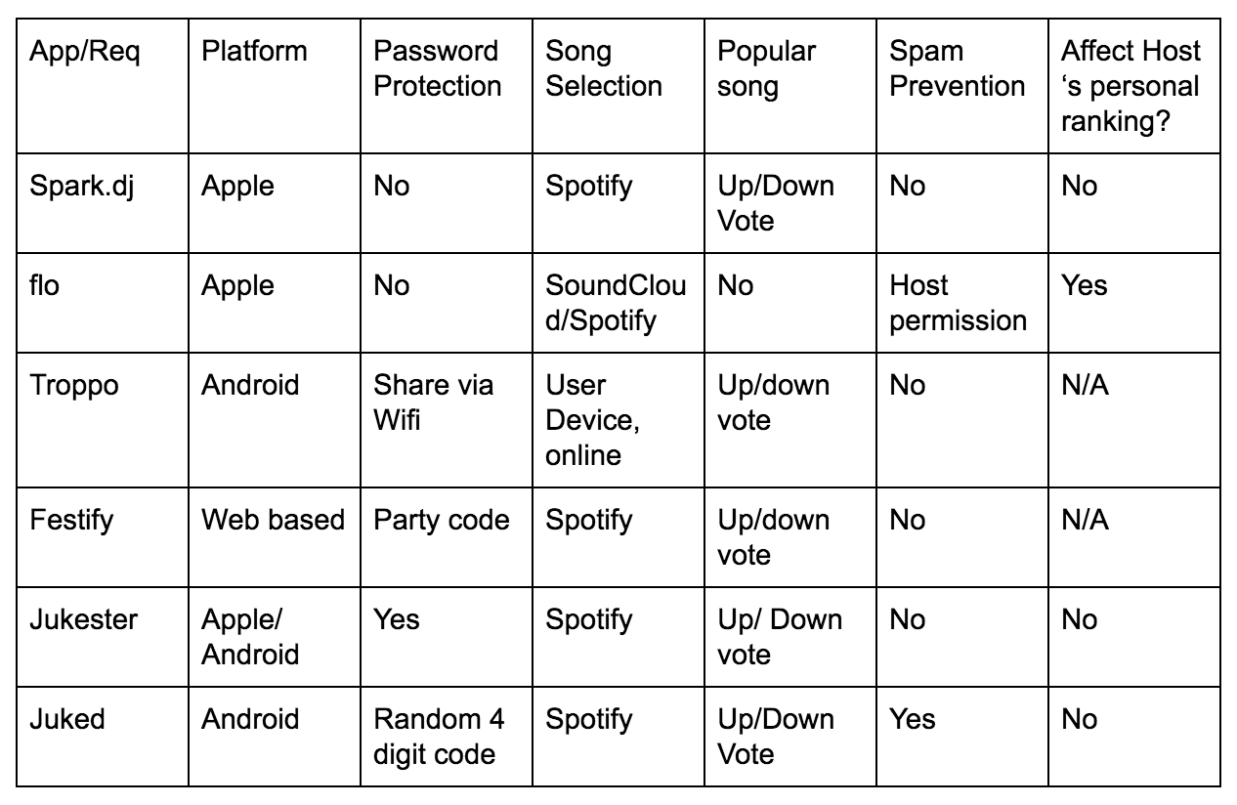
Competitors

Slide 6
Classes
User
Base class that allows to search and pick songs.
Host
Host inherits all methods from user, but has a hostID field. The hostID determines what methods the host can use to control the lobby.
Song
Will not contain any methods. An object that keeps track of the name, id, and number of votes
Notes:
Add classes and mini description of what they do

Slide 7
Classes Continued
Lobby
Lobby will contain a playlist and all the users. This is where the power to create the users and hosts are.
Playlist
The playlist makes use of the song object. The playlist consists of a queue that holds song objects. Most of the methods in the playlist class deal with adding or removing songs from the playlist queue.

Slide 8
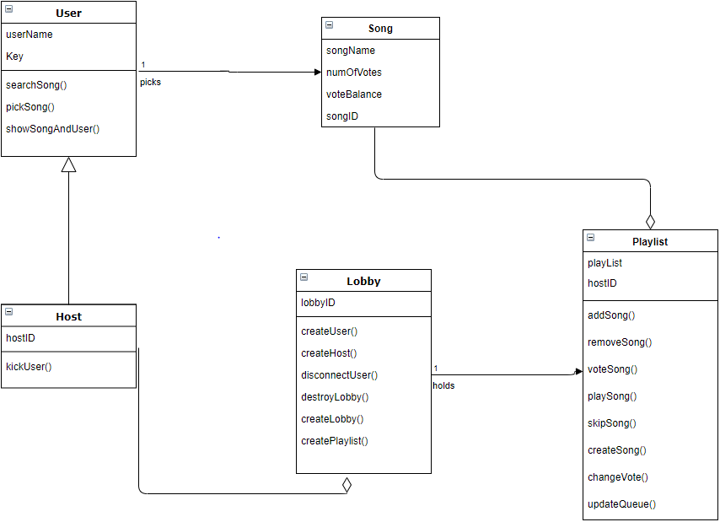
Class Structure
Enter class structure diagram here

Slide 9
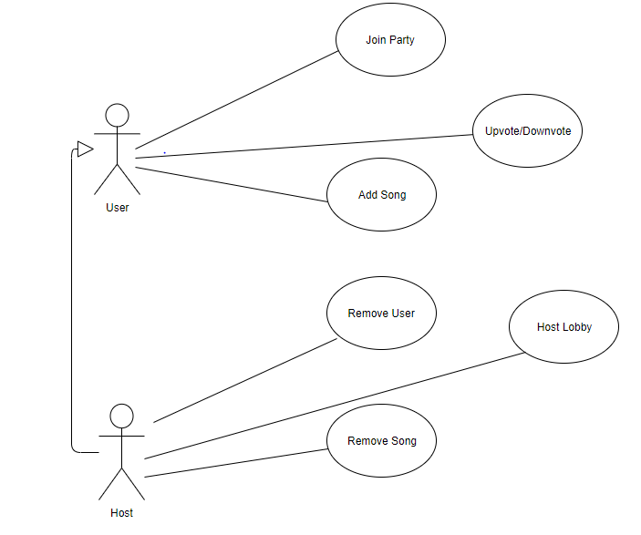
Use Cases
Notes:
Need to get rid of the outline box

Slide 10
Activity Diagrams
Splash Screen
Determine if user is a host or guest
Handle lobby code
Enter nickname
Display corresponding homescreen
Guest Screen
Song Options
Leave Party
Host Screen
Administrative options
Song options
End party

Slide 11
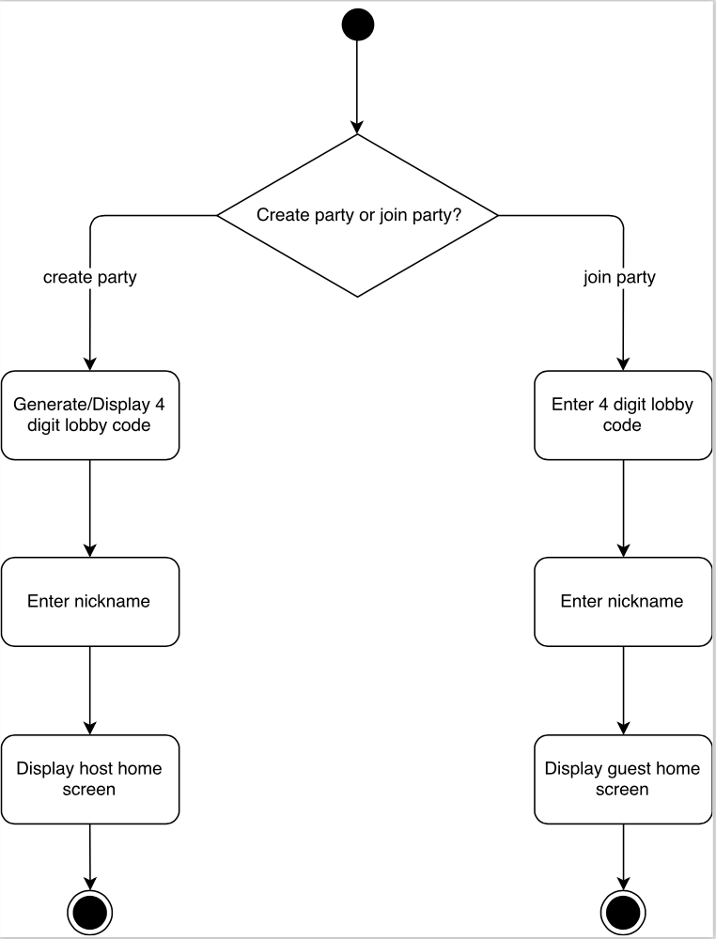
Splash

Slide 12
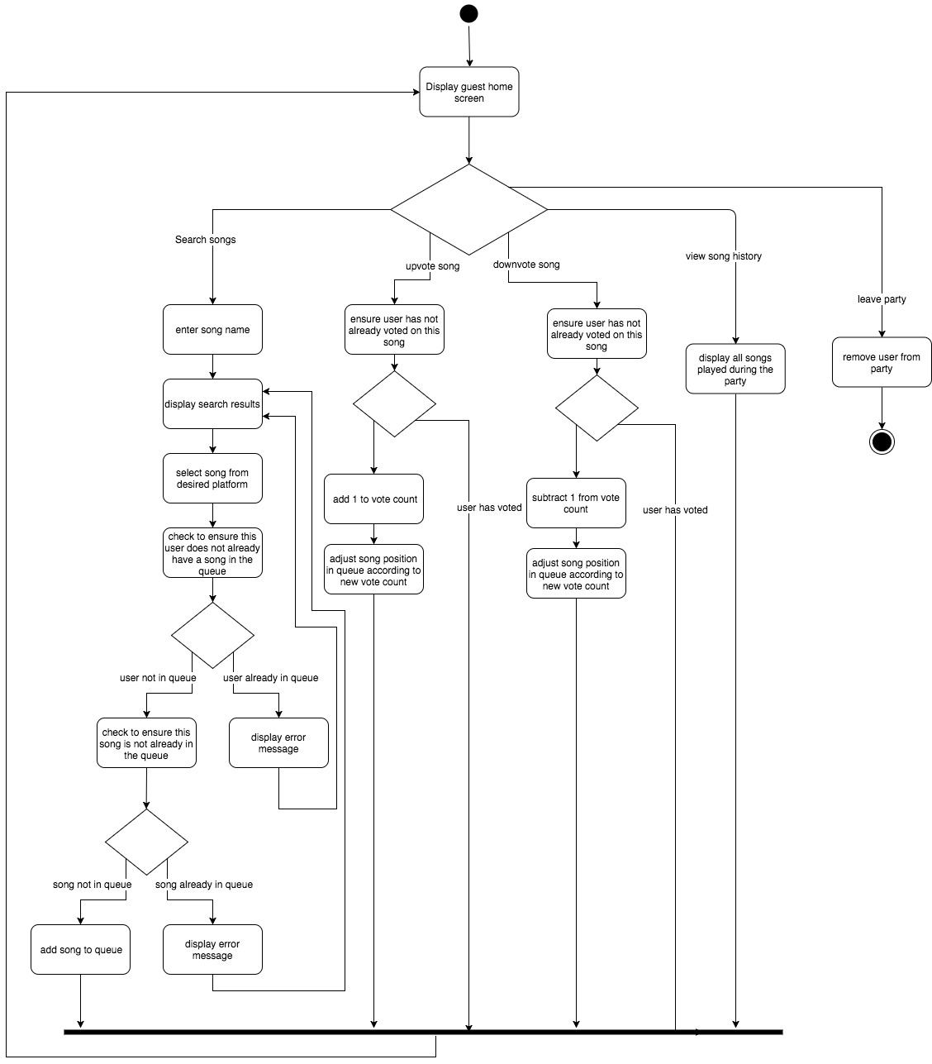
Guest

Slide 13
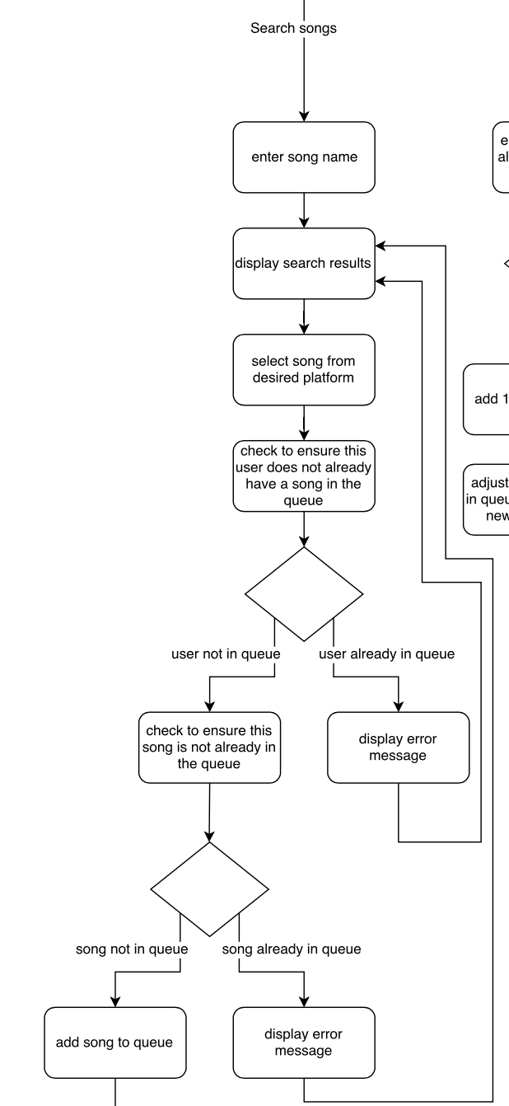
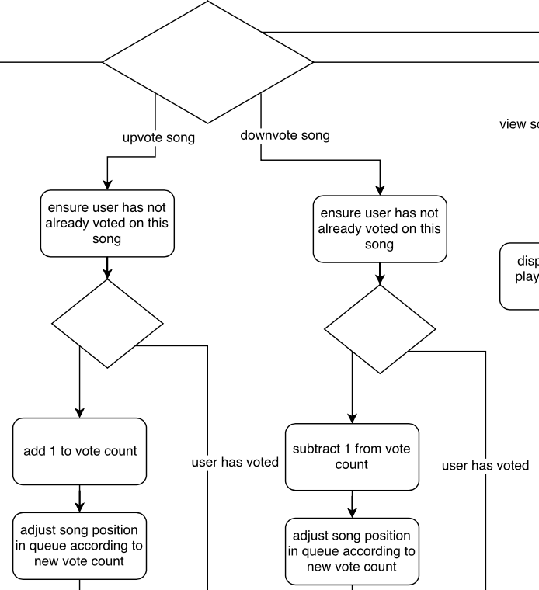

Slide 14
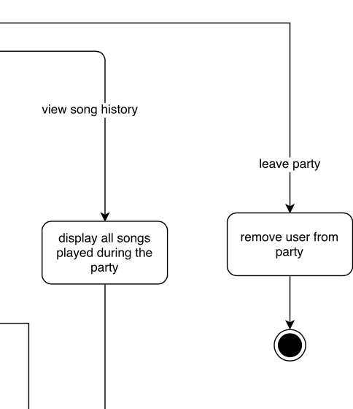

Slide 15
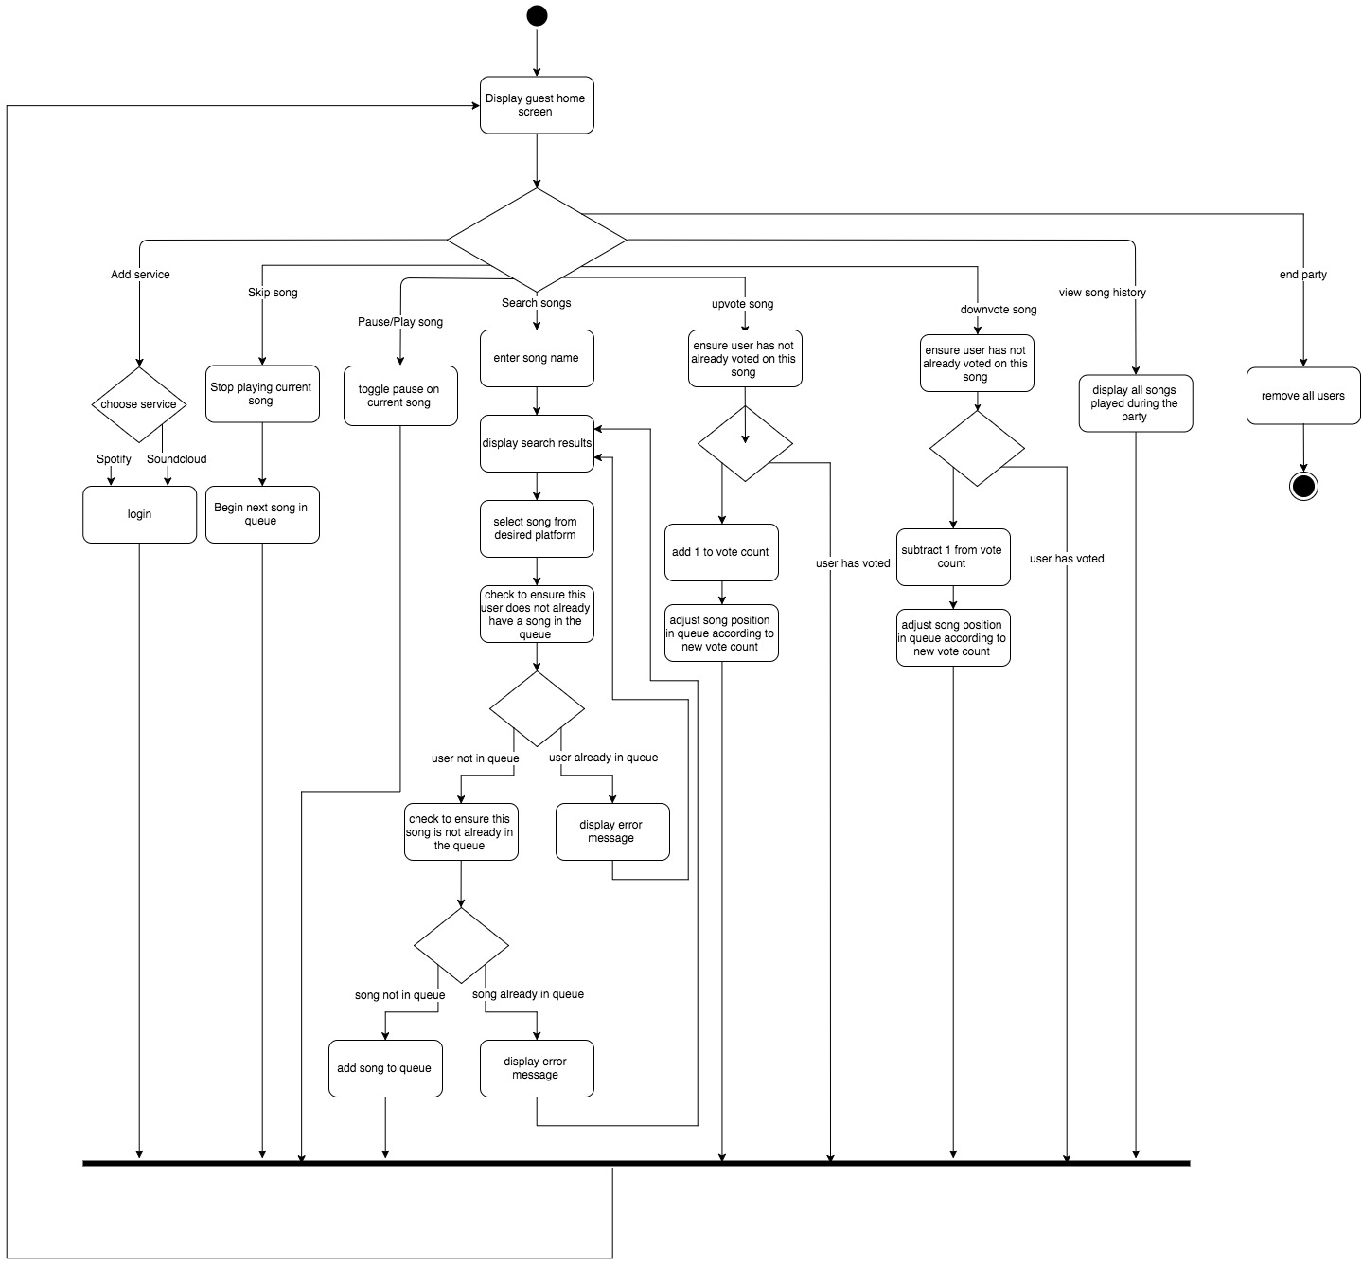
Host

Slide 16
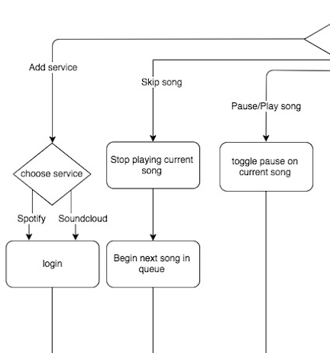

Slide 17
Analytical Diagrams | UI/UX Mockup
Broad overview over:
Splash Screen
Lobby Screen
Settings Screen

Slide 18
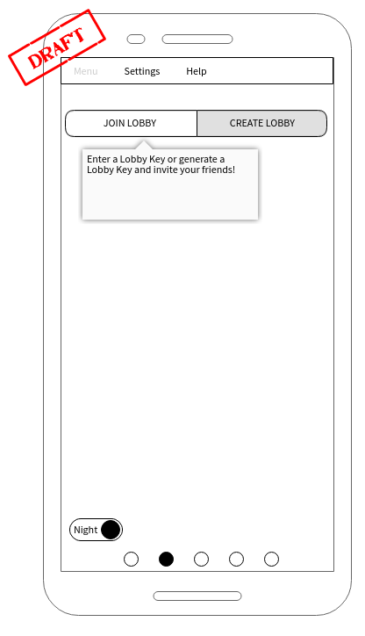
Choose rather to be a host or a guest
Host -> Generates a lobby key
Guest -> Enter a lobby key

Slide 19
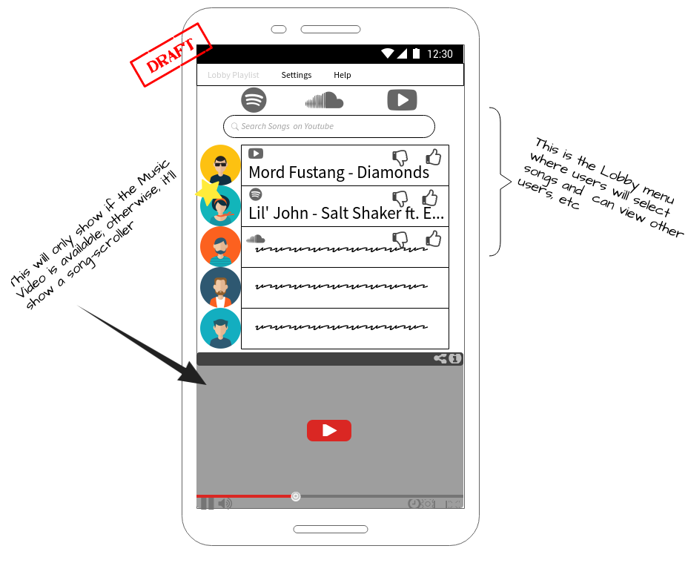

Slide 20
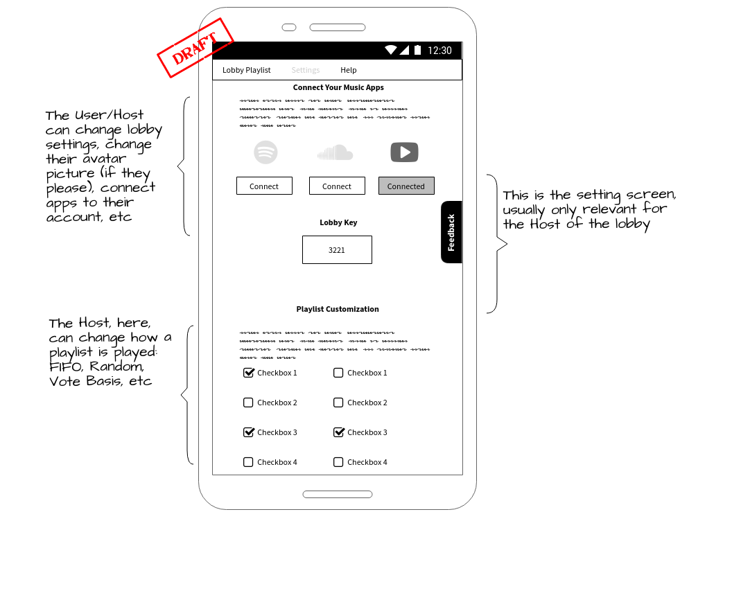

Slide 21
Priorities
Required
Spotify and Soundcloud support
Possible
Host can allow users to have more song choices per round
Host can choose queueing method
Future Work (If Time is Available)
Youtube support for music videos

Slide 22
Risks
Not able to obtain APIs or limited functionality for what we want to accomplish
Approval
We don’t see this being an issue for a school project, however.
A lot of vectors for race conditions that will have to be checked for
North Korea nukes the U.S and sends the world into an Apocalyptic state
Project will not be finished by the end of the semester

Slide 23
Our Perspective
Planning everything out, such as our diagrams, will make coding easier as we start to do so.
Possibly run into problems with methods overlapping and not working together.
We decided on a simple layout to make our products ease of use as high as possible.

