Slide 1
CS 106S: Bioinformatics – Genome Wide Association Studies
Written 2019 by Daniel Wu

Slide 2
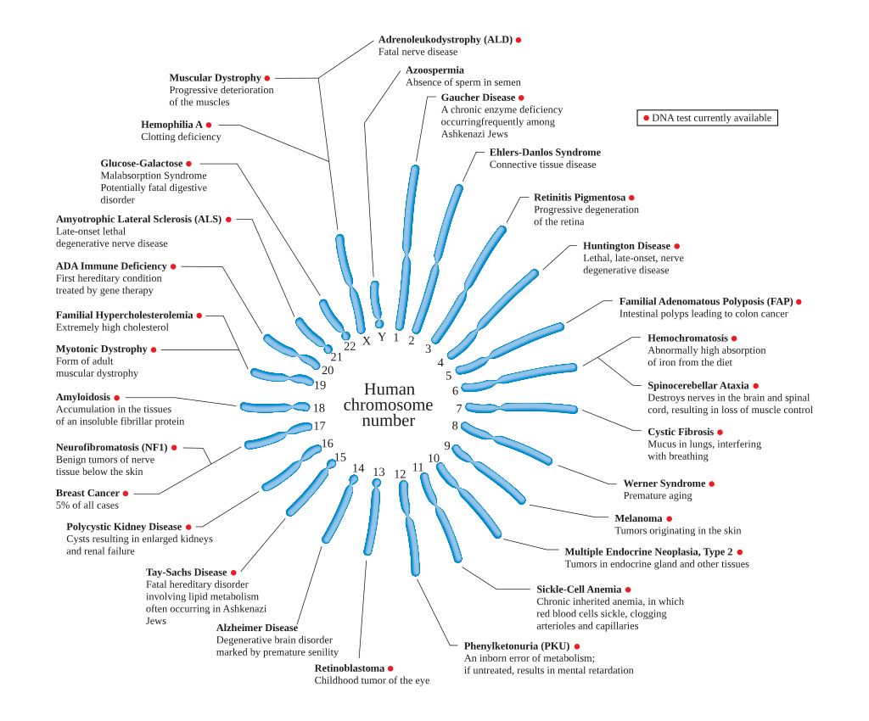
Single Gene
Disorders

Slide 3
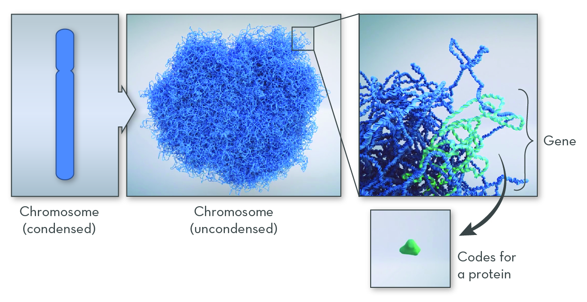
Goals
Be 23 and me

Slide 4


Slide 5
Today…
GWAS for Diagnosis

Slide 6
Ethics?

Slide 7
Get Started
Get the starter code:
https://bit.ly/2HMOTXj
Full link:
https://www.dropbox.com/sh/arpsnyg0lrkvior/AAB1-ZuKFBXQexn-TvSJ-jgAa?dl=0
If you want, explore other datasets: https://github.com/apoursh/sailors-compbio/tree/master/data

Slide 8
Genome Wide Association Studies
Examine the data
Ideas for discovering correlations
Explore advanced methods
Analyze results

Slide 9
Questions?

