Slide 1

CS4S High School 2016 Visual Programming & Physical Computing, with Scratch & MaKeys MaKeys
Mr Daniel Hickmott
Research Assistant
School of Education, Faculty of Education and Arts
18th July 2016

Slide 2
Presentation Contents
What is Visual Programming?
Examples of Visual Programming Languages
What is Physical Computing?
Examples of Physical Computing Devices
Activities

Slide 3
What is Visual Programming?
“any programming language that lets users create programs by manipulating program elements graphically rather than by specifying them textually”¹
They often use visual metaphors, such as:
Fitting puzzle pieces together (Scratch², Blockly Games³)
Flowcharts (e.g. Flowgorithm⁴)
No typing out code or syntax errors!
Some languages can be used online (e.g. Scratch) without installing anything

Slide 4
Examples of Visual Programming Languages
Scratch
Code Club⁵
CS First⁶
Snap!⁷
Used in UC Berkeley’s Beauty & Joy of Computing course⁸
More features than Scratch, but smaller community
AppInventor
LEGO Mindstorms

Slide 5
What is Physical Computing?
Usually refers to hardware or software that involves:
Physical interaction (not with a keyboard & mouse)
The use of sensors
Interacting with a motion sensor (e.g. the Microsoft Kinect⁹)
Sensors can be used to record information from the “real world” like:
Temperature
Humidity
Noise levels

Slide 6
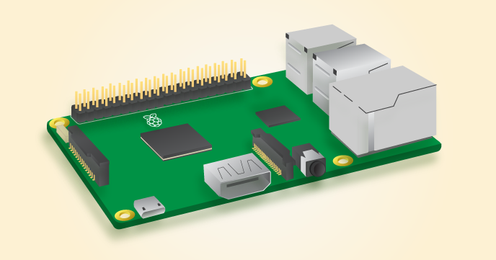
Examples of Physical Computing Devices
MaKey MaKey¹⁰
Raspberry Pi¹¹
Arduino¹²

Slide 7
Activities
There are two main activities in this session, please complete them in the following order.
1. Introduction to Scratch
Can work on your own or in pairs
2. Making an Interactive Quiz with Scratch & a MaKey MaKey
Working in pairs is recommended
If you finish these before the session ends, please let us know. We have an extra activity you can complete.

Slide 8
References
What is Visual Programming?
1. Visual programming language - Wikipedia https://en.wikipedia.org/wiki/Visual_programming_language
2. Scratch https://scratch.mit.edu/
3. Blockly Games https://blockly-games.appspot.com/
4. Flowgorithm http://www.flowgorithm.org/
Examples of Visual Programming Languages
5. Code Club https://codeclubau.org/resources/
6. CS First https://www.cs-first.com/materials
7. Snap! http://snap.berkeley.edu/
8. University of California at Berkley - Beauty & Joy of Computing Course http://bjc.berkeley.edu/website/curriculum.html

Slide 9
References
What is Physical Computing?
9. Scratch2Kinect http://scratch.saorog.com/
Examples of Physical Computing Devices
10. MaKey MaKey http://makeymakey.com/
11. Raspberry Pi https://www.raspberrypi.org/
12. Arduino https://www.arduino.cc/

Slide 10
References
Alternatives to AppInventor
9: TouchDevelop: https://www.touchdevelop.com/
10: Codea: http://twolivesleft.com/Codea/
11: Kino: http://kino.pad2play.com/

