Slide 1
The secrets of
Computer Science
for Girls
Twitter: @Mango77Peggy
Email: peggy.mangovski1@det.nsw.edu.au
Get the slides > https://goo.gl/wRbRKe
Please go to www.kahoot.it on your device or computer > a pin will be provided in a few minutes!

Slide 2

Why don’t we have more girls in CS?
Intimidating
Low Confidence
Lack of role models
Lack of exposure
Stereotypes
Parent discouragement / lack of support
Not interesting / not relevant
Not useful for an ATAR
Not needed for career goals
Too hard / perception of difficulty
Go to www.kahoot.it
Wait for pin
Enter nickname

Slide 3
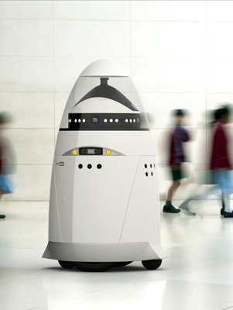
The world is changing rapidly...
More than five million jobs, almost 40 per cent of Australian jobs that exist today, have a moderate to high likelihood of disappearing in the next 10 to 15 years due to technological advancements causing
digital disruption.

Slide 4

What does the future look like for girls?
3.5 Million!!!
70%
job opportunities that girls won’t have!

Slide 5

What are the solutions?
STEM
Outreach
Age helps
= Computer Science
Passion/Creativity
Real World Problems
Science
Technology
Engineering
Mathematics
Encourage disrupters

Slide 6
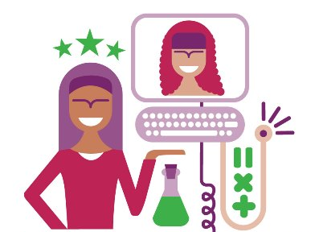
Futures are brighter..
For STEM GirlS!
33%
more $$
Higher Pay
Advantage over others
More opportunities & jobs

Slide 7
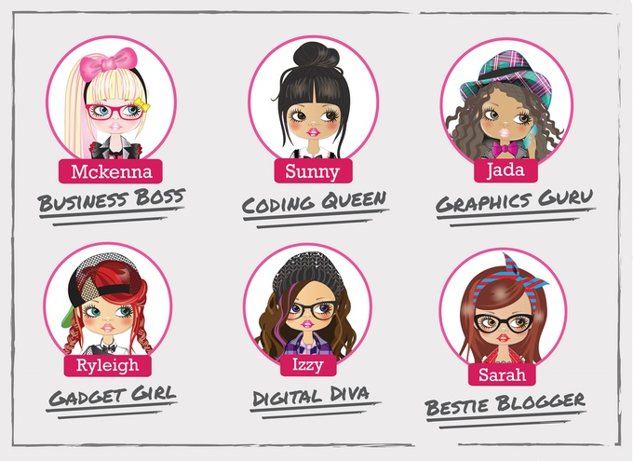
What are STEM Skills?
Creativity
Problem Solving
Collaboration
Communication
Critical Thinking
Resilience / Grit
Using technology to design or make
Application of Math /Science in the real world

Slide 8
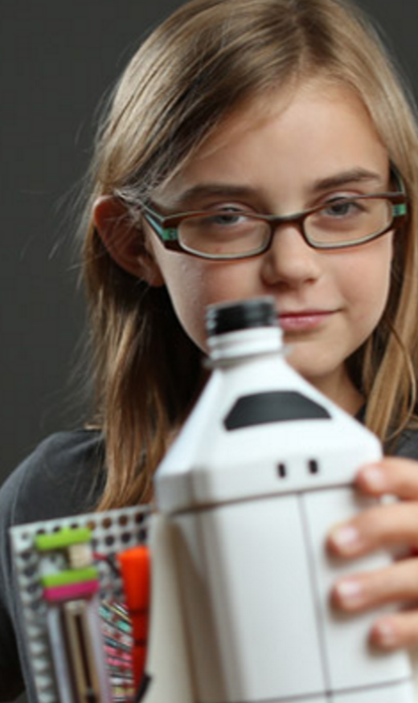
STEM projects with a Creative Computer Science focus
Textiles + Electronics + Lilypad = eTextiles or wearables
Conductive Paint + Makey Makey + Scratch = Musical or Interactive Art
Little Bits + Arduino + recycled materials = IOT (Internet of Things) inventions / prototypes
Adobe Illustrator + Hummingbird + Colour printer = Interactive Story/Comic books
Famous Artists + Paint + Sphero SPRK = Bot Paintings
Social Issue + Adobe Photoshop + App Inventor = Educational Games / Helper Apps

Slide 9
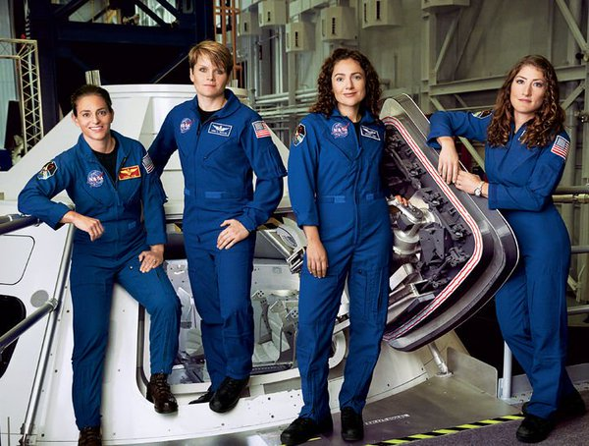
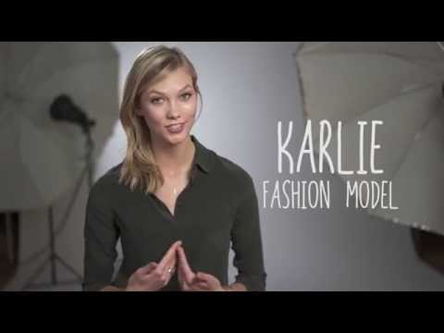
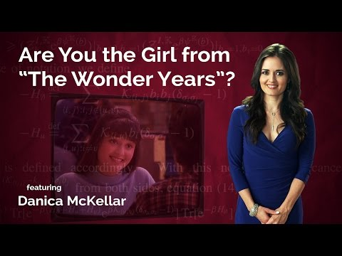
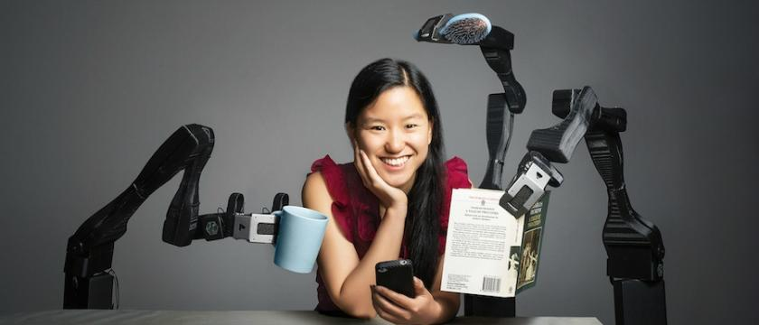
Inspirational
Stem Sistas

Slide 10
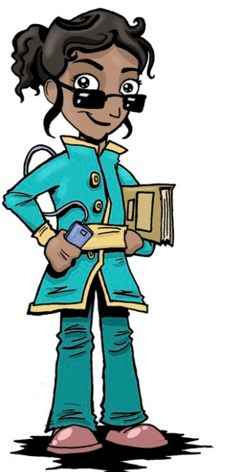
Other Girl Friendly Resources
Code.org
Made with Code
Minecraft EDU
Tech Girls Are Superheroes
Khan Academy

