Slide 1
Minimum Spanning Tree (Find the cheapest set of roads in this map that ensures all parks are connected)
2
1
2
3
1
5
4
1
2
2
1
4

Slide 2
Run by hand…
Step 1: Select any vertex to be the first vertex of T.
Step 2: Consider the edges which connect vertices in T to vertices outside T. Pick the one with minimum weight. Add this edge and the extra vertex to T. (If there are two or more edges of minimum weight, choose any one of them.)
Step 3: Repeat Step 2 until T contains every vertex of the graph.
(Start at Nobbys Head)
5
4
4
5
3
2
4
1
6
2
5
1
7
7
5
5
2
4
Notes:
Step 1: Select any vertex to be the first vertex of T.
Step 2: Consider the edges which connect vertices in T to vertices outside T. Pick the one with minimum weight. Add this edge and the extra vertex to T. (If there are two or more edges of minimum weight, choose any one of them.)
Step 3: Repeat Step 2 until T contains every vertex of the graph.

Slide 3
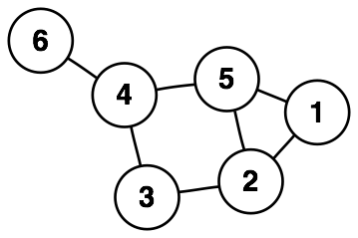
Vertex Cover Find the minimum number of cameras to place in the parks so that all roads are “covered”

Slide 4
Run by hand…
Rule 1: Any pendant vertices will not be in the VC and thus the vertex they are attached to will have to be.
Rule 2: If there is a degree-two vertex with adjacent
neighbours, then there is a vertex cover of optimal size
that includes both of these neighbours.
Notes:
Rule 1: Any pendant vertices will not be in the VC and thus the vertex they are attached to will have to be.
Rule 2: If there is a degree-two vertex with adjacent
neighbours, then there is a vertex cover of optimal size
that includes both of these neighbours.

Slide 5
Dominating set Find the minimum number of trucks to place in the parks so that all other parks are safe

Slide 6
Run by hand…

