Slide 1


WELCOME!
University of Newcastle, Australia
10th October 2019

Slide 2
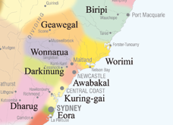
This land
We acknowledge and respect the Pambalong clan of the Awabakal people, traditional custodians of this land.
Notes:
Awaba = traditional name for Lake Macquarie
Awabakal people lived in NCL, Lake MACQ and lower Hunter

Slide 3

Introductions
I'm Elena
I studied a Bachelor of Mathematics
I studied a PhD in computer science at UoN
I subsequently work in Bioinformatics for a number of years
Since 2012 I have worked in the School of Education

Slide 4
Introductions
I'm Daniel
PhD Candidate in School of Education
Studying Teacher Professional Development for the Digital Technologies curriculum
Interested in Computer Science and its applications to different disciplines
Completed my Software Engineering degree in 2014
Facilitating workshops in this area since 2013

Slide 5
Introductions
I'm Ben
Final year of my bachelor of IT at the University of Newcastle
Majoring in Interactive Media
Focussing on Media Production, Web Design and Development
Interested in applying digital technologies in creative design, visual storytelling and virtual reality

Slide 6
Introductions
And you?

Slide 7
Housekeeping
Toilets
Fire alarm
Login
Login: gen504
Password: Coding.2019

Slide 8
Workshop Aims
Introduce Computer Science, Coding & Computational Thinking
Provide examples of hands-on activities that can be used in the classroom
Provide examples of high quality resources for you to explore further

Slide 9
Workshop Schedule – Day 1
Time | Session | Location
9:00am – 9:15am | Registration | HC47
9:15am – 9:45am | An introduction to Coding and Computational Thinking | HC47
9:45am – 10:45am | Unplugged Approaches for Teaching Coding | HC47
10:45am – 11:00am | Morning Tea | HA96
11:00am – 12:30pm | Moving from Unplugged to Blocks Coding | HC47
12:30pm – 1:00pm | Lunch | HA158
1:00pm – 1:30pm | Coding: One Teacher’s Journey | HC47
1:30pm – 3:00pm | Creative Computing with Scratch | HC47

Slide 10
Workshop Schedule – Day 2
Time | Session | Location
9:00am – 9:15am | Registration | HC47
9:15am – 10:45am | Moving from Blocks to Text Coding | HC47
10:45am – 11:00am | Morning Tea | HA158
11:00am – 12:30pm | Physical Computing with BBC Micro:Bits | HC47
12:30pm – 1:00pm | Lunch | HA158
1:00pm – 2:30pm | Lesson Planning Activity | HC47
2:30pm – 2:50pm | Sharing Session | HC47
2:50pm – 3:00pm | Survey | HC47
3:00pm – 4:00pm | Focus Group Discussion (Optional) | HC47

Slide 11
Coding and Computational Thinking
Computer Science is a large and diverse field of study, its focus is on problem solving (usually with solutions involving the use of computers)
Coding (or Programming) is the act of writing instructions for a computer in a programming language
Computational Thinking is a way of approaching problems – “thinking like a Computer Scientist”¹

Slide 12
Coding
Code should be written for humans first and computers second
Visual Programming Languages, such as Scratch, allow anyone to get started Coding without knowing particular keywords and syntax

Slide 13
Coding
Encouraging students to learn how to code has become a global movement
Hour of Code²
Code Club³
The Digital Technologies subject in the National Curriculum includes programming and algorithms⁴

Slide 14
Computational Thinking
“Computer science is no more about computers than astronomy is about telescopes, biology is about microscopes or chemistry is about beakers and test tubes. Science is not about tools, it is about how we use them and what we find out when we do”⁵

Slide 15
Computational Thinking
Not thinking about or like a Computer⁶
A way of approaching a problem in a way that a computer can be used to solve it
Involves breaking a problem into a step-by-step solution (an algorithm)

Slide 16
Computational Thinking
According Brennan and Resnick⁷ – the creators of Scratch – there are 3 key dimensions of computational thinking :
computational concepts (such as loops, parallelism, etc.),
computational practices (such as debugging projects or remixing others’ work),
and computational perspectives

Slide 17
Computational Thinking
According Brennan and Resnick⁷ – the creators of Scratch – there are 3 key dimensions of computational thinking :
computational concepts (such as loops, parallelism, etc.),

Slide 18
Computational Concepts
Sequences
“a particular activity or task is expressed as a series of individual steps or instructions that can be executed by the computer. Like a recipe, a sequence of programming instructions specifies the behavior or action that should be produced”

Slide 19
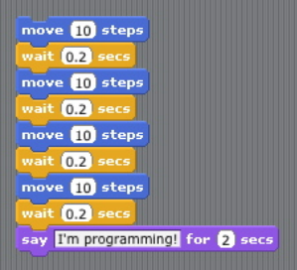
Computational Concepts
Sequences

Slide 20
Computational Concepts
Loops
“But what if we wanted the cat to move and wait 50 or 100 or 1000 more times? Loops are a mechanism for running the same sequence multiple times”

Slide 21
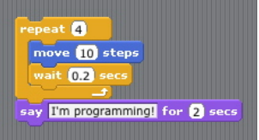
Computational Concepts
Loops

Slide 22
Computational Concepts
Events
“Events – one thing causing another thing to happen – are an essential component of interactive media”

Slide 23
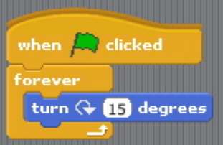
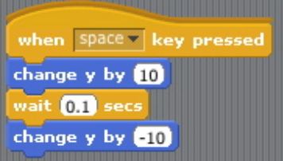
Computational Concepts
Events

Slide 24
Computational Concepts
Conditionals
“the ability to make decisions based on certain conditions, which supports the expression of multiple outcomes.”

Slide 25
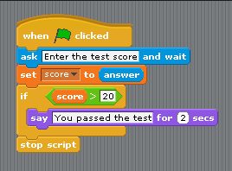
Computational Concepts
Conditionals

Slide 26
Computational Thinking in K – 12?
Should every student become a Computer Scientist or Software Engineer?
By 2020 half of all STEM jobs will be in computing⁸
Automation and “innovation” are creating and changing current careers
Are there any benefits other than preparing students for their careers?

Slide 27
Resources
Web Sites
Computer Science 4 Fun: http://www.cs4fn.org/
Computer Science Field Guide: http://csfieldguide.org.nz/
Online Courses
CSER (Uni of Adelaide) Digital Technologies MOOCS: https://csdigitaltech.appspot.com/course
Google’s Exploring Computational Thinking Course: https://www.google.com/edu/resources/programs/exploring-computational-thinking/

Slide 28
References
1. “Computational Thinking Benefits Society” - Jeannette M. Wing
http://socialissues.cs.toronto.edu/index.html%3Fp=279.html
2. Hour of Code - https://code.org/learn
3. Code Club Australia - http://www.codeclubau.org/
4. “Digital Technologies Curriculum” – ACARA
http://www.australiancurriculum.edu.au/technologies/digital-technologies/curriculum/f-10?layout=1
5. Michael R. Fellows, Ian Parberry (1993) "SIGACT trying to get children excited about CS". in: Computing Research News. January 1993.
6. Computational Thinking – Barefoot CAS
http://barefootcas.org.uk/barefoot-primary-computing-resources/concepts/computational-thinking/
7. New frameworks for studying and assessing the development of computational thinking
http://web.media.mit.edu/~kbrennan/files/Brennan_Resnick_AERA2012_CT.pdf
8. Rebooting the Pathway to Success – ACM
http://pathways.acm.org/

