Slide 1

Computer Science without a Computer
Dr Elena Prieto
10th October 2019

Slide 2
Presentation Contents
The Digital Technologies Curriculum
Teaching CS without a Computer
An Example – Following Instructions
Resources – Computer Science Unplugged
Resources – TryComputing
CS Unplugged –Image Representation

Slide 3
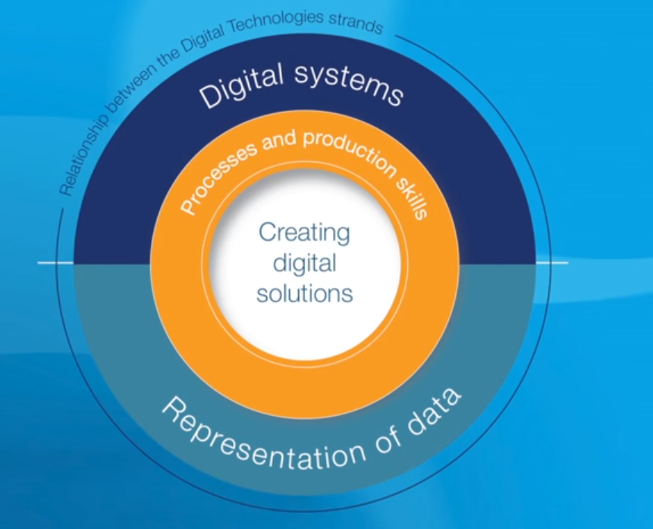
Digital technologies curriculum
The new Digital Technologies curriculum received final endorsement in January 2016
It can be found here: http://www.australiancurriculum.edu.au/technologies/digital-technologies/curriculum/f-10
“In which students use computational thinking and information systems to define, design and implement digital solutions.”

Slide 4
Digital technologies curriculum
By the end of Year 4, students will have had opportunities to create a range of digital solutions, such as interactive adventures that involve user choice, modelling simplified real world systems and simple guessing games.
By the end of Year 6, students will have had opportunities to create a range of digital solutions, such as games or quizzes and interactive stories and animations.
We will be looking at it in more detail tomorrow and how it fits within the NSW syllabus

Slide 5
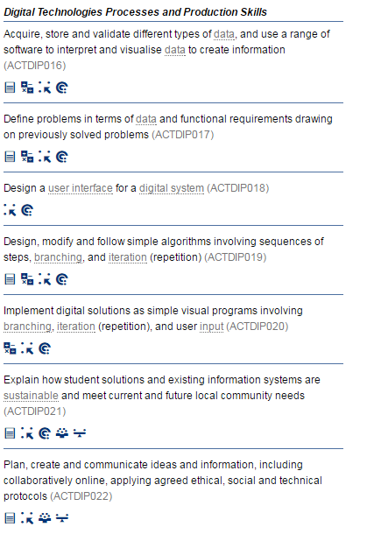
Digital technologies curriculum
Years 5 and 6

Slide 6
Resources – Computer Science Unplugged
A collection of activities to teach CS concepts without a computer
Developed by Tim Bell, Ian Whitten and Michael Fellows
Covers a large range of topics relevant to DT curriculum
Has links to NZ computing curriculum, but not Australian DT (yet, but it is linked from AIS website⁶)
Activities targeted at age groups 5 – 12, but for anyone

Slide 7
Resources - TryComputing
A collection of lesson plans for teaching Computing concepts⁵
Part of the TryEngineering collection of lesson plans
Covers wide range of topics
Science & Engineering
Sponsored by IEEE (Institute of Electrical and Electronics Engineers)
Has activities for ages 8 - 18
Some activities require the use of a computer

Slide 8
Resources – Code.org
Code.org® is a nonprofit dedicated to expanding access to computer science in schools and increasing participation by women and underrepresented minorities.
Provides collection of resources for teaching Computing
Has activities for ages 2 - 99
Very widely used – hour of code

Slide 9
An Example - Following Instructions
Computers follow precise and specific instructions
Write an algorithm (sequence of steps)
Code it in a language the Computer understands
What if people could only understand instructions exactly?
E.g. if I pointed to a closed door and said “go through that door” – what would you do?³

Slide 10
An Example – My robotic friends
This activity can be found in the Code.org website here
It takes approximately 45 minutes of class time
You don’t need a computer for it….but you may need lots of cups…

Slide 11
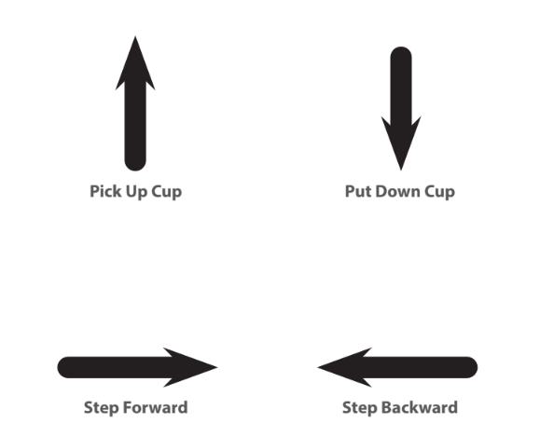
An Example – My robotic friends

Slide 12


An Example – My robotic friends

Slide 13
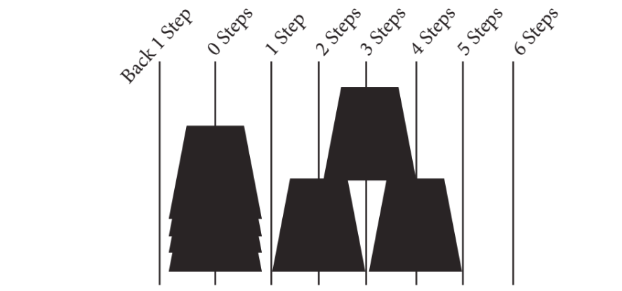
An Example – My robotic friends

Slide 14

An Example – My robotic friends

Slide 15


An Example – My robotic friends

Slide 16




An Example – My robotic friends
16

Slide 17
An Example – My loopy robotic friends
This activity can be found in the Code.org website here
It takes approximately 45 minutes of class time
This lesson serves as introduction to loops, using the set of "robot" programming instructions.
Students will develop critical thinking skills by looking for patterns of repetition in the movements of classmates and determining how to simplify those repeated patterns using loops.

Slide 18

An Example – My loopy robotic friends
Notes:
Ask a volunteer (or a group of volunteers) to come forward to help program this one on the board. If you make them stick strictly to the “no symbols other than those on the key” rule, it will probably take a while!

Slide 19

An Example – My loopy robotic friends
Just discuss, it’s not necessary to run the program
Notes:
Give students the opportunity to brainstorm shorter ways to relay the code that they’re about to create. (This bit can be skipped over if your students start saying things like: “Move forward 6 times.” Since that will open the discussion about how to show “six times” with symbols.)
Once students have put together the idea of “repeating” code, give them the vocabulary around it. Make sure to share with them that often the terms “repeat something” and “loop something” are often used interchangeably.

Slide 20
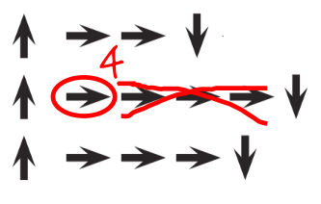
An Example – My loopy robotic friends
Notes:
Give students the opportunity to brainstorm shorter ways to relay the code that they’re about to create. (This bit can be skipped over if your students start saying things like: “Move forward 6 times.” Since that will open the discussion about how to show “six times” with symbols.)
Once students have put together the idea of “repeating” code, give them the vocabulary around it. Make sure to share with them that often the terms “repeat something” and “loop something” are often used interchangeably.

Slide 21

An Example – My loopy robotic friends
Notes:
Let each group discuss how the stack should be built, then instruct each group to translate the algorithm into symbols. Make sure each group writes down the symbol algorithm somewhere for the "robot" to read later. As students are work
Do: When groups have finished their instructions, have each pair trade with another pair to run one another's code. Remind students to be on the lookout for bugs, but not to interrupt a robot until it's finished running the program.
Discuss: When all of the pairs have had a chance to run their programs, ask a few to share their solutions with the class. Use this opportunity to discuss how groups came up with different solutions to the same puzzle. In particular, you might ask of each program:
How did they identify the loops?
Are there other ways those loops could have been written?
How much shorter is the program with loops than it would be without?
Is the program easier to understand with loops, or written out longhand? Why?
ing on their programs, remind them to be on the lookout for opportunities to replace a repeating pattern with a loop.

Slide 22
CS Unplugged
A collection of free teaching material that teaches Computer Science through engaging games and puzzles.
Based on a constructivist approach: students are given challenges based on a few simple rules, and in the process of solving those challenges they uncover powerful ideas.
The activities are also very kinesthetic - the bigger the materials, the better.

Slide 23
An example – Image representation
Have you noticed there are different fonts in a computer type set?
a a a

Slide 24
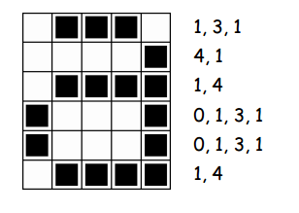
An example – Image representation

Slide 25
An example – Image representation

Slide 26
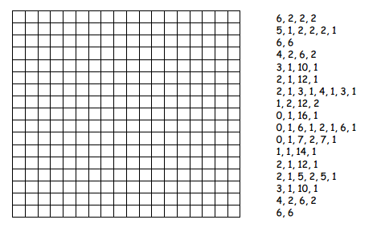
An example – Image representation

Slide 27
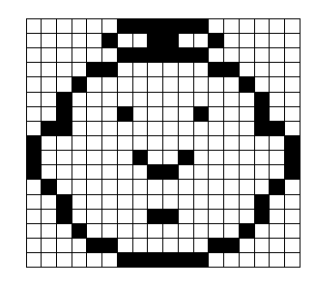
An example – Image representation

