Slide 1


WELCOME!
University of Newcastle, Australia
13th – 14th November 2017

Slide 2
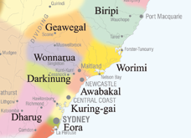
This land
We acknowledge and respect the Pambalong clan of the Awabakal people, traditional custodians of this land.
Notes:
Awaba = traditional name for Lake Macquarie
Awabakal people lived in NCL, Lake MACQ and lower Hunter

Slide 3

Introductions
I'm Elena
I studied a Bachelor of Mathematics
I studied a PhD in computer science at UoN
I subsequently work in Bioinformatics for a number of years
Since 2012 I have worked in the School of Education

Slide 4
Introductions
I'm Daniel
PhD student at the University of Newcastle’s School of Education
Studying Teacher Professional Development for the Digital Technologies curriculum
Interested in Computer Science and its applications to different disciplines
Completed my Software Engineering degree in 2014
Facilitating workshops in this area since 2013

Slide 5
Introductions
I'm Felicia
I studied Mathematics teaching
Currently studying a PhD
Principal research assistant for the Girls in Maths project led by Prof Jenny Gore

Slide 6
Introductions
And you?

Slide 7
Housekeeping
Toilets
Fire alarm
Login
Login: gen700
Password: November.17

Slide 8
Workshop Aims
Introduce concepts in the new Standard Mathematics Syllabus
Explore implementation of those concepts using computer programming
Provide examples of hands-on activities that can be used in the classroom

Slide 9
Workshop Schedule – Day 1
Time | Session | Location
9:00am – 9:15am | Registration | ICT3.37
9:15am – 9:45am | Workshop Schedule & Coding and Computational Thinking | ICT3.37
9:45am – 10:45am | Introduction to Networks Concepts Activity | ICT3.37
10:45am – 11:00am | Morning Tea | ICT3.98
11:00am – 12:30pm | Minimum Spanning Tree Activity | ICT3.37
12:30pm – 1:00pm | Lunch | ICT3.98
1:00pm – 3:00pm | Coding in Snap! Activity | ICT3.37

Slide 10
Workshop Schedule – Day 2
Time | Session | Location
9:15am – 9:45am | Talk by Dr Judy-anne Osborn | ICT3.37
9:15am – 10:45am | Creating Networks in Edgy Activity (Part 1) | ICT3.37
10:45am – 11:00am | Morning Tea | ICT3.98
11:00am – 12:00 pm | Creating Networks in Edgy Activity (Part 2) | ICT3.37
12:00pm – 1:00pm | Finding Minimum Spanning Trees in Edgy Activity (Part 1) | ICT3.37
1:00pm – 1:30pm | Lunch | ICT3.98
1:30pm – 2:20pm | Finding Minimum Spanning Trees in Edgy Activity (Part 2) | ICT3.37
2:20pm – 2:50pm | Moving from Blocks Languages to Text Languages Activity | ICT3.37
2:50pm – 3:00pm | Workshop wrap-up and survey | ICT3.37

Slide 11
Coding and Computational Thinking
Computer Science is a large and diverse field of study, its focus is on problem solving (usually with solutions involving the use of computers)
Coding (or Programming) is the act of writing instructions for a computer in a programming language
Computational Thinking is a way of approaching problems – “thinking like a Computer Scientist”¹

Slide 12
Coding
Code should be written for humans first and computers second
Visual Programming Languages, such as Scratch, allow anyone to get started Coding without knowing particular keywords and syntax

Slide 13
Coding
Encouraging students to learn how to code has become a global movement
Hour of Code²
Code Club³
The Digital Technologies subject in the National Curriculum includes programming and algorithms⁴

Slide 14
Computational Thinking
Not thinking about or like a Computer⁶
A way of approaching a problem in a way that a computer can be used to solve it
Involves breaking a problem into a step-by-step solution (an algorithm)

Slide 15
Computational Thinking
“Computer science is no more about computers than astronomy is about telescopes, biology is about microscopes or chemistry is about beakers and test tubes. Science is not about tools, it is about how we use them and what we find out when we do”⁵

Slide 16
Computational Thinking in K – 12?
Should every student become a Computer Scientist or Software Engineer?
By 2020 half of all STEM jobs will be in computing⁷
Automation and “innovation” are creating and changing current careers
Are there any benefits other than preparing students for their careers?

Slide 17
Computational Thinking in K – 12?
Help students understand the digital world and the processes which make it possible
Gives students a new way of creating digital artefacts and worlds
Adds another problem-solving approach to students’ “toolkits”

Slide 18
Coding and Maths
Some would argue that Maths and Coding are inseparable and that to be a good Coder you need a solid background in Maths
There is definitely overlap and there are some areas of Maths (e.g. algebra, numbers and operations) that are essential to understanding Coding
There are many examples of combining Maths and Coding in a variety of real-life projects
We will hear about some of these today and tomorrow

Slide 19
Coding and Learning Maths
Seymour Papert: Mindstorms (1980) and The Children's Machine: Rethinking School In The Age Of The Computer (1994)
Led development of the Logo language, one of the first coding languages designed for educational purposes

Slide 20
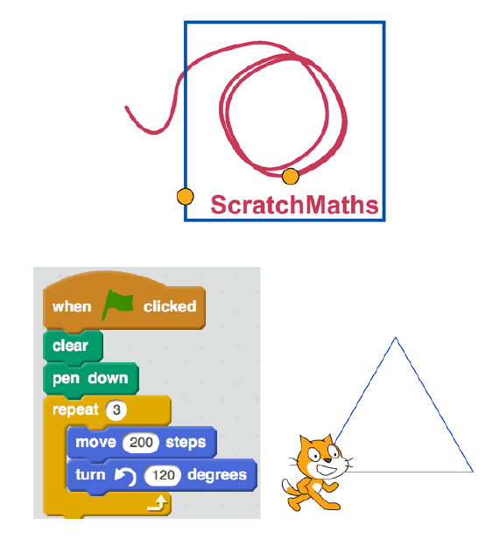
Coding and Learning Maths
Developed in England
The project leaders in England, Richard Noss and Celia Hoyles (from University College London), have worked with Papert
Uses Scratch, which has been influenced by the design of languages/environments like Logo and Boxer, as the Coding language
Coding helps develop understanding of mathematics in a range of areas

Slide 21
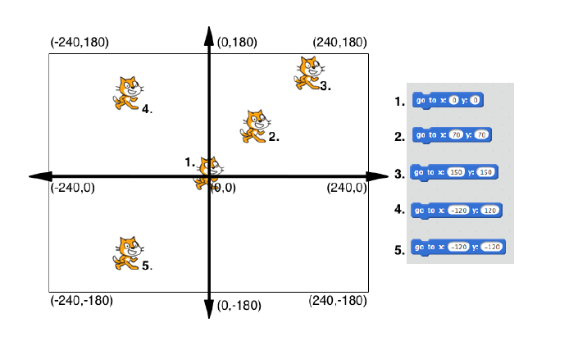
Coding and Learning Maths
In 2D games we have a canvas, which is a Cartesian plane
A lot of games (e.g. Super Mario or Space Invaders) involve moving sprites (images) around a canvas

Slide 22
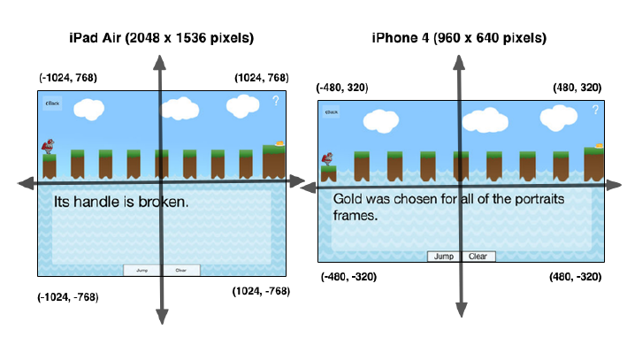
Coding and Learning Maths
It gets more complicated: iPads and iPhone (and all the different models) have different sized screens
For example, what happens if we tell our hero to move to (-960, 400)?

Slide 23
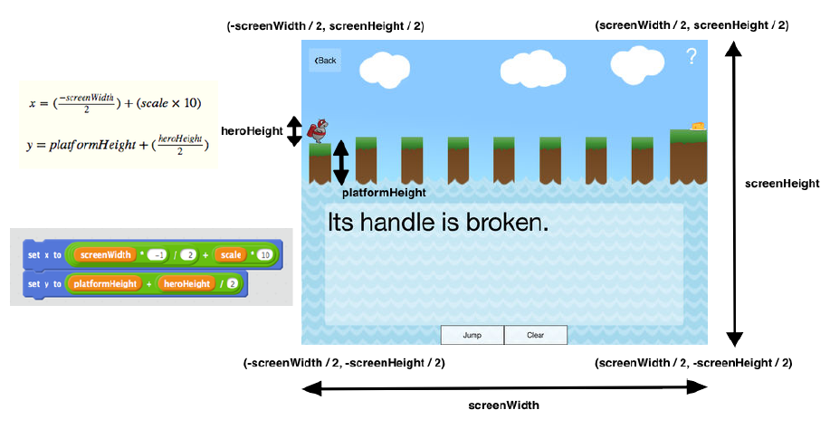
Coding and Learning Maths
We can solve this issue with Coding & Algebra!

Slide 24
Mathematics Standard 2 Syllabus
A student:
solves problems using networks to model decision-making in practical problems (MS2-12-8)
chooses and uses appropriate technology effectively in a range of contexts, and applies critical thinking to recognise appropriate times and methods for such use (MS2-12-9)
uses mathematical argument and reasoning to evaluate conclusions, communicating a position clearly to others and justifying a response (MS1-12-10)

Slide 25
Mathematics Standard 2 Syllabus
A student:
solves problems using networks to model decision-making in practical problems (MS2-12-8)
chooses and uses appropriate technology effectively in a range of contexts, and applies critical thinking to recognise appropriate times and methods for such use (MS2-12-9)
uses mathematical argument and reasoning to evaluate conclusions, communicating a position clearly to others and justifying a response (MS1-12-10)

Slide 26
Mathematics Standard 2 Syllabus
N2.1: Networks
Students:
identify and use network terminology, including vertices, edges, paths, the degree of a vertex, directed networks and weighted edges (ACMGM078, ACMGM083)
solve problems involving network diagrams
recognise circumstances in which networks could be used, for example the cost of connecting various locations on a university campus with computer cables (ACMGM079)
given a map, draw a network to represent the map, for example travel times for the stages of a planned journey
draw a network diagram to represent information given in a table
investigate and solve practical problems, for example the Königsberg Bridge problem or planning a garbage bin collection route

Slide 27
Mathematics Standard 2 Syllabus
N2.1: Networks
Students:
identify and use network terminology, including vertices, edges, paths, the degree of a vertex, directed networks and weighted edges (ACMGM078, ACMGM083)
solve problems involving network diagrams
recognise circumstances in which networks could be used, for example the cost of connecting various locations on a university campus with computer cables (ACMGM079)
given a map, draw a network to represent the map, for example travel times for the stages of a planned journey
draw a network diagram to represent information given in a table
investigate and solve practical problems, for example the Königsberg Bridge problem or planning a garbage bin collection route

Slide 28
Mathematics Standard 2 Syllabus
N2.2: Shortest Paths
Students:
determine the minimum spanning tree of a given network with weighted edges (ACMGM101, ACMGM102)
determine the minimum spanning tree by using Kruskal's or Prim's algorithms or by inspection
determine the definition of a tree and a minimum spanning tree for a given network
use minimum spanning trees to solve minimal connector problems, for example minimising the length of cable needed to provide power from a single power station to substations in several towns
find the shortest path from one place to another in a network with no more than 10 vertices
identify the shortest path on a network diagram (ACMGM084)
recognise a circumstance in which a shortest path is not necessarily the best path or contained in any spanning tree

Slide 29
Mathematics Standard 2 Syllabus
N2.2: Shortest Paths
Students:
determine the minimum spanning tree of a given network with weighted edges (ACMGM101, ACMGM102)
determine the minimum spanning tree by using Kruskal's or Prim's algorithms or by inspection
determine the definition of a tree and a minimum spanning tree for a given network
use minimum spanning trees to solve minimal connector problems, for example minimising the length of cable needed to provide power from a single power station to substations in several towns
find the shortest path from one place to another in a network with no more than 10 vertices
identify the shortest path on a network diagram (ACMGM084)
recognise a circumstance in which a shortest path is not necessarily the best path or contained in any spanning tree

Slide 30
What do Computer Scientists do?
Fix computers?
Write code at a desk 40 hours a week?
Create video games?
Work at a bank, Facebook or Google?

Slide 31
What do Computer Scientists do?
Write educational software and simulations for training
Train the next generation of Mathematics teachers
Work with Biologists and Medical Researchers to find new ways of identifying diseases
Study how our memories work and how they can be “augmented” by technology
Compete in international robot soccer tournaments
And much more!

Slide 32
Resources
Web Sites
Computer Science 4 Fun: http://www.cs4fn.org/
Computer Science Field Guide: http://csfieldguide.org.nz/
Project Euler : https://projecteuler.net/
Bebras: https://www.bebras.edu.au/bebras365/
Online Courses
CSER (Uni of Adelaide) Digital Technologies MOOCS: https://csdigitaltech.appspot.com/course
Google’s Exploring Computational Thinking Course: https://www.google.com/edu/resources/programs/exploring-computational-thinking/

Slide 33
References
1. “Computational Thinking Benefits Society” - Jeannette M. Wing
http://socialissues.cs.toronto.edu/index.html%3Fp=279.html
2. Hour of Code - https://code.org/learn
3. Code Club Australia - http://www.codeclubau.org/
4. “Digital Technologies Curriculum” – ACARA
http://www.australiancurriculum.edu.au/technologies/digital-technologies/curriculum/f-10?layout=1
5. Michael R. Fellows, Ian Parberry (1993) "SIGACT trying to get children excited about CS". in: Computing Research News. January 1993.
6. Computational Thinking – Barefoot CAS
http://barefootcas.org.uk/barefoot-primary-computing-resources/concepts/computational-thinking/
7. Rebooting the Pathway to Success – ACM
http://pathways.acm.org/

