Slide 1

Computer Science without a Computer
Dr Elena Prieto
Lecturer
School of Education
21st November 2016

Slide 2
Presentation Contents
The Digital Technologies Curriculum
Teaching CS without a Computer
An Example – Following Instructions
Resources – Computer Science Unplugged
Resources – TryComputing
CS Unplugged – Binary Numbers and Image Representation

Slide 3
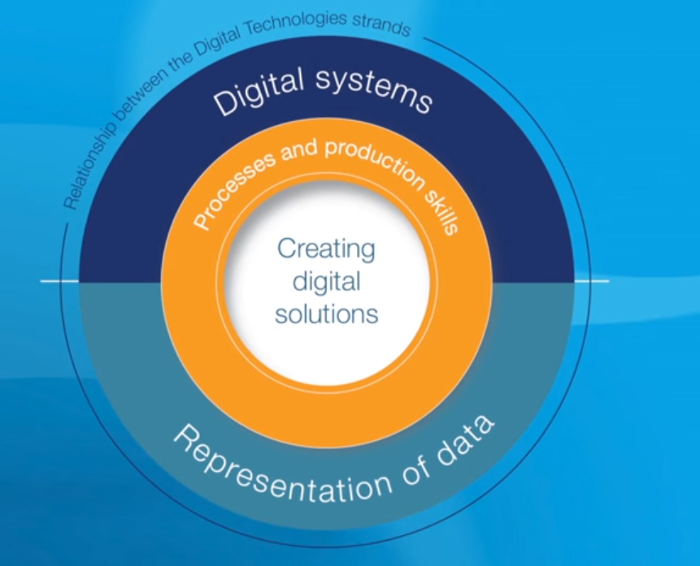
Digital technologies curriculum
The new Digital Technologies curriculum received final endorsement in January 2016
It can be found here: http://www.australiancurriculum.edu.au/technologies/digital-technologies/curriculum/f-10
“In which students use computational thinking and information systems to define, design and implement digital solutions.”

Slide 4
Digital technologies curriculum
By the end of Year 2, students will have had opportunities to create a range of digital solutions through guided play and integrated learning, such as using robotic toys to navigate a map or recording science data with software applications.
By the end of Year 4, students will have had opportunities to create a range of digital solutions, such as interactive adventures that involve user choice, modelling simplified real world systems and simple guessing games.
By the end of Year 6, students will have had opportunities to create a range of digital solutions, such as games or quizzes and interactive stories and animations.
We will be looking at it in more detail tomorrow and how it fits within the NSW syllabus

Slide 5
Teaching CS without a Computer
“Computer science is not about machines, in the same way that astronomy is not about telescopes. There is an essential unity of mathematics and computer science.” - Michael R. Fellows¹
In this session we will do some activities from Computer Science Unplugged²
Using paper and pens – no need for a computer
Get you thinking like a Computer Scientist

Slide 6
An Example - Following Instructions
Computers follow precise and specific instructions
Write an algorithm (sequence of steps)
Code it in a language the Computer understands
What if people could only understand instructions exactly?
E.g. if I pointed to a closed door and said “go through that door” – what would you do?³

Slide 7
An Example - Following Instructions
On the square piece of paper on your desk, perform the following steps:
Draw a dot in the centre of your page.
Starting at the top left-hand corner of the page draw a straight line through the dot finishing at the bottom right hand corner.
Starting at the bottom left-hand corner of the page draw a line through the dot, finishing at the top right hand corner.
Write your name in the triangle in the centre of the left-hand side of the page.

Slide 8
An Example - Following Instructions
You should have something that looks like this:

Slide 9
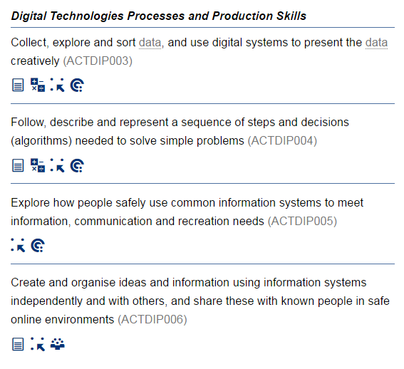
Digital technologies curriculum
Years 1 and 2

Slide 10
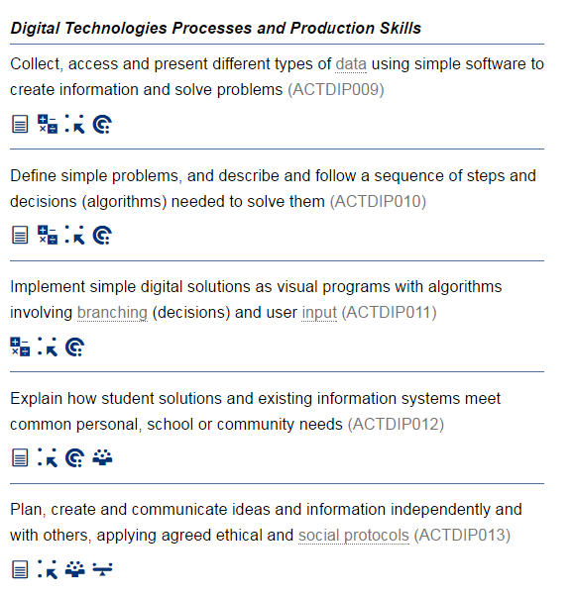
Digital technologies curriculum
Years 3 and 4

Slide 11
Resources – Computer Science Unplugged
A collection of activities to teach CS concepts without a computer
Developed by Tim Bell, Ian Whitten and Michael Fellows
Covers a large range of topics relevant to DT curriculum
Has links to NZ computing curriculum, but not Australian DT (yet, but it is linked from AIS website⁶)
Activities targeted at age groups 5 – 12, but for anyone

Slide 12
Resources - TryComputing
A collection of lesson plans for teaching Computing concepts⁵
Part of the TryEngineering collection of lesson plans
Covers wide range of topics
Science & Engineering
Sponsored by IEEE (Institute of Electrical and Electronics Engineers)
Has activities for years 8 - 18
Some activities require the use of a computer

Slide 13
CS Unplugged – Binary Numbers
When a binary number card is not showing, it is represented by a zero.
When it is showing, it is represented by a one.
This is the binary number system.
Our system is called the decimal system.
What number is 01001 in decimal?
What would 17 be in binary?
How about 6, 15, 21…
Notes:
Q1 – 9
Q2 – 10001

Slide 14
CS Unplugged – Binary Numbers
What do you notice about the number of dots on the cards?
How many dots would the next card have if we carried on to the left?
What is the biggest number you can make? What is the smallest?

Slide 15
CS Unplugged – Binary Numbers
Is there more than one way to get any number?
Is there any number you can’t make between the smallest and biggest numbers?
Now try counting from zero onwards, is there a pattern?

Slide 16
CS Unplugged – Binary Numbers
What happens when you put a 0 on the right of a binary number?
Is there a pattern for odd and even numbers?

Slide 17
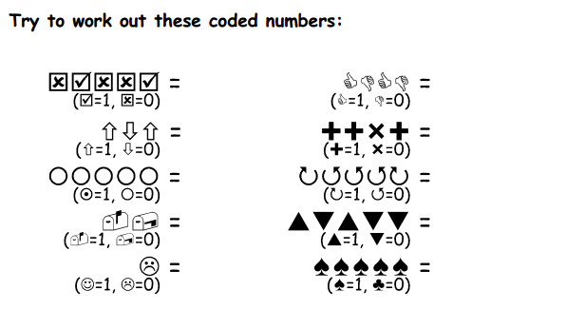
CS Unplugged – Binary Numbers

Slide 18
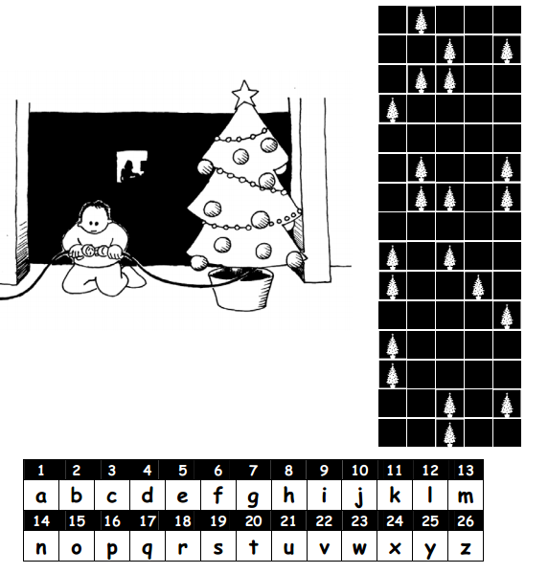
CS Unplugged – Binary Numbers
Notes:
Help im trapped

Slide 19
CS Unplugged – Binary Numbers
Have you noticed there are different fonts in a computer type set?
a a a

Slide 20
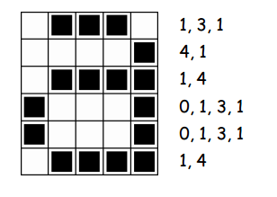
CS Unplugged – Binary Numbers

Slide 21
CS Unplugged – Binary Numbers

Slide 22
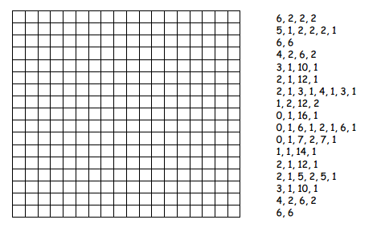
CS Unplugged – Binary Numbers

Slide 23
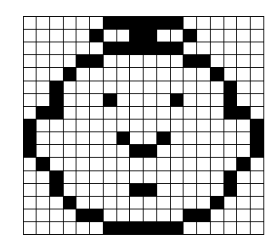
CS Unplugged – Binary Numbers

Slide 24
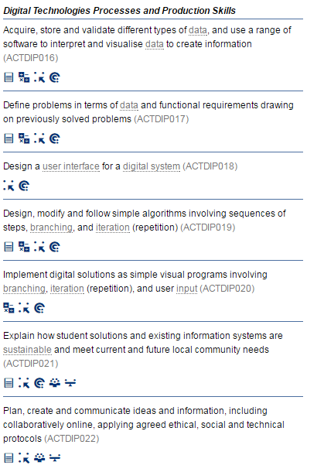
Digital technologies curriculum
Years 5 and 6

Slide 25
References
Teaching CS without a Computer
1: ”Computer Science and Mathematics in the Elementary Schools” - Michael R. Fellows (1991)
2: Computer Science Unplugged http://csunplugged.org/
An Example – Following Instructions
3: Computer Science Unplugged - Marching Orders activity http://csunplugged.org/programming-languages/#Marching_Orders
4: Youtube - Crazy teacher making a peanut butter sandwich at Lange middle school 2013 https://www.youtube.com/watch?v=F7AbbFT1Vwc
Resources – TryComputing
5: IEEE TryComputing http://www.trycomputing.org/
AIS NSW – K-6 Computational Thinking
6: https://www.aisnsw.edu.au/Services/Partnerships_in_Education/STEM/Pages/CT.aspx

