Slide 1
CS Unplugged

Slide 2
Computational Thinking
Not thinking about or like a Computer
A way of thinking that allows us to approach problems in a way that a computer can be used to solve those problems
For example, a GPS in your car
Involves breaking a problem into a step-by-step solution (an algorithm)

Slide 3
Coding
The act of writing instructions for a computer to follow in a language that it understands (Code)
When we want a computer to follow instructions, we require:
Computational Thinking
Coding
There are many Coding languages – we focus on Scratch in this project

Slide 4
Computational Thinking
Bebras Challenge: https://www.bebras.edu.au/
Please have a look at the activities on your desk
If you want to learn more about computational thinking, including teaching resources, please have a look at:
http://www.digitaltechnologieshub.edu.au/teachers/topics/computational-thinking

Slide 5
Coding
Encouraging students to learn how to code has become a global movement
Hour of Code
Code Club
The Digital Technologies subject in the National Curriculum includes programming and algorithms
In NSW, we have the ‘coding across the curriculum’ area

Slide 6
Unplugged Approaches
There are approaches for teaching Computational Thinking without Coding or using a computer at all
We will look at a couple of unplugged examples from CSUnplugged: http://csunplugged.org/
Some of the ScratchMaths activities are unplugged but most involve Coding with Scratch

Slide 7
Computers run on electricity and maths!

Slide 8
Have you noticed the different fonts in a computer type set?
a a a

Slide 9
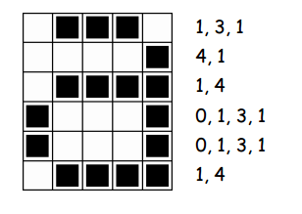

Slide 11


Slide 12


Slide 13


How do computers know?
Sometimes mistakes can be passed on in transmission
How do computers know if there’s been a mistake?

