Slide 1
Computer Science
without a Computer!

Slide 2
Session Schedule
Teaching CS without a Computer
Computer Science Unplugged
CS Unplugged – Binary Numbers
CS Unplugged – Image Representation

Slide 3
Teaching CS without a Computer
“Computer science is not about machines, in the same way that astronomy is not about telescopes. There is an essential unity of mathematics and computer science.” - Michael R. Fellows¹
In this session we will do some activities from Computer Science Unplugged²
Using paper and pens – no need for a computer
Get you thinking like a Computer Scientist

Slide 4
Computer Science Unplugged
A collection of activities to teach CS concepts without a computer
Developed by Tim Bell, Ian Whitten and Michael R. Fellows
Covers a large range of topics relevant to DT curriculum
Activities targeted at age groups 5 – 12, but for anyone

Slide 5
CS Unplugged – Binary Numbers
When a binary number card is not showing, it is represented by a zero.
When it is showing, it is represented by a one.
This is the binary number system.
Our system is called the decimal system.
What number is 01001 in decimal?
What would 17 be in binary?
How about 6, 15, 21…
Notes:
Q1: 9
Q2: 10001

Slide 6
CS Unplugged – Binary Numbers
What do you notice about the number of dots on the cards?
How many dots would the next card have if we carried on to the left?
What is the biggest number you can make? What is the smallest?

Slide 7
CS Unplugged – Binary Numbers
Is there more than one way to get any number?
Is there any number you can’t make between the smallest and biggest numbers?
Now try counting from zero onwards, is there a pattern?

Slide 8
CS Unplugged – Binary Numbers
What happens when you put a 0 on the right of a binary number?
Is there a pattern for odd and even numbers?

Slide 9
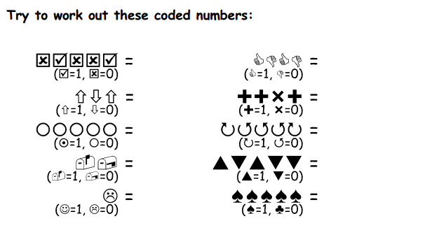
CS Unplugged – Binary Numbers

Slide 10
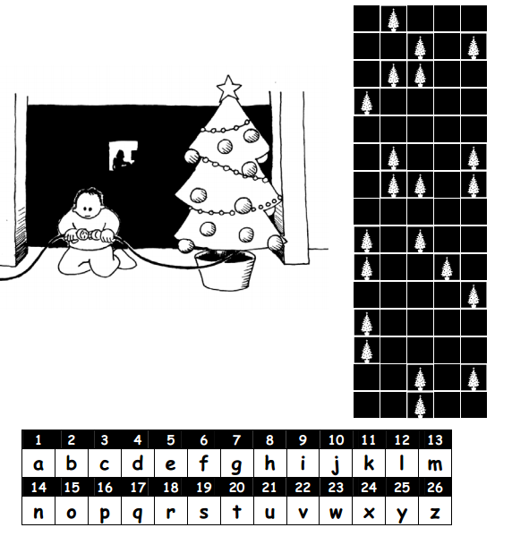
CS Unplugged – Binary Numbers

Slide 11
CS Unplugged – Image Representation
Have you noticed there are different fonts in a computer type set?
a a

Slide 12
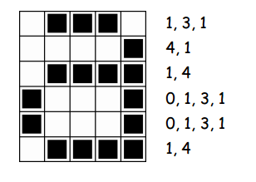
CS Unplugged – Image Representation

Slide 13
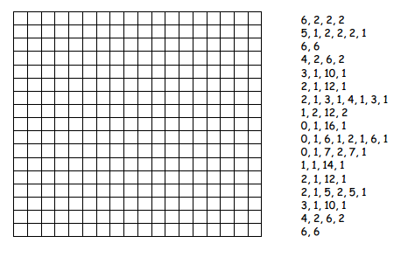
CS Unplugged – Image Representation

Slide 14
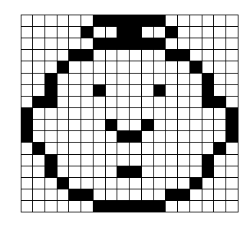
CS Unplugged – Image Representation

Slide 15
References
1. ”Computer Science and Mathematics in the Elementary Schools” - Michael R. Fellows (1991)
2. Computer Science Unplugged – http://csunplugged.org/

