Slide 1
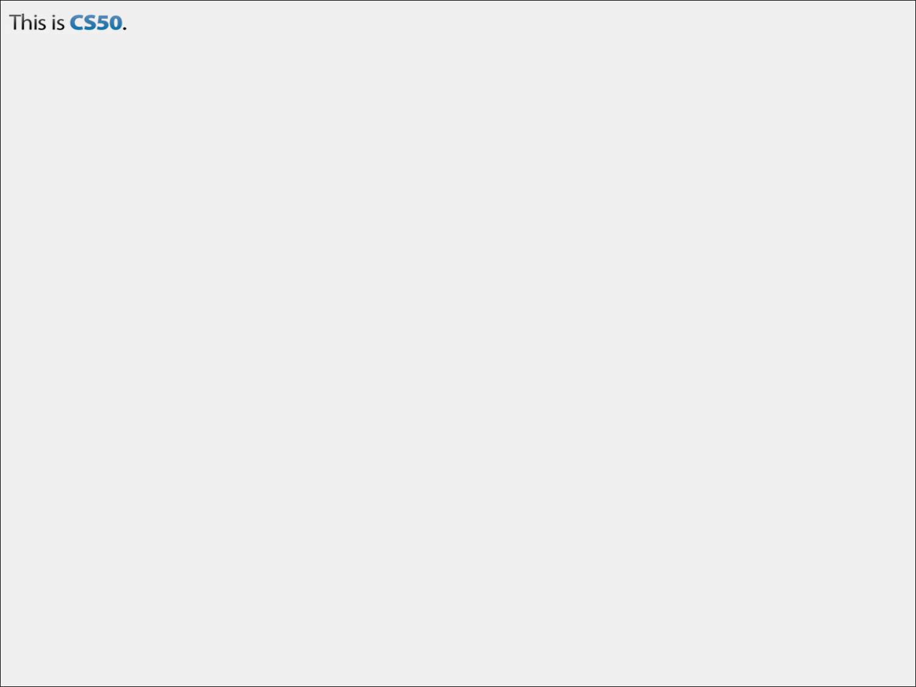
CS50 Section #2
Monday 5:30-7:00pm
60 Oxford 330
September 24, 2012

Slide 2
Today’s Agenda
Introductions
Administrivia & Course Expectations
Functions & Scope
Magic Numbers
Arrays
Command-Line Arguments
Cryptography
Problem Set 1 Recap and Questions
Looking Ahead to Problem Set 2
Cool Constructs / Miscellany (Time Permitting)
We’ll take a break sometime around here.

Slide 3

About Me
Doug Lloyd
Class of 2009 (Computer Science)
E-mail: lloyd@cs50.net
Cell: 781-534-8860 (emergencies only!!)

Slide 4
About You!
Just the typical introductory section stuff. Tell us:
  Your name, year, and House/dorm
  Your hometown
  Your concentration (or potential concentration)
  Any other fun fact(s) you want to share

Slide 5
My Expectations for You
To see you in section every week!
To participate in class. This week is an aberration because there is so much material to cover, but usually participation is a must—you get more out of the class that way, and it makes it more fun for everyone.
To seek out help when you need it. This subject can be tough, and there is a large support staff here to help!
To put in the work required to make this semester of CS50 a fun and productive one!

Slide 6
What You Can Expect of Me
To see me in section every week!
To respond to e-mails within 24 hours (typically much less).
To return your problem sets to you promptly, and with helpful suggestions and notes.
To put in the work required to make this semester of CS50 a fun and productive one!
To usually come equipped with candy or some other thing to snack on during section ☺

Slide 7
Course Resources
Watch Problem Set walkthroughs
  Better yet, attend them on Fridays!
cs50.net/lectures
  Lecture slides, scribe notes, videos, code
Office Hours
  Mon-Thurs 8pm-midnight in Annenberg
apps.cs50.net/discuss
  Be sure to run a quick search before posting your questions!
  Also be sure to mark your post as Private to Staff if you’re posting any of your own code

Slide 8
Today’s Agenda
Introductions
Administrivia & Course Expectations
Functions & Scope
Magic Numbers
Arrays
Command-Line Arguments
Cryptography
Problem Set 1 Recap and Questions
Looking Ahead to Problem Set 2
Cool Constructs / Miscellany (Time Permitting)

Slide 9
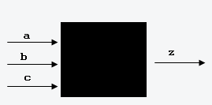
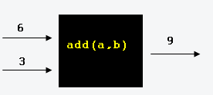
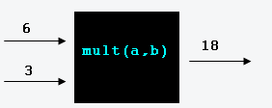
Functions (1)
What is a function?
  Simply put, a function is a black box with a set of inputs and a single output.

Slide 10
Functions (2)
Why do we use functions?
  Organization
    Functions help break up a complicated problem into more manageable subparts.
  Simplification
    Smaller components are easier to design, implement, and debug!
  Reusability
    Functions are recyclable; you only need to write them once, but can use them as often as needed!

Slide 11
Functions (3)
How do we build a function?
We start with a function declaration. Function declarations have three parts.
<return type> is what type of variable the function will output. For example, an integer (int), a character (char), a floating-point number (float or double).
<name> is what you think it is! It’s how you refer to the function.
<argument list> are the list of all inputs. In the argument list, each argument must have a type and a name.
Let’s look at an example:
<return type> <name> (<argument list>);

Slide 12
Declaring Functions
A function to add two integers:
A function to multiply two integers:
int add_two_nums(int a, int b);
int mult_two_nums(int x, int y);
What about a function you’d use to start your whole program? Maybe it would look something like:
int main(int argc, char *argv[]);
Though, main() is special; it does not require a function declaration.

Slide 13
Function Definition
A function declaration is not enough. After we make a function declaration, we need to define the function so that, when the function is called, it has predictable behavior. Let’s look at how we might do that for one of the functions we’ve already declared.

Slide 14
Defining add_two_nums()
int add_two_nums(int a, int b);
int add_two_nums(int a, int b)
{
int sum;
sum = a + b;
return sum;
}
First, our declaration. Notice that it precedes our definition.
Next, we need to define the function so that it has a behavior we might expect. Here’s one such way of doing this (and note that there are many others)
This is where we store our output. Notice the variable’s type.
Here’s where the work is actually done.
Here, we RETURN the answer. Notice that the returned variable, sum, is the same type as the return type of the function, int.

Slide 15
Making Function Calls
Making a function call is quite simple.
int main()
{
int arg1 = 3;
int arg2 = 5;
int result = add_two_nums(arg1, arg2);
return 0;
}
So, whatever gets returned by the function add_two_nums() is stored in the int variable result.
Using return 0 in main() is a convention. It means the function completed with no errors. And, if the computer executes the code all the way up to this statement, that would be the case.

Slide 16
Function Miscellany (1)
A function that returns nothing should be given the type void.
void print_my_name() {
printf(“Doug\n”);
return;
}
Notice that there is nothing being returned here. That’s because the function is void. In fact, this return statement is optional…though for style purposes, I’d like you to use them.

Slide 17
Function Miscellany (2)
Some functions have no inputs, but an output. A good example is a random-number generator.
Some functions have no output, but do have inputs. For example, seeding a random number generator.
int rand();
void srand(unsigned int x) {
// stuff happens
}

Slide 18
In-Section Problem #1
Declare and write a function validTriangle(), that takes three real numbers representing the lengths of the three sides of a triangle as its arguments, and outputs a true or false value corresponding to whether or not the three inputted sides are capable of making a triangle.
Note the following:
A triangle may not have a side with negative length
A triangle may not have a side with zero length
The sum of the lengths of two of the sides of the triangle must be greater than the length of the third side.

Slide 19
Variable Scope (1)
Scope is a characteristic of a variable that defines from which functions it can be accessed.
A local variable can only be accessed within the function in which it is created.
A global variable can be accessed by any function.
Scope can be tricky. Let’s walk through one example.

Slide 20
scope_practice1.c
Declared outside of ALL functions (including main()), so global
int i_am_global;
void main() {
int num1 = 3, num2 = 4, larger;
larger = max(num1, num2);
printf("%d is the larger number computed by max().\n", larger);
max2(num1, num2);
printf("%d is the larger number from the global variable via
max2().\n", i_am_global);
return;
}
int max(int x, int y) {
int greater_num;
greater_num = (x > y ? x : y); /* More on this construct later */
return greater_num;
}
void max2(int x, int y) {
i_am_global = (x > y ? x : y);
return;
}
Variables this color are local to main()
Variables this color are local to max()
Variables this color are local to max2()

Slide 21



Slide 22
Global variables are very often BAD style.
Sometimes they are necessary, but often times they are not.
If you feel that you need to use a global variable, e-mail me.
So looking back to our previous example…

Slide 23
scope_practice1.c
int i_am_global;
void main() {
int num1 = 3, num2 = 4, larger;
larger = max(num1, num2);
printf("%d is the larger number computed by max().\n", larger);
max2(num1, num2);
printf("%d is the larger number from the global variable via
max2().\n", i_am_global);
return;
}
int max(int x, int y) {
int greater_num;
greater_num = (x > y ? x : y); /* More on this construct later */
return greater_num;
}
void max2(int x, int y) {
i_am_global = (x > y ? x : y);
return;
}
Which is better, then: max() or max2()?

Slide 24
Variable Scope (2)
Variables in C are passed by value, which means that the function being called will make its own copy of the arguments, and will not be able to change the value of the arguments in the calling function.
Bearing this in mind, let’s see a second scope example. This time, see if you can figure out what is printed at the end of the function’s execution.

Slide 25
scope_practice2.c
int increment(int x); /* Function declaration */
void main() {
int x = 1;
int y;
y = increment(x);
printf("%d %d \n", x, y);
return;
}
int increment(int x) {
x++;
return x;
}
What is printed to the screen when this program has completed execution?
1 2

Slide 26
Magic Numbers (1)
Consider the following pseudocode:
“52” is a magic number. Any ideas why it would be considered a magic number?
void deal_cards(deck name) {
int j = 0;
for(j = 0; j < 52; j++)
deal_card(j);
return;
}

Slide 27
Magic Numbers (2)
What if, tomorrow, a deck of cards suddenly had 56 cards instead of 52?
We’d have to go back and change the 52 in our code to a 56.
That might not be such a hassle, but consider all of the functions that deal with decks of cards. And some of them may use that “52” a number of times. It could take a while!
Here’s a possible solution.

Slide 28
Is this any better?
void deal_cards(deck name) {
int deck_size = 52;
int j = 0;
for(j = 0; j < deck_size; j++)
deal_card(j);
return;
}
This fixes one problem, but it also introduces a few others. Can you think of some potential problems with this solution?

Slide 29
#define
When we need to eliminate a magic number (like 52), we usually use #define
#define goes through all of your code during the compiling process, and replaces any instances of a “identifier” that you use with the number you assign.
Let’s take a look at our card dealing function one more time.

Slide 30
Finally repaired
#define DECK_SIZE 52
void deal_cards(deck name) {
int j = 0;
for(j = 0; j < DECK_SIZE; j++)
deal_card(j);
return;
}
Now, if the size of a deck changes, all that needs to be changed is that 52, and all uses of DECK_SIZE will change automatically.

Slide 31
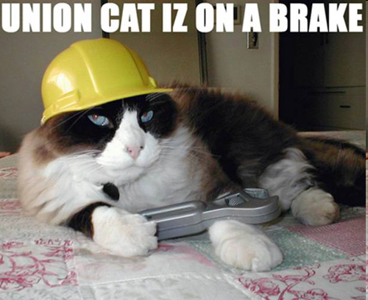
And so are we! For a few minutes, anyway.

Slide 32
Today’s Agenda
Introductions
Administrivia & Course Expectations
Functions & Scope
Magic Numbers
Arrays
Command-Line Arguments
Cryptography
Problem Set 1 Recap and Questions
Looking Ahead to Problem Set 2
Cool Constructs / Miscellany (Time Permitting)

Slide 33
Arrays (1)
Arrays are data structures that can be be used to hold multiple values of the same type at contiguous memory locations.
Think about your local Harvard Mail Center.
  An array is a block of contiguous space in memory (the bank of mailboxes) which has been partitioned into smaller identically-sized blocks of space (individual mailboxes).
  These smaller spaces can each store a certain amount of data (mail) all of the same type (letters and small packages), which can be accessed directly by an index number (mailbox number).

Slide 34
Arrays (2)
C arrays always start at index 0. If an array has n elements, the last element in the array is at index (n-1).
Unlike other languages, C will not prevent programs from accessing elements past the end (or before the beginning) of arrays, even though this can cause errors of various degrees. Examples of declaring and accessing an array:
int student_grades[5];
double menu_prices[10];
student_grades[0] = 95;
menu_prices[6] = 7.49;
menu_prices[10] = 5.99;
trouble brewing…

Slide 35
Arrays (3)
Arrays can be multidimensional as well. All you need to do is add another size specifier:
A multi-dimensional array is accessed analogously to that of a one-dimensional array.
C arrays can have any number of dimensions, unlike physical entities which are restricted to three.
int array_2d[5][5];
array_2d[2][4] = 3;

Slide 36
Perceiving an Array (1)
For two dimensional arrays, this can be easy:
Declaration: int A[5][5];
A[0][0] | A[0][1] | A[0][2] | A[0][3] | A[0][4]
A[1][0] | A[1][1] | A[1][2] | A[1][3] | A[1][4]
A[2][0] | A[2][1] | A[2][2] | A[2][3] | A[2][4]
A[3][0] | A[3][1] | A[3][2] | A[3][3] | A[3][4]
A[4][0] | A[4][1] | A[4][2] | A[3][4] | A[4][4]

Slide 37
Perceiving an Array (2)
For three-or-more dimensional arrays, this may not be easy, you might want to look at it another way:
Declaration: int A[2][2][2];
A[0][0][0] | A[0][0][1] | A[0][1][0] | A[0][1][1] | A[1][0][0] | A[1][0][1] | A[1][1][0] | A[1][1][1]
A[0][0][0] | A[0][0][1] | A[0][1][0] | A[0][1][1] | A[1][0][0] | A[1][0][1] | A[1][1][0] | A[1][1][1]
A[0][0][0] | A[0][0][1] | A[0][1][0] | A[0][1][1] | A[1][0][0] | A[1][0][1] | A[1][1][0] | A[1][1][1]
A[0][0][0] | A[0][0][1] | A[0][1][0] | A[0][1][1] | A[1][0][0] | A[1][0][1] | A[1][1][0] | A[1][1][1]
The contents of “cell” A[0]
The contents of “cell” A[0][1]
The contents of cell A[0][1][0]
Regardless of how you choose to think about arrays, this is actually how they look in memory.

Slide 38
More on Arrays (1)
Whole arrays cannot be assigned the same way that regular values are; the contents of array foo cannot be assigned to another array bar just by saying bar = foo. Instead, you must copy over each element, one at a time (probably using a loop).
When a function is called with an array as an argument, a reference to the array is passed, not the entire array. This means that if the function being called changes the contents of the array in any way, then the contents of the array are really changed.
Note that this is quite diﬀerent from the way that other variables are handled.
The basis for this will become much clearer when we discuss pointers later in the semester.

Slide 39
array_practice1.c
void set_array(int array[4]) {
array[0] = 22;
}
void set_int(int x) {
x = 22;
}
void main() {
int a = 10;
int b[4] = { 0, 1, 2, 3 };
set_int(a);
set_array(b);
printf("%d %d\n", a, b[0]);
return;
}
The call to set_int() doesn’t change a at all, but the call to set_array() does change the contents of b.
This program prints 10 22.
? ? ?

Slide 40
array_practice2.c
Below is an example of how a one-dimensional array might be used. This might be part of a program to keep track of a section’s grades on a particular assignment:
#define CLASS_SIZE 20
#define EMPTY -1
void init_array(int array[], int size);
void main() {
int i;
int scores_array[CLASS_SIZE];
init_array(scores_array, CLASS_SIZE);
/* Populate Array */
for(i = 0; i < CLASS_SIZE; i++) {
printf("Enter score for student %d: ", i);
scores_array[i] = GetInt();
}
return;
}
void init_array(int array[], int size) {
int i;
/* Initialize all cells to be empty */
for(i = 0; i < size; i++) {
array[i] = EMPTY;
}
return;
}

Slide 41
Practice Problem #2
Write a function that accepts as its parameters an integer array (called, say, arr) and an integer (called, say, size) representing the size of that array. In the body of the function, determine whether that array is in descending numerical order from arr[0] to arr[size-1]. If it is, return the string “yes” to the calling function. Otherwise, return the string “no”. Do NOT modify the contents of arr.

Slide 42
Command-Line Arguments
You’ve been (or, will be soon ☺), beginning each of your programs this way:
argc and argv are two special variables automatically created for you at runtime. They are used to read information from the command-line.
int main(int argc, char *argv[])
Side note: For reasons that will be explained later in the course, you may also see this as char **argv

Slide 43
argc
argc tells you how many command line arguments there are. For example, in:
there is only 1 command-line argument, but in:
there are 3.
me@cloud (~/pset1): ./greedy
me@cloud (~/pset1): ./greedy 1024 ftw!

Slide 44
argv
argv is where those command line arguments are stored. As you can see by its declaration (char *argv[]), argv is an array. As an example, in:
you can access elements of the array at any point in the program just as you would normally access an array:
me@cloud (~/pset1): ./greedy 1024 ftw!
argv[0] = “./greedy”
argv[1] = “1024”
argv[2] = “ftw!”
argv[3] = ???
Note: All command-line arguments are stored as strings (aka char *)
Check out functions such as atoi() for how to convert strings to more useful types.

Slide 45
Modifying mario.c
Imagine if, instead of asking for the height of the Mario pyramid the program itself, we instead collected it on the command line.
As an at-home exercise, rewrite the beginning of the program. How would we:
  Check to make sure that we had the right number of command line arguments?
  Put those arguments into a usable form?

Slide 46
This is where you find the atoi() function
#include <stdio.h>
#include <stdlib.h>
int main(int argc, char *argv[]) {
if(argc != 2) {
printf("Sorry...not enough arguments!");
return 1;
}
for(int j = 0; argv[1][j] != ‘\0’; j++)
if(!isnum(argv[1][j]) {
printf(“You must enter a positive integer!”);
return 2;
}
int height = atoi(argv[1]);
/* et cetera */
}
Checks for exactly two command line arguments
Why?
What am I doing in this loop?
atoi() converts a string to an integer.

Slide 47
Cryptography Basics
The act and study of enciphering (putting into code) information is known as cryptography, and the people who attempt to “undo” and study cryptography are known as cryptanalysts.
In Problem Set 2, if you choose to do the standard edition, you are primarily charged with the former task–to write some ciphers to encode information.
The hacker edition also puts you in the position of being a cryptanalyst, as you are asked to decode some sensitive information (passwords) as well.

Slide 48

Very relevant Problem Set 2 information to follow!

Slide 49
Caesar Cipher
The simplest type of encryption method we will be discussing in this course is the Caesar Cipher.
To implement a Caesar Cipher, one simply chooses a “key”, some integer value from 0 to (k – 1), where k is the length of the alphabet under consideration.
For our purposes, we will be using the English alphabet, so k = 26. Then, one takes each letter they wish to encode in the message and applies the following formula to it:
c_{i} = (p_{i} + k) mod 26

Slide 50
Vigenère Cipher (1)
The Vigenère Cipher, at ﬁrst glance, looks signiﬁcantly more complex than the Caesar Cipher. In reality, it is just a gloriﬁed version of the same. The formula to encipher, in fact, is nearly identical–save for one small (though important!) change:
Where i is the i^{th} letter of the message, j is the j^{th} use of a letter in the keyword, and m is the length of the keyword.
Let’s see an example of how this works on the next slide.
c_{i} = (p_{i} + k_{(j mod m)}) mod 26

Slide 51
Vigenère Cipher (2)
C | L | A | S | S |  | T | I | M | E | !
PLAINTEXT :
KEYWORD :
CIPHERTEXT :
0 1 2 3 4 5 6 7 8 9 10 i
C | O | M | P | U |  | T | E | R | C
0 1 2 3 4 5 6 7 8 j
0 1 2 3 4 5 6 7 0 j mod m
E | Z | M | H | M |  | M | M | D | G | !
0 1 2 3 4 5 6 7 8 9 10 i
Psst…you probably want to take a look at http://en.wikipedia.org/wiki/ASCII for this!
Notice that we do not use the letters of the keyword to encipher spaces or non-letters

Slide 52
Modern-Day Encryption
Today, ciphers tend to be a little bit more complicated than some letter-shifting or some fancy French letter-shifting.
Going into great detail about these encryption techniques is outside of the scope of this course (take CS120!), but some well-known algorithms are:
RSA SEAL
DES / 3DES RC4

Slide 53
Today’s Agenda
Introductions
Administrivia & Course Expectations
Functions & Scope
Magic Numbers
Arrays
Command-Line Arguments
Cryptography
Problem Set 1 Recap and Questions
Looking Ahead to Problem Set 2
Cool Constructs / Miscellany (Time Permitting)

Slide 54
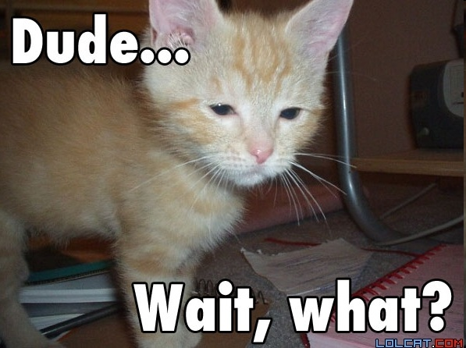
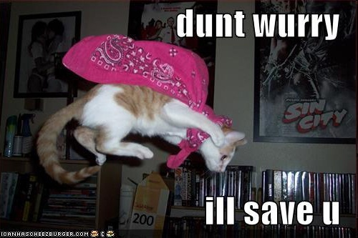
Recap of Problem Set 1

Slide 55
Looking Ahead
In Problem Set 2, you’ll need to:
  Take the previously mentioned formula for Caesar Cipher and translate it into C code
  Take the previously mentioned formula for Vigenere Cipher and translate it into C code
Or, if you think you can “Hack” it:
  Be doing some serious password cracking and hacking.
caesar.c
vigenere.c
crack.c

Slide 56
Practice Problem #3
Write a program that prompts the user for a message, and then outputs the message with its first letter capitalized, with all other letters in alternating case, as in the example below:
thanks for the add
ThAnKs FoR tHe AdD
For simplicity, you may assume that the user will only input lowercase letters and spaces.

Slide 57
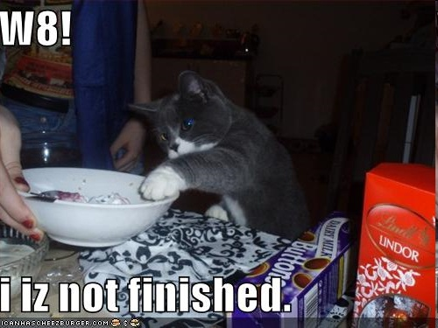
Haha j/k
We’re done

Slide 58
Cool Constructs
You’ve already learned about a few conditional statements, notably if, else, and switch.
There is another one that is particularly useful, which we have already seen, called the ternary operator (?:) – aka “question-mark-colon”
The ternary operator takes three arguments. Let’s take a look at an example.

Slide 59
?:
int greatest(int x, int y)
{
int z;
z = (x > y) ? x : y;
return z;
}
Result if expression is false
Boolean expression
Result if expression is true

Slide 60
Type Casting
C provides an operator to force a conversion from one type to another, called a type cast (or simply a cast).
To perform a cast, you simply place the name of the type to be converted to surrounded by parentheses before the expression to be converted. For example:
int i, j;
double a, e, f;
a = 100 / (double) i;
j = (int) (e + f);
In the ﬁrst expression, the integer i is cast to type double before it is used in the division. Note that this forces C to do this division using ﬂoating point arithmetic, rather than integer arithmetic.
Trust me, you will come to LOVE type casting and will find it will often come in handy!

