Slide 1
CS50 Section #7
Monday 5:30-7:00pm
Maxwell Dworkin 319
October 24, 2010

Slide 2
Today’s (Short) Agenda
Problem Set 5 Discussion
The Wonderful World of Valgrind
Hash Tables
Trees and Tries
Looking Ahead to Problem Set 6
Bit Strings
Huffman Encoding
You are only asked to stay through this part of section. If you want, you can leave after. If you want to stay, and time permits, we’ll do bit strings and Huffman in class as well.

Slide 3
Final Project
Secret item not on the agenda!
The final project specification will be online soon.
Start thinking about it!
Final project deadlines:
  Pre-proposal: Mon 11/7, noon
  Proposal: Mon 11/14, noon
  Hackathon: Fri 12/2, 8:00pm – Sat 12/3, 7:00am
  Status Report: Mon 12/5, noon
  Implementation: Thu 12/8, noon
  Fair: Fri 12/9, 11:00am—4:30pm
Be sure to read the spec when it goes up and e-mail me with questions!

Slide 4
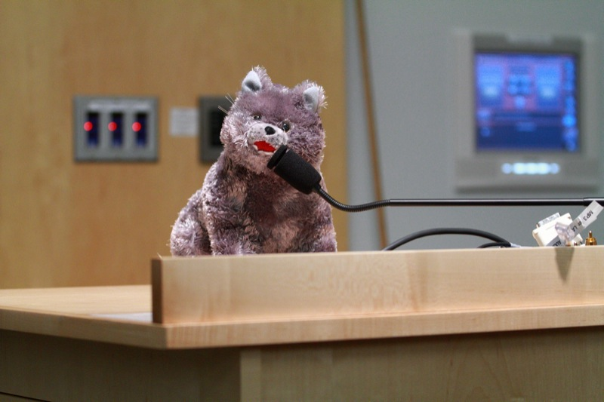
Problem Set 5
Whodunit? Recover?? Resize???

Slide 5

VALGRIND!

Slide 6
Linked Lists Redux (1)
We know that linked lists are data structures that support efficient insertion and deletion of elements. In fact, we can do these operations in O(1).
Lookup operations in a linked list, however, is Θ(n), where n is the number of items in the list. Thus, as the list grows longer, the average time to look up an element takes proportionally longer.

Slide 7
Linked Lists Redux (2)
How can we build a lookup function that doesn’t have to loop over all of the elements stored in our data structure?
  One option would be for us to change our data structure so that something about the structure of a piece of data tells us where to find it.
A hash table is a data structure where insertion, deletion, and lookup of data can each be accomplished in Θ(1)!
  The caveat: hash tables do not easily support ordering or sorting of the stored data.
If we were building something like, oh, I don’t know, a SPELL CHECKER or something, however, hash tables are a good idea, since we don’t have any real reason to print out the entire list of words in our dictionary, sorted out.
In such a spell checker, we might use our hash table to store strings (char *), but the principle can be generalized for all data types.

Slide 8
Hash Tables
A hash table is basically an array, coupled with a hash function, which is used to map the stored object to indices of the array.
For our purposes, we will define hash functions to return a hash code, an integer value.
Logically, since we are using arrays, our hash code should be in the range [0, array size – 1] (or be put into that range by using the modulo operator %)

Slide 9
Hash Functions (1)
There are infinitely many hash functions, but not all of them are effective or good.
Here’s an example of a very simple hash function:
int hash(char *str) {
int sum = 0, len = strlen(str);
for(int j = 0; j < len; j++)
sum += str[j];
return sum % ARRAYSIZE;
}
What is happening in this hash function?

Slide 10
Hash Functions (2)
It can be tough to write an effective hash function. You have my permission to use hash functions you find online, but you absolutely must cite the hash function if you do so.
You also can write your own hash function. Good hash functions have five properties.

Slide 11
Properties of a Hash Function
The hash code is fully determined by the string (or other data) being hashed, and by nothing else.
The hash code for two identical strings is the same (no random numbers in the calculation)
The hash function uses the whole string (or the entire piece of data) being hashed.
The hash function “uniformly distributes” the data.
The hash function can generate very different hash code for similar, but not identical, strings (or other pieces of data)

Slide 12
Hash Example
0
1
2
3
4
5
6
7
8
9
Assume we have some hash function at our disposal, hash1()
hash1(“Bart”); returns 5
hash1(“Lisa”); returns 7
Note that neither insertion, nor lookup, requires iterating through the array.
“Bart”
“Lisa”

Slide 13
Pop Quiz!
What is one of the HUGE problems that could have occurred in the previous example?
What if “Bart” and “Lisa” had both hashed to the value 5? Then what would we do? We certainly wouldn’t want to clobber either value.
When this happens, it is called a collision. Next we will cover two methods of dealing with collisions.

Slide 14
Probing (1)
In this method, in the event of a collision, the algorithm tries array elements separately until a vacancy is found.
0
1
2
3
4
5
6
7
8
9
hash(“Bart”); returns 5
hash(“Lisa”); returns 5
hash(“Maggie”); returns 6
hash(“Homer”); returns 7
hash(“Marge”); returns 5
“Bart”
“Lisa”
“Maggie”
“Homer”
“Marge”

Slide 15
Probing (2)
This technique is subject to a problem called “clustering”.
As we saw, once a collision occurs during insertion, there will be two table cells next to each other that are occupied.
Afterwards, an insertion that collides with either of those cells will cause that cluster to grow.
Now the probability is even larger that another collision will cause the cluster to grow.
This technique is also subject to another problem: You can only insert as many elements as there are slots in the array. This could lead to an infinite loop problem (why?)

Slide 16
Probing (3)
The method of probing we just looked at is called “linear probing”. There is also, for example, “quadratic probing”.
In “quadratic probing”, we first check the cell of the hash value h. If that is occupied, we check h + 1². If that is occupied, we check h + 2^{2,} h + 3^{2,} h + 4², etc…
Can you predict a problem with this method as well?

Slide 17
Probing (4)
Assume hash function hash2() always returns a hash value of 0.
hash2(“Doug”);
hash2(“Nick”);
hash2(“Jane”);
hash2(“Corinne”);
All those empty cells, and no place to go! (Can resolve the problem by having hash table size be prime)
0
1
2
3
4
5
6
7
“Doug”
“Nick”
“Jane”
(0+0)%8 = 0, (0+1)%8 = 1, (0+4)%8 = 4, (0+9)%8 = 1, (0+16)%8 = 0, (0+25)%8 = 1, (0+36)%8 = 4, (0+49)%8 = 1, (0+64)%8 = 0, (0+81)%8 = 1, (0+100)%8 = 4, (0+121)%8 = 1
Pattern: 0, 1, 4, 1, 0, 1, 4, 1…

Slide 18
Separate Chaining (1)
An alternative to the probing model is the separate chaining model.
In separate chaining, each element of the hash table is a pointer to the head of a linked list.
  OMG DATA STRUCTURE COMBO!!1!one!
If you choose to use hash tables in PS6, this is the method you will want to use.

Slide 19
Separate Chaining (2)
This clustering problem will not occur here (Yay!)
Insertion: Hash the string. Is there an element pointed to by the pointer in the array location pointed to by the hash code?
  No: Then this is the new head of the linked list.
  Yes: Make this element the new head of the linked list and set its “next” arrow to be the old head of the linked list.
    Why do it this way and not the other way? Insertion is O(1) this way, and not O(n)!
Lookup: Hash the string. Go to the linked list pointed to in array[hashcode], scan through it. Find it, return true. Else, return false.
Let’s look at an example.

Slide 20

Separate Chaining (3)
node *array[10];
0
1
2
3
4
5
6
7
8
9
Marge
Bart
hash(“Bart”); returns 1
hash(“Lisa”); returns 4
hash(“Maggie”); returns 5
hash(“Homer”); returns 6
hash(“Marge”); returns 1
Lisa
Maggie
Homer
typedef struct _node {
char word[10];
struct _node *next;
} node;

Slide 21
Trees (1)
Trees are a very useful data structure that look very similar to something we have already seen before. (Surprise, surprise…)
In our discussion on trees (not tries), we will consider only binary trees.
The structure of a binary tree node is:
typedef struct _tree {
int data;
struct _tree *left;
struct _tree *right;
} tree;

Slide 22
Trees (2)
Though the structure of a tree node looks like a doubly-linked list node, they are actually very different.
This difference is in the meaning we assign (just like stacks and queues with respect to singly-linked lists). For example, we refer to left and right children nodes, not prev and next nodes.
Binary tree nodes must point only at their children (or NULL). They may not, by definition, point back to themselves or any other node.

Slide 23

Trees (3)
10
5
14
3
8
13
18
1
4
16

Slide 24
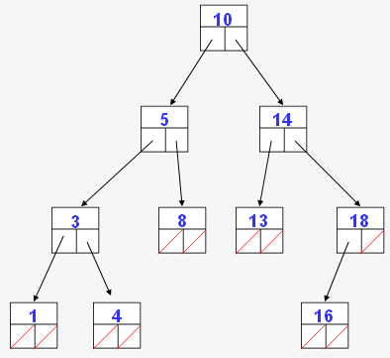
Binary Search Trees
The tree I just showed you is a special case of a tree called a binary search tree.
In such a tree, for each node, every value on its left child’s side is less than the node’s associated value of the node and every value on the right side is greater.
This makes performing binary search on such a tree extremely easy (hence the name of the tree!)
On the next page, we’ll look at the code for binary search with this tree.

Slide 25
Binary Search Using
Binary Search Trees
root
bool
binary_search(node *root, value val) {
if (root == NULL)
return false;
if (root->val == val)
return true;
else if (val < root->val)
return binary_search(root->left, val);
else
return binary_search(root->right, val);
}

Slide 26
Tries (1)
An associative array (aka a dictionary) is a generalized array that allows you to associate values with keys that are more descriptive than simple integers, as with ordinary arrays.
For instance, suppose you need a data structure that allows you to look up the records for a student starting from his or her 8-digit university ID. A simple array would need too many entries.
You could use a hash table, extracting hash codes from either the numerical or the string representation of the student IDs.
Or you could build a tree, placing the student records at the leaves of the tree. In such a tree, the paths from the root to a leaf would be labeled with digits of the ID. Each interior (non-leaf) node could therefore have as many as ten children. To find a student record, you would start at the root and use successive digits of the student’s ID to choose successive child nodes until you reach the desired record or you reach a dead end (meaning that the student hasn’t yet been inserted in the tree).
This type of tree is called a trie (pronounced “try”)

Slide 27
Tries (2)
In the previous example, the structure of a trie node would look something like this.
So, as we can see, a binary tree is just a special case of a trie, where the number of children is 2.
On the next slide, let’s imagine that my student ID is 55203626 and David Malan’s is 55203942.
typedef struct _trie {
char *data;
struct _trie *children[10];
} trie;

Slide 28

NULL
By following the path representing each digit of the ID number, we arrive at the right person. Recall that my ID number was 55203626 and David’s was 55203942. Since there is no student whose ID number is 5, 55, 552, 5520, 55203, 552036, 552039, 5520362, or 5520394, the data value at that location is NULL. Let’s take a look at another example of this where this is not the case.
5
NULL
5
NULL
2
NULL
0
NULL
3
NULL
9
6
NULL
NULL
2
4
NULL
NULL
6
2
Doug Lloyd
David Malan

Slide 29
Tries (3)
We’re going to keep the structure pretty similar.
So in this case, we’re checking to see if a number is prime or not.
typedef struct _trie2 {
bool prime;
struct _trie2 *children[10];
} trie2;

Slide 30
---
1
5
8
false
true
false
0
7
2
9
7
false
true
false
false
true
2
3
6
false
true
false
9
0
Primes: 5, 17, 89, 173, 8269
Non-primes: 1, 8, 10, 57, 82, 172, 826, 8260
false
true

Slide 31
Final Thoughts
 | Hash Tables | Tries
Insertion | O(1) | O(1)
Deletion | O(1) | O(1)
Lookup | O(numhash(n)) | O(strlen(n))
Size | Comparatively small | Comparatively huge

Slide 32
Problem Set 6 (1)
In Problem Set 6, you will be implementing a spell checker.
You are provided with a dictionary of words, and you will later have to determine whether or not the words in a given input file are valid.
You must decide whether or not to build the spell checker using a hash table or using a trie (or something different??), now that you are aware of the pros and cons of each.

Slide 33
Problem Set 6 (2)
You’ll notice on the CS50 website that you will be challenging “THE BIG BOARD”. Try and get your score (load, check, size, and unload times) to be as good as it can!
You may also want to become friends with the str(n)cpy() and/or memcpy() functions. It is very likely to prevent a number of errors that you might encounter without it.
Good luck!

Slide 34
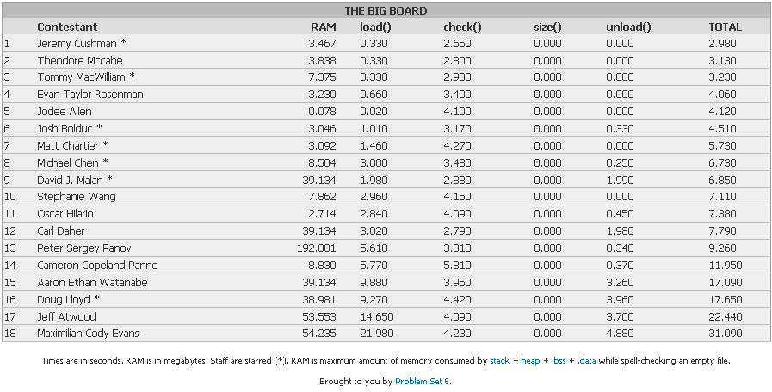
THE BIG BOARD
Beat my TOTAL time by 7:00pm on Friday 10/29…win a prize!
(My time will (hopefully) get a bit better than this, trust me!)

Slide 35
Problem Set 6 Tips
load()
  Hash table or trie – it’s ENTIRELY up to you. Both are weighed equally well, if designed well. No preferences here.
  The ‘\n’ is not considered a letter of the word in the dictionary.
  Befriend str(n)cpy() and memcpy(), unless you want to experience some befuddling errors.
size()
  Don’t make it any more complicated than it needs to be!
check()
  Don’t forget to put your words in all lowercase before you start checking them!
unload()
  Hash tables: And how is it that we free a singly-linked list()?
  Tries: Delete all the subtrees before you delete the root!

Slide 36
Bit Strings (1)
As you surely know by this point, everything stored on your computer is stored as a string of 0s and 1s
Usually, your computer interprets these bit strings as ints, floats, bools, FILEs, etc…
However it is also possible to interpret this data simply as a bit string. It’s like viewing an int as an array of 32 boolean values, false and true, except you can’t access the elements using simple array notation s[i].
The good news is, the bit string is much better than such an array, and you can still operate on its elements!

Slide 37
Bit Strings (2)
The four operands &, |, ~, and ^ are called the bitwise operators.
  & is bitwise AND
    Notice that this is NOT the same as &&
  | is bitwise OR
    Notice that this is NOT the same as ||
  ~ is bitwise NOT
    Notice that this is NOT the same as !
  ^ is bitwise XOR

Slide 38
Bit Strings (3)
On the next several slides, we’re going to look at how these operators work.
For simplicity, you should know that we will be using 8 bit integers.
What does this mean about the values that those integers can take on. If they are signed? If they are unsigned?

Slide 39
&, bitwise AND
Bitwise AND is written a & b
Each output bit is 1 if the corresponding bits of a and b are both 1. 0 otherwise.
a 01011011
b 10001101
a & b 00001001
a 10110101
b 01010101
a & b 00010101

Slide 40
|, bitwise OR
Bitwise OR is written a | b
Each output bit is 1 if either of the corresponding bits of a and b are 1. 0 otherwise.
a 01011011
b 10001101
a | b 11011111
a 10110101
b 01010101
a | b 11110101

Slide 41
~, bitwise NOT
Bitwise NOT is written ~a (thus, it is a unary operator)
Each output bit is 1 if the corresponding bits of a is 0. 0 otherwise.
a 01011011
~a 10100100
a 10110101
~a 01001010

Slide 42
^ , bitwise XOR
Bitwise XOR (exclusive OR) is written a ^ b
Each output bit is 1 if exactly one the corresponding bits of a and b is 1. 0 otherwise.
a 01011011
b 10001101
a ^ b 11010110
a 10110101
b 01010101
a ^ b 11100000

Slide 43
Summary Table
a | b | a & b | a | b | ~a | a ^ b
0 | 0 | 0 | 0 | 1 | 0
0 | 1 | 0 | 1 | 1 | 1
1 | 0 | 0 | 1 | 0 | 1
1 | 1 | 1 | 1 | 0 | 0

Slide 44
Shift Operators (1)
There are two other operators on bit strings that work in conjunction with the ones previously described.
These are left shift (<<) and right shift (>>)
The expression s << i treats integer s as a bit string, and i as the number of bits to shift that string to the left. Zero bits are inserted at the right, and bits shifted beyond the boundary of the string are discarded.

Slide 45
Shift Operators (2)
Why is this useful? Consider the following.
If you want to multiply an integer by 10, what do you do?
You’re doing a form of bit shifting! Shifting everything to the left and padding the right side with zeroes. It’s (kinda) equivalent to
6 * 10 = 60
394 * 10 = 3940
6 << 1
394 << 1

Slide 46
Shift Operators (3)
The difference in C is that we work in binary, so instead of multiplying by 10 when we left shift by 1, we multiply by 2.
The same applies for right shift and division, by the way.
In general:
Formerly, you would have needed a for loop or to #include <math.h> to accomplish this task!
s << i
equals
s * 2^{i}

Slide 47
Data Compression
All of these 1s and 0s take up a lot of space. For example, each character in a text file takes up 8 bits, because they are encoded with the ASCII standard, a fixed-length encoding scheme.
But there are 128 characters in the regular ASCII standard (256 in the expanded). Do we really use all of those characters all the time?
If not, then isn’t it possible to store each character using LESS than 8 bits per character?
  If not EVERY character, then it would certainly be space-efficient to use less than 8 bits for the characters that we use most frequently.

Slide 48
Intro to Huffman Encoding
Though it may not seem like it, and though there is not a problem set on Huffman encoding this year, knowing how to Huffman encode can definitely be a relevant skill.
Unlike ASCII, Huffman encoding uses a variable-length encoding scheme. Specifically, if we can figure out which characters occur most frequently, we can use less than 8 bits to represent them. If we do this, however, some of the least-frequently occuring characters will require more than 8 bits to represent them without introducing ambiguity.
Overall, the goal is to use less bits than a fixed-length encoding scheme would allow us.
And this is the major element behind Huffman encoding.

Slide 49
The Prefix Property (1)
Huffman encoding works because it retains something called the prefix property.
An encoding scheme with the prefix property guarantees that no bit representation for any of the characters is a prefix of any other character’s representation.
An encoding with the prefix property is said to be immediately decodable.
Why do we care? Let’s consider the following example.

Slide 50
The Prefix Property (2)
A | 0
B | 1
C | 01
D | 11
If we were to encode the string “CAB” using the scheme at left, we would get 0101.
But now, imagine you are presented with the bit string 0101. Do you know that it is “CAB”? No. It could be:
  ABAB
  CAB
  CC
  ABC
This coding scheme does NOT adhere to the prefix property, and is thus not immediately decodable. Let’s see why.

Slide 51
The Prefix Property (3)
A | 0
B | 10
C | 110
D | 111
Using the scheme at left, we know that if we see 010100, the only possible decoding is “ABBA”.
Likewise, 1110111 can only represent “DAD”.
The prefix property eliminates any possible ambiguity in representations.
This coding scheme DOES adhere to the prefix property. No character’s bit representation is the prefix to any other character’s bit representation. It is immediately decodable as a result.

Slide 52
Huffman Encoding (1)
The first step in Huffman encoding is to do a character count. You should note that uppercase and lowercase versions of the same letter are DIFFERENT characters.
After you get this, you create a forest of binary trees, where each tree is a single node that stores information about the character, and how frequently it occurs in the file to be compressed.

Slide 53
Huffman Encoding (2)
After we do that, we just execute the following loop until only one tree remains in the forest.
  Remove the two trees from the forest that have the smallest frequency counts in the root.
  Create a new tree node where the children are the two trees from step 1, the character is -1 (SENTINEL) and the frequency is the sum of the two child nodes.
  Insert this new tree into the forest.

Slide 54
Huffman Encoding (3)
Trees created using this algorithm have some interesting properties.
  Characters are at the leaves of the tree.
  The path to each leaf is necessarily unique, so the paths from the root to the leaf can be used to encode that character.
  It can be proved that this method produces encodings that have the prefix property.
  It can be proved that these encodings produce the smallest possible file size for this class of encodings.
  The frequency field of the root node of the final tree will contain the total number of characters in the file.

Slide 55
Walking Through Huffman
A | 10
B | 20
C | 15
D | 18
E | 30
F | 19
G | 6
H | 5
Suppose we have a file with the frequency table at left. That is, how many times each character appears in the original file.
Let’s construct the Huffman coding tree for this frequency table, and see what results.

Slide 56

A 10 B 20 C 15 D 18 E 30 F 19 G 6 H 5

Slide 57









Slide 58


Slide 60


Slide 62


Slide 64


Slide 66
etc…

Slide 67

-1 123
0 1
-1 51 -1 72
0 1 0 1
-1 21 E 30 -1 33 -1 39
0 1 0 1 0 1
A 10 -1 11 C 15 D 16 F 19 B 20
0 1
Remember, visualizing “going down the left path” = 0, and “going down the right path” = 1, we now have a Huffman encoding for each of the characters in the original file.
H 5 G 6

Slide 68
Final Huffman Encoding
A | 000
B | 111
C | 100
D | 101
E | 01
F | 110
G | 0011
H | 0010
First, confirm that this code meets the prefix property.
Next, let’s look at how efficiently we were able to compress this file!

Slide 69
Non-Huffman File
Character | Frequency | Encoding | Bits/Char | Total
A | 10 | 01000001 | 8 | 80
B | 20 | 01000010 | 8 | 160
C | 15 | 01000011 | 8 | 120
D | 18 | 01000100 | 8 | 144
E | 30 | 01000101 | 8 | 240
F | 19 | 01000110 | 8 | 152
G | 6 | 01000111 | 8 | 48
H | 5 | 01001000 | 8 | 40
All | 123 | n/a | 8 | 984 bits

Slide 70
Huffman File
Character | Frequency | Encoding | Bits/Char | Total
A | 10 | 000 | 3 | 30
B | 20 | 111 | 3 | 60
C | 15 | 100 | 3 | 45
D | 18 | 101 | 3 | 54
E | 30 | 01 | 2 | 60
F | 19 | 110 | 3 | 57
G | 6 | 0011 | 4 | 24
H | 5 | 0010 | 4 | 20
All | 123 | n/a | 3.125 | 350 bits

Slide 71
Savings
So, our original file, using the ASCII standard, used 984 bits.
Our compressed file, using the Huffman standard, used just 350 bits.
This means that the Huffman encoding scheme reduced the size of our file by 64.4%!
But a Huffman-encoded file is not typically readable by a computer. So now we need to…

Slide 72
Huffman Decompression
Huffman decompression is really easy! Just use the following algorithm:
  Start at the root node.
  If the next bit is 0, go to the left child, else go to the right child.
  If you are at a node with a non-sentinel character value, write that character and restart the algorithm from the first step.
  If you are at a node with a sentinel character value, continue the algorithm from the second step.

Slide 73
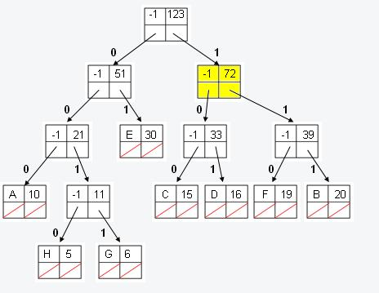
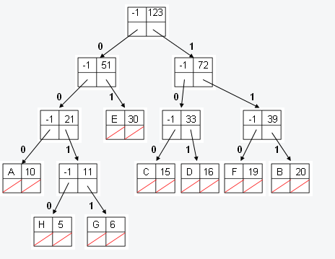
Decoding:
11000010001

Slide 74
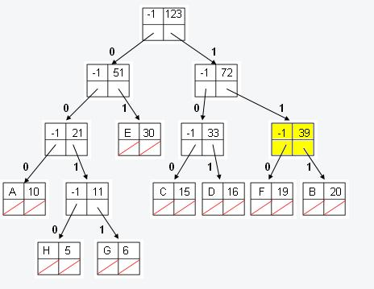
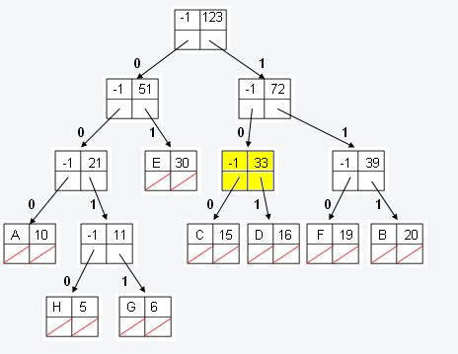
Decoding:
11000010001

Slide 75
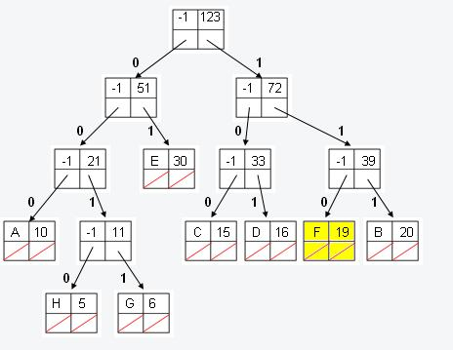
Decoding:
11000010001
F

Slide 76
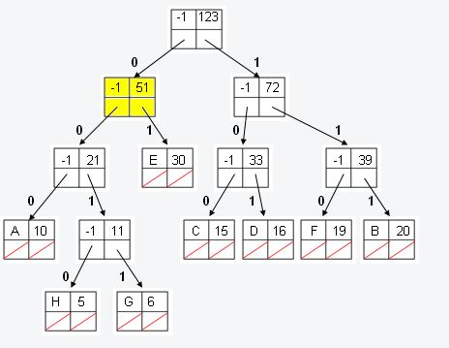
Decoding:
11000010001
F

Slide 77
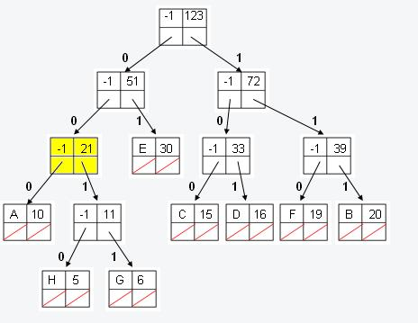
Decoding:
11000010001
F

Slide 78
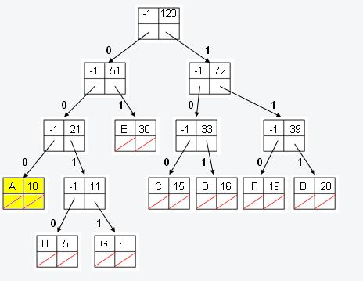
Decoding:
11000010001
FA

Slide 79
Decoding:
11000010001
FA

Slide 80
Decoding:
11000010001
FA

Slide 81
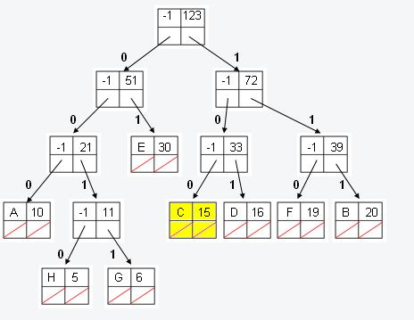
Decoding:
11000010001
FAC

Slide 82
Decoding:
11000010001
FAC

Slide 83
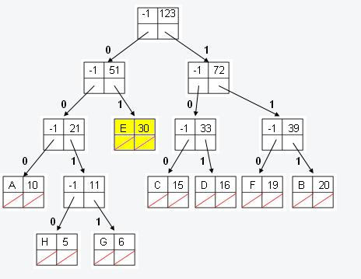
Decoding:
11000010001
FACE

Slide 84


Section
Section

