Slide 1

CS50 Section #7
Monday 5:30-7:00pm
60 Oxford 330
October 29, 2012

Slide 2
Today’s (Short) Agenda
Trees (Redux)
Bit Strings
Huffman Encoding
Problem Set 6 Tips

Slide 3
Trees (1)
Trees are a very useful data structure that look very similar to something we have already seen before.
When we talk about trees, we usually mean “binary trees”.
The structure of a binary tree node is:
typedef struct _tree {
int data;
struct _tree *left;
struct _tree *right;
} tree;

Slide 4
Trees (2)
Though the structure of a tree node looks like a doubly-linked list node, they are actually very different.
This difference is in the meaning we assign (just like stacks and queues with respect to singly-linked lists). For example, we refer to left and right children nodes, not prev and next nodes.
Binary tree nodes must point only at their children (or NULL). They may not, by definition, point back to themselves or any other node.

Slide 5

Trees (3)
10
5
14
3
8
13
18
1
4
16

Slide 6
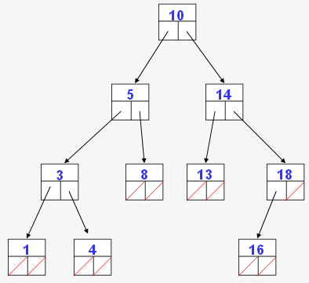
Binary Search Trees
The tree I just showed you is a special case of a tree called a binary search tree.
In such a tree, for each node, every value on its left child’s side is less than the node’s associated value of the node and every value on the right side is greater.
This makes performing binary search on such a tree extremely easy (hence the name of the tree!)
On the next page, we’ll look at the code for binary search with this tree.

Slide 7
Binary Search Using
Binary Search Trees
root
bool
binary_search(node *root, value val) {
if (root == NULL)
return false;
if (root->val == val)
return true;
else if (val < root->val)
return binary_search(root->left, val);
else
return binary_search(root->right, val);
}

Slide 8
Binary Tree Operations
Some main operations to perform with a tree
  Create a tree node
  Add a node to the tree
  Delete a node from the tree
    This we won’t do; it’s a bit complex and for Problem Set 6 it’s not necessary since the only time we delete a node from the tree is when we delete the whole tree
  Search the tree
    This we’ve already seen
  Traverse the tree and print out everything in it
I’ve deliberately left comments out of these! At home exercise: Fill in the comments – why do these work the way they do?!

Slide 9
Build a Tree Node
tree *create_node(int val) {
tree *t = malloc(sizeof(tree));
if(t == NULL)
return NULL;
t->data = val;
t->left = NULL;
t->right = NULL;
return t;
}

Slide 10

Visually…
tree *create_node(int val) {
tree *t = malloc(sizeof(tree));
if(t == NULL)
return NULL;
t->data = val;
t->left = NULL;
t->right = NULL;
return t;
}
t
7
tree *root = create_node(7);

Slide 11
Inserting Into a Tree
bool insert(tree **root, int val) {
tree *t = *root;
if(t == NULL) {
tree *new = create_node(val); // reusing functions!
if(new == NULL)
return false;
*root = new;
return true;
}
if(val == t->data) // no duplicates allowed!
return false;
if(val < t->data)
return insert(&(t->left), val);
else
return insert(&(t->right), val);
}

Slide 12
Visually…
bool insert(tree **root, int val) {
tree *t = *root;
if(t == NULL) {
tree *new = create_node(val); // reusing functions!
if(new == NULL)
return false;
*root = new;
return true;
}
if(val == t->data) // no duplicates allowed!
return false;
if(val < t->data)
return insert(&(t->left), val);
else
return insert(&(t->right), val);
}
root
t
7
t
insert(&root, 9);
9
new

Slide 13
Searching a Tree
bool search_tree(tree *root, int val) {
if(root == NULL)
return false;
if(root->data == val)
return true;
else if(val < root->data)
return search_tree(root->left, val);
else
return search_tree(root->right, val);
}

Slide 14
Deleting a Whole Tree
void delete_tree(tree *root) {
if(root == NULL)
return;
delete_tree(root->left);
delete_tree(root->right);
free(root);
return;
}

Slide 15
Printing a Binary (Search) Tree In Order
void in_order(tree *root) {
if(root == NULL)
return;
in_order(root->left);
printf(“%d “, root->data);
in_order(root->right);
return;
}

Slide 16
GREAT NEWS!
You don’t have to implement any of those functions in Problem Set 6!
Befriend our API! (You need to, to understand the pset). With it, you can:
  mktree (equivalent to making a node)
  plant (equivalent to inserting a node)
  pick (equivalent to deleting a node)
  rmtree (equivalent to deleting a tree)

Slide 17
Bit Strings (1)
As you surely know by this point, everything stored on your computer is stored as a string of 0s and 1s
Usually, your computer interprets these bit strings as ints, floats, bools, FILEs, etc…
However it is also possible to interpret this data simply as a bit string. It’s like viewing an int as an array of 32 boolean values, false and true, except you can’t access the elements using simple array notation s[i].
The good news is, the bit string is much better than such an array, and you can still operate on its elements!

Slide 18
Bit Strings (2)
The four operands &, |, ~, and ^ are called the bitwise operators.
  & is bitwise AND
    Notice that this is NOT the same as &&
  | is bitwise OR
    Notice that this is NOT the same as ||
  ~ is bitwise NOT
    Notice that this is NOT the same as !
  ^ is bitwise XOR

Slide 19
Bit Strings (3)
On the next several slides, we’re going to look at how these operators work.
For simplicity, you should know that we will be using 8 bit integers.
What does this mean about the values that those integers can take on. If they are signed? If they are unsigned?

Slide 20
&, bitwise AND
Bitwise AND is written a & b
Each output bit is 1 if the corresponding bits of a and b are both 1. 0 otherwise.
a 01011011
b 10001101
a & b 00001001
a 10110101
b 01010101
a & b 00010101

Slide 21
|, bitwise OR
Bitwise OR is written a | b
Each output bit is 1 if either of the corresponding bits of a and b are 1. 0 otherwise.
a 01011011
b 10001101
a | b 11011111
a 10110101
b 01010101
a | b 11110101

Slide 22
~, bitwise NOT
Bitwise NOT is written ~a (thus, it is a unary operator)
Each output bit is 1 if the corresponding bits of a is 0. 0 otherwise.
a 01011011
~a 10100100
a 10110101
~a 01001010

Slide 23
^ , bitwise XOR
Bitwise XOR (exclusive OR) is written a ^ b
Each output bit is 1 if exactly one the corresponding bits of a and b is 1. 0 otherwise.
a 01011011
b 10001101
a ^ b 11010110
a 10110101
b 01010101
a ^ b 11100000

Slide 24
Summary Table
a | b | a & b | a | b | ~a | a ^ b
0 | 0 | 0 | 0 | 1 | 0
0 | 1 | 0 | 1 | 1 | 1
1 | 0 | 0 | 1 | 0 | 1
1 | 1 | 1 | 1 | 0 | 0

Slide 25
Shift Operators (1)
There are two other operators on bit strings that work in conjunction with the ones previously described.
These are left shift (<<) and right shift (>>)
The expression s << i treats integer s as a bit string, and i as the number of bits to shift that string to the left. Zero bits are inserted at the right, and bits shifted beyond the boundary of the string are discarded.

Slide 26
Shift Operators (2)
Why is this useful? Consider the following.
If you want to multiply an integer by 10, what do you do?
You’re doing a form of bit shifting! Shifting everything to the left and padding the right side with zeroes. It’s (kinda) equivalent to
6 * 10 = 60
394 * 10 = 3940
6 << 1
394 << 1

Slide 27
Shift Operators (3)
The difference in C is that we work in binary, so instead of multiplying by 10 when we left shift by 1, we multiply by 2.
The same applies for right shift and division, by the way.
In general:
Formerly, you would have needed a for loop or to #include <math.h> to accomplish this task!
s << i
equals
s * 2^{i}

Slide 28
Data Compression
All of these 1s and 0s take up a lot of space. For example, each character in a text file takes up 8 bits, because they are encoded with the ASCII standard, a fixed-length encoding scheme.
But there are 128 characters in the regular ASCII standard (256 in the expanded). Do we really use all of those characters all the time?
If not, then isn’t it possible to store each character using LESS than 8 bits per character?
  If not EVERY character, then it would certainly be space-efficient to use less than 8 bits for the characters that we use most frequently.

Slide 29
Intro to Huffman Encoding
Knowing how to Huffman encode can definitely be a relevant skill.
Unlike ASCII, Huffman encoding uses a variable-length encoding scheme. Specifically, if we can figure out which characters occur most frequently, we can use less than 8 bits to represent them.
If we do this, however, some of the least-frequently occuring characters will require more than 8 bits to represent them without introducing ambiguity.
Overall, the goal is to use less bits than a fixed-length encoding scheme would allow us.

Slide 30
The Prefix Property (1)
Huffman encoding works because it retains something called the prefix property.
An encoding scheme with the prefix property guarantees that no bit representation for any of the characters is a prefix of any other character’s representation.
An encoding with the prefix property is said to be immediately decodable.
Why do we care? Let’s consider the following example.

Slide 31
The Prefix Property (2)
A | 0
B | 1
C | 01
D | 11
If we were to encode the string “CAB” using the scheme at left, we would get 0101.
But now, imagine you are presented with the bit string 0101. Do you know that it is “CAB”? No. It could be:
  ABAB
  CAB
  CC
  ABC
This coding scheme does NOT adhere to the prefix property, and is thus not immediately decodable. Let’s see why.

Slide 32
The Prefix Property (3)
A | 0
B | 10
C | 110
D | 111
Using the scheme at left, we know that if we see 010100, the only possible decoding is “ABBA”.
Likewise, 1110111 can only represent “DAD”.
The prefix property eliminates any possible ambiguity in representations.
This coding scheme DOES adhere to the prefix property. No character’s bit representation is the prefix to any other character’s bit representation. It is immediately decodable as a result.

Slide 33
Huffman Encoding (1)
The first step in Huffman encoding is to do a character count. You should note that uppercase and lowercase versions of the same letter are DIFFERENT characters.
After you get this, you create a forest of binary trees, where each tree is a single node that stores information about the character, and how frequently it occurs in the file to be compressed.

Slide 34
Huffman Encoding (2)
After we do that, we just execute the following loop until only one tree remains in the forest.
  Remove the two trees from the forest that have the smallest frequency counts in the root.
  Create a new tree node where the children are the two trees from step 1 (with the less-frequent on the left), the character is an impossible character (-1 and 0 are common) and the frequency is the sum of the two child nodes.
  Insert this new tree into the forest.

Slide 35
Huffman Encoding (3)
Trees created using this algorithm have some interesting properties.
  Characters are at the leaves of the tree.
  The path to each leaf is necessarily unique, so the paths from the root to the leaf can be used to encode that character.
  It can be proved that this method produces encodings that have the prefix property.
  It can be proved that these encodings produce the smallest possible file size for this class of encodings.
  The frequency field of the root node of the final tree will contain the total number of characters in the file.

Slide 36
Walking Through Huffman
A | 10
B | 20
C | 15
D | 18
E | 30
F | 19
G | 6
H | 5
Suppose we have a file with the frequency table at left. That is, how many times each character appears in the original file.
Let’s construct the Huffman coding tree for this frequency table, and see what results.

Slide 37

A 10 B 20 C 15 D 18 E 30 F 19 G 6 H 5

Slide 38









Slide 39


Slide 41


Slide 43


Slide 45


Slide 47
etc…

Slide 48

-1 123
0 1
-1 51 -1 72
0 1 0 1
-1 21 E 30 -1 33 -1 39
0 1 0 1 0 1
A 10 -1 11 C 15 D 16 F 19 B 20
0 1
Remember, visualizing “going down the left path” = 0, and “going down the right path” = 1, we now have a Huffman encoding for each of the characters in the original file.
H 5 G 6

Slide 49
Final Huffman Encoding
A | 000
B | 111
C | 100
D | 101
E | 01
F | 110
G | 0011
H | 0010
First, confirm that this code meets the prefix property.
Next, let’s look at how efficiently we were able to compress this file!

Slide 50
Non-Huffman File
Character | Frequency | Encoding | Bits/Char | Total
A | 10 | 01000001 | 8 | 80
B | 20 | 01000010 | 8 | 160
C | 15 | 01000011 | 8 | 120
D | 18 | 01000100 | 8 | 144
E | 30 | 01000101 | 8 | 240
F | 19 | 01000110 | 8 | 152
G | 6 | 01000111 | 8 | 48
H | 5 | 01001000 | 8 | 40
All | 123 | n/a | 8 | 984 bits

Slide 51
Huffman File
Character | Frequency | Encoding | Bits/Char | Total
A | 10 | 000 | 3 | 30
B | 20 | 111 | 3 | 60
C | 15 | 100 | 3 | 45
D | 18 | 101 | 3 | 54
E | 30 | 01 | 2 | 60
F | 19 | 110 | 3 | 57
G | 6 | 0011 | 4 | 24
H | 5 | 0010 | 4 | 20
All | 123 | n/a | 3.125 | 350 bits

Slide 52
Savings
So, our original file, using the ASCII standard, used 984 bits.
Our compressed file, using the Huffman standard, used just 350 bits.
This means that the Huffman encoding scheme reduced the size of our file by 64.4%!
But a Huffman-encoded file is not typically readable by a computer. So now we need to…
Not entirely true, as our file also needs to include room for the overhead of including the frequency table so that things can be decompressed, which takes up roughly (256 characters) * (4 bytes/int to store each character’s frequency) = 1,024 bytes. Ouch! But no matter the file size, this overhead is constant…so a serious advantage attaches for larger files!

Slide 53
Huffman Decompression
(aka puff)
Huffman decompression is really easy! Just use the following algorithm:
  Start at the root node.
  If the next bit is 0, go to the left child, else go to the right child.
  If you are at a node with a non-sentinel character value, write that character and restart the algorithm from the first step.
  If you are at a node with a sentinel character value, continue the algorithm from the second step.

Slide 54
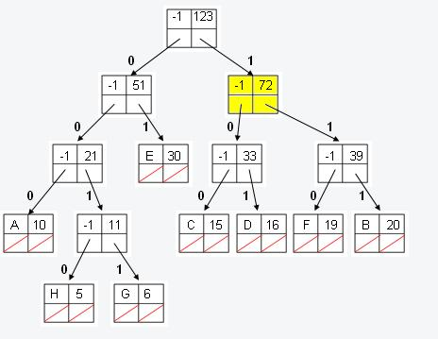
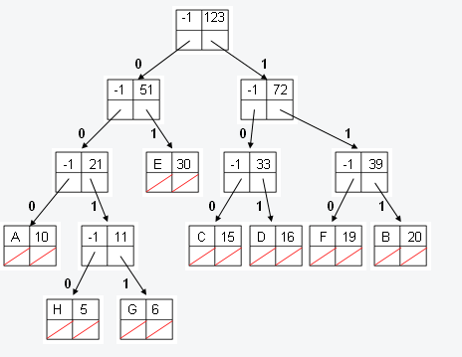
Decoding:
11000010001

Slide 55
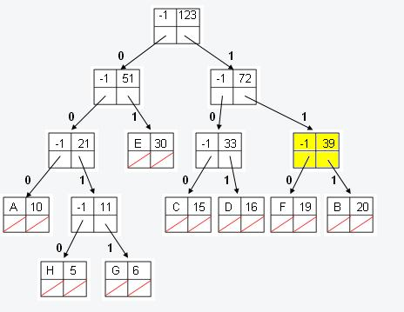
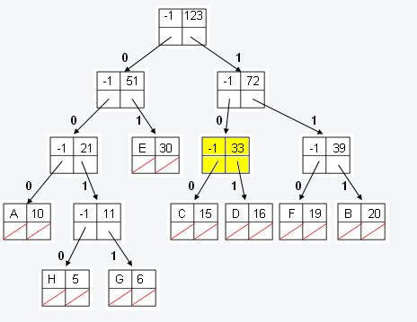
Decoding:
11000010001

Slide 56
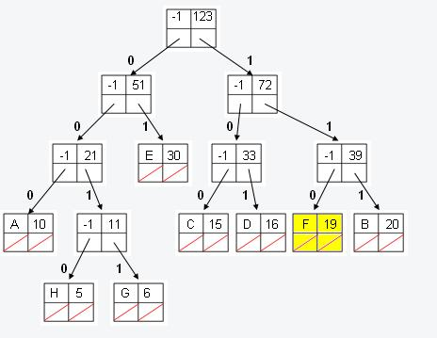
Decoding:
11000010001
F

Slide 57
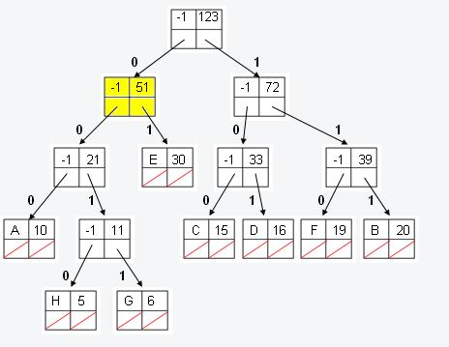
Decoding:
11000010001
F

Slide 58
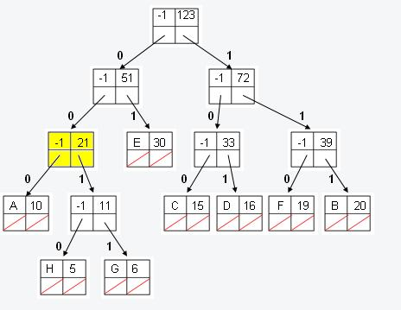
Decoding:
11000010001
F

Slide 59
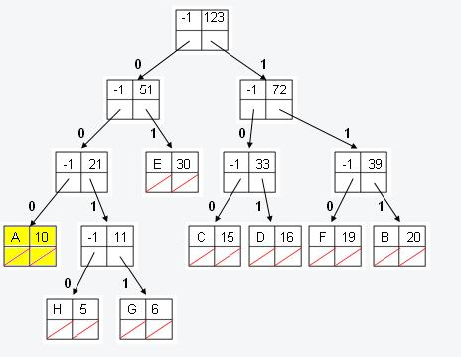
Decoding:
11000010001
FA

Slide 60
Decoding:
11000010001
FA

Slide 61
Decoding:
11000010001
FA

Slide 62
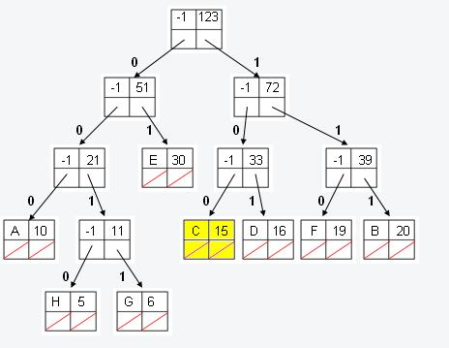
Decoding:
11000010001
FAC

Slide 63
Decoding:
11000010001
FAC

Slide 64
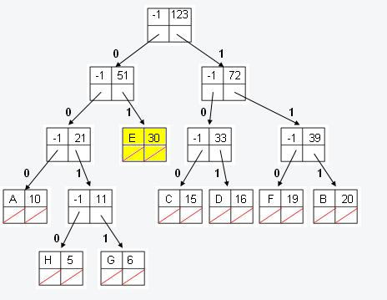
Decoding:
11000010001
FACE

Slide 65
Problem Set 6 Tips
Problem Set 6 is as much about coding as it is about learning how to interface with our APIs in tree.h, huffile.h, and forest.h
Make understanding those a priority; it’ll make your life a lot easier.

Slide 66
Your PS6 12-step program
Make sure you have the right number of command-line arguments
Open the Huffman-compressed file (hfopen)
Open the file to write to (fopen)
Read in the Huffman file’s Huffeader (hread)
Make sure the magic number matches
Make sure the frequency checksum matches
Create a tree node for each symbol based upon its frequency (mktree)
Plant that node in the Huffman forest (plant) – loop back to 7 until finished
Combine the trees in the Huffman forest together until you have just one big tree – the Huffman tree (so…while(________))
Read in the bits from the Huffman file and use them to traverse the tree – 0’s to the left, 1’s to the right – until the file is done. (bread)
When you hit a leaf node, write the character represented to the decompressed file and reset your traversal pointer back to the root
Clean up your mess so you don’t have memory leaks!
Step 9 is the real hard part. But…carefully study our definitions of Forest, Plot, and Tree, and befriend pick() and plant() and you’ll breeze right through it! Maybe try actually drawing it out, instead of just coding?

Slide 67

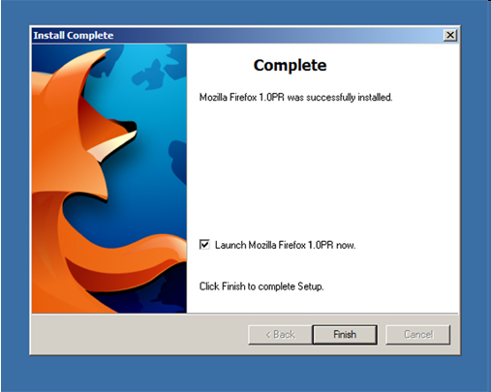
Section
Section

