Slide 1
CS50 Section #9
Monday 5:30-6:15pm
Maxwell Dworkin 319
November 7, 2011

Slide 2
Today’s Agenda
Problem Set 7 Discussion (5:37-5:40)
JavaScript
  Syntax (5:40-5:55)
  Document Object Model (DOM) (5:55-6:05)
Quick PS8 Tips (6:05-6:10)

Slide 3
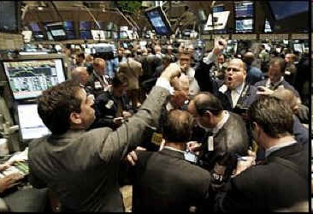
Problem Set 7

Slide 4
Quiz 1 Review
You just received a topic review for Quiz 1.
By Thursday 11/10, you’ll be e-mailed a Quiz 1 practice question set.
By Saturday 11/12, you’ll be e-mailed an answer key to the practice set. We’ll discuss answers that are still confusing at that point.
Material for Quiz 1 will cover everything throughout the entire course, but will be focused on material after Quiz 0.
We’ll go into the practice questions, then any questions you might have.

Slide 5
JavaScript (1)
JavaScript developed alongside HTML at the birth of the World Wide Web.
It is different from the other web programming languages we’ve discussed in that it runs client-side (on the local machine of the user) as opposed to server-side.
What are some of the implications of this?
  Most browsers in use today can restrict what type of JavaScript can be executed. (e.g. ad-blocking)
  Since JavaScript is interpreted by the user’s browser, as opposed to simply being read in, the source code must be fully available to the browser (and thus, the user).
It is therefore very dangerous to hardcode sensitive information into anything you write in JavaScript.

Slide 6
JavaScript (2)
As just mentioned, JavaScript is interpreted, rather than compiled (like C).
Also, JavaScript was deliberately designed to fail gracefully.
  You may write JavaScript that contains errors and you’d never know it.
  Unlike PHP, your page will not fail to render if there’s a JavaScript syntax error.
A debugging tool like Firebug (for Firefox) is critical for writing clean, predictable JavaScript.

Slide 7
Basic JavaScript Syntax (1)
JavaScript syntax is similar to C and PHP.
Variables are declared by assignment.
This creates a global variable named age that will have the value 24.
  Note the lack of a type specifier. (like PHP)
  This means that JavaScript is loosely typed.
If you don’t want a global variable, use the var keyword.
age = 24;
var i = 0;

Slide 8
Basic JavaScript Syntax (2)
Arrays can be declared by setting a variable equal to an expression in brackets.
Arrays are resized dynamically, so you never need to specify a size. If you try to reference an out of bounds index (one that you haven’t yet initialized), its type will be considered undefined.
Arrays can also contain any type of value, even mixing different types in the same array is okay.
var array = [];
var oneToFive = [1,2,3,4,5];
var array = [1, “two”, function() {return 3}, 4.001];

Slide 9
Basic JavaScript Syntax (3)
JavaScript operators are similar to C, but there are some useful differences.
+
  Adds numbers, but also concatenates strings (like the . operator does in PHP)
  This prints “Problem Set 8!” to the page.
string1 = “Problem ”;
string2 = “Set ”;
string3 = “8!”;
document.write(string1 + string2 + string3);

Slide 10
Basic JavaScript Syntax (4)
You can also use += to build strings!
= and == are similar to how they work in C
== can also be used to test the equivalence of strings! (no strcmp()necessary!)
Also, since JavaScript is loosely typed, == will also try to perform conversions. That means:
Evaluates to true.
There is also ===, which compares value AND type of a variable:
Evaluates to false.
var html = ”<li>”;
html += ”Empty Seat”;
html += ”</li>”;
Document.write(html);
“1” == 1;
“1” === 1;

Slide 11
Basic JavaScript Syntax (5)
typeof
  Even though JavaScript is loosely typed, it still knows what individual types are
  typeof returns the type of its operand.
    Possible types are: number, boolean, string, object, function, null, or undefined.
dogName = ”Spot”;
document.write(typeof dogName);
dogAge = 5;
document.write(typeof dogAge);

Slide 12
Basic JavaScript Syntax (6)
You have the standard if-else, for, while, and do-while.
You also have switch, though JavaScript’s switch is more versatile:
switch(weirdVar) {
case 5:
document.write(”5”);
break;
case 3.14:
document.write(”pi”);
break;
case ”hello”:
document.write(”greetings”);
break;
default:
document.write(”unknown”);
break;
}
Case labels can still only contain literals. You cannot use another variable or a conditional expression.

Slide 13
Basic JavaScript Syntax (7)
Lastly, you may want to use for...in
You may have noticed (if you examined w3schools, for instance), that PHP has an operator called “foreach” to iterate through an array.
This prints: “Monday Tuesday Wednesday”
var weekArray = [’Monday’, ’Tuesday’, ’Wednesday’];
for(var day in weekArray)
document.write(day + ” ”);

Slide 14
Basic JavaScript Syntax (8)
JavaScript functions are called first-class objects.
  This means they have the same status as a variable. They can be created dynamically and passed to or returned from functions.
This property is most useful when we talk about event handlers.
JavaScript lets you associate functions with specific actions taken by the user or the user’s browser. These are called “events”.

Slide 15
Basic JavaScript Syntax (9)
<input type=”text” onfocus=”alert(’Enter your name’);” />
This would create a text box that pops up instructions when “on focus” (when you move the cursor inside the box).
You could also:
And then have the input call that instead.
function alertName()
{
alert(”Enter your name”);
}
<input type=”text” onfocus=”alertName();” />

Slide 16
Basic JavaScript Syntax (10)
Event handlers can see additional information about the circumstances in which they were called. You use the event parameter (optional) to access this info.
This script would let you know which button was clicked.
function alertName(event)
{
var trigObj = event.srcElement
alert(”You clicked on the ” + trigObj.value + ”button”);
}
...
<input type=”button” value=”Click Me” onclick=”alertName(event);” />
<input type=”button” value=”Don’t Click Me” onclick=”alertName(event);” />

Slide 17
Basic JavaScript Syntax (11)
Objects in JavaScript are a container, like a struct in C.
JavaScript objects can contain both variables (called properties) and functions (called methods).
Creating an object is very simple:
car = new Object();

Slide 18
Basic JavaScript Syntax (12)
You can modify this object however you like.
The last line would enable you to call car.makeSound() and have the function vroom() execute, if it was defined at some point beforehand.
It’s often useful to be able to create a new object with certain properties already filled out on demand.
car.color = ”red”;
car[”year”] = 2005;
car.makeSound = vroom;

Slide 19
Basic JavaScript Syntax (13)
Such functions are called constructors. The constructor:
Would create a new object with properties name, class, and id. A new student could thus be made:
function student(name, class, id)
{
this.name = name;
this.class = class;
this.id = id;
}
dougLloyd = new student(“Doug Lloyd”, 2009, 55249287);

Slide 20
The Document Object Model (1)
Objects in JavaScript can contain anything, including other objects.
One important hierarchy exemplifying this is the Document Object Model [DOM]
The DOM defines a way of treating the elements that make up an HTML page as objects for use in JavaScript.
In this way, we can manipulate these elements programmatically.
Let’s look at a simple DOM.

Slide 21
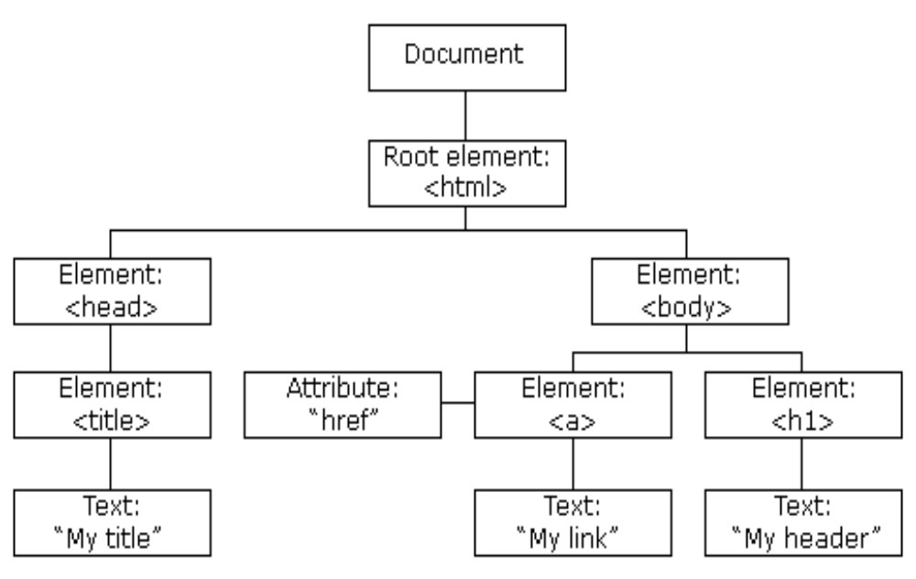
The Document Object Model (2)
From this, we can reverse-construct the HTML page that made this DOM.

Slide 22
The Document Object Model (3)
<html>
<head>
<title>
My title
</title>
</head>
<body>
<h1>
My header
</h1>
<a href=””>
My link
</a>
</body>
</html>

Slide 23
DOM Properties (1)
innerHTML
  Holds the inner text value of some HTML element.
  The inner text value of the <i> tag in <i>Hello <b>world</b></i> is…
nodeName
  The name of an element or attribute.
  The nodeName of the tag <img src=“helloworld.jpg” /> is img and the nodeName of its src attribute is src.
Hello <b>world</b>

Slide 24
DOM Properties (2)
nodeValue
  The value of an attribute. For the src attribute of the last img tag, the nodeValue is the string helloworld.jpg
parentNode
  A reference to a node’s parent
childNodes
  An array containing a node’s children
attributes
  An array containing the attributes of a node.

Slide 25
DOM Properties (3)
style
  A special object representing the “style” of a node.
  The style object itself has properties representing various CSS style attributes that an element may possess.
  For example:
  is equivalent to styling the node with
  in CSS
node.style.backgroundColor = “red”
node { background-color: red; }

Slide 26
DOM Methods (1)
getElementById(id)
  Gets the element with a given ID (id) under this node.
getElementsByTagName(tag)
  Get all elements under this node with the given tag name.
appendChild(node)
  Add the given node to the children of this node.
removeChild(node)
  Remove the given node from the children of this node.

Slide 27
DOM Methods (2)
Our root for accessing DOM nodes is usually the document object, which is globally accessible.
The document represents the whole page and everything contained in it.
So, if we’re looking for a div with the id purpleDiv and we want to make its background purple, we could:
document.getElementById(“purpleDiv”).style.backgroundColor = “purple”;

Slide 28
Using the DOM
When this power to manipulate is combined with event handlers, a page can immediately become dynamic in itself.
What’s happening here?
<html>
<script type=”text/javascript”>
function turnPurple()
{
document.getElementById(”purpleDiv”).style.backgroundColor = ”purple”;
}
</script>
<body>
<div id=”purpleDiv”>Turn me purple!</div>
<input type=”button” value=”Do it!” onclick=”turnPurple();” />
</body>
</html>

Slide 29
Problem Set 8
In Problem Set 8, you will:
  Thoroughly examine the Google Maps JavaScript API and the Google Earth API (page “7 < 14” of the spec)
  Write code to pick people up if they’re close enough to the shuttle. (pickup())
  Write code to drop people off who are close enough to their destination. (dropoff())
  Implement the extra feature!
Got a late day left? Now’s the time to use it if you want to, because there’s no more chances after this!

Slide 30
What is an API?
API stands for “Application Programming Interface” – it’s a way to abstract away an implementation, but still allow an end user to make use of the code.
For example, we may not know how Google wrote its distance() function, but we can use it, because we included their API in our code.
APIs are another example of why we write functions—to make them portable for use in multiple applications. Here though, the definitions are simply invisible to us, and we must trust the coder that the function does what it says it will do.

Slide 31
Google Maps
Now, let’s consider the Google Maps API.
You likely will not get through PS8 without taking a look at the Google Maps JS and Google Earth APIs development guide. We WILL NOT be covering these in depth today (that’s part of the assignment!)
Google also provides several individual examples that make clear the behavior of each aspect of the API. Try them out!
http://code.google.com/apis/maps/documentation/javascript/tutorial.html
http://code.google.com/apis/earth/documentation/

Slide 32
Getting Started with Google Maps (1)
Before you create a page that uses the Google Maps JS API, make sure to include the following in your <head> element.
Replace XXX with the key you received when you signed up to you the API. (We provide one for you for PS8, so no need to do anything different than the distro)
<script src=”http://maps.google.com/jsapi?key=XXX”
type=”text/javascript”>
</script>

Slide 33
Getting Started with Google Maps (2)
Typically you do most of your work within the <body> tag than with it, but in this case, you’ll need to modify it slightly to ensure proper operation of the Google Maps API.
Now that you know about event handlers, what do you think this does?
<body onload=”load();” onunload=”unload();” ...>

Slide 34
NOTE
Remember what I told you last week:
  The way programmers learn is by doing. This week, that’s what you’ve got to do.
  There’s a lot of independent study this week, but just make use of the resources we provide you!
  This problem set’s difficulty, again, is inherent in its “new stuff”, not in its degree of complexity.
  YOU CAN DO IT!
http://code.google.com/apis/maps/documentation/javascript/tutorial.html
http://code.google.com/apis/earth/documentation/

Slide 35
Problem Set 8
There are two major functions that need to be written for this problem set.
  pickup()
  dropoff()
You of course may write as many functions as you need/want as part of these functions.
We’ll go over some basic ideas for these two functions now.
  Psst…don’t forget you have to tweak populate() a little bit!

Slide 36
pickup()
Set a variable to count how many people may be picked up at the current location
Scan through the passengers on the map [for(var k = 0; k < passengers.length; k++)]
Get the lat/long of that person’s location and check to see if they have a placemark set.
  Within 15.0 meters? Push the person into the passenger (seats) array if the bus isn’t full already.
  Remove their marker from the map.
  Increment your counter variable.
If your counter is 0, announce that no one can currently get on the bus
Update the “seats” div (from index.html) appropriately, given who has gotten off the bus.
  Maybe use an update() function to set the contents of this div (using the DOM, of course)!
  Document.getElementById(“seats”).innerHTML = …;

Slide 37
dropoff()
Set a variable (at 0) to count how many people may be dropped off at the current location.
Scan through the passengers on the bus [for(var k = 0; k < seats.length; k++)]
Get the lat/long of that person’s house.
  Within 30.0 meters? Splice the person out of the passenger (seats) array.
  Increment your counter variable.
If your counter is 0, announce that no one wants to get off the bus
Update the “seats” div (from index.html) appropriately, given who has gotten off the bus.
  Maybe use the update() function again?

Slide 38
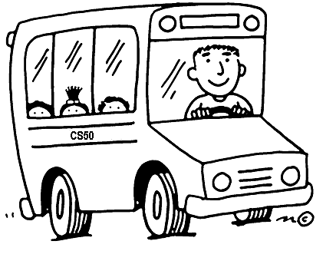
Off We Go!

