Slide 1
Search
Linear: O(n), Ω(1)
Binary: O(log n), Ω(1)
3 | 17 | 24 | 50 | 150
3 | 17 | 24 | 50 | 150
(looking for the number 50)

Slide 2
Sorting Algorithms: Insertion
!
!
O(n²), Ω(n)
Look for smallest # in unsorted part
Put it in front, “push” rest down
Repeat until all sorted
42 | 3 | 50 | 17
!
!
3 | 42 | 50 | 17
!
3 | 17 | 42 | 50
3 | 17 | 42 | 50
3 | 17 | 42 | 50

Slide 3
Sorting Algorithms: Selection
!
!
42 | 3 | 50 | 17
O(n²), Ω(n²)
Look for smallest # in unsorted part
Switch it with the first slot of the unsorted
Repeat until all sorted
!
!
3 | 42 | 50 | 17
!
!
3 | 17 | 50 | 42
3 | 17 | 42 | 50
3 | 17 | 42 | 50

Slide 4

Sorting Algorithms:
Bubble
42 | 3 | 50 | 17
3 | 42 | 50 | 17
O(n²), Ω(n)
Go down list
  If two adjacent #’s are out of order, swap ‘em
When at end of list, repeat if swaps were made
3 | 42 | 50 | 17
3 | 42 | 17 | 50
3 | 42 | 17 | 50
3 | 17 | 42 | 50
(+ once more through to make sure everything’s in order, that there aren’t any swaps)

Slide 5
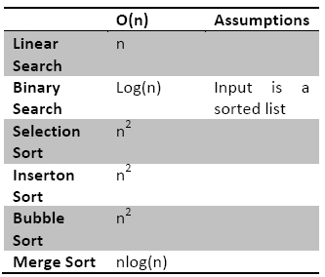
Time Complexity
O(n) – worst case
Θ(n) – expected/average case
Ω(n) – best case
(n = size of input)
Constant > Log > Linear > Quadratic > Polynomial > Exponential > Factorial

Slide 6
Complexity Math
O(f+g) = maximum of O(f), O(g)
O(f*g) = O(f)*O(g)
f:
for(j=0; j<n; j++)
{
//constant time stuff
}
g:
for (i=0; i<n; i++)
{
for(j=0; j<n; j++)
{
//stuff in constant time
}
}
O(n)
O(n²)
O(f+g) = O(n²) + O(n)
O(f*g) = O(n³)

