Slide 1

Section
Pointers,
Dynamic Memory Allocation

Slide 2
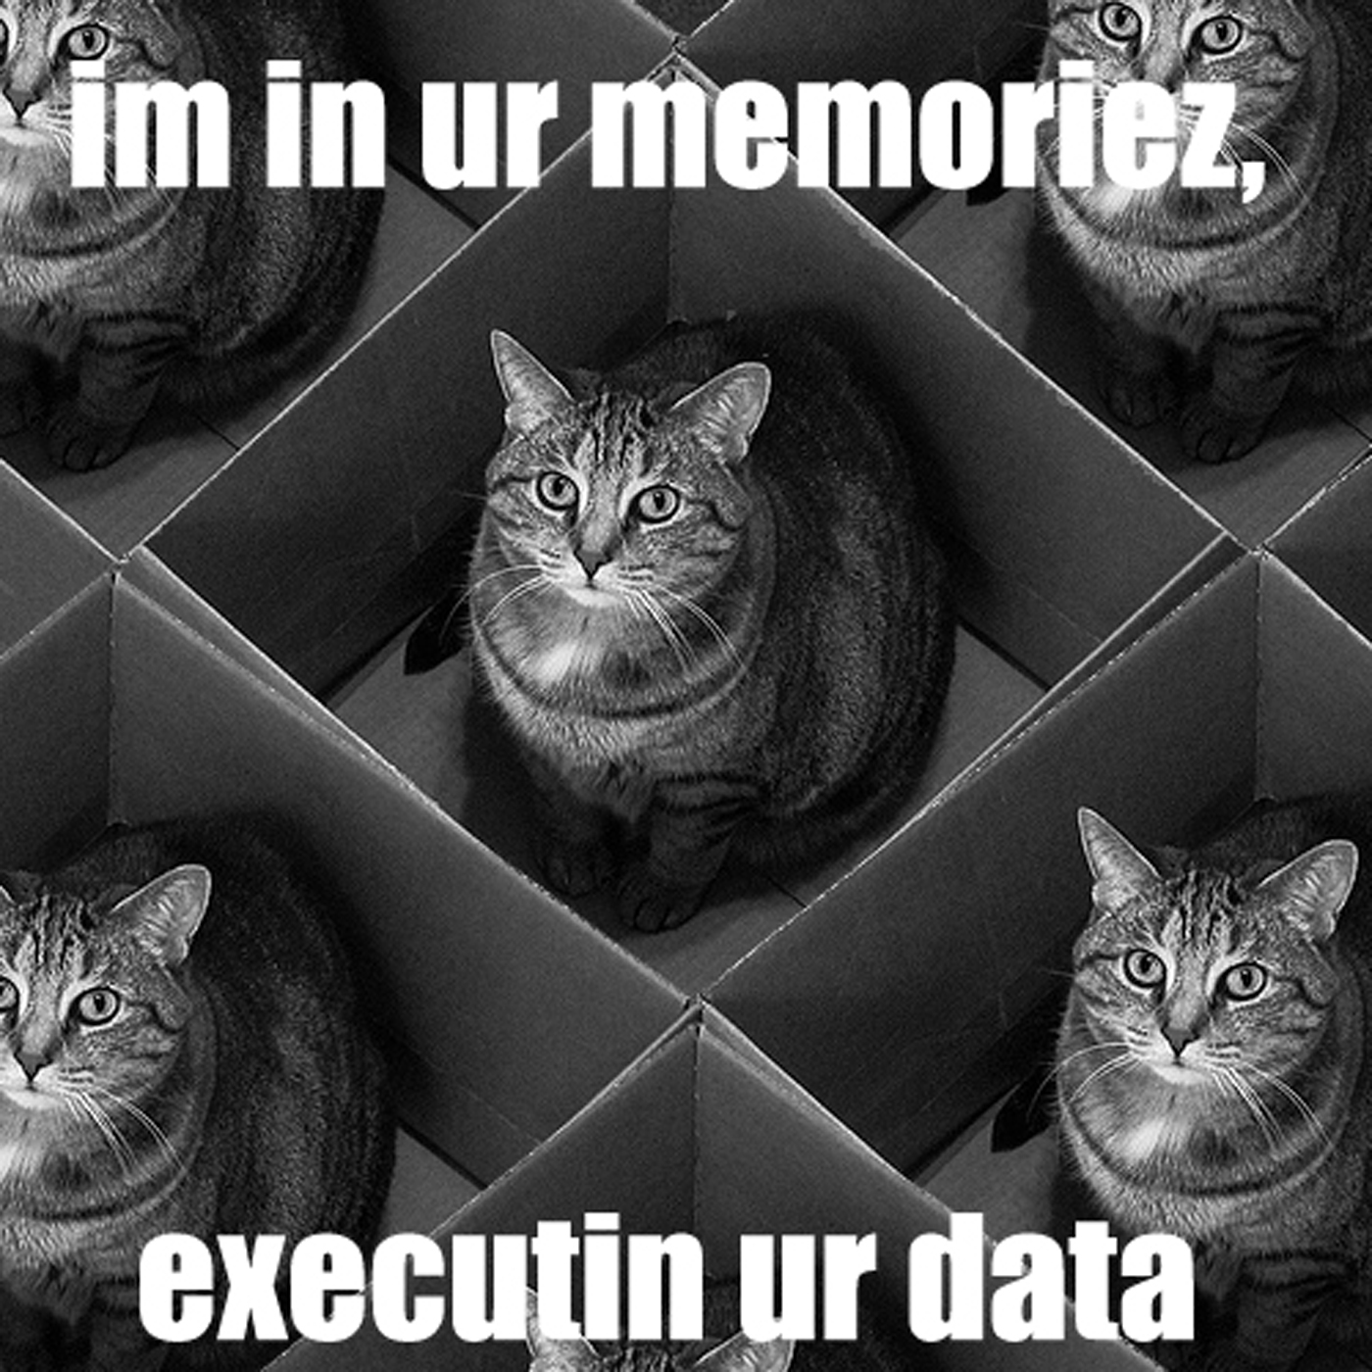
Memory (RAM)
load code/data into memory to execute
Memory: big array of 8-bits (1 byte)
  “boxes” to store data, each with an address
Notes:
Code/data live in files on disk
Need to know address to know where to go to (e.g. all the same cat)

Slide 3
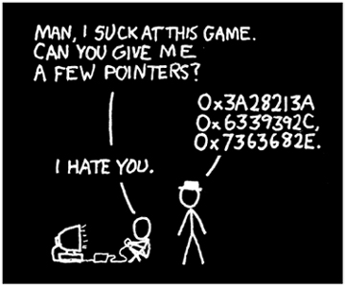
Pointers
Contains: a memory address
Data type: what’s at the address
  char * : char
  int * : int
  Etc.
Uses: share data via location (reference)
  Later: faster ordered lists
Notes:
Powerful and risky.

Slide 4
Pointer Notation
Declaration:
<data_type> *<var_name>;
  int *p; char *word;
Afterwards:
* - “go to” (derefrence)
& - “address of”

Slide 5
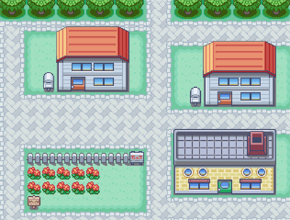

Analogy
r == place that holds addr
&r == 4350 Pallet Town
*r == Rose
Rose’s House, r
r
Video time!
4350 Pallet Town

Slide 6

Recap
i j
64
int i, j;
5
p
If...
int i=5;
int *p;
p=&i;
*p=64;

Slide 7
What’s actually happening:
int i = 5;
int *p;
i
64
5
0x858
p = &i;
p
*p = 64;
0x858
0x619

Slide 8
Practice!
int a = 3, b = 4, c = 5;
int *pa = &a, *pb = &b, *pc = &c;
a | b | c | pa | pb | pc
3 | 4 | 5 | &a | &b | &c
a = b * c;
a *= c;
b = *pa;
pc = pa;
*pb = b * c;
c = (*pa) * (*pb);
*pc = a * (*pb);
20 4 5 &a &b &c
100 4 5 &a &b &c
100 100 5 &a &b &c
100 100 5 &a &b &a
100 500 5 &a &b &a
100 500 50000 &a &b &a
50000 500 50000 &a &b &a

Slide 9
Pointer Arithmetic
Can move down array with math
  Just add/subtract integer
  Instead of index #’s
  Need not worry about type size
arr
0x0213f
0 | 1 | 2 | 3 | 4 | 5 | 6
O |  | h | a | i | ! | \0
p
p+1 p+2 p+3 p+4 p+5 p+6
0x0213f
&arr[1] &arr[2] &arr[3] &arr[4] &arr[5] &arr[6]

Slide 10
Pointers & Arrays
a an array:
a == &a[0]
a[i] == *((a)+(i))
Differences:
Space: pointer only vs. whole array
Can’t reassign array names
Notes:
Array names are just like pointers to the first element of the array
Array = implicit pointer

Slide 11
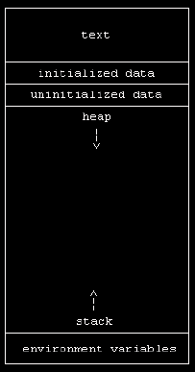
Memory (RAM)
Heap
Grows top down
For Malloc()
Dynamic
Stack
Grows bottom up
For function calls & their parameters
Notes:
Memory allocated dynamically, while program is running & does disappear when function returns

Slide 12
Malloc()
“Memory ALLOCation”
Allocates memory, returns a pointer
Takes # of bytes as argument
Usage:
<var_type> *<ptr_name> = malloc(<#bytes>);
But data type sizes vary, so...
<ptr_type> *<ptr_name> =
malloc(<length>*sizeof(*<datatype>));
Ex: int *pa = malloc(3*sizeof(int));
char *s = malloc(strlen(wrd)*sizeof(char)+1);

Slide 13
More Malloc()
Be sure to check return for NULL!
  Never dereference NULL
Free (m)allocated memory at the end!
  free(<ptr_name>);
  Only once!

Slide 14
Mo’ Practice
1)
int i, j;
int *ap, *bp;
ap = &I;
bp = ap;
j = 10;
*bp = j++;
What’s i and j?
2) Write a call to malloc() requesting space for an array of 4 double values.
How do you access the third element of the array?
3)
int i = 5;
int *p;
p = &i;
a) printf(“%p”,p); gives?
b) printf(“%d”,*p); gives?
i
p
0x11
4) What’s *(&(*(p+2))?
0x020
L | A | W | L | Z
0x11 0x12 0x13 0x14 0x15
Notes:
Haha, changed it so it works now! (I think….)

