Slide 1

CS50 Section #6
Monday 5:30-7:00pm
60 Oxford 330
October 22, 2012

Slide 2
Today’s Agenda
Problem Set 4 Discussion
Linked Lists and Analogous Data Structures
Hash Tables
Trees and Tries
Looking Ahead to Problem Set 5

Slide 3
Final Project
Secret item not on the agenda!
The final project specification will be online soon.
Start thinking about it!
Final project deadlines:
  Pre-proposal: Mon 11/5, noon
  Proposal: Mon 11/12, noon
  Status Report: Wed 11/28, noon
  Hackathon: Wed 12/5, 8:00pm – Thu 12/6, 7:00am
  Implementation: Sun 12/9, noon
  Fair: Mon 12/10, 11:00am—4:30pm
Be sure to read the spec when it goes up and e-mail me with questions!

Slide 4

Problem Set 5
Whodunit? Recover?? Resize???

Slide 5
Linked Lists (1)
Thus far in the course, our only data type for representing collections of values has been the array.
Arrays are great for element lookup (just use the element’s index!), but unless we want to insert right at the end, inserting elements into an array is a potentially very expensive operation.
We however have a new data structure that can solve this problem.

Slide 6
Linked Lists (2)
Linked lists make element insertion and deletion very easy.
Lists are a good choice when the number of objects in your list is not known when you start the problem, and the size of the list may grow or shrink during the task.
A linked list is a collection of a special kind of struct that contains (1) data and (2) a pointer to the next element of the list.
These pointers create a chain of elements that we can follow from the beginning to the end, hitting each element.
Let’s look at an example.

Slide 7
Singly-Linked Lists (1)
typedef struct _sllist {
int val;
struct _sllist *next;
} sllist;
This is why I said your structs should always have a temporary name. A self-referential struct must have some sort of way of referring to itself before its definition is complete!
sllist stands for “singly linked-list”. As you can see, each element has two parts. A value, and a pointer to the next element. The value could be anything: a char, a char *, an int, a bool, a float, a day_t, anything!

Slide 8
Singly-Linked Lists (2)
You can see why insertion/deletion is so much cleaner here than for arrays. To insert an element, we just change the “next” pointers to reflect the new ordering. To delete, we just do the same.
We do, however, lose the ability to look up quickly. We have to traverse the entire list from the beginning to find the element.

Slide 9
Singly-Linked Lists (3)
In the next several slides, we’re going to take a look at (aka define) four functions that you should know how to basically manipulate when working with linked lists.
  sllist *llist_create(int val);
  bool llist_insert_after(sllist *x, int val);
  sllist *llist_append(sllist *head, int val);
  sllist *llist_delete_node(sllist *head, int val);
  void llist_destroy_list(sllist *head);
You should also be able to do this one! But it’ll be an at-home exercise!

Slide 10
sllist *llist_create(int val) {
// create a new element
sllist *head = malloc(sizeof(sllist));
if(head == NULL) {
printf(“Error! malloc() failure!\n”);
return NULL;
}
// initialize the element
head->val = val; // no name collision here
head->next = NULL;
return head;
}

Slide 11
bool llist_insert_after(sllist *x, int val) {
// create a new element
sllist *new_ele = malloc(sizeof(sllist));
if(new_ele == NULL)
return false;
// initialize the element
new_ele->val = val; // no name collision here
// insert the element
new_ele->next = x->next;
x->next = new_ele;
return true;
}
Let’s draw this out and take a look to confirm that what we have makes sense.

Slide 12
llist_insert_after(x, 3);
new_ele
3
// insert the element
new_ele->next = x->next;
x->next = new_ele;
Notice how important the order of these statements are!
1 2 4 6
3
This red square is used to indicate NULL. This is the end of the list.
x

Slide 13
sllist *llist_append(sllist *head, int val) {
// traverse to find the end of the list
sllist *trav = head;
while(trav->next != NULL)
trav = trav->next;
// initialize the element
trav->next = (sllist *) malloc(sizeof(sllist));
if(trav->next == NULL) {
printf(“Failure to append node to list!\n”);
return head;
}
trav->next->val = val;
trav->next->next = NULL; // new end of list
return head;
}

Slide 14
void llist_destroy_list(sllist *head) {
if(head == NULL)
return;
else {
llist_destroy_list(head->next);
free(head);
}
return;
}
Destroying a singly linked list is substantially simpler by doing it recursively. Doubly-linked lists (next!) can be destroyed iteratively.

Slide 15
Singly-Linked Lists (4)
Implementing llist_insert_after() is relatively straightforward, but can you think about implementing llist_insert_before()?
With singly-linked lists, it is much more difficult, and so instead we have an alternative linked list node type that will make this and other operations much simpler.

Slide 16
Doubly-Linked Lists
typedef struct _dllist {
int val;
struct _dllist *prev;
struct _dllist *next;
} dllist;
dllist stands for “doubly linked-list”. As you can see, each element has three parts. A value, and a pointer to the next element in the list, and a pointer to the previous element in the list.
Let’s visualize a doubly-linked list!

Slide 17
2 3 5 8
Based on this, think to yourself about how you would consider implementing llist_insert_before() with a doubly-linked list. Or, llist_delete_node() with both a singly- and a doubly-linked list.

Slide 18
bool llist_insert_after(dllist *x, int val) {
// create a new element
dllist *new_ele = malloc(sizeof(dllist));
if(new_ele == NULL)
return false;
// initialize the element
new_ele->val = val; // no name collision here
// insert the element
new_ele->prev = x;
new_ele->next = x->next;
x->next->prev = new_ele; // WHAT?!?!?
x->next = new_ele;
return true;
}

Slide 19
new_ele
// insert the element
new_ele->prev = x;
new_ele->next = x->next;
x->next->prev = new_ele;
x->next = new_ele;
8
x
6
9
llist_insert_after(x, 8);

Slide 20
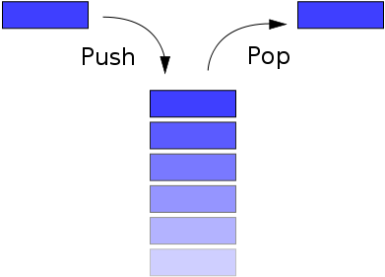
Stacks (1)
Stacks are LIFO (last-in, first-out) data structures.
Recall our previous encounter with stacks: The stack frame. Obviously, that is also a stack!

Slide 21
Stacks (2)
The operations for a stack are:
  push (insert an element on the top of the stack)
  pop (remove the element from the top of the stack)

Slide 22
Stacks (3)
What does a stack look like, in C?
Look familiar?
Difference from a SLL? We can only insert to and remove from the front of the “list”.
If we restrict ourselves in such a way, then we have implemented a stack.
typedef struct _stack {
VALUE val;
struct _stack *next;
} stack_t;

Slide 23
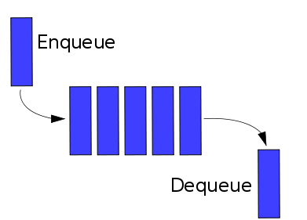
Queues (1)
Queues are FIFO (first-in, first-out) data structures.
Think about waiting in line at the bank. If you are the first person in line, you are the first person helped.
If bank lines were like stacks, instead, the LAST person in line would be the first person helped.

Slide 24
Queues (2)
The operations for a queue are:
  enqueue (insert an element into the back of the of the queue)
  dequeue (remove the element from the front of the queue)

Slide 25
Queues (3)
For this, it helps to maintain pointers to the beginning and end of the queue.
What does a queue look like, in C?
Looks even MORE familiar!
Difference from a stack? We need to restrict ourselves to enqueuing to the end of the list, and dequeueing from the front of the list.
If we restrict ourselves in such a way, then we have implemented a queue.
typedef struct _queue {
VALUE val;
struct _queue *next;
} queue_t;

Slide 26
Linked Lists Redux (1)
We know that linked lists are data structures that support efficient insertion and deletion of elements. In fact, we can do these operations in O(1).
Lookup operations in a linked list, however, is Θ(n), where n is the number of items in the list. Thus, as the list grows longer, the average time to look up an element takes proportionally longer.

Slide 27
Linked Lists Redux (2)
How can we build a lookup function that doesn’t have to loop over all of the elements stored in our data structure?
  One option would be for us to change our data structure so that something about the structure of a piece of data tells us where to find it.
A hash table is a data structure where insertion, deletion, and lookup of data can each be accomplished in Θ(1)!
  The caveat: hash tables do not easily support ordering or sorting of the stored data.
If we were building something like, oh, I don’t know, a SPELL CHECKER or something, however, hash tables are a good idea, since we don’t have any real reason to print out the entire list of words in our dictionary, sorted out.
In such a spell checker, we might use our hash table to store strings (char *), but the principle can be generalized for all data types.

Slide 28
Hash Tables
A hash table is basically an array, coupled with a hash function, which is used to map the stored object to indices of the array.
For our purposes, we will define hash functions to return a hash code, an integer value.
Logically, since we are using arrays, our hash code should be in the range [0, array size – 1] (or be put into that range by using the modulo operator %)

Slide 29
Hash Functions (1)
There are infinitely many hash functions, but not all of them are effective or good.
Here’s an example of a very simple hash function:
int hash(char *str) {
int sum = 0, len = strlen(str);
for(int j = 0; j < len; j++)
sum += str[j];
return sum % ARRAYSIZE;
}
What is happening in this hash function?

Slide 30
Hash Functions (2)
It can be tough to write an effective hash function. You have my permission to use hash functions you find online, but you absolutely must cite the hash function if you do so.
You also can write your own hash function. Good hash functions have five properties.

Slide 31
Properties of a Hash Function
The hash code is fully determined by the string (or other data) being hashed, and by nothing else.
The hash code for two identical strings is the same (no random numbers in the calculation)
The hash function uses the whole string (or the entire piece of data) being hashed.
The hash function “uniformly distributes” the data.
The hash function can generate very different hash code for similar, but not identical, strings (or other pieces of data)

Slide 32
Hash Example
0
1
2
3
4
5
6
7
8
9
Assume we have some hash function at our disposal, hash1()
hash1(“Bart”); returns 5
hash1(“Lisa”); returns 7
Note that neither insertion, nor lookup, requires iterating through the array.
“Bart”
“Lisa”

Slide 33
Pop Quiz!
What is one of the HUGE problems that could have occurred in the previous example?
What if “Bart” and “Lisa” had both hashed to the value 5? Then what would we do? We certainly wouldn’t want to clobber either value.
When this happens, it is called a collision. Next we will cover two methods of dealing with collisions.

Slide 34
Probing (1)
In this method, in the event of a collision, the algorithm tries array elements separately until a vacancy is found.
0
1
2
3
4
5
6
7
8
9
hash(“Bart”); returns 5
hash(“Lisa”); returns 5
hash(“Maggie”); returns 6
hash(“Homer”); returns 7
hash(“Marge”); returns 5
“Bart”
“Lisa”
“Maggie”
“Homer”
“Marge”

Slide 35
Probing (2)
This technique is subject to a problem called “clustering”.
As we saw, once a collision occurs during insertion, there will be two table cells next to each other that are occupied.
Afterwards, an insertion that collides with either of those cells will cause that cluster to grow.
Now the probability is even larger that another collision will cause the cluster to grow.
This technique is also subject to another problem: You can only insert as many elements as there are slots in the array. This could lead to an infinite loop problem (why?)

Slide 36
Probing (3)
The method of probing we just looked at is called “linear probing”. There is also, for example, “quadratic probing”.
In “quadratic probing”, we first check the cell of the hash value h. If that is occupied, we check h + 1². If that is occupied, we check h + 2^{2,} h + 3^{2,} h + 4², etc…
Can you predict a problem with this method as well?

Slide 37
Probing (4)
Assume hash function hash2() always returns a hash value of 0.
hash2(“Doug”);
hash2(“Bethany”);
hash2(“Samantha”);
hash2(“Justin”);
All those empty cells, and no place to go! (Can resolve the problem by having hash table size be prime)
0
1
2
3
4
5
6
7
“Doug”
“Bethany”
“Samantha”
(0+0)%8 = 0, (0+1)%8 = 1, (0+4)%8 = 4, (0+9)%8 = 1, (0+16)%8 = 0, (0+25)%8 = 1, (0+36)%8 = 4, (0+49)%8 = 1, (0+64)%8 = 0, (0+81)%8 = 1, (0+100)%8 = 4, (0+121)%8 = 1
Pattern: 0, 1, 4, 1, 0, 1, 4, 1…

Slide 38
Separate Chaining (1)
An alternative to the probing model is the separate chaining model.
In separate chaining, each element of the hash table is a pointer to the head of a linked list.
  OMG DATA STRUCTURE COMBO!!1!one!
If you choose to use hash tables in PS5, this is the method you will want to use.

Slide 39
Separate Chaining (2)
This clustering problem will not occur here (Yay!)
Insertion: Hash the string. Is there an element pointed to by the pointer in the array location pointed to by the hash code?
  No: Then this is the new head of the linked list.
  Yes: Make this element the new head of the linked list and set its “next” arrow to be the old head of the linked list.
    Why do it this way and not the other way? Insertion is O(1) this way, and not O(n)!
Lookup: Hash the string. Go to the linked list pointed to in array[hashcode], scan through it. Find it, return true. Else, return false.
Let’s look at an example.

Slide 40

Separate Chaining (3)
node *array[10];
0
1
2
3
4
5
6
7
8
9
Marge
Bart
hash(“Bart”); returns 1
hash(“Lisa”); returns 4
hash(“Maggie”); returns 5
hash(“Homer”); returns 6
hash(“Marge”); returns 1
Lisa
Maggie
Homer
typedef struct _node {
char word[10];
struct _node *next;
} node;

Slide 41
Trees (1)
Trees are a very useful data structure that look very similar to something we have already seen before. (Surprise, surprise…)
In our discussion on trees (not tries), we will consider only binary trees.
The structure of a binary tree node is:
typedef struct _tree {
int data;
struct _tree *left;
struct _tree *right;
} tree;

Slide 42
Trees (2)
Though the structure of a tree node looks like a doubly-linked list node, they are actually very different.
This difference is in the meaning we assign (just like stacks and queues with respect to singly-linked lists). For example, we refer to left and right children nodes, not prev and next nodes.
Binary tree nodes must point only at their children (or NULL). They may not, by definition, point back to themselves or any other node.

Slide 43

Trees (3)
10
5
14
3
8
13
18
1
4
16

Slide 44
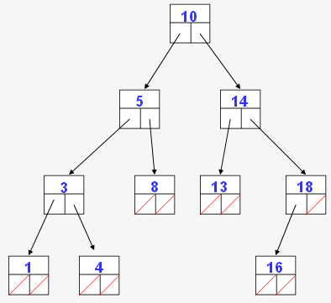
Binary Search Trees
The tree I just showed you is a special case of a tree called a binary search tree.
In such a tree, for each node, every value on its left child’s side is less than the node’s associated value of the node and every value on the right side is greater.
This makes performing binary search on such a tree extremely easy (hence the name of the tree!)
On the next page, we’ll look at the code for binary search with this tree.

Slide 45
Binary Search Using
Binary Search Trees
root
bool
binary_search(node *root, value val) {
if (root == NULL)
return false;
if (root->val == val)
return true;
else if (val < root->val)
return binary_search(root->left, val);
else
return binary_search(root->right, val);
}

Slide 46
Tries (1)
An associative array (aka a dictionary) is a generalized array that allows you to associate values with keys that are more descriptive than simple integers, as with ordinary arrays.
For instance, suppose you need a data structure that allows you to look up the records for a student starting from his or her 8-digit university ID. A simple array would need too many entries.
You could use a hash table, extracting hash codes from either the numerical or the string representation of the student IDs.
Or you could build a tree, placing the student records at the leaves of the tree. In such a tree, the paths from the root to a leaf would be labeled with digits of the ID. Each interior (non-leaf) node could therefore have as many as ten children. To find a student record, you would start at the root and use successive digits of the student’s ID to choose successive child nodes until you reach the desired record or you reach a dead end (meaning that the student hasn’t yet been inserted in the tree).
This type of tree is called a trie (pronounced “try”)

Slide 47
Tries (2)
In the previous example, the structure of a trie node would look something like this.
So, as we can see, a binary tree is just a special case of a trie, where the number of children is 2.
On the next slide, let’s imagine that my student ID is 55203626 and David Malan’s is 55203942.
typedef struct _trie {
char *data;
struct _trie *children[10];
} trie;

Slide 48

NULL
By following the path representing each digit of the ID number, we arrive at the right person. Recall that my ID number was 55203626 and David’s was 55203942. Since there is no student whose ID number is 5, 55, 552, 5520, 55203, 552036, 552039, 5520362, or 5520394, the data value at that location is NULL. Let’s take a look at another example of this where this is not the case.
5
NULL
5
NULL
2
NULL
0
NULL
3
NULL
9
6
NULL
NULL
2
4
NULL
NULL
6
2
Doug Lloyd
David Malan

Slide 49
Tries (3)
We’re going to keep the structure pretty similar.
So in this case, we’re checking to see if a number is prime or not.
typedef struct _trie2 {
bool prime;
struct _trie2 *children[10];
} trie2;

Slide 50
---
1
5
8
false
true
false
0
7
2
9
7
false
true
false
false
true
2
3
6
false
true
false
9
0
Primes: 5, 17, 89, 173, 8269
Non-primes: 1, 8, 10, 57, 82, 172, 826, 8260
false
true

Slide 51
Final Thoughts
 | Hash Tables | Tries
Insertion | O(1) | O(1)
Deletion | O(1) | O(1)
Lookup | O(numhash(n)) | O(strlen(n))
Size | Comparatively small | Comparatively huge

Slide 52
Problem Set 5 (1)
In Problem Set 5, you will be implementing a spell checker.
You are provided with a dictionary of words, and you will later have to determine whether or not the words in a given input file are valid.
You must decide whether or not to build the spell checker using a hash table or using a trie (or something different??), now that you are aware of the pros and cons of each.
You must decide how to best optimize your solution.

Slide 53
Problem Set 5 (2)
You’ll notice on the CS50 website that you will be challenging “THE BIG BOARD”. Try and get your score (load, check, size, and unload times) to be as good as it can!
You may also want to become friends with the str(n)cpy() and/or memcpy() functions. It is very likely to prevent a number of errors that you might encounter without it.
Good luck!

Slide 54
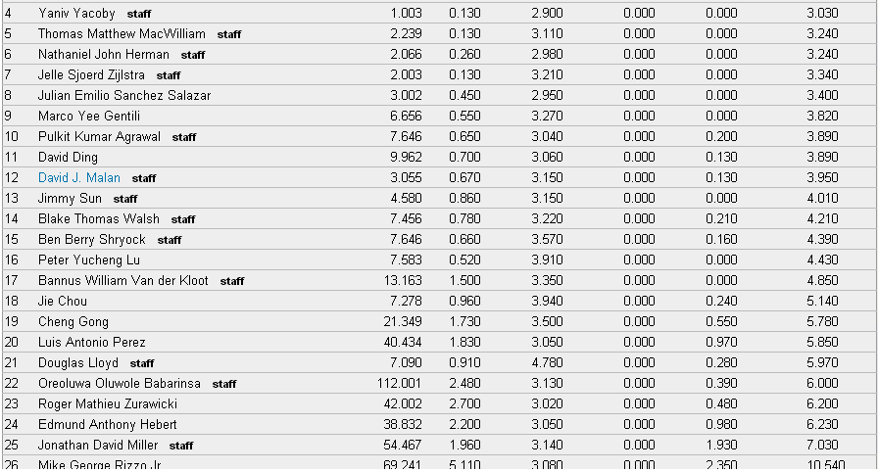
THE BIG BOARD
Beat my TOTAL time by noon on Thursday…win a prize! (It is eminently beatable now, but I reserve the right to improve my time before the deadline!)

Slide 55
Problem Set 5 Tips
load()
  Hash table or trie – it’s ENTIRELY up to you. Both will perform equally well, if designed well. No preferences here.
  The ‘\n’ is not considered a letter of the word in the dictionary.
  Befriend str(n)cpy() and memcpy(), unless you want to experience some befuddling errors.
size()
  Don’t make it any more complicated than it needs to be!
check()
  Don’t forget to put your words in all lowercase before you start checking them!
unload()
  Hash tables: And how is it that we free a singly-linked list()?
  Tries: Delete all the subtrees before you delete the root!

Slide 56

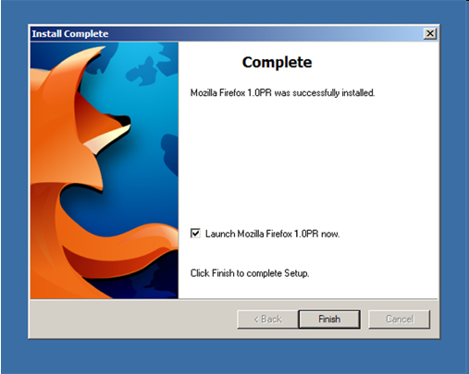
Section
Section

