Slide 1
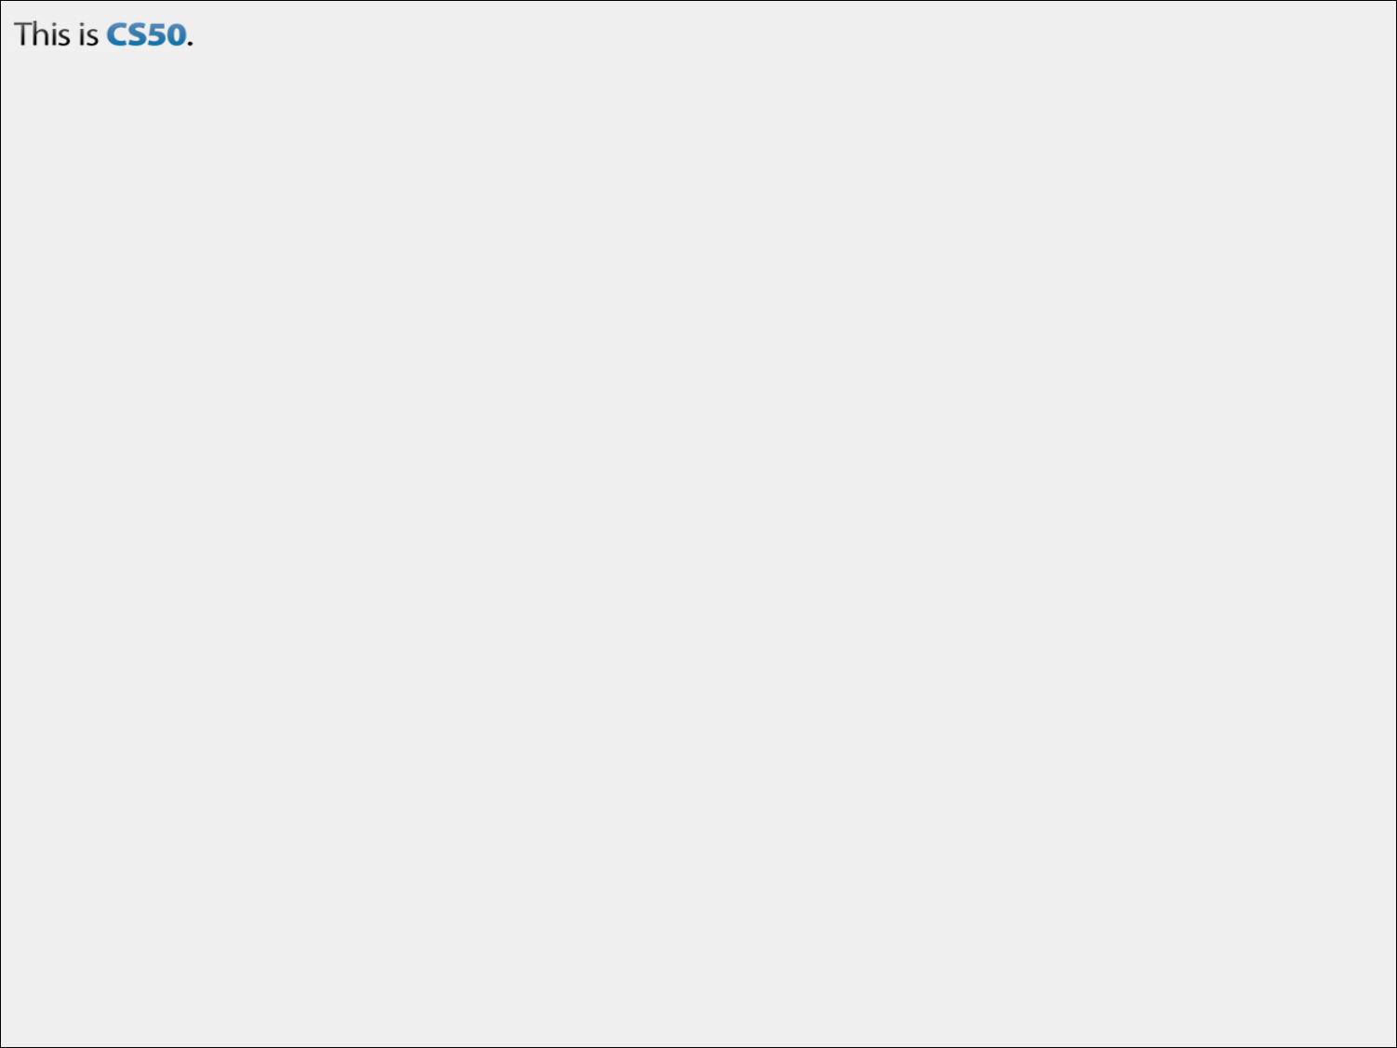
CS50 Section #1
Sunday 2:30-4:00pm
Maxwell Dworkin 319
September 16, 2012

Slide 2
Today’s Agenda
Introductions
Administrivia & Course Expectations
Scratch and C
Looking Ahead to Problem Set 1

Slide 3
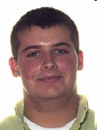
About Me
Doug Lloyd
Class of 2009 (Computer Science)
E-mail: lloyd@cs50.net
Cell: 781-534-8860 (emergencies only!!)

Slide 4
About You!
Just the typical introductory section stuff. Tell us:
  Your name, year, and House/dorm
  Your hometown
  Your concentration (or potential concentration)
  Any other fun fact(s) you want to share

Slide 5
My Expectations for You
To see you in section every week!
To participate in class. These first two weeks are an aberration because there is so much material to cover, but usually participation is a must—you get more out of the class that way, and it makes it more fun for everyone.
To seek out help when you need it. This subject can be tough, and there is a large support staff here to help!
To put in the work required to make this semester of CS50 a fun and productive one!

Slide 6
What You Can Expect of Me
To see me in section every week!
To respond to e-mails within 24 hours (typically much less).
To return your problem sets to you promptly, and with helpful suggestions and notes.
To put in the work required to make this semester of CS50 a fun and productive one!
To usually come equipped with candy or some other thing to snack on during section ☺

Slide 7
Course Resources
Watch Problem Set walkthroughs
  Better yet, attend them on Fridays!
cs50.net/lectures
  Lecture slides, scribe notes, videos, code
Office Hours
  Full schedule on cs50.net/ohs
http://apps.cs50.net/discuss
  Be sure to run a quick search before posting your questions!

Slide 8
Today’s Agenda
Introductions
Administrivia & Course Expectations
Scratch and C
Looking Ahead to Problem Set 1

Slide 9
Scratch
In Problem Set 0, we had you play around with Scratch.
Unfortunately, programming more complex things aren’t quite as easy as “drag-and-drop” as it was with Scratch puzzle pieces; it’s still fun though!
Everything you can do in Scratch (and more) can be replicated in C syntax.
Let’s look at some Scratch-C analogs.

Slide 10

Scratch and C (1)
int main(void)
{
Both of these blocks trigger the start of the program. In Scratch, when the green flag is clicked, the first puzzle piece below the “When Flag Clicked” is executed. In C, when your executable is compiled and run, the first line of code in main() is executed.

Slide 11
Scratch and C (2)
printf(“Hello!”);
OR
printf(“Hello!\n”);
These will both output a message to the screen. In Scratch, it’s a sprite with a speech bubble. In C, it goes to the standard output (stdout)—the terminal screen.

Slide 12
Scratch and C (3)
CAUTION! Note the double equals sign for equality testing!
(__ < __)
(__ > __)
(__ == __)
These all compare the value of two variables, integers, or characters.

Slide 13
Scratch and C (4)
variable = 0;
Now see that the single equals sign is for variable assignment
Both of these set the given variable to a given value.

Slide 14
Scratch and C (5)
variable = variable + 1;
variable += 1;
variable++;
All four of these increase variable’s value by 1. For all three of the C instructions, + may be substituted with -. For the first two, you may also substitute *, /, and % (mod). Don’t forget that; these will come in handy later!

Slide 15
Scratch and C (6)
(__ && __)
(__ || __)
(!__)
These are the boolean comparisons. The result of these comparisons are always FALSE (in C, zero), or TRUE (in C, nonzero).

Slide 16


Scratch and C (7)
while(1)
{
// something
}
while(condition)
{
// something
}
The “forever” loop in Scratch is referred to as a “while” loop in C. The top loop will go on forever, regardless. The bottom loop will go on so long as the condition described is true.

Slide 17

Scratch and C (8)
int x;
for(x = 0; x < 10; x++)
{
// something
}
The “repeat” loop in Scratch is referred to as a “for” loop in C. The loop in each case will occur 10 times.

Slide 18

Scratch and C (9)
if(condition)
{
// do thing 1
}
else
{
// do thing 2
}
The “if-else” blocks are a fork in the road type situation in both Scratch and C. If the condition is true, only the statements between the braces governed by “if” are executed. Otherwise, the statements between the “else” are executed. If-else’s can be daisy chained together for a multiply-forked path.

Slide 19
Scratch and C (10)
return;
return 0;
return __;
When a function or a program is finished, it should conclude with a “return” statement, which “returns” it to a previously-calling function or, if main(), indicates that main() is finished.

Slide 20
New Stuff in C
A section entitled “New Stuff in C” could probably go on for hours. This is really going to zone in on one key difference—types.
Variables in Scratch really could only take on numeric values. In C, there are many different, well, types of values that can be taken on.

Slide 21
You can have…
Integers (ints)
Characters (chars)
Floating-point values (floats or doubles)
Really huge integers (long longs)
Strings (strings)
Booleans (bools)
As well as types you can create yourself! More on that later in the semester.
These two, only by
#include <cs50.h>
at the top of your file.

Slide 22
Now that we’ve got that out of the way…
Partner up, we’re going to do some in-class exercises converting short programs written in Scratch to C syntax, to give you some practice writing C.
There’ll be three problems. Then we’ll review.

Slide 23
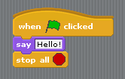
Practice Problem #1

Slide 24
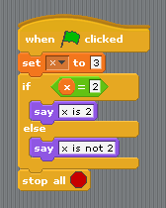
Practice Problem #2

Slide 25
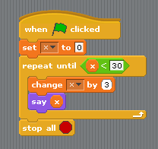
Practice Problem #3
BONUS: Can you do this using two different kinds of loops so that the same effect is achieved?

Slide 26
Practice Problem #1
int main(void)
{
printf(“Hello!\n”);
return 0;
}

Slide 27
Practice Problem #2
int main(void)
{
int x = 3;
if(x == 2)
{
printf(“x is 2\n”);
}
else
{
printf(“x is not 2\n”);
}
return 0;
}

Slide 28
Practice Problem #3a
int main(void)
{
int x = 0;
while(x < 30)
{
x += 3;
printf(“%d\n”, x);
}
return 0;
}

Slide 29
Practice Problem #3b
int main(void)
{
int x;
for(x = 0; x < 30; x += 3)
{
printf(“%d\n”, x);
}
return 0;
}

Slide 30
Today’s Agenda
Introductions
Administrivia & Course Expectations
Scratch and C
Looking Ahead to Problem Set 1

Slide 31
Problem Set 1

