Slide 1

CS50 Section #3
Monday 5:30-7:00pm
60 Oxford 330
October 1, 2012

Slide 2
Today’s Agenda
P-Set 2 Recap and Questions
How CS50 Is Graded
Arrays Redux
O and Ω
Sorting and Searching Algorithms
Recursion!
Looking Ahead to P-Set 3
We’ll take a break sometime around here.

Slide 3

Problem Set 2 Recap and Questions
caesar.c
vigenere.c

Slide 4

CS50 Grading
Your problem sets are graded on four scales:
  Scope (this week out of 3 points)
  Correctness (this week out of 5 points)
  Design (this week out of 2 points, usually 5)
  Style (this week out of 2 points, usually 5)
A grade in CS50 should not be viewed as a percentage of points earned out of possible points.
YES! RLY!

Slide 5
Scope
Have you completed all of the programs the spec asks you to?
0 | 1 | 2 | 3
This week’s scale

Slide 6
Correctness
Does your code do what it is supposed to do? (Cycle through until the right number of skittles are guessed; print a proportional bar chart)
Does it handle all error conditions? (A greedy input of less than $0.00; when all inputted values for the chart are “0”)
0 | 1 | 2 | 3 | 4 | 5
This week’s scale

Slide 7
Design
Is the approach that you used a good one? (Using as few variables as needed, using one loop instead of two—if it can be done)
How efficiently does your code run? (if it takes 30 seconds to get the right answer compared to 0.05 seconds)
0 | 1 | 2
This week’s scale

Slide 8
Design Example
better
while(change >= 25) {
change -= 25;
coins++;
}
while(change >= 10) {
change -= 10;
coins++;
}
while(change >= 5) {
change -= 5;
coins++;
}
while(change)
change--;
coins++;
}
while(change) {
if(change >= 25) {
change -= 25;
coins++;
continue;
}
else if(change >= 10)
change -= 10;
coins++;
continue;
}
else if(change >= 5)
change -= 5;
coins++;
continue;
}
else
change--;
coins++;
}
}
coins += (change / 25);
change %= 25;
coins += (change / 10);
change %= 10;
coins += (change / 5);
change %= 5;
coins += change;
Notice that I think the blue one is better! Better design does not necessarily have a direct relationship to code length!

Slide 9
Style
Does your code look “pretty”? (Yes, this actually matters.) Do your braces line up, no line wrapping, etc.
Do your variables have logical names? (It’s better to say the number of “height” is “height” or “hgt” and not “x”, e.g.)
Do you have a sufficient number of comments? (An overabudance of comments, however, would also be bad style)
0 | 1 | 2
This week’s scale

Slide 10
Problem Set 1 Score Range
0 | 1 | 2 | 3 | 4 | 5 | 6 | 7 | 8 | 9 | 10 | 11 | 12
Future Problem Set Score Range
0 | 1 | 2 | 3 | 4 | 5 | 6 | 7 | 8 | 9 | 10 | 11 | 12 | 13 | 14 | 15 | 16 | 17 | 18
If you are in the GREEN, then you are doing well. Your work is meeting the expectations of the course. There is room for improvement still, and you should work for that, but you have no cause to worry about grades. [80% of the time]
If you are in the YELLOW, you probably need to focus on improving at least one of your design, correctness, or style, but otherwise you are doing well. [15% of the time]
If you are in the BLUE, you are really doing great. Keep it up! [<5% of the time]
If you are in the RED, come and talk to me so we can together find areas you are struggling in and can help you get back on track. [<1% of the time]

Slide 11
What these scores correspond to in letter grades (in MY opinion)
0 | 1 | 2 | 3 | 4 | 5 | 6 | 7 | 8 | 9 | 10 | 11 | 12
E | D- | D+ | C- | C+ | B- | B | B+ | A- | A
0 | 1 | 2 | 3 | 4 | 5 | 6 | 7 | 8 | 9 | 10 | 11 | 12 | 13 | 14 | 15 | 16 | 17 | 18
E | D- | D | D+ | C- | C | C+ | B- | B | B+ | A- | A

Slide 12
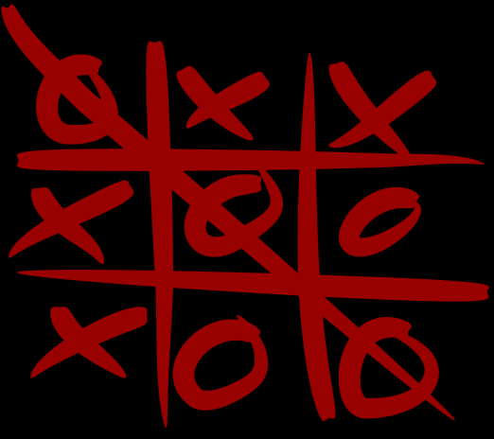
Arrays Redux
We’ve already learned about arrays…but we haven’t really done anything that uses them. Let’s build a (probably too) simple game that uses one:

Slide 13
Tic Tac Toe
What should we use to represent our game board?
How do we let a user enter a value into a square?
How do we check to see if a win condition has been met?
Lastly, we need to print the board!
char ttt_board[3][3];
1 | 2 | 3
4 | 5 | 6
7 | 8 | 9
First pick a square…
…then choose a letter.
We have eight possible wins and one draw condition.

Slide 14
Setting Up The Board
/* Global variables and constants */
#define DIM 3
#define BLANK ‘_’
char ttt_board[DIM][DIM]; // declared globally
int main(int argc, char *argv[]) {
for(int i = 0; i < DIM; i++) {
for(int j = 0; j < DIM; j++) {
ttt_board[i][j] = BLANK;
}
}
/* More to come */
}
Since we have a global variable though, accessible by all functions, why not break this into a separate function?

Slide 15
/* Global variables and constants */
#define DIM 3
#define BLANK ‘_’
char ttt_board[DIM][DIM]; // declared globally
/* Function declarations*/
void init_board();
int main(int argc, char *argv[]) {
init_board();
/* More to come */
}
void init_board() {
for(int i = 0; i < DIM; i++) {
for(int j = 0; j < DIM; j++) {
ttt_board[i][j] = BLANK;
}
}
return;
}

Slide 16
Make Your Move
Now we probably want to allow users to make a move. We’ll first prompt them to provide a location, then we’ll determine if that location is a good one, and then—if so—we’ll update the board.
Let’s separate this into two functions. One checks for a VALID move, and the other actually updates the board.

Slide 17
bool is_valid_move(int sq) {
int usable_num = (sq – 1);
int row = usable_num / DIM;
int col = usable_num % DIM;
if(ttt_board[row][col] == BLANK)
return true;
else
return false;
}
void make_move(char c, int sq) {
int usable num = (sq – 1);
int row = usable_num / DIM;
int col = usable_num % DIM;
ttt_board[row][col] = c;
return;
}
What is happening here?

Slide 18
Printing the board
This one shouldn’t be too bad. Let’s work on it together!
This might be helpful for scramble! (hint!)
void print_board() {
for(int j = 0; j < DIM; j++) {
for(int k = 0; k < DIM; k++)
printf(“%c “, ttt_board[j][k]);
printf(“\n\n”);
}
return;
}

Slide 19
Did I win yet?
There are nine possible end-game situations. Eight of them are wins, and one of them is a full board with no winner (a draw). As an at-home exercise, write a function to check for end-of-game.
Now let’s look at everything put together.

Slide 20
/* Header files */
#include <stdio.h>
#include <cs50.h>
/* Global variables and constants */
#define DIM 3
#define BLANK ‘_’
char ttt_board[DIM][DIM]; // declared globally
/* Function declarations */
void init_board();
bool is_valid_move(int sq);
void make_move(char c, int sq);
void print_board();
bool game_over();
int main(int argc, char *argv[]) {
init_board();
int sq = 0;
while(!game_over()) {
do {
printf(“Enter your square: “);
sq = GetInt();
} while((sq < 1) || (sq > 9) || (!is_valid_move(sq)));
printf(“Enter your letter (X/O): “);
char c = GetChar(); // This should really be error-checked
make_move(c, sq);
print_board();
}
return 0;
}
This code would be an example of one with FAR too few comments throughout…
Whoops…probably could have included
#define MAX_SQ 9
above!

Slide 21
Computational Complexity
Erm…
There’s a lot of text behind here.
Sry.
(We’re skipping it for now, but definitely read it at home.)
Computer scientists analyze the complexity of algorithms to better understand the resources they require, both in terms of time required to produce a result and space required for the storage of data. The time complexity of an algorithm is not a description of the exact number of operations needed to complete the algorithm. Complexity deals with how fast this number grows as we increase the size of the input to some arbitrarily large value. This lets us know how the well the algorithm “scales” with larger problems.
In this course, we usually consider the worst-case complexity of an algorithm (O), on the assumption that we could run into worst-case inputs in normal use. In lecture, you saw that there also is notation for discussing the expected and best-case complexity (Θ and Ω) , but we will leave those for a future course in algorithms. In CS 50, when we ask for the time behavior of an algorithm, assume we are asking for the worst case, unless we state otherwise.

Slide 22
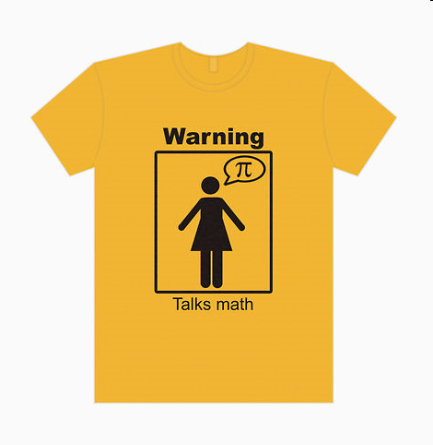
MATH CONTENT APPROACHING!

Slide 23
When we talk about input size, we mean whatever makes sense with respect to the algorithm.
  For a string, probably the length of the string
  For an array, probably the number of elements in the array
Computational complexity is a measure of an algorithm based off of this input size. We will call it f(n)

Slide 24
Usually, we don’t care specifically about f(n), but rather the order of f(n).
That is, if we know that an algorithm, in the worst case, will perform f(n) atomic operations, where f(n) is:
Then we would say that the algorithm in question is O(n³), not O(5n³ + n² – 8)
Similarly,
would also be considered to run in O(n³)
f(n) = 5n³ + n² - 8
g(n) = 12n³ + 9n + 55

Slide 25
Formal Definition
f(n) is in the class O(g(n)) if and only if there are constants c > 0 and n₀ ≥ 1 such that:
for all n > n₀
“A function f(n) is in the class of functions of order g(n) if and only if cg(n) eventually surpasses f(n) when n becomes large enough.”
f(n) ≤ cg(n)

Slide 26
Common Classes
In computer science, we typically run into a subset of all possible classes. In order from “fastest/best” to “slowest/worst” (approximately):
  O(1) – constant
  O(log n) – logarithmic
  O(n) – linear
  O(n log n) - linearithmic
  O(n²) – quadratic
  O(n^{c}) – polynomial (where c > 2)
  O(c^{n}) – exponential
  O(n!) – factorial
Let’s take a look at some examples of a few of these classes

Slide 27
O(1)
Will always take 1 operation, or c operations, where c is independent of n, in the worst case.
int youre_getting_four(int array[3]) {
return 4;
}
int add_two_nums(int a, int b) {
return a + b;
}

Slide 28
O(n)
Will take n operations in the worst case.
bool find_num(int x, int array[5]) {
int j;
for(j = 0; j < 5; j++) {
if(array[j] == x)
return true;
}
return false;
}
2 | 5 | 1 | 3 | 4
1 | 2 | 3 | 4 | 5
Assume main() calls find_num(5, arr);

Slide 29
What do you think?
for(int j = 0; j < m; j++) {
// loop body running in O(1)
}
O(m)
for(int j = 0; j < p; j++) {
for(int k = 0; k < p; k++) {
// loop body running in O(1)
}
}
O(p²)
for(int j = 0; j < k; j++) {
// loop body running in O(n)
}
O(kn)

Slide 30
Ω / Θ
Ω(n) represents the best case running time for certain algorithms. Instead of going into great detail about it now, we will be discussing Ω(n) in the context of the searching and sorting algorithms.
Θ(n) represents the average case running time. This is less important than either O(n) or Ω(n), but we will still mention it as we go along.

Slide 31
Today’s Agenda
P-Set 2 Recap and Questions
How CS50 Is Graded
Arrays Redux
O and Ω
Sorting and Searching Algorithms
Recursion!
Looking Ahead to P-Set 3

Slide 32
Selection Sort
Take (select) the smallest unsorted element and add it to the end of the sorted list.
Steps of the algorithm:
  Search the unsorted part of the data to find the smallest value
  Swap the smallest value with the first value in the unsorted part
  Repeat until complete
3 5 2 6 4
2 5 3 6 4
2 3 5 6 4
2 3 4 6 5
2 3 4 5 6
2 3 4 5 6
Complexity Analysis:
Worst-Case: O(n²)
Best-Case: Ω(n²)
Expected Case: Θ(n²)
Why twice?

Slide 33
Bubble Sort
Swap adjacent pairs of items, so that the highest values “bubble” up to the top
Steps of the algorithm:
  If two adjacent elements are not in ascending order, swap them, and take note that a swap has been made.
  After a full scan, repeat if any changes have been made.
Complexity Analysis:
Worst-Case: O(n²)
Best-Case: Ω(n²)
Expected Case: Θ(n²)

Slide 34
Coding Bubble Sort
(Bubbling Up…Smaller Values to the Front)
void bubblesort(int array[], int n) {
int i, j, tmp;
if(n <= 1) // Array sorted by default
return;
i = 1;
do {
for(j = n-1; j >= i; --j) {
if(array[j-1] > array[j]) {
tmp = array[j-1];
array[j-1] = array[j];
array[j] = tmp;
}
}
} while(++i < n); // Increment before comparing
return;
}
I’ll leave it to you to put comments into this one!

Slide 35
Insertion Sort
Similar to selection sort, except that instead of swapping two elements at a time, it shifts the unsorted part of the array
  Scan the unsorted part of data to find smallest value
  Insert smallest value into first position, shift any elements as necessary
  Repeat until list is sorted
Complexity Analysis:
Worst-Case: O(n²)
Best-Case: Ω(n)
Expected Case: Θ(n²)

Slide 36
Linear Search
We’ve actually already seen linear search during this section. Look familiar?
bool find_num(int x, int array[5]) {
int j;
for(j = 0; j < 5; j++) {
if(array[j] == x)
return true;
}
return false;
}
As the name implies, linear search linearly proceeds through an array of integers until it finds what it’s looking for.
Now, together, let’s calculate the best-case, worst-case, and expected-case runtimes of this algorithm.

Slide 37
Calculating Runtime for Linear Search
In the best case, linear search will find the target immediately. That is,
In the worst case, linear search will find the target at the last change. That is,
In the average case then, linear search is:
Ω(1)
O(n)
Θ(n)

Slide 38
Binary Search
Binary search is only performable successfully on a SORTED array.
It is the first algorithm we have encountered with a runtime that is not O(n) or O(n²).
Let’s take a look at how we might use binary search to find an element in a sorted, 25 element array.
We keep tabs on a start point (green arrow), end point (red arrow), and note the cell that we are looking for, 18, by coloring it blue.
int arr[25] = {1, 2, 3, 4,…,23, 24, 25};
bool in_array = binary_search(18, arr);

Slide 39
1 | 2 | 3 | 4 | 5 | 6 | 7 | 8 | 9 | 10 | 11 | 12 | 13 | 14 | 15 | 16 | 17 | 18 | 19 | 20 | 21 | 22 | 23 | 24 | 25
1 | 2 | 3 | 4 | 5 | 6 | 7 | 8 | 9 | 10 | 11 | 12 | 13 | 14 | 15 | 16 | 17 | 18 | 19 | 20 | 21 | 22 | 23 | 24 | 25
1 | 2 | 3 | 4 | 5 | 6 | 7 | 8 | 9 | 10 | 11 | 12 | 13 | 14 | 15 | 16 | 17 | 18 | 19 | 20 | 21 | 22 | 23 | 24 | 25
1 | 2 | 3 | 4 | 5 | 6 | 7 | 8 | 9 | 10 | 11 | 12 | 13 | 14 | 15 | 16 | 17 | 18 | 19 | 20 | 21 | 22 | 23 | 24 | 25
1 | 2 | 3 | 4 | 5 | 6 | 7 | 8 | 9 | 10 | 11 | 12 | 13 | 14 | 15 | 16 | 17 | 18 | 19 | 20 | 21 | 22 | 23 | 24 | 25
Step 1:
Calculate the midpoint of the current array. If (end-start) is odd, consistently round one way.
Step 2:
If you have found the element you are looking for, stop.
Step 3a:
If the element you are looking for is greater than the value of midpoint, set the beginning of the array to the current midpoint+1 and go back to Step 1.
Step 3b:
If the element you are looking for is less than the value of midpoint, set the end of the array to the current midpoint-1 and go back to Step 1.

Slide 40
Complexity Analysis of Binary Search
Each iteration of the search algorithm eliminates one-half of the remaining elements of the array.
That means that in an array containing k elements, it will take a maximum of log k iterations to find the target.
Complexity Analysis:
Worst-Case: O(log n)
Best-Case: Ω(1)
Expected Case: Θ(log n)

Slide 41
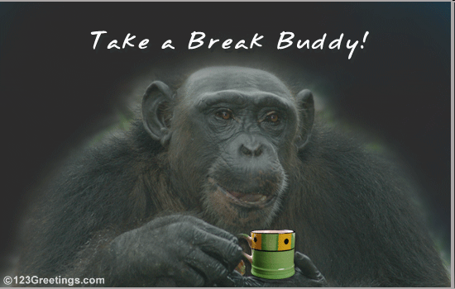

Slide 42
Recursion
Stylistically, an “elegant” program is one that solves an interesting problem in a way that is simple to read and easy to visualize.
Recursion is one common way to create an elegant solution to a problem.
A recursive function is one that, as part of its execution, invokes itself.
Recursion is critical in the “divide and conquer” problem-solving style. Let’s see an example.

Slide 43
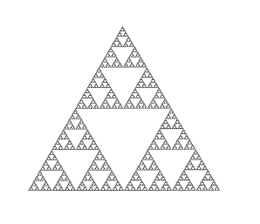
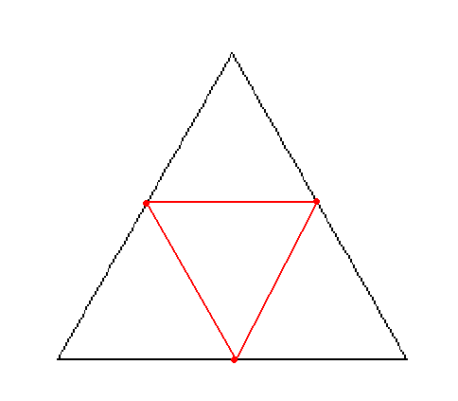
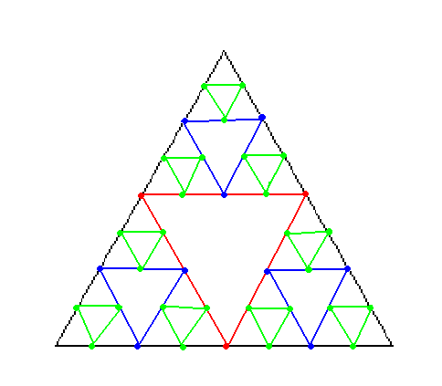
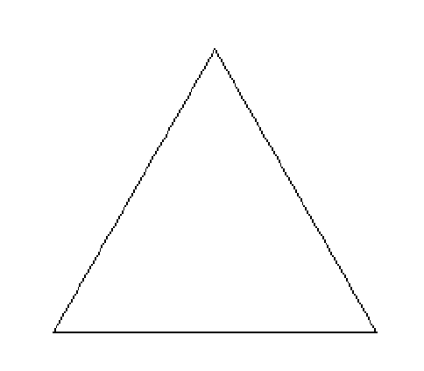
Sierpinski Triangle
Start with an equilateral triangle pointing upward.
Connect the midpoints of its sides to form 4 new equilateral triangles.
If these triangles are large enough to subdivide further, continue to apply these steps.

Slide 44
Wrapping Your Head Around Recursion
Recursion is not the simplest thing to get one’s head around.
Let’s take a look at a few examples to see if we can pin things down a little bit.
We’ll look at the factorial function first.

Slide 45
Factorial (1)
The factorial function, fact(n) is equal to value of all integers less than or equal to n (but greater than 0) multiplied together.
fact(1) = 1
fact(2) = 2 * 1 = 2
fact(3) = 3 * 2 * 1 = 6
fact(4) = 4 * 3 * 2 * 1 = 24
etc..

Slide 46
Factorial (2)
But, can’t it also be said that the following are true?
fact(1) = 1
fact(2) = 2 * 1
fact(3) = 3 * 2 * 1
fact(4) = 4 * 3 * 2 * 1
fact(1)
fact(2)
fact(3)

Slide 47
Factorial (3)
This fact will form the basis for our recursive definition of the factorial function.
There are two fundamental parts to any recursive function:
  First, the base case, which will terminate the recursive process.
  Second, the recursive case, which is where the recursive process actually occurs.
It’s easiest to see this by building the factorial function and analyzing it that way.

Slide 48
Factorial (4)
int fact(int n) {
if(n <= 1)
return 1;
else
return n * fact(n-1);
}
Here’s the base case. Can you see why? Recursion terminates when we’re taking fact(1)
Here’s the recursive case. Can you see why? Recursion continues. It creates a problem nearly identical to the original problem, but is slightly closer to solving that problem.

Slide 49
Factorial (5)
Let’s compare the iterative version of fact() to a recursive version of the same function.
int fact_r(int n) { int fact_it(int n) {
if(n <= 1) int prod = 1;
return 1; while(n > 0) {
else prod *= n;
return n * fact_r(n-1); n--;
} }
return prod;
}
Typically, as in this example, recursive procedures replace loops.

Slide 50
Practice Problem - Recursion
According to the Collatz Conjecture, given any natural number (nonzero, positive integer) if you follow the below procedure you will eventually arrive back at the number 1:
  If the input number is even, divide by 2.
  If the input number is odd, multiply by 3 and add 1.
With a partner, write a function collatz() that takes as its parameter an integer, and recursively calculates the number of steps taken for the input integer to get back to 1.
You may not assume that the input is necessarily a natural number.

Slide 51
int collatz(int n) {
// Start off with some error checking
if(n < 1) {
printf(“Not a natural number.\n”);
return -1;
}
// This means we’re done
if(n == 1)
return 0;
if(n % 2) // What does this mean?
return 1 + collatz(3*n + 1);
else
return 1 + collatz(n/2);
return 0; // Insurance. We’ll never get here.
}

Slide 52
A Little More on Recursion
A function can be recursive even if it doesn’t call itself directly. Consider the functions even() and odd() deﬁned below. Can you see what they do?
bool even(unsigned int n) {
return (n == 0) ? true : odd(n - 1);
}
bool odd(unsigned int n) {
return (n == 0) ? false : even(n - 1);
}
These two functions would be termed mutually recursive

Slide 53
The Call Stack (1)
When a function is called, some space is set aside in memory speciﬁcally for that call of the function. Local variables are allocated in that space, and other important information is stashed there too, like the location in the code to return to after the call is complete. This space is called a frame. Every function call results in a new frame being created.
Of course, more than one function’s frame may be active at one time. If main calls make move, which calls get direction, then all three of these functions have open frames.
Frames are arranged on top of each other in a stack. The frame for the most recently called function is on top. When a function is entered, a new frame for it is pushed on the top of the stack and becomes the active frame. When that function ﬁnishes, its frame is destroyed and the one for the function below becomes active again.

Slide 54
The Call Stack (2)
On the next slide, the image is a visualization of the stack. Reading downward, we will see the stack at successive points in time. Reading left to right, we see frames in terms of their age. The rightmost frame active at any given time is the open frame. The one immediately to its left will be the one that is active when the rightmost frame returns.

Slide 55
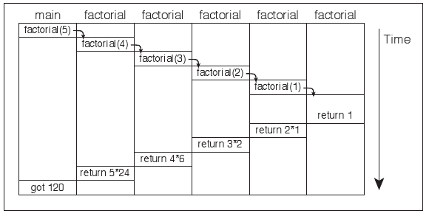
The Call Stack (3)
Older Frames
Newer Frames

Slide 56
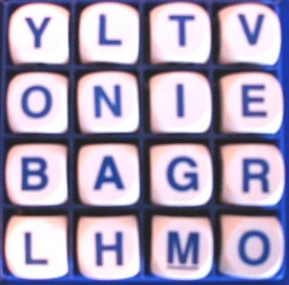
Looking Ahead
In Problem Set 3, you’ll need to make this:
Only a little less graphic-y and a lot more text-based. Because we’re nice like that.

Slide 57
Problem Set 3 – Tips!
draw()
  Easy as it sounds; all you need to do is some quick printf()s – look back at our draw function from earlier!
scramble()
  It will REALLY help to draw this out on a piece of paper and map the relationships out. Once you figure out the formula, it’s a piece of cake!
lookup()
  Employ binary search. Remember the dictionary.words array is already sorted!

Slide 58


