Slide 1
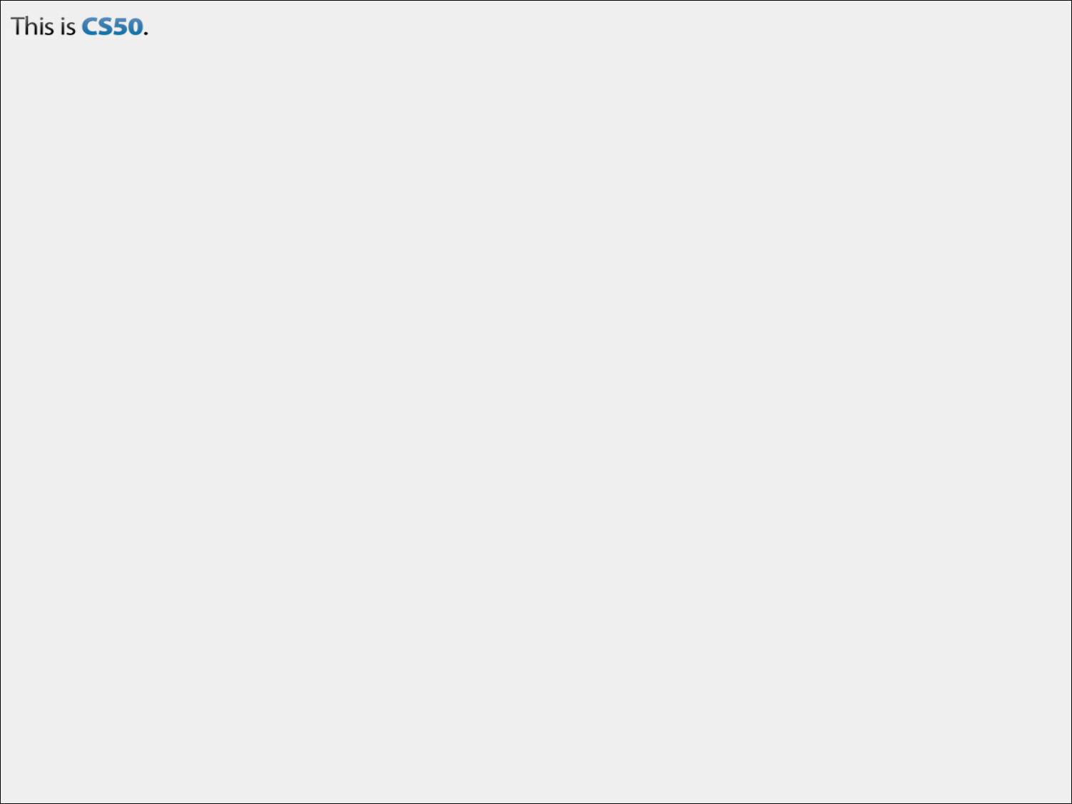
CS50 Section #4
Monday 5:30-7:00pm
60 Oxford 330
October 8, 2012

Slide 2
Today’s Agenda
Pointers
Dynamic Memory Allocation
Structures (time permitting)
Quiz 0 Questions
We’ll take a break, time permitting, but the most important thing is ensuring that you understand the material in today’s section.

Slide 3

Just kidding…we survive…and you will too!

Slide 4
Don’t Be Scared!
Pointers have a scary reputation among students because they give you the power to screw up pretty epically.
The screw-ups, however, are very easy to control if you exercise discipline when you use your pointers.
Today, I’m going to try to teach you, in about 45 minutes, this discipline.

Slide 5
Memory (1)
Your code lives in files on a disk drive. The drive is also home to other data that may be read or written to.
This disk drive is just a storage space, however. We can’t work directly from the disk drive, we have to move things from the disk drive to memory (RAM).
Want to learn all about how this works? Take CS61

Slide 6
Memory (2)
Memory is a big array of 8-bit wide bytes.
The processor’s instruction set (another CS61 subject), tells the computer to treat some cells of memory as code, some as integers, some as strings, etc.
Each of the data types we have been using occupies different amounts of memory.
  A char takes up exactly one byte.
  An int takes up four bytes. (consecutive)

Slide 7
Memory (3)
On the next slide, we will look at a represenation of a 100 byte memory.
Each cell is 8-bits wide.
Notice that we will also give each of the cells a number. Memories are just large “arrays” of 8-bits cells, so each number will correspond to that cell’s address.

Slide 8
Memory (4)
00 | 01 | 02 | 03 | 04 | 05 | 06 | 07 | 08 | 09
10 | 11 | 12 | 13 | 14 | 15 | 16 | 17 | 18 | 19
20 | 21 | 22 | 23 | 24 | 25 | 26 | 27 | 28 | 29
30 | 31 | 32 | 33 | 34 | 35 | 36 | 37 | 38 | 39
40 | 41 | 42 | 43 | 44 | 45 | 46 | 47 | 48 | 49
50 | 51 | 52 | 53 | 54 | 55 | 56 | 57 | 58 | 59
60 | 61 | 62 | 63 | 64 | 65 | 66 | 67 | 68 | 69
70 | 71 | 72 | 73 | 74 | 75 | 76 | 77 | 78 | 79
80 | 81 | 82 | 83 | 84 | 85 | 86 | 87 | 88 | 89
90 | 91 | 92 | 93 | 94 | 95 | 96 | 97 | 98 | 99

Slide 9
Pointers (0)
Before we get into the nitty-gritty, I want you to think of pointers just like this.
int
int *
5
int k;
k = 5;
int *k_ptr;
k_ptr = &k;
k
k_ptr
Don’t worry about this line just yet…

Slide 10
Pointers (1)
A pointer is a data item whose
  value is a memory address, and
  type describes the data located at that memory
Pointers allow data structures to be shared. Previously we have “passed by value”. Now, pointers enable us to “pass by reference”.
What other data type that we have seen allows us to pass by reference? What do you think that means about that data type?

Slide 11
Pointers (2)
Pointers make a computer environment more like the real world.
Imagine everything was a variable, if I create something called “Doug’s Notebook”, it doesn’t make sense, if you want to update notes in the notebook, to xerox every page of the book and take that xeroxed copy, make notes in it, and then throw it out. No notes in my actual notebook will have been updated.
This is what we do, however, when we pass by value.

Slide 12
Pointers (3)
Pointers have other cool benefits too.
As of right now, arrays are our only structure for representing an ordered list. It can take O(n) time to insert or remove an element into an ordered list.
Pointers allow us to create linked lists, where insertion and deletion of elements can be completed in O(1) time.

Slide 13
Creating a Pointer (1)
The simplest value of a pointer is the NULL pointer. As the name implies, this is a pointer that points to…nothing.
When you create a pointer, but are not setting its value immediately, it is always good style (and very safe!) to set the value of the pointer to be NULL.
You can check whether a pointer is null by comparing it to NULL using ==.

Slide 14
Creating a Pointer (2)
Pointers can be derived from array names.
After the above declaration, almost any mention of prices implicitly converts it to a pointer-to-double whose value is the address of prices’ first element.
Here’s the big secret: An array’s name is actually a pointer to its first element!
double prices[6];

Slide 15
Creating a Pointer (3)
C has an address-extraction operator (&) that returns the address of the item to the right of the operator.
Examples:
  If x is a variable of type int, then &x is a pointer-to-int whose value is the address of x.
  If arr is an array of doubles, then &arr[i] is a pointer-to-double whose value is the address of the element of arr at index i.

Slide 16
Dereferencing (1)
The main purpose of a pointer is to allow you to modify or inspect the location it points to.
Here’s the terminology:
If we have a pointer pc which is a pointer-to-char:
  Then, *pc is the location pointed to by pc.
The assignment:
  *pc = ‘\0’;
Would store the null terminator character into the location pointed to by pc.

Slide 17
Dereferencing (2)
When used in this way, the (*), here called the unary star, is called the dereference operator, because it goes through the pointer to access the location it refers to.
If you dereference a NULL pointer, you segfault. But the compiler won’t stop you from doing this. Hence a reason why pointers are dangerous.

Slide 18
Dereferencing (3)
What do you get if you do the following?
You get p. Think of it like this: &(*p). Dereferencing the pointer, *p returns what p points to. Then, you are taking the address of what p points to…but since p is a pointer to that item, p IS that address.
&*p

Slide 19
Syntax (1)
To actually code into existence a pointer (a pointer-to-int, for example), all you need to do is the following:
We read this as “p can be dereferenced with the * operator, and when you do that, you get an int.”
int *p;
But you can’t dereference it if it hasn’t been assigned to something…or you get weird behavior!

Slide 20
Syntax (2)
You can create multiple pointers on one line. But those *’s are important. That is:
Will create three pointers-to-int, pa, pb, and pc. But,
Will create a pointer-to-int px, and two actual integer variables, py and pz.
int *pa, *pb, *pc;
int *px, py, pz;

Slide 21
Type Casting with Pointers (1)
C is extremely liberal (perhaps to a fault) about allowing casts between pointer types. Any pointer value can be cast to any pointer type.
A C programmer can use pointer type casting to view memory contents according to whatever type is most useful at the moment.

Slide 22
Type Casting with Pointers (2)
The type pointer-to-void (void *) is special. You CANNOT dereference a void *, because it is not known what type of data it points to.
void * is used as a generic pointer type. For example, a data structure may need to contain space for a pointer-to-int at some occasions, and at others for a pointer-to-double.
Basic takeaway: To dereference a void *, it must be first cast to a more specific pointer type. But until that time, you can use the void * notation to allow them to be stored and passed from one function to another without obscuring the fact that they’re pointers.

Slide 23
Look Back (1)
int *
int
35
5
k_ptr
k
Now, let’s do the following:
*k_ptr = 35;
What do you think happens?

Slide 24
Look Back (2)
int *
int
5
k_ptr
k
And what about this?
int
int m;
m = 4;
k_ptr = &m;
4
What do you think happens?
m

Slide 25
Look Back (3)
int *
int
5
k_ptr
k
And what about this?
int
*k_ptr = &m;
What do you think happens?
Of course, this presumes that the memory location that m is stored at is 0xBC42. We usually use hexadecimal to represent locations in memory.
4
0xBC42
m

Slide 26
Pointer Size
We have discussed the sizes of various types.
  chars are 1-byte wide
  ints are 4-bytes wide
Well, pointers are just addresses. On a 32-bit computer, addresses are 32-bits wide. On a 64-bit computer, addresses are 64-bits wide.
So, all pointers are 32- or 64-bits wide, depending on the hardware.

Slide 27
Pointer Quiz
Assume that the following declarations have been made prior to the statements:
int a = 3, b = 4, c = 5;
int *pa = &a, *pb = &b, *pc = &c;
Also assume that, initially, pa = 0x4, pb = 0x8, and pc = 0xC.
 | a | b | c | pa | pb | pc
a = b * c
a *= c
b = *pa;
pc = pa;
*pb = b * c;
c = (*pa) * (*pc)
*pc = a * (*pb)

Slide 28
Pointer Quiz
Assume that the following declarations have been made prior to the statements:
int a = 3, b = 4, c = 5;
int *pa = &a, *pb = &b, *pc = &c;
Also assume that, initially, pa = 0x4, pb = 0x8, and pc = 0xC.
 | a | b | c | pa | pb | pc
a = b * c | 20 | 4 | 5 | 0x4 | 0x8 | 0xC
a *= c | 15 | 4 | 5 | 0x4 | 0x8 | 0xC
b = *pa; | 3 | 3 | 5 | 0x4 | 0x8 | 0xC
pc = pa; | 3 | 4 | 5 | 0x4 | 0x8 | 0x4
*pb = b * c; | 3 | 20 | 5 | 0x4 | 0x8 | 0xC
c = (*pa) * (*pc) | 3 | 4 | 15 | 0x4 | 0x8 | 0xC
*pc = a * (*pb) | 3 | 4 | 12 | 0x4 | 0x8 | 0xC

Slide 29
Arrays and Pointers (1)
If z has been defined as an array, then in almost any context where z is mentioned, it is converted into a pointer to the first element of the array, &z[0].
z[i] is just some “syntactic sugar” for *(z + i).
Basically, a function parameter declared as type array-of-X behaves exactly as if it had type pointer-to-X

Slide 30
Arrays and Pointers (2)
This is why, earlier in the semester, I said that sometimes you will see char *argv[], and sometimes you may see char **argv.
There are differences though. When you define an array, storage is allocated for the array’s contents. When you define a pointer variable, the only storage allocated is for the pointer, not anything else it may later point to.
Let’s look at an example of this on the next slide.

Slide 31
Arrays and Pointers (3)
char s0[] = { ‘x’, ‘y’, ‘z’, ‘\0’ };
char s1[] = “xyz”;
char *s2 = “xyz”;
The first two definitions are identical. You can never assign a new value to s0 (or s1) itself, but you can change individual characters.
In s2, you CAN make it point to another string or specific character. But you cannot just modify s2[2], for example, because s2 points to a literal string constant. You can read, but not rewrite it.

Slide 32
Passing by Reference
Consider the following function using pointers.
void swap(int *p1, int *p2)
{
int temp;
temp = *p1;
*p1 = *p2;
*p2 = temp;
}
By dereferencing its arguments, it is able to directly modify variables defined in its caller. So, in the snippet:
int j = 0;
int k = 1;
swap(&j, &k)
printf(“%d %d\n”, j, k);
Notice that this would NOT work if we were passing by value.
You get:
1 0

Slide 33
Dynamic Memory Allocation
The heap is the term for the pool of available memory that can be allocated dynamically, that is, while your program is running.
Dynamically allocated memory does NOT disappear when the function in which it’s associated returns to the caller.
Thus far in the course, all memory we’ve used has been static (size of storage is fixed when the program is compiled) or local to a particular function, so that the storage is deallocated when the function returns.

Slide 34
malloc() (1)
FUN FACT: sizeof() is NOT a function.
Recall that a function requires arguments to have type specifiers, as in:
int add_two_nums(int a, int b);
sizeof() actually has the ability to take a type as an argument—though you can also pass it a variable name—and so it cannot actually be termed a function. That is why it is termed an operator.
malloc() is a function provided by the C library that allocates a block of memory from the heap and returns a pointer to it.
Whenever a program needs fresh storage at runtime, it may make a call to malloc().
The argument to malloc() is the number of bytes requested.
C provides the sizeof() operator for determining the size of a particular type on a given set of hardware.

Slide 35
malloc() (2)
The type of pointer returned by malloc() is always of type void *, so it requires you to cast it. (WHY?)
Technically, however, you can just do the following, which is an implicit cast:
I ALWAYS do the former, though according to the course style guide, you should do the latter.
I don’t care which you choose to use!
int *pa = (int *) malloc(sizeof(int));
int *pa = malloc(sizeof(int));

Slide 36
malloc() (3)
What happens, however, if you have run out of memory on the heap? (It happens!)
You’ll get back a pointer to nothing…a NULL pointer. If you try and dereference that, you’ll segfault.
This is good coding practice. EVERY TIME you call to malloc(), you should do a NULL-check.
int *pa = malloc(sizeof(int));
if(pa == NULL) {
printf(“Error – out of memory!\n”);
return 1;
}

Slide 37
free() (1)
Remember that memory that is dynamically created is not automatically released when the function it is created in is terminated.
For that reason, the companion function to malloc() is free(). free() releases any memory that was dynamically allocated back to the system.
When you have finished using a piece of dynamically allocated memory, you absolutely must free() it.
Failure to do so will result in a memory leak.

Slide 38
free() (2)
int main(int argc, char **argv) {
// Get an array of four integers
int *k_ptr = malloc(4 * sizeof(int));
// Check valid memory
if(k_ptr == NULL)
return 1;
/* Do a bunch of stuff */
// No longer need k_ptr, release
free(k_ptr);
return 0;
}
The argument to free() is only the name of a pointer that was dynamically allocated.
So what does this mean about free()’s function declaration? It must be:
void free(_______ ptr);
So what does this mean about free()’s function declaration? It must be:
void free(void *ptr);

Slide 39
Golden Rules
All memory that you malloc() must subsequently be free()’d.
Only memory that was produced by malloc() should be free()’d.
Do not “double free()”.

Slide 40
DMA Practice Questions
1. What are the values of m and n after this snippet of code has executed?
ap
bp
int m, n;
int *ap, *bp;
ap = &m;
bp = ap;
n = 10;
*bp = n++;
11
10
m
n

Slide 41
2. What does the following program do?
void f1(int a);
void f2(int *a);
int main() {
int a = 4;
f1(a);
printf("%d\n", a);
f2(&a);
printf("%d\n", a);
}
void f1(int a) {
a--;
}
void f2(int *a) {
(*a)--;
}
It will print out:
4
3

Slide 42
3. Write a call to malloc() requesting space for an array consisting of 7 double values. How do you access the third element of the array?
double *dptr = (double *) malloc(7 * sizeof(double));
dptr[2]
OR
*(dptr + 2)

Slide 43
Structures (1)
Structures provide a way to unify several variables of different types into a single variable type which can be assigned its own name.
We use structures (structs) to group together useful data types that have a logical relationship.
Think of a structure like a super variable.
Let’s build the struct for a vehicle.

Slide 44
Structures (2)
Here is a potential definition for a vehicle struct:
Structures wouldn’t be useful to us unless we could access the data within the structure. We access those fields using the dot (.) operator. Let’s write code that creates a structure for my car.
struct car_t {
int year;
char make[10];
char model[10];
bool automatic;
int odometer;
double engsize;
};

Slide 45
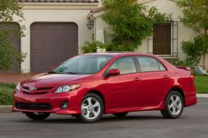
Structures (3)
struct car_t dougscar;
dougscar.year = 2011;
dougscar.make = “Toyota”;
dougscar.model = “Corolla”;
dougscar.automatic = false;
dougscar.odometer = 17500;
dougscar.engsize = 1.8;
year, make, model, lic_plate, odometer, and engsize are all the fields of the struct. The type is struct car_t and the variable name is dougscar.

Slide 46
typedef (1)
Recall the type of our last structure. It was struct car_t. This is a rather cumbersome type name.
C programmers rarely ever declare or define structure variables as shown previously. Instead, they use typedef to provide a convenient type name.
Let’s take a look at our last structure definition again, this type using typedef.

Slide 47
typedef (2)
temporary name
typedef struct _car_t {
int year;
char make[10];
char model[10];
bool automatic;
int odometer;
double engsize;
} car_t;
For now, we won’t get into why you need a temporary and a permanent name. But typically, your temporary name is the same as your permanent name, plus the “struct” and prefixed with an underscore, as shown here.
field definitions of the structure
Perm. name

Slide 48
typedef (3)
Now, when you define a variable of type car_t, you don’t need to do:
Instead, you can just put:
Neat trick, huh? You can use typedef to create all sorts of new types!
struct car_t dougscar;
car_t dougscar;

Slide 49
Using Structures or Defined Types
Unlike all other types, you must “declare” your type at the top of your program file before you actually use it.
After that however, you may use it just like any other type, including passing it as arguments to a function (usually by pointers) and also having it returned by some functions.
Let’s look at an example

Slide 50
// Header files
#include <stdio.h>
#include <cs50.h>
// Type declarations
typedef struct _person_t {
string name;
char gender;
int age;
} person_t;
// Function declarations
person_t *make_person(person_t *p, string n, char g, int a);
int main(int argc, char **argv) {
person_t doug; // Statically declared
make_person(&doug, “Doug”, ‘M’, 25);
printf(“Name - %s\n”, doug.name);
printf(“Gender - %c\n”, doug.gender);
printf(“Age - %d\n”, doug.age);
return 0;
}

Slide 51
person_t *make_person(person_t *p, string n, char g, int a) {
(*p).name = n;
(*p).gender = g;
(*p).age = a;
return p;
}
Fun little trick. When you need to dereference a pointer to a structure AND access a field of that structure, you can use the “->” (arrow) operator. So let’s look at the above function again, using that operator.
person_t *make_person(person_t *p, string n, char g, int a) {
p->name = n;
p->gender = g;
p->age = a;
return p;
}
That is, (*[pointer]).[field] is equivalent to [pointer]->[field]

Slide 52
Dynamic Creation of Structures
// Header files
#include <stdio.h>
#include <cs50.h>
// Type declarations
typedef struct _person_t {
string name;
char gender;
int age;
} person_t;
// Function declarations
person_t *make_person(person_t *p, string n, char g, int a);
int main(int argc, char **argv) {
person_t *doug = malloc(sizeof(person_t));
make_person(doug, “Doug”, ‘M’, 25);
/* Do whatever */
free(doug);
return 0;
}

