Slide 1
Diamond: Automating Data Management and Storage for Wide-area, Reactive Applications
Irene Zhang, Niel Lebeck, Pedro Fonseca, Brandon Holt, Raymond Cheng, Ariadna Norberg, Arvind Krishnamurthy, Henry M. Levy
Presented by Zirui Zhao
11/2/2018

Slide 2
Reactive Application
Application with distributed nodes
Automatically propagate changes
Notes:
Reactive applications have some shared data stored on cloud

Slide 3
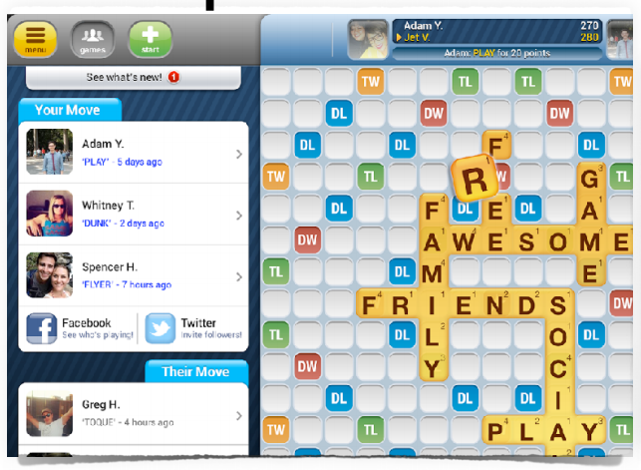
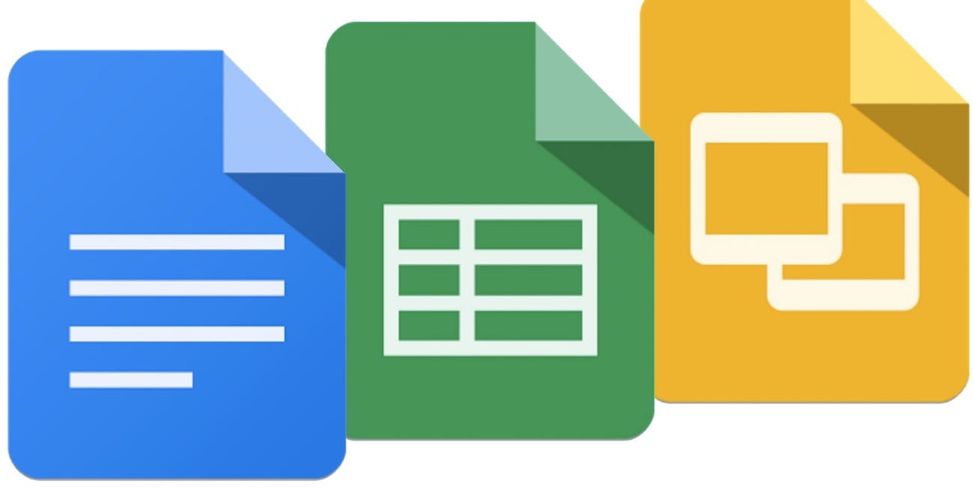
Background
Notes:
Reactive app: Google Docs Family, Words with Friends, Online Board Games
Preserve data consistency

Slide 4
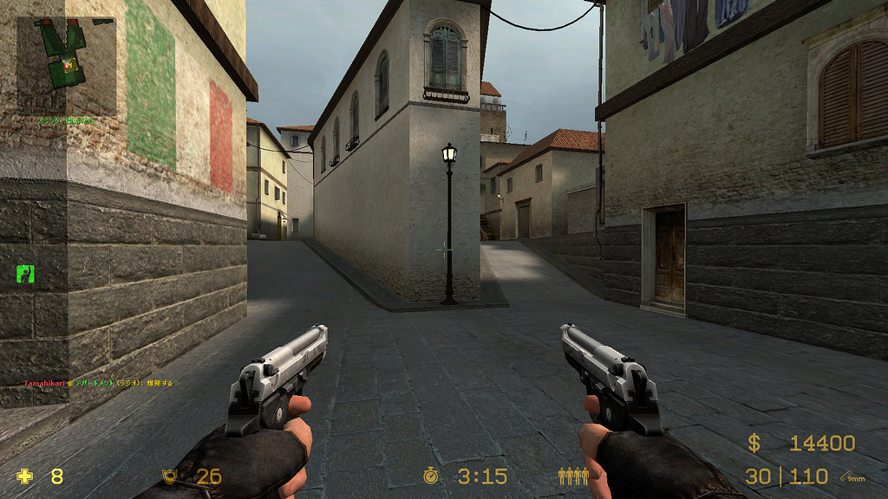
Background
Notes:
FPS games DO NOT care about data loss, they calculate every event on server. FPS game has a continues stream and push data to the client

Slide 5
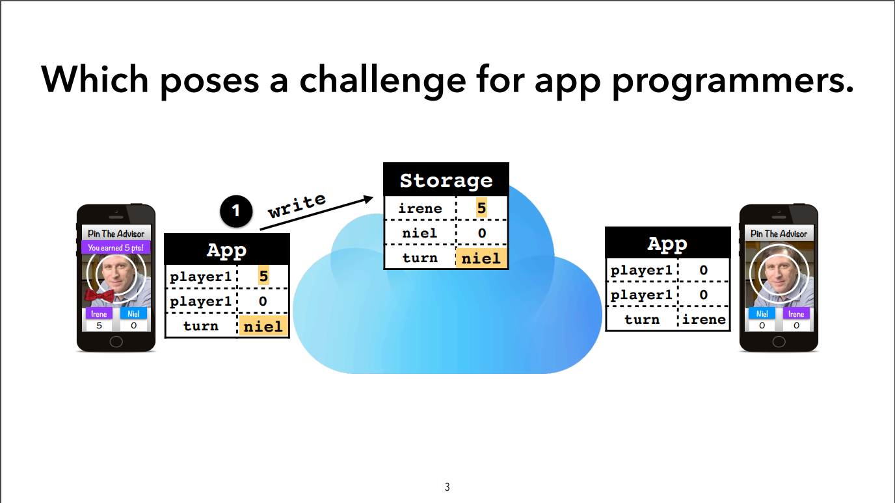
Race Condition
Notes:
Irene just made a move, earned 5 points, and it will be Neil’s turn. Irene’s client wrote the data to cloud storage. But Neil doesn’t know it is his turn, so Neil is waiting for Irene, and Irene is waiting for Neil and it is a deadlock. How can we let Neil know that Irene just changed the shared data

Slide 6
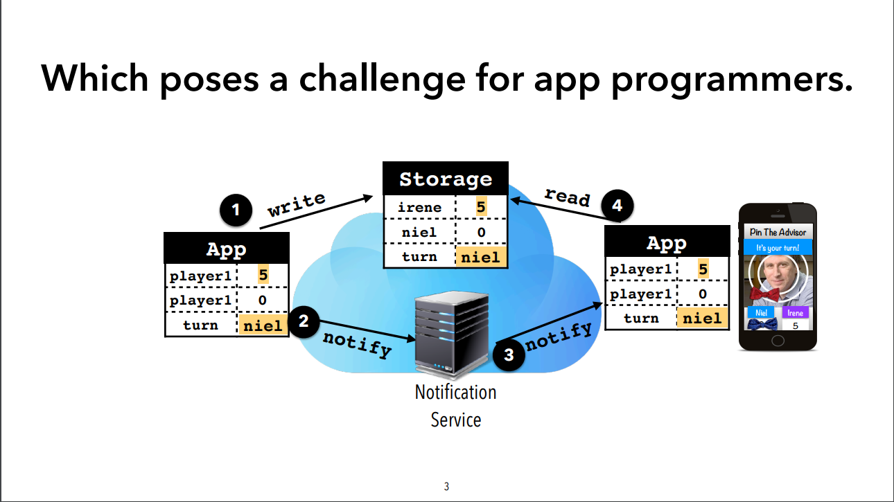
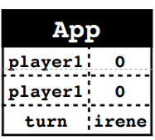
Traditional Approach
Failure
Notes:
To resolve that kind of problem, we add a notification server. After writing data to cloud storage, Irene will send another request to notification server to notify she just changed the shared data. Them, the notification server will broadcast to all other clients. In this case, it is just Neil. After receiving a notification from the server, Neil knows Irene just made a change to cloud storage so it is time to pull data from cloud storage.
But what if the third step failed, then they will wait for each other again…

Slide 7
Traditional Approach
Bob
Notes:
Another challenge mentioned in their paper is race condition. I am not familiar with the game they demonstrated here so I am not sure what exactly happened. They claimed when a new player, Bob, joined the game, if Neil received the notification from Irene first and Bob write to the storage first. Bob may think it is his turn and Neil will also think it is his turn. So, it violates the isolation between players. In fact, I don’t think this is valid example in real life. In principle, we should never trust any data sent from clients and the server should always validate user’s input. In this case, some turn-based game, the server should store who is allowed to make a move and it should check if the write request from a valid client. Which means, in this case, the server think it is Neil’s turn so it will decline Bob’s write request. So, it wouldn’t violate any isolation between players.

Slide 8



Wide-area Storage System
High latency
Notes:
Another way to solve the problem is to use some existing distributed cloud storage such as Dropbox, Google Drive or OneDrive. I remember Office used to use OneDrive to sync changes between different users. But these cloud storage systems are not designed for frequent changes. So, the latency will be really high and it will not achieve real time edition.

Slide 9
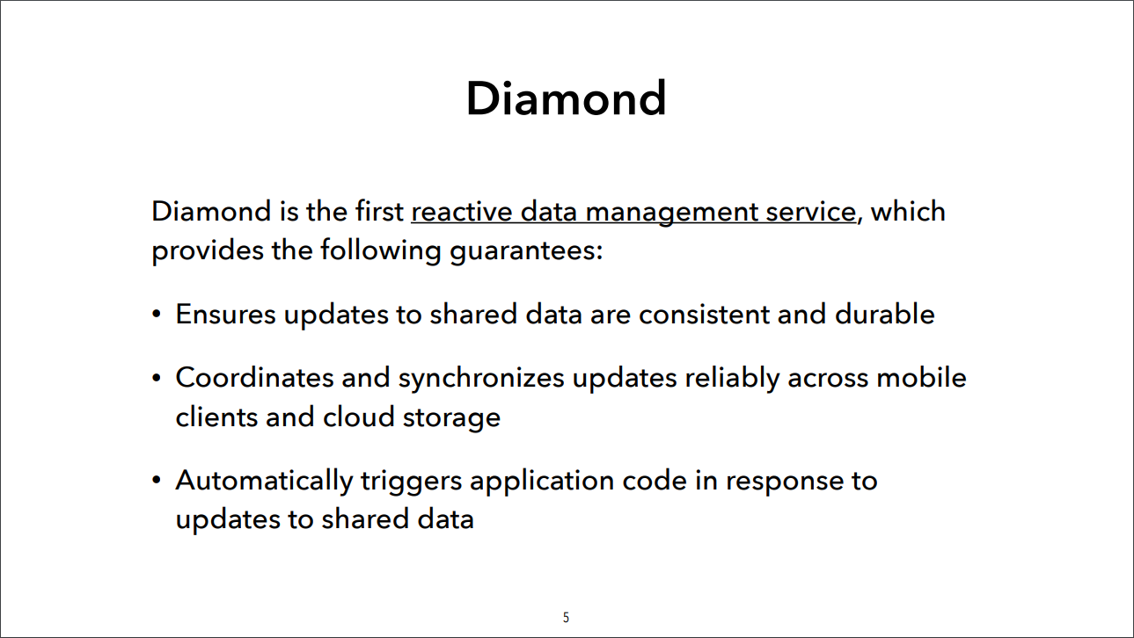
Diamond
Notes:
So, the problem they were talking about can be solved, but it is complicated to solve and they want to propose a unified interface to help SDE develop a reactive app in a short time.
The whole diamond system has two part, diamond library and diamond cloud. Which corresponding to client side and server side.

Slide 10



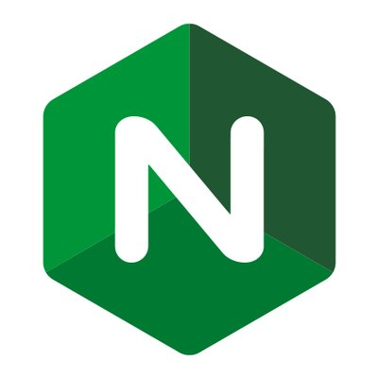
MVC Model
Notes:
Before introducing their diamond library, I want talk about MVC model which is famous in software engineering, and that’s my field. So, MVC stands for Model, View, Controller. Model is about data structure and how and where we store those data, it shouldn’t depends controller. View is about how to show these data to the user, it is GUI. Then, the controller is about how to handle users’ request, it can be a HTTP server, it deals with your product’s logic.

Slide 11
MVC Model
Model
Controller
Notes:
So, from a software engineering aspect, what they are mainly trying to do is building a model which can support data sharing and automatic propagation. So, the developer can focus on the controller or vire

Slide 12
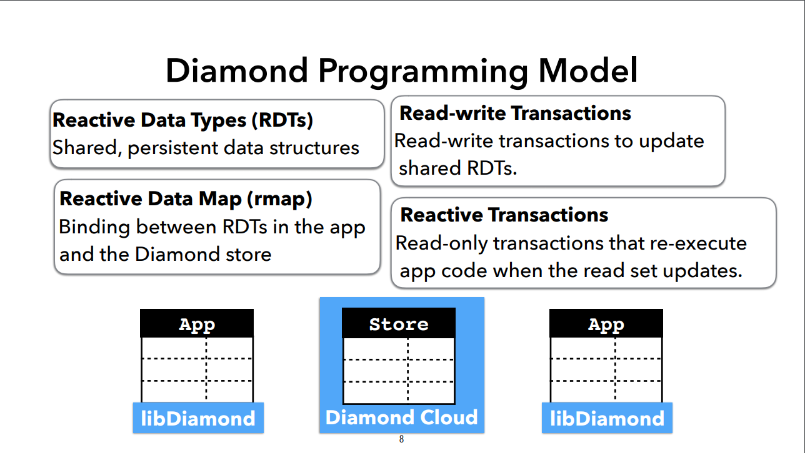

Slide 13
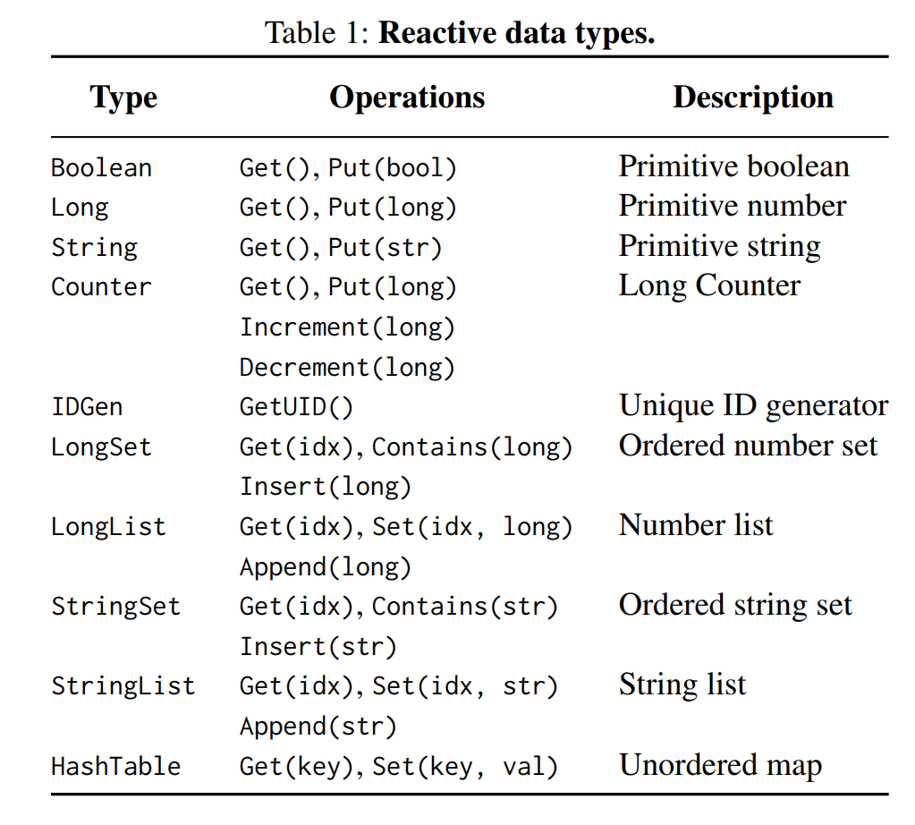

Reactive Data Types
Conflict-free Replicated Data-types (CRDTs)
Collection Types
Notes:
Simple data structures including primitives (e.g., string, long), collections (e.g., list) and Conflict-free Data Types (e.g., counter, set)
And they think it is enough to use these basic types
But I don’t think so. In fact, we don’t need to define these types, we can always use types supported by the language by using remote procedure call.

Slide 14
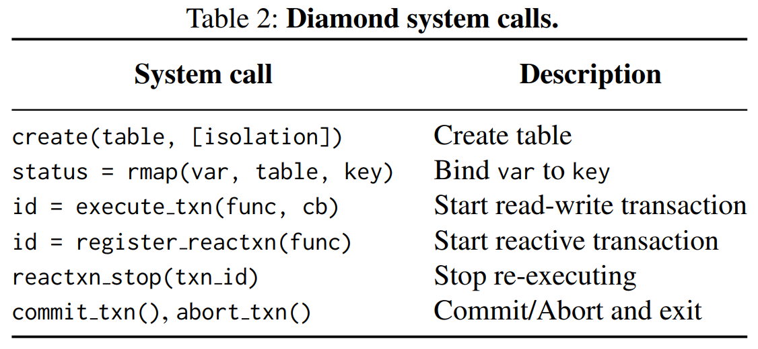
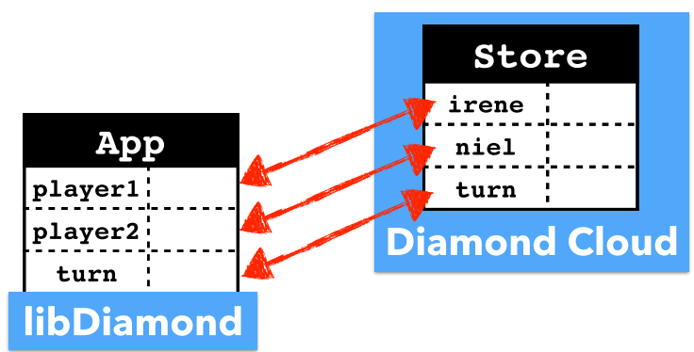
Reactive Data Map (rmap)

Slide 15
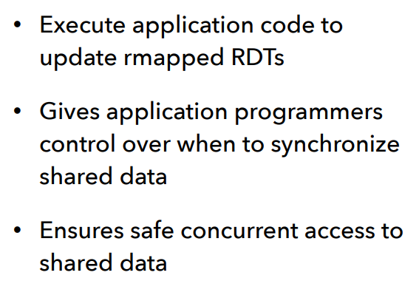
Read-write Transaction
begin();
player1 = 0;
player2 = 0;
turn = “irene”;
commit();

Slide 16
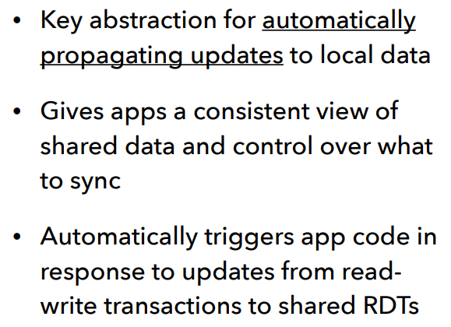
Reactive Transaction
registerReactiveTxn (displayUI(player1,player2, turn));

Slide 17
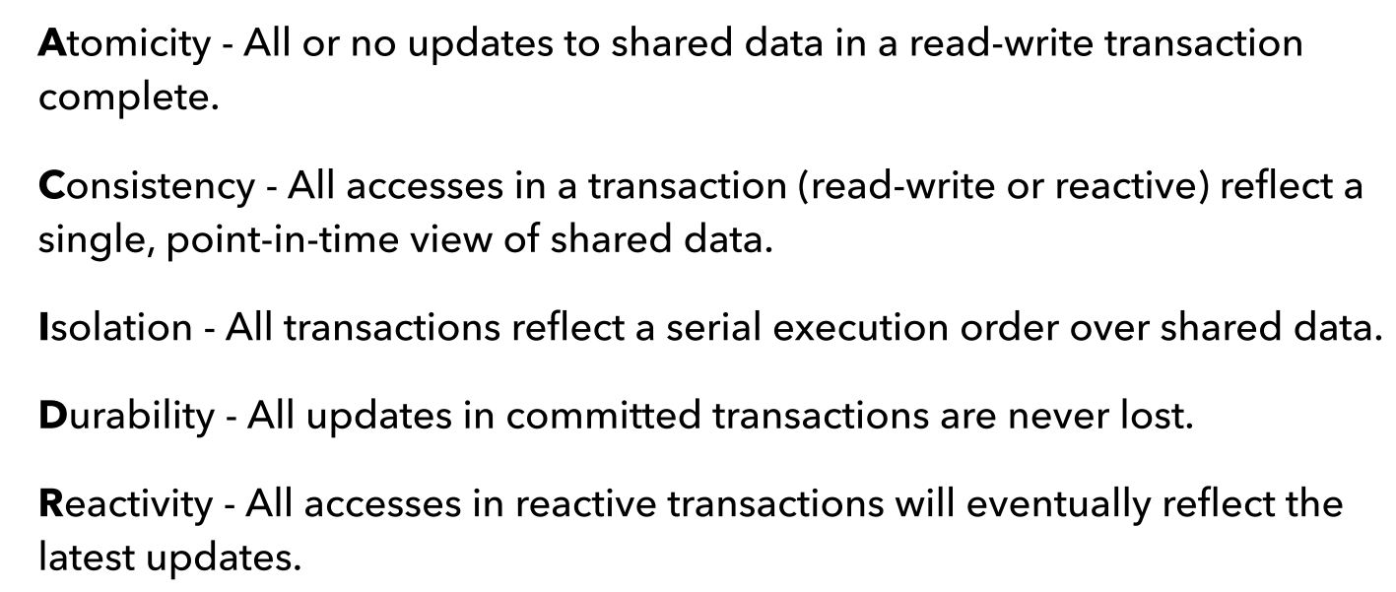
Diamond Cloud

Slide 18
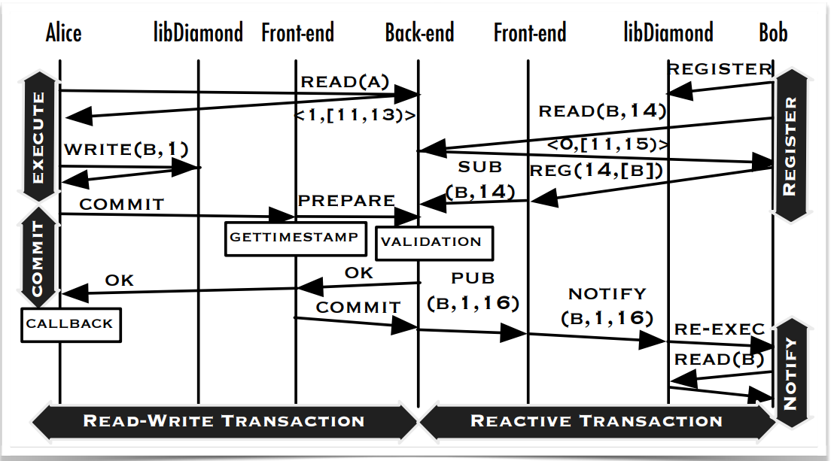
Notes:
This diagram show how they implemented their whole procedure. Bob register some subscribers and Alice write some data to local variables. Then Alice commit her change to cloud storage, get a timestamp, do validation. After that, Alice’s client may invoke a callback function to modify her view. In the meantime, the server publish the data to Bob, and Bob’s client will also invoke a callback function to change the GUI.

Slide 19
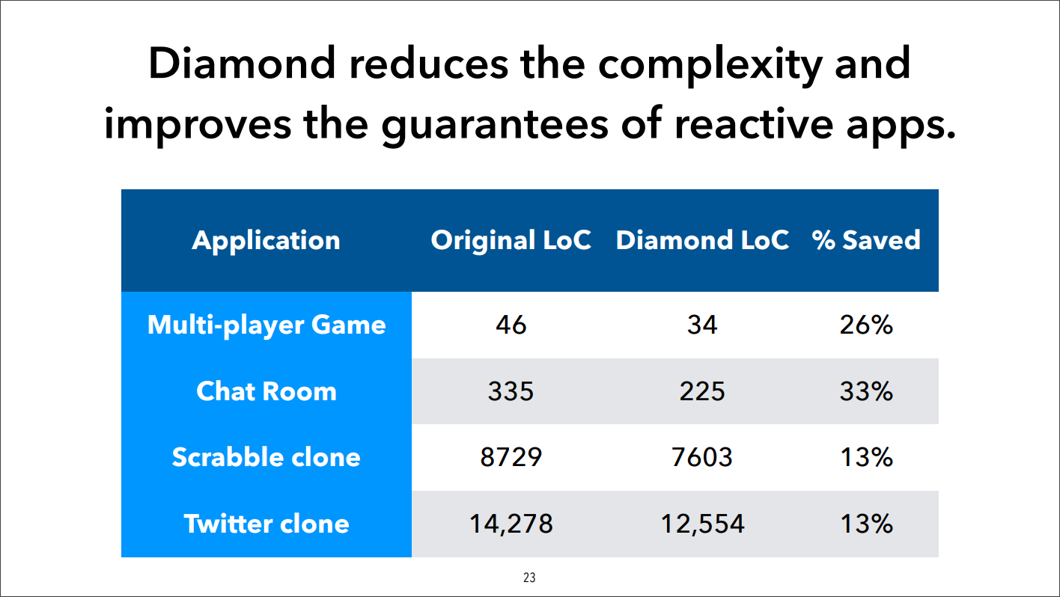
Notes:
Here are their evaluation results. Because their motivation is helping developer to reduce their workload, they count lines-of-code to measure how complex is the implementation. They re-implemented several applications using diamond to see how many lines-of-code can be saved by diamond. The first two applications don’t a GUI, most of codes are dealing with data synchronization. So, it saved about 30% line-of-code. But for last two applications, there are lots of codes are dealing with GUI, the lines-of-code saved by diamond have a lower percentage

Slide 20
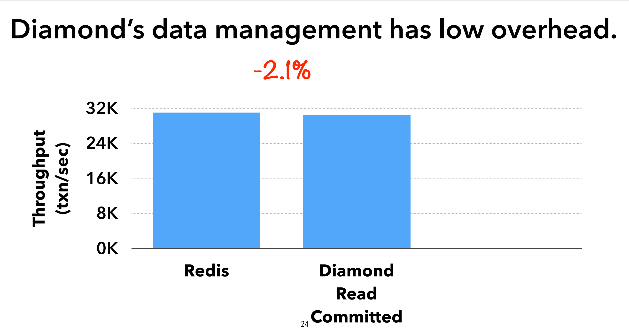
Notes:
Another evaluation is about their diamond cloud. they

Slide 21
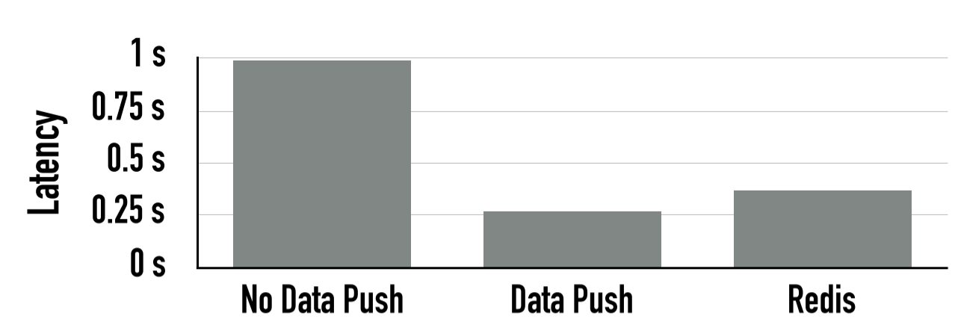
Notes:
Data push notifications reduce this latency by batching updates with reactive transaction notifications to populate the client-side cache.

