Slide 1
Push-Button Verification of File Systems via Crash Refinement
Helgi Sigurbjarnarson, James Bornholt, Emina Torlak, Xi Wang
University of Washington
Presented by: Nomaan Dossaji

Slide 2
Problem
Correctly implement a file system
Difficult because complex data structures that need to be resilient to system crashes/power failures
Proof burden
Notes:
writing proofs requires both a high degree of expertise and a significant time investment

Slide 3
Overview
Authors used Yggdrasil to implement
YminLFS
Yxv6+sync
Yxv6+group_commit
Notes:
YminLFS a log structured file system
Yxv6 a journaling file system (keeps track of changes not committed to the main file system by recording intentions of changes) resembles xv6 & FSCQ

Slide 4
Yggdrasil
Toolkit that helps programmers write file systems and formally verify their correctness in a pushbutton fashion
Fully automated reasoning
Yggdrasil asks programmers for three inputs: a specification of the expected behavior, an implementation, and consistency invariants indicating whether a file system image is in a consistent state
Single-threaded systems
Provides optimizations and reverifies the code

Slide 5
Why Crash Refinement
If the same operations occur on 2 systems, they will transition to equivalent consistent states
The statement above is too strong for systems that interact with external storage so Crash Refinement is introduced

Slide 6
Crash Refinement Definitions
Crash-free equivalence
Crash refinement without recovery
Recovery idempotence
Crash refinement with recovery
No-op
System crash refinement
Notes:
1. F1 is correct with respect to F0 if, starting from equivalent consistent states and invoking the same operation on both systems, any state produced by F1 is equivalent to some state produced by F0. 2. one function is crash refinement of the other 3. Recover after reboot. same state even if recover function run many times after crashing (crashing while recovering) 4. kinda like 3…. 5. run background operations (no-ops) 6.

Slide 7
Crash Refinement
Captures the presence of non-determinism
Any disk state produced by a correct implementation must also be producible by the specification
Use Z3 to automate the proof process
Notes:
Definition is amenable to Satisfiability Module Theories (SMT) reasoning

Slide 8
Yggdrasil Plugins
Identifies where the system crashed
Allows programmers to add plug-in visualizer
Plug-ins for optimizations also allowed

Slide 9
YminLFS
Log-structured file system
Does not overwrite blocks and no garbage collection
Minimal to construct, but still tricky
Yggdrasil found 2 bugs when implementing
One in the lookup logic and one in the data layout
Notes:
Took less than 4 hours for authors to make
Bugs were found by verifier but not by the test

Slide 10
Yggdrasil Effects on YminLFS
Yggdrasil found 2 bugs when implementing
One in the lookup logic and one in the data layout
Optimization:
Removed 3 flushes from mknod
Notes:
Removed each flush and tried to re-verify the code with optimizer plugin

Slide 11
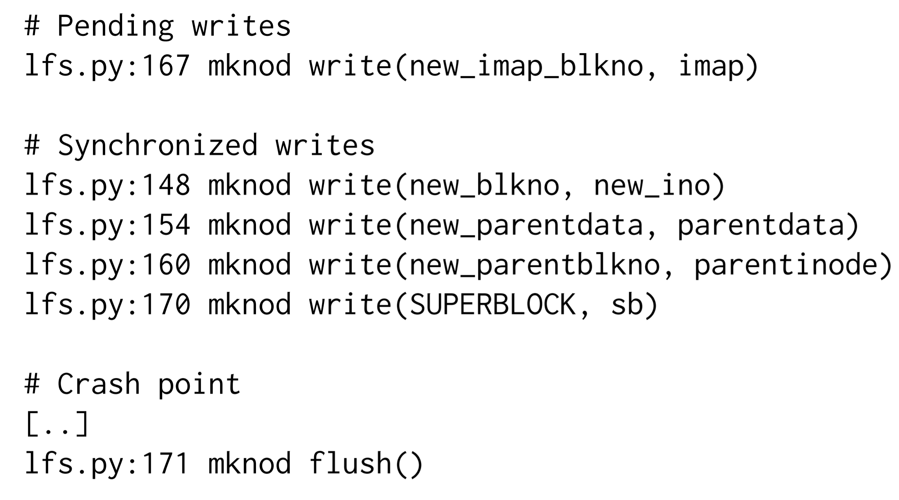
Counterexample

Slide 12
Yxv6 File System
Journaling file system
Modular design enabled by crash refinement to scale up to SMT reasoning
Multiple layers to bound reasoning one layer at a time
+ sync groups multiple system calls to 1 transaction and commits when log is full
Notes:
Too complex for state of the art SMT solvers

Slide 13
Yxv6 Layers
Asynchronous Disk
Transactional Disk
Manages separate data disks
Ability to start, commit, and add to transactions. Can also read data.
Virtual Transactional Disk
Inodes
File System
Notes:
1. disk model used to implement YminLFS
2. Manages separate data disks Ability to start, commit, and add to transactions. Can also read data. uses a log disk

Slide 14
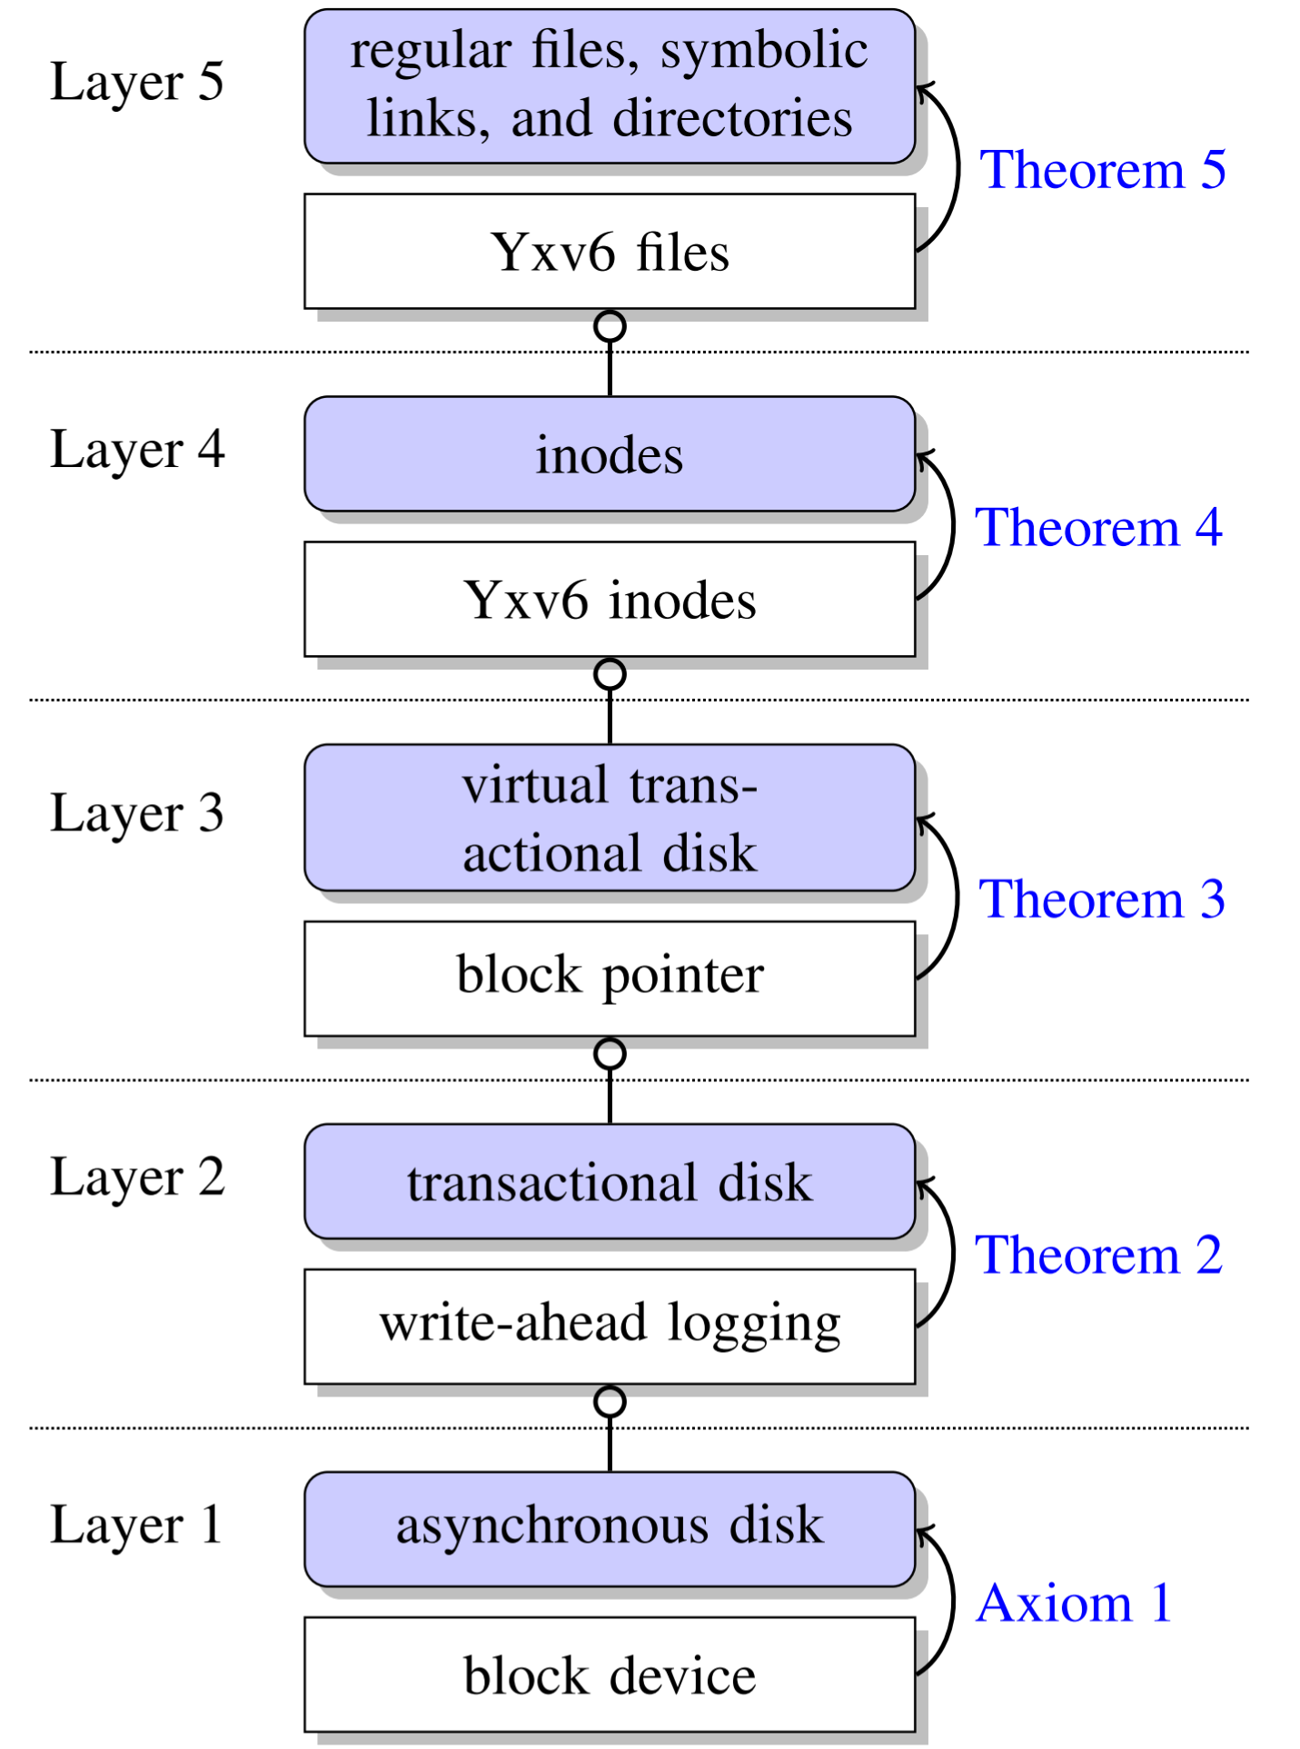

Slide 15
Yxv6 Finitization
Operations need to be finite except for:
Searching: to verify, check if index is marked free in bitmap
Unlinking a file to free data blocks. Instead move inode to orphan inodes disk and garbage collector frees blocks

Slide 16
Yxv6 Correctness
Passed fsstress tests
Authors utilize Yxv6 for Yggdrasil’s development
Applied disk block enumerator from Ferrite toolkit to verify after crash and recovery

Slide 17
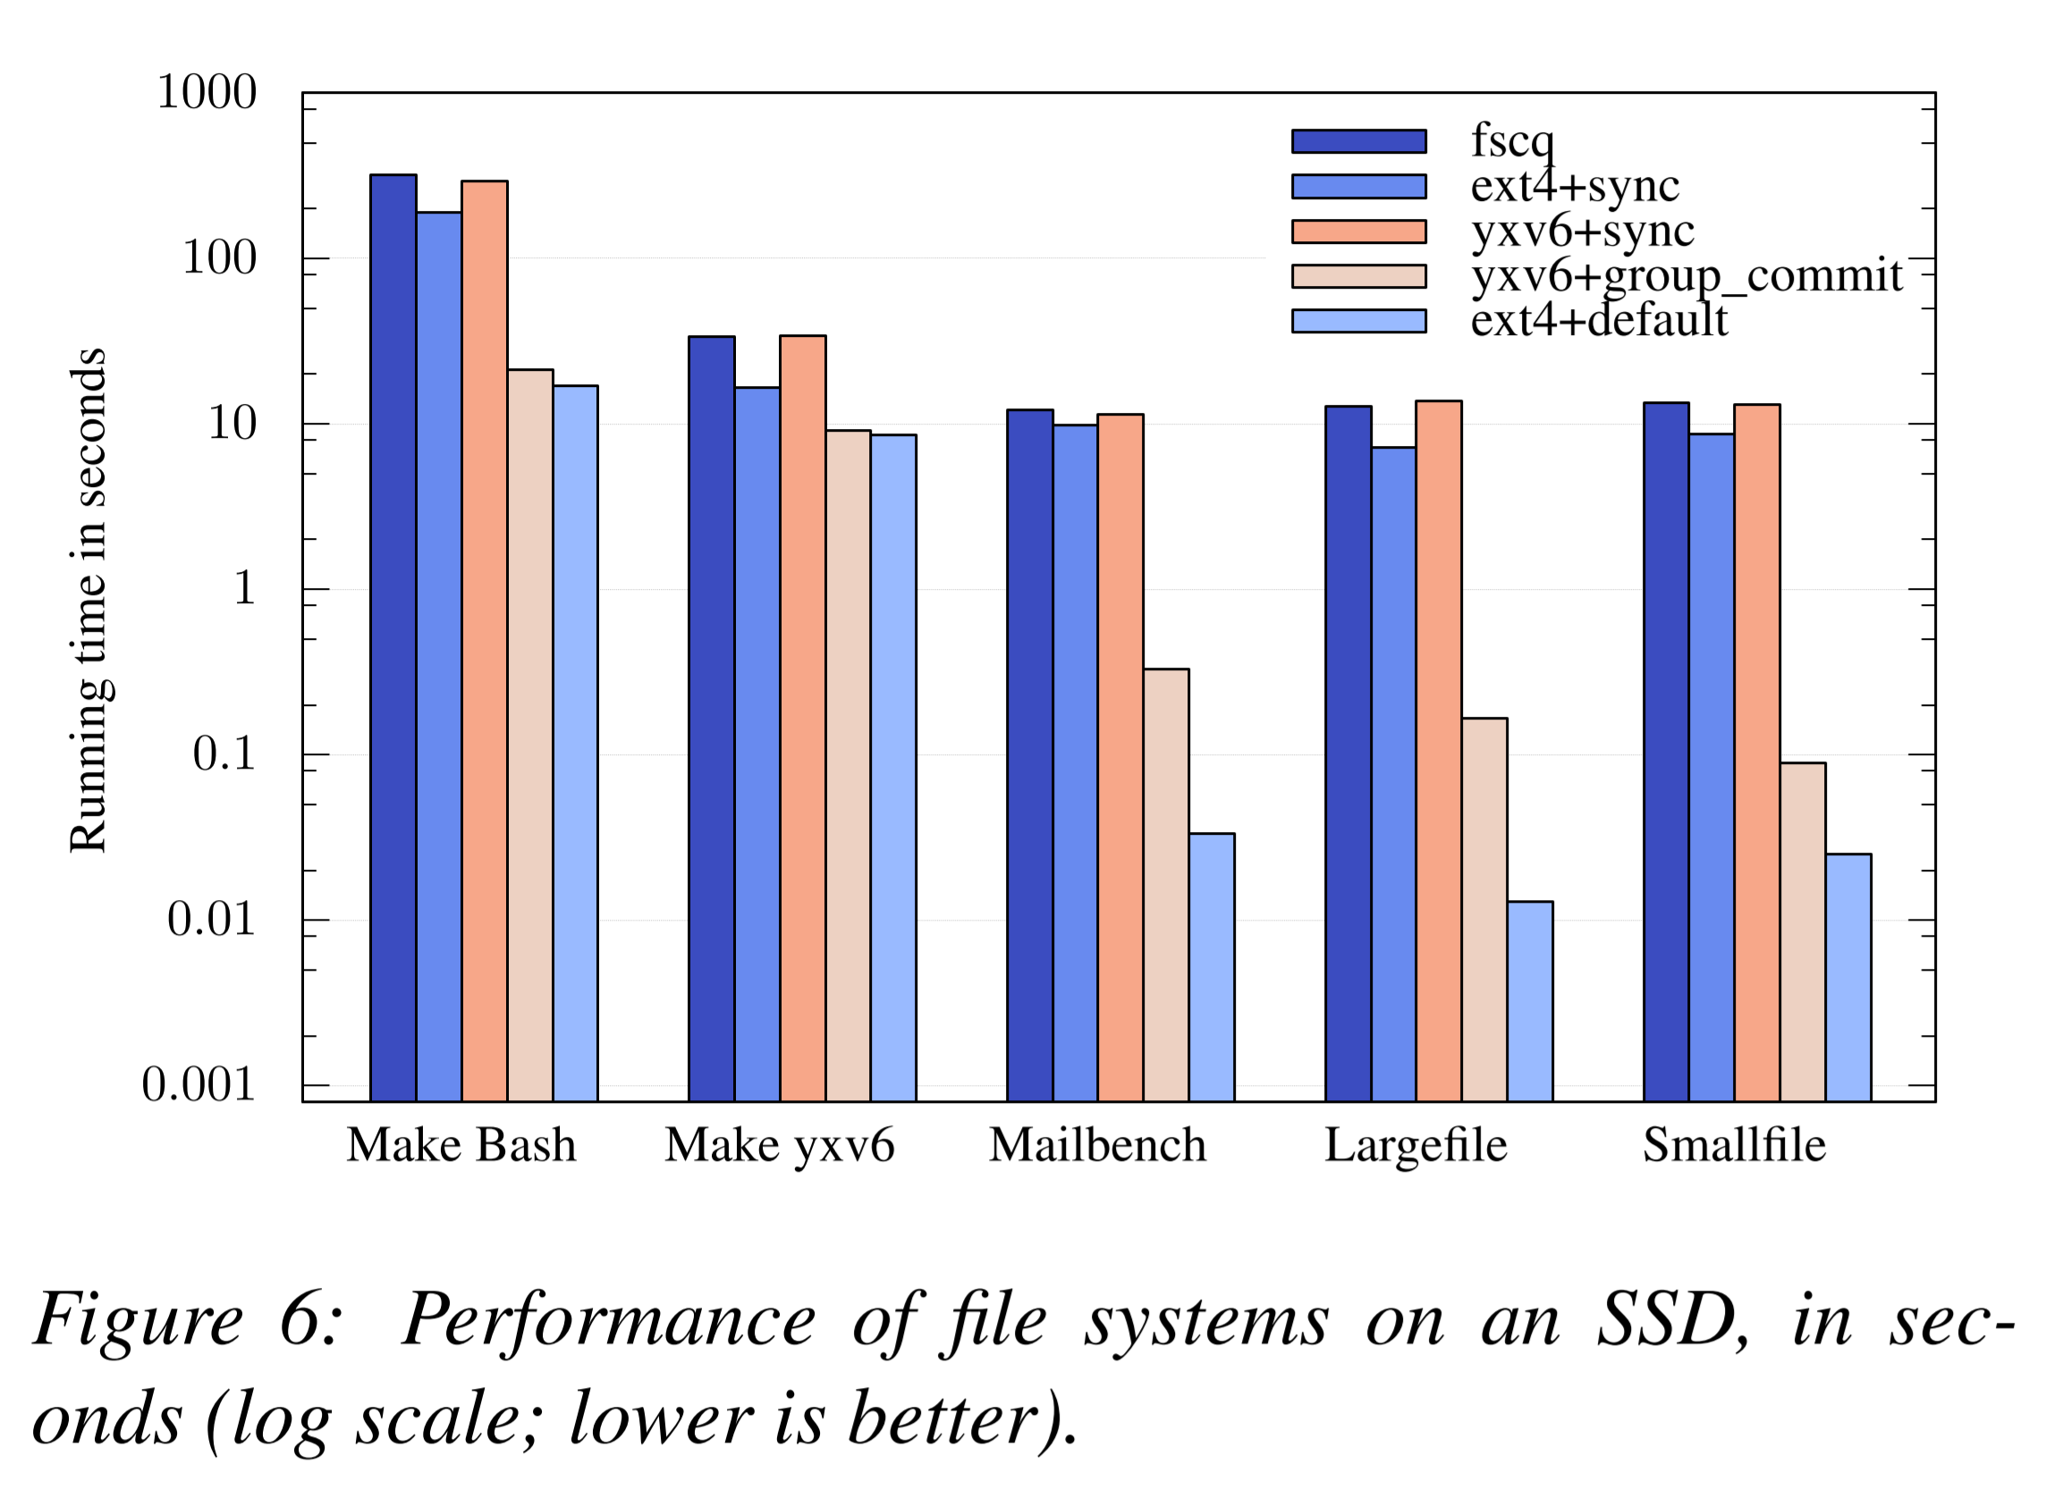
Results SSD

Slide 18
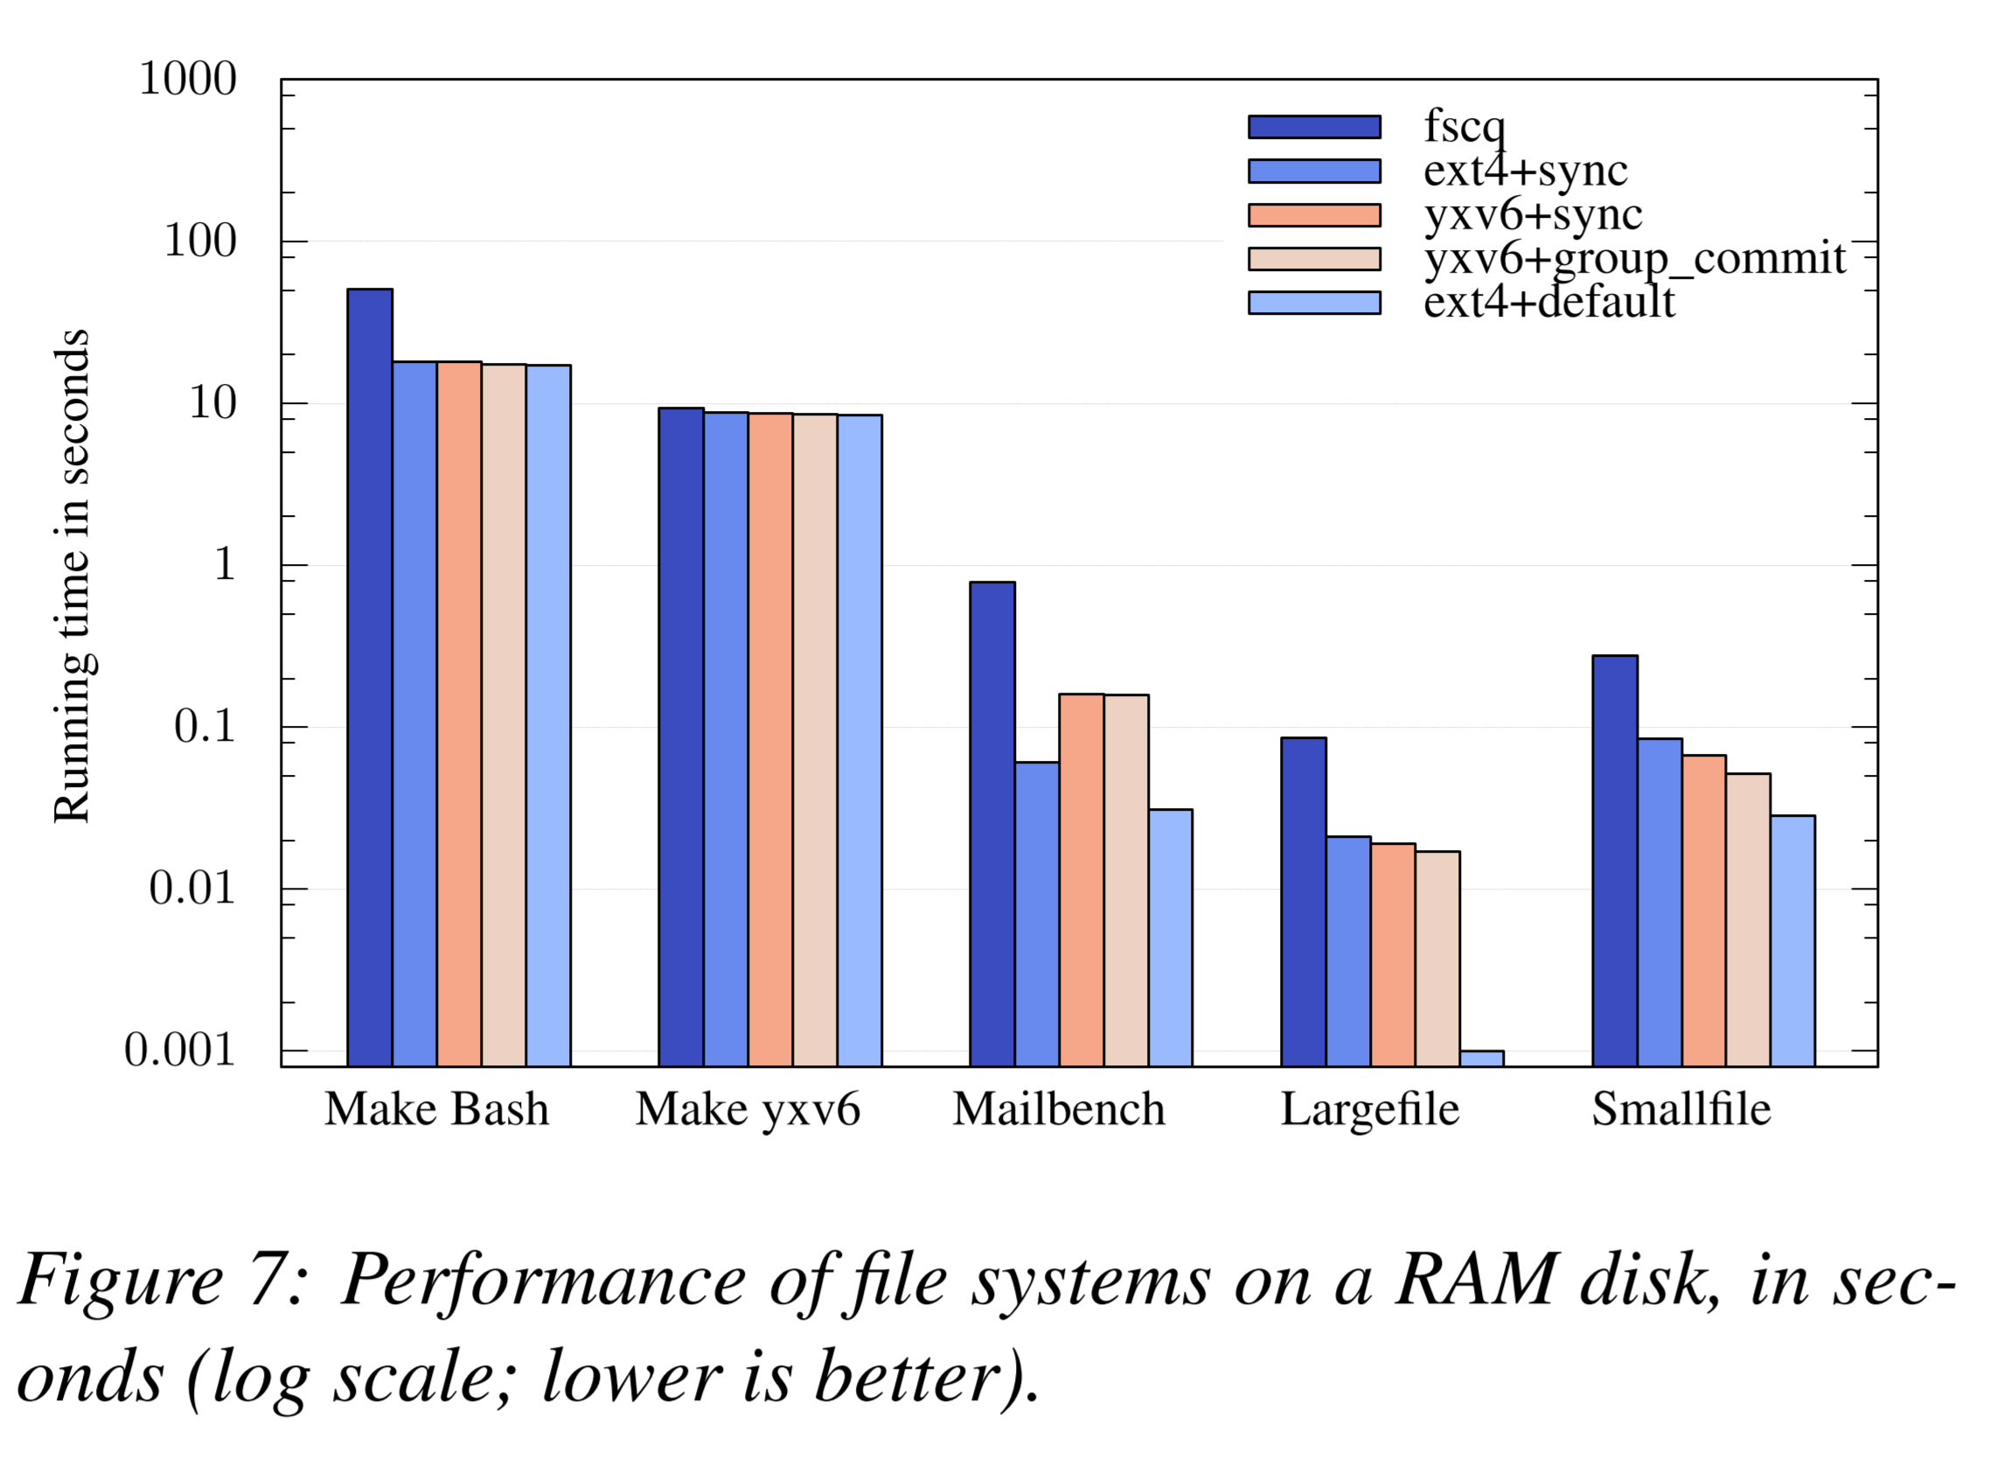
Results RAM
Notes:
better than FSCQ on RAM maybe bc of Python-to-C compiler

Slide 19
Yggdrasil Other Uses
Application-level verification such as with Ycp
Persistent log data structure Ylog
Found bugs in Arrakis
Notes:
Ylog uses the same on-disk layout as Arrakis… when comparing found crash recovery logic was not idempotent and log can end up with garbage data if system crashed during recovery

Slide 20
Limitations
Single threaded
Cython – Python to C compiler unverified
Reliance on other ideas:
SMT for automated reasoning
Z3
Cannot repair corrupted file systems
Notes:
Ran against all Z3 git repo in the past 3 years (1417 versions)

Slide 21
Class Comments
No support in concurrent systems (multi-threaded systems)
Crash refinement can be useful in other areas
More thorough evaluation such as references/baselines for other verification
36 hours for single core

