Slide 1

Morpheus:
Towards Automated SLOs for Enterprise Clusters
Sangeetha Abdu Jyothi* Carlo Curino†
Jonathan Yaniv** Ruslan Mavlyutov^^
Ishai Menache†
Íñigo Goiri†
Shravan Matthur Narayanamurthy†
Alexey Tumanov^
Subru Krishnan†
Janardhan Kulkarni † Sriram Rao†
* University of Illinois, Urbana-Champaign
** Technion - Israel Institute of Technology
^ University of California, Berkeley
^^ University of Fribourg
†

Slide 2

Operator/User tensions
Resources
Resources
T
T
Time
Time
Container
Operator
User
Our focus is on batch jobs in big data enterprise clusters
Periodic jobs should run predictably –
output available by deadline
Run as many jobs as possible
Fair-sharing

Slide 3


Roadblock: Unpredictability
Sharing-induced
Inherent
resource-sharing, queueing etc stragglers, failures, skew, hardware changes
2
1.8
1.6
1.4
1.2
1
0.8
0.6
Relative runtime
Resources
Time
Q1 Q3 Q4 Q6 Q12
275-node cluster, TPC-H queries
deadline
deadline
25% of user tickets due to unpredictability

Slide 4
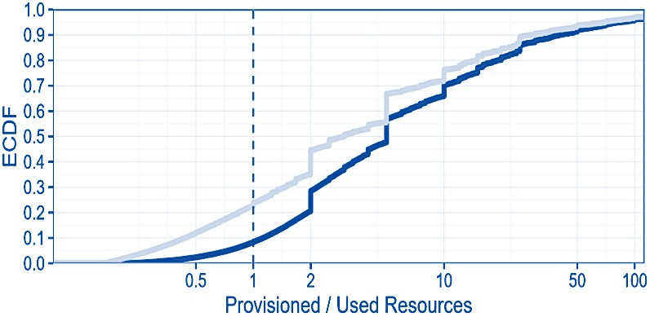



Current “solution”: Over-provisioning
Prov./ peak
Prov./ average
Users over-provision > 75% jobs
50-k node COSMOS cluster

Slide 5

Towards automated SLOs
System focuses on periodic jobs
Empirically >60% are periodic
Our results:
5-13x reduction in deadline SLO violations Reduce cluster size by 14-28%

Slide 6
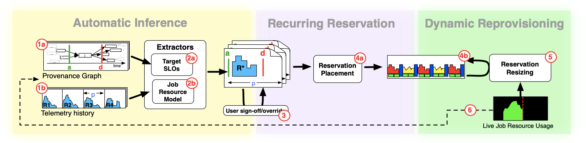
Overall Architecture
Use Provenance Graph (PG) to capture inter-job data dependencies
SLO extractor use PG to statically derive deadline
Job Resource Model take history to create tight envelope R*
User sign-off/override
Online packing algorithm for reservation placement
Monitor job progress and automatically adjust resource provision
Notes:
1. The user periodically submits JobX with manually provisioned resources. In the meantime, the underlying infrastructure captures: (a) Data-dependencies and ingress/egress operations in the Provenance Graph (PG). (b) Resource utilization of each run (marked as the R1-R4 skylines in Fig. 3) in a Telemetry-History (TH) database. 2. The SLO Inference performs an offline analysis of the successful runs of JobX: (a) From the PG it derives a deadline d—the SLO. (b) From the TH, it derives a model of the job resource demand over time, R ∗ . We refer to R ∗ as the job resource model 3. The user signs off (or optionally overrides) the automatically-generated SLO and job resource model. 4. Morpheus enforces SLOs via recurring reservations: (a) Adds a recurring reservation for JobX into the cluster agenda—this sets aside resources over time based on the job resource model R ∗ . (b) New instances of JobX run within the recurring reservation (dedicated resources). 5. The Dynamic Reprovisioning component monitors the job progress online, and increases/decreases the reservation, to mitigate inherent execution variability. 6. Morpheus constantly feeds back into Step 2 the PG and telemetry information of the new runs for continuous learning and refinement of the SLO and the job resource model.

Slide 7
Morpheus Overview
User sign-off
Logs
Automatic Inference Module
Dynamic Reprovisioning
Reservation Mechanism
SLO
resource estimate
Monitoring
Quantify user requirements
Pack jobs efficiently
Respond to unpredictabilities

Slide 8
Automatic Inference Module
User sign-off
Logs
Deadlines
Reservation Mechanism
Dynamic Reprovisioning
Resource Estimate
Quantify user requirements
Derive deadline SLOs
Estimate job resource demands

Slide 9
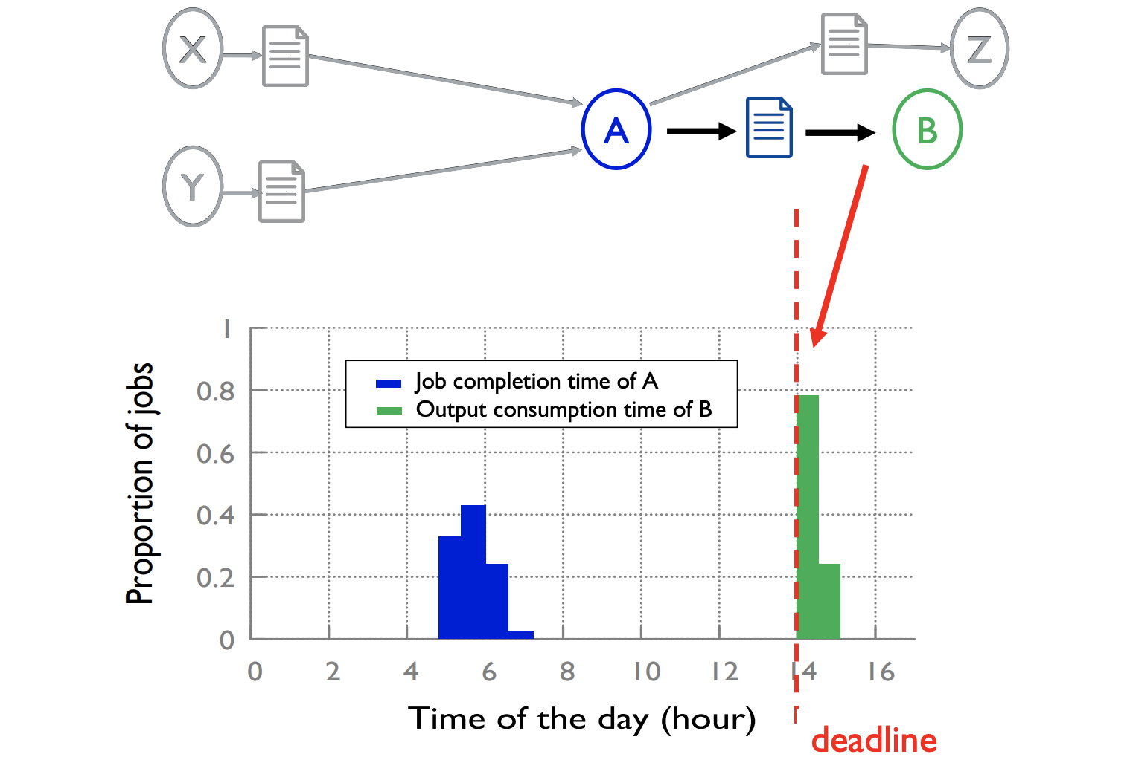
Deadline SLOs (PG)
Notes:
nodes represent jobs and files in our clusters, and edges capture read/write operations among jobs, files, and all ingress/egress operations
To this end, we rely on four random variables, in chronological order: TinAvail, time at which job inputs are available (i.e., the time of last write to any input); Tstart, time when the job starts execution; Tend, time when the job completes execution; ToutRead, time at which any job output is first read.

Slide 10


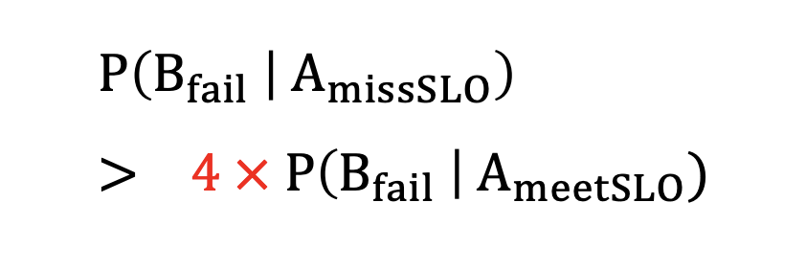
Deadline SLO validation
1.0
A
B
CDF over jobs
0.8
0.6
0.4
0.2
arrival
deadline
0.01 0.1 1 10 100 1000
Spare time before deadline
(normalized by job duration)
Valid estimate
~70% of jobs have high scheduling flexibility

Slide 11
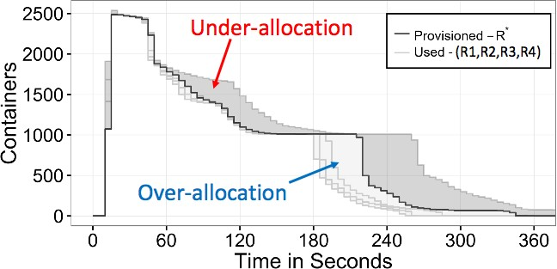
Job Resource Demand
Usage patterns (container skylines) of multiple instances of the same job
Generate the best fitting model using Linear Program
Fitting controlled by a parameter, ⍺ (higher ⍺ -> less resources)
Other alternatives – Jockey [Eurosys‘12], PerfOrator [SoCC’16]

Slide 12
Reservation Mechanism
User sign-off
Automatic Inference Module
LCM
Dynamic Reprovisioning
LowCost
SLO
resource estimate
Pack jobs efficiently
Compact storage of jobs based on Least Common Multiple (LCM) of periods LowCost Packing Algorithm

Slide 13


















LCM Representation
45%
40%
35%
30%
25%
20%
15%
10%
5%
0%
Job A
portion of total (%)
periodic jobs
Job B
instances
Job C
Entire plan
LCM
1'
2'
5'
10'
15'
30'
45'
1h 1.5h
2h 3h 4h 6h 8h 12h
1d 2d 3d 4d 1w
periodicity
Smallest repeating unit stored – Least Common Multiple (LCM) of periods Efficient storage
Predictable allocation for users
13
Notes:
The small fraction of jobs with periods that are not amenable (off-kilter or periods larger than one day) are accommodated using non-periodic reservations for each instance. We note that the LCM can be reconfigured in case of many such outliers.

Slide 14
Other key techniques (in the paper)
new job
LowCost Packing Algorithm
Heuristic for achieving a balanced allocation Load-aware online packing
Resources
Time
arrival
deadline
Dynamic reprovisioning Continuous monitoring of jobs
Allocate more resources when “progress” is slow
Notes:
In a nutshell, the idea behind LowCost is to allocate each incoming job in a way that is costefficient with respect to maxt c(t). To that end, LowCost follows a greedy procedure which places containers iteratively at cost-efficient positions.
In more detail, LowCost handles the stages one by one in reverse chronological order

Slide 15
Experiments
Implementation:
Recurrent reservation mechanism, packing algorithm, and dynamic reprovisioning in Apache Hadoop/YARN
Stand-alone inference subsystem
Workload:
Enterprise-trace: Three-month trace from 50k-node COSMOS cluster
Hadoop-trace: One-month trace from 4k-node Hadoop cluster
TPC-H: Standard TPC-H benchmark

Slide 16
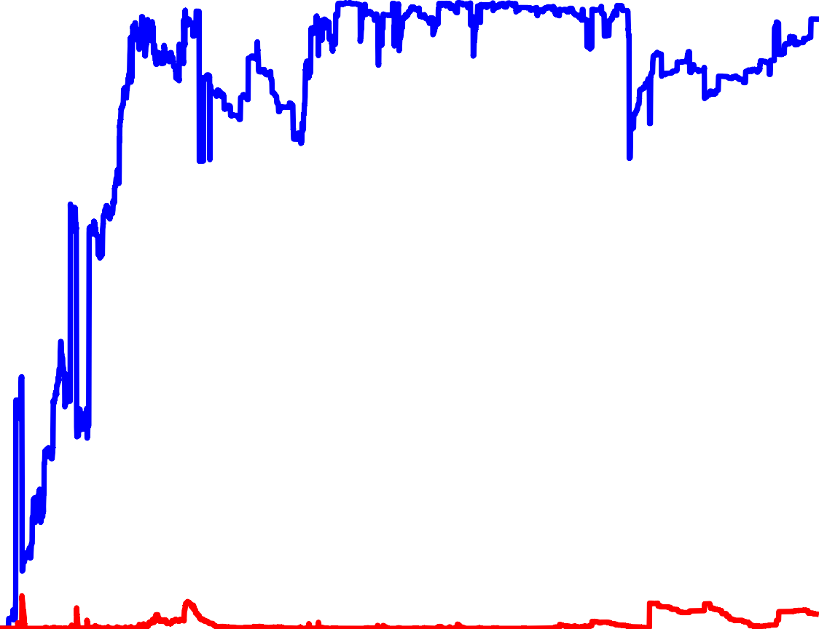


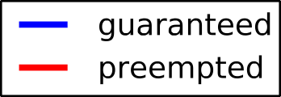


Evaluation – Scalability test
80
60
40
20
allocated memory (TB)
)
B (T
y
r
o
m
e
m
0 ₀
1 2 3 4 5 6 7 8
time(hours)
2700-node cluster with 92 TB memory
Morpheus can handle load in production clusters
Notes:
At peak, aggregate guaranteed capacity exceeds the 92TB of container memory, reaching maximum cluster capacity. The system remains responsive throughout the experiment with reservation submission latencies within 10sec.

Slide 17
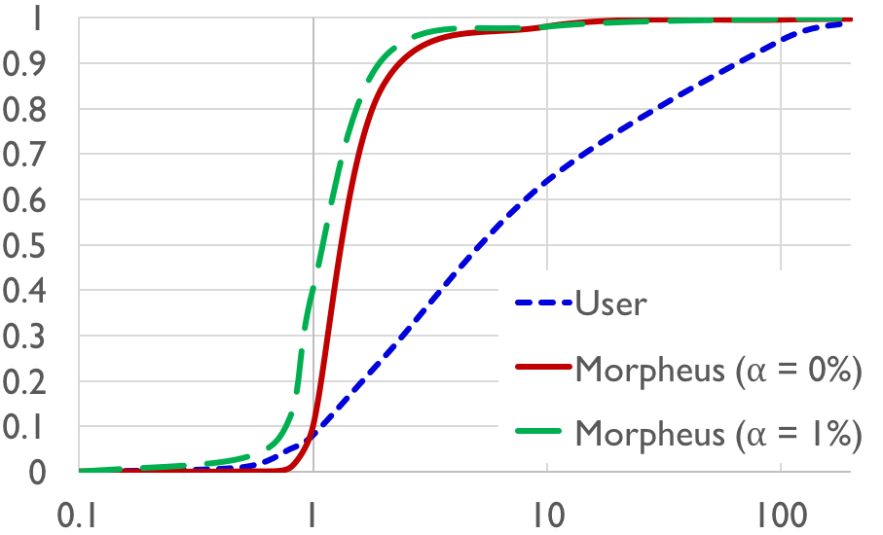
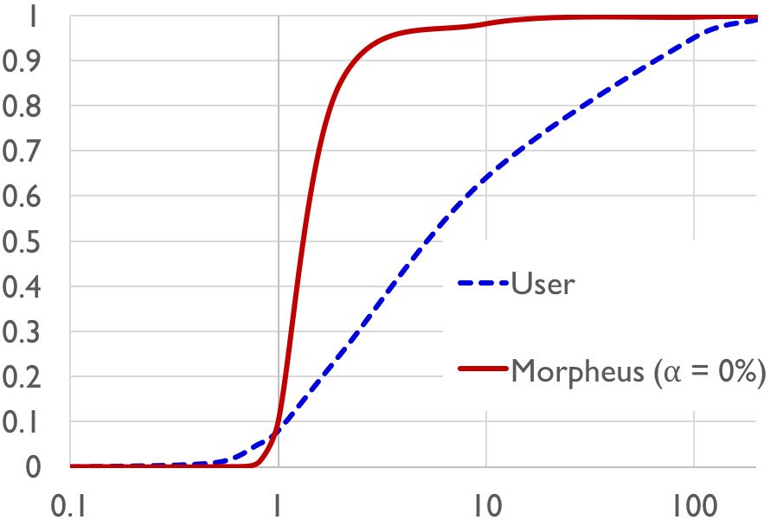
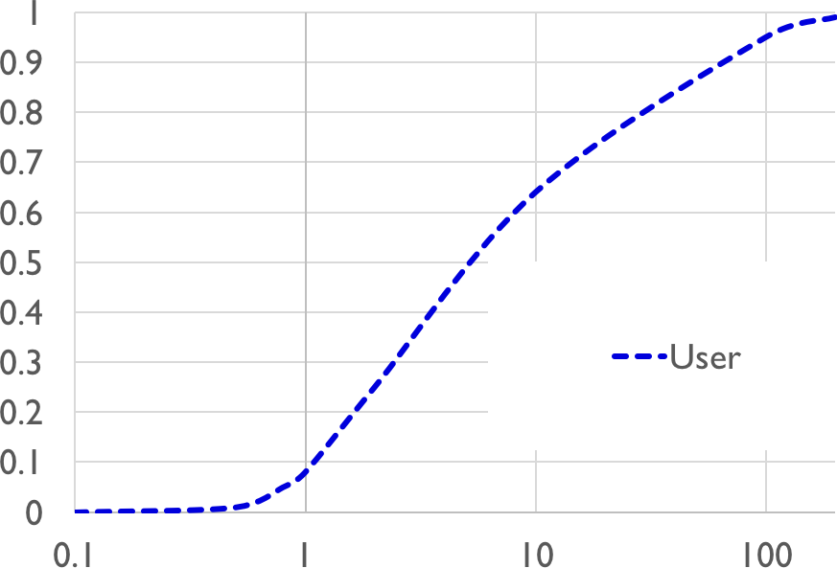
Evaluation – Resource estimation
Morpheus provides more accurate resource estimates
Level of fitting controllable in the inference module of Morpheus
Higher ⍺ → Tighter fitting → Less over-provisioning
CDF
Provisioned / used resources

Slide 18
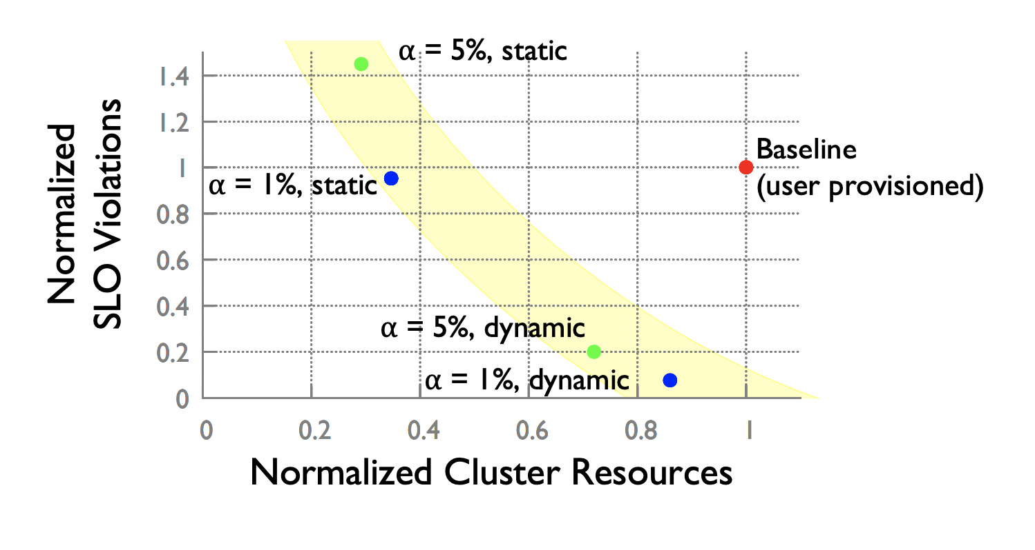
Evaluation

Slide 19

Conclusion
Predictable performance with lesser resources and higher utilization
Three main ideas
Automatic inference
Recurrent reservations
Dynamic reprovisioning
5-13x reduction in SLO violations
14-28% reduction in cluster size

Slide 20
Discussion
How consistent task sizes are in real deployment
Shown in paper, >60% jobs are periodic
Variance in task size will impact effectiveness
Dynamic reprovisioning
Cold start scenario
Backward compatibility with fair-queueing
Manual SLO
Application specific tools
Use deep learning to make decisions
Off-killer jobs handling not ideal
Is it a good idea for periodic jobs to have higher priority

