Slide 1
REM: Resource-Efficient Mining for Blockchains Fan Zhang, Ittay Eyal, and Robert Escriva, Cornell University; Ari Juels, Cornell Tech; Robbert van Renesse, Cornell University Presenter: Xudong Shao (xudongs2)

Slide 2
Fundamental Knowledge
Concensus Mechanism for blockchain
Question
&
Answer
What is the blockchain?
Distributed ledger(Just make it simple now)
Who is going to produce that ledger?
How to protect it from attackers in the network?
Why would someone spend computational power
to record all the transactions?
......
Concensus Mechanism
POW POS DPOS PoET REM ......

Slide 3
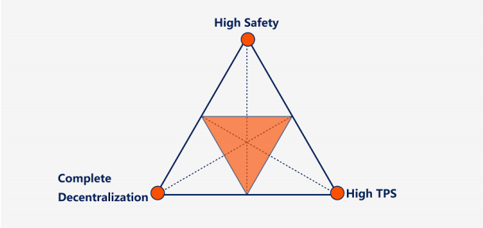
Fundamental Knowledge
Mundellian Trilemma(Impossible Trinity)

Slide 4
Bitcoin and POW
…
…
Block Header
4 bytes Version
32 bytes Previous Block Hash
32 bytes Merkle Root
4 bytes Timestamp
4 bytes Difficulty Target
4 bytes Nonce
Block Header Hash: made by hashing the block header twice(SHA256)
Coinbase transaction And transaction fees
Is it possible to make the work useful?

Slide 5
Stale and Broken chip problem
Stale chip problem:
Miners have a financial incentive
to power mining rigs with cheap
, outmoded SGX-enabled CPUs
used solely for mining
Broken chip problem:
An attacker that can corrupt a
single SGX-enabled node can win
every sensus round and break the
system completely

Slide 6
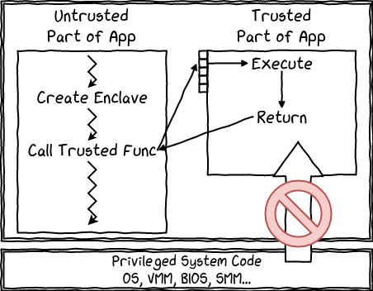
SGX (Intel Software Guard Extensions)
Intel Software Guard Extensions (SGX) is a set of central processing unit (CPU) instruction codes from Intel that allows user-level code to allocate private regions of memory, called enclaves, that are protected from processes running at higher privilege levels.
Hardware protection on user-level code
Enclave can read&write memory outside
No other process can access enclave memory
SGX permits the execution of trustworthy code
in an isolated, tamper-free environment, and
can prove remotely that outputs represent
the result of such execution.

Slide 7
Attestation for SGX
One important property for SGX: a remote system can verify the software running in an enclave and communicate securely with it.
Quote can only be verified by accessing
Intel's Attestion Service (IAS) which is a
pulic service maintained by intel
Measurement:
A hash of initial state
produced by CPU
Supplementary data:
Provided by process
Quote
Digitally signed using a
hardware-protected key
Based on SGX
PoET(Proof of Elapsed Time)
Each participant in the blockchain
network waits a random amount of time
The first participant to finish waiting
gets to be leader for the new block
Enclave
A proof that the measured software
is running in an SGX-protected enclave

Slide 8
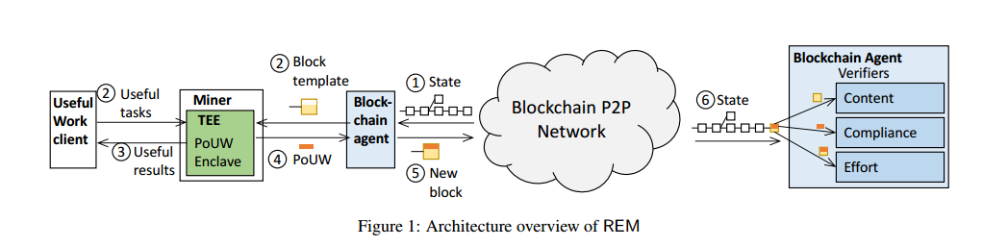
Overview of PoUW/REM
Userful work clients:
Supply useful workloads to REM miners
Blockchain agent:
Collect transactions and generates a block template
Miner:
Take the block template and PoUW work
to produce the PoUWs

Slide 9
Overview of PoUW/REM
PoUW Enclave:
Randomly determines whether the work results
in a block by treating each instruction as a
Bernouli trial
SGX-generated attestation for enclave's
compliance with REM
Blockchain agent:
Produce a block
SGX-generated attestation for difficulty
parameter
Other Blockchain agents:
Receive the block and verify

Slide 10
Overview of PoUW/REM
Two key assumptions:
Intel assigns a signing key only to a valid CPU
Intel doesn't block valid nodes in the network
Let's move on
We will talk about this later

Slide 11
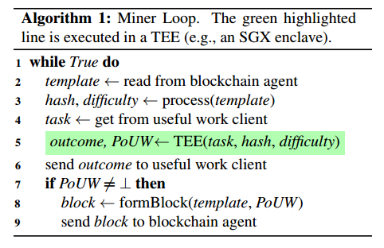
Implementation Details
Workflow of the miner
PoUW enclave generate a random number and check whether it's
smaller than the value target
In order to reduce overhead, divide useful work into subtasks
Run each subtask and count its instructions
Call SRNG to determine whether at least one instruction has won
If so, produces an attestation

Slide 12
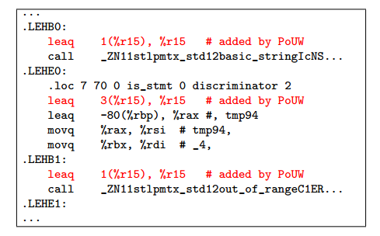
Implementation Details
Security Instruction Counting
A customized toolchain for dynamic runtime checks
1. Source code to assembly code & reserve one register as counter
2. The assembly code is rewritten so the counter counts the instructions
-----------------------------Runtime------------------------------------------
1. PoUWruntime.so serves as “in-enclave” loader that launches useful work
program with input and collects result
2. Use SRNG to draw random value and determine whether a new block
should be generated

Slide 13
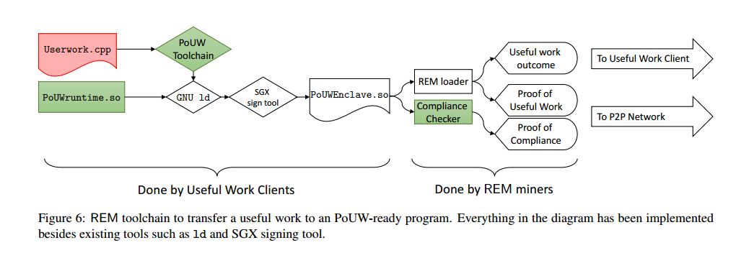
Implementation Details

Slide 14
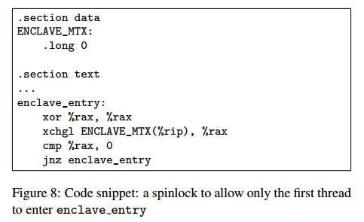
Implementation Details
We have to make sure that once implemented that the code
can't alter its behavior.
Security Instruction Counting
1. Enforcing Non-Writable Code Pages
Taken directly from the ELF program header
2. Enforcing Single Threading

Slide 15
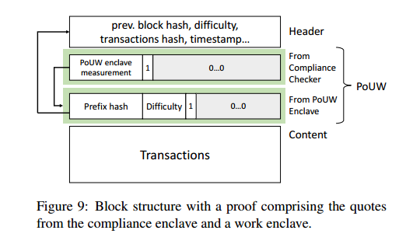
Implementation Details
Hierarchical Attestation
two-layer hierarchical attestation
1. Useful work program attestation on the mining process
(from work enclave)
2. Static-analysis Compliance checker(from compliance enclave)
confirms the text sectoin is non-writable
validates the work program's compliance
verifies the PoUW runtime is correctly linked and identical to the
expected runtime code
verifies the only entry point
calculates the fingerprint and outputs an attestion
The compliance enclave is verified through the hard-coded measurement
in the blockchain agent.

Slide 16
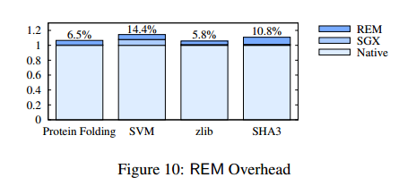
Implementation Details
Overhead of REM
Native : Compile with the standard toolchain
SGX: Compile in SGX-prerelease mode and run with the SGX
driver v1.7
REM: Instrument the code using REM toolchain

Slide 17
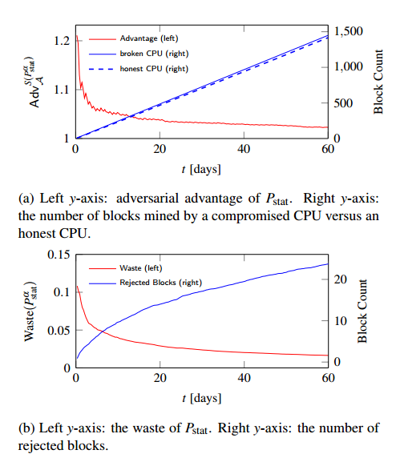
Implementation Details
Tolerating Compromised SGX CPUs
we assume SGX chips are manufactured in a secure fashion, some
number of individual instances could be broken by well-resourced
adversaries.
The basic idea here is
“If a miner is way too lucky, her block shall not be accepted”

Slide 18
Conclusion
PoUW: a proof of useful work scheme that avoids waste
Overhead is small

Slide 19
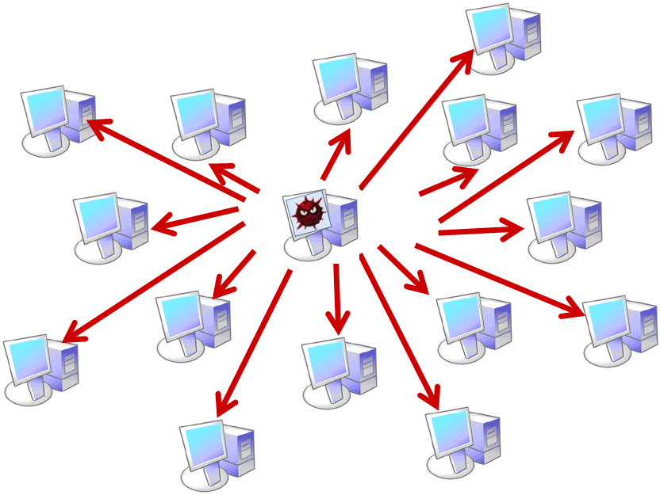
Something I disagree/don't like in this paper
Miners must contact IAS to verify attestations
Easy to suffer from network attack like DDOS,
Man-in-the-middle, etc.
Single point of failure

Slide 20
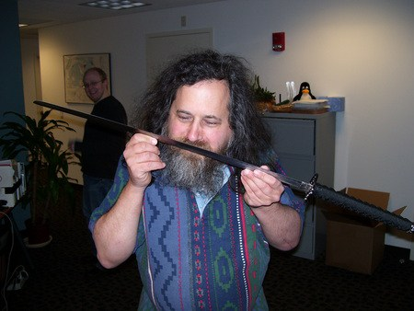
Something I disagree/don't like in this paper
Intel may have full control of the network !!!
Don't use Intel processors newer than Core2, they
have backdoors.
However, due to the impossible trinity, I don't blame it.

Slide 21
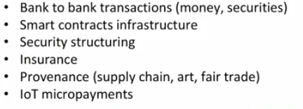
Something I disagree/don't like in this paper
Do they really need the threat model ?
(Watch the video of the presenter)
This can be used for those organizations having no interests in creating a new coin.

Slide 22
Is it possible to make the verification locally?
Enhanced Privacy ID or EPID
Group signature
Hardware based key ---> Join request ---> IAS server must have these keys online
Intel SGX Remote attestation is Not Sufficient Blackhat 2017
https://www.youtube.com/watch?v=9A9XNx9_Vyc&t=2405s 42min-43min

Slide 23

What's going on in the blockchain world?
Bitcoin POW Satoshi
Ethereum POW/POS Vitalik Buterin
EOS DPOS Daniel Larimer
...

