Slide 1
Google MapReduce
Jeff Dean, Sanjay Ghemawat
Notes:
I will be presenting MapReduce by Jeff Dean and Sanjay Ghemawat, this paper came out in 2004 and in my opinion has been one of the most influential works in big data distributed systems.

Slide 2
Motivation
Google had a lot of tasks which involve a large dataset.
Doing it on a single server is kind of slow
Needed a general purpose framework to support the different tasks.
Also needs to be easy
Abstract the middleware,communication etc.
Programming paradigm that can represent different problems.
Notes:
Let’s teleport back to 2004 and see what motivated Google to build Map Reduce. They were hardling a lot of data and had multiple applications which were processing the data. Doing this processing on a single server was slow. They also needed a general purpose framework as it would be easy to just build the application instead of worrying about deployment. To solve these problems they came up with MapReduce

Slide 3
What is Map Reduce ?
Programming model
Users specify map which generates an intermediate set of key value pairs after processing.
Users also specify a reduce function which combine the intermediate output of map.
Easily parallelizable
Many real world tasks can be modeled this way.
Abstracts details like Automatic parallelization and distribution, Fault tolerance, IO Scheduling etc.
Notes:
It is a programming model for batch cluster computing. The users specify two functions map and reduce, map takes

Slide 4
Programming model
Inspired by Map and reduce in lisp
Map(key1,value1) -> list(key2,value2)
Processes input key/value pair
Produces set of intermediate pairs
Reduce(key2,list(values2)) -> list(values)
Combines all intermediate values for a particular key
Produces a set of merged output values (usually just one)
Notes:
The authors were inspired by map and reduce of Lisp, they wanted to take the functional route.

Slide 5
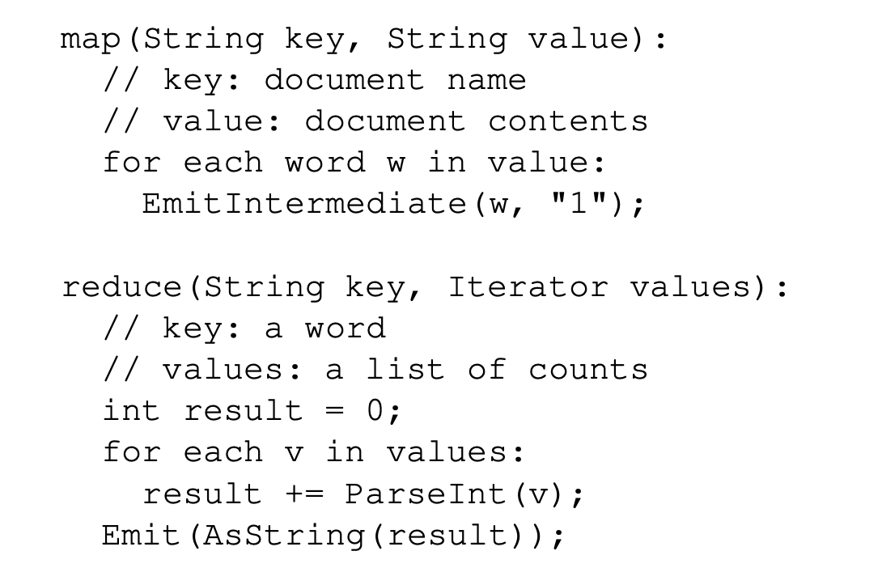
Example : word count
Notes:
Let’s consider an example for word count where it is required to count the occurence of each word in a file, you are given document name and content

Slide 6
Implementation

Slide 7
Implementation Overview
Typical Google cluster 2004
Dual core x86 machines running Linux
2-4 GB of memory per node
Commodity networking hardware 100 megabit or 1 gigabit link.
Machines can fail
Storage is provided by inexpensive IDE disks attached directly to machine.
Implemented in C++

Slide 8
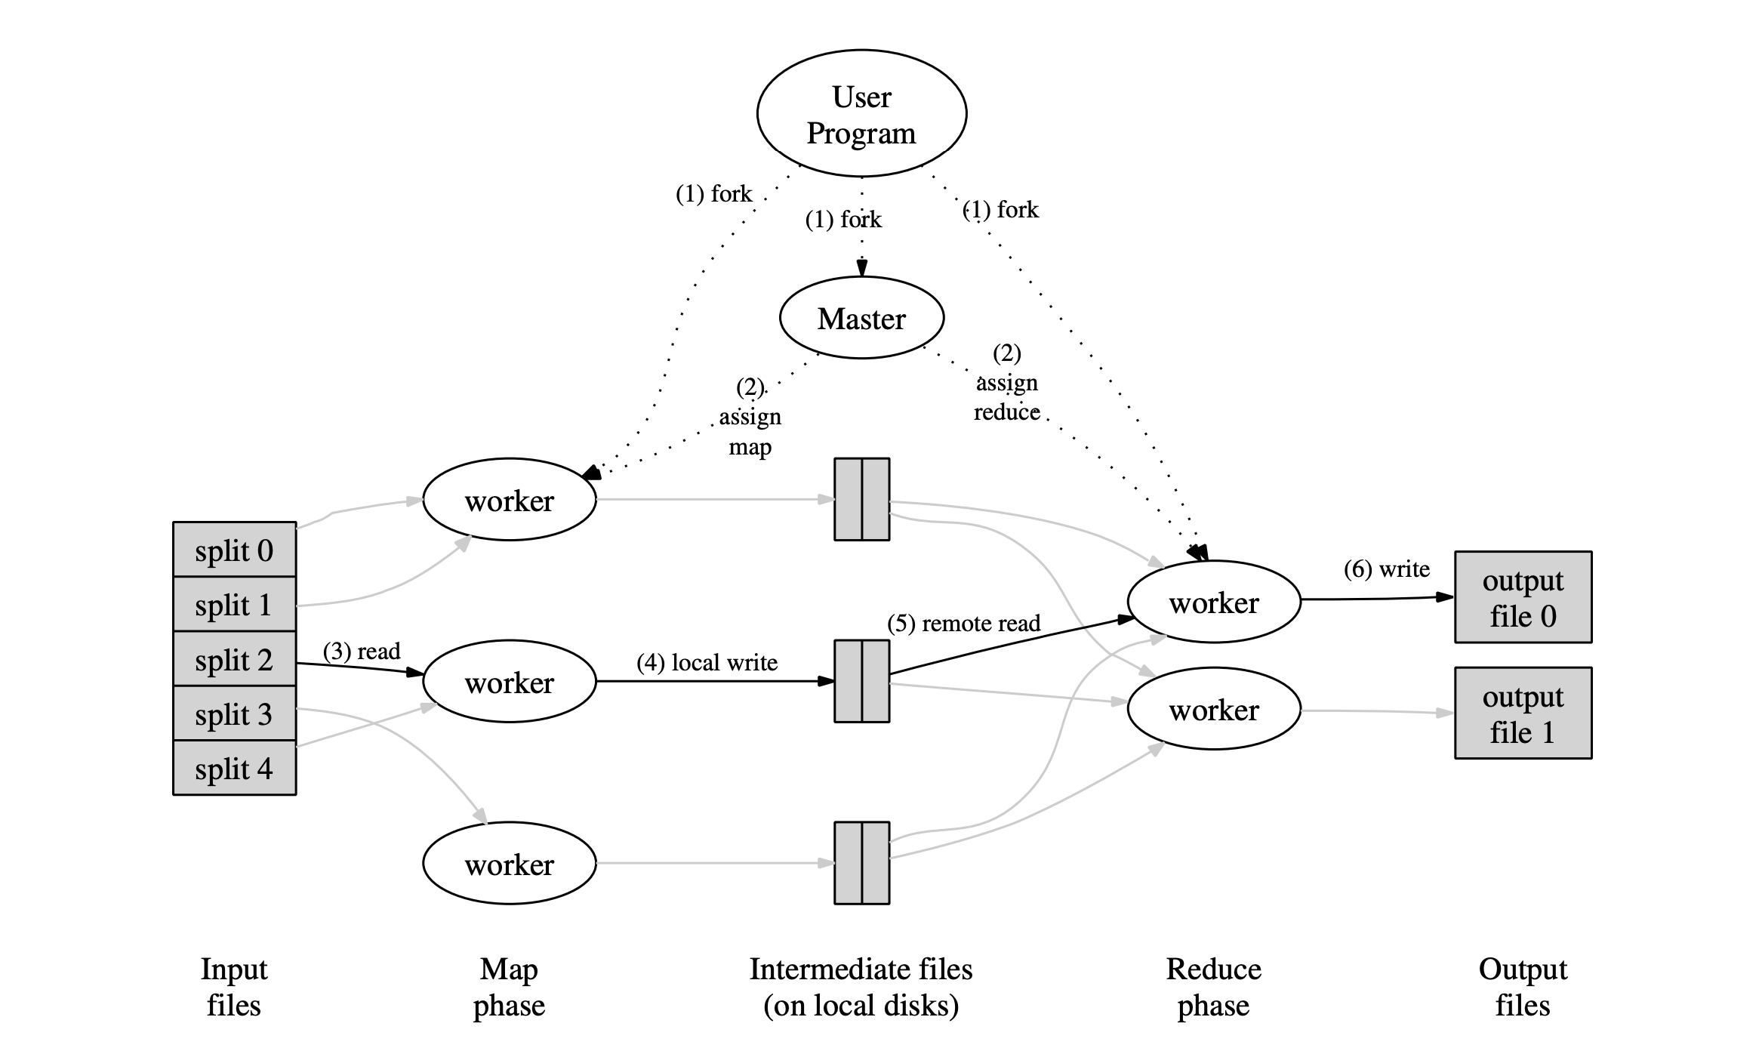
Execution model - driver
Map reduce library in the user program first splits the input files into M peices and starts up M copies of the program called workers.
One copy of the program acts as the master.
There are M map tasks and R reduce tasks

Slide 9
Execution model - map
Each worker M takes up its input split reads input data and runs the map function on it.
The intermediate key value pairs are buffered in memory.
Periodically write key-value pairs to R regions

Slide 10
Execution model - reduce
Reduce worked notified by master reads data via RPC.
For each key it passes intermediate data through reduce function.
Writes to output file and returns control to user program.

Slide 11
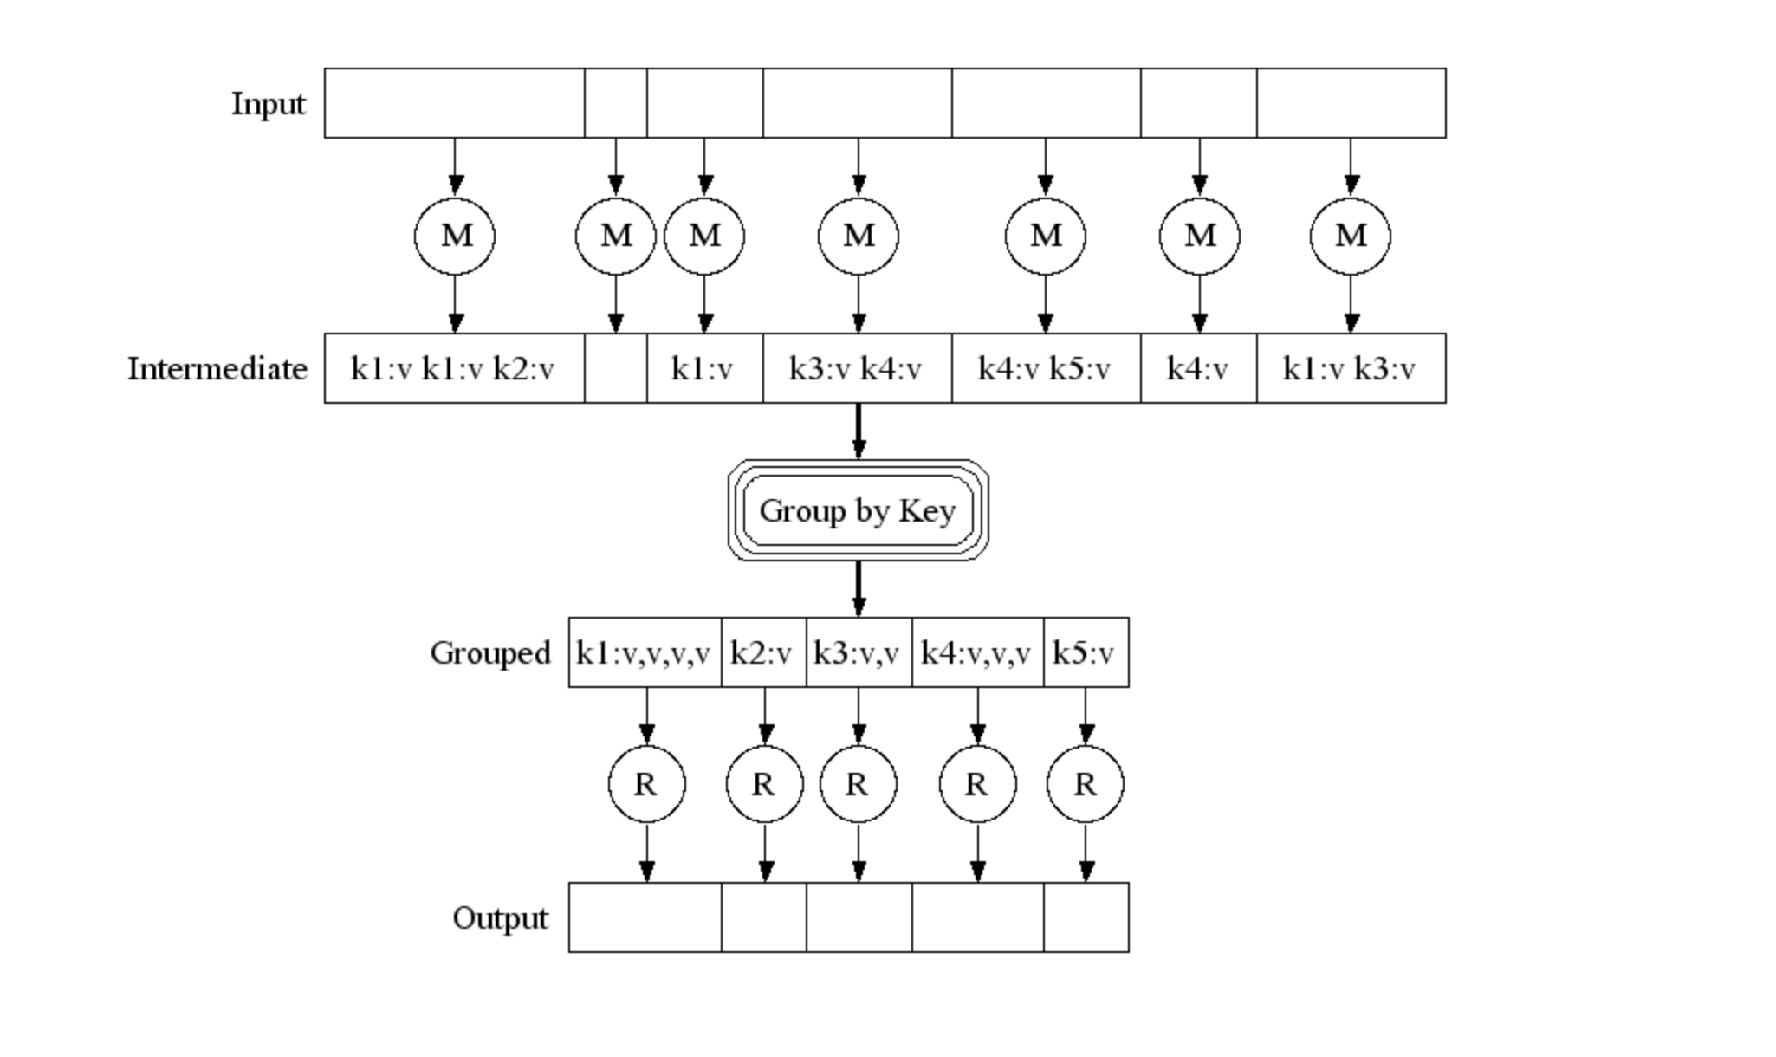
Execution

Slide 12
Master worker
Stores state of every Map and reduce task (IDLE,in-progress, completed)
Stores Identity of workers
Information regarding input and output files
Map Reduce aims to provide sequential execution semantics.

Slide 13
Handling Failures
Worker Failures:
map task reset to (idle) and scheduled on a different worker.
Reducers notified. Tasks have to be restarted completely.
Master Failures:
Master periodically checkpoints its data structures on failure
new master can start from last checkpoint.
Notes:
Map Reduce is resillient to large order worker failures

Slide 14
Locality
Uses GFS distributed file system.
Each file split up into 64MB blocks and replicated 3 times.
Scheduler considers the availability of a particular block at worker for input data.
Failing that scheduler considers network topology and select closest node to replica.

Slide 15
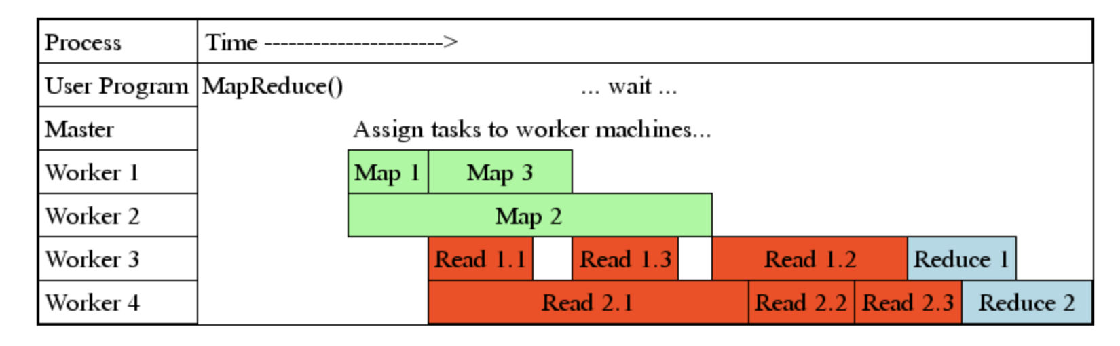
Granularity - Picking M, R
M number of map workers and R reduce workers.
Ideally, M + R > Num_workers , helps load balancing and easy recovery.
O(M+R) scheduling decisions by Master.
O(M*R) states in memory
Consider Locality while selecting R.
E.g M = 200, 000 and R = 5, 000, using 2,000 worker machines
Notes:
If M+R > num_workers each worker performs multiple tasks, dynamic load balancing

Slide 16
Backup Tasks - Dealing with Stragglers
There could be stragglers due to hardware issues.
Master runs backup instances of slow workers on backup workers when execution is close to completion.
Backup execution of in-progress tasks.
Drastically decreases long execution time.
Very low resource overhead.

Slide 17
Refinements - Additional Benefits
Partitioning Function : partition input data based on custom function.
Guaranteed ordering on individual worker.
Combiner: combines task on same machine before sending out to network.
Skip Records: optional mode which skips bad records that cause bugs.
Allows local execution for testing and debugging.
Ability to monitor status of task via http
Counter : provides counter facility to count events.

Slide 18
Evaluation
Setup:
1800 machine cluster, 2ghz Xeon 4gb memory
160gb IDE

Slide 19
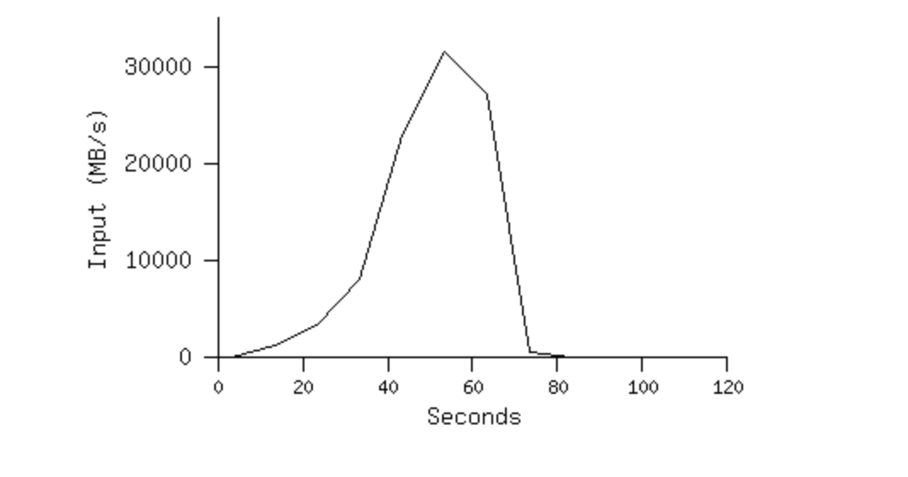
MR_GREP
Locality optimization helps:
1800 machines read 1 TB of data at peak of ~31 GB/s
Without this, rack switches would limit to 10 GB/s
Startup overhead is significant for short jobs

Slide 20
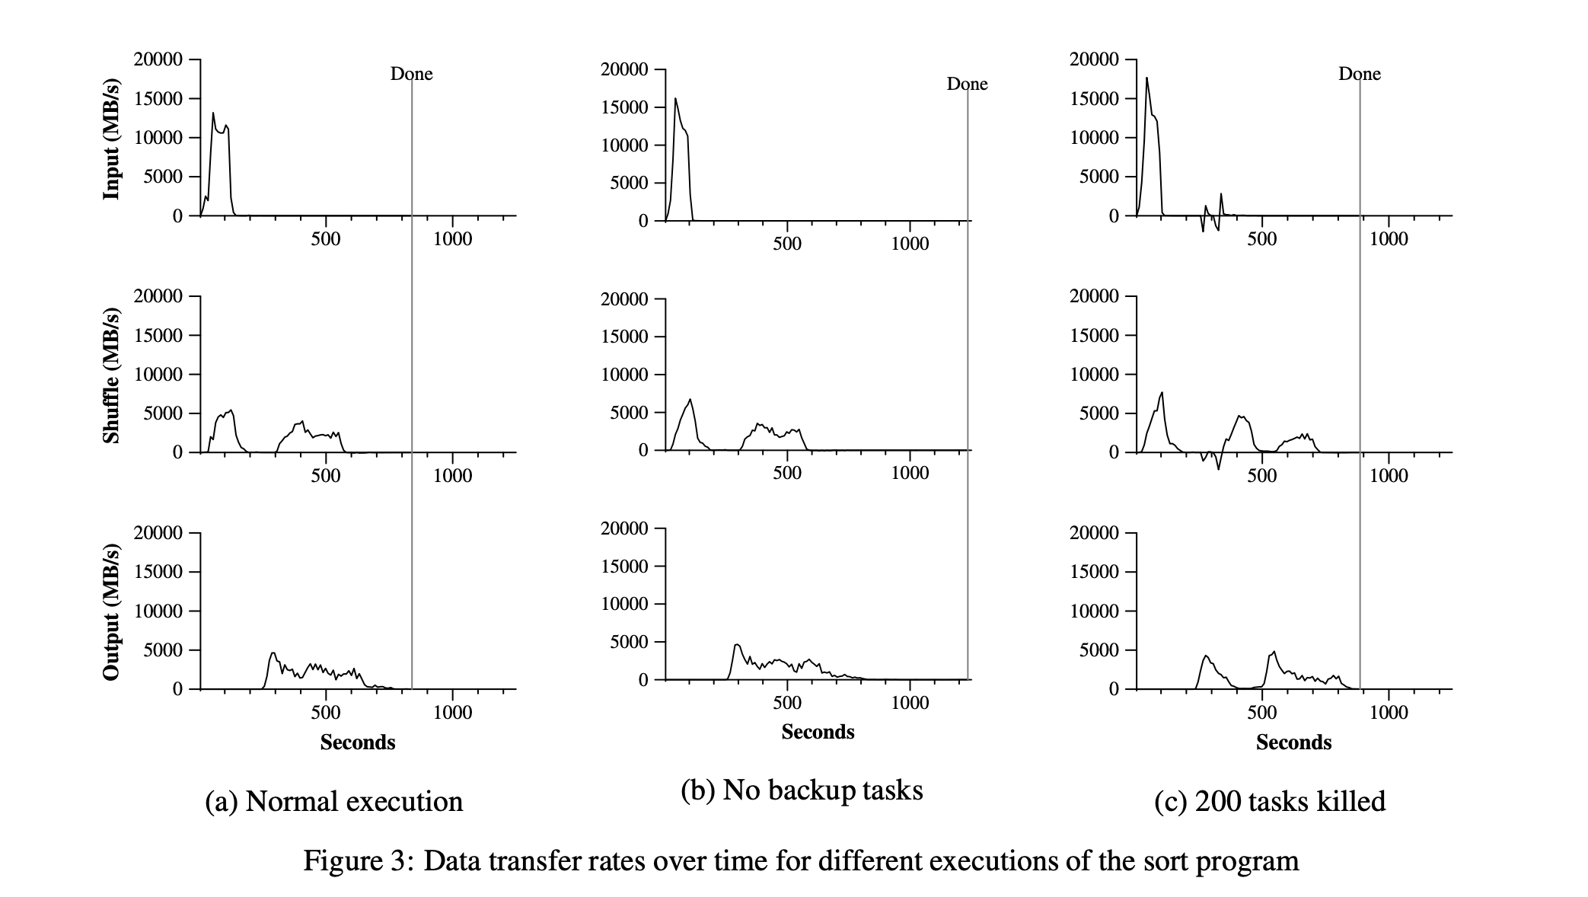
MR_SORT
Notes:
Backup tasks reduce job completion time significantly
System deals well with failures

Slide 21
Impact

Slide 22
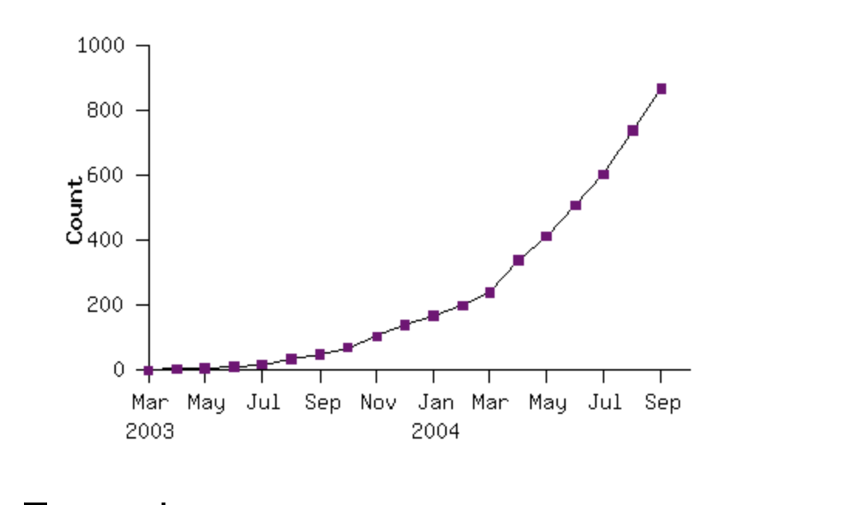
What it changed
Move to commodity hardware
Made writing tasks easier as the runtime system would take care of all the details.
Programmers need not have experience with parallel/dist systems
Scalability !
Google rewrote indexing system to use MR

Slide 23
Impact of MapReduce
Application that showed that commodity cluster computing can actually do meaningful tasks.
Gave rise to open source implementation Hadoop which is being by a lot of companies for wide range of tasks.
Started a whole new field of big data cluster computing.
Inspired a lot of distributed systems at Google alone like Pregel, F1, DistBelief.

Slide 24



Hadoop
Written in Java
Open source ! and supported actively
Hadoop itself has a lot of systems written on top of it which use its execution engine.
Hive is a SQL engine
Pig is a scripting engine
Mahout is a linear algebra framewoerk

Slide 25
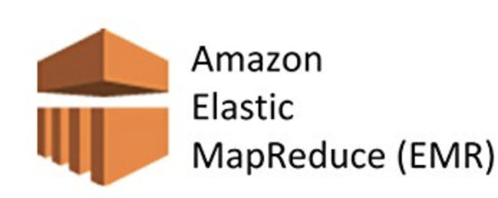


MapReduce today
Still being used heavily
Google in 2014 stated that they do not use MapReduce anymore for most of their critical applications.
Hadoop the open source implementation of Map Reduce is still popular, but isn’t suitable for machine learning workloads.
Amazon provides Elastic Map Reduce and Azure also provides a service.
Cloudera and Hortonworks provide their own distribution of Hadoop.
Apache Spark which follows the Resilient Distributed Dataset (RDD) approach looks set to overtake Hadoop for BI workloads.

Slide 26
Discussion
Michael Stonebraker and other DB experts have questioned the novelty of MapReduce on multiple occasions , do we agree/disagree?
How does MapReduce paradigm work for today’s machine learning workloads ?
Some say that the MapReduce paper is in fact not so revolutionary but it is the Google File System paper which is. Thoughts ?

