Slide 1
Lost at C: A User Study on the Security Implications of Large Language Model Code Assistants
Author: Gustavo Sandoval, Hammond Pearce, Teo Nys, Ramesh Karri, Siddharth Garg, Brendan Dolan-Gavitt
Affiliation: New York University
Presenters: Abram Bradley, Lu Liu, Gaddy Morales, Byounghyeun Kwak
Notes:
Hello, I am Byounghyeun Kwak, the first presenter.
Today, we will be presenting a paper titled "A User Study on the Security Implications of Large Language Model Code Assistants." The author, affiliation, and presenter details are as follows

Slide 2
Outline
In this presentation, we will be going over
Introduction
Background
LLM's Functionality and Productivity
Security Considerations
3. Design of user study
Overview and Recruitment
Methodology of the Study
Data Analysis and Statistical Validation
Results and analysis
RQ1 - Functionality
RQ2 - Security analysis
RQ3 - Origin of bugs
Discussion
Conclusion
Notes:
We will start with the Introduction and Background to explore the purpose of the research and the Research Questions.
Next, we'll dive into the design and outcomes of the actual User Study, then, wrapping up with the key conclusions.

Slide 3
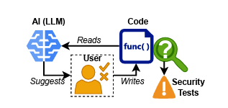
Introduction
User Study
RQ1 | Can an AI assistant help beginners write better code?
RQ2 | Does using AI to write code lead to an acceptable level of security issues?
RQ3 | What's the source of bugs in code created with AI assistance?
Notes:
The use of AI-based code assistance through LLMs has become widespread. Many of you have likely used LLMs at least once for writing or modifying code.
With this increased usage, concerns have arisen about the security of the code provided by LLMs.
They conducted a user study / targeting computer science students / to evaluate the impact of LLM usage on code security.
This research addresses the following three research questions:
The first question concerns / to the functionality of LLMs.
The second question / focus on the core theme of this study, / which is the security assessment.
Lastly, if there are security errors in the code generated by AI, they wanted to dig up these errors origin.

Slide 4




Background
LLM's Functionality Developer’s Productivity
Autocomplete
LLM
Security Considerations
LLMs might learn and replicate insecure or buggy code.
Code can be insecure based on its execution context with other code.
Analysis Method
Manual
Fuzzers
Static
Run-time
* Token : a basic unit of information used in programming, natural language processing
Notes:
Most recent studies demonstrate that LLM code assistance is boosting developers' productivity. Traditional autocomplete features typically focus on predicting one token at a time. However, LLMs operate by considering a sequence of tokens in a chain. This allows LLMs to understand the context more deeply and predict the next possible token or sequence of tokens in that context.
Thus, LLMs go beyond simple word or phrase autocompletion, having the capability to generate entire sentences, lines of code, and even full functions or code blocks. Theoretically, AI-generated code can contain security errors for two main reasons.
LLMs might learn and replicate insecure or buggy code.
** Code can be insecure based on its execution context with other code.
In this study, they observed real-world outcomes through user study
and among various security error analysis methods, primarily used manual analysis jointly with static and runtime analysis. ----------------------------------------------------------------------------------------------------------------------------------------------------------------------------------------- Manual Analysis: Experts manually inspect the code to identify security vulnerabilities and logic errors by closely examining the code's structure and logic.
Static Analysis: Automated tools scan the code without executing it, detecting potential security vulnerabilities and coding errors based on predefined patterns and rules.
Run-time Analysis: This method involves monitoring the code's behavior during execution to identify security issues and bugs that only appear while the program is running.
Fuzzer: Fuzzing tools automatically generate random input data for the program, aiming to crash it and uncover hidden bugs and security vulnerabilities that might not be detected through other analysis methods. ** Code that is secure in isolation may become insecure depending on the sequence in which it is executed with other pieces of code
For example (1), consider the 'MD5' hash algorithm, which was widely used to protect sensitive information. MD5 has been cryptographically broken and should no longer be used. However, code examples using MD5 remain in open-source repositories. Therefore, LLMs may learn to (incorrectly) suggest MD5 for hashing passwords.
For example (2), consider storing text in a buffer, which can be done safely using functions like snprintf. However, if that buffer has just been freed, then the same line of code calling snprintf would result in a use-after-free vulnerability.

Slide 5
Design of user study : Overview and Recruitment
Research Objective
To evaluate the security implications of using Large Language Models (LLMs) as code assistants in programming tasks
Study Design Overview
C based shopping list program
Participant Recruitment
Target Audience: Undergraduate and graduate students majoring in computer science
Recruitment Methods: Promotion through university social media, university mailing list, and related courses
Rationale: Experience in programming and basic knowledge of the C language
Incentives for Participation
Participants offered monetary compensation

Slide 6
Design of user study : Methodology of the Study
Programming Assignment
Task: Implementation of a singly-linked 'shopping list' structure in C language
12 functions - individually assessable
basic and “tricky” functions
2 week time limit
Coding Groups
Control unassisted 29 participants
Codex assisted inline suggestions 29 participants
Autopilot LLM only 30 solutions, 3 LLMs
Experimental Infrastructure
A cloud-based Integrated Development Environment (IDE) customized for the study
Records interactions and code suggestions
Execution Strategy
Participants are randomly divided into control (no assistance) and assisted (with Codex assistance) groups
Use of a standardized development environment to minimize external variables

Slide 7
Design of user study : Data Analysis and Statistical Validation
Data Analysis Strategy
Quantitative assessment
functionality
security
Statistical Validation Methods - statistical hypothesis testing
code security and functionality tradeoff
statistical method of determining significance of a hypothesis
10% threshold
Comparative hypothesis testing:
Number of compiling functions and unit tests passed
Non-inferiority hypothesis testing:
Bug incidence, Common Weakness Enumeration (CWE)
Open Science
Publication of research data and findings to encourage further research and validation within the academic and industrial communities

Slide 8
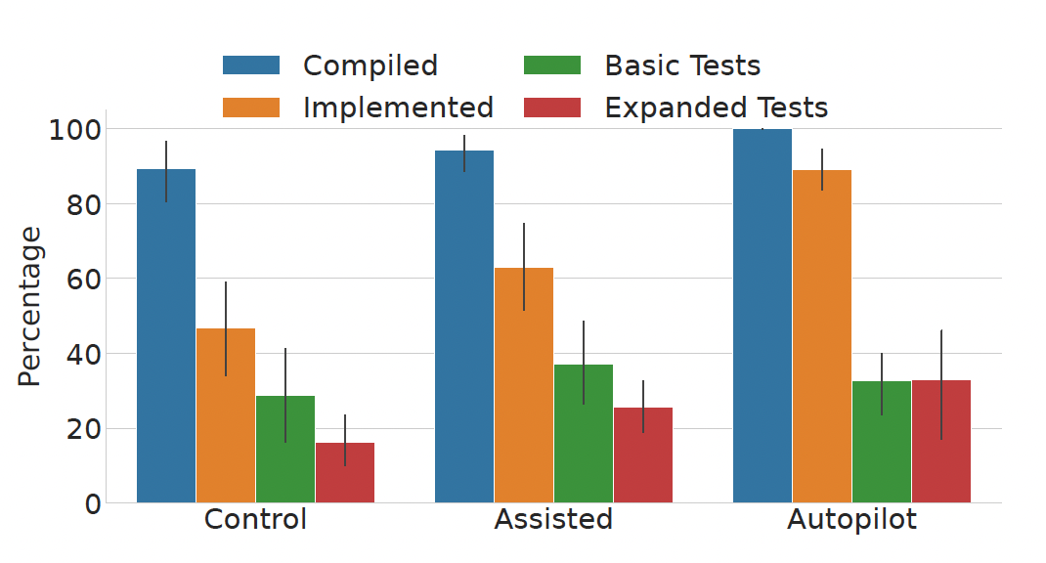
Results and analysis : RQ1 Functionality
Purpose
To evaluate the impact of AI assistance on the functional aspects of coding.
Key Findings
Assisted group showed slightly higher function implementation and compilation rates.
No statistically significant differences, indicating subtle AI impact.
Passing Tests: Assisted group marginally better at basic and expanded tests.
Code Quantity: Assisted group wrote more lines, suggesting enhanced thoroughness or exploration.
Conclusions
AI assistance slightly improves functionality.
Marginal performance gains in implementation, compilation, and test passing rates.
Non-significant differences suggest a moderate impact on functionality.
The "Autopilot" group in the study refers to a set of solutions generated entirely by the AI code assistant without human intervention.
Notes:
For the RQ1: it talked about can AI code assistant enhance the functional quality of code produced by beginners?
The goal of this research was to assess the effectiveness of AI assistance in coding, specifically whether it helps developers create code that's more functional, has fewer errors, and aligns more closely with project requirements than code written without such assistance.
The findings of the study indicate that developers who used AI assistance showed a slight improvement in implementing and compiling functions, as well as in passing basic and expanded unit tests, compared to the control group. Despite this, the performance enhancements were not statistically significant. This suggests that while AI can assist with coding, its impact on improving the functional correctness of code is not substantial. Additionally, the assisted group tended to write more lines of code, hinting that AI might promote a more detailed approach to coding or inspire developers to engage more deeply with the coding process.
The results indicate that AI code assistance slightly improves code functionality. The 'assisted' group performed marginally better in terms of the percentage of functions implemented, compiled, and passing tests compared to the 'control' group. However, these differences weren't statistically significant, suggesting that while AI assistance might aid in coding, the impact on functionality is not profound.

Slide 9
Results and analysis : RQ2 Security Analysis
Purpose
To investigate the security implications of using AI code assistants.The aim is to understand the security risks associated with AI-assisted coding, specifically examining the incidence rate of Common Weakness Enumerations (CWEs) in the produced code.
Key Findings
AI-assisted group shows no significant increase in CWEs/LoC.
Lower incidence of severe CWEs in AI-assisted, functionally correct code.
Non-inferiority testing confirms AI-assisted code's comparable security.
CWE rates vary by function, highlighting task-dependent impact.
Conclusions
Enhanced Security: AI has potential to reduce severe vulnerabilities.
Workflow Integration: Supports AI assistants' inclusion without heightening security risks.
Vigilance Needed: Developers must remain alert when using AI assistance.
Notes:
For the RQ2, is the frequency of security bugs in code crafted with AI assistance within acceptable limits when compared to code developed without such assistance?
The analysis aims to explore the security implications of utilizing AI code assistants by assessing the associated risks and analyzing the incidence rate of Common Weakness Enumerations (CWEs) in the code produced with AI help. The primary metric used for this evaluation is CWEs per Line of Code (LoC), which indicated a minimal security impact from the LLM assistance.
The study found AI-assisted coding didn't increase Common Weakness Enumerations (CWEs) per Line of Code (LoC) compared to code from the control group, and showed fewer severe vulnerabilities, especially in functionally tested code. Further tests revealed AI's security impact is comparable to control group code but varies by coding task.
For RQ2, it concludes that AI assistance could positively influence code security, especially in diminishing severe vulnerabilities. The study suggests using AI helpers in creating software because they don't really increase security dangers and can even lessen certain risks. At the same time, the study also points out that developers need to stay alert when using AI tools. Even though AI can be helpful, developers still need to do thorough checks and follow strong security steps when writing code. This highlights that AI's role in coding is helpful but complex.

Slide 10
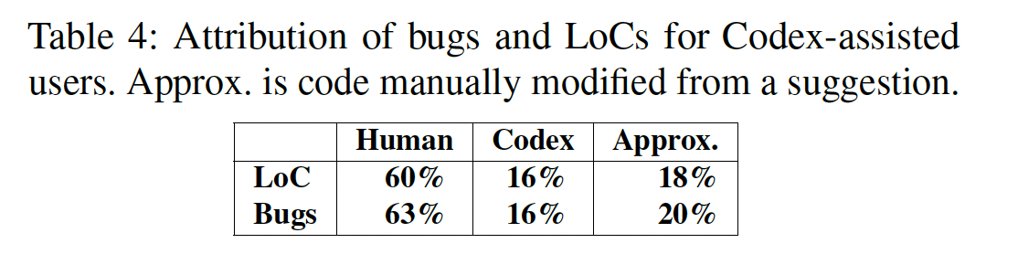
Results and analysis : RQ3 Origin of Bugs
Purpose
To ascertain the source of bugs in code written with AI assistance. The goal here is to distinguish between bugs introduced by human developers and those introduced by the AI.
Key Findings
After using the visualization tool to reviewing 564 security vulnerabilities:
63% of bugs introduced by humans.
36% of bugs from LLM suggestions (16% verbatim, 20% modified).
60% of non-template code written by humans.
Conclusions
AI serves as a complementary tool, not a standalone solution.
Critical evaluation and testing of AI suggestions are crucial.
Insights can guide enhancements in AI code assistant capabilities.
Notes:
For RQ3: In what manner do users employing AI assistance engage with potentially vulnerable code suggestions, and what is the source of bugs in a system aided by a Large Language Model?
The purpose of RQ3 is to identify the origins of bugs in code developed with AI assistance, aiming to differentiate between bugs introduced by human developers and those by the LLM itself. The method categorizes bugs into three types: bugs directly adopted from Large Language Model suggestions, bugs adopted with modifications made by the user, and bugs that are entirely user-generated. This classification helps in understanding the interaction between human developers and AI tools and the impact on code quality.
The findings of the study highlight the distribution of bugs in AI-assisted coding. Utilizing a visualization tool to examine the influence on user code, the analysis of 564 security vulnerabilities revealed that 63% of the bugs were introduced by humans, while 36% were linked to the LLM — 16% of these were direct LLM suggestions, and 20% were modifications of such suggestions by users. Furthermore, 60% of the code, excluding template contributions, was written by humans, which correlates with the finding that the ratio of bugs closely reflects the human versus AI contribution to the codebase.
The conclusions from the study emphasize the supportive role of AI in software development. AI code assistants are beneficial as aids in the coding process but are not foolproof; hence, developers must actively engage and critically evaluate AI-generated code. The findings from this RQ offer valuable insights for enhancing AI code assistants to better align with human coding practices and minimize bug introduction.

Slide 11
Discussion: RQ1 - Productivity
RQ1: Supported by previous studies, usage of LLMs increased developer productivity
The users using AI code completions had more lines of code than those who did not
For simple functions, AI alone performed relatively well

Slide 12
Discussion: RQ2 - Security
Contrary to previous research, the study showed LLMs do not produce significantly more vulnerable code
Previous studies showed LLMs produced code with security vulnerabilities
But, previous studies did not considered what developers would do when given these vulnerabilities: accept, reject, edit
With human interaction, vulnerabilities showed to be less than 10%
The same benefit/risk standard accepted by the medical community

Slide 13
Discussion: RQ3 - Bugs
The quality of code the LLM output, was strongly correlated with the quality of code input
If the user themself was writing buggy code, the LLM was more likely to suggest buggy code
Make sense because the LLM uses the previous code written to produce its output
When compared side-by-side, users produce more bugs (63%) than LLMs (36%)

Slide 14
Threats to Validity
User selection
Students were used instead of professionals
Previous work has shown little difference for these groups
Code assignment difficulty
The code was intentionally given irregularities
Index by 1 instead of 0
No return values
C was used which is inherently more difficult and insecure
Data capture
Data capture was limited to snapshots every 60 seconds
More fine grained analysis like keypresses, was not used

Slide 15
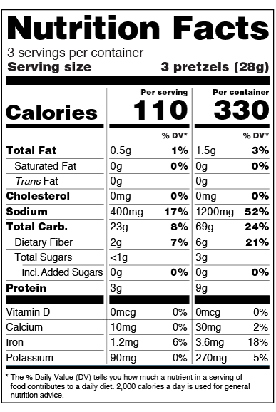
Conclusion
Contrary to previous studies, LLMs showed to increase productivity without increasing vulnerabilities
Vulnerabilities correlated more with the skill of the developer than the usage of LLM tools
The study recommended adding “nutritional labels” to LLM outputs so developers are more informed about the snippets they are considering

Slide 16
Thank you for listening
Do you have any questions?

Slide 17
Backup Slides

