Slide 1
World of code: Enabling a Research Workflow for mining and analyzing the universe of Open-source VCS data
Original Authors: Yuxing Ma, Tapajit Dey, Chris Bogart, Sadika Amreen, Marat Valiev, Adam Tutko,David Kennard, Russell, Zaretzki, Audris Mockus
Presented by: Utkarsh Pratiush
Notes:
Hi My Name is Utkarsh. I am a PhD student here at UT. I will give a short presentation on WoC. I chose this topic as IVictor, Cavin and I are trying to understand the storage requirement of WoC and so we can provide storage suggestions tot professor Mockus. Presenting this paper is hard because, there are various details discussed in the paper and difficult to cover in a short presentation. I encourage everyone who is more interested to look at the paper

Slide 2
Structure
Motivation
Related work
Background
Methodology
Application as discussed in paper
Future work/challenges
Notes:
I have structured my talk in this way, where I will talk about motivation, Background, Related work, Methodology, application as described in the paper and future work/challenges

Slide 3
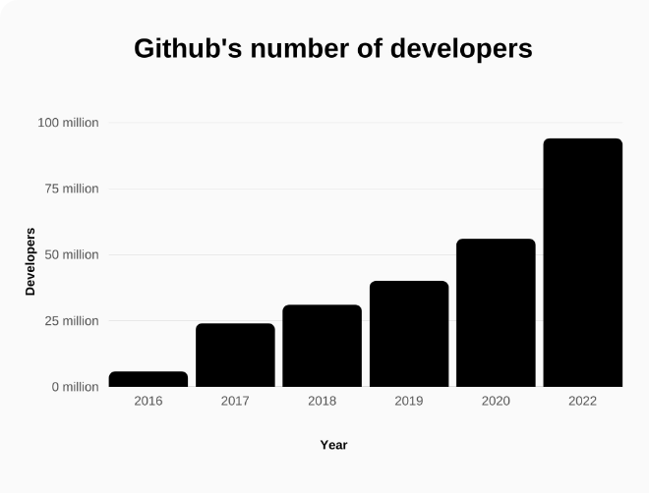
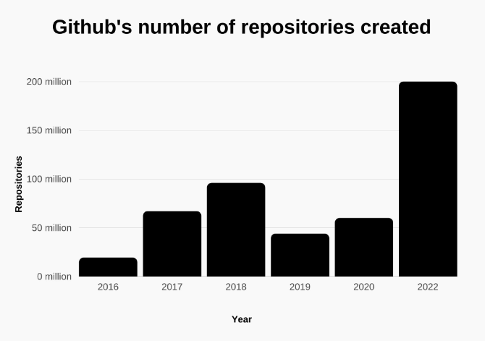
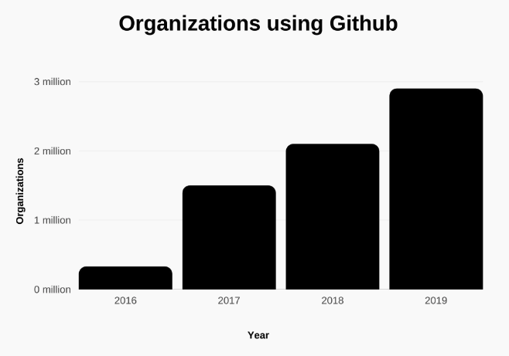
Motivation
Want to answer questions like? ->What are the top 10 most popular programming languages used in OSS?
-> What are the largest open source projects by contributor count in GitHub?
At an organization level want to answer questions like? ->Estimate productivity of employees
->Assess potential vulnerability
https://www.usesignhouse.com/blog/github-stats
Notes:
these 3 plots shows use of Version-control system is increasing exponentially→ Here taken example of Github can be any VSC[bitbucket, gitlab etc]

Slide 4
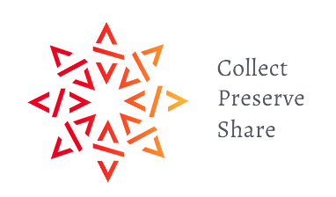

Related work and what WoC brings to table
several large-scale software mining efforts exist and may be roughly subdivided into attempts at preservation, data sharing for research purposes, and construction of decision support tools.
And many more…
WoC focuses on : ->Open source-related research ->Efficient update of this huge database that it builds on ->Preserve git objects and cross-references, so relationships between code and people is readily available.

Slide 5
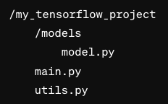
background
Blobs: Each file (model.py, main.py, utils.py) is stored as a blob, containing the file's data.
Git objects
Trees: represent directories.
Each tree object can point to blobs and other trees.
models' tree:
Root tree:
objects:
1. Blobs
2. Trees 3. Commits
4. Tags
Let’s take TensorFlow example
Commits: Current snapshot of Tensorflow project.
Tags: Tensorflow version 1.0: Specifies the release
More info: https://git-scm.com/book/en/v2/Git-Internals-Git-Objects
Notes:
git objects is central to world of code There are 4 types of git pbject. Blobs: These are used to store the file data. Each version of a file is represented by a blob, which is identified by a SHA1 hash. Trees: Trees are like folders that organize the structure of the repository. They contain pointers to blobs (files) and other trees (subdirectories), essentially keeping track of how all the blobs are arranged at any given commit. Commits: A commit object points to a tree object that represents the state of the repository at a certain point in time. Commits contain metadata such as the author, the date, and a message describing the changes. They also point to the previous commit(s), creating the history of changes. Tags: Tags are references to specific commits and are typically used to mark release points like v1.0, v2.0, etc. They make it easier to identify certain snapshots, especially for the purpose of versioning. -> I will give an example to cover this concept

Slide 6
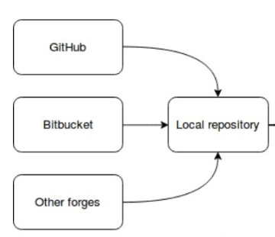
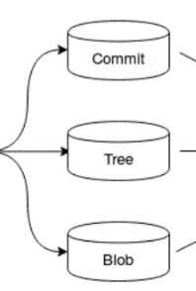
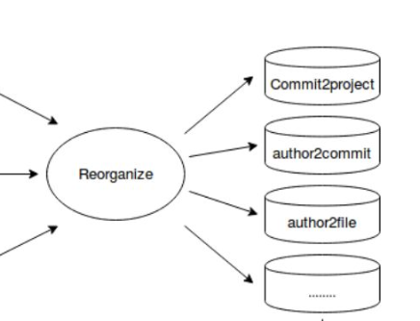
Methodology
We have stored the objects but how do we get info about project names, Authors and relationship?
Git object retrieval 1.5PB →80TB -> 95% reduction
Discover and retrieve
Extract: git objects
Discovery: a) Manual search
b) Html Parsing
c)Use of REST/GraphAL API’s
d) Git project url
Reorganize
Once project discovered it can be retirved by cloning the repo. Due to huge number of repos a) Need : High Network bandwidth and storage b) Run multiple threads per server
Results in a database with 12 mappings.
Notes:
There are 3 major steps how data handled in WoC:
Discovery: a) Manual search
b) Html Parsing
c)Use of REST/GraphAL API’s
d) Git project url Once project discovered it can be retirved by cloning the repo. Due to huge number of repos a) Need : High Network bandwidth and storage b) Run multiple threads per server
Extract: Once repository are cloned: git objects are extracted
Results in a database with 12 mappings. Seperated into 32 (rather than 128) databases

Slide 7
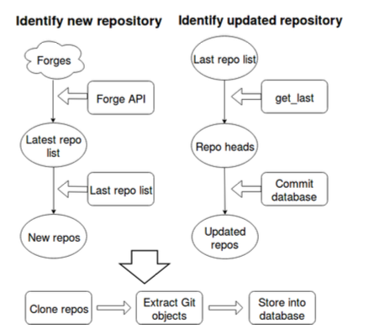
Data update
– Identify new repositories, clone and extract Git objects – Identify updated repository and retrieve only newly added Git objects
Notes:
Now talking about updating the data from time to time : There are around 90M projects, including forks→ updating them can be very challenging both in terms of hardare and reduntant data. To give a perpective . Currently, to clone all git repositories (that includes over 90M along with forks) total time would be around 600 single-thread servers which runs for a week-→ and the result would occupy over 1.5PB of disk space. The main point is that fortunately, git objects are immutable and can be leveraged to simplify and speed up the updates. More generally, to get acceptable update times, WoC use a combination of two approaches as described in this flow chart[one can take a look in paper for more details.

Slide 8
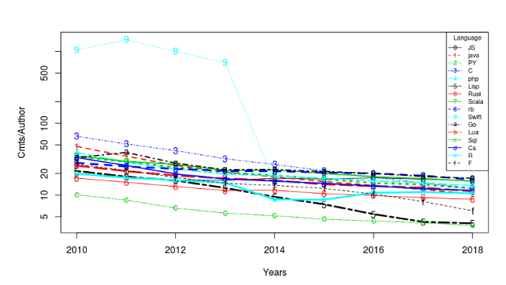
Applications as described in paper
1. Use of programming languages
2. Correcting Developer Identity Errors
Fig. Productivity by Language
3. Cross-ecosystem comparison studies
File cloning across ecosystems
Developer migration across ecosystems
4. Python ecosystem analysis
5. Repository filtering tool
6. A number of research publications have utilized the WoC database
Notes:
1. Use of programming languages : Language popularity may influence developers decisions as it may affect the market for their software as well as their job prospects. For example: What language- specific API should developer provide for their component? What language should the developer use to implement their product?
Fig. 10. The commits/author ratio decreases for most languages, perhaps because as a language becomes more popular, the less experienced contributors join and lower the average productivity. The paper describes the maps used in WoC to come to this conclusion
2. Correcting Developer Identity Errors
One of the particularly troubling data quality issues with, version control systems is developer name disambiguation-> use author-to-commit map
3. Cross-ecosystem comparison studies: a)Qhow ecosystem tools and practices influence development behavior. One such statistic is rate of file cloning -> joining maps like blob- to-commit and commit-to-project mappings, filtering for blobs one can answer these questions b) Developer migration across ecosystems ->by joining author-to-commit and commit-to-project data & identity matching
4. Python Ecosystem analysis: Q Investigating open source sustainability of projects and identifying feature complete projects: The researcher analyzed PyPi packages' initial releases, filtering out non-unique setup.py files. Ninety-six percent of the packages' repositories were identified in 20 minutes. Repositories were cross-verified with PyPi file data to confirm their connection to the packages. 5. repository filtering tool: One of the education researcher wanted to understand the impact of self-administered programming tutorials. he was able to accomplish it using keyword matching and project-to-commit map 6. WoC used in research: The relationship between dependencies of NPM packages The investigation of what attributes drive the adoption of a software technology Bottomline: We notice that deeper questions about project content would have been out of reach without WoC;

Slide 9
Further challenges/directions
1. Availability of API
2. Accommodate massive queries needs powerful hardware
3. Additional methods/procedures to improve acquisition: as project discovery procedure is only an approximation.
4. Reliably clean, correct and augment the collected data
Notes:
1. To Reach more audience: Availibility of API is very important: As of now Python and Perl are available but more languages needed. 2. Processing hundreds of terabytes of data on powerful clusters may be out of reach of most research groups -> To accommodate massive queries -> more powerful hardware is required 3. WoC should also accommodate additional data and computational procedures needed for discovering, correcting, cleaning, augmenting, and modeling the underlying data.
4. How to reliably clean, correct, integrate, and augment the collected data so that the resulting analyses accurately reflect the modeled phenomena is a concern.

Slide 10
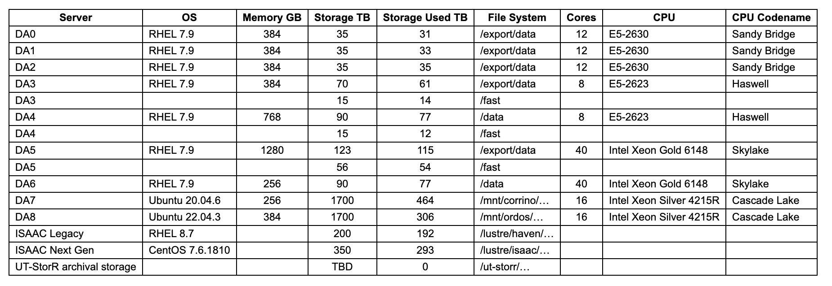
Our Project
Credits: Victor Hazlewood
Thanks

