Slide 1
Presentation on “A Pipeline Framework for Heterogeneous Execution Environment of Big Data Processing”
by Dongyao Wu et. al.
Jay Ashworth, Gabriel Laboy, Andrew Mueller

Slide 2
Introduction - The Problem
Simplified problem
Given input A, we want to produce output B with a multitude of transformations
Machine learning, data analysis, data reduction, etc...
Frameworks that aim to achieve this:
Crunch, Pig, and Cascading among others
Purpose: Facilitate big data job integration and pipelining
Framework Characteristics
Built on single data-processing execution environments
Require coding in specific interfaces & programming paradigms
Key Takeaway:
These frameworks aim to simplify big data processing but come with limitations related to flexibility and programming requirements

Slide 3
Introduction - The Problem
Adaptation to Change
Continuous evolution to meet new requirements
Need for integrating various legacy components
Complexity in Maintenance
Maintenance becomes time-consuming due to evolving applications
Software/hardware changes quite rapidly
Keeping up with these changes is demanding
Key Takeaway:
The dynamic nature of big data applications necessitates more adaptable and flexible pipeline frameworks to efficiently manage and evolve with the technological and business landscapes
Let us introduce:
Pipeline61 framework

Slide 4
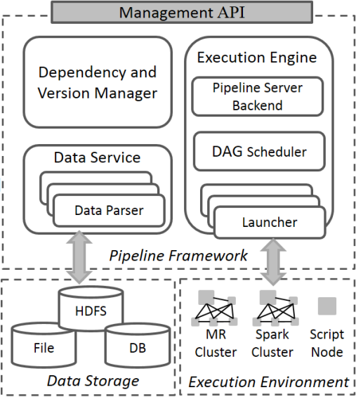
II. Proposed Solution - Pipeline61
Three main components
Execution Engine
Trigger, monitor, and manage pipeline execution
Data Service
I/O layer to manage data exchange and conversion
Dependency & Version Manager
Automate version control and dependency management

Slide 5
IIa. Pipe Model
Pipeline components divided into Pipes
Name
Version
Automatically increases for new versions of pipe
Pipeline Server
Input/Output Path
URL with protocol and address of data
Protocol represents system types
Data Input/Output Format
Execution Context
Execution environment required by framework
Execution Context
Spark ExecutionContext
SparkProc attribute for RDDs
SparkSQL for DataFrame objects
MapReduce ExecutionContext
Allow specification of Mapper, Reducer, Combiner, and Partitioner
Other parameters added as key-value parameters
Shell ExecutionContext
Script files or in-line commands
Includes Python, R
Manual conversion of data required
Notes:
RDD is resilient distributed dataset (in Spark) - fault-tolerant collection of elements distributed over cluster of machines

Slide 6
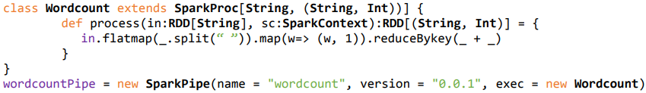
IIa. Pipe Model

Slide 7
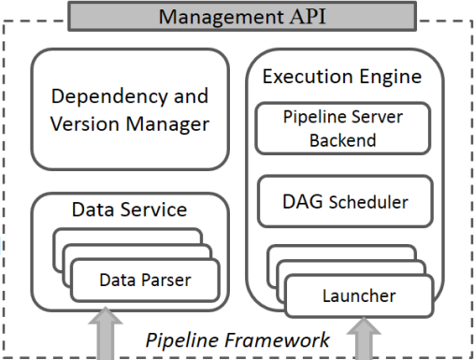
IIb. Execution Engine
Pipeline Server Backend
Message handlers to receive and process user requests and running tasks
DAG Scheduler
Traverses task graph and submits tasks for execution
Scheduled when all parents tasks completed
Task Launchers
Launch execution processes for pipes
Created through APIs of execution frameworks
Initiated and executed in process (scripts)
Spark Launcher
Sub-process as driver process to execute job
MR Launcher
Sub-process to submit the job
Shell Launcher
Sequence of channeled processes (scripts and commands)
Notes:
Pipeline server - Has runtime status messages which can trigger scheduling and recovery events
Spark launcher - driver process executes spark job and send notifications back to pipeline for monitoring
MR launcher - sub-process waits on job completion and sends status back to server
Shell launcher - processes handle shells scripts and commands and returns state messages on completion

Slide 8
IIc. Data Service
Data Parsers
Pipes execute independently at runtime
Read and write data in execution environment given format and protocol
For certain pipe frameworks, use native API
Examples
Spark pipe
Spark - text to RDD
SparkSQL - JDBC/JSON to Spark DataFrame
Python pipe
PythonHadoop - HDFS CSV to Python DataFrame
New data parsers can be made for flexibility
Use parsing toolkits like Apache Tika

Slide 9
IIId. Dependency & Version Manager
Dependency and Version Manager
Help maintain, track, and analyze historical information on data and pipeline components
Data Snapshot
Input and output location and data of every execution instance
Status of execution
Pipeline Execution Trace
Data flow graph of every execution instance
Each node has meta-data for component
Pipe Dependency Trace
Historical meta-data for different versions of components in pipeline
Stored as a tree for each component
Name, version, author, update timestamp, library dependencies

Slide 10
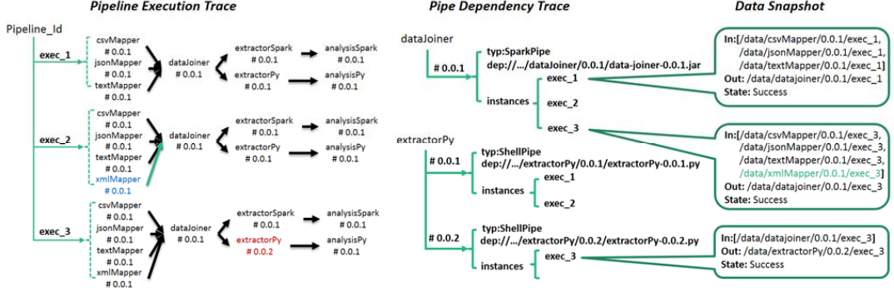
Historical and Dependency Information Tree Example

Slide 11
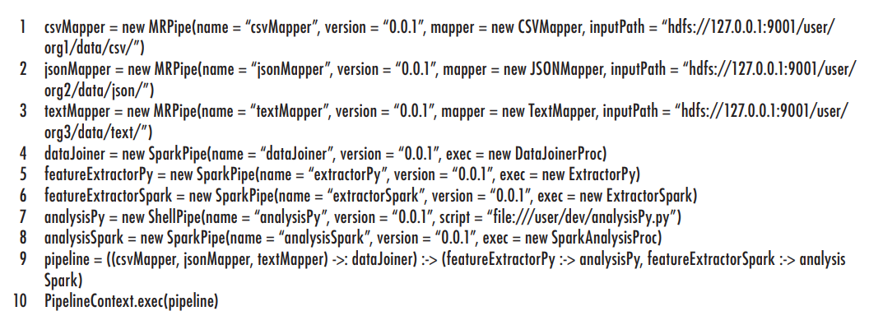
IIIa. Usage Example

Slide 12
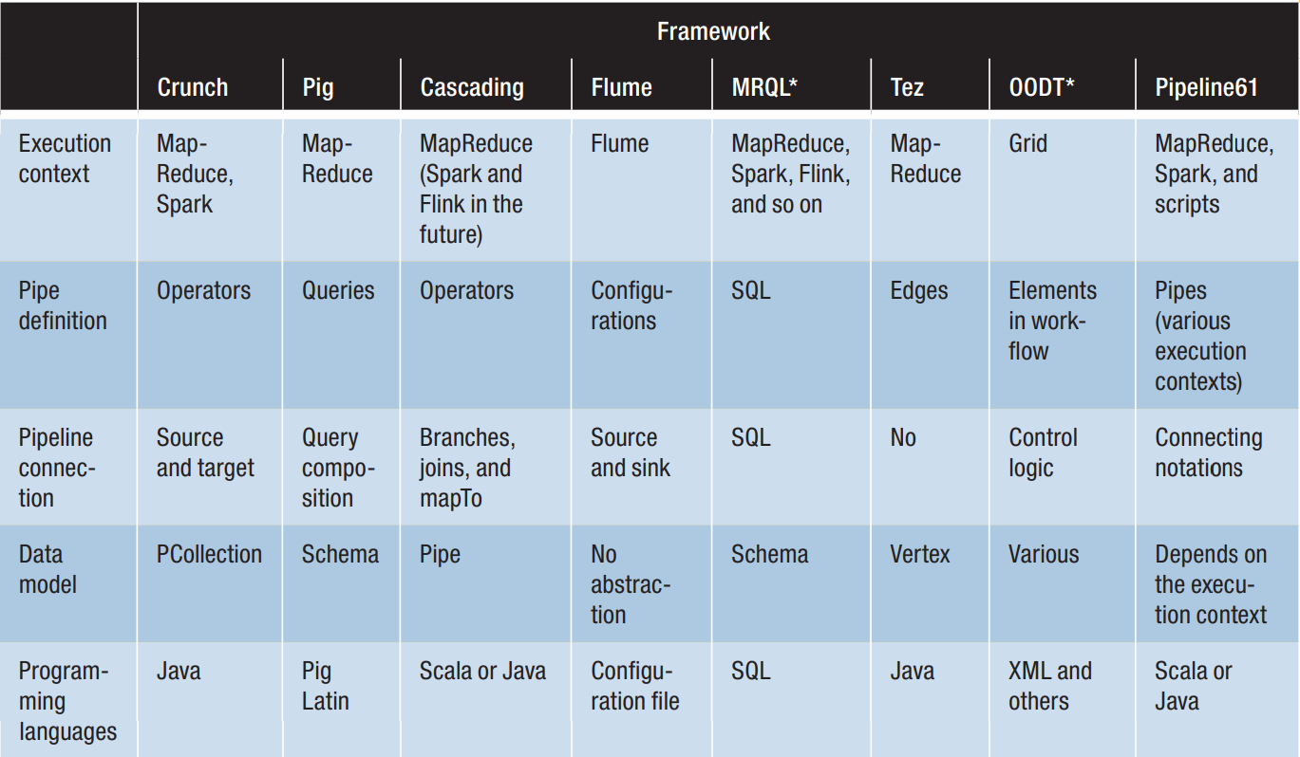
IIIb. Results - Comparison to Other Frameworks

Slide 13
IIIc. Conclusion
Pipeline61 offers several advantages for software engineers developing data pipelines over existing pipeline frameworks:
Use of custom scripts from many languages.
Integration of Heterogeneous Data-Processing Jobs
Reuse of Existing Programming Paradigms
Automated Version Control and Dependency Management
Improves Maintainability of Code
Programmable Interfaces in Different Programming Languages
Deep Integration with Contemporary Big Data Processing Frameworks
Explicitly Defined Provenance Information
Enables Reproducibility
The primary disadvantage of Pipeline61 is execution speed due to increased complexity.

