Slide 1
Comparing Manual and Automated Feature Engineering
A Kaggle Case Study
Cameron Rader, Suneil Patel, Smit Patel
University of Tennessee, Knoxville

Slide 2
Background & Motivation
Feature engineering converts raw data into meaningful inputs for Machine Learning models.
Features:
Can include things like age, sex, survival or not. Categories that classify data samples
Critical for performance:
Selecting relevant features reduces noise and overfitting.
Impacts interpretability:
Transparent features aid trust in high-stakes domains (e.g., healthcare).
Affects computational cost:
Fewer features can speed up training and inference.

Slide 3
Related Work & Research Gap
Manual vs. automated feature engineering literature:
Manual: Domain-driven selection shown effective in structured data
(Nyúl & Udupa, 1999).
Principle Component Analysis (PCA): Reduces dimensionality, retains variance, but loses direct feature semantics
(Jolliffe, 2002).
Autoencoders: Capture non-linear patterns, black-box nature reduces interpretability
(Hinton et al., 2006).
Tree-based importance: Model-specific feature ranking, may inherit algorithmic biases
(Lundberg & Lee, 2017).
Gap: No unified comparison of all four methods on small, tabular datasets.

Slide 4
Research Questions
This study addresses:
RQ1: How do manual and automated pipelines compare in predictive performance?
RQ2: What are the trade-offs between model interpretability and computational efficiency?
RQ3: Which method offers the best balance for small, structured datasets?

Slide 5
Dataset & Preprocessing
Kaggle Titanic dataset: 891 passengers, 12 feature categories like age, gender, class, survival, etc.
Exploratory Data Analysis:
19% missing 'Age' features
0.2% missing 'Embarked' features
Imputation:
Median passenger 'age' was used to fill in 'NaN' values
Missing 'Embarked' values were corrected using the most commonly occurring port of embarkation i.e. (Cherbourg, Queenstown, and Southampton)
Encoding:
The 'Sex' and 'Embarked' columns contain text (e.g., "male", "female", "Southampton).
Using one-hot encoding these features are created to numbers, normalizing data
Drop the encoded features one level to avoid multicollinearity, or potential redundancy in features that can confuse machine learning models.
Scaling:
We used a Standard Scaler to put all numeric values (like age or fare) on the same scale, so no one feature dominates the model.

Slide 6
Feature Engineering Techniques
Four pipelines evaluated:
Manual Selection: 8 features chosen via EDA and domain intuition.
PCA: 5 principal components capturing ≥90% variance, linear projection.
Autoencoder: PyTorch model (input→64→5→64→input), trained 50 epochs, captures non-linear structure.
Importance Ranking: Top 8 features by Random Forest Gini importance for transparency.

Slide 7
Model & Evaluation
Random Forest Classifier:
Configuration: 100 trees, random_state=42.
Evaluation: Stratified 5-fold cross-validation for robust performance estimates.
Metrics: Accuracy, Precision, Recall, F1-score to capture classification balance.
Computational Cost: Wall-clock training time measured per fold.

Slide 8
Quantitative Results
Method | Accuracy | Precision | Recall | F1-Score | Train Time (s)
Manual | 0.8137 | 0.7720 | 0.7336 | 0.7501 | 1.8124
PCA | 0.7733 | 0.7076 | 0.6987 | 0.7025 | 0.4653
Autoenc. | 0.7756 | 0.7032 | 0.7162 | 0.7092 | 0.4244
Imp(sel) | 0.8036 | 0.7575 | 0.7191 | 0.7365 | 0.4190

Slide 9
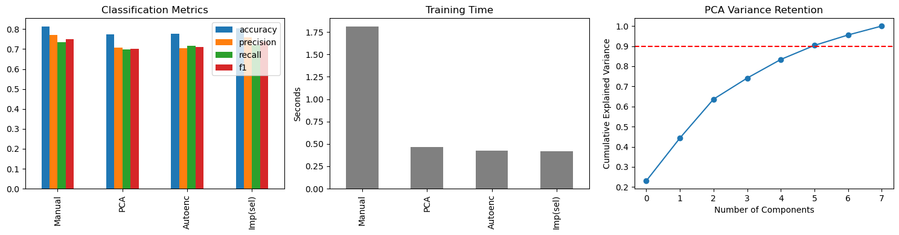
Visual Results

Slide 10
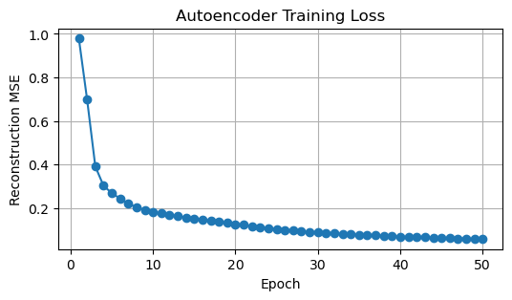
Autoencoder Loss Curve
Reconstruction MSE over 50 training epochs.
Shows convergence and stability of the autoencoder model.
Helps assess capacity of latent representation.

Slide 11
Interpretation of Results
Key takeaways:
Manual features deliver highest accuracy (0.8137) but longest training time (1.81s).
Automated methods cut training time (~0.42s) at a modest performance drop (~4%).
Tree-based importance balances performance (0.8036 accuracy) and efficiency.
PCA and autoencoder features reduce interpretability due to transformed representations.

Slide 12
Limitations & Validity
Internal Validity:
Fixed hyperparameters; potential bias without nested CV.
External Validity:
Findings may not generalize to image/text domains.
Construct Validity:
Interpretability measured by feature semantics; user studies could refine.

Slide 13
Future Work & Conclusion
Future Work:
Develop hybrid pipelines combining manual curation with automated refinement.
Evaluate methods on diverse datasets with statistical significance testing.
Hybrid approach could offer optimal balance of performance, interpretability, and efficiency.

Slide 14
Sources
REFERENCES
L. G. Ny´ul and J. K. Udupa, ”On standardizing the MR image intensity
scale,” Magn. Reson. Med., vol. 42, pp. 1072–1081, 1999.
I. T. Jolliffe, Principal Component Analysis, 2nd ed. Springer, 2002.
G. E. Hinton and R. R. Salakhutdinov, ”Reducing the dimensionality of
data with neural networks,” Science, vol. 313, no. 5786, pp. 504–507,
2006.
Y. Bengio, P. Lamblin, D. Popovici, and H. Larochelle, ”Greedy layer-
wise training of deep networks,” in Proc. NIPS, 2007, pp. 153–160.
S. M. Lundberg and S.-I. Lee, ”A unified approach to interpreting model
predictions,” in Advances in Neural Information Processing Systems,
2017.

Slide 15
Thank You
Questions?

Slide 16
Appendix #1
Column | Type | Description | Missingness
PassengerId | Integer | Unique ID for each passenger | 0%
Survived | 0 or 1 | Target variable: 0 = did not survive; 1 = survived | 0%
Pclass | Categorical | Passenger class (1 = 1st, 2 = 2nd, 3 = 3rd) | 0%
Name | String | Passenger’s full name (contains title, which can be parsed for additional signal) | 0%
Sex | Categorical | “male” or “female”—one of the strongest predictors of survival | 0%
Age | Numeric | Age in years (has ~19% missing values; often imputed with median or predicted by title) | ~19%
SibSp | Integer | # of siblings/spouses aboard—used as a proxy for family size/support | 0%
Parch | Integer | # of parents/children aboard—another family‐size measure | 0%
Ticket | String | Ticket number (alphanumeric; often high‐cardinality and not directly used without feature engineering) | 0%
Fare | Numeric | Passenger fare (continuous; typically log‑transformed or binned) | 0%
Cabin | String | Cabin number (many missing; sometimes reduced to “has cabin” binary or deck letter) | ~77%
Embarked | Categorical | Port of embarkation (C = Cherbourg, Q = Queenstown, S = Southampton; ~0.2% missing) | ~0.2%

Slide 17
Appendix #2
ML: Machine Learning
EDA: Exploratory Data Analysis
PCA: Principal Component Analysis
RF: Random Forest (an ensemble tree‑based classifier)
CV: Cross‑Validation (we used stratified 5‑fold CV)
MSE: Mean Squared Error (used as the autoencoder’s reconstruction loss)
GPU: Graphics Processing Unit (often used to accelerate neural‑network training)
CPU: Central Processing Unit (the general‑purpose processor we ran our experiments on)
RQ: Research Question

Slide 18
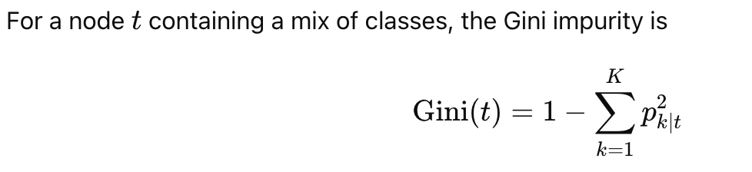
The Random Forest’s Gini importance for feature jjj is the average (or sum, depending on implementation) of that feature’s total impurity decrease across all the trees, usually normalized so that all importances sum to 1.

Slide 19
We picked the Titanic dataset for our case study because it perfectly exemplifies all the challenges and opportunities of feature engineering in a way that’s:
Publicly Accessible & Reproducible – Available on Kaggle with a single CSV download, no API keys or special permissions required. – Anyone can rerun our notebook end‑to‑end and validate exactly the same results.
Small & Manageable – Only 891 rows means experiments (including cross‑validation and neural autoencoder training) finish in seconds—ideal for interactive exploration in Jupyter or live demos. – At the same time it’s large enough to show real performance differences across methods.
Mixed Data Types & Missingness – Contains continuous (Age, Fare), categorical (Sex, Embarked, Pclass), and sparse/text fields (Cabin, Name) so we can demonstrate imputation, encoding, scaling, and even text‑derived features. – Roughly 19% of Age values are missing and some Cabin entries are absent—letting us showcase standard imputation strategies and their impact.
Clear, Well‑Understood Target – Survival (0/1) is unambiguous, widely studied, and has known decision‑rules (“women and children first,” class stratification), which helps us validate that our pipelines pick up meaningful signals.
Benchmark Familiarity – Because Titanic is so commonly used in tutorials and research, it’s easy to compare our findings with existing literature or troubleshoot unexpected behaviors by referencing community examples.
Together, these properties make Titanic the perfect “sandbox” for illustrating how manual and automated feature‐engineering techniques perform, both in terms of model accuracy and practical considerations like runtime and interpretability.

