Slide 1
Web Checkout
Lance Burgo, Ji Gu, Shobhit Jaiswal
CS 545 - Human Computer Interaction

Slide 2
Project Description
Create a simple checkout process for the web (primarily for use by desktops & laptops)
Specific focus: purchasers of mobile phone hardware
Allow users to interact with it simply and quickly
Chosen focus of 5 E’s
Primary: error-free
Secondary: efficient
Focus on simplicity, usability, lack of confusion
Ensure information is passed to user in a concise and clear way
Iterate design through user input and evaluation

Slide 3
Initial Data
Checkout abandonment is a key area directly affecting online business
User concerns often sited:
Hidden charges
Needing to register before buying
The process takes too long
Difficulty in filling forms
Online shoppers make up a large and diverse demographic; typically men and women between the ages of 18-63
Notes:
More details about checkout abandonment can be found here: http://econsultancy.com/us/blog/7730-why-do-consumers-abandon-online-purchases
More information about online shoppers can be found here: http://www.buysight.com/blog/2010/04/23/whos-shopping-online/

Slide 4
Users
Scoured the web for information on users and website checkout
Prototype with users
Created working prototype
Asked users to interact with it
Users provided positive and negative feedback
Provided quiz for users to take which quantified some feedback
Also utilized user personas for guidance while designing the website. See the next slide to view the personas that we utilized during the design process.

Slide 5


User Personas
Joel Sera
Graduate student
Age 24
Joel has shopping savvy and because he must both work and study, he prefers to shop online
He comfortably uses the web for shopping online and likes the convenience
He has a student loan to fund his studies and tries to spend wisely
He dislikes it when online retailers intersperse unnecessary information when he is trying to make a purchase
Susan Whitaker
Marketing Manager, age 48
Susan has two children, a son (age 13) and daughter (age 16).
She has been married for 20 years.
Susan works full time, usually about 50 hours per week

Slide 6
Design Process
Paper prototyping
Allowed us to focus on and agree about design layout before build
Iterative design focusing on user feedback and expected user interaction
Iterations can be found online: http://goo.gl/1SNk9
Focus on Perception-Attention-Retention (P-A-R)
Simple, obvious placement of buttons, warnings, errors; infer meaning along with its label
Added guide to the top (user always aware of position in the process)
Animation between steps gives visual reference to progress
At core, interaction intentionally works like most forms (move through with the tab key, press enter to submit)
Leverage HTML5 technologies to create error-free, simple design
Notes:
Initially, each member of the group created a paper prototype. Then we each demoed them to each other in a Google+ Hangout. We then discussed and used pieces of all of our paper prototypes for the final design. We then spent a few weeks actually designing our initial prototype for the web.

Slide 7
Design Concepts
Used 5 E’s as success criteria
Primary: error tolerant.
Secondary: efficient.
Simplicity
Reduce
No page refresh allows quick interaction
Animations allow user to perceive sense of control and location
Persistent cart contents & total give constant feedback
Organize
Actions and steps are clearly and simply labeled
User sees flow of all steps initially, which provides context
Accessibility
Web design conforms to modern standards and should work with screen readers and other accessibility tools
Notes:
1. Primary: Error tolerant
Error category:
Invalid inputs
Required inputs missing
Error in a section not corrected after clicking ‘CONTINUE’ button
Hidden errors that have passed validation but the customer is aware of during the ‘CONFIRM ORDER’ section
Shipping option selection
Design method:
Use extensive validations throughout the website for customer inputs.
Allow the customer to edit inputs before clicking ‘PURCHASE’ button.
Always-on ‘CART’ panel to remind the customer of his or her shipping cost.
2. Secondary: efficient.
Efforts on error tolerance during a checkout process lead to a more efficient process in the following ways
Transition from one section to another is coupled with validation to speed up error correction
Instant validation messages help the user correct errors in an efficient way
Edit function in the ‘CONFIRMATION’ section offers the user a way to quickly jump to the section to correct any hidden errors that have passed validation
Other design methods to improve efficiency
Sectioned design help the user to navigate directly through ‘BACK/CONTINUE’ button in the same page (no page refreshing)
Always-on ‘CART’ panel reminds the user of his/her order details including quantity, item cost, shipping cost and total charge.
Dynamic process flow panel help the customer understand the process and also visualize the stage of his/her checkout process

Slide 8
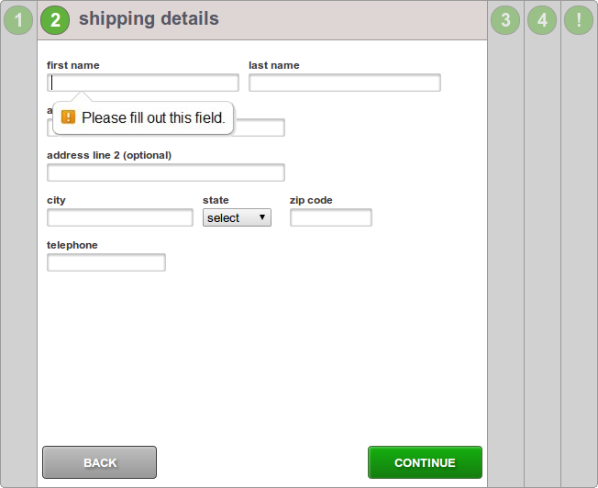
First Design
Initial design utilized HTML5 notifications, which had 2 problems
No informative error messages (except for email)
No validation of fields (except for email)
No enforcement of required drop-downs
Issues with auto-fill (automatic copy of redundant information)

Slide 9
User Feedback
Data collected through online surveys and interviews conducted by the team
Sample size included 23 individuals within our target demographic
User priorities at checkout
Smooth, simple user interface
Security
User concerns
Auto-fill for billing information
Character limitations in form fields
Notes:
SURVEY DATA-
1-Have you ever experienced frustration with the checkout process when shopping online?
YES-30% NO-70%
2- Have you ever abandoned an online purchase due to difficulty at checkout?
YES-69% NO-31%
3-Do you prefer sites that don't force you to register an account (create a username and Password) when you go through checkout?
YES-11% NO-89%
4. How GUI's are important as customer point of view?
YES-100% NO-0%
5. Process of checkout is safe or not. How important is safe transaction in middle of process
SAFE -80% NOT SAFE-20%
6. How much importance does a carrier brand (AT&T, T-Mobile etc.) play in your selection of the type of smartphone/tablet?
YES -78% NO-22%
7. How much interest do you have in the accessories of smartphone/tablet during the smartphone/tablet checkout process?
YES -31% NO-69%
8-What kind of problem you might face during checkout process?
Unnecessary advertisement
9. On a scale of 1 to 4 (1 being bad, 4 being good)
3(OUT OF 4)

Slide 10
Final Product
Final product can be found here: http://goo.gl/5XRyy
User experience results:
Largely positive feedback
Users reported that errors were caught early and validated, resulting in better overall experience and fewer overall errors
Usability and feedback were noted as high, interface was described as “smooth”

Slide 11
Future…
More detailed error messages
What characters are permitted
Specific reasons why their entry was rejected
Server-side scripting
Current prototype is only client-side scripting
To provide a legitimate checkout, it would be necessary to create a wealth of server-side code to communicate all information back to a central server
Sign-in functionality to register users

