Slide 1
Purdue CS555: Cryptography Lecture 5
Instructor: Hanshen Xiao
Teaching Assistant: Justin He
course website: https://cs55500.github.io/

Slide 2
Recap
Preliminaries of Computational Complexity
Model of Computation
Complexity Classes
Reduction
P, NP, NPC, BPP
One-way Function
Construction of One-way Function and PRG
Average and Worst Case Hardness

Slide 3
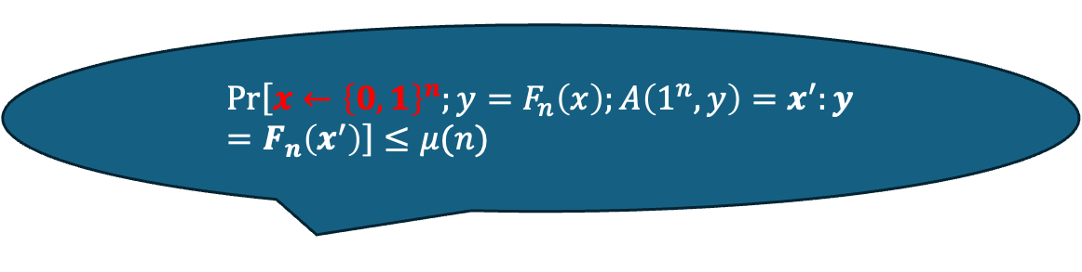
Average-case Hardness and Worst-case Hardness
$$\operatorname{Pr}\left[x←{\left\{0,1\right\}}^{n};y=F_{n}\left(x\right);A\left(1^{n},y\right)=x^{′}:y=F_{n}\left(x^{′}\right)\right]≤μ(n)$$
For the random secret (with entropy) the user fully controls, we can talk about average-case hardness, such as one-way function
The meaning of worst-case hardness depends on the context
IND-CPA: the adversary can arbitrarily select the challenge
worst case indistinguishability holds for any input candidate pair
Lattice worst-case hardness
worst case there exists some case which is hard to break

Slide 4
Today
Implication of One-way Function
Construction of PRG
Construction of Hardcore Bit (Goldreich-Levin (GL) Theorem)

Slide 5
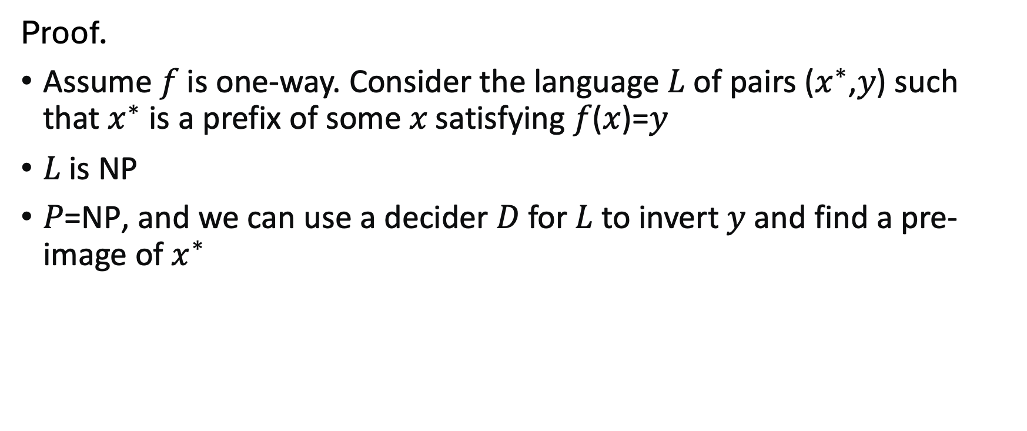
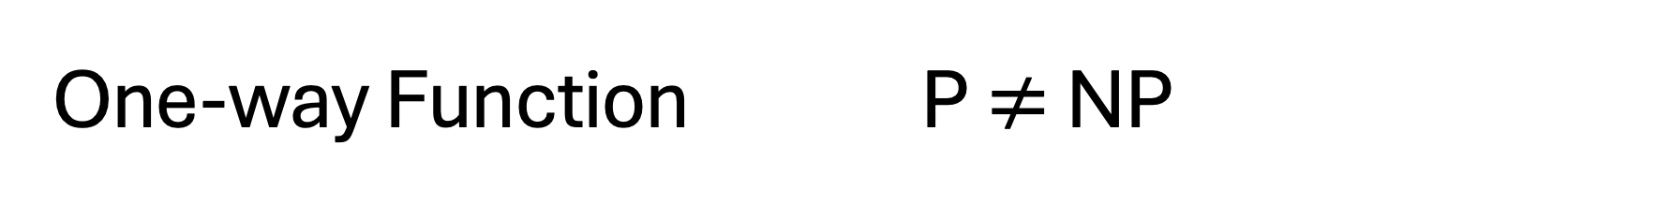
One-way Function P $≠$ NP
Proof.
Assume 𝑓 is one-way. Consider the language 𝐿 of pairs ($x^{∗}$,𝑦) such that $x^{∗}$is a prefix of some 𝑥 satisfying 𝑓($x$)=𝑦
𝐿 is NP
𝑃=NP, and we can use a decider 𝐷 for 𝐿 to invert 𝑦 and find a pre-image of $x^{∗}$

Slide 6
Construction of PRG

Slide 7
Recap: Hardcore Bit Formal Definition
For any function (family) $F:{\{0,1\}}^{n}→{\{0,1\}}^{m},$ a function $B:{\{0,1\}}^{n}→{\{0,1\}}^{}$ is a hardcore predicate if for every p.p.t. adversary $A$, there is a negligible function $μ$ s.t.
$$\operatorname{Pr}\left[x←{\left\{0,1\right\}}^{n};y=F\left(x\right):A\left(y\right)=B(x)\right]≤\frac{1}{2}+ μ(n)$$

Slide 8
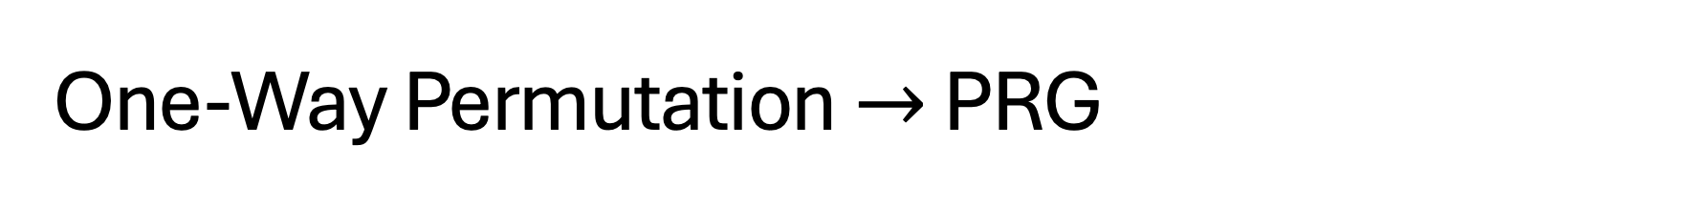
One-Way Permutation $→$ PRG
CONSTRUCTION
Let $F$ be a one-way permutation, and $B$ an associated hardcore predicate for $F$.
Then, define $G\left(x\right)=F\left(x\right)||B(x)$ .
Theorem: $G$ is a PRG assuming $F$ is a one-way permutation.
(Note that $G$ stretches by one bit. We already know how to turn this into a $G′$ that stretches to any poly number of bits.)

Slide 9


Proof by Next-bit Unpredictability
Theorem: $G$ is a PRG assuming $F$ is a one-way permutation.
Proof: Assume for contradiction that $G$ is not a PRG. Therefore, there is a next-bit predictor $D$and a polynomial function $p$such that
$$\operatorname{Pr}\left[x←{\left\{0,1\right\}}^{n};y=G\left(x\right):D\left(y_{1…n}\right)=y_{n+1}\right]≥\frac{1}{2}+1/p(n)$$
Therefore, there is a next-bit predictor $D$and a polynomial function $p$such that
$$\operatorname{Pr}\left[x←{\left\{0,1\right\}}^{n}:D(F(x))=B(x)\right]≥\frac{1}{2}+1/p(n)$$
So, $D$ is a hardcore bit predictor! QED.

Slide 10
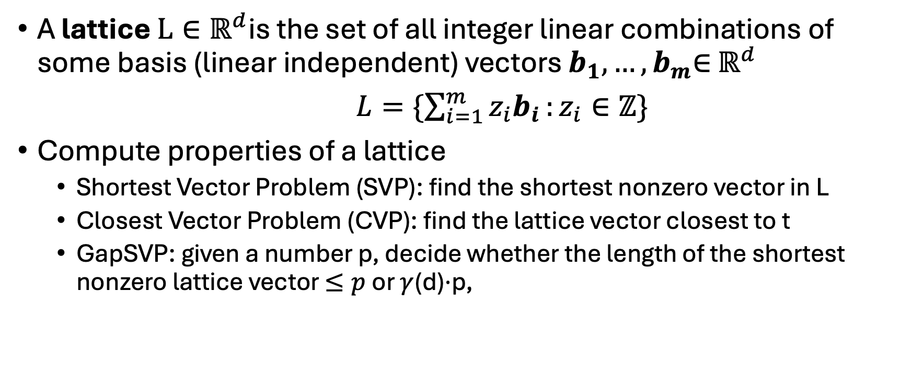
Lattice Problem
A lattice $L∈ℝ^{d}$is the set of all integer linear combinations of some basis (linear independent) vectors $b_{1},…,b_{m}$∈ $ℝ^{d}$
$L=\{\sum_{i=1}^{m}{z_{i}b_{i}}:z_{i}∈ℤ\}$
Compute properties of a lattice
Shortest Vector Problem (SVP): find the shortest nonzero vector in L
Closest Vector Problem (CVP): find the lattice vector closest to t
GapSVP: given a number p, decide whether the length of the shortest nonzero lattice vector $≤p$ or $γ$(d)⋅p,

Slide 11
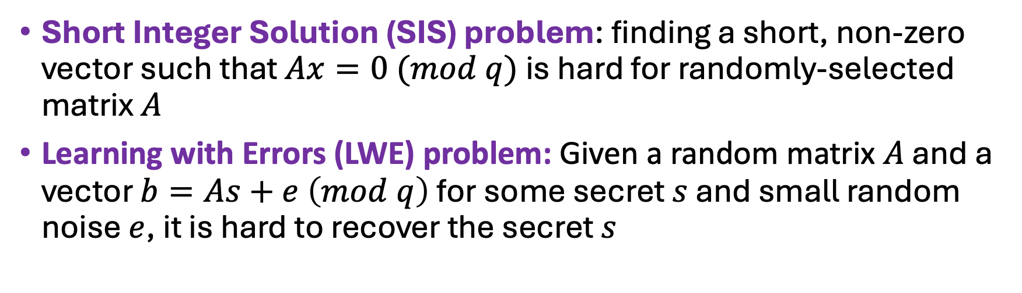
Examples when Average and Worst Case are Equally Hard
Short Integer Solution (SIS) problem: finding a short, non-zero vector such that $Ax=0 (mod q)$ is hard for randomly-selected matrix $A$
Learning with Errors (LWE) problem: Given a random matrix $A$ and a vector $b=As+e \left(mod q\right)$ for some secret $s$ and small random noise $e$, it is hard to recover the secret $s$
[1]. Ajtai, Miklós. "Generating hard instances of lattice problems." Proceedings of the twenty-eighth annual ACM symposium on Theory of computing. 1996.
[2]. Ajtai, Miklós. "The shortest vector problem in L2 is NP-hard for randomized reductions." Proceedings of the thirtieth annual ACM symposium on Theory of computing. 1998.
[3] Micciancio, Daniele, and Oded Regev. "Worst-case to average-case reductions based on Gaussian measures." SIAM journal on computing 37.1 (2007): 267-302.

Slide 12
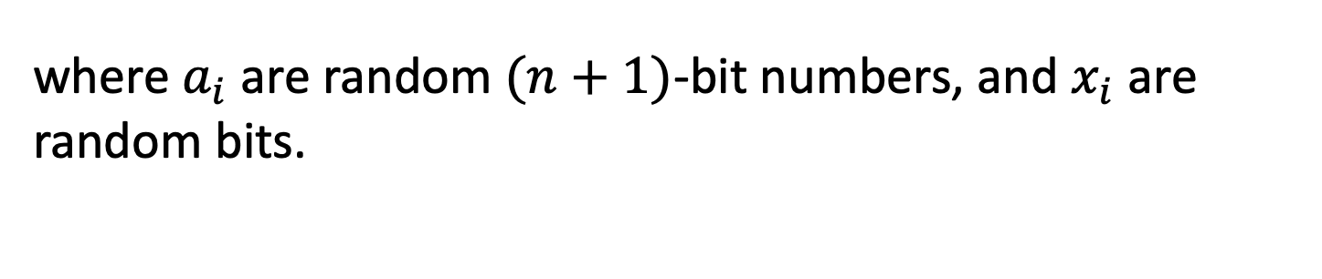
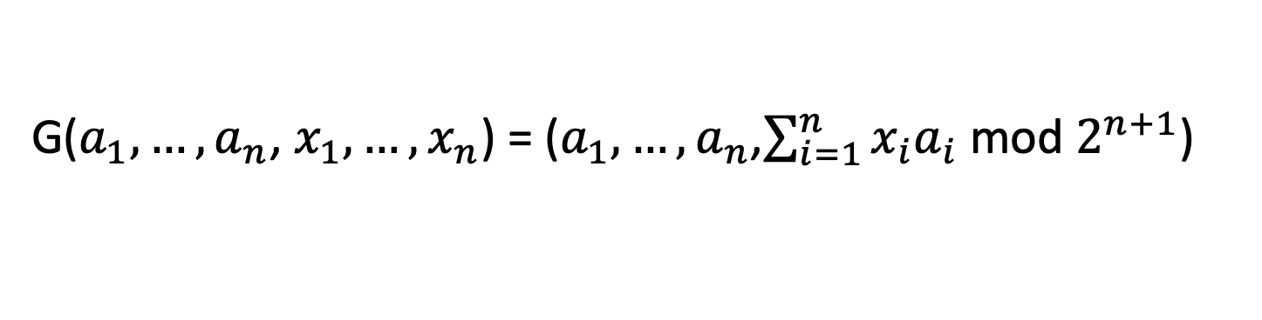
Another Construction of PRG
A PRG Candidate from the average-case hardness of Subset-sum:
G($a_{1},…,a_{n}$, $x_{1},…,x_{n}$) = ($a_{1},…,a_{n}$,$\sum_{i=1}^{n}{x_{i}a_{i}}$ mod $2^{n+1}$)
where $a_{i}$ are random $(n+1)$-bit numbers, and $x_{i}$ are random bits.
If lattice problems are hard on the worst-case, G is a PRG.

Slide 13

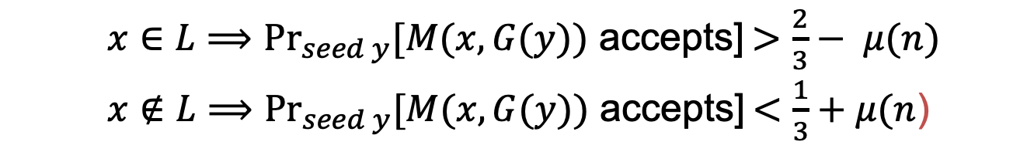
Application of PRGs: De-randomization
Theorem: if PRGs exist, then $BPP⊆ ∩_{ε>0}TIME\left(2^{m^{ε}}\right).$
(in English) if PRGs exist, then every randomized poly-time algorithm can be simulated in deterministic sub-exponential time.
Proof Sketch: use PRG that expands from ${n=m}^{ε}$ bits to $m$ bits.
$x∈L⟹{Pr}_{seed y}[M(x,G(y))$ accepts] $>\frac{2}{3}− μ(n)$
$x∉L⟹{Pr}_{seed y}[M(x,G(y))$ accepts] $<\frac{1}{3}+μ(n$)
Why?
If the above is not true, M is a distinguisher for the PRG!
Note:
M is a (known, fixed, fixed poly-time) distinguisher.

Slide 14
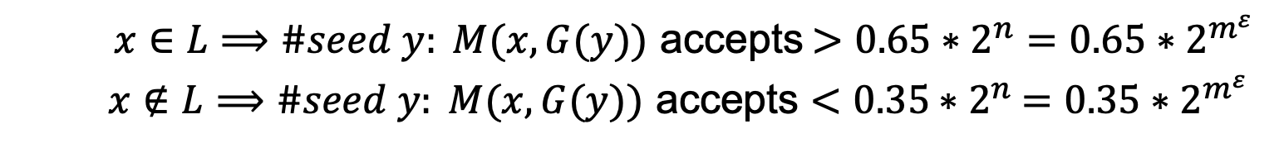

Application of PRGs: De-randomization
Theorem: if PRGs exist, then $BPP⊆ ∩_{ε>0}TIME\left(2^{m^{ε}}\right).$
(in English) if PRGs exist, then every randomized poly-time algorithm can be simulated in deterministic sub-exponential time.
Proof Sketch: : use PRG that expands from ${n=m}^{ε}$ bits to $m$ bits.
$x∈L⟹\#seed y: M(x,G(y))$ accepts $>0.65∗2^{n}=0.65∗2^{m^{ε}}$
$x∉L⟹\#seed y: M(x,G(y))$ accepts $<0.35$ $∗2^{n}$ $=0.35∗2^{m^{ε}}$
Here is the deterministic algorithm: enumerate over all seeds $y$and run $M\left(x,G\left(y\right)\right).$ If #accepts $>0.65∗2^{m^{ε}}$, accept else reject.

Slide 15
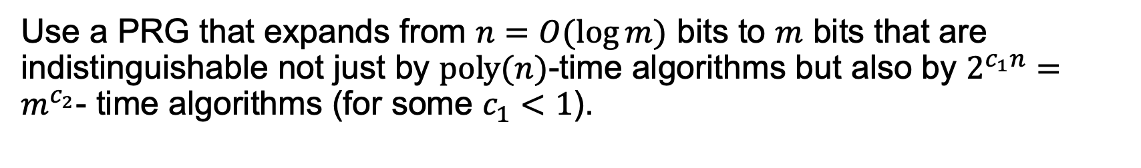

Application of PRGs: De-randomization
Theorem: If “exponentially secure” PRGs exist, then $BPP=P.$
Proof Sketch:
Use a PRG that expands from $n=O(\log{m)}$ bits to $m$ bits that are indistinguishable not just by $poly(n)$-time algorithms but also by $2^{c_{1}n}=m^{c_{2}}$- time algorithms (for some $c_{1}<1$).
The previous proof goes through mutatis mutandis, using crucially the fact that the randomized algorithm (adversary for us) runs in fixed polynomial-time.

Slide 16
Construction of Hardcore Bit

Slide 17

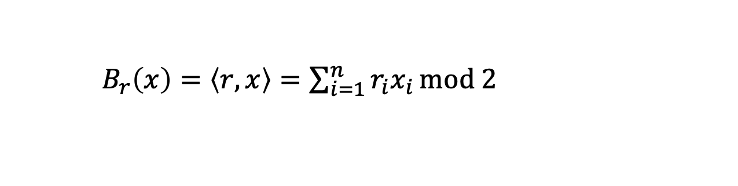
Goldreich-Levin (GL) Theorem
Let ${\{B}_{r}:{\{0,1\}}^{n}→\{0,1\}\}$ where
$B_{r}\left(x\right)=\left\langle r,x\right\rangle =\sum_{i=1}^{n}{r_{i}x_{i}}mod 2$
be a collection of predicates (one for each $r$). Then, a random $B_{r}$is hardcore for every one-way function $F$. That is, for every one-way function $F$, every PPT $A$, there is a negligible function $μ$ s.t.
$$\operatorname{Pr}\left[x←{\left\{0,1\right\}}^{n};r←{\left\{0,1\right\}}^{n}:A\left(F\left(x\right),r\right)=B_{r}(x)\right]≤\frac{1}{2}+μ(n)$$

Slide 18

GL Theorem: Alternative Interpretation
For every one-way function/permutation $F$, there is a related one-way function/permutation
$F^{′}\left(x,r\right)=(F\left(x\right),r)$
which has a deterministic hardcore predicate. In particular, the predicate $B\left(x,r\right)=$ $\left\langle r,x\right\rangle mod 2$ is hardcore for $F^{′}$.
$$\operatorname{Pr}\left[x←{\left\{0,1\right\}}^{n};r←{\left\{0,1\right\}}^{n}:A\left(F′\left(x,r\right)\right)=\left\langle r,x\right\rangle \right]≤\frac{1}{2}+μ(n)$$
This statement is sufficient to construct PRGs from any OWP.

Slide 19
Proof of GL Theorem
Assume for contradiction there is a predictor $P$
$$\operatorname{Pr}\left[x←{\left\{0,1\right\}}^{n};r←{\left\{0,1\right\}}^{n}:P\left(F\left(x\right),r\right)=\left\langle r,x\right\rangle \right]≥\frac{1}{2}+1/p(n)$$
We will need to show an inverter $A$ for $F$
$$\operatorname{Pr}\left[x←{\left\{0,1\right\}}^{n} :A\left(F\left(x\right)\right)=x^{′}:F\left(x^{′}\right)=F(x)\right]≥1/p′(n)$$

Slide 20
Proof of GL Theorem
Let’s make our lives easier: assume a perfect predictor $P$
Assume for contradiction there is a predictor $P$
$$\operatorname{Pr}\left[x←{\left\{0,1\right\}}^{n};r←{\left\{0,1\right\}}^{n}:P\left(F\left(x\right),r\right)=\left\langle r,x\right\rangle \right]=1$$
We will need to show an inverter $A$ for $F$
$$\operatorname{Pr}\left[x←{\left\{0,1\right\}}^{n} :A\left(F\left(x\right)\right)=x^{′}:F\left(x^{′}\right)=F(x)\right]≥1/p′(n)$$

Slide 21
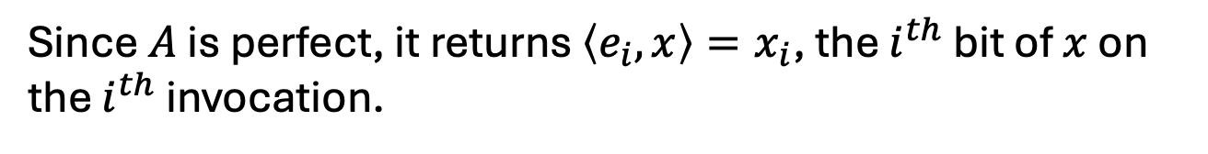
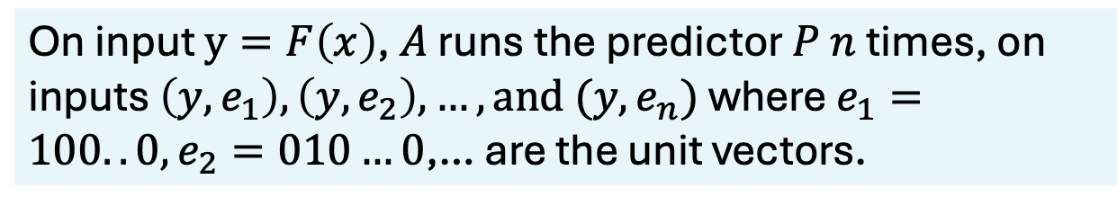
Proof of GL Theorem
Let’s make our lives easier: assume a perfect predictor $P$
Assume for contradiction there is a predictor $P$
$$\operatorname{Pr}\left[x←{\left\{0,1\right\}}^{n};r←{\left\{0,1\right\}}^{n}:P\left(F\left(x\right),r\right)=\left\langle r,x\right\rangle \right]=1$$
The inverter $A$ works as follows:
On input $y=F\left(x\right)$, $A$ runs the predictor $P$ $n$ times, on inputs $\left(y,e_{1}\right), \left(y,e_{2}\right),…, and (y,e_{n})$ where $e_{1}=100..0, e_{2}=010…0$,… are the unit vectors.
Since $A$ is perfect, it returns $\left\langle e_{i},x\right\rangle =x_{i}$, the $i^{th}$ bit of $x$ on the $i^{th}$ invocation.

Slide 22
Proof of GL Theorem
OK, now let’s assume less: assume a pretty good predictor $P$
Assume for contradiction there is a predictor $P$
$$\operatorname{Pr}\left[x←{\left\{0,1\right\}}^{n};r←{\left\{0,1\right\}}^{n}:P\left(F\left(x\right),r\right)=\left\langle r,x\right\rangle \right]≥\frac{3}{4}+1/p(n)$$
First, we need an averaging argument.
Claim: For at least a $1/2p(n)$ fraction of the $x$,
$$\operatorname{Pr}\left[r←{\left\{0,1\right\}}^{n}:P\left(F\left(x\right),r\right)=\left\langle r,x\right\rangle \right]≥\frac{3}{4}+1/2p(n)$$
Proof: Exercise in counting.
Call these the good $x.$

Slide 23
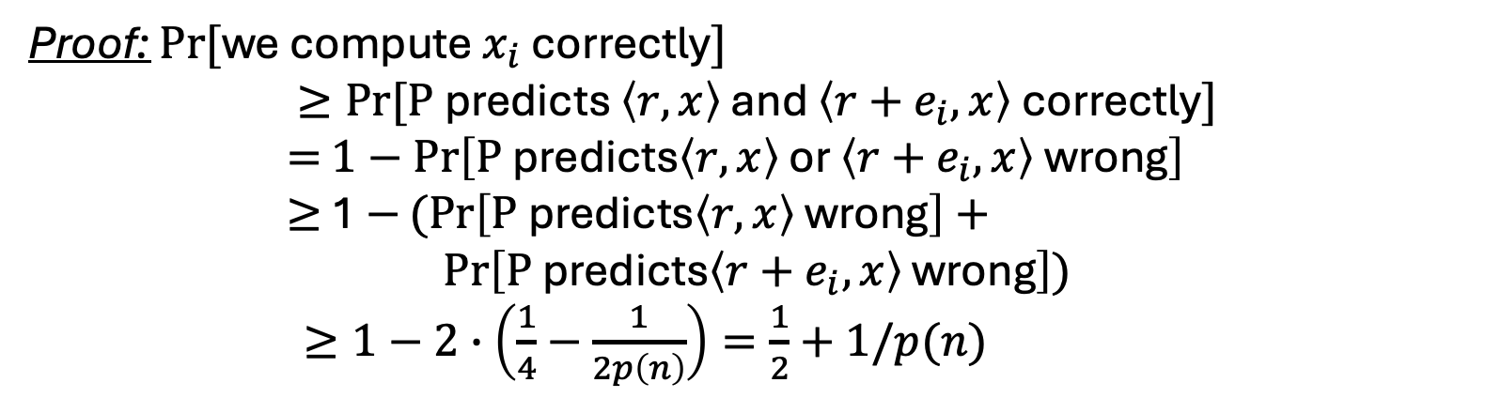
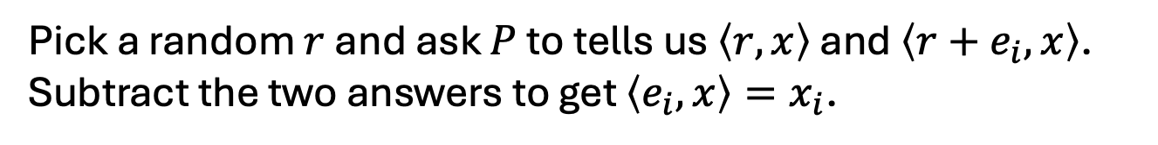
Proof of GL Theorem
For at least a $1/2p(n)$ fraction of the $x$,
$$\operatorname{Pr}\left[r←{\left\{0,1\right\}}^{n}:P\left(F\left(x\right),r\right)=\left\langle r,x\right\rangle \right]≥\frac{3}{4}+1/2p(n)$$
Key Idea: Linearity
Pick a random $r$ and ask $P$ to tells us $\left\langle r,x\right\rangle$ and $\left\langle r+e_{i},x\right\rangle$. Subtract the two answers to get $\left\langle e_{i},x\right\rangle =x_{i}$.
Proof: $Pr⁡[$we compute $x_{i}$ correctly$]$
$$≥Pr⁡[\text{P} \text{predicts} \left\langle r,x\right\rangle \text{and} \left\langle r+e_{i},x\right\rangle \text{correctly}]$$
$=$ $1−\operatorname{Pr}\left[\text{P} \text{predicts}\left\langle r,x\right\rangle \text{or} \left\langle r+e_{i},x\right\rangle \text{wrong}\right]$
$≥$ 1 $−(Pr\left[\text{P} \text{predicts}\left\langle r,x\right\rangle \text{wrong}\right]+$
$$\operatorname{Pr}\left[\text{P} \text{predicts}\left\langle r+e_{i},x\right\rangle \text{wrong}\right])$$
$≥1−2∙\left(\frac{1}{4}−\frac{1}{2p\left(n\right)}\right)=\frac{1}{2}+1/p(n)$
(by union bound)

Slide 24
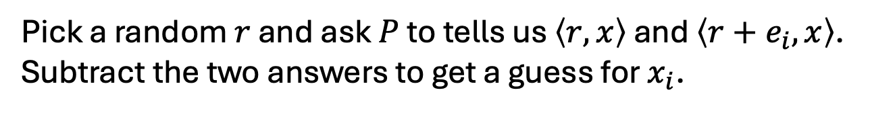
Proof of GL Theorem
For at least a $1/2p(n)$ fraction of the $x$,
$$\operatorname{Pr}\left[r←{\left\{0,1\right\}}^{n}:P\left(F\left(x\right),r\right)=\left\langle r,x\right\rangle \right]≥\frac{3}{4}+1/2p(n)$$
Inverter A:
Repeat for each $i∈\left\{1,2,…,n\right\}$:
Repeat $\log{n}∗p(n)$ times:
Pick a random $r$ and ask $P$ to tells us $\left\langle r,x\right\rangle$ and $\left\langle r+e_{i},x\right\rangle$. Subtract the two answers to get a guess for $x_{i}$.
Compute the majority of all such guesses and set the bit as $x_{i}$
Output the concatenation of all $x_{i}$ as $x.$
Analysis: Chernoff + Union Bound

Slide 25
Now the real Proof…
Assume (after averaging) that for $≥1/2p(n)$ fraction of the $x$,
$$\operatorname{Pr}\left[r←{\left\{0,1\right\}}^{n}:P\left(F\left(x\right),r\right)=\left\langle r,x\right\rangle \right]≥\frac{1}{2}+1/2p(n)$$

Slide 26
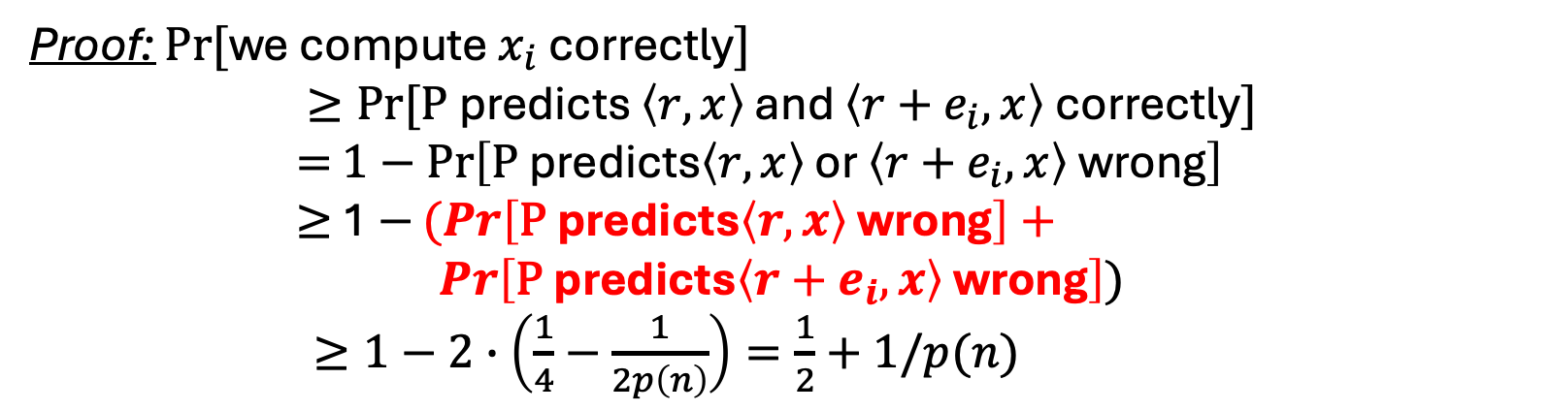
Who’s the culprit here?
For at least a $1/2p(n)$ fraction of the $x$,
$$\operatorname{Pr}\left[r←{\left\{0,1\right\}}^{n}:P\left(F\left(x\right),r\right)=\left\langle r,x\right\rangle \right]≥\frac{3}{4}+1/2p(n)$$
Pick a random $r$ and ask $P$ to tells us $\left\langle r,x\right\rangle$ and $\left\langle r+e_{i},x\right\rangle$. Subtract the two answers to get $\left\langle e_{i},x\right\rangle =x_{i}$.
Proof: $Pr⁡[$we compute $x_{i}$ correctly$]$
$$≥Pr⁡[\text{P} \text{predicts} \left\langle r,x\right\rangle \text{and} \left\langle r+e_{i},x\right\rangle \text{correctly}]$$
$=$ $1−\operatorname{Pr}\left[\text{P} \text{predicts}\left\langle r,x\right\rangle \text{or} \left\langle r+e_{i},x\right\rangle \text{wrong}\right]$
$≥$ 1 $−(Pr\left[\text{P} \text{predicts}\left\langle r,x\right\rangle \text{wrong}\right]+$
$$\operatorname{Pr}\left[\text{P} \text{predicts}\left\langle r+e_{i},x\right\rangle \text{wrong}\right])$$
$≥1−2∙\left(\frac{1}{4}−\frac{1}{2p\left(n\right)}\right)=\frac{1}{2}+1/p(n)$
We need a more careful analysis on their correlation
(by union bound)

Slide 27
Now on to the Real Proof
Assume (after averaging) that for $≥1/2p(n)$ fraction of the $x$,
$$\operatorname{Pr}\left[r←{\left\{0,1\right\}}^{n}:P\left(F\left(x\right),r\right)=\left\langle r,x\right\rangle \right]≥\frac{1}{2}+1/2p(n)$$
Key Idea: Pairwise independence

Slide 28
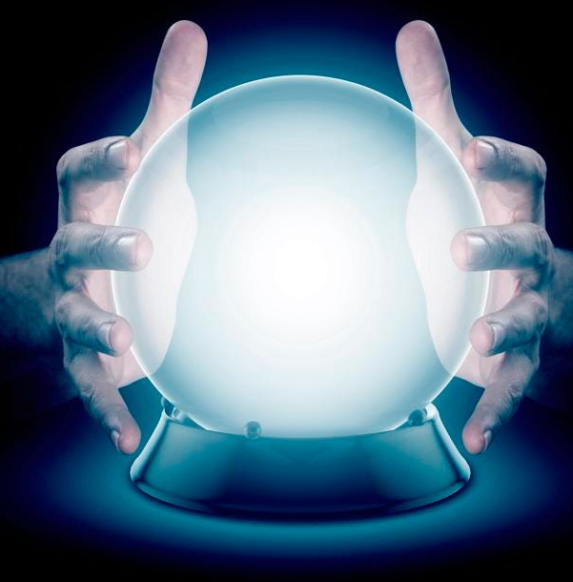

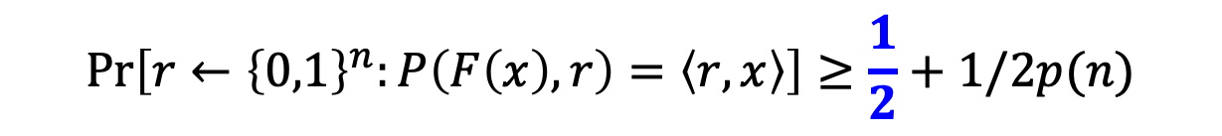
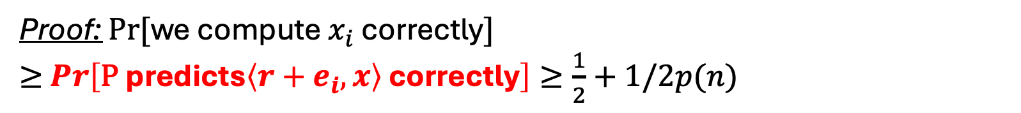
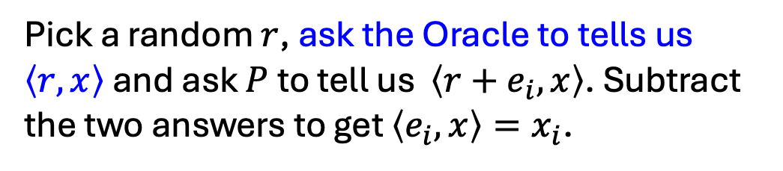
A Proof of the GL Theorem
(attributed to Charlie Rackoff)
Assume (after averaging) that for $≥1/2p(n)$ fraction of the $x$,
$$\operatorname{Pr}\left[r←{\left\{0,1\right\}}^{n}:P\left(F\left(x\right),r\right)=\left\langle r,x\right\rangle \right]≥\frac{1}{2}+1/2p(n)$$
For a minute, assume we have a bit of help/advice.
Pick a random $r$, ask the Oracle to tells us $\left\langle r,x\right\rangle$ and ask $P$ to tell us $\left\langle r+e_{i},x\right\rangle$. Subtract the two answers to get $\left\langle e_{i},x\right\rangle =x_{i}$.
Proof: $Pr⁡[$we compute $x_{i}$ correctly$]$
$≥$ $\operatorname{Pr}\left[\text{P} \text{predicts}\left\langle r+e_{i},x\right\rangle \text{correctly}\right]≥\frac{1}{2}+1/2p(n)$

Slide 29

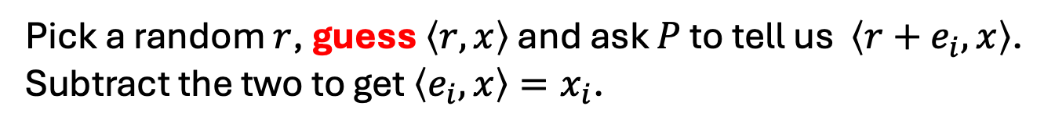
A Proof of the GL Theorem
(attributed to Charlie Rackoff)
Assume (after averaging) that for $≥1/2p(n)$ fraction of the $x$,
$$\operatorname{Pr}\left[r←{\left\{0,1\right\}}^{n}:P\left(F\left(x\right),r\right)=\left\langle r,x\right\rangle \right]≥\frac{1}{2}+1/2p(n)$$
Pick a random $r$, guess $\left\langle r,x\right\rangle$ and ask $P$ to tell us $\left\langle r+e_{i},x\right\rangle$. Subtract the two to get $\left\langle e_{i},x\right\rangle =x_{i}$.
If our guesses are all correct, then the analysis works out just as before.
But what’s the chance…?
Let’s focus on $m= O(n log{n}{(p(n))}^{2})$ possibility of $r$

Slide 30
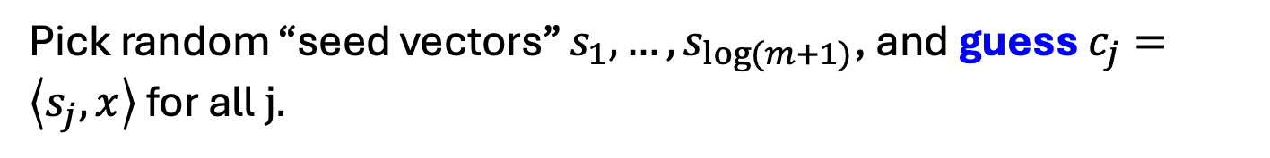
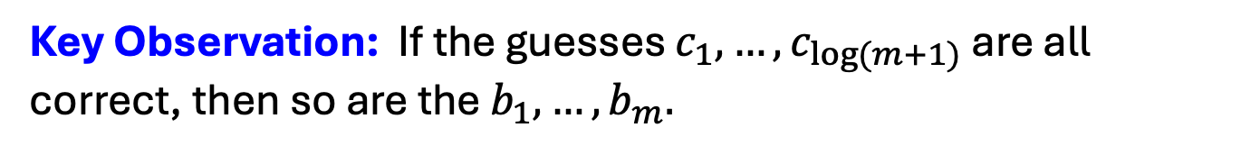
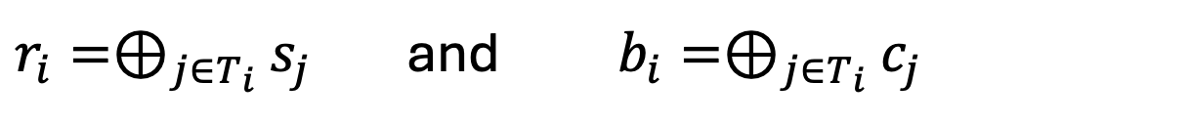
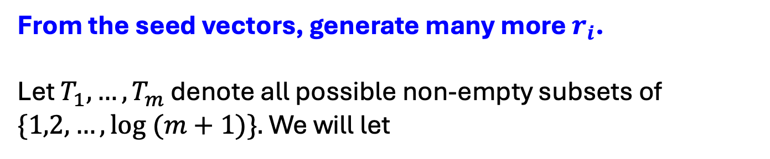
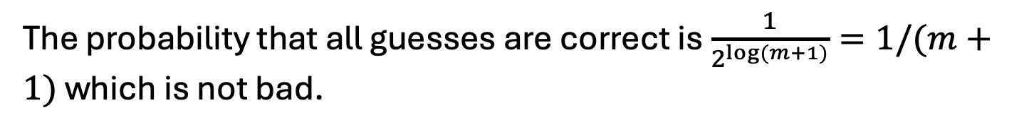
Parsimony in Guessing
Pick random “seed vectors” $s_{1},…,s_{\log{(m+1)}}$, and guess $c_{j}=\left\langle s_{j},x\right\rangle$ for all$j.$
The probability that all guesses are correct is $\frac{1}{2^{\log{(m+1)}}}=1/(m+1)$ which is not bad.
From the seed vectors, generate many more $r_{i}$.
Let $T_{1},…,T_{m}$ denote all possible non-empty subsets of $\{1,2,…,\log{(m+1)\}.}$ We will let
$r_{i}=⊕_{j∈T_{i}}$ $s_{j}$ and $b_{i}=⊕_{j∈T_{i}}$ $c_{j}$
Key Observation: If the guesses $c_{1},…,c_{\log{(m+1)}}$ are all correct, then so are the $b_{1},…,b_{m}.$

Slide 31
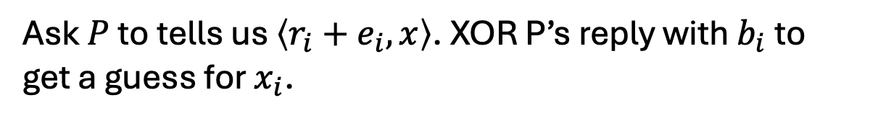

The OWF Inverter
Generate random $s_{1},…,s_{log⁡(m+1)}$ and bits $c_{1},…,c_{log⁡(m+1)}$.
From them, derive $r_{1},…,r_{log⁡(m+1)}$ and bits $b_{1},…,b_{m}$ as in the previous slide.
Repeat for each $i∈\left\{1,2,…,n\right\}$:
Repeat $100n{(p(n))}^{2}$ times:
Ask $P$ to tells us $\left\langle r_{i}+e_{i},x\right\rangle$. XOR P’s reply with $b_{i}$to get a guess for $x_{i}$.
Compute the majority of all such guesses and set the bit as $x_{i}$
Output the concatenation of all $x_{i}$ as $x.$

Slide 32

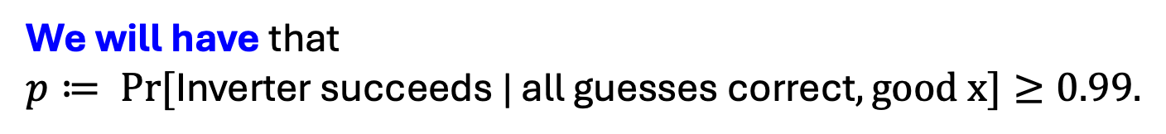

Analysis of the Inverter
Let’s condition on the guesses $c_{1},…,c_{log⁡(m+1)}$ being all correct.
The main issue: The $r_{i}$ are not independent (can’t do Chernoff)
Key Observation: The $r_{i}$ are pairwise independent.
Therefore, can apply Chebyshev!
We will have that
$p≔ Pr⁡[\text{Inverter} \text{succeeds}\text{ | }\text{all} \text{guesses} \text{correct}, good x]≥0.99.$

Slide 33
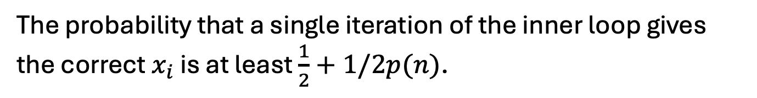

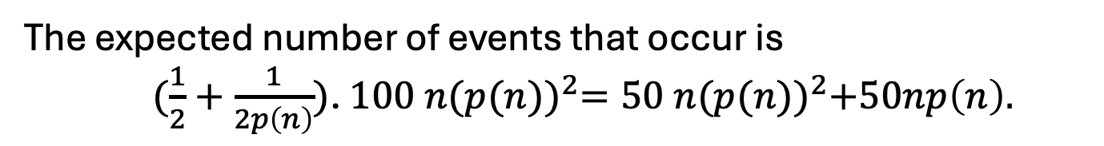
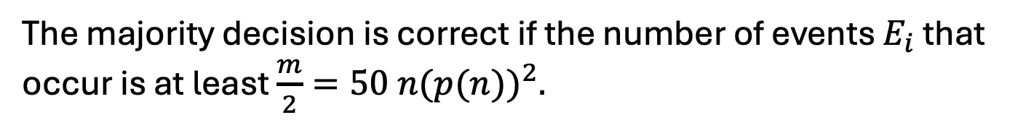
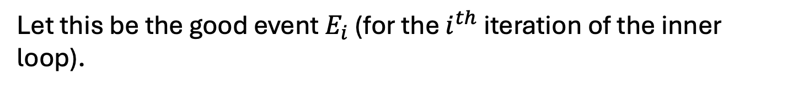
Analysis of the Inverter
The probability that a single iteration of the inner loop gives the correct $x_{i}$ is at least $\frac{1}{2}+1/2p(n)$.
Let this be the good event $E_{i}$ (for the $i^{th}$ iteration of the inner loop).
The majority decision is correct if the number of events $E_{i}$ that occur is at least $\frac{m}{2}=50 n{(p(n))}^{2}.$
The expected number of events that occur is
$(\frac{1}{2}+\frac{1}{2p\left(n\right)})$. $100 n{(p(n))}^{2}=50 n{(p(n))}^{2}+50np\left(n\right).$
The variance (independent sum) is
$≈\frac{1}{4}∙100 n{\left(p\left(n\right)\right)}^{2}=25n{\left(p\left(n\right)\right)}^{2}$

Slide 34
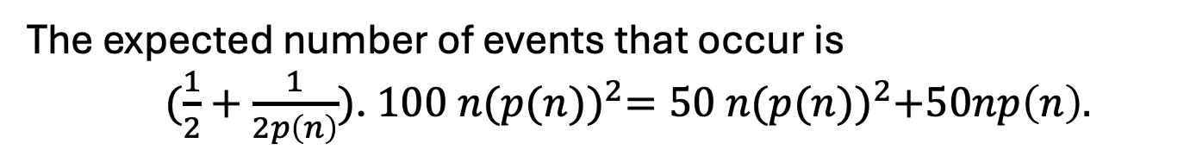
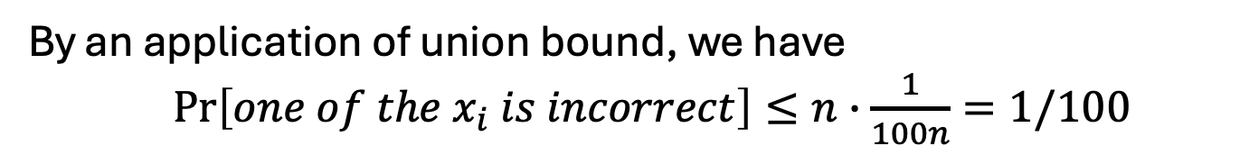
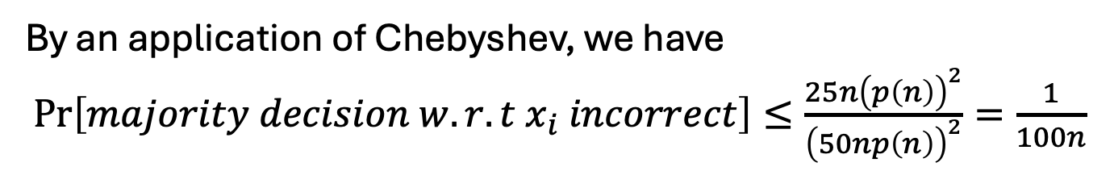
Analysis of the Inverter
The expected number of events that occur is
$(\frac{1}{2}+\frac{1}{2p\left(n\right)})$. $100 n{(p(n))}^{2}=50 n{(p(n))}^{2}+50np\left(n\right).$
The variance is $≈\frac{1}{4}∙100 n{\left(p\left(n\right)\right)}^{2}=25n{\left(p\left(n\right)\right)}^{2}$
By an application of Chebyshev, we have
$\operatorname{Pr}\left[majority decision w.r.t x_{i} incorrect\right]≤\frac{25n{\left(p\left(n\right)\right)}^{2}}{{\left(50np\left(n\right)\right)}^{2}}=\frac{1}{100n}$
By an application of union bound, we have
$\operatorname{Pr}\left[one of the x_{i} is incorrect\right]≤n∙\frac{1}{100n}=1/100$
$∴$ The inverter outputs the correct inverse w.p. $p≥0.99.$

Slide 35
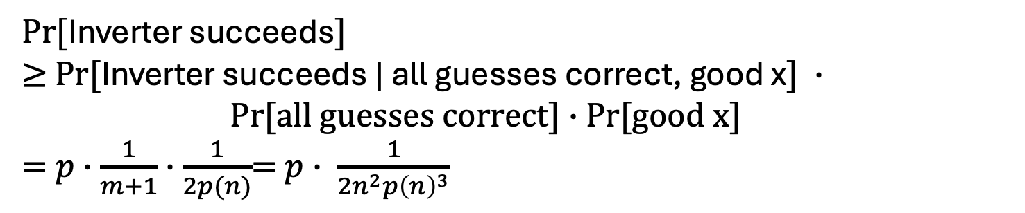
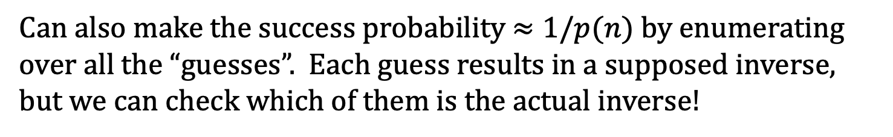
Putting it all together
$Pr⁡[$Inverter succeeds$]$
$≥$ $Pr⁡[$Inverter succeeds | all guesses correct, good x$] ∙$ $Pr[all guesses correct]∙$ Pr[good x]
= $p∙\frac{1}{m+1}∙\frac{1}{2p(n)}$= $p∙ \frac{1}{{2n}^{2}{p\left(n\right)}^{3}}$
So, it suffices to show that $p$is large.
By our calculation (last two slides), $p≥0.99$, so we are done.
Can also make the success probability $≈1/p(n)$ by enumerating over all the “guesses”. Each guess results in a supposed inverse, but we can check which of them is the actual inverse!

Slide 36
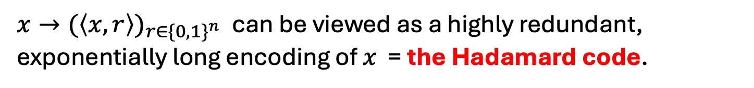
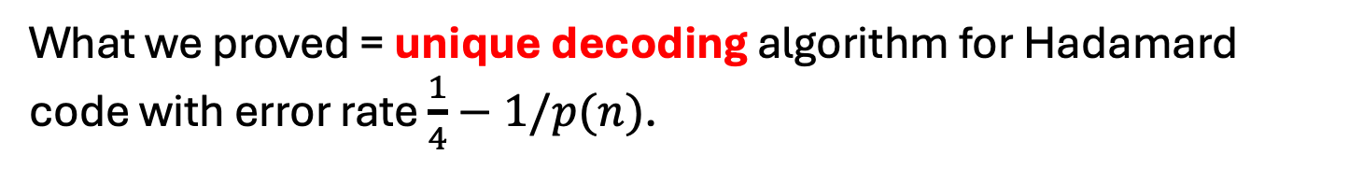
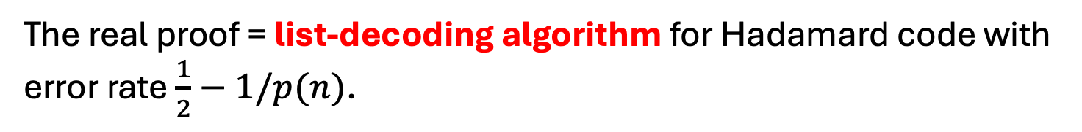
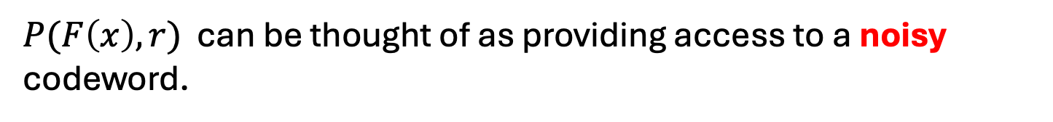
The Coding-Theoretic View of GL
$x→{(\left\langle x,r\right\rangle )}_{r∈{\{0,1\}}^{n}}$ can be viewed as a highly redundant, exponentially long encoding of $x$ = the Hadamard code.
$P(F\left(x\right),r)$ can be thought of as providing access to a noisy codeword.
What we proved = unique decoding algorithm for Hadamard code with error rate $\frac{1}{4}−1/p(n)$.
The real proof = list-decoding algorithm for Hadamard code with error rate $\frac{1}{2}−1/p(n)$.

Slide 37

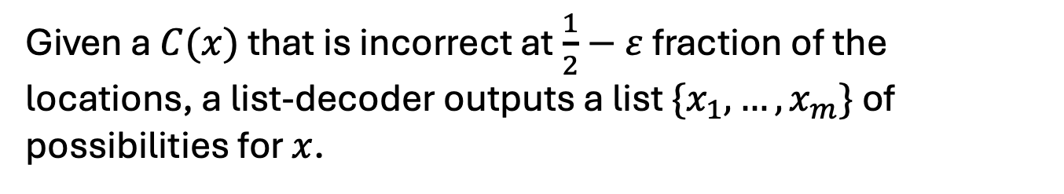
Hardcore Predicates from any
List-Decodable Code
(due to Impagliazzo and Sudan)
$x→C(x)$ is the encoding.
Given a $C(x)$ that is incorrect at $\frac{1}{2}−ε$ fraction of the locations, a list-decoder outputs a list $\{x_{1},…,x_{m}\}$ of possibilities for $x$.
The hardcore predicate is
$$B_{i}\left(x\right)= {C(x)}_{i}.$$
A hardcore-bit predictor gives us access to a corrupted codeword. Running the list-decoder on it gives us the list of possible inverses. The fact that the OWF is easy to compute means that we can filter out the bogus (non-)inverses.

