Slide 1
Purdue CS555: Cryptography Lecture 10
Instructor: Hanshen Xiao
Teaching Assistant: Justin He
course website: https://cs55500.github.io/

Slide 2
Recap
Discrete Log Assumption
Diffie-Hellman Key Exchange
Diffie-Hellman/El Gamal Encryption

Slide 3
Today
Trapdoor Permutations
RSA Encryption
Goldwasser-Micali (GM) Encryption (Quadratic Residusity)

Slide 4
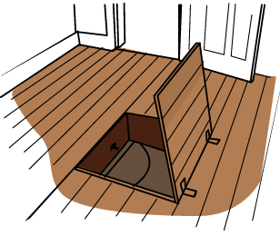
Trapdoor One-way Permutations
Trapdoor One-way Functions
One-way Functions
F
Easy to compute
Hard to invert
Easy to invert
domain
range
given a trapdoor
range
Domain = Range

Slide 5
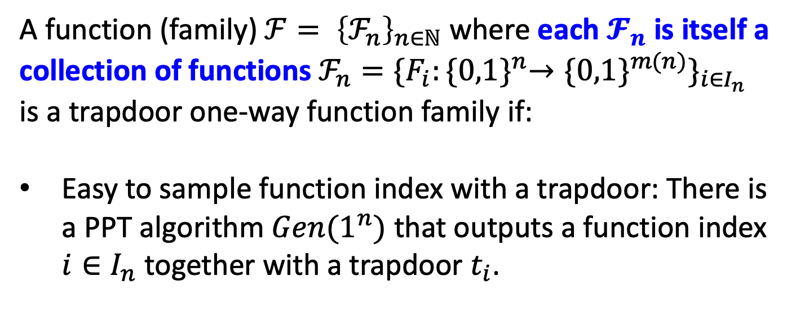
Trapdoor Functions: The Definition
A function (family${\text{) }ℱ= \left\{ℱ_{n}\right\}}_{n∈ℕ}$ where each $𝓕_{n}$ is itself a collection of functions $ℱ_{n}=\{F_{i}:{\{0,1\}}^{n}→{\{0,1\}}^{m(n)}\}_{i∈I_{n}}$ is a trapdoor one-way function family if:
Easy to sample function index with a trapdoor: There is a PPT algorithm $Gen(1^{n})$ that outputs a function index $i∈I_{n}$ together with a trapdoor $t_{i}$.

Slide 6
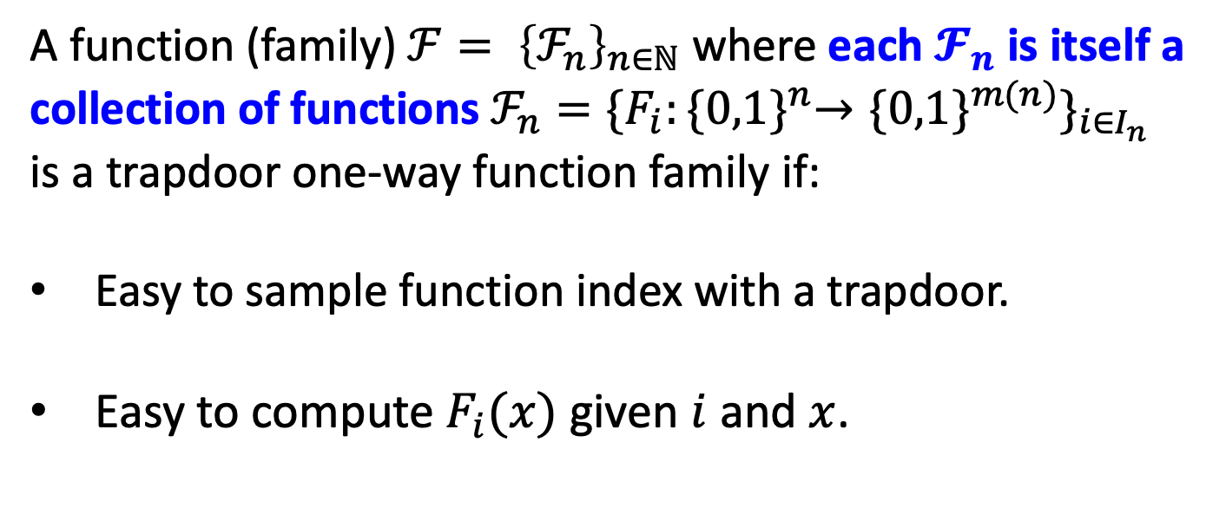
Trapdoor Functions: The Definition
A function (family${\text{) }ℱ= \left\{ℱ_{n}\right\}}_{n∈ℕ}$ where each $𝓕_{n}$ is itself a collection of functions $ℱ_{n}=\{F_{i}:{\{0,1\}}^{n}→{\{0,1\}}^{m(n)}\}_{i∈I_{n}}$ is a trapdoor one-way function family if:
Easy to sample function index with a trapdoor.
Easy to compute $F_{i}(x)$ given $i$ and $x$.

Slide 7
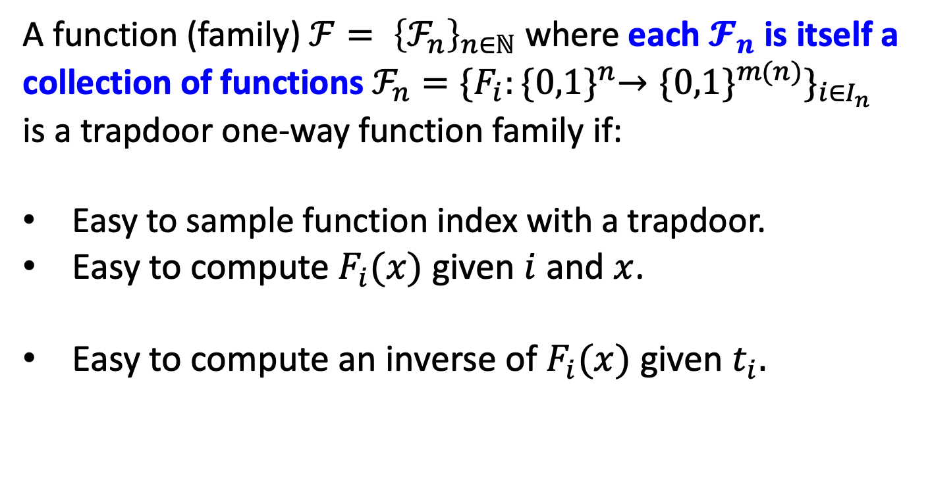
Trapdoor Functions: The Definition
A function (family${\text{) }ℱ= \left\{ℱ_{n}\right\}}_{n∈ℕ}$ where each $𝓕_{n}$ is itself a collection of functions $ℱ_{n}=\{F_{i}:{\{0,1\}}^{n}→{\{0,1\}}^{m(n)}\}_{i∈I_{n}}$ is a trapdoor one-way function family if:
Easy to sample function index with a trapdoor.
Easy to compute $F_{i}(x)$ given $i$ and $x$.
Easy to compute an inverse of $F_{i}(x)$ given $t_{i}.$

Slide 8
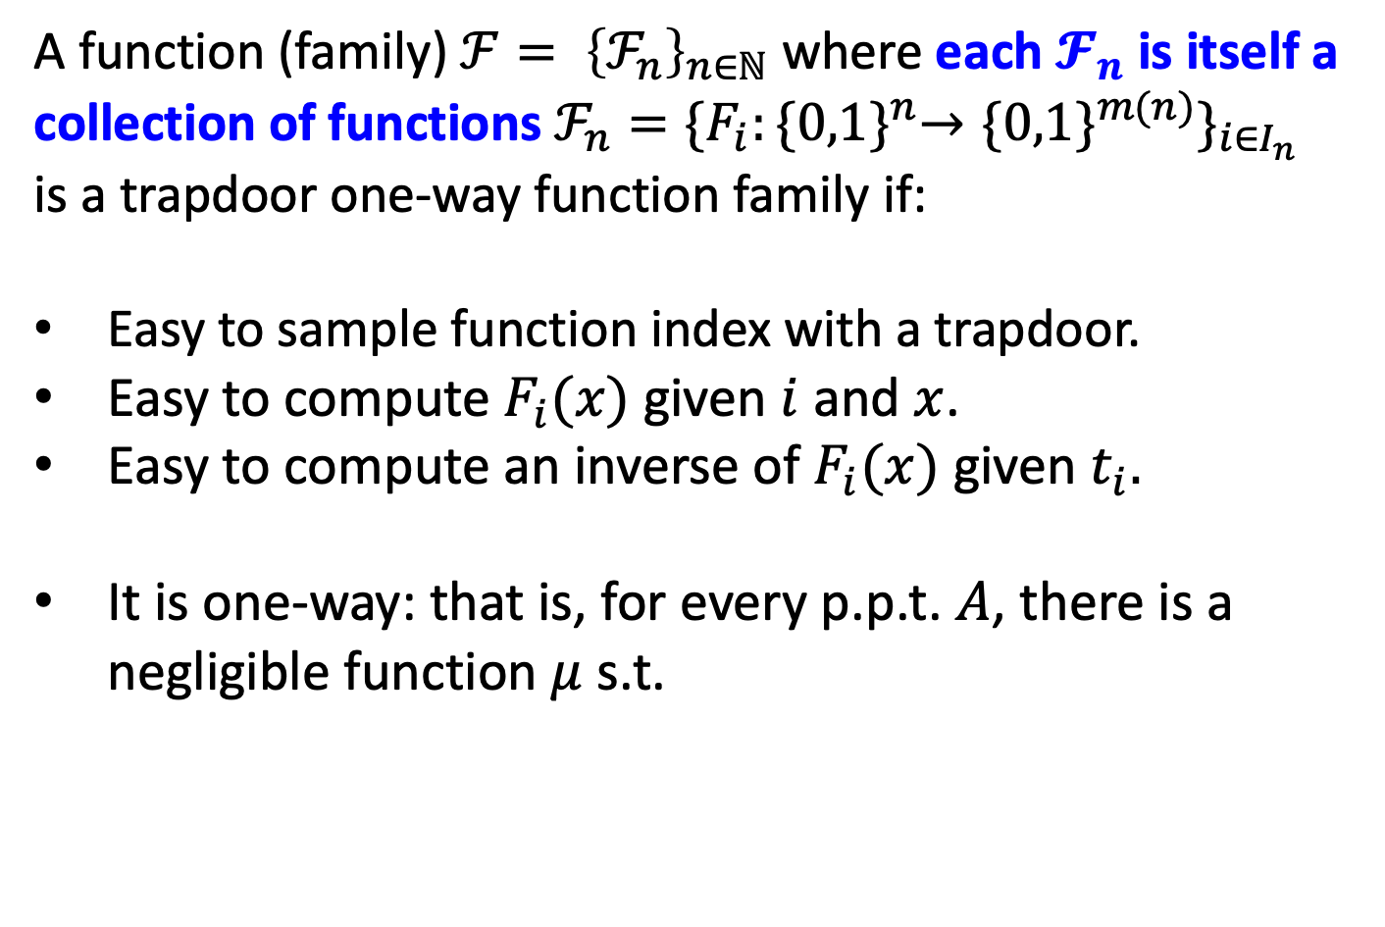

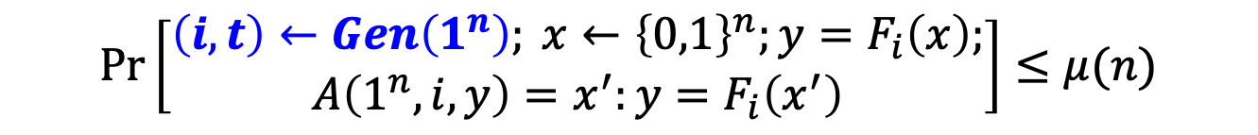
Trapdoor Functions: The Definition
A function (family${\text{) }ℱ= \left\{ℱ_{n}\right\}}_{n∈ℕ}$ where each $𝓕_{n}$ is itself a collection of functions $ℱ_{n}=\{F_{i}:{\{0,1\}}^{n}→{\{0,1\}}^{m(n)}\}_{i∈I_{n}}$ is a trapdoor one-way function family if:
Easy to sample function index with a trapdoor.
Easy to compute $F_{i}(x)$ given $i$ and $x$.
Easy to compute an inverse of $F_{i}(x)$ given $t_{i}.$
It is one-way: that is, for every p.p.t. $A$, there is a negligible function $μ$ s.t.
Trapdoor $t_{i}$ is secret
$$\operatorname{Pr}\left[\begin{aligned}\left(i,t\right)←Gen\left(1^{n}\right); x←{\left\{0,1\right\}}^{n};y=F_{i}\left(x\right); \\ A\left(1^{n},i,y\right)=x^{′}:y=F_{i}\left(x^{′}\right)\end{aligned}\right]≤μ(n)$$

Slide 9

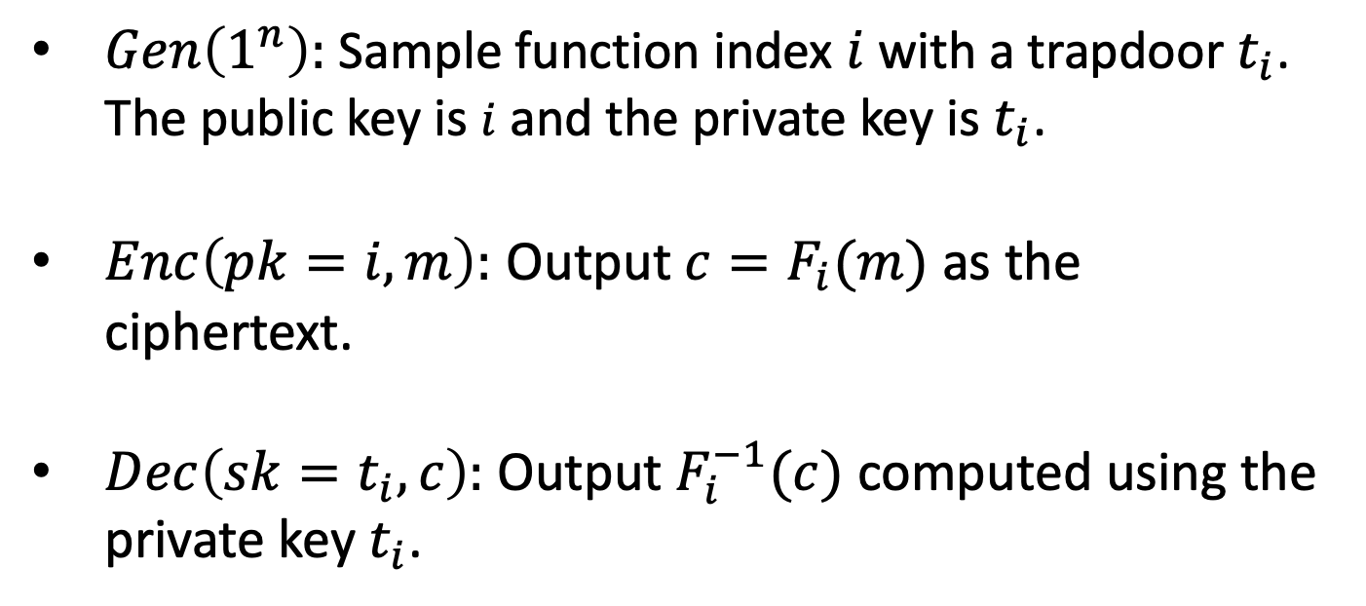
From Trapdoor Permutations to IND-Secure Public-key Encryption
$Gen\left(1^{n}\right):$ Sample function index $i$ with a trapdoor $t_{i}$. The public key is $i$ and the private key is$t_{i}$.
$Enc\left(pk=i,m\right):$ Output ${c=F}_{i}(m)$ as the ciphertext.
$Dec\left(sk=t_{i},c\right):$ Output $F_{i}^{−1}(c)$ computed using the private key $t_{i}$.
Could reveal partial info about m!
So, not IND-secure!

Slide 10
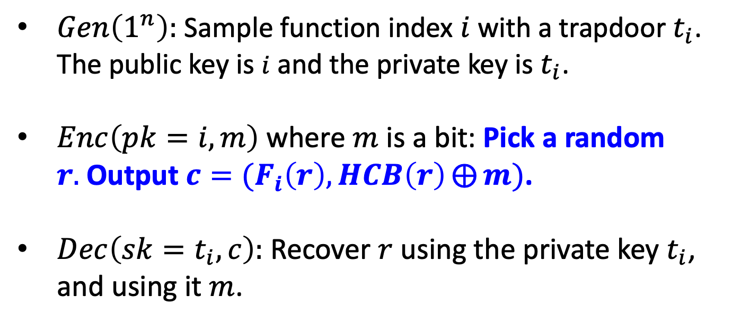
From Trapdoor Permutations to IND-Secure Public-key Encryption
$Gen\left(1^{n}\right):$ Sample function index $i$ with a trapdoor $t_{i}$. The public key is $i$ and the private key is$t_{i}$.
$Enc\left(pk=i,m\right)$ where $m$ is a bit: Pick a random $r.$Output ${c=(F}_{i}\left(r\right),HCB\left(r\right)⨁{m})$.
$Dec\left(sk=t_{i},c\right):$ Recover $r$ using the private key $t_{i}$, and using it $m$.
This is IND-CPA secure: Proof by Hybrid argument (exercise).

Slide 11
Trapdoor Permutations: Candidates
Trapdoor Permutations are exceedingly rare.
Two candidates (both need factoring to be hard):
The RSA (Rivest-Shamir-Adleman) Function
The Rabin/Blum-Williams Function: $x^{2}mod pq$

Slide 12
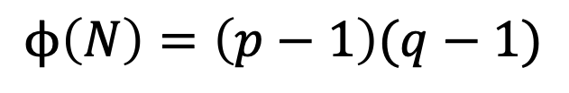
Review: Number Theory
Let’s review some number theory from L8.
Let $N=pq$ be a product of two large primes.
Fact: $Z_{N}^{∗}=\{a ∈Z_{N}:gcd\left(a,N\right)=1\}$ is a group.
group operation is multiplication mod $N$.
inverses exist and are easy to compute.
the order of the group is
$$ϕ\left(N\right)=\left(p−1\right)(q−1)$$

Slide 13


The RSA Trapdoor Permutation
Today: Let $e$ be an integer with $\gcd\left(e,ϕ(N)\right)=1.$ Then, the map $F_{N,e}\left(x\right)=x^{e} mod N$ is a trapdoor permutation.
Key Fact: Given $d$ such that $ed=1 mod ϕ\left(N\right)$, it is easy to compute $x$ given $x^{e}$.
Proof: ${(x}^{e})^{d}=x^{kϕ\left(N\right)+1}=(x^{ϕ\left(N\right)})^{k}∙x=x mod N$
(for some integer k)
This gives us the RSA trapdoor permutation collection.
$${\{F}_{N,e}:\gcd\left(e,N\right)=1\}$$
Trapdoor for inversion: $d=e^{−1}mod ϕ\left(N\right)$.

Slide 14
The RSA Trapdoor Permutation
Today: Let $e$ be an integer with $\gcd\left(e,ϕ(N)\right)=1.$ Then, the map $F_{N,e}\left(x\right)=x^{e} mod N$ is a trapdoor permutation.
Hardness of inversion without trapdoor = RSA assumption
given $N,e$ (as above) and $x^{e}$mod N, hard to compute $x.$
We know that if factoring is easy, RSA is broken (and that’s the only known way to break RSA)
Major Open Problem: Are factoring and RSA equivalent?

Slide 15
The RSA Trapdoor Permutation
Today: Let $e$ be an integer with $\gcd\left(e,ϕ(N)\right)=1.$ Then, the map $F_{N,e}\left(x\right)=x^{e} mod N$ is a trapdoor permutation.
Hardcore bits (galore) for the RSA trapdoor one-way perm:
The Goldreich-Levin bit $GL\left(r;r^{′}\right)= \left\langle r,r′\right\rangle mod 2$
The least significant bit $LSB\left(r\right)$
The “most significant bit” ${HALF}_{N}\left(r\right)=1$ iff $r<N/2$
In fact, any single bit of $r$ is hardcore.

Slide 16
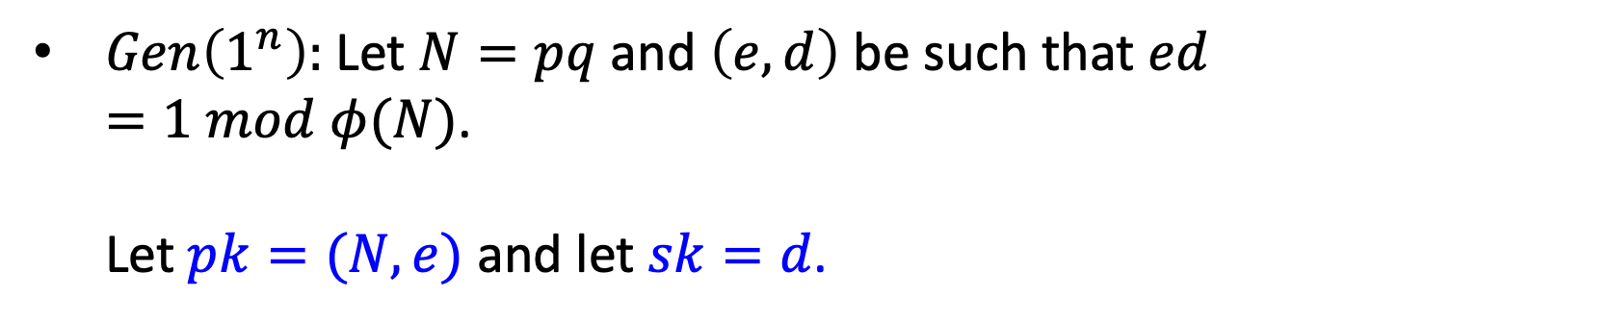
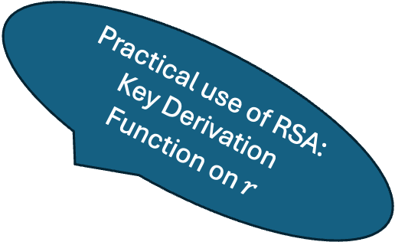
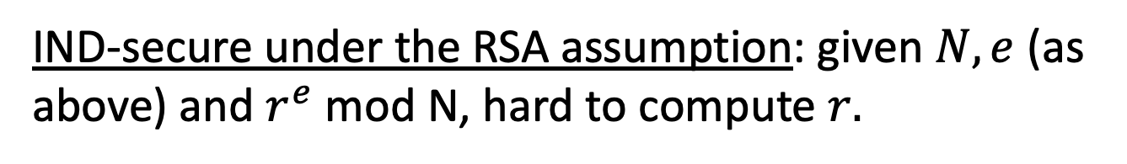
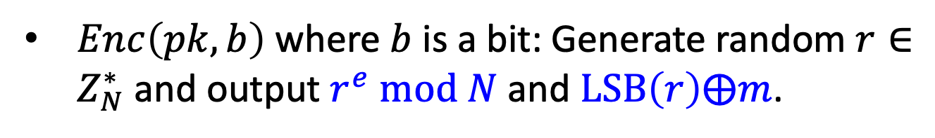
RSA Encryption
$Gen\left(1^{n}\right):$Let $N=pq$ and $\left(e,d\right)$ be such that $ed=1 mod φ(N)$. Let $pk=(N,e)$ and let $sk=d$.
$Enc\left(pk,b\right)$ where $b$ is a bit: Generate random $r∈Z_{N}^{∗}$and output $r^{e} mod N$ and $LSB\left(r\right)⨁m$.
Practical use of RSA: Key Derivation Function on $r$
$Dec\left(sk,c\right)$: Recover $r$ via RSA inversion.
IND-secure under the RSA assumption: given $N,e$ (as above) and $r^{e}$mod N, hard to compute $r.$

Slide 17
Constructions of Public-key Encryption
✅ Diffie-Hellman/El Gamal
✅ Trapdoor Permutations (RSA)
3: Quadratic Residuosity/Goldwasser-Micali
4: Post-Quantum Security & Lattice-based Encryption

Slide 18
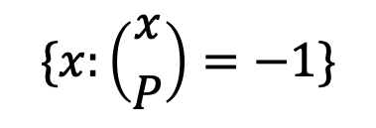
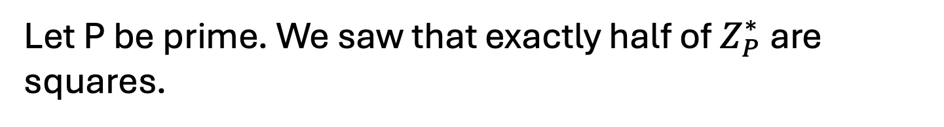

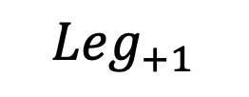
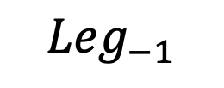
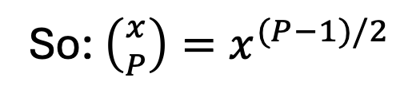
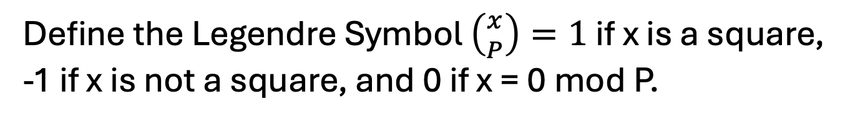
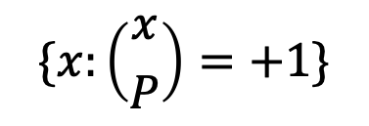
Quadratic Residues mod P
Let P be prime. We saw that exactly half of $Z_{P}^{∗}$ are squares.
Define the Legendre Symbol $\left({x \atop P}\right)=1$ if x is a square, -1 if x is not a square, and 0 if x = 0 mod P.
So: $\left({x \atop P}\right)=x^{(P−1)/2}$
$${Leg}_{−1}$$
$${Leg}_{+1}$$
$$Z_{P}^{∗}$$
$$\{x:\left({x \atop P}\right)=−1\}$$
$$\{x:\left({x \atop P}\right)=+1\}$$

Slide 19
Quadratic Residues mod P
Let P be prime. We saw that exactly half of $Z_{P}^{∗}$ are squares.
It is easy to compute square roots mod P. We will show it for the case where P = 3 (mod 4).
Claim: The square roots of $x$ mod P are ${± x}^{(P+1)/4}$
Proof: $({± x}^{(P+1)/4})^{2}$ $=x^{(P+1)/2}={x∙x}^{(P−1)/2}=x mod P$

Slide 20
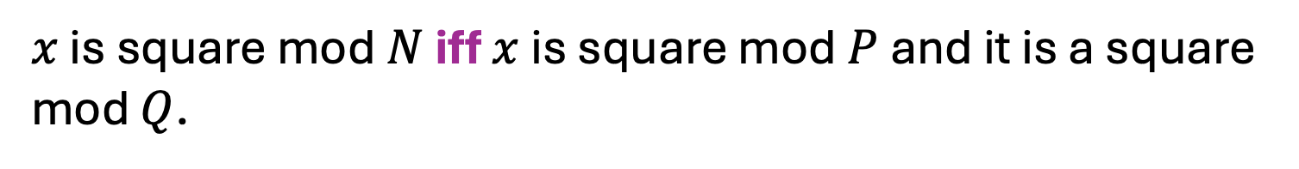
Quadratic Residues mod N
Now, let N = PQ be a product of two primes and look at $Z_{N}^{∗}$
$x$ is square mod $N$ iff $x$ is square mod $P$ and it is a square mod $Q$.
Notes:
For x to be a square mod N, it has to be a square mod P and square mod Q.
And conversely, if x = y1^2 mod P and x = y2^2 mod Q, then x = CRT(y1,y2)^2 mod PQ.

Slide 21
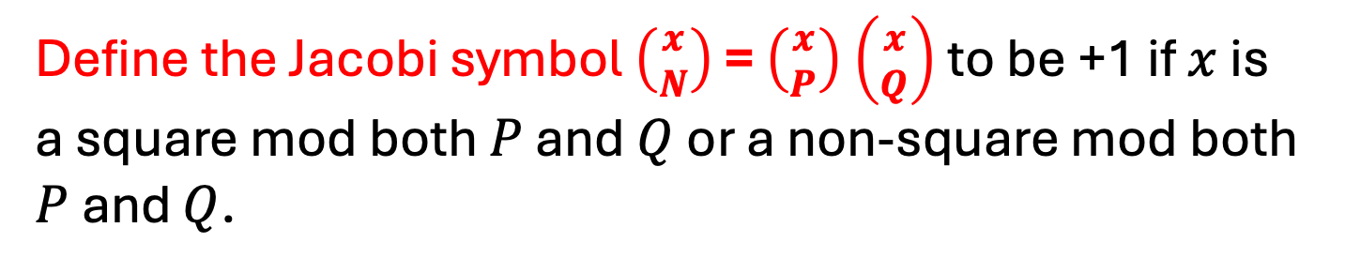

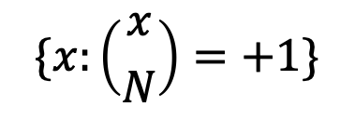
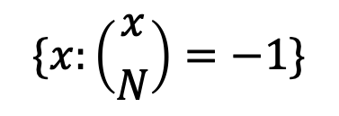

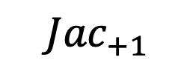
Quadratic Residues mod N
Define the Jacobi symbol $\left({x \atop N}\right)$ = $\left({x \atop P}\right)$ $\left({x \atop Q}\right)$ to be +1 if $x$ is a square mod both $P$ and $Q$ or a non-square mod both $P$ and $Q$.
$$Z_{N}^{∗}$$
$${Jac}_{−1}$$
$${Jac}_{+1}$$
$$\{x:\left({x \atop N}\right)=−1\}$$
$$\{x:\left({x \atop N}\right)=+1\}$$

Slide 22
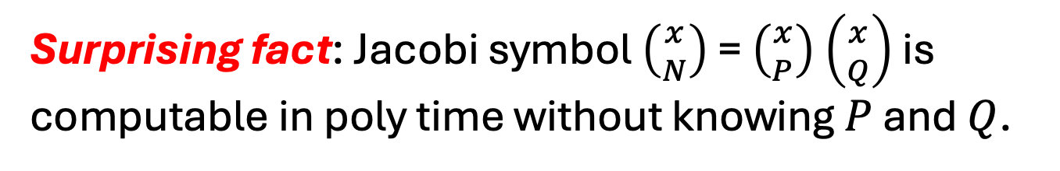
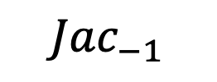
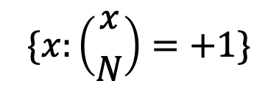
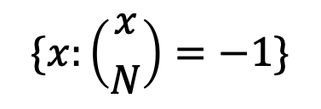

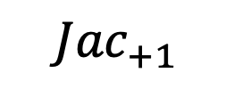
Quadratic Residues mod N
$$Z_{N}^{∗}$$
$${Jac}_{−1}$$
$${Jac}_{+1}$$
$$\{x:\left({x \atop N}\right)=−1\}$$
$$\{x:\left({x \atop N}\right)=+1\}$$
Surprising fact: Jacobi symbol $\left({x \atop N}\right)$ = $\left({x \atop P}\right)$ $\left({x \atop Q}\right)$ is computable in poly time without knowing $P$ and $Q$.
Notes:
Proof sketch on the board. Use the reciprocity law (x/N) = (N/x) (-1)^{(x-1)(N-1)/4} and (x/N) = (x mod N / N) and the supplementary facts (1 // N) = (-1)^{n-1/2} and (2 // N) = (-1)^{n^2-1/8}.

Slide 23

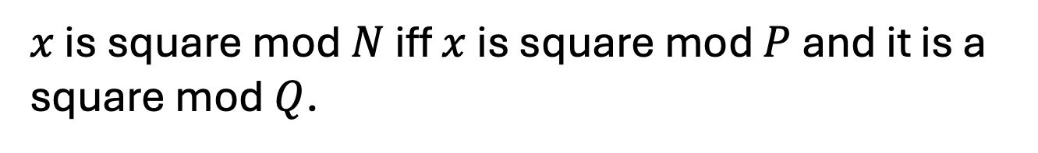
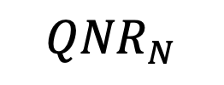
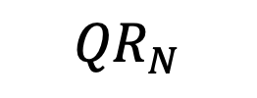
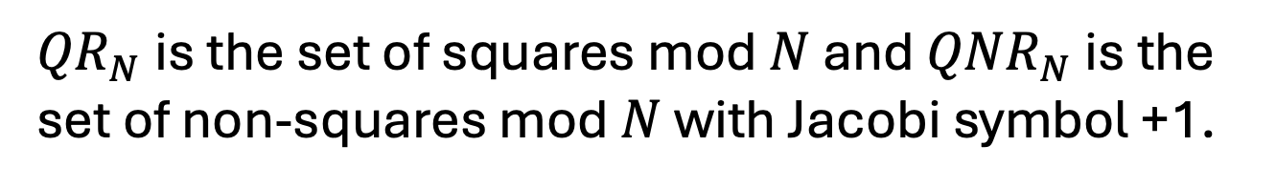
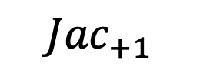

Quadratic Residues mod N
$x$ is square mod $N$ iff $x$ is square mod $P$ and it is a square mod $Q$.
$${Jac}_{+1}$$
So: ${QR}_{N}= \{x:\left({x \atop P}\right)=\left({x \atop Q}\right)=+1\}$
$${QR}_{N}$$
${QNR}_{N}= \{x:\left({x \atop P}\right)=\left({x \atop Q}\right)=−1\}$
$${QNR}_{N}$$
${QR}_{N}$ is the set of squares mod $N$ and ${QNR}_{N}$ is the set of non-squares mod $N$ with Jacobi symbol +1.
Notes:
For x to be a square mod N, it has to be a square mod P and square mod Q.
And conversely, if x = y1^2 mod P and x = y2^2 mod Q, then x = CRT(y1,y2)^2 mod PQ.

Slide 24
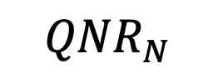
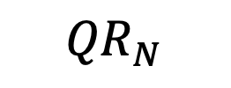
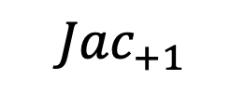
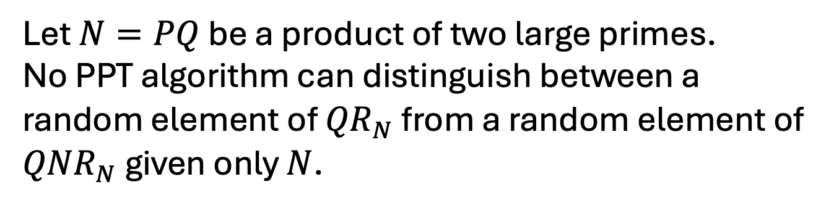
Recognizing Squares mod N
… seems hard
Let $N=PQ$ be a product of two large primes.
Quadratic Residuosity Assumption (QRA)
Let $N=PQ$ be a product of two large primes. No PPT algorithm can distinguish between a random element of ${QR}_{N}$ from a random element of ${QNR}_{N}$ given only $N$.
$${Jac}_{+1}$$
$${QR}_{N}$$
$${QNR}_{N}$$

Slide 25
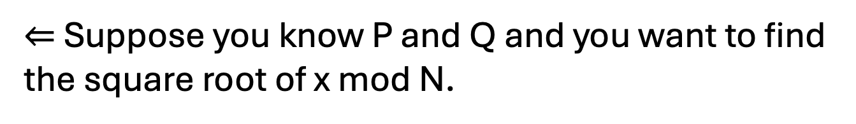
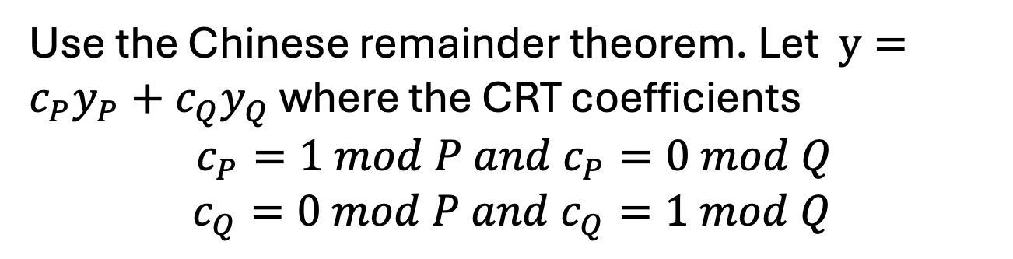
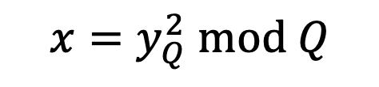
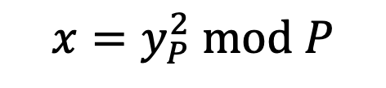
Finding Square Roots Mod N
… is as hard as factoring N
$⇐$ Suppose you know P and Q and you want to find the square root of x mod N.
Find the square roots of y mod P and mod Q.
$$x=y_{P}^{2} mod P$$
$$x=y_{Q}^{2} mod Q$$
Use the Chinese remainder theorem. Let $y=c_{P}y_{P}+c_{Q}y_{Q}$ where the CRT coefficients
$$c_{P}=1 mod P and{ c}_{P}=0 mod Q$$
$c_{Q}=0 mod P and{ c}_{Q}=1 mod Q$
Then $y$ is a square root of x mod N.
Notes:
Need CRT. E.g. x = 1 mod 3 and x = 2 mod 5 => x is unique mod 15. x = c_3 * 1 + c_5 * 2. c_3 = 10 is 1 mod 3 and 0 mod 5. c_5 = 6 is 1 mod 5 and 0 mod 3. So x = 10*1+6*2 = 22 = 7 mod 15.
For x to be a square mod N, it has to be a square mod P and square mod Q.
And conversely, if x = y1^2 mod P and x = y2^2 mod Q, then x = CRT(y1,y2)^2 mod PQ.

Slide 26
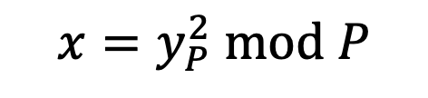
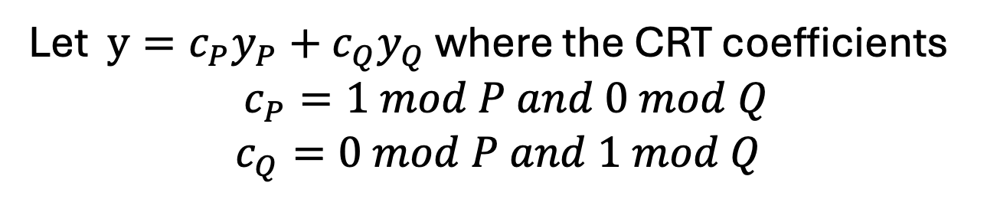
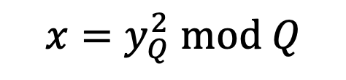
Finding Square Roots Mod N
… is as hard as factoring N
Suppose you know P and Q and you want to find the square root of x mod N.
Find the square roots of y mod P and mod Q.
$$x=y_{P}^{2} mod P$$
$$x=y_{Q}^{2} mod Q$$
Let $y=c_{P}y_{P}+c_{Q}y_{Q}$ where the CRT coefficients
$$c_{P}=1 mod P and 0 mod Q$$
$c_{Q}=0 mod P and 1 mod Q$
So, if x is a square, it has 4 distinct square roots mod N.
Notes:
For x to be a square mod N, it has to be a square mod P and square mod Q.
And conversely, if x = y1^2 mod P and x = y2^2 mod Q, then x = CRT(y1,y2)^2 mod PQ.

Slide 27
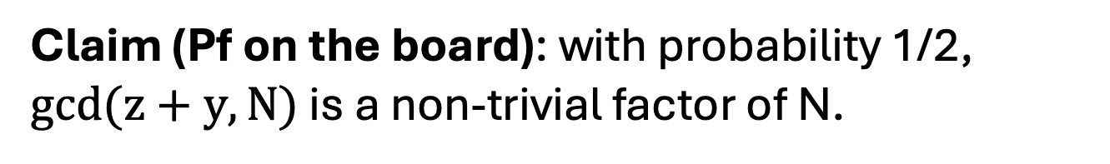
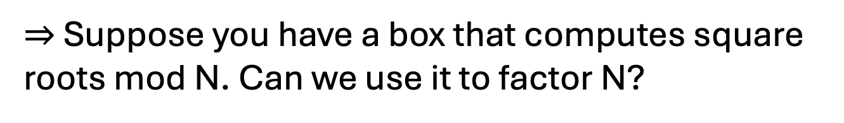
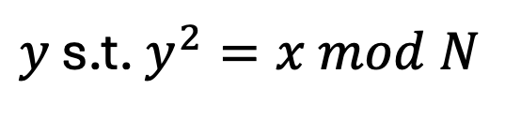

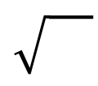
Finding Square Roots Mod N
… is as hard as factoring N
$⇒$Suppose you have a box that computes square roots mod N. Can we use it to factor N?
$$x$$
$y$ s.t. $y^{2}=x mod N$
Feed the box $x=z^{2} mod N$ for a random z.
Claim (Pf on the board): with probability 1/2, $gcd(z+y,N)$ is a non-trivial factor of N.

Slide 28



Goldwasser-Micali (GM) Encryption
$Gen\left(1^{n}\right):$Generate random $n$-bit primes $p$ and $q$ and let $N=pq$. Let $y∈{QNR}_{N}$ be some non-quadratic residue with Jacobi symbol +1. Let $pk=(N,y)$ and let $sk=(p,q)$.
$Enc\left(pk,b\right)$ where $b$ is a bit:
Generate random $r∈Z_{N}^{∗}$and output $r^{2} mod N$ if $b=0$ and $r^{2}y mod N$ if $b=1$.
$Dec\left(sk,c\right)$: Check if $c∈Z_{N}^{∗}$is a quadratic residue using $p$ and $q$. If yes, output 0 else 1.

Slide 29

Goldwasser-Micali (GM) Encryption
$Enc\left(pk,b\right)$ where $b$ is a bit:
Generate random $r∈Z_{N}^{∗}$and output $r^{2} mod N$ if $b=0$ and $r^{2}y mod N$ if $b=1$.
IND-security follows directly from the quadratic residuosity assumption.

Slide 30



GM is a Homomorphic Encryption
Given a GM-ciphertext of $b$ and a GM-ciphertext of $b′$, I can compute a GM-ciphertext of $b+b^{′}mod 2.$
without knowing anything about $b$ or $b′$!
$Enc\left(pk,b\right)$ where $b$ is a bit:
Generate random $r∈Z_{N}^{∗}$and output $r^{2}y^{b} mod N.$
Claim: $Enc\left(pk,b\right)∙Enc(pk,b^{′})$ is an encryption of $b⨁b^{′}= b+b^{′}mod 2$.
Notes:
Pf: QNR*QNR = QR.

