Slide 1
Purdue CS555: Cryptography
Lecture 4
Instructor: Hanshen Xiao
Teaching Assistant: Justin He
course website: https://cs55500.github.io/

Slide 2
Recap
Pseudorandom Generator (PRG)
One bit to (poly) many bits
Equivalence to Next-bit Unpredictability (UBN)
Hybrid Argument

Slide 3
Today
Preliminaries of Computational Complexity
  Model of Computation
  Complexity Classes
  Reduction
  P, NP, NPC, BPP
One-way Function
Construction of One-way Function and PRG
Average and Worst Case Hardness
Implication of PRG

Slide 4
Computational Complexity
The study of the resources required to solve computational problems
How much time and space
How to classify problems based on their inherent difficulty
Which problems are tractable (efficiently solvable) and which are intractable

Slide 5
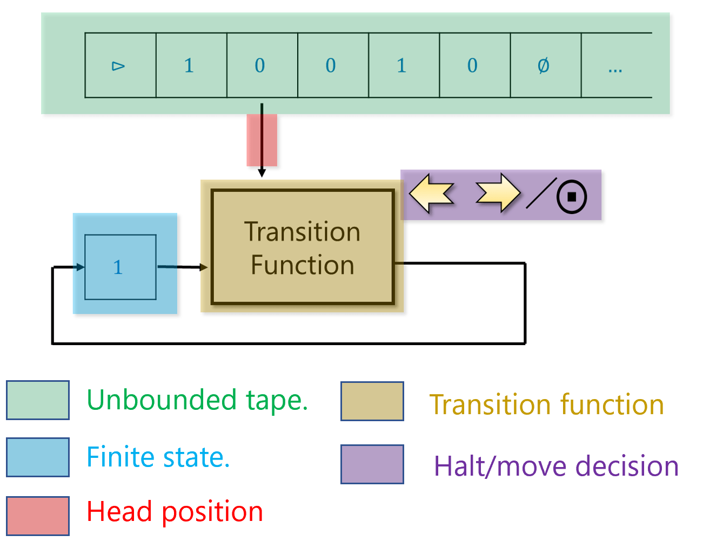

Basic Model of Computation
-- Defining computability and complexity
Algorithm: informal, high-level idea
Turing Machine: canonical formal model of algorithm
  An infinite tape divided into cells (memory)
  A head reads/writes one symbol at a time and moves left or right
  A transition function on finite states $Q$ and tape alphabets $Γ$
  $δ\left(Q×Γ\right)→Q×Γ×\{L,R\}$
  takes current state and tape symbol, and outputs: 1) the next state, the symbol to write, and the direction to move the tape head (Left or Right)
  Computation proceeds step by step until it reaches an accept or reject state (halting).

Slide 6
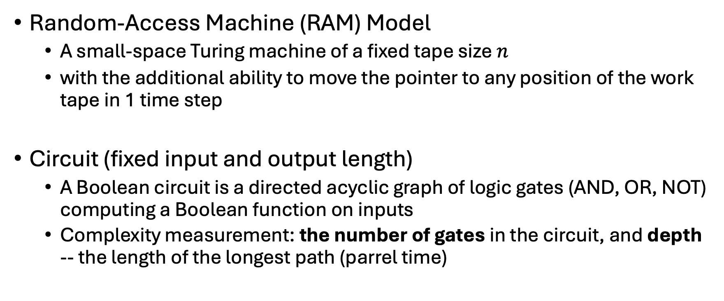
Other Models of Computation
Random-Access Machine (RAM) Model
  A small-space Turing machine of a fixed tape size $n$
  with the additional ability to move the pointer to any position of the work tape in 1 time step
Circuit (fixed input and output length)
  A Boolean circuit is a directed acyclic graph of logic gates (AND, OR, NOT) computing a Boolean function on inputs
  Complexity measurement: the number of gates in the circuit, and depth -- the length of the longest path (parrel time)

Slide 7
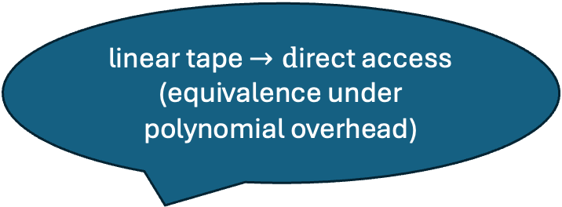
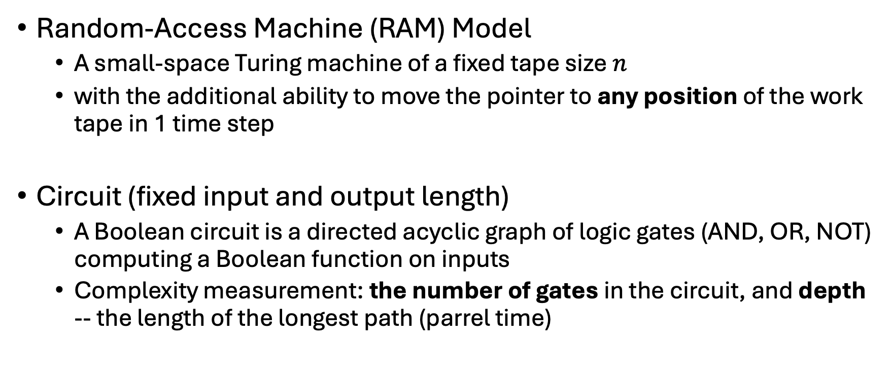
Other Models of Computation
linear tape $→d$irect access (equivalence under polynomial overhead)
Random-Access Machine (RAM) Model
  A small-space Turing machine of a fixed tape size $n$
  with the additional ability to move the pointer to any position of the work tape in 1 time step
Circuit (fixed input and output length)
  A Boolean circuit is a directed acyclic graph of logic gates (AND, OR, NOT) computing a Boolean function on inputs
  Complexity measurement: the number of gates in the circuit, and depth -- the length of the longest path (parrel time)
Equivalence: output instructions from $\left(\left\{read\right\}×\left[n\right]\right)∪\left(\left\{write\right\}×\left[n\right]×\{0,1\}\right)$:
In each time step, for specific $i∈[n]$, one either reads a bit at $i$ or write a new bit

Slide 8
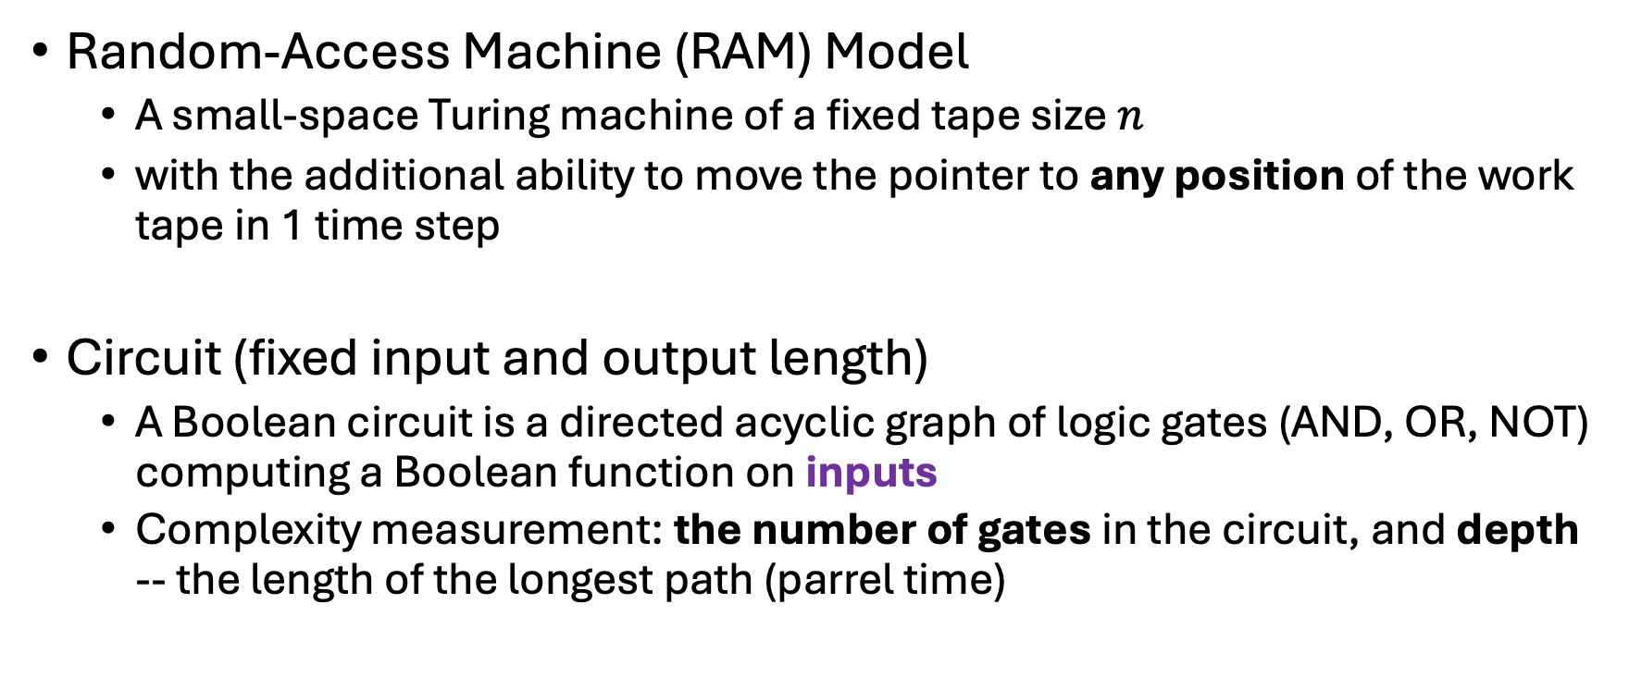
Other Models of Computation
Random-Access Machine (RAM) Model
  A small-space Turing machine of a fixed tape size $n$
  with the additional ability to move the pointer to any position of the work tape in 1 time step
Circuit (fixed input and output length)
  A Boolean circuit is a directed acyclic graph of logic gates (AND, OR, NOT) computing a Boolean function on inputs
  Complexity measurement: the number of gates in the circuit, and depth -- the length of the longest path (parrel time)
Non-uniform model
Polytime TM corresponds to a family of Poly size circuits

Slide 9
Relationship
Algorithms: The informal, high-level idea.
Turing Machines: The canonical formal model of algorithms.
RAM model: A more realistic, machine-level model equivalent (up to poly overhead) to TMs.
Circuits: A different formalization, useful for non-uniform complexity and parallel computation.

Slide 10
Complexity Classes
Problem types
Decision problem
  Is a given number q a prime?
  Does a graph have a Hamiltonian cycle?
Searching Problem
  Find a satisfying assignment to a Boolean formula?
Optimization Problem
  Find the shortest path in a graph.
Counting Problem
  Count the number of perfect matchings in a bipartite graph

Slide 11
Complexity Classes Reduction
Problem types
Decision problem
  Is a given number q a prime?
  Does a graph have a Hamiltonian cycle?
Searching Problem
  Find a satisfying assignment to a Boolean formula?
Optimization Problem
  Find the shortest path in a graph.
Counting Problem
  Count the number of perfect matchings in a bipartite graph
Is the solution starting with 0

Slide 12
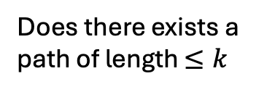
Complexity Classes
Problem types
Decision problem
  Is a given number q a prime?
  Does a graph have a Hamiltonian cycle?
Searching Problem
  Find a satisfying assignment to a Boolean formula?
Optimization Problem
  Find the shortest path in a graph.
Counting Problem
  Count the number of perfect matchings in a bipartite graph
Does there exists a path of length $≤k$

Slide 13

Complexity Classes
Problem types
Decision problem
  Is a given number q a prime?
  Does a graph have a Hamiltonian cycle?
Searching Problem
  Find a satisfying assignment to a Boolean formula?
Optimization Problem
  Find the shortest path in a graph.
Counting Problem
  Count the number of perfect matchings in a bipartite graph
Is the number of perfect matchings $≤k$

Slide 14
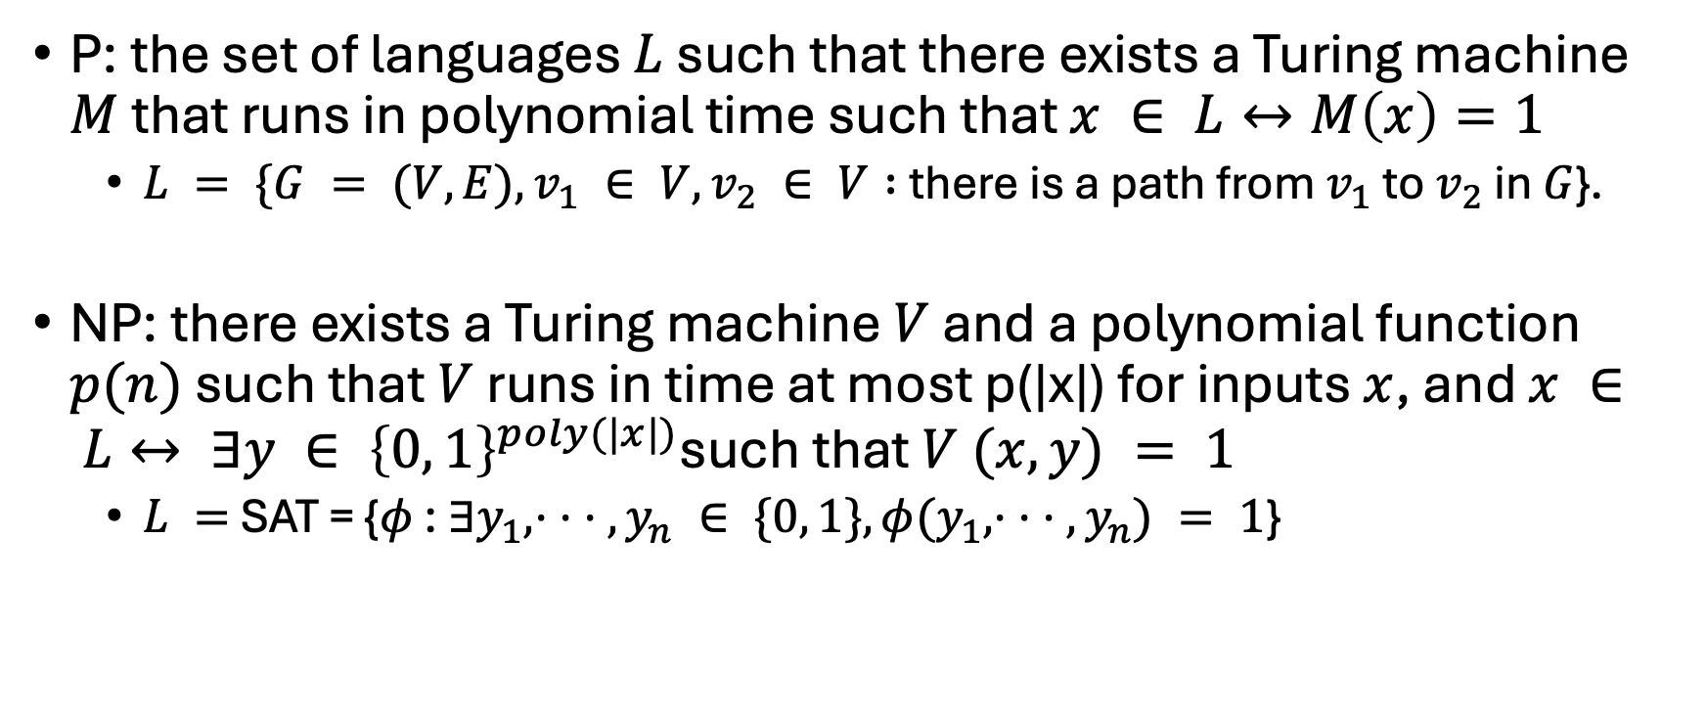
Complexity Classes of Decision Problem
P: the set of languages $L$ such that there exists a Turing machine $M$ that runs in polynomial time such that $x ∈ L↔M\left(x\right)=1$
  $L = \{G = (V, E), v_{1} ∈ V, v_{2} ∈ V :$there is a path from $v_{1}$ to $v_{2}$ in $G$}.
NP: there exists a Turing machine $V$ and a polynomial function $p(n)$ such that $V$ runs in time at most p(|x|) for inputs $x$, and $x ∈ L↔ ∃y ∈ {\left\{0, 1\right\}}^{poly(|x|)}$such that $V (x, y) = 1$
  $L =$SAT = {$φ$ : $∃y_{1}, · · · , y_{n} ∈ \{0, 1\}, φ(y_{1}, · · · , y_{n}) = 1$}
y: witness/solution: easy to verify whether a proposal is satisfied or not

Slide 15
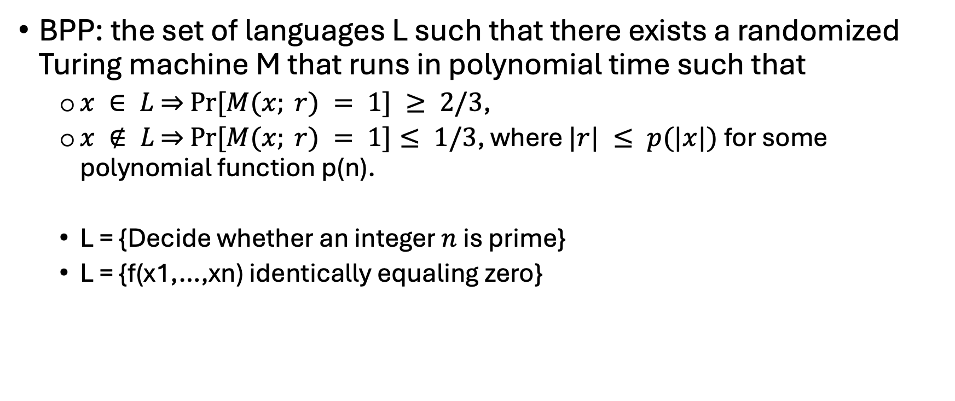
Complexity Classes of Decision Problem
BPP: the set of languages L such that there exists a randomized Turing machine M that runs in polynomial time such that
  $x ∈ L$⇒ $Pr⁡[M(x; r) = 1] ≥ 2/3$,
  $x ∉ L$ ⇒ $\operatorname{Pr}{[M(x; r) = 1]}≤ 1/3$, where $|r| ≤ p(|x|)$for some polynomial function p(n).
  L = {Decide whether an integer $n$ is prime}
  L = {f(x1,…,xn) identically equaling zero}

Slide 16

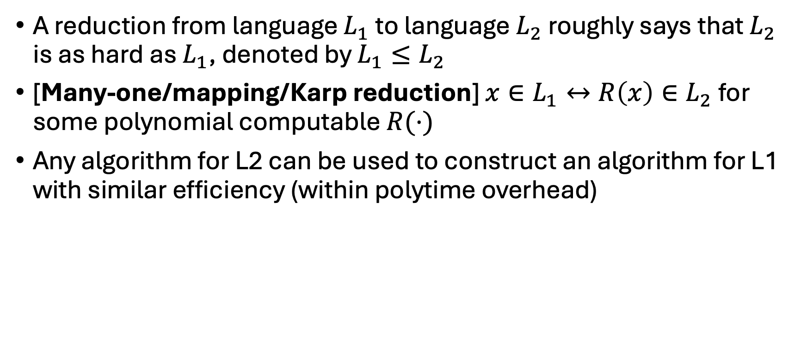
Reduction
A reduction from language $L_{1}$ to language $L_{2}$ roughly says that $L_{2}$ is as hard as $L_{1}$, denoted by $L_{1}≤L_{2}$
[Many-one/mapping/Karp reduction] $x∈L_{1}↔R\left(x\right)∈L_{2}$ for some polynomial computable $R(⋅)$
Any algorithm for L2 can be used to construct an algorithm for L1 with similar efficiency (within polytime overhead)
If we have an algorithm A for $L_{2}$, for any $x$, we first compute $R(x)$ and then $A(R(x))$

Slide 17
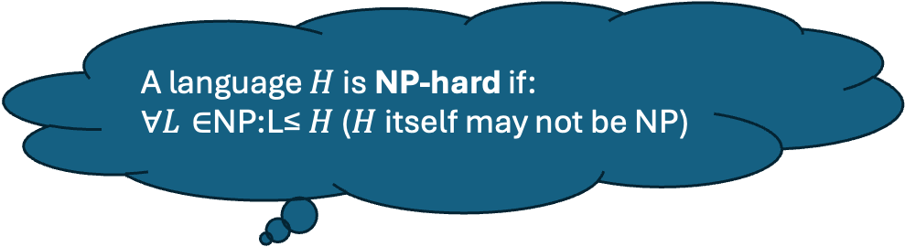
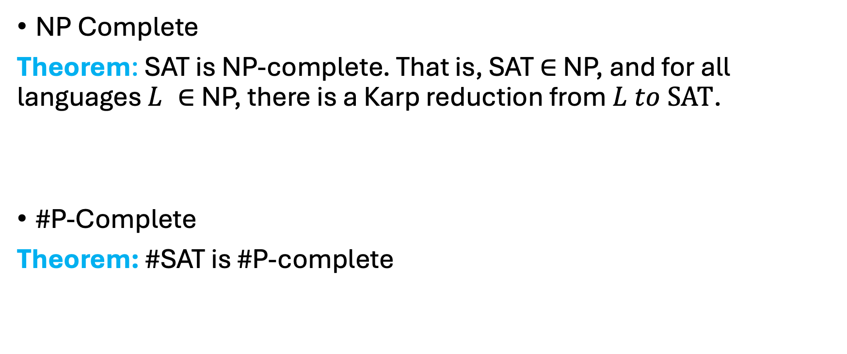
Completeness
A language $H$ is NP-hard if:
∀$L∈$NP:L≤ $H$ ($H$ itself may not be NP)
NP Complete
Theorem: SAT is NP-complete. That is, SAT ∈ NP, and for all languages $L ∈$NP, there is a Karp reduction from $L to SAT$.
#P-Complete
Theorem: #SAT is #P-complete
Counting problem:
how many satisfying assignments for a SAT

Slide 18
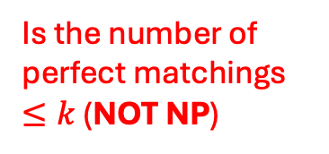
Complexity Classes
Problem types
Decision problem
  Is a given number q a prime?
  Does a graph have a Hamiltonian cycle?
Searching Problem
  Find a satisfying assignment to a Boolean formula?
Optimization Problem
  Find the shortest path in a graph.
Counting Problem
  Count the number of perfect matchings in a bipartite graph
Is the number of perfect matchings $≤k$ (NOT NP)

Slide 19
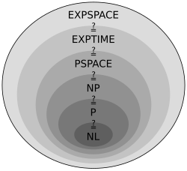
More Classes
NL: Nondeterministic Logarithmic Space

Slide 20
One-way Functions (Informally)
F
Easy to
compute
Hard to
invert
domain
range

Slide 21
Defining One-way Function (Try 1)
A function (family${\text{) }\left\{F_{n}\right\}}_{n∈ℕ}$ where $F_{n}:{\{0,1\}}^{n}→{\{0,1\}}^{m(n)}$ is one-way if for every p.p.t. adversary $A$, there is a negligible function $μ$ s.t.
$$\operatorname{Pr}\left[x←{\left\{0,1\right\}}^{n};y=F_{n}\left(x\right):A\left(1^{n},y\right)=x\right]≤μ(n)$$
Consider $F_{n}\left(x\right)=0$ for all x.
This is one-way according to the above definition.
In fact, impossible to find the inverse even if $A$ has unbounded time.
Conclusion: not a useful/meaningful definition.

Slide 22

Defining One-way Function (Try 1)
A function (family${\text{) }\left\{F_{n}\right\}}_{n∈ℕ}$ where $F_{n}:{\{0,1\}}^{n}→{\{0,1\}}^{m(n)}$ is one-way if for every p.p.t. adversary $A$, there is a negligible function $μ$ s.t.
$$\operatorname{Pr}\left[x←{\left\{0,1\right\}}^{n};y=F_{n}\left(x\right):A\left(1^{n},y\right)=x\right]≤μ(n)$$
The Right Definition: Impossible to find an inverse in p.p.t.

Slide 23
One-way Function Formal Definition
A function (family${\text{) }\left\{F_{n}\right\}}_{n∈ℕ}$ where $F_{n}:{\{0,1\}}^{n}→{\{0,1\}}^{m(n)}$ is one-way if for every p.p.t. adversary $A$, there is a negligible function $μ$ s.t.
$$\operatorname{Pr}\left[x←{\left\{0,1\right\}}^{n};y=F_{n}\left(x\right);A\left(1^{n},y\right)=x^{′}:y=F_{n}\left(x^{′}\right)\right]≤μ(n)$$
Can always find an inverse with unbounded time
… but should be hard with probabilistic polynomial time
One-way Permutations:
One-to-one one-way functions with $m\left(n\right)=n.$

Slide 24
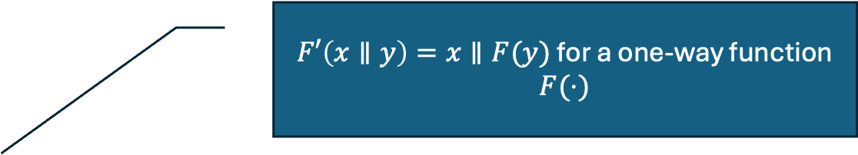
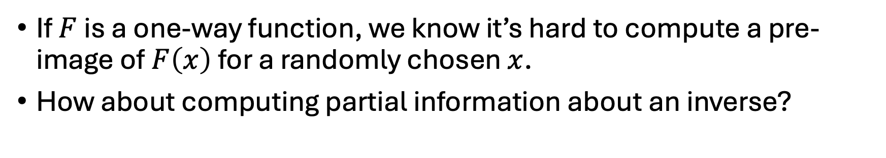
Hardcore Bit
If $F$ is a one-way function, we know it’s hard to compute a pre-image of $F\left(x\right)$ for a randomly chosen $x$.
How about computing partial information about an inverse?
$F′\left(x∥y\right)=x∥F(y)$ for a one-way function $F(⋅)$
Exercise: There are one-way functions for which it is easy to compute the first half of the bits of an inverse.

Slide 25

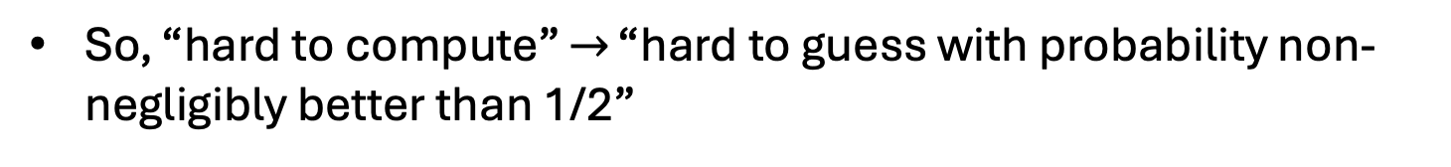
Hardcore Bit
If $F$ is a one-way function, we know it’s hard to compute a pre-image of $F\left(x\right)$ for a randomly chosen $x$.
HARDCORE BIT (Try 1)
Nevertheless, there has to be a hardcore set of hard to invert inputs. Concretely: Does there exist some bit of $x$ that is hard to guess with probability non-negligibly better than 1/2?
Nevertheless, there has to be a hardcore set of hard to invert inputs. Concretely: Does there necessarily exist some bit of $x$ that is hard to compute?
Any bit can be guessed correctly w.p. 1/2
So, “hard to compute” $→$ “hard to guess with probability non-negligibly better than 1/2”

Slide 26
Hardcore Bit
If $F$ is a one-way function, we know it’s hard to compute a pre-image of $F\left(x\right)$ for a randomly chosen $x$.
HARDCORE BIT (Try 1)
For any function (family) $F:{\{0,1\}}^{n}→{\{0,1\}}^{m},$ a bit $i=i(n)$ is hardcore if for every p.p.t. adversary $A$, there is a negligible function $μ$ s.t.
$$\operatorname{Pr}\left[x←{\left\{0,1\right\}}^{n};y=F\left(x\right):A\left(y\right)= x_{i}\right]≤\frac{1}{2}+ μ(n)$$

Slide 27
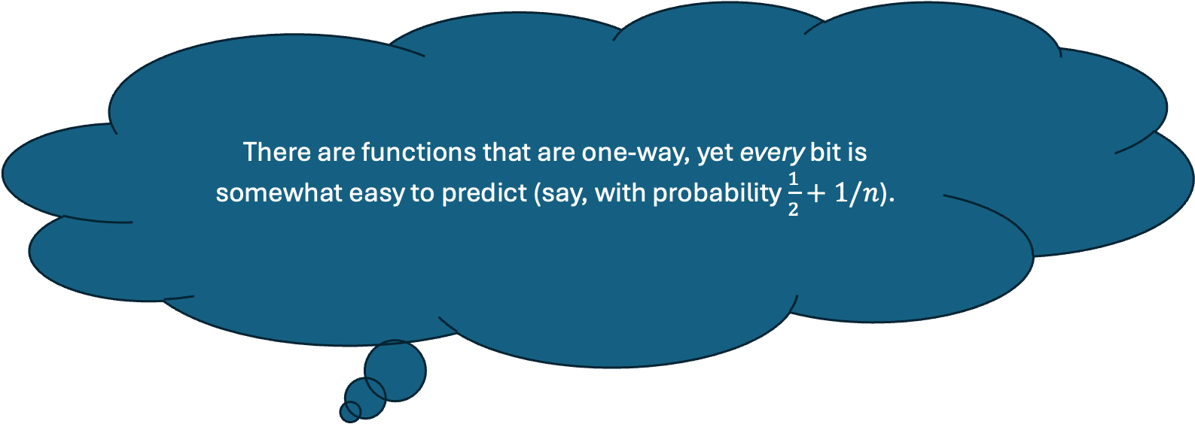
Hardcore Bit
If $F$ is a one-way function, we know it’s hard to compute a pre-image of $F\left(x\right)$ for a randomly chosen $x$.
There are functions that are one-way, yet every bit is somewhat easy to predict (say, with probability $\frac{1}{2}+1/n$).
HARDCORE BIT (Try 1)
For any function (family) $F:{\{0,1\}}^{n}→{\{0,1\}}^{m},$ a bit $i=i(n)$ is hardcore if for every p.p.t. adversary $A$, there is a negligible function $μ$ s.t.
$$\operatorname{Pr}\left[x←{\left\{0,1\right\}}^{n};y=F\left(x\right):A\left(y\right)= x_{i}\right]≤\frac{1}{2}+ μ(n)$$

Slide 28
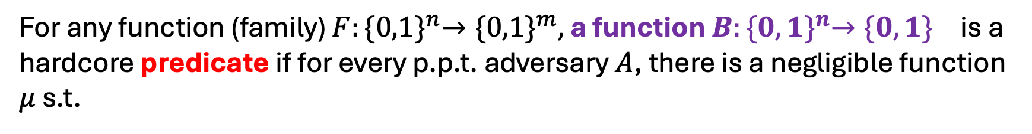
Hardcore Bit Formal Definition
For any function (family) $F:{\{0,1\}}^{n}→{\{0,1\}}^{m},$ a function $B:{\{0,1\}}^{n}→{\{0,1\}}^{}$ is a hardcore predicate if for every p.p.t. adversary $A$, there is a negligible function $μ$ s.t.
$$\operatorname{Pr}\left[x←{\left\{0,1\right\}}^{n};y=F\left(x\right):A\left(y\right)=B(x)\right]≤\frac{1}{2}+ μ(n)$$
For us, henceforth, a hardcore bit will mean a hardcore predicate.

Slide 29
Illustration
Easy to
compute
F(x)
Hard to
compute
x
B(x)
Easy to
compute

Slide 30
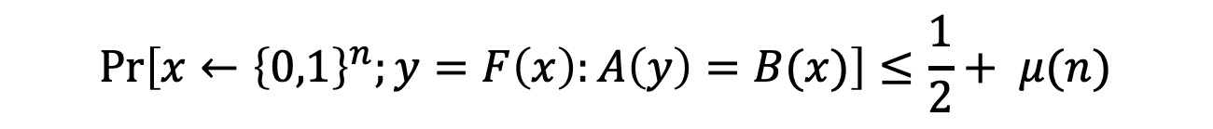
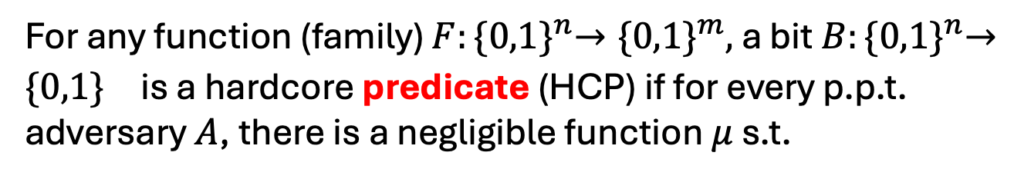
Discussion on the Definition
HARDCORE PREDICATE
For any function (family) $F:{\{0,1\}}^{n}→{\{0,1\}}^{m},$ a bit $B:{\{0,1\}}^{n}→{\{0,1\}}^{}$ is a hardcore predicate (HCP) if for every p.p.t. adversary $A$, there is a negligible function $μ$ s.t.
$$\operatorname{Pr}\left[x←{\left\{0,1\right\}}^{n};y=F\left(x\right):A\left(y\right)=B(x)\right]≤\frac{1}{2}+ μ(n)$$
1. Definition of HCP makes sense for any function family, not just one-way functions.
2. Some functions can have information-theoretically hard to guess predicates (e.g., compressing functions)
3. We’ll be interested in settings where $x$ is uniquely determined given $F(x)$, yet $B(x)$ is hard to predict given $F(x)$

Slide 31
Average-case Hardness and
Worst-case Hardness
For the random secret (with entropy) the user fully controls, we can talk about average-case hardness, such as one-way function
The meaning of worst-case hardness depends on the context
  IND-CPA: the adversary can arbitrarily select the challenge
  worst case indistinguishability holds for any input candidate pair
  Lattice worst-case hardness
  worst case there exists some case which is hard to break

Slide 32
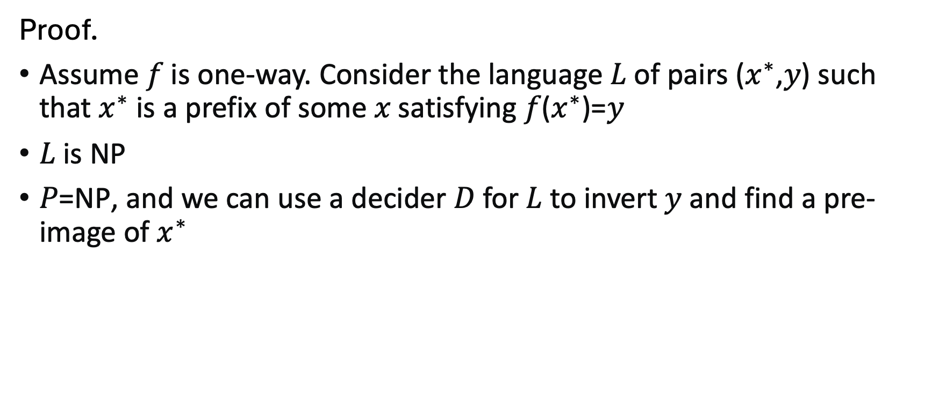

One-way Function P $≠$ NP
Proof.
Assume 𝑓 is one-way. Consider the language 𝐿 of pairs ($x^{∗}$,𝑦) such that $x^{∗}$is a prefix of some 𝑥 satisfying 𝑓($x^{∗}$)=𝑦
𝐿 is NP
𝑃=NP, and we can use a decider 𝐷 for 𝐿 to invert 𝑦 and find a pre-image of $x^{∗}$

Slide 33
Construction of PRG

Slide 34

One-Way Permutation $→$ PRG
CONSTRUCTION
Let $F$ be a one-way permutation, and $B$ an associated hardcore predicate for $F$.
Then, define $G\left(x\right)=F\left(x\right)||B(x)$ .
Theorem: $G$ is a PRG assuming $F$ is a one-way permutation.
(Note that $G$ stretches by one bit. We already know how to turn this into a $G′$ that stretches to any poly number of bits.)

Slide 35


Proof by Next-bit Unpredictability
Theorem: $G$ is a PRG assuming $F$ is a one-way permutation.
Proof: Assume for contradiction that $G$ is not a PRG. Therefore, there is a next-bit predictor $D$and a polynomial function $p$such that
$$\operatorname{Pr}\left[x←{\left\{0,1\right\}}^{n};y=G\left(x\right):D\left(y_{1…n}\right)=y_{n+1}\right]≥\frac{1}{2}+1/p(n)$$
Therefore, there is a next-bit predictor $D$and a polynomial function $p$such that
$$\operatorname{Pr}\left[x←{\left\{0,1\right\}}^{n}:D(F(x))=B(x)\right]≥\frac{1}{2}+1/p(n)$$
So, $D$ is a hardcore bit predictor! QED.

Slide 36
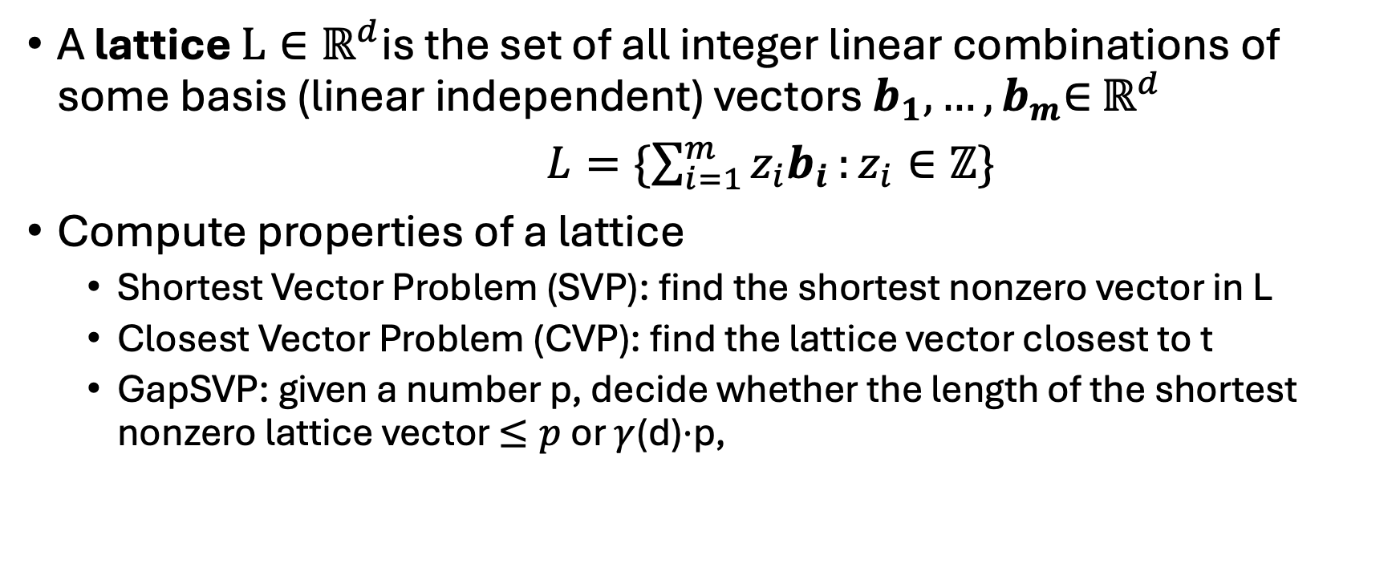
Lattice Problem
A lattice $L∈ℝ^{d}$is the set of all integer linear combinations of some basis (linear independent) vectors $b_{1},…,b_{m}$∈ $ℝ^{d}$
$L=\{\sum_{i=1}^{m}{z_{i}b_{i}}:z_{i}∈ℤ\}$
Compute properties of a lattice
  Shortest Vector Problem (SVP): find the shortest nonzero vector in L
  Closest Vector Problem (CVP): find the lattice vector closest to t
  GapSVP: given a number p, decide whether the length of the shortest nonzero lattice vector $≤p$ or $γ$(d)⋅p,

Slide 37
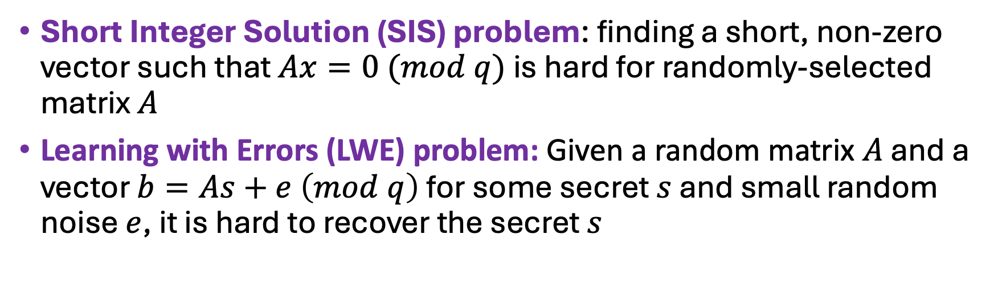
Examples when Average and Worst Case are Equally Hard
Short Integer Solution (SIS) problem: finding a short, non-zero vector such that $Ax=0 (mod q)$ is hard for randomly-selected matrix $A$
Learning with Errors (LWE) problem: Given a random matrix $A$ and a vector $b=As+e \left(mod q\right)$ for some secret $s$ and small random noise $e$, it is hard to recover the secret $s$
[1]. Ajtai, Miklós. "Generating hard instances of lattice problems." Proceedings of the twenty-eighth annual ACM symposium on Theory of computing. 1996.
[2]. Ajtai, Miklós. "The shortest vector problem in L2 is NP-hard for randomized reductions." Proceedings of the thirtieth annual ACM symposium on Theory of computing. 1998.
[3] Micciancio, Daniele, and Oded Regev. "Worst-case to average-case reductions based on Gaussian measures." SIAM journal on computing 37.1 (2007): 267-302.

Slide 38
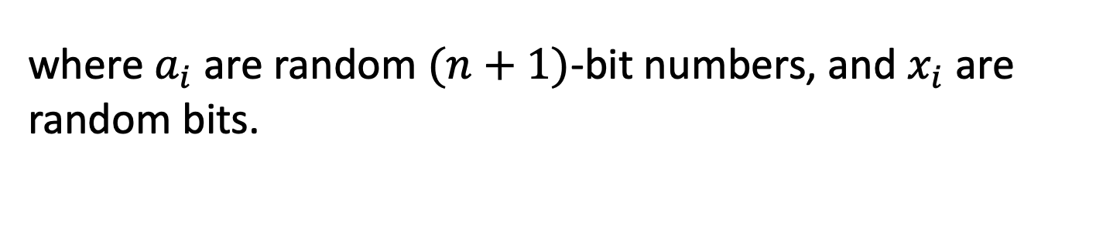
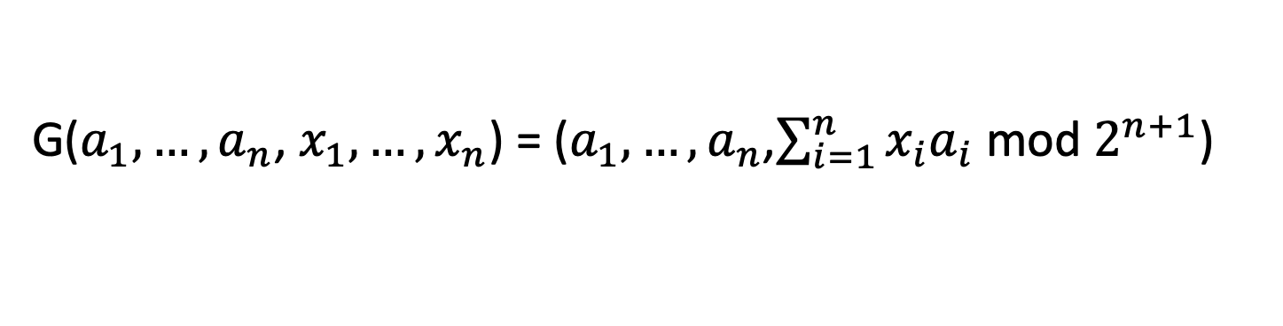
Another Construction of PRG
A PRG Candidate from the average-case hardness of Subset-sum:
G($a_{1},…,a_{n}$, $x_{1},…,x_{n}$) = ($a_{1},…,a_{n}$,$\sum_{i=1}^{n}{x_{i}a_{i}}$ mod $2^{n+1}$)
where $a_{i}$ are random $(n+1)$-bit numbers, and $x_{i}$ are random bits.
If lattice problems are hard on the worst-case, G is a PRG.

Slide 39

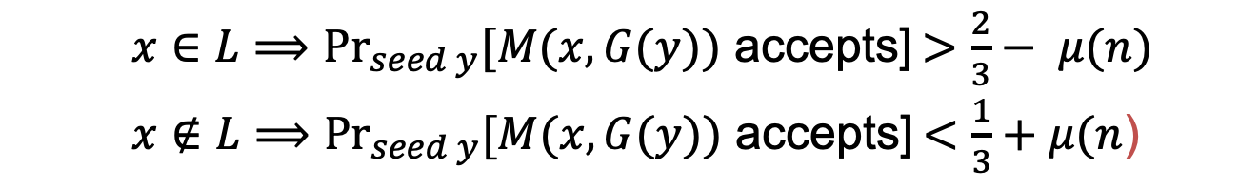
Application of PRGs: De-randomization
Theorem: if PRGs exist, then $BPP⊆ ∩_{ε>0}TIME\left(2^{m^{ε}}\right).$
(in English) if PRGs exist, then every randomized poly-time algorithm can be simulated in deterministic sub-exponential time.
Proof Sketch: use PRG that expands from ${n=m}^{ε}$ bits to $m$ bits.
  $x∈L⟹{Pr}_{seed y}[M(x,G(y))$ accepts] $>\frac{2}{3}− μ(n)$
  $x∉L⟹{Pr}_{seed y}[M(x,G(y))$ accepts] $<\frac{1}{3}+μ(n$)
Why?
If the above is not true, M is a distinguisher for the PRG!
Note:
M is a (known, fixed, fixed poly-time) distinguisher.

Slide 40
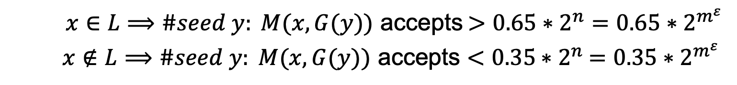

Application of PRGs: De-randomization
Theorem: if PRGs exist, then $BPP⊆ ∩_{ε>0}TIME\left(2^{m^{ε}}\right).$
(in English) if PRGs exist, then every randomized poly-time algorithm can be simulated in deterministic sub-exponential time.
Proof Sketch: : use PRG that expands from ${n=m}^{ε}$ bits to $m$ bits.
  $x∈L⟹\#seed y: M(x,G(y))$ accepts $>0.65∗2^{n}=0.65∗2^{m^{ε}}$
  $x∉L⟹\#seed y: M(x,G(y))$ accepts $<0.35$ $∗2^{n}$ $=0.35∗2^{m^{ε}}$
Here is the deterministic algorithm: enumerate over all seeds $y$and run $M\left(x,G\left(y\right)\right).$ If #accepts $>0.65∗2^{m^{ε}}$, accept else reject.

Slide 41
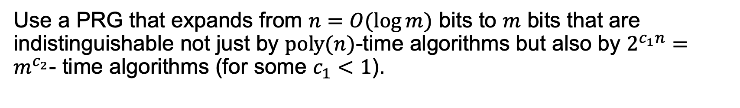

Application of PRGs: De-randomization
Theorem: If “exponentially secure” PRGs exist, then $BPP=P.$
Proof Sketch:
Use a PRG that expands from $n=O(\log{m)}$ bits to $m$ bits that are indistinguishable not just by $poly(n)$-time algorithms but also by $2^{c_{1}n}=m^{c_{2}}$- time algorithms (for some $c_{1}<1$).
The previous proof goes through mutatis mutandis, using crucially the fact that the randomized algorithm (adversary for us) runs in fixed polynomial-time.

