Slide 1
Purdue CS555: Cryptography Lecture 16
Instructor: Hanshen Xiao
Teaching Assistant: Justin He
course website: https://cs55500.github.io/

Slide 2

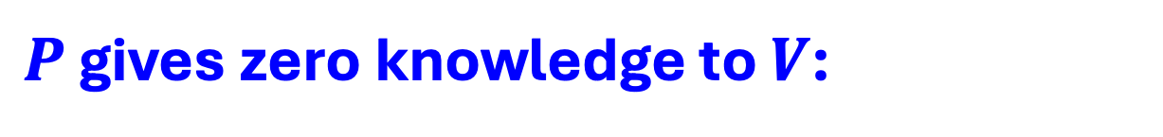
How to Define Zero-Knowledge?
After the interaction, $V$ knows:
The theorem is true; and
A view of the interaction
(= transcript + coins of V)
$P$ gives zero knowledge to $V$:
When the theorem is true, the view gives V nothing that he couldn’t have obtained on his own without interacting with P.

Slide 3
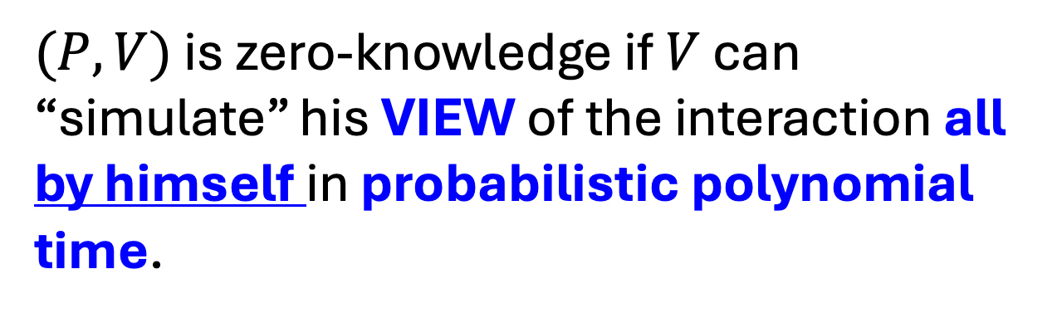
How to Define Zero-Knowledge?
$(P,V)$ is zero-knowledge if $V$ can “simulate” his VIEW of the interaction all by himself in probabilistic polynomial time.

Slide 4


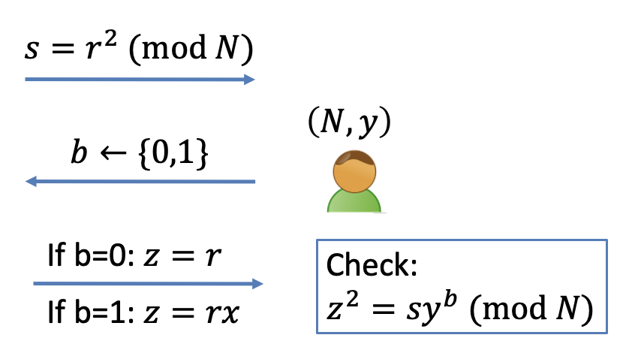




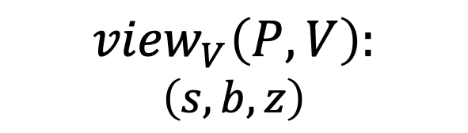
The Simulation Paradigm
PPT “simulator” $S$
$${sim}_{S}:$$
$$\left(s,b,z\right)$$
$$\left(N,y\right)$$
$${view}_{V}\left(P,V\right):$$
$Transcript= \left(s,b,z\right),$
Coins = $b$
$${view}_{V}\left(P,V\right):$$
$$\left(s,b,z\right)$$

Slide 5
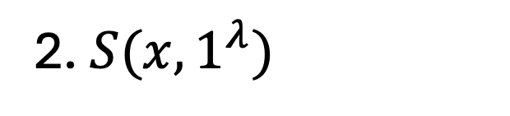
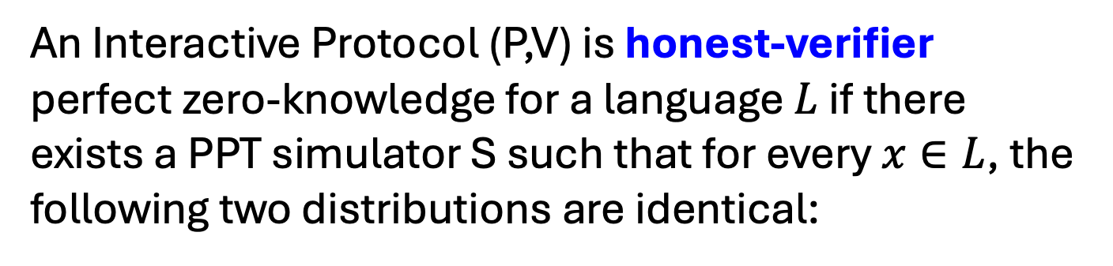
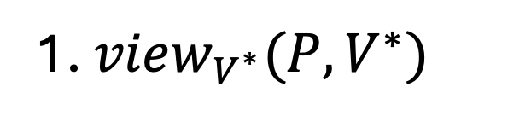
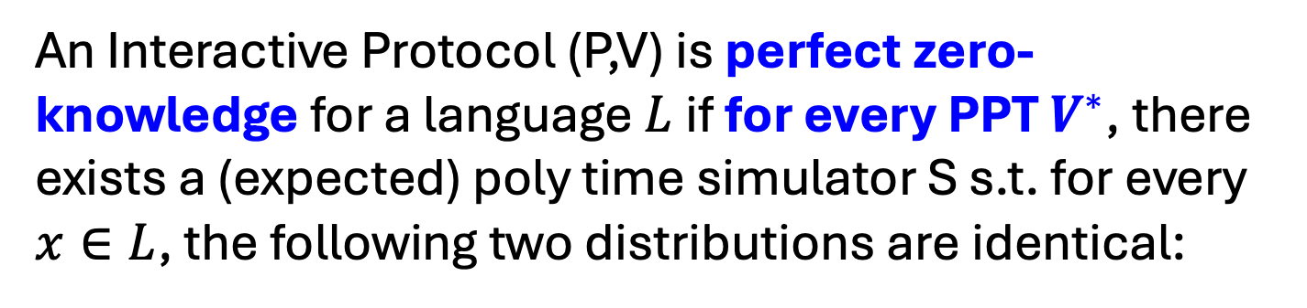
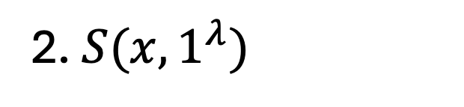
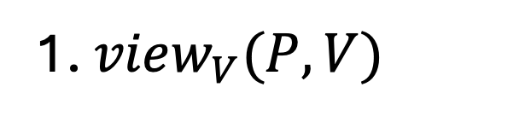
What if V is NOT HONEST.
OLD DEF
An Interactive Protocol (P,V) is honest-verifier perfect zero-knowledge for a language $L$if there exists a PPT simulator S such that for every $x∈L$, the following two distributions are identical:
1. ${view}_{V}(P,V)$
2. $S(x,1^{λ})$
REAL DEF
An Interactive Protocol (P,V) is perfect zero-knowledge for a language $L$if for every PPT $V^{∗}$, there exists a (expected) poly time simulator S s.t. for every $x∈L$, the following two distributions are identical:
1. ${view}_{V^{∗}}(P,V^{∗})$
2. $S(x,1^{λ})$

Slide 6

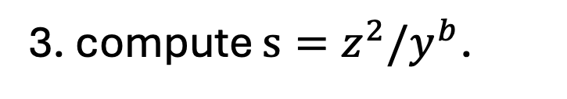
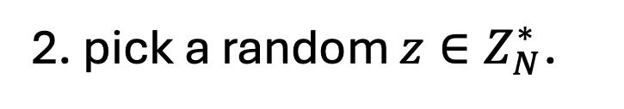
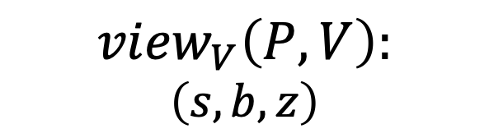
Previous Theorem: Zero Knowledge
Claim: The QR protocol is honest verifier zero knowledge.
Simulator S works as follows:
1. First pick a random bit b.
2. pick a random $z∈Z_{N}^{∗}$.
3. compute $s=z^{2}/y^{b}$.
$${view}_{V}\left(P,V\right):$$
$$\left(s,b,z\right)$$
4. output $(s,b,z)$.
Exercise: The simulated transcript is identically distributed as the real transcript in the interaction (P,V).

Slide 7


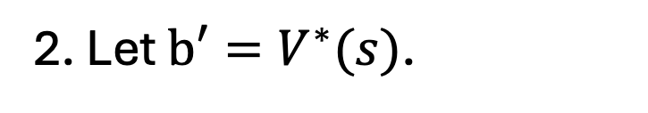
NEED: Zero Knowledge
Theorem: The QR protocol is (malicious verifier) zero knowledge.
Simulator S works as follows:
1. First set $s=\frac{z^{2}}{y^{b}}$ for a random z and feed s to $V^{∗}$.
2. Let $b′=V^{∗}(s)$.
3. If $b^{′}=b$, output $(s,b,z)$ and stop.
4. Otherwise, go back to step 1 and repeat. (also called “rewinding”).

Slide 8
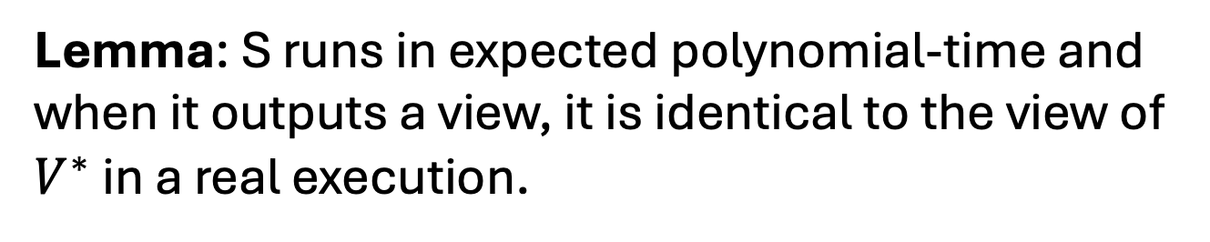
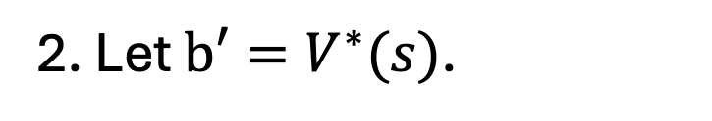
Simulator S works as follows:
1. First set $s=\frac{z^{2}}{y^{b}}$ for a random z and feed s to $V^{∗}$.
2. Let $b′=V^{∗}(s)$.
3. If $b^{′}=b$, output $(s,b,z)$ and stop.
4. Otherwise, go back to step 1 and repeat. (also called “rewinding”).
Lemma: S runs in expected polynomial-time and when it outputs a view, it is identical to the view of $V^{∗}$ in a real execution.

Slide 9
What Made it Possible?
1. Each statement had multiple proofs of which the prover chooses one at random.
2. Each such proof is made of two parts: seeing either one on its own gives the verifier no knowledge; seeing both imply 100% correctness.
3. Verifier chooses to see either part, at random. The prover’s ability to provide either part on demand convinces the verifier.

Slide 10

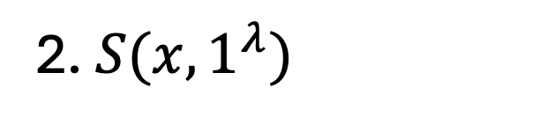
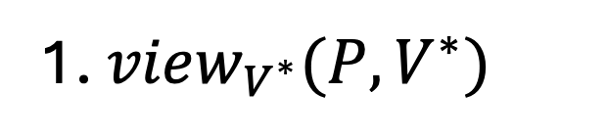
Zero Knowledge Proofs
An Interactive Protocol (P,V) is a perfect/statistical/computational zero-knowledge proof system for a language $L$if it is
Complete
Sound and
Zero knowledge: for every PPT $V^{∗}$, there exists a (expected) poly time simulator S s.t. for every $x∈L$, the following two distributions are identical/statistically close/computationally close:
1. ${view}_{V^{∗}}(P,V^{∗})$
2. $S(x,1^{λ})$

Slide 11
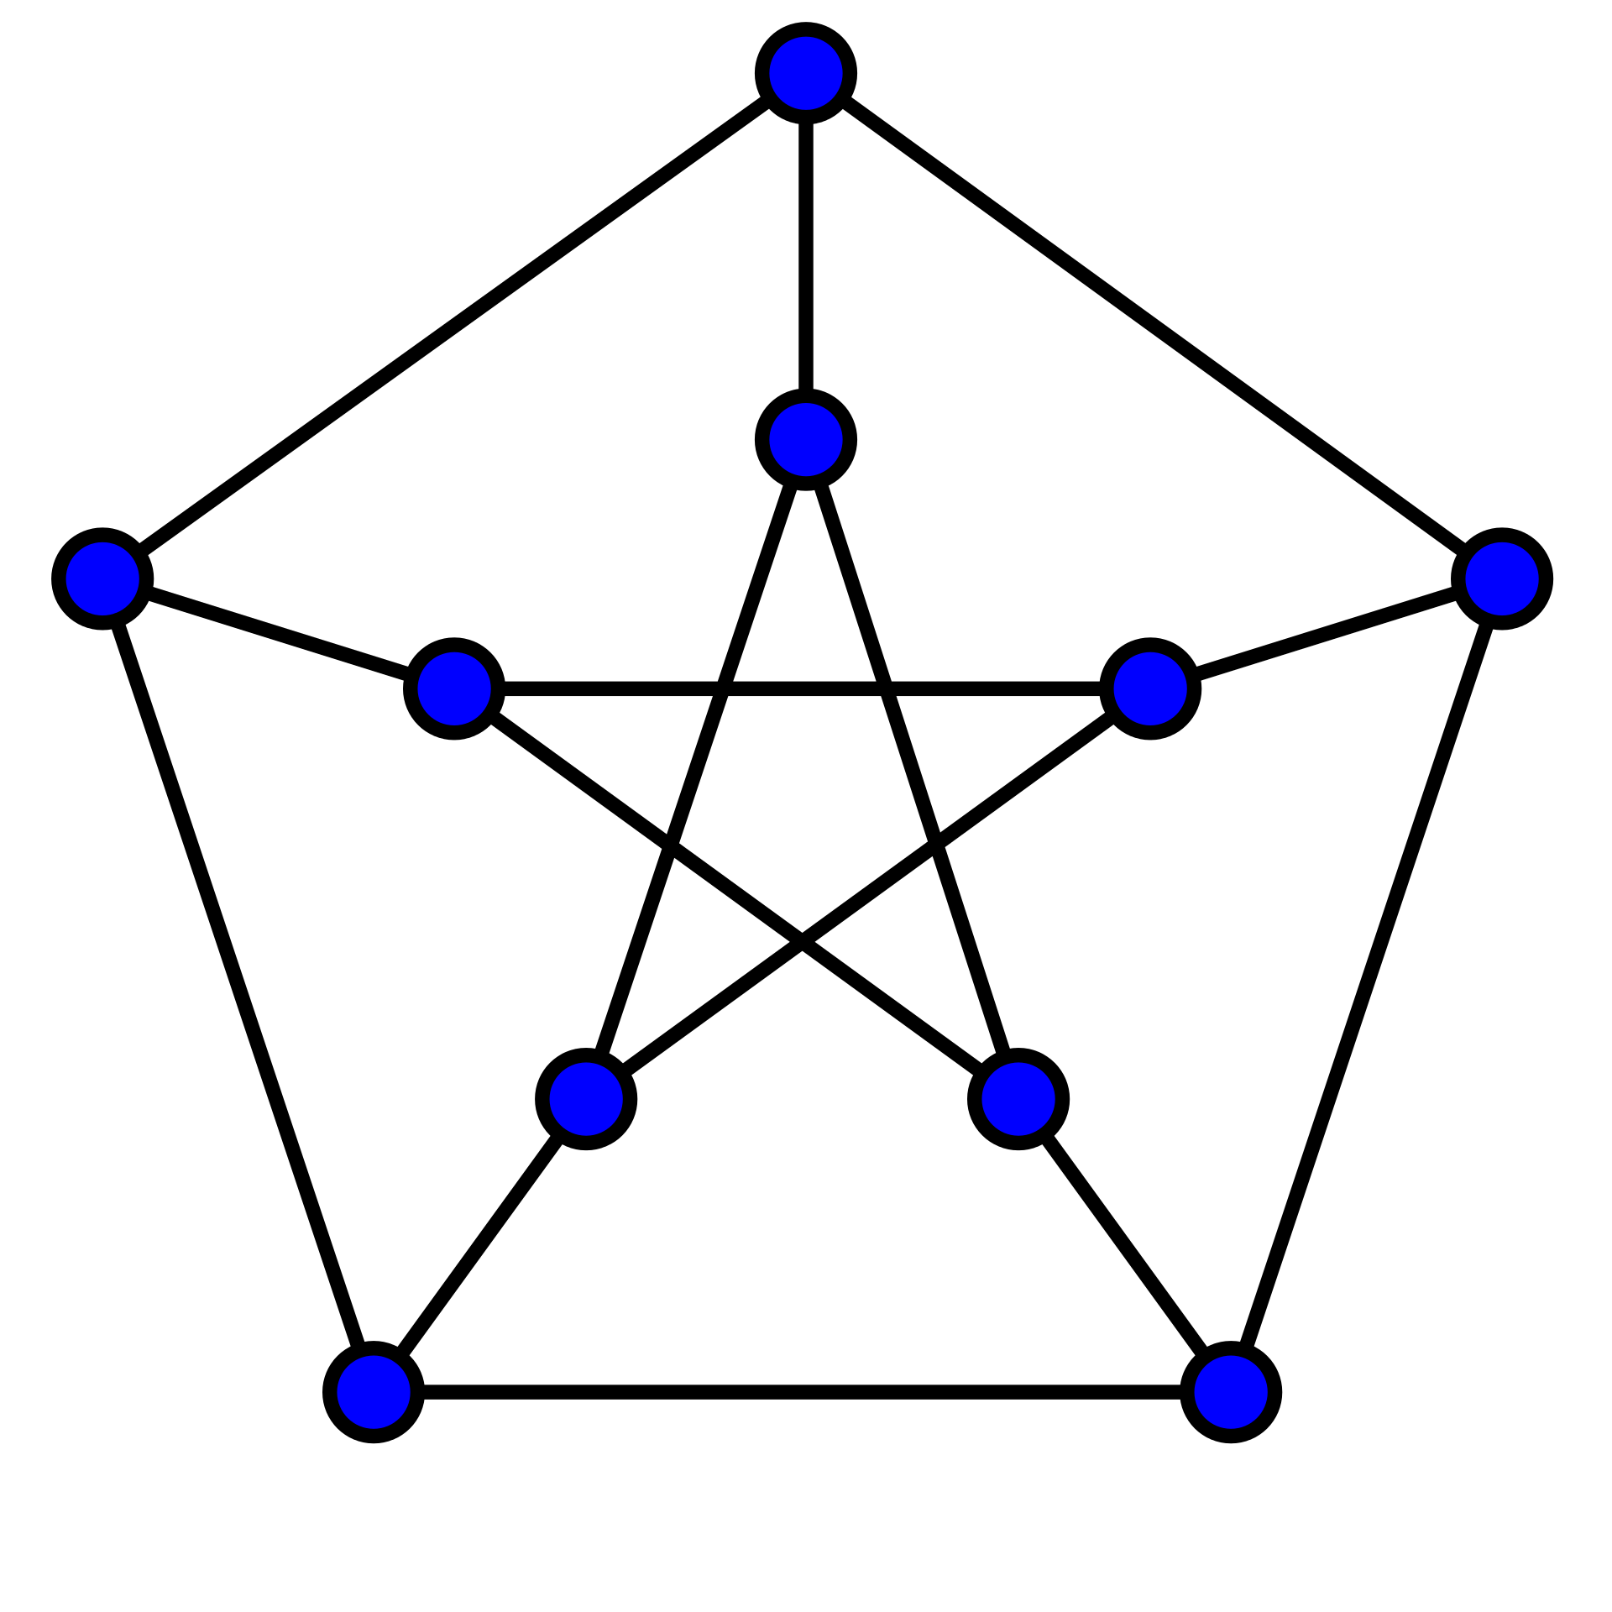
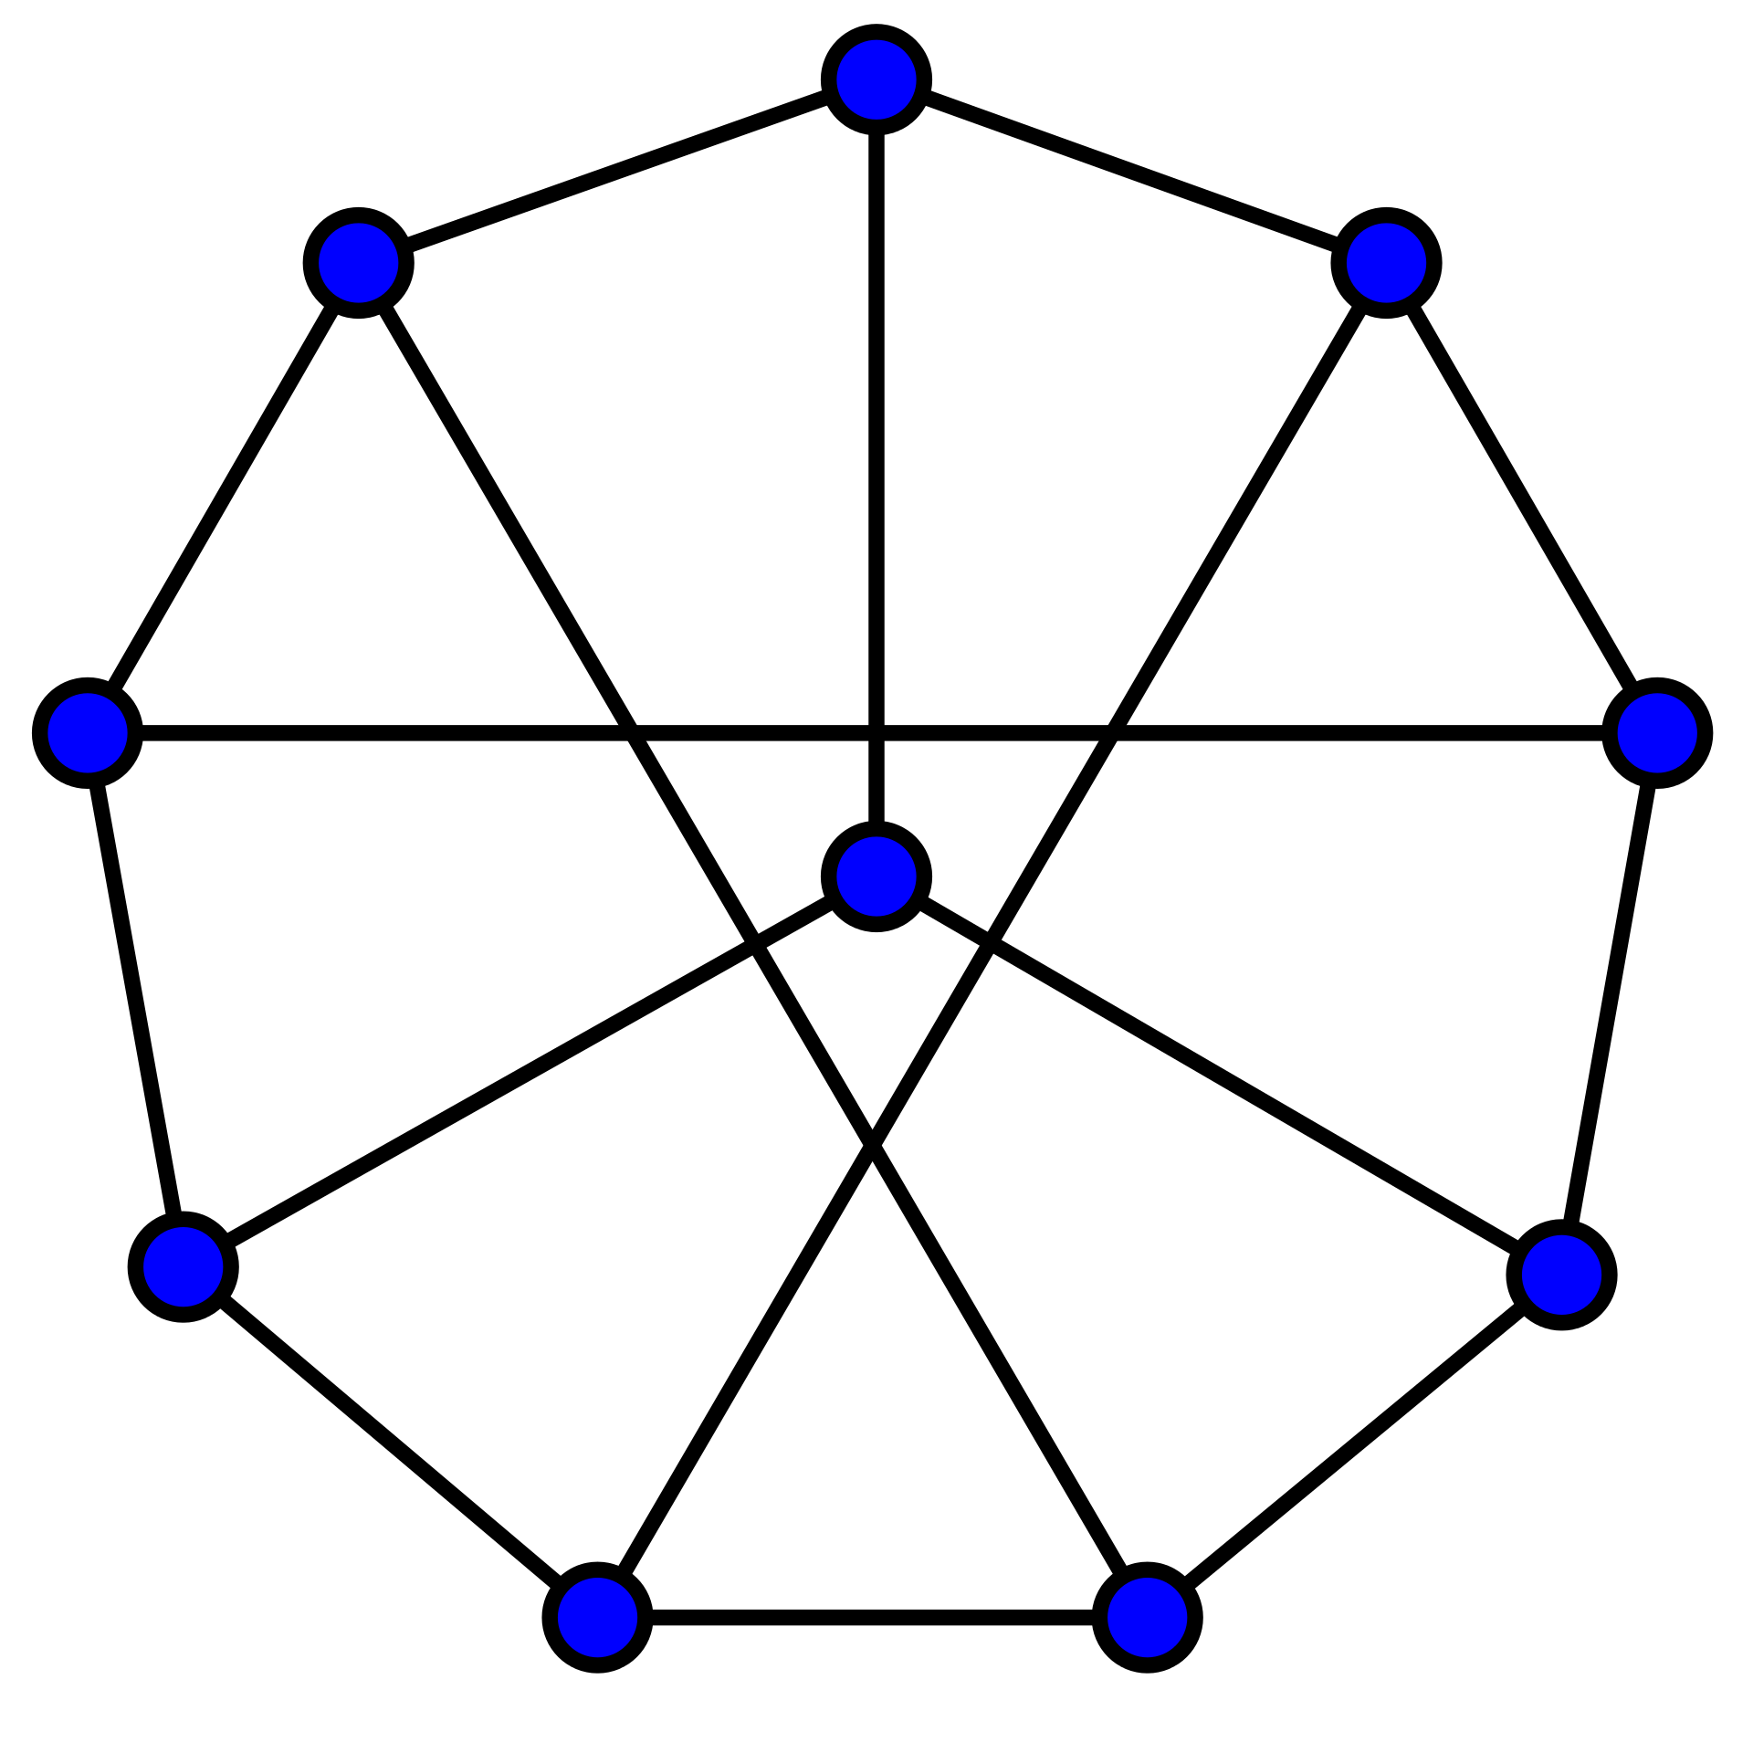
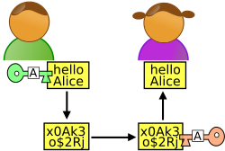

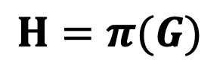
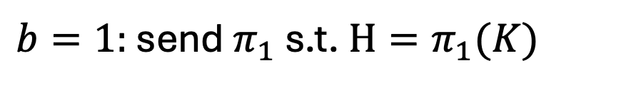
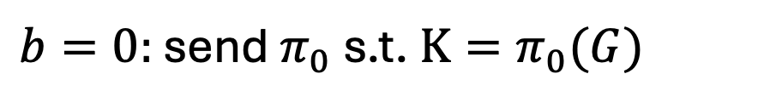
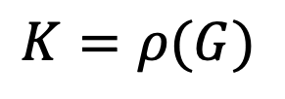
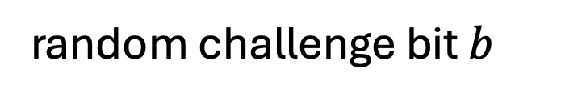
ZK Proof for Graph Isomorphism
1
1
2
6
2
6
5
7
10
3
8
5
8
9
4
10
3
4
Graph G
9
7
Graph H
$K=ρ(G)$
$$H=π(G)$$
where $ρ$ is a random permutation
random challenge bit $b$
Verifier
Prover
$b=0:$ send $π_{0}$ s.t. $K=π_{0}(G)$
$b=1:$ send $π_{1}$ s.t. $H=π_{1}(K)$

Slide 12
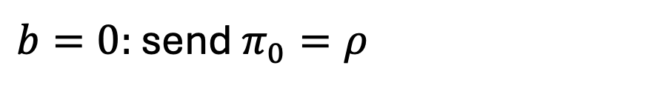
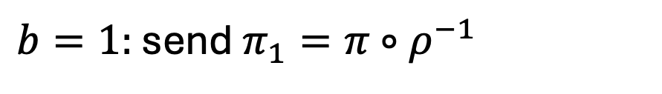
ZK Proof for Graph Isomorphism
Completeness?
$K=ρ(G)$
$$H=π(G)$$
where $ρ$ is a random permutation
random challenge bit $b$
Verifier
Prover
$b=0:$ send $π_{0}=ρ$
$b=1:$ send $π_{1}=π∘ρ^{−1}$

Slide 13
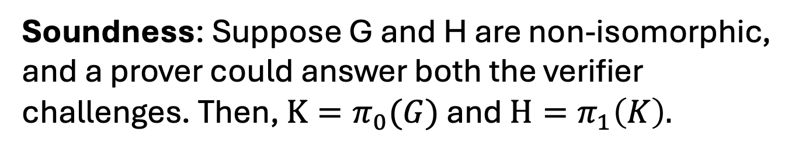
ZK Proof for Graph Isomorphism
Soundness: Suppose G and H are non-isomorphic, and a prover could answer both the verifier challenges. Then, $K=π_{0}(G)$ and $H=π_{1}\left(K\right).$
In other words, $H{=π}_{1}∘π_{0}(G)$, a contradiction!
$K=ρ(G)$
$$H=π(G)$$
where $ρ$ is a random permutation
random challenge bit $b$
Verifier
Prover
$b=0:$ send $π_{0}=ρ$
$b=1:$ send $π_{1}=π∘ρ^{−1}$

Slide 14
ZK Proof for Graph Isomorphism
Zero Knowledge?
$K=ρ(G)$
$$H=π(G)$$
where $ρ$ is a random permutation
random challenge bit $b$
Verifier
Prover
$b=0:$ send $π_{0}=ρ$
$b=1:$ send $π_{1}=π∘ρ^{−1}$

Slide 15
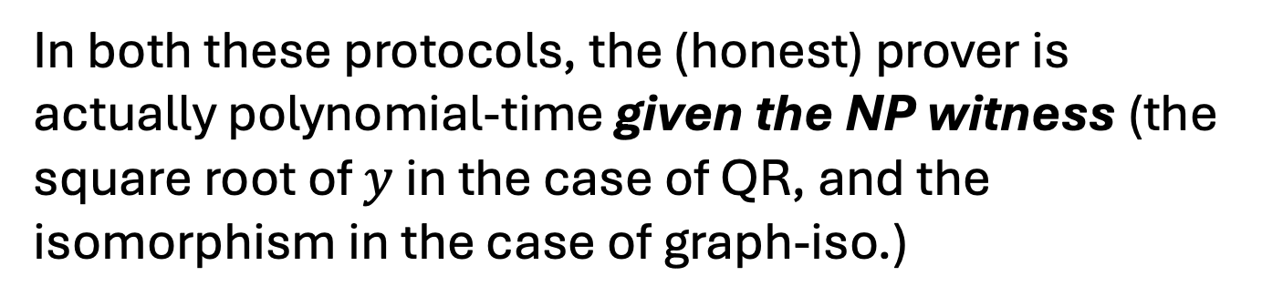

Efficient Prover (given a Witness)
In both these protocols, the (honest) prover is actually polynomial-time given the NP witness (the square root of $y$ in the case of QR, and the isomorphism in the case of graph-iso.)
Soundness is nevertheless against any, even computationally unbounded, prover $P^{∗}$.

Slide 16
Do all NP languages have Perfect ZK proofs?
We showed two languages with perfect ZK proofs. Can we show this for all NP languages?
Theorem [Fortnow’89, Aiello-Hastad’87] No, unless bizarre stuff happens in complexity theory (technically: the polynomial hierarchy collapses.)

Slide 17
Do all NP languages have ZK proofs?
Nevertheless, today, we will show:
Theorem [Goldreich-Micali-Wigderson’87] Assuming one-way functions exist, all of NP has computational zero-knowledge proofs.
This theorem is amazing: it tells us that everything that can be proved (in the sense of Euclid) can be proved in zero knowledge!

Slide 18
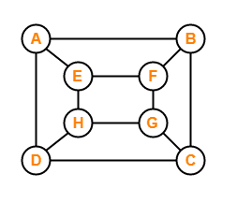
Zero Knowledge Proof for Hamiltonicity
NP-Complete Problem:
Every other problem in NP can be reduced to it.
Let us first design a protocol in the lead-box model.

Slide 19
Zero Knowledge Proof for 3-Coloring
NP-Complete Problem:
Every other problem in NP can be reduced to it.

Slide 20


We need a commitment scheme (aka a “promise hiding scheme”).
Bit b
Commit to b:
b
b
Sender
Open: b,
Receiver
1. Hiding: The locked box should completely hide b.
2. Binding: Sender shouldn’t be able to open to 1-b.

Slide 21
We will show a construction using one-way permutations.
Bit b
Commit to b:
b
ACCEPT/REJECT
Sender
Open: b,
Receiver
1. Hiding: The locked box should completely hide b.
2. Binding: Sender shouldn’t be able to open to 1-b.

Slide 22
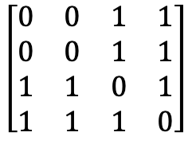
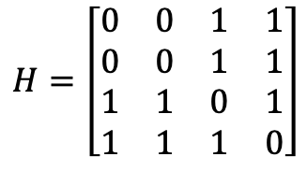

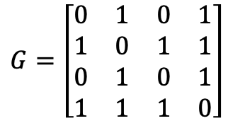
Zero Knowledge Proof for Hamiltonicity
1
2
1
2
Graph G
Graph G
$$\left[\begin{matrix}0 & 0 & 1 & 1 \\ 0 & 0 & 1 & 1 \\ 1 & 1 & 0 & 1 \\ 1 & 1 & 1 & 0\end{matrix}\right]$$
4
3
4
3
$$H=π(G)$$
$$G=\left[\begin{matrix}0 & 1 & 0 & 1 \\ 1 & 0 & 1 & 1 \\ 0 & 1 & 0 & 1 \\ 1 & 1 & 1 & 0\end{matrix}\right]$$
1
3
$$H=\left[\begin{matrix}0 & 0 & 1 & 1 \\ 0 & 0 & 1 & 1 \\ 1 & 1 & 0 & 1 \\ 1 & 1 & 1 & 0\end{matrix}\right]$$
4
2

Slide 23
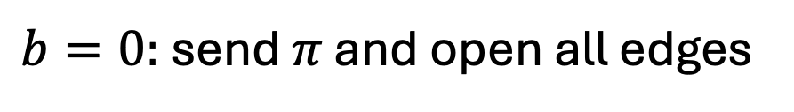
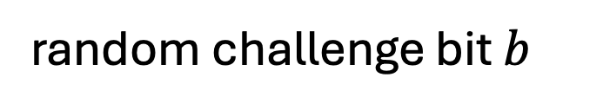
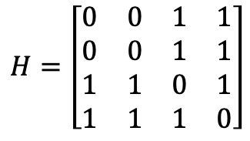
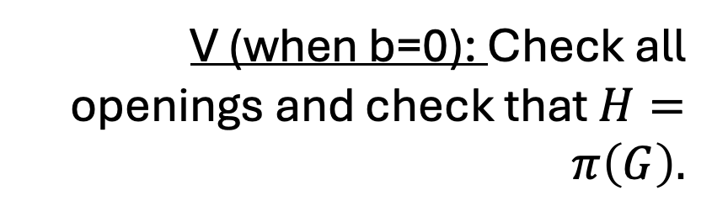
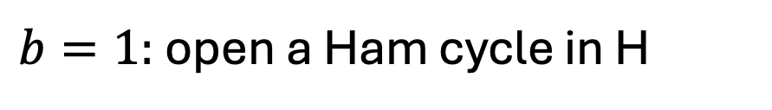
Zero Knowledge Proof for Hamiltonicity
1
2
1
2
Graph G
Graph G
4
3
4
3
$$H=π(G)$$
$$H=\left[\begin{matrix}0 & 0 & 1 & 1 \\ 0 & 0 & 1 & 1 \\ 1 & 1 & 0 & 1 \\ 1 & 1 & 1 & 0\end{matrix}\right]$$
random challenge bit $b$
$b=0:$ send $π$ and open all edges
$b=1:$ open a Ham cycle in H
V (when b=0): Check all openings and check that $H=π\left(G\right).$

Slide 24
Zero Knowledge Proof for Hamiltonicity
1
2
1
2
Graph G
Graph G
4
3
4
3
$$H=π(G)$$
$$H=\left[\begin{matrix}0 & 0 & 1 & 1 \\ 0 & 0 & 1 & 1 \\ 1 & 1 & 0 & 1 \\ 1 & 1 & 1 & 0\end{matrix}\right]$$
random challenge bit $b$
$b=0:$ send $π$ and open all edges
$b=1:$ open a Ham cycle in H
V (when b=1): Check the openings correspond to a cycle.

Slide 25
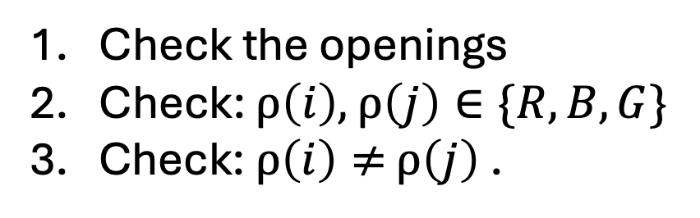





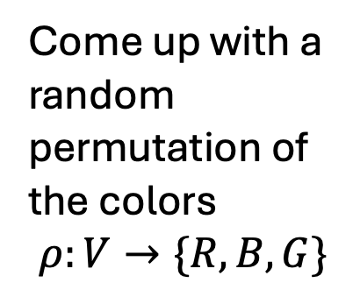
Zero Knowledge Proof for 3COL
1
2
1
2
Graph G
=(V,E)
Graph G
4
3
4
3
$$…$$
$$ρ(1)$$
$$ρ(n)$$
$$ρ\left(1\right),…,ρ(n)$$
Come up with a random permutation of the colors
$$ρ:V→\{R,B,G\}$$
random edge $(i,j)$
open $ρ(i)$ and $ρ(j)$
Check the openings
Check: $ρ\left(i\right),$ $ρ\left(j\right)∈\{R,B,G\}$
3. Check: $ρ\left(i\right)≠$ $ρ\left(j\right)$ .

Slide 26
Zero Knowledge Proof for 3COL
1
2
1
2
Graph G
=(V,E)
Graph G
4
3
4
3
$$…$$
$$ρ(1)$$
$$ρ(n)$$
random edge $(i,j)$
open $ρ(i)$ and $ρ(j)$
Completeness: Exercise.

Slide 27
Zero Knowledge Proof for 3COL
1
2
1
2
Graph G
=(V,E)
Graph G
4
3
4
3
$$…$$
$$ρ(1)$$
$$ρ(n)$$
random edge $(i,j)$
open $ρ(i)$ and $ρ(j)$
Soundness: If the graph is not 3COL, in every 3-coloring (that P commits to), there is some edge whose end-points have the same color.
V will catch this edge and reject with probability $≥1/|E|$.

Slide 28
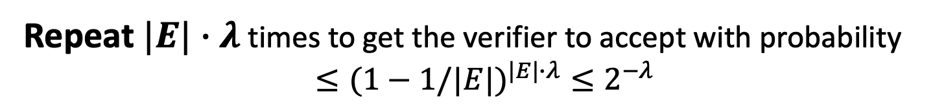

Zero Knowledge Proof for 3COL
1
2
1
2
Graph G
=(V,E)
Graph G
4
3
4
3
$$…$$
$$ρ(1)$$
$$ρ(n)$$
random edge $(i,j)$
open $ρ(i)$ and $ρ(j)$
Repeat $|E|∙λ$ times to get the verifier to accept with probability $≤(1−1/|E|)^{|E|∙λ}≤2^{−λ}$

Slide 29
Commitment Schemes

Slide 30
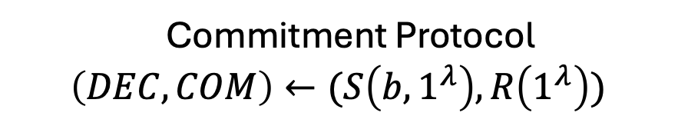
Commitment Schemes
ACCEPT/REJECT
Bit b
Commitment Protocol
$$\left(DEC,COM\right)←(S\left(b,1^{λ}\right),R\left(1^{λ}\right))$$
Receiver R
Sender S
DEC
COM
b, DEC
1. Completeness: R always accepts in an honest execution.

Slide 31

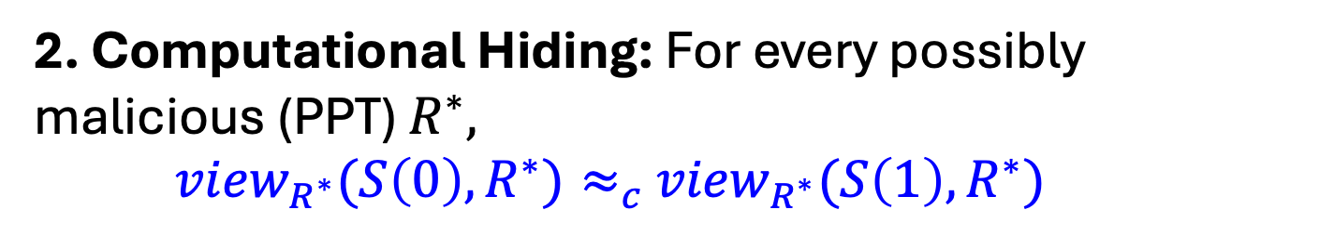
Commitment Schemes
ACCEPT/REJECT
Bit b
Commitment Protocol
$$\left(DEC,COM\right)←(S\left(b,1^{λ}\right),R\left(1^{λ}\right))$$
Receiver R
Sender S
DEC
COM
b, DEC
2. Computational Hiding: For every possibly malicious (PPT) $R^{∗},$
${view}_{R^{∗}}(S\left(0\right),R^{∗})≈_{c}$ ${view}_{R^{∗}}(S\left(1\right),R^{∗})$

Slide 32
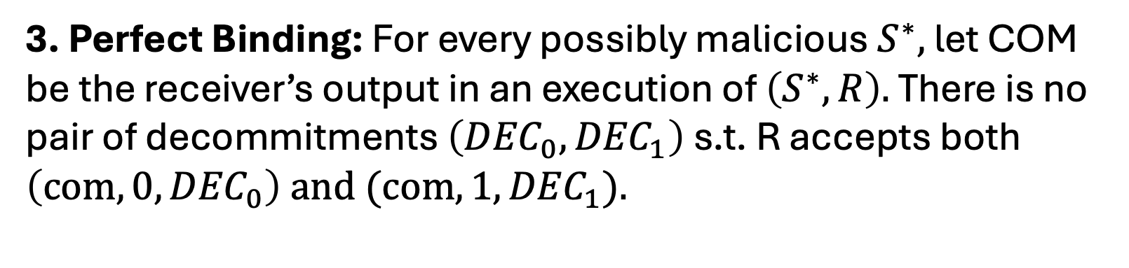
Commitment Schemes
ACCEPT/REJECT
Bit b
Commitment Protocol
$$\left(DEC,COM\right)←(S\left(b,1^{λ}\right),R\left(1^{λ}\right))$$
Receiver R
Sender S
DEC
COM
b, DEC
3. Perfect Binding: For every possibly malicious $S^{∗},$ let COM be the receiver’s output in an execution of $\left(S^{∗},R\right).$ There is no pair of decommitments $\left({DEC}_{0},{DEC}_{1}\right)$ s.t. R accepts both $\left(com,0,{DEC}_{0}\right) and (com,1,{DEC}_{1}).$

Slide 33
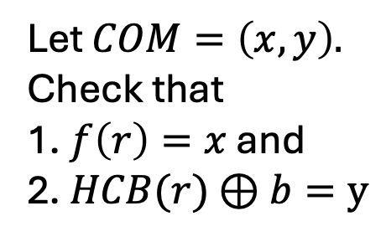


A Commitment Scheme from any OWP
Bit b
$$COM=(f\left(r\right),HCB(r)⊕b)$$
Sender S
Receiver R
$$DEC=r$$
Let $COM=\left(x,y\right).$ Check that
1. $f\left(r\right)=x$ and
2. $HCB(r)$ $⊕b=y$
$$OPEN:(b,r)$$
1. Completeness: Exercise.
2. Comp. Hiding: by the hardcore bit property.
3. Perfect Binding: because f is a permutation.

Slide 34
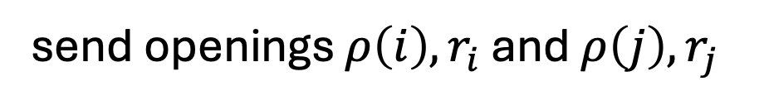

Back to ZK Proof for 3COL
1
2
1
2
Graph G
=(V,E)
Graph G
4
3
4
3
$$\{Com\left(ρ\left(k\right);r_{k}\right)\}_{k=1}^{n}$$
random edge $(i,j)$
send openings $ρ\left(i\right), r_{i}$ and ${ρ\left(j\right),r}_{j}$

Slide 35
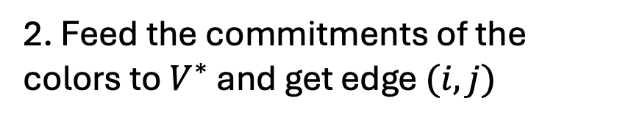







Why is this zero-knowledge?
Simulator S works as follows:
1. First pick a random edge $(i^{∗},j^{∗})$
Color vertices$i^{∗}$ and $j^{∗}$ with random, different colors
$$\{Com\left(ρ\left(k\right);r_{k}\right)\}_{k=1}^{n}$$
Color all other vertices red.
edge $(i,j)$
2. Feed the commitments of the colors to $V^{∗}$and get edge $(i,j)$
3. If $\left(i,j\right)≠(i^{∗},j^{∗})$, go back and repeat.
send openings $r_{i}$ and $r_{j}$
4. If $\left(i,j\right)=(i^{∗},j^{∗})$, output the commitments and openings $r_{i}$ and $r_{j}$ as the simulated transcript.

Slide 36

Why is this zero-knowledge?
Lemma:
Assuming the commitment is hiding, S runs in expected polynomial-time.
When S outputs a view, it is comp. indist. from the view of $V^{∗}$ in a real execution.
$$\{Com\left(ρ\left(k\right);r_{k}\right)\}_{k=1}^{n}$$
edge $(i,j)$
send openings $r_{i}$ and $r_{j}$

Slide 37



Why is this zero-knowledge?
Simulator S works as follows (call this Hybrid 0)
1. First pick a random edge $(i^{∗},j^{∗})$
Color vertices $i^{∗}$ and $j^{∗}$ with random, different colors
$$\{Com\left(ρ\left(k\right);r_{k}\right)\}_{k=1}^{n}$$
Color all other vertices red.
edge $(i,j)$
2. Feed the commitments of the colors to $V^{∗}$ and get edge $(i,j)$
3. If $\left(i,j\right)≠(i^{∗},j^{∗})$, go back and repeat.
send openings $r_{i}$ and $r_{j}$
4. If $\left(i,j\right)=(i^{∗},j^{∗})$, output the commitments and openings $r_{i}$ and $r_{j}$ as the simulated transcript.

Slide 38

Why is this zero-knowledge?
Not-a-Simulator S works as follows (call this Hybrid 1)
1. First pick a random edge $(i^{∗},j^{∗})$
Permute a legal coloring and color all vertices correctly.
$$\{Com\left(ρ\left(k\right);r_{k}\right)\}_{k=1}^{n}$$
edge $(i,j)$
2. Feed the commitments of the colors to $V^{∗}$ and get edge $(i,j)$
3. If $\left(i,j\right)≠(i^{∗},j^{∗})$, go back and repeat.
send openings $r_{i}$ and $r_{j}$
4. If $\left(i,j\right)=(i^{∗},j^{∗})$, output the commitments and openings $r_{i}$ and $r_{j}$ as the simulated transcript.

Slide 39
Why is this zero-knowledge?
Claim: Hybrids 0 and 1 are computationally indistinguishable, assuming the commitment scheme is computationally hiding.
Proof: By contradiction. Show a reduction that breaks the hiding property of the commitment scheme, assuming there is a distinguisher between hybrids 0 and 1.

Slide 40

Why is this zero-knowledge?
Not-a-Simulator S works as follows (call this Hybrid 1)
1. First pick a random edge $(i^{∗},j^{∗})$
Permute a legal coloring and color all vertices correctly.
$$\{Com\left(ρ\left(k\right);r_{k}\right)\}_{k=1}^{n}$$
edge $(i,j)$
2. Feed the commitments of the colors to $V^{∗}$ and get edge $(i,j)$
3. If $\left(i,j\right)≠(i^{∗},j^{∗})$, go back and repeat.
send openings $r_{i}$ and $r_{j}$
4. If $\left(i,j\right)=(i^{∗},j^{∗})$, output the commitments and openings $r_{i}$ and $r_{j}$ as the simulated transcript.

Slide 41



Why is this zero-knowledge?
Here is the real view of V* (Hybrid 2)
1. First pick a random edge $(i^{∗},j^{∗})$
Permute a legal coloring and color all edges correctly.
$$\{Com\left(ρ\left(k\right);r_{k}\right)\}_{k=1}^{n}$$
edge $(i,j)$
2. Feed the commitments of the colors to $V^{∗}$ and get edge $(i,j)$
3. If $\left(i,j\right)≠(i^{∗},j^{∗})$, go back and repeat.
send openings $r_{i}$ and $r_{j}$
4. If $\left(i,j\right)=(i^{∗},j^{∗})$, output the commitments and openings $r_{i}$ and $r_{j}$ as the transcript.

Slide 42

Why is this zero-knowledge?
Claim: Hybrids 1 and 2 are identical.
Hybrid 1 merely samples from the same distribution as Hybrid 2 and, with probability $1−1/|E|$, decides to throw it away and resample.

Slide 43
Put together:
Theorem: The 3COL protocol is zero knowledge.

Slide 44


Examples of NP Assertions
My public key is well-formed (e.g. in RSA, the public key is $N$, a product of two primes together with an e that is relatively prime to $φ\left(N\right).$)
Encrypted bitcoin (or Zcash): “I have enough money to pay you.” (e.g. I will publish an encryption of my bank account and prove to you that my balance is $≥\$X.)$
Running programs on encrypted inputs: Given Enc(x) and y, prove that y = PROG(x).

Slide 45
Examples of NP Assertions
Running programs on encrypted inputs: Given Enc(x) and y, prove that y = PROG(x).
More generally: A tool to enforce honest behavior without revealing information.

