Slide 1
Purdue CS555: Cryptography Lecture 15
Instructor: Hanshen Xiao
Teaching Assistant: Justin He
course website: https://cs55500.github.io/

Slide 2
Zero-Knowledge Proof

Slide 3
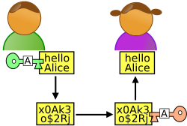
Beyond Secure Communication
x
y
Alice
Bob
Much more than communicating securely.
Complex Interactions: proofs, computations, games.
Complex Adversaries: Alice or Bob, adaptively chosen.
Complex Properties: Correctness, Privacy, Fairness.

Slide 4
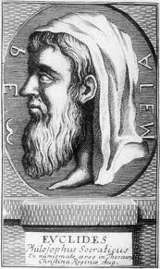
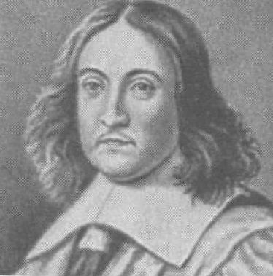
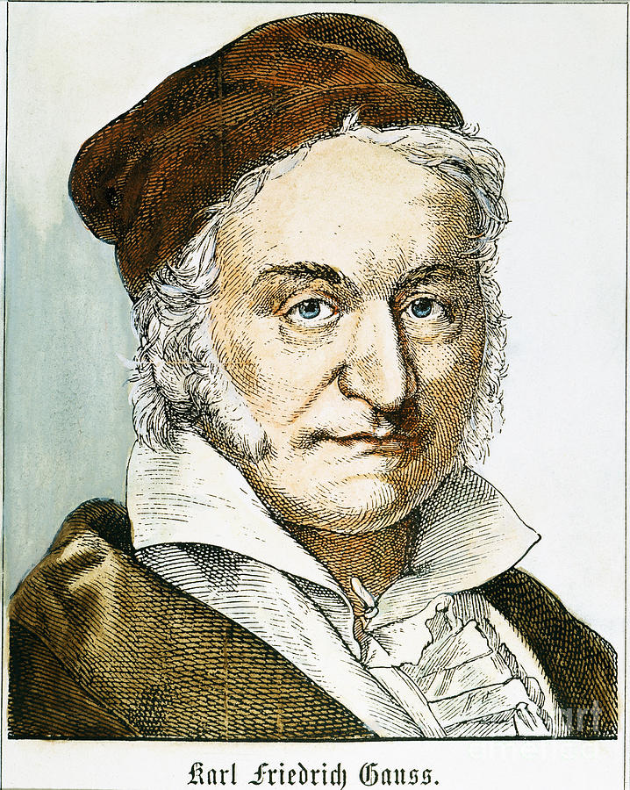
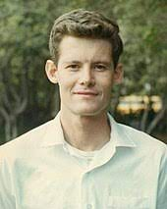
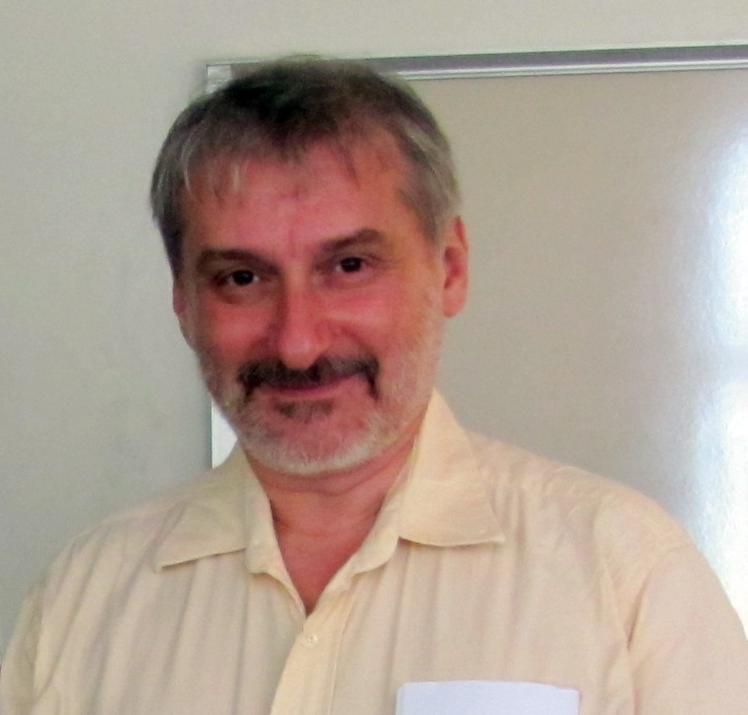
Classical Proofs
Steve Cook
Leonid Levin
Prover writes down a string (proof); Verifier checks.
Axiom 1
Axiom 2
Axiom 1⇒A
A⇒B
QED
a²+b²
a
b

Slide 5
Proofs
Claim/Theorem
accept/reject
proof
Prover
Verifier

Slide 6

Efficiently Verifiable Proofs: $𝓝𝓟$
Claim/Theorem
accept/reject
proof
Prover
Verifier
Works hard
Polynomial-time

Slide 7

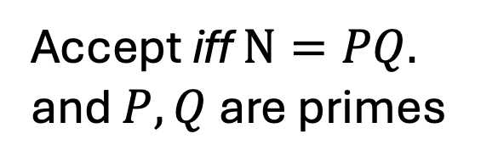
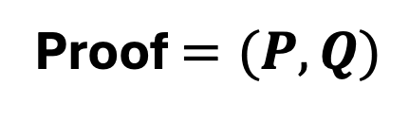
Theorem: $N$ is a product of two prime numbers
Proof $=(P,Q)$
Verifier
Prover
Accept iff $N=PQ.$
and $P,Q$are primes

Slide 8
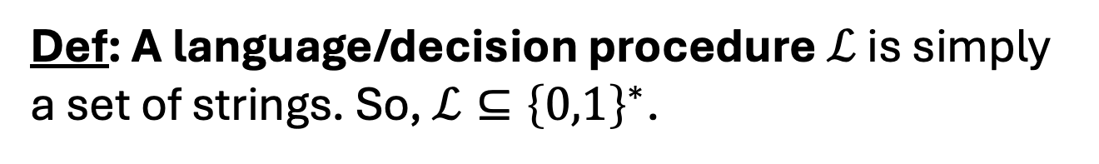
Efficiently Verifiable Proofs: $𝓝𝓟$
Claim/Theorem
accept/reject
proof
Prover
Verifier
Works hard
Polynomial-time
Def: A language/decision procedure $ℒ$ is simply a set of strings. So, $ℒ⊆{\left\{0,1\right\}}^{∗}$.

Slide 9
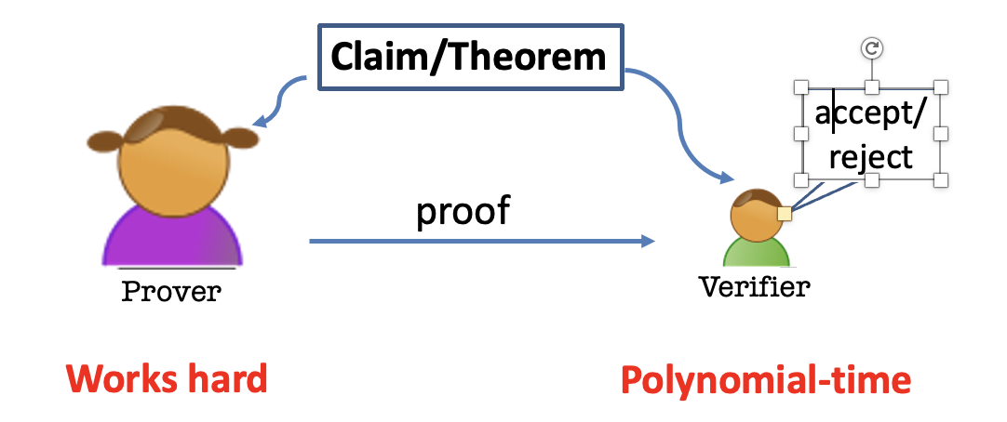
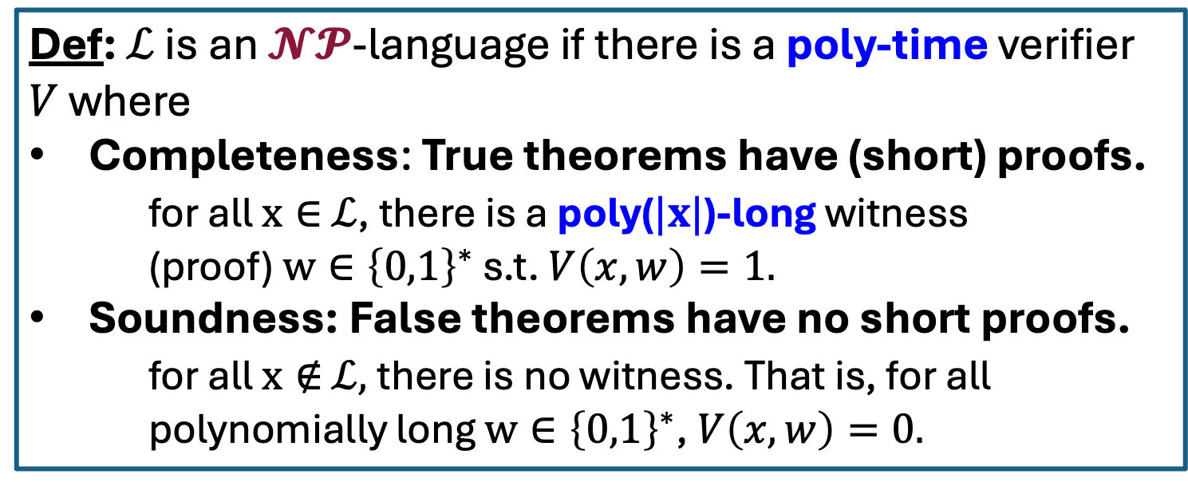
Efficiently Verifiable Proofs: $𝓝𝓟$
Def: $ℒ$ is an $𝓝𝓟$-language if there is a poly-time verifier $V$ where
Completeness: True theorems have (short) proofs.
for all $x∈$ $ℒ$, there is a poly($|x|$)-long witness (proof) $w∈{\left\{0,1\right\}}^{∗}$ s.t. $V\left(x,w\right)=1.$
Soundness: False theorems have no short proofs.
for all $x∉$ $ℒ,$there is no witness. That is, for all polynomially long $w∈{\left\{0,1\right\}}^{∗}$, $V\left(x,w\right)=0.$

Slide 10
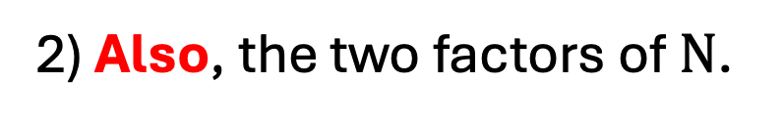
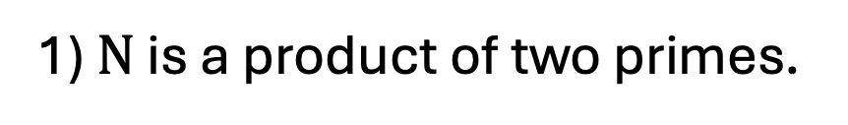
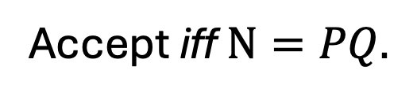
Theorem: $N$ is a product of two prime numbers
Proof $=(P,Q)$
Verifier
Prover
Accept iff $N=PQ.$
After interaction, Bob the Verifier knows:
1) $N$ is a product of two primes.
2) Also, the two factors of $N$.

Slide 11


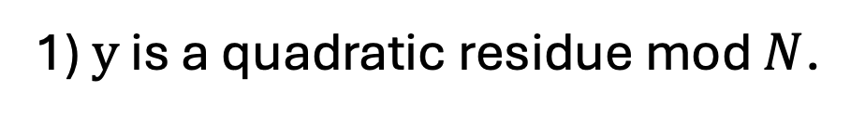
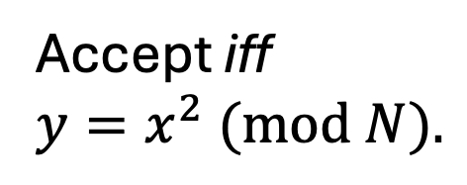

Theorem: $y$ is a quadratic residue mod $N$
Proof $=x∈Z_{N}^{∗}$
Verifier
Prover
Accept iff
$y=x^{2} (mod N).$
After interaction, Bob the Verifier knows:
1) $y$ is a quadratic residue mod $N$.
2) Also, the square root of $y$.

Slide 12
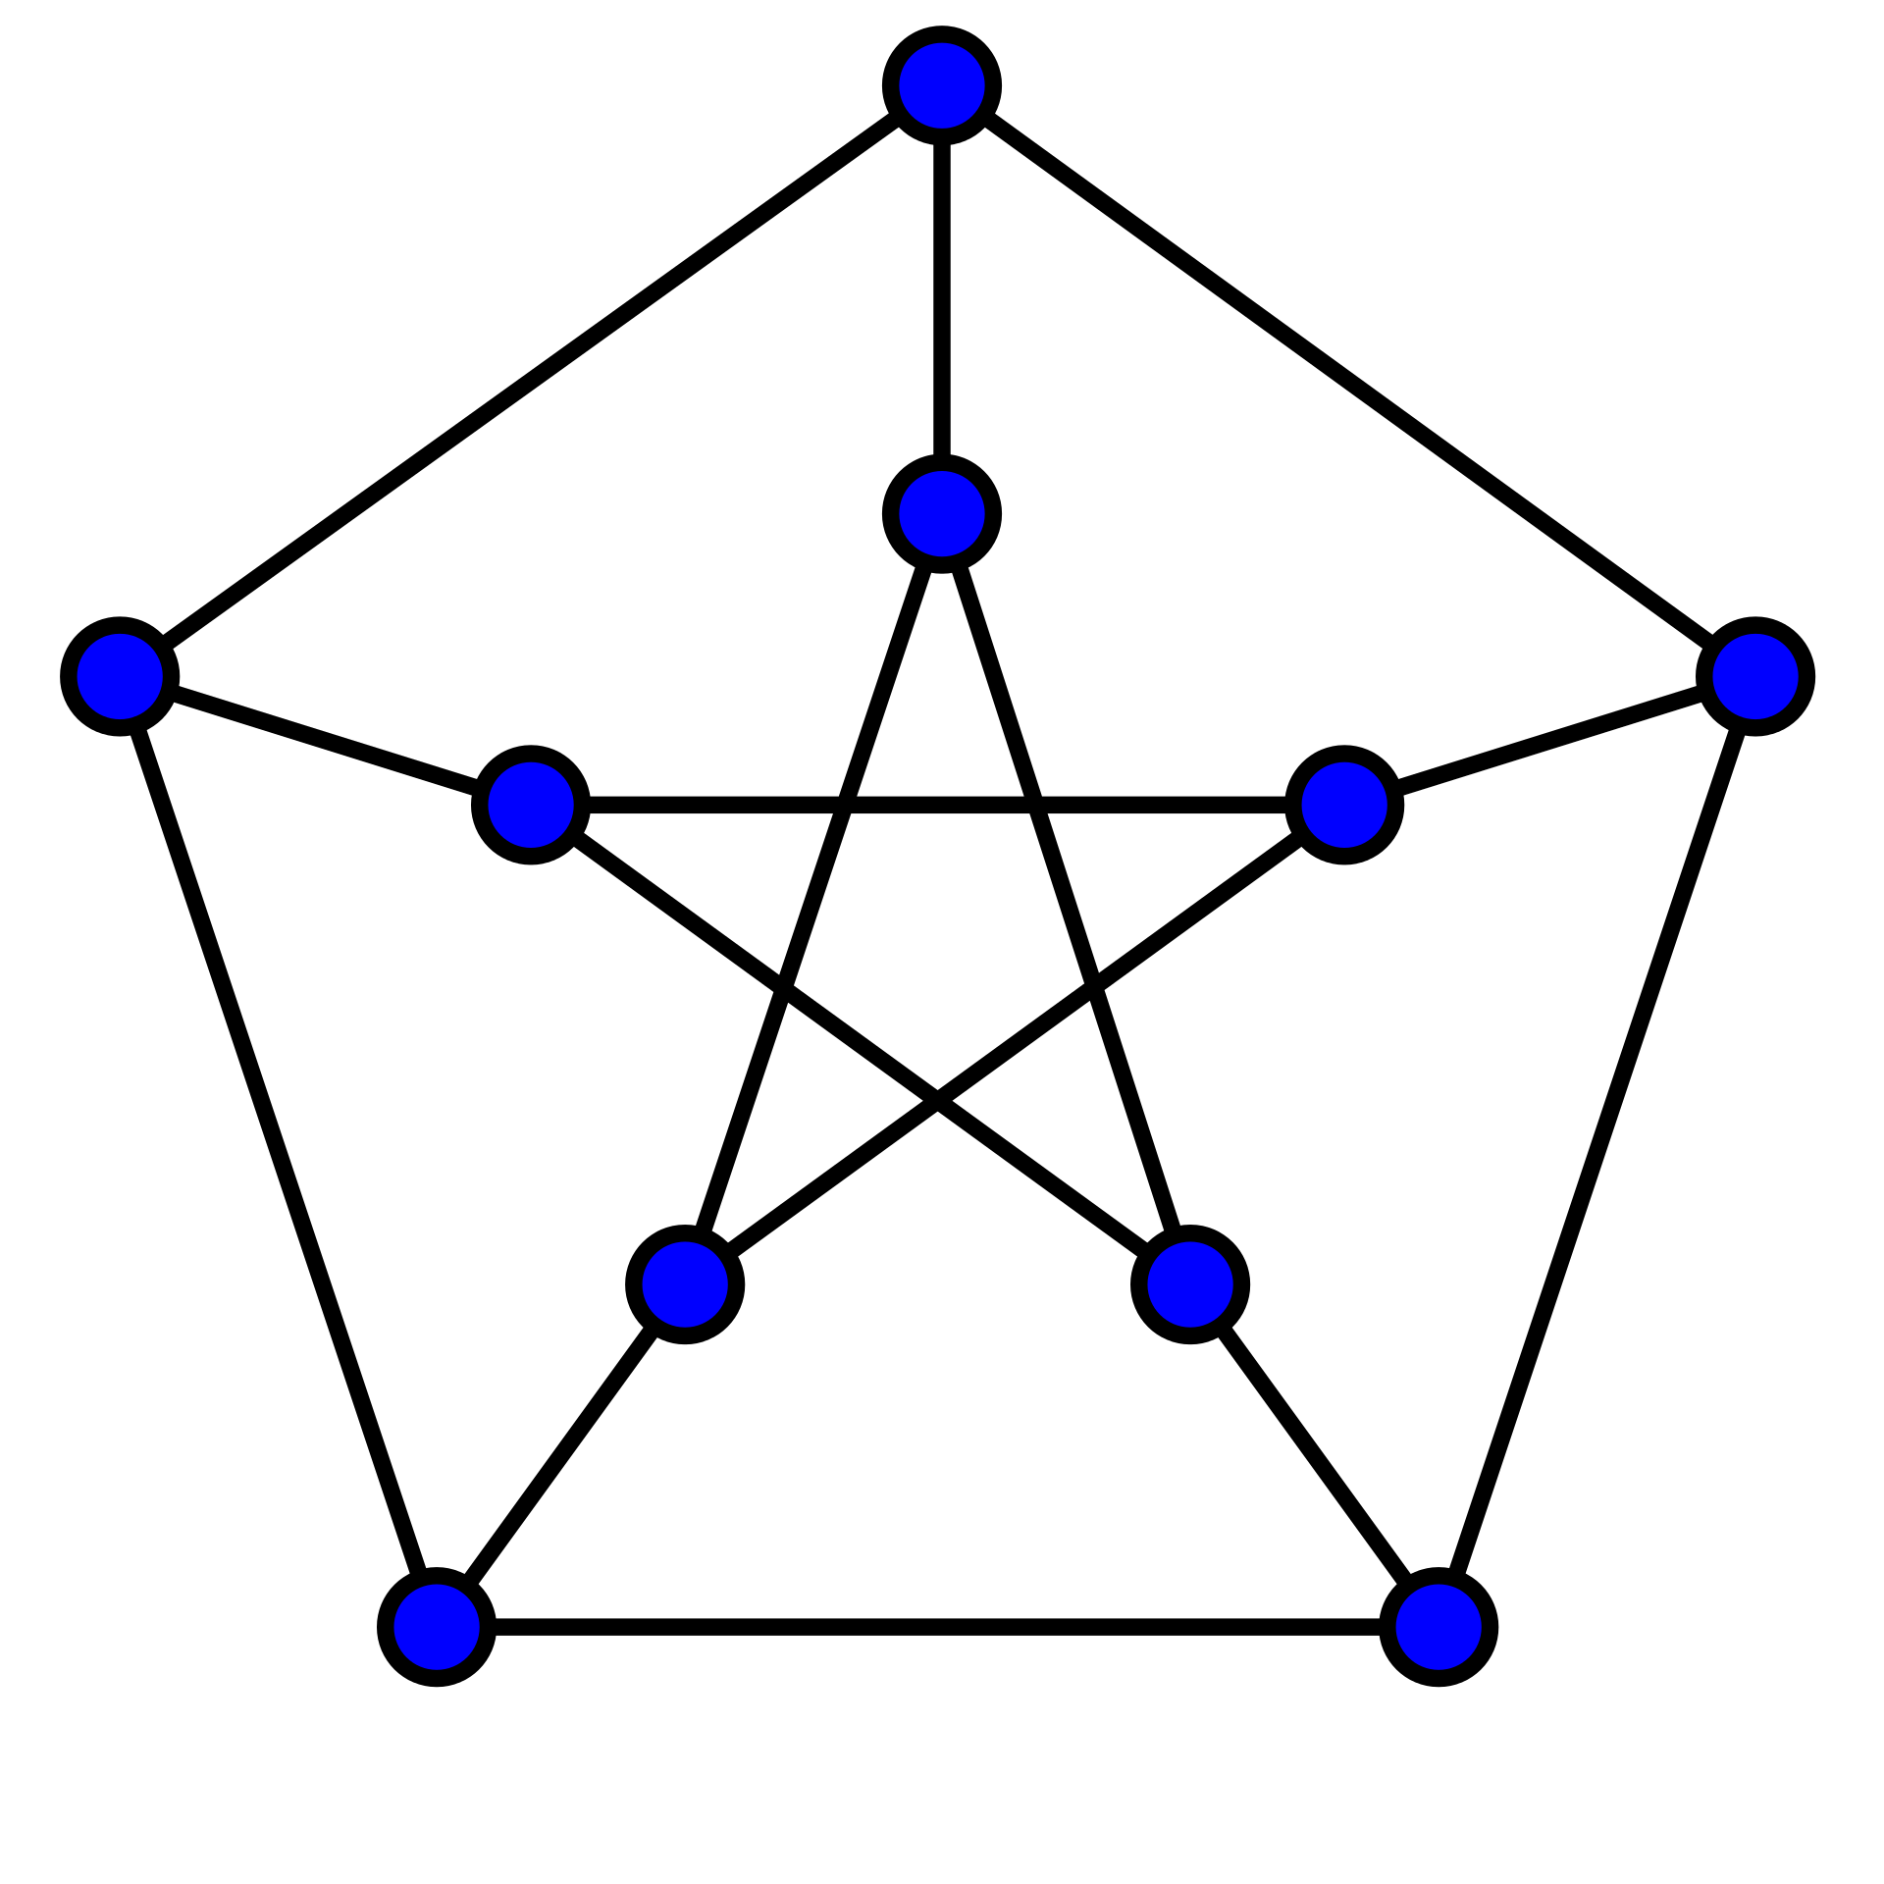
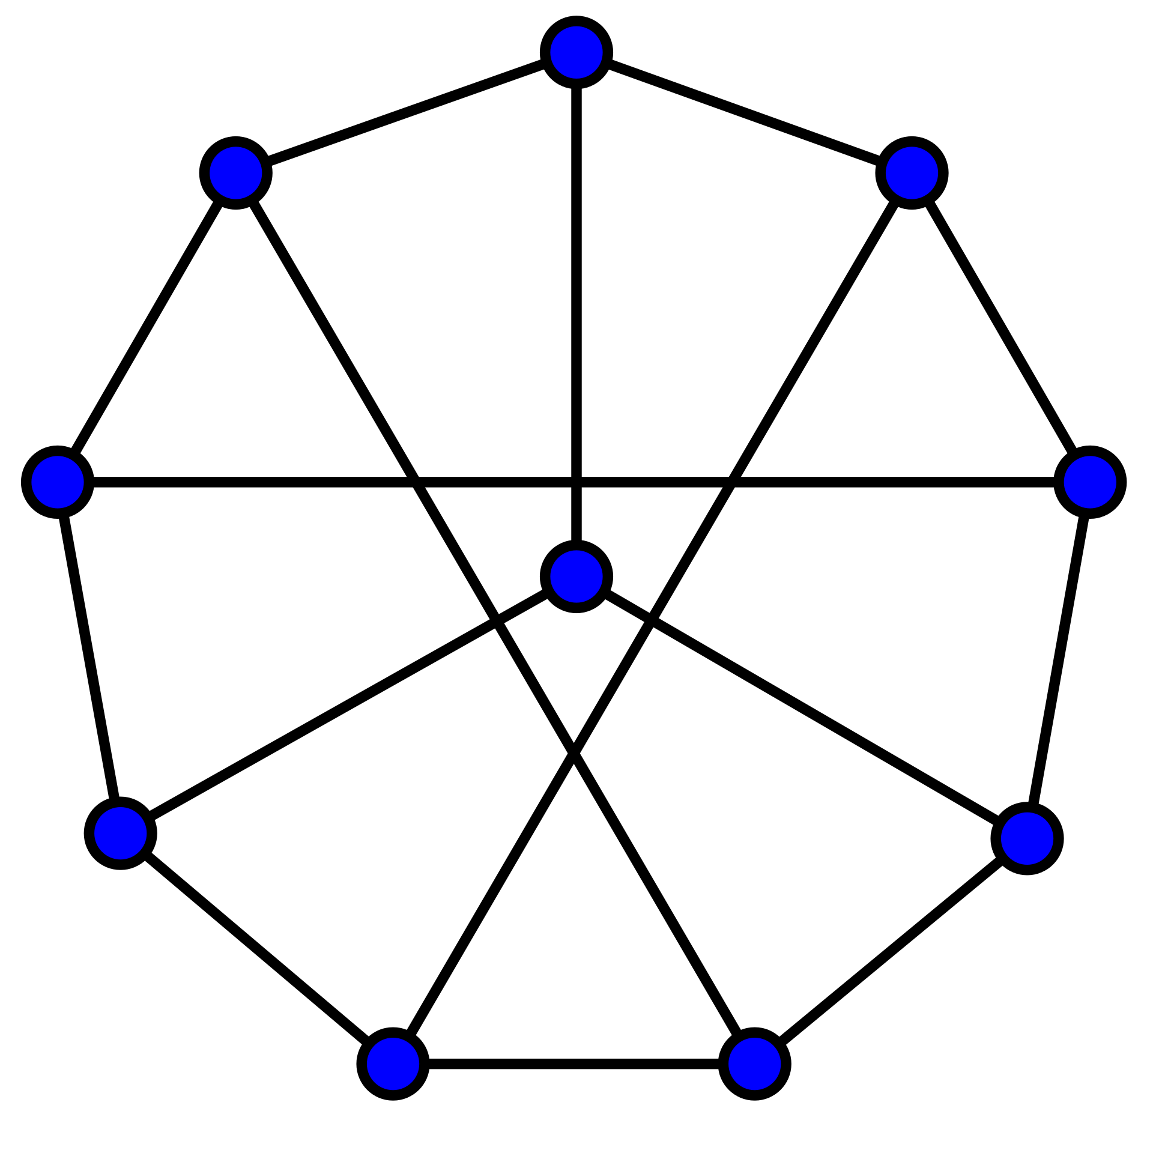
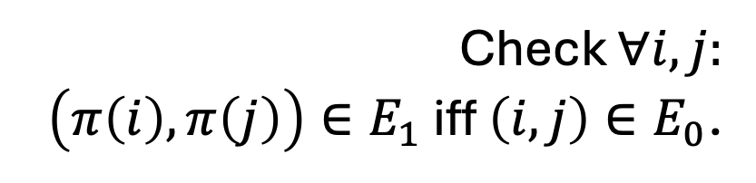

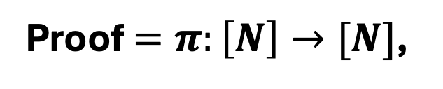
Theorem: Graphs $G_{0}$ and $G_{1}$ are isomorphic.
1
1
2
6
2
6
5
7
10
3
5
8
8
9
4
10
3
4
9
7
Proof $=π:\left[N\right]→[N]$,
the isomorphism
Verifier
Prover
Check $∀i,j:$
$\left(π\left(i\right),π\left(j\right)\right)∈E_{1}$ iff $\left(i,j\right)∈E_{0}$.

Slide 13
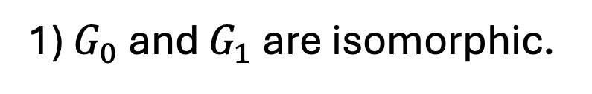
Theorem: Graphs $G_{0}$ and $G_{1}$ are isomorphic.
1
1
2
6
2
6
5
7
10
3
8
5
8
9
4
10
3
4
9
7
Proof $=π:\left[N\right]→[N]$,
the isomorphism
Verifier
Prover
After interaction, Bob the Verifier knows:
1) $G_{0}$ and $G_{1}$ are isomorphic.
2) Also, the isomorphism.

Slide 14
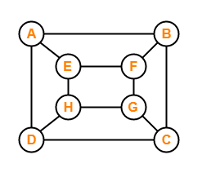

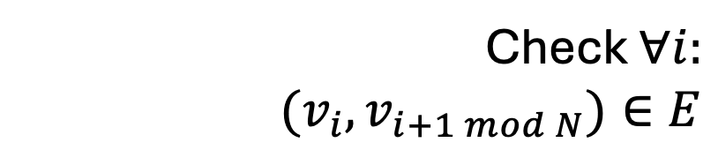
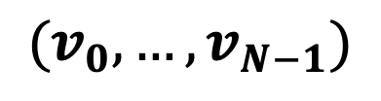
Theorem: Graphs $G$ has a Hamiltonian cycle.
Proof = Hamiltonian cycle
$$(v_{0},…,v_{N−1})$$
Verifier
Prover
Check $∀i:$
$$(v_{i},v_{i+1 mod N})∈E$$

Slide 15
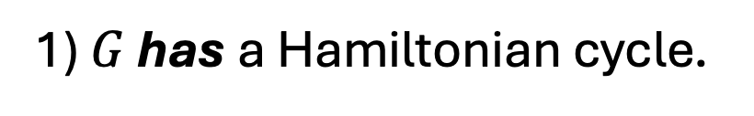
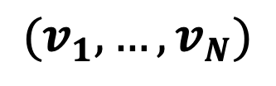
Theorem: Graphs $G$ has a Hamiltonian cycle.
Proof = Hamiltonian cycle
$$(v_{1},…,v_{N})$$
Verifier
Prover
After interaction, Bob the Verifier knows:
1) $G$ has a Hamiltonian cycle.
2) Also, the Hamiltonian cycle itself.

Slide 16
Theorem: Graphs $G$ has a Hamiltonian cycle.
Proof = Hamiltonian cycle
$$(v_{1},…,v_{N})$$
Verifier
Prover
NP-Complete Problem:
Every one of the other problems can be reduced to it

Slide 17
Theorem: $y$ is a quadratic residue mod $N$
Proof $=x∈Z_{N}^{∗}$
Verifier
Prover
Accept iff
$y=x^{2} (mod N).$
After interaction, Bob the Verifier knows:
1) $y$ is a quadratic residue mod $N$.
2) Also, the square root of $y$.

Slide 18
Is there any other way?

Slide 19
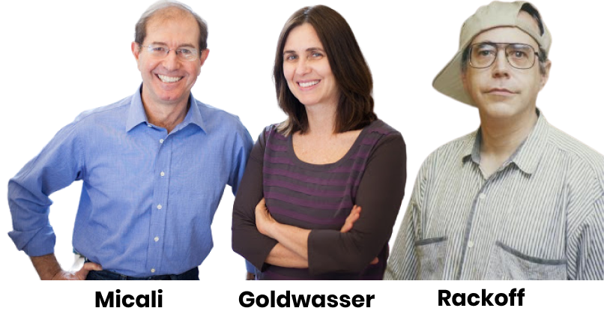
Zero Knowledge Proofs
“I will prove to you that I could’ve sent you a proof if I felt like it.”
Prover

Slide 20
Zero Knowledge Proofs
“I will not give you the square root, but I will prove to you that I could provide one if I wanted to.”
Prover

Slide 21
Two (Necessary) New Ingredients
1. Interaction: Rather than passively reading the proof, the verifier engages in a conversation with the prover.
2. Randomness: The verifier is randomized and can make a mistake with a (exponentially small) probability.

Slide 22
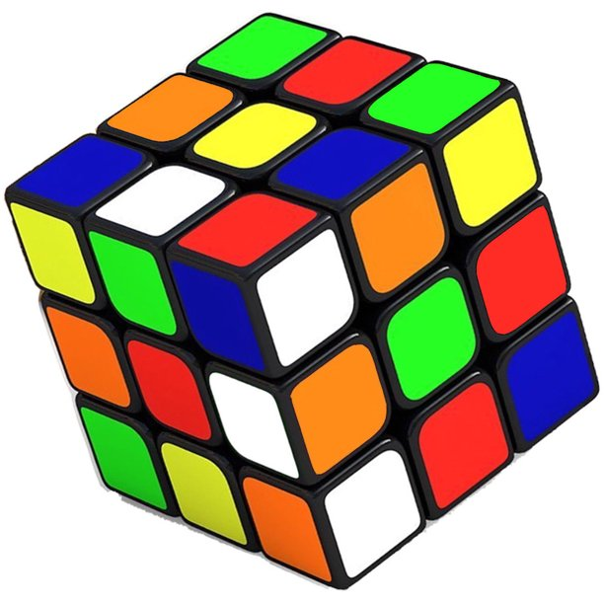

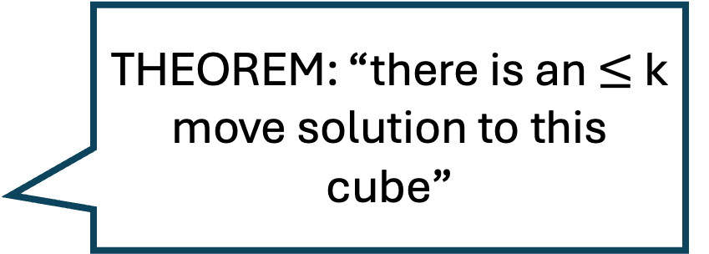
Here is the idea.
THEOREM: “there is an $≤$k move solution to this cube”
Prover

Slide 23
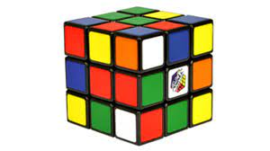
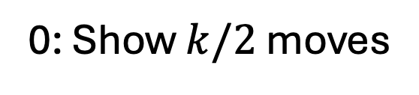
Here is the idea.
“Random” config
Challenge (0 or 1)
0: Show $k/2$ moves
Verifier
Prover

Slide 24
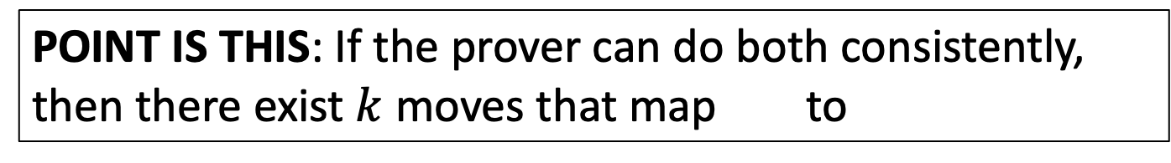
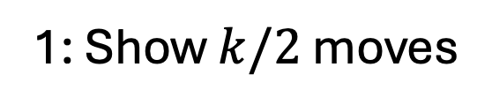
Here is the idea.
“Random” config
Challenge (0 or 1)
1: Show $k/2$ moves
Verifier
Prover
POINT IS THIS: If the prover can do both consistently, then there exist $k$ moves that map to

Slide 25






Interactive Proofs for a Language $ℒ$
Claim/Theorem
$$a_{1}$$
accept/reject
$$q_{1}$$
$$a_{2}$$
$$q_{2}$$
Verifier
Prover
$$…$$
Probabilistic Polynomial-time
Comp. Unbounded

Slide 26





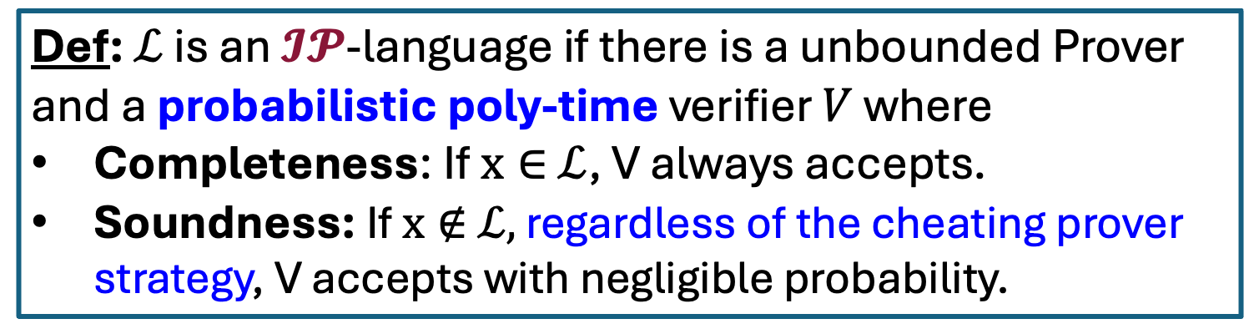
Interactive Proofs for a Language $ℒ$
Claim/Theorem
$$a_{1}$$
accept/reject
$$q_{1}$$
$$a_{2}$$
$$…$$
Verifier
Prover
Def: $ℒ$ is an $𝓘𝓟$-language if there is a unbounded Prover and a probabilistic poly-time verifier $V$ where
Completeness: If $x∈$ $ℒ$, V always accepts.
Soundness: If $x∉$ $ℒ,$ regardless of the cheating prover strategy, V accepts with negligible probability.

Slide 27
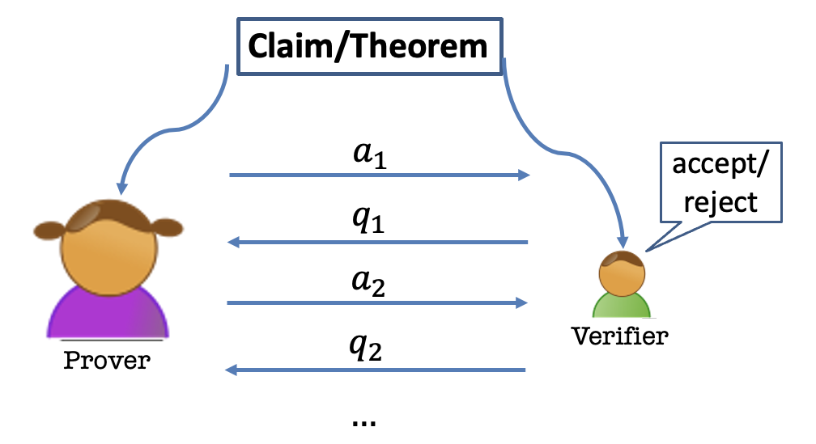
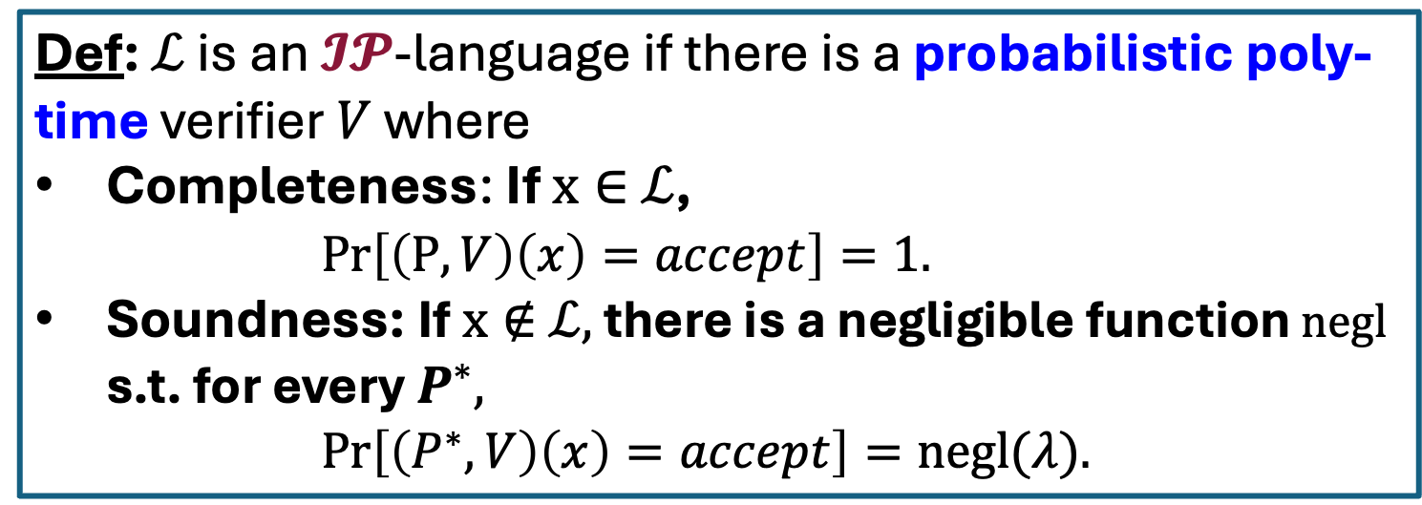
Interactive Proofs for a Language $ℒ$
Def: $ℒ$ is an $𝓘𝓟$-language if there is a probabilistic poly-time verifier $V$ where
Completeness: If $x∈$ $ℒ$,
$Pr\left[\left(P,V\right)\left(x\right)=accept\right]=1.$
Soundness: If $x∉$ $ℒ,$ there is a negligible function $negl$ s.t. for every $P^{∗},$
$Pr\left[\left(P^{∗},V\right)\left(x\right)=accept\right]=negl(λ).$

Slide 28
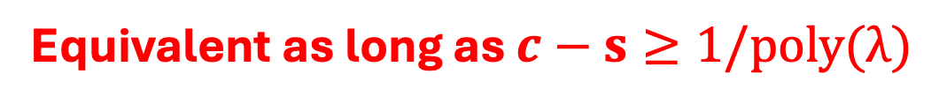
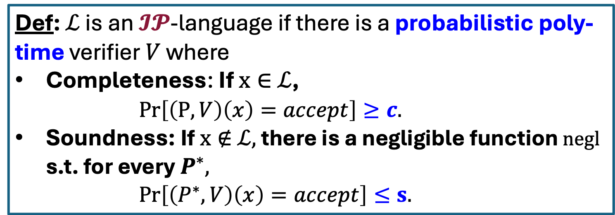
Interactive Proofs for a Language $ℒ$
Def: $ℒ$ is an $𝓘𝓟$-language if there is a probabilistic poly-time verifier $V$ where
Completeness: If $x∈$ $ℒ$,
$Pr\left[\left(P,V\right)\left(x\right)=accept\right]≥c.$
Soundness: If $x∉$ $ℒ,$ there is a negligible function $negl$ s.t. for every $P^{∗},$
$Pr\left[\left(P^{∗},V\right)\left(x\right)=accept\right]≤s.$
Equivalent as long as $c−s≥1/poly(λ)$

Slide 29
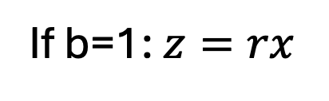
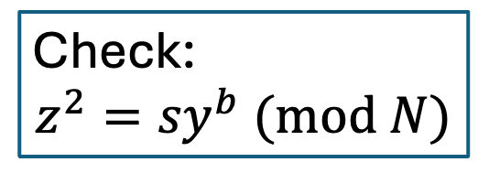
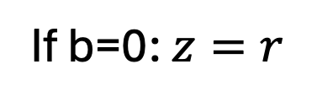



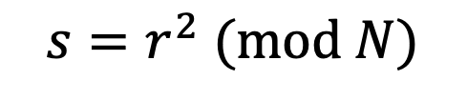
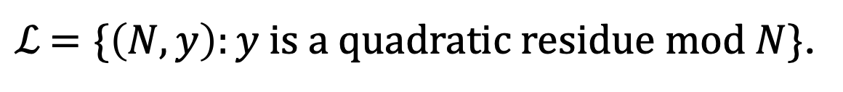
Interactive Proof for QR
$ℒ$ $=\{\left(N,y\right):y is a quadratic residue mod N\}$.
$${s=r}^{2} (mod N)$$
$$\left(N,y\right)$$
$$\left(N,y\right)$$
$$b←\{0,1\}$$
If b=0: $z=r$
Check:
$${z^{2}=sy}^{b} (mod N)$$
If b=1: $z=rx$

Slide 30
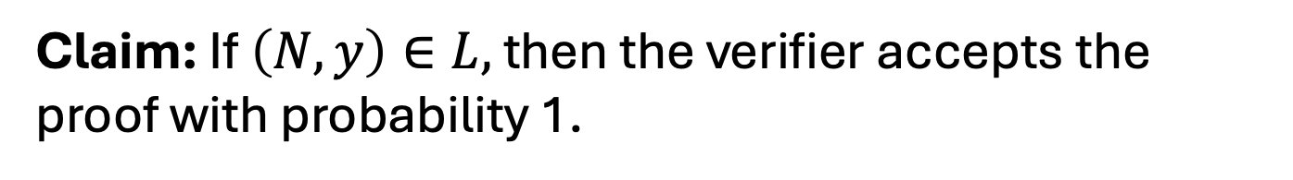
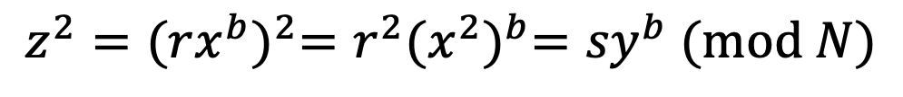
Completeness
Claim: If $\left(N,y\right)∈L,$ then the verifier accepts the proof with probability 1.
Proof:
$${z^{2}={(rx^{b})}^{2}=r^{2}{(x^{2})}^{b}=sy}^{b} (mod N)$$
So, the verifier’s check passes and he accepts.

Slide 31
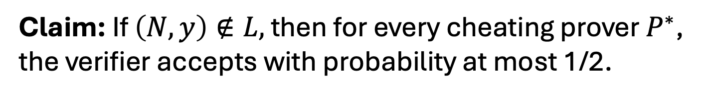
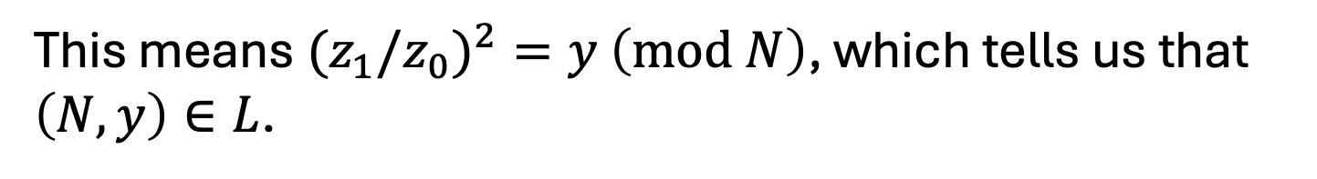
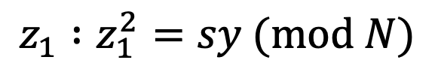
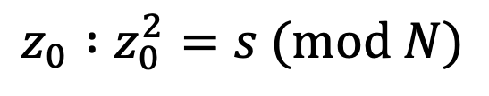
Soundness
Claim: If $\left(N,y\right)∉L,$ then for every cheating prover $P^{∗}$, the verifier accepts with probability at most 1/2.
Proof:
Suppose the verifier accepts with probability > 1/2.
Then, there is some $s∈Z_{N}^{∗}$ s.t. the prover produces
$$z_{0} :z_{0}^{2}=s (mod N)$$
$$z_{1} :z_{1}^{2}=sy (mod N)$$
This means${(z}_{1}/z_{0})^{2}=y$ $\left(mod N\right)$, which tells us that $\left(N,y\right)∈L$.

Slide 32
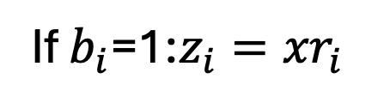







Interactive Proof for QR
$ℒ$ $=\{\left(N,y\right):y is a quadratic residue mod N\}$.
$$s_{i}=r_{i}^{2} (mod N)$$
$$\left(N,y\right)$$
$$\left(N,y\right)$$
$$b_{i}←\{0,1\}$$
If $b_{i}$=0: $z_{i}=r_{i}$
Check for all i:
$$z_{i}^{2}=s_{i}y^{b} (mod N)$$
If $b_{i}$=1:$z_{i}={xr}_{i}$
REPEAT sequentially $λ$ times.

Slide 33

Soundness
Claim: If $\left(N,y\right)∉L,$ then for every cheating prover $P^{∗}$, the verifier accepts with probability at most ${(\frac{1}{2})}^{λ}$.
Proof:
Exercise.

Slide 34
This is Zero-Knowledge.
But what does that mean?
$${s=r}^{2} (mod N)$$
$$\left(N,y\right)$$
$$\left(N,y\right)$$
$$b←\{0,1\}$$
If b=0: $z=r$
Check:
$${z^{2}=sy}^{b} (mod N)$$
If b=1: $z=rx$

Slide 35


How to Define Zero-Knowledge?
After the interaction, $V$ knows:
The theorem is true; and
A view of the interaction
(= transcript + coins of V)
$P$ gives zero knowledge to $V$:
When the theorem is true, the view gives V nothing that he couldn’t have obtained on his own without interacting with P.

Slide 36

How to Define Zero-Knowledge?
$(P,V)$ is zero-knowledge if $V$ can generate his VIEW of the interaction all by himself in probabilistic polynomial time.

Slide 37

How to Define Zero-Knowledge?
$(P,V)$ is zero-knowledge if $V$ can “simulate” his VIEW of the interaction all by himself in probabilistic polynomial time.

Slide 38








The Simulation Paradigm
PPT “simulator” $S$
$${sim}_{S}:$$
$$\left(s,b,z\right)$$
$$\left(N,y\right)$$
$${view}_{V}\left(P,V\right):$$
$Transcript= \left(s,b,z\right),$
Coins = $b$
$${view}_{V}\left(P,V\right):$$
$$\left(s,b,z\right)$$

Slide 39



Zero Knowledge: Definition
An Interactive Protocol (P,V) is zero-knowledge for a language $L$if there exists a PPT algorithm S (a simulator) such that for every $x∈L$, the following two distributions are indistinguishable:
1. ${view}_{V}(P,V)$
2. $S(x,1^{λ})$
(P,V) is a zero-knowledge interactive protocol if it is complete, sound and zero-knowledge.

Slide 40

Perfect Zero Knowledge: Definition
An Interactive Protocol (P,V) is perfect zero-knowledge for a language $L$if there exists a PPT algorithm S (a simulator) such that for every $x∈L$, the following two distributions are identical:
1. ${view}_{V}(P,V)$
2. $S(x,1^{λ})$
(P,V) is a zero-knowledge interactive protocol if it is complete, sound and zero-knowledge.

Slide 41



Computational Zero Knowledge: Definition
An Interactive Protocol (P,V) is statistical zero-knowledge for a language $L$if there exists a PPT algorithm S (a simulator) such that for every $x∈L$, the following two distributions are statistically indistinguishable:
1. ${view}_{V}(P,V)$
2. $S(x,1^{λ})$
(P,V) is a zero-knowledge interactive protocol if it is complete, sound and zero-knowledge.

Slide 42

Computational Zero Knowledge: Definition
An Interactive Protocol (P,V) is computational zero-knowledge for a language $L$if there exists a PPT algorithm S (a simulator) such that for every $x∈L$, the following two distributions are computationally indistinguishable:
1. ${view}_{V}(P,V)$
2. $S(x,1^{λ})$
(P,V) is a zero-knowledge interactive protocol if it is complete, sound and zero-knowledge.

Slide 43




Zero Knowledge
Claim: The QR protocol is zero knowledge.
Simulator S works as follows:
1. First pick a random bit b.
2. pick a random $z∈Z_{N}^{∗}$.
3. compute $s=z^{2}/y^{b}$.
$${view}_{V}\left(P,V\right):$$
$$\left(s,b,z\right)$$
4. output $(s,b,z)$.
Exercise: The simulated transcript is identically distributed as the real transcript in the interaction (P,V).

Slide 44






What if V is NOT HONEST.
OLD DEF
An Interactive Protocol (P,V) is honest-verifier perfect zero-knowledge for a language $L$if there exists a PPT simulator S such that for every $x∈L$, the following two distributions are identical:
1. ${view}_{V}(P,V)$
2. $S(x,1^{λ})$
REAL DEF
An Interactive Protocol (P,V) is perfect zero-knowledge for a language $L$if for every PPT $V^{∗}$, there exists a (expected) poly time simulator S s.t. for every $x∈L$, the following two distributions are identical:
1. ${view}_{V^{∗}}(P,V^{∗})$
2. $S(x,1^{λ})$

Slide 45
Previous Theorem: Zero Knowledge
Claim: The QR protocol is honest verifier zero knowledge.
Simulator S works as follows:
1. First pick a random bit b.
2. pick a random $z∈Z_{N}^{∗}$.
3. compute $s=z^{2}/y^{b}$.
$${view}_{V}\left(P,V\right):$$
$$\left(s,b,z\right)$$
4. output $(s,b,z)$.
Exercise: The simulated transcript is identically distributed as the real transcript in the interaction (P,V).

Slide 46



NEED: Zero Knowledge
Theorem: The QR protocol is (malicious verifier) zero knowledge.
Simulator S works as follows:
1. First pick a random s and “feed it to” $V^{∗}$.
2. Let $b=V^{∗}(s)$.
$${view}_{V^{∗}}\left(P,V^{∗}\right):$$
$$\left(s,b,z\right)$$
Now what???

Slide 47



NEED: Zero Knowledge
Theorem: The QR protocol is (malicious verifier) zero knowledge.
Simulator S works as follows:
1. First set $s=\frac{z^{2}}{y^{b}}$ for a random z and feed s to $V^{∗}$.
2. Let $b′=V^{∗}(s)$.
3. If $b^{′}=b$, output $(s,b,z)$ and stop.
4. Otherwise, go back to step 1 and repeat. (also called “rewinding”).

Slide 48


Simulator S works as follows:
1. First set $s=\frac{z^{2}}{y^{b}}$ for a random z and feed s to $V^{∗}$.
2. Let $b′=V^{∗}(s)$.
3. If $b^{′}=b$, output $(s,b,z)$ and stop.
4. Otherwise, go back to step 1 and repeat. (also called “rewinding”).
Lemma: S runs in expected polynomial-time and when it outputs a view, it is identical to the view of $V^{∗}$ in a real execution.

Slide 49
What Made it Possible?
1. Each statement had multiple proofs of which the prover chooses one at random.
2. Each such proof is made of two parts: seeing either one on its own gives the verifier no knowledge; seeing both imply 100% correctness.
3. Verifier chooses to see either part, at random. The prover’s ability to provide either part on demand convinces the verifier.

