Slide 1
Purdue CS555: Cryptography Lecture 8
Instructor: Hanshen Xiao
Teaching Assistant: Justin He
course website: https://cs55500.github.io/

Slide 2
Recap
GGM Construction of Pseudorandom Functions
Application of Pseudorandom Functions
Identity Identification
Message Authentication Codes (MACs): Privacy v.s. Integrity

Slide 3
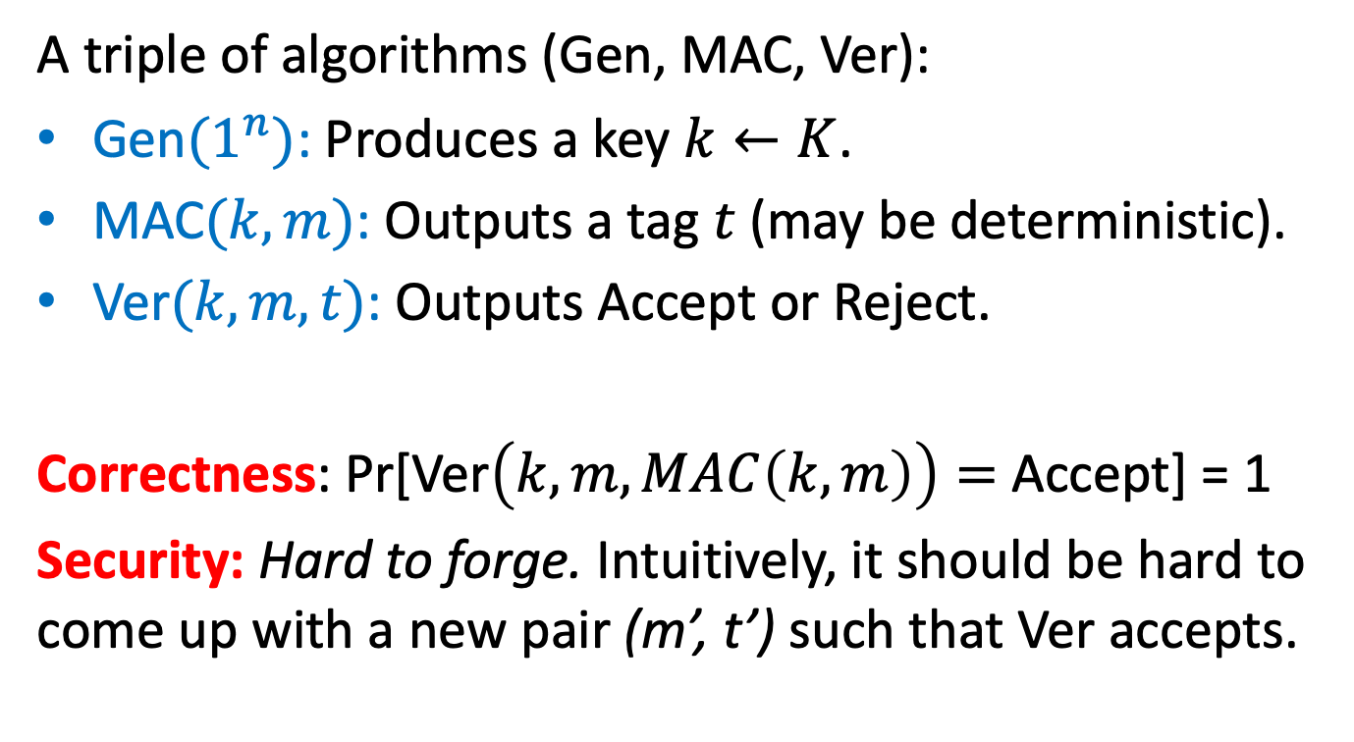
Message Authentication Codes (MACs)
A triple of algorithms (Gen, MAC, Ver):
Gen${(1}^{n})$: Produces a key $k←K$.
MAC$(k, m)$: Outputs a tag $t$ (may be deterministic).
Ver$(k, m, t)$: Outputs Accept or Reject.
Correctness: Pr[Ver$\left(k, m, MAC\left(k, m\right)\right)=$ Accept] = 1
Security: Hard to forge. Intuitively, it should be hard to come up with a new pair (m’, t’) such that Ver accepts.

Slide 4
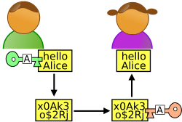
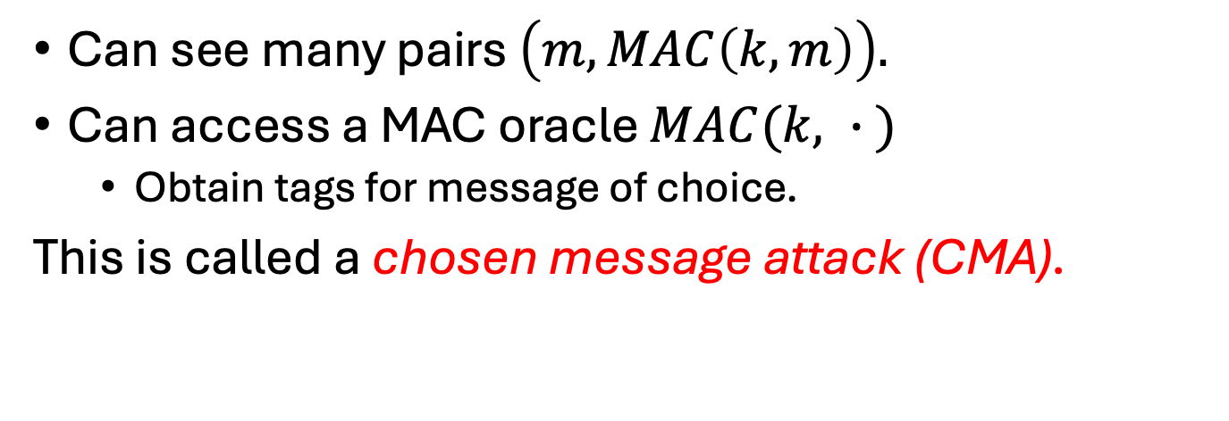
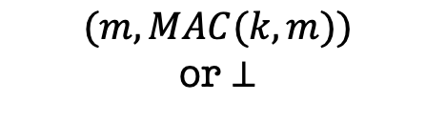

What is the power of the adversary?
m
$$(m, MAC(k, m))$$
$$(m, MAC(k, m))$$
or $⊥$
Alice
Bob
Can see many pairs $\left(m, MAC\left(k, m\right)\right).$
Can access a MAC oracle $MAC(k, ∙ )$
Obtain tags for message of choice.
This is called a chosen message attack (CMA).

Slide 5
Defining MAC Security
Total break: The adversary should not be able to recover the key k.
Universal break: The adversary can generate a valid tag for every message.
Existential break: The adversary can generate a new valid tag t for some message m.
We will require MACs to be secure against the existential break!!

Slide 6


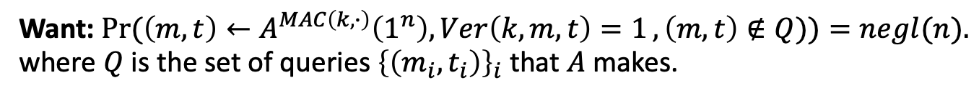

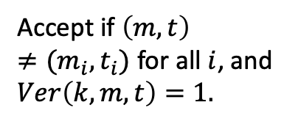



EUF-CMA Security
Existentially Unforgeable against Chosen Message Attacks
$$m_{1}$$
$${t_{1}= MAC(k, m}_{1})$$
$$k←K$$
$$m_{2}$$
$${t_{2}= MAC(k, m}_{2})$$
…
$$(m, t)$$
Accept if $\left(m, t\right)≠(m_{i}, t_{i})$ for all $i$, and $Ver\left(k, m, t\right)=1.$
Want: $\operatorname{Pr}{(\left(m, t\right)←A^{MAC\left(k, ∙\right)}\left(1^{n}\right), Ver\left(k, m, t\right)=1}, \left(m, t\right)∉Q))=negl(n).$
where $Q$ is the set of queries ${\left\{\left(m_{i}, t_{i}\right)\right\}}_{i}$ that $A$ makes.

Slide 7



Wait… Does encryption not solve this?
m
$$Enc(k, m)$$
Alice
Bob
K$ey k$
Key $k$

Slide 8


Wait… Does encryption not solve this?
m
$m⊕k$
$m′⊕k$
Alice
Bob
Can toggle between m and m’
K$ey k$
Key $k$
One-time pad (and encryption schemes in general) are malleable.

Slide 9


Wait… Does encryption not solve this?
m
$(r,f_{k}(r)⊕m$)
$(r,f_{k}\left(r\right)⊕m^{′})$
Alice
Bob
Can toggle between m and m’
K$ey k$
Key $k$
One-time pad (and encryption schemes in general) are malleable.
Privacy and Integrity are very different goals!

Slide 10
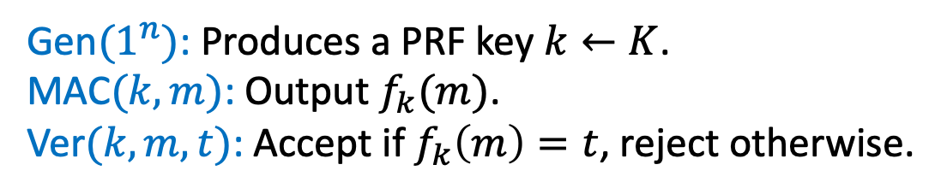



Constructing a MAC
m
$$(m, MAC_{k}\left(m\right))$$
Alice
Bob
K$ey k$
Key $k$
Gen${(1}^{n})$: Produces a PRF key $k←K$.
MAC$(k, m)$: Output $f_{k}(m)$.
Ver$(k, m, t)$: Accept if $f_{k}\left(m\right)=t$, reject otherwise.
Security: Our earlier unpredictability lemma about PRFs essentially proves that this is secure!

Slide 11
Dealing with Replay Attacks
The adversary could send an old valid (m, tag) at a later time.
In fact, our definition of security does not rule this out.
In practice:
Append a time-stamp to the message. Eg. (m, T, MAC(m, T)) where T = 21 Sep 2022, 1:47pm.
Sequence numbers appended to the message (this requires the MAC algorithm to be stateful).

Slide 12

TODAY
Applications of Pseudo-Random Functions (PRF):
a. Identification Protocols
b. Authentication
c. Encryption secure against Active Attacks
d. Applications to Learning Theory

Slide 13



Privacy and Integrity!
m
${ (c=\left(x,f_{k}\left(x\right)⨁m\right), tag=f}_{k′}(c))$
Alice
Bob
K$eys k,k′$
Keys $k,k′$
MACs give us integrity, but not (necessarily) privacy.
Solution: Encrypt, then MAC!

Slide 14
TODAY
Applications of Pseudo-Random Functions (PRF):
a. Identification Protocols
b. Authentication
c. Encryption secure against Active Attacks
d. Applications to Learning Theory

Slide 15
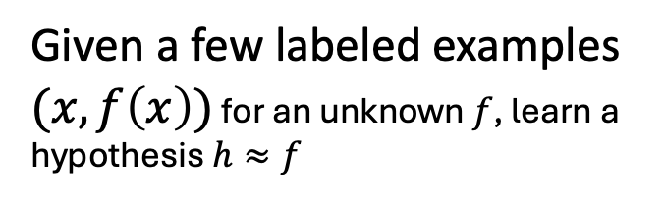
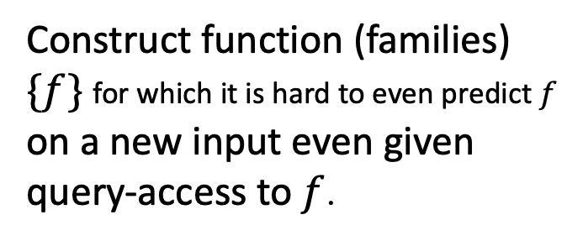
Negative Results in Learning Theory
Learning Theory / ML:
Cryptography (PRFs):
Given a few labeled examples $(x,f\left(x\right))$ for an unknown $f$, learn a hypothesis $h≈f$
Construct function (families) $\{f\}$ for which it is hard to even predict $f$ on a new input even given query-access to $f$.
Theorem [Kearns and Valiant 1994]: Assuming PRFs exist, there are hypothesis classes that cannot be learned by polynomial-time algorithms.

Slide 16
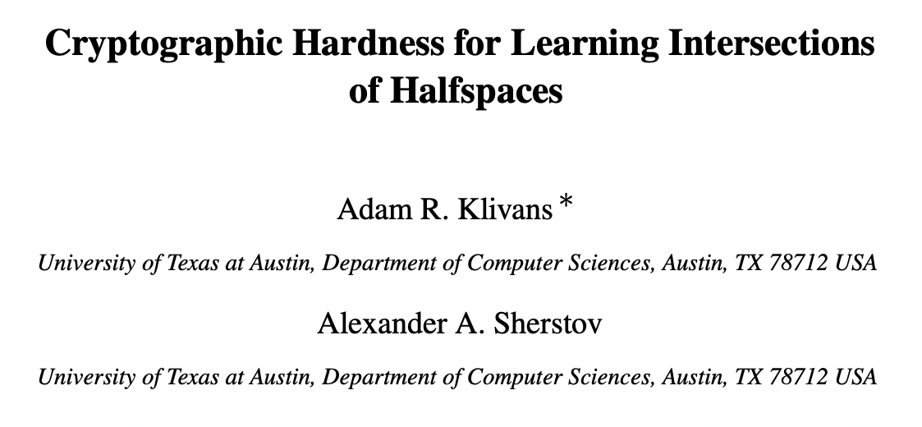
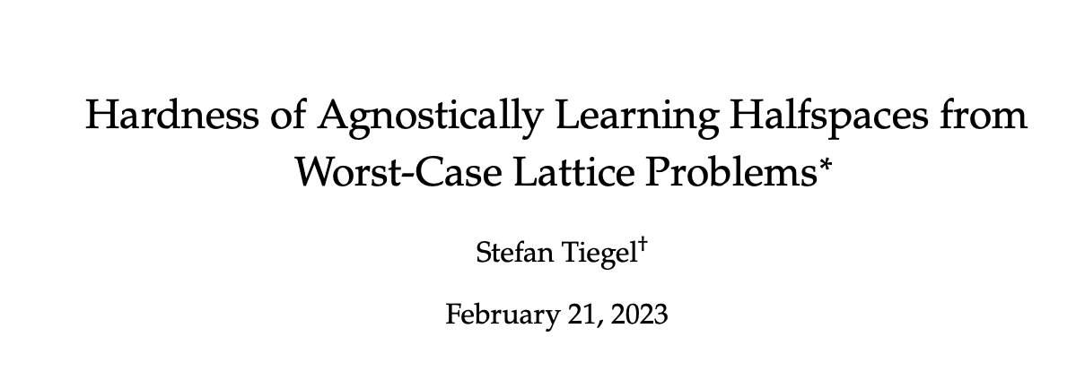
Lots of More Negative Results…
-
-
-
+
+
-
+
-
-
Intersections of halfspaces
+
+
-
-
-
+
“Agnostic learning” of halfspaces

Slide 17
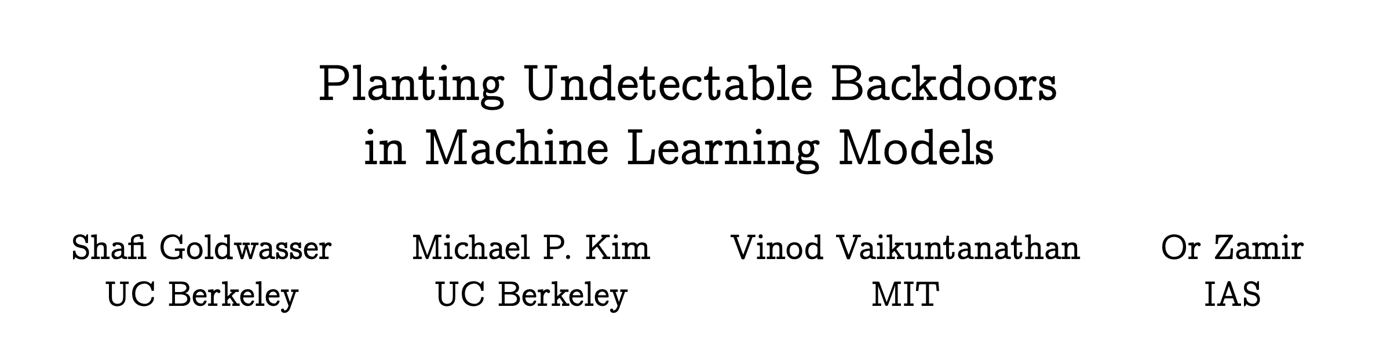
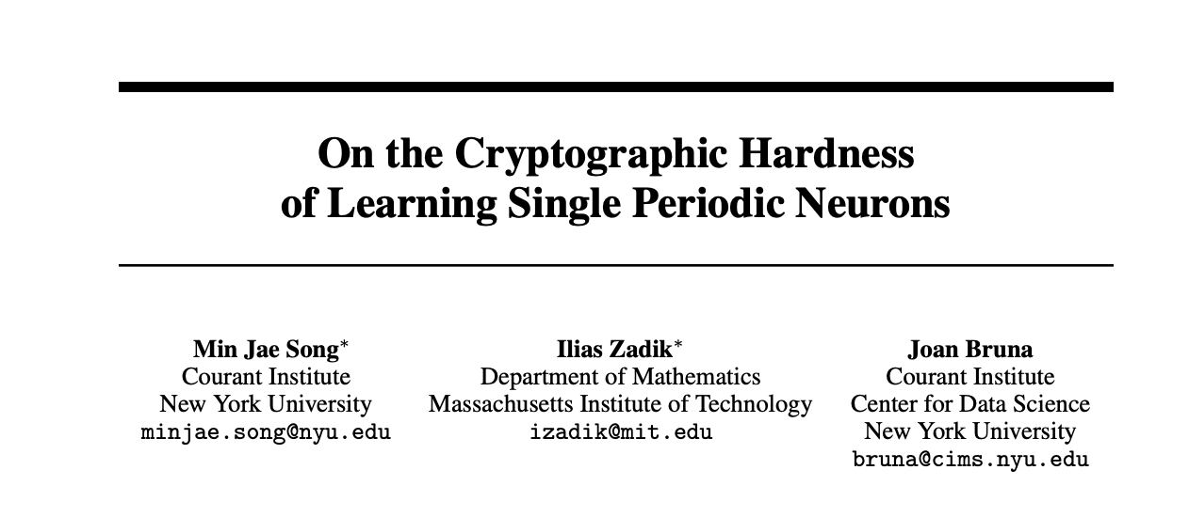
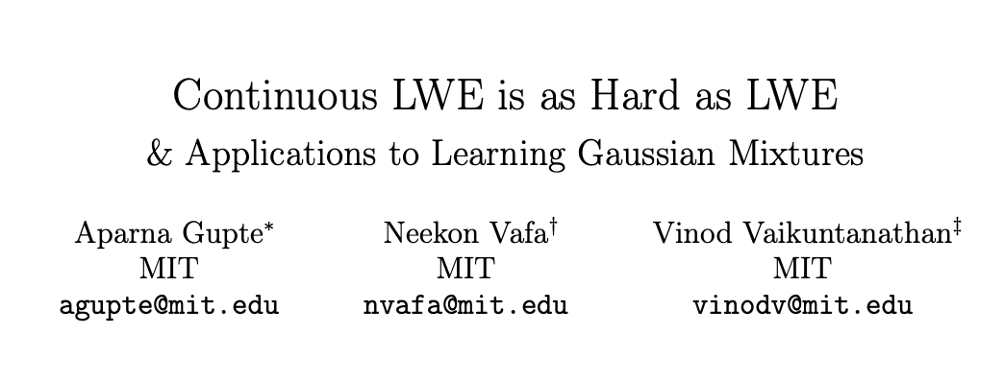
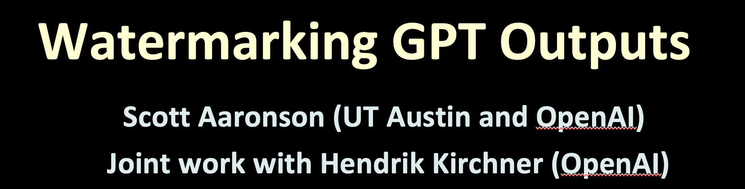
Lots of More Applications…

Slide 18
Public-Key Encryption

Slide 19
Agenda
Key Agreement and Public-key Encryption: Definition and Properties
Constructions
1: Diffie-Hellman/El Gamal
2: Trapdoor Permutations (RSA)
3: Quadratic Residuosity/Goldwasser-Micali
4: Learning with Errors/Regev

Slide 20

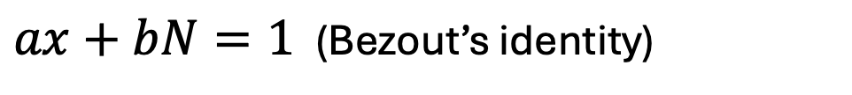
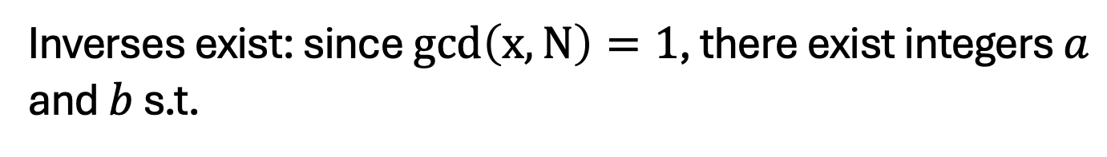
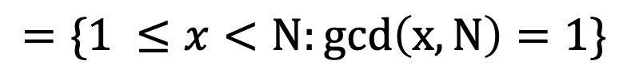
The Multiplicative Group $ℤ_{N}^{∗}$
$$=\{1 ≤x<N:gcd\left(x,N\right)=1\}$$
Theorem: $ℤ_{N}^{∗}$is a group under multiplication mod N.
Inverses exist: since $gcd\left(x,N\right)=1$, there exist integers $a$ and $b$ s.t.
$ax+bN=1$ (Bezout’s identity)
Thus, $ax=1 \left(mod N\right)$ or $a=x^{−1} (mod N)$.

Slide 21
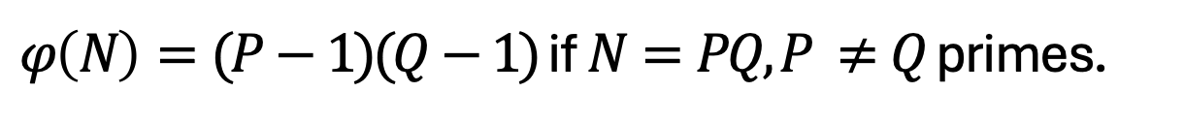

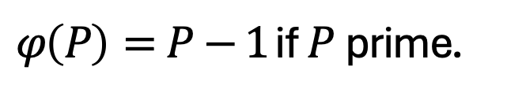

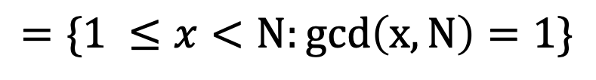
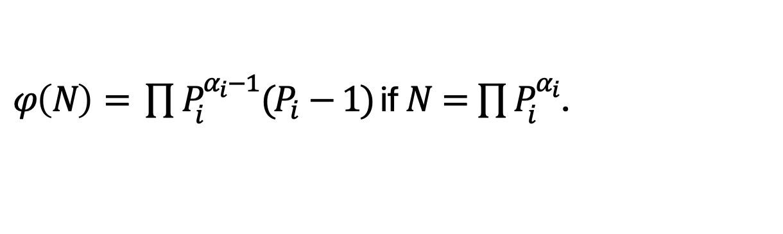
The Multiplicative Group $ℤ_{N}^{∗}$
$$=\{1 ≤x<N:gcd\left(x,N\right)=1\}$$
Theorem: $ℤ_{N}^{∗}$is a group under multiplication mod N.
Order of $ℤ_{N}^{∗}$ = Euler’s totient function $φ(N)$.
$φ\left(P\right)=P−1$ if $P$ prime.
$φ\left(N\right)=(P−1)(Q−1)$ if $N=PQ, P ≠Q$ primes.
$φ\left(N\right)= \prod{P_{i}^{α_{i}−1}(P_{i}−1)}$ if $N=\prod{P_{i}^{α_{i}}}$.
Theorem [Lagrange, Euler]:
For every $a∈ℤ_{N}^{∗}, a^{φ\left(N\right)}=1 mod N.$

Slide 22






Examples
$$ℤ_{2}^{∗}=\{1\}$$
$$ℤ_{3}^{∗}=\{1,2\}$$
$$ℤ_{4}^{∗}=\{1,3\}$$
$$ℤ_{5}^{∗}=\{1,2,3,4\}$$
$$ℤ_{6}^{∗}=\{1,5\}$$
$$ℤ_{7}^{∗}=\{1,2,3,4,5,6,7\}$$

Slide 23

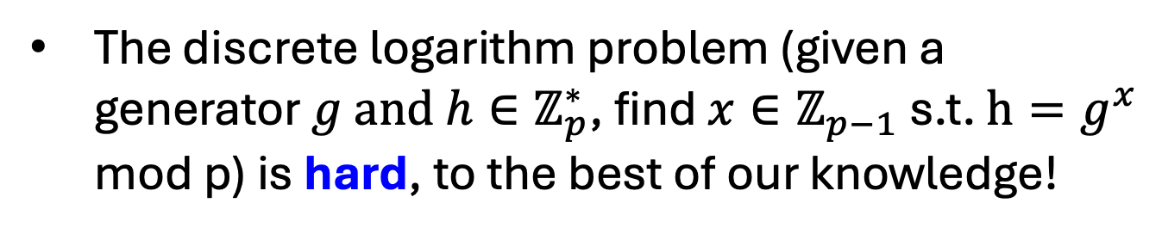
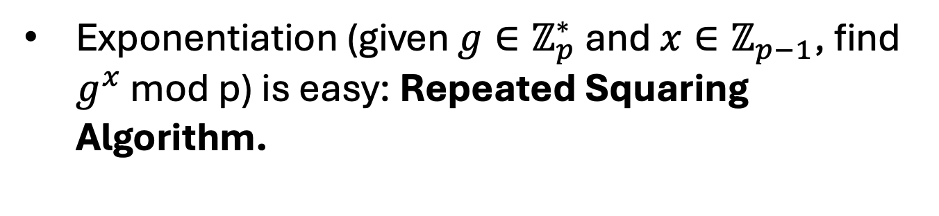
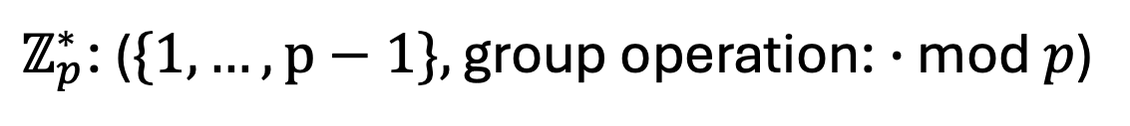
The Multiplicative Group $ℤ_{p}^{∗}$
$ℤ_{p}^{∗}$: ($\{1,…,p−1\},$ group operation: $∙$ mod $p$)
Computing the group operation is easy.
Computing inverses is easy: Extended Euclid.
Exponentiation (given ${g∈ℤ}_{p}^{∗}$and $x∈ℤ_{p−1}$, find $g^{x}$ mod p) is easy: Repeated Squaring Algorithm.
The discrete logarithm problem (given a generator ${g and h∈ℤ}_{p}^{∗}$, find $x∈ℤ_{p−1}$ s.t. $h=g^{x}$ mod p) is hard, to the best of our knowledge!

Slide 24
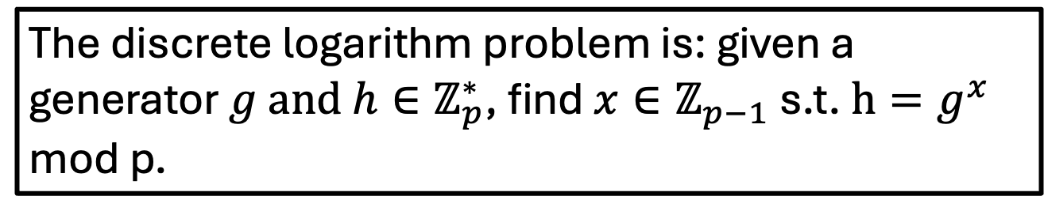
The Discrete Log Assumption
The discrete logarithm problem is: given a generator ${g and h∈ℤ}_{p}^{∗}$, find $x∈ℤ_{p−1}$ s.t. $h=g^{x}$ mod p.
Distributions…
Is the discrete log problem hard for a random p? Could it be easy for some p?
2. Given p: is the problem hard for all generators g?
3. Given p and g: is the problem hard for all x?
Notes:
Any primes fore whih it is easy? Not known
How about any generators?
Any x?
Random self-reduction
State the discrete log assumption

Slide 25
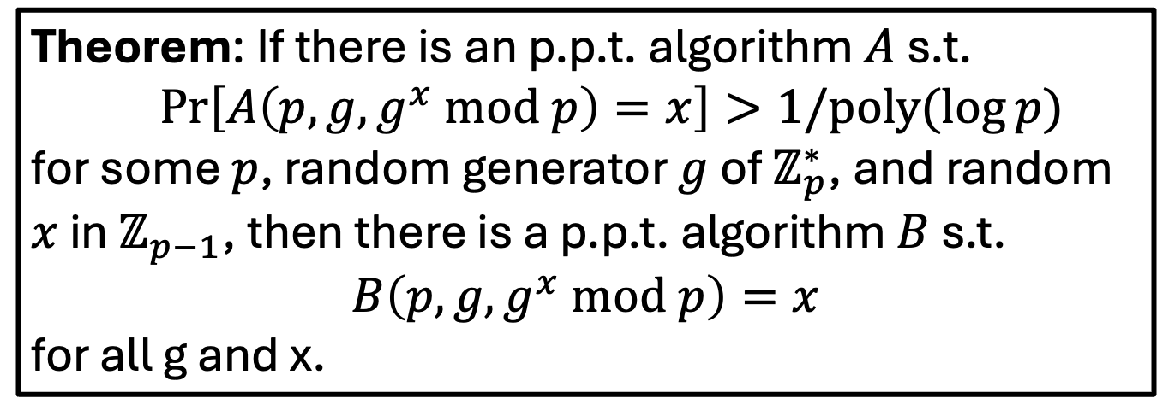
Random Self-Reducibility of DLOG
Theorem: If there is an p.p.t. algorithm $A$ s.t.
$Pr\left[A\left(p,g,g^{x} mod p\right)=x\right]>1/poly(\log{p)}$
for some $p$, random generator $g$ of $ℤ_{p}^{∗}$, and random $x$ in $ℤ_{p−1}$, then there is a p.p.t. algorithm $B$ s.t.
$$B\left(p,g,g^{x} mod p\right)=x$$
for all g and x.
Proof: On the board.
Notes:
Any primes fore whih it is easy? Not known
How about any generators?
Any x?
Random self-reduction
State the discrete log assumption

Slide 26
Random Self-Reducibility of DLOG
Theorem: If there is an p.p.t. algorithm $A$ s.t.
$Pr\left[A\left(p,g,g^{x} mod p\right)=x\right]>1/poly(\log{p)}$
for some $p$, random generator $g$ of $ℤ_{p}^{∗}$, and random $x$ in $ℤ_{p−1}$, then there is a p.p.t. algorithm $B$ s.t.
$$B\left(p,g,g^{x} mod p\right)=x$$
for all g and x.
2. Given p: is the problem hard for all generators g?
… as hard for any generator is it for a random one.
3. Given p and g: is the problem hard for all x?
… as hard for any x is it for a random one.
Notes:
Any primes fore whih it is easy? Not known
How about any generators?
Any x?
Random self-reduction
State the discrete log assumption

Slide 27
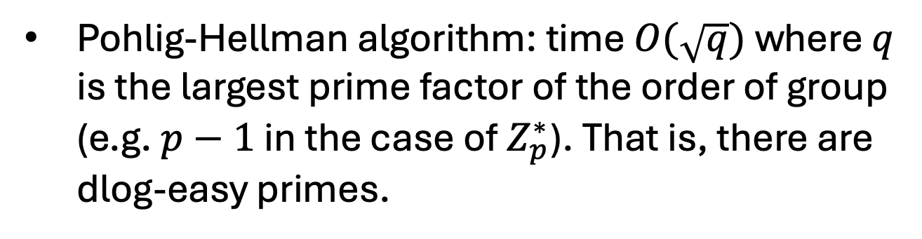
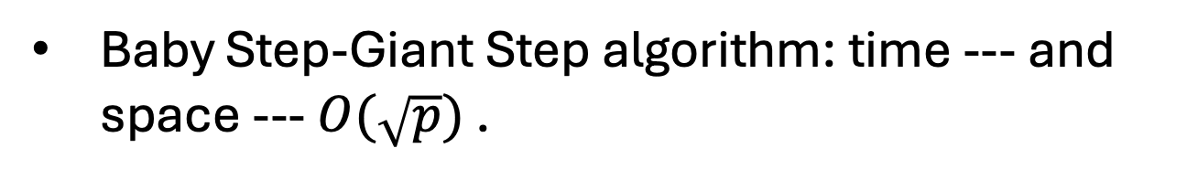
Algorithms for Discrete Log (for General Groups)
Baby Step-Giant Step algorithm: time --- and space --- $O(\sqrt{p})$ .
Pohlig-Hellman algorithm: time $O(\sqrt{q})$ where $q$ is the largest prime factor of the order of group (e.g. $p−1$ in the case of $Z_{p}^{∗}$). That is, there are dlog-easy primes.
Notes:
Any primes fore whih it is easy? Not known
How about any generators?
Any x?
Random self-reduction
State the discrete log assumption

Slide 28
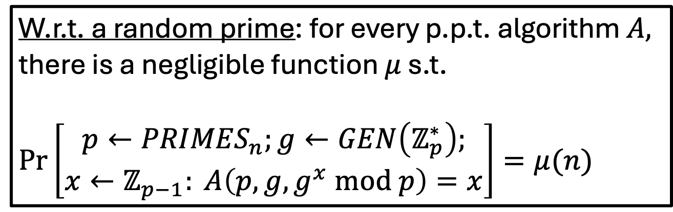
The Discrete Log (DLOG) Assumption
W.r.t. a random prime: for every p.p.t. algorithm $A,$ there is a negligible function $μ$ s.t.
$Pr\left[\begin{aligned}p←{PRIMES}_{n};g←GEN\left(ℤ_{p}^{∗}\right); \\ x←ℤ_{p−1}: A\left(p,g,g^{x} mod p\right)=x\end{aligned}\right]=μ(n)$
Notes:
Any primes fore whih it is easy? Not known
How about any generators?
Any x?
Random self-reduction
State the discrete log assumption

Slide 29
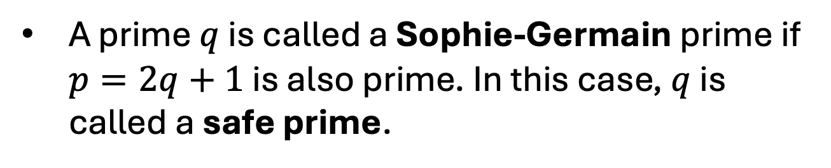
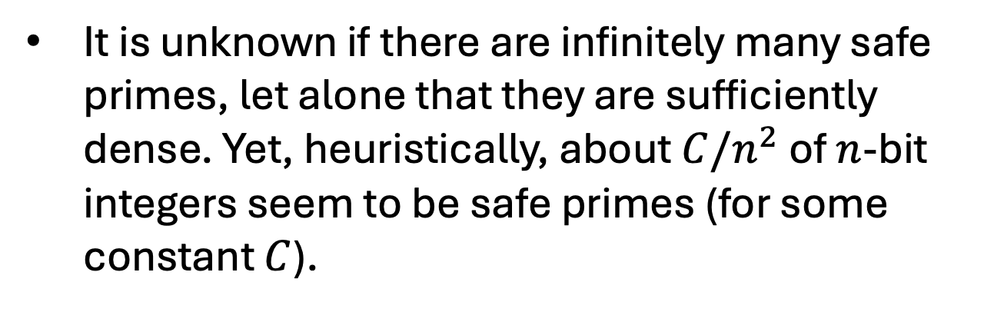
Sophie-Germain Primes and Safe Primes
A prime $q$ is called a Sophie-Germain prime if $p=2q+1$ is also prime. In this case, $q$ is called a safe prime.
Safe primes are maximally hard for the Pohlig-Hellman algorithm.
It is unknown if there are infinitely many safe primes, let alone that they are sufficiently dense. Yet, heuristically, about $C/n^{2}$ of $n$-bit integers seem to be safe primes (for some constant $C$).
Notes:
Any primes fore whih it is easy? Not known
How about any generators?
Any x?
Random self-reduction
State the discrete log assumption

Slide 30
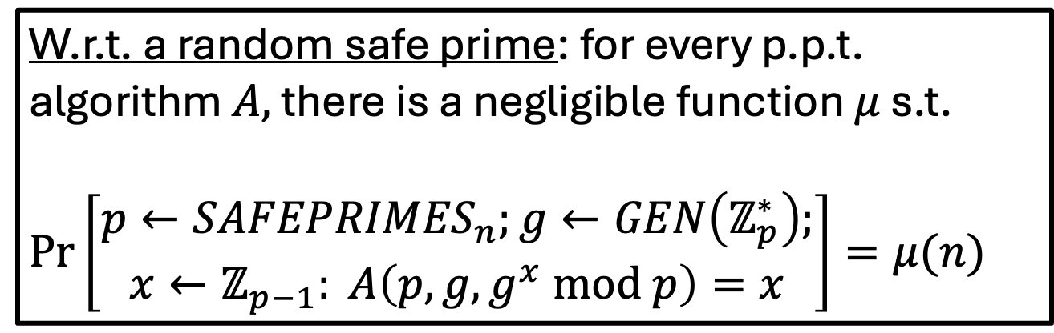
The Discrete Log (DLOG) Assumption
(the “safe prime” version)
W.r.t. a random safe prime: for every p.p.t. algorithm $A,$ there is a negligible function $μ$ s.t.
$Pr\left[\begin{aligned}p←{SAFEPRIMES}_{n};g←GEN\left(ℤ_{p}^{∗}\right); \\ x←ℤ_{p−1}: A\left(p,g,g^{x} mod p\right)=x\end{aligned}\right]=μ(n)$
Notes:
Any primes fore whih it is easy? Not known
How about any generators?
Any x?
Random self-reduction
State the discrete log assumption

Slide 31
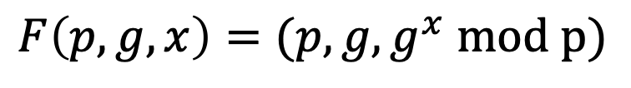
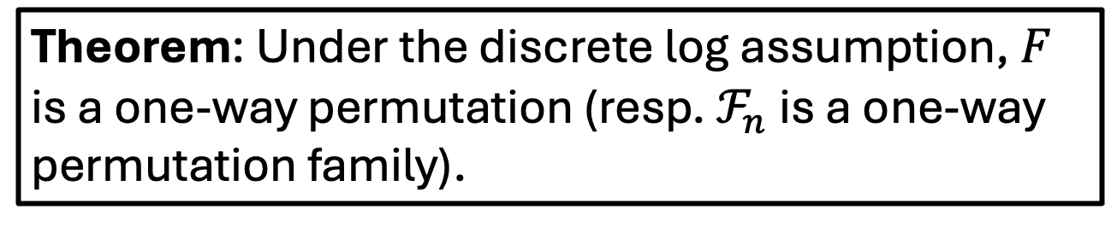
One-way Permutation (Family)
$$F\left(p,g,x\right)=(p,g,g^{x} mod p)$$
$ℱ_{n}={\{F}_{n,p,g}\}$ where $F_{n,p,g}\left(x\right)=(p,g,g^{x} mod p)$
Theorem: Under the discrete log assumption, $F$ is a one-way permutation (resp. $ℱ_{n}$ is a one-way permutation family).

Slide 32
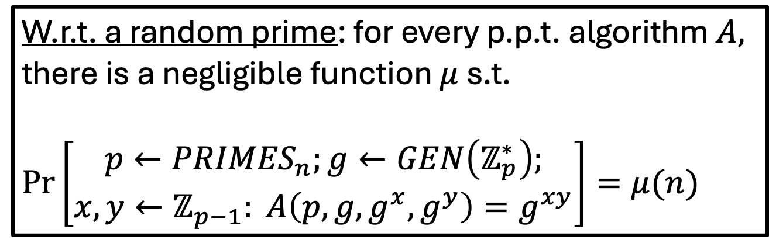
Computational Diffie-Hellman (CDH) Assumption
W.r.t. a random prime: for every p.p.t. algorithm $A,$ there is a negligible function $μ$ s.t.
$Pr\left[\begin{aligned}p←{PRIMES}_{n};g←GEN\left(ℤ_{p}^{∗}\right); \\ x,y←ℤ_{p−1}: A\left(p,g,g^{x},g^{y}\right)=g^{xy}\end{aligned}\right]=μ(n)$
CDH
DLOG
OPEN
Notes:
Any primes fore whih it is easy? Not known
How about any generators?
Any x?
Random self-reduction
State the discrete log assumption

Slide 33


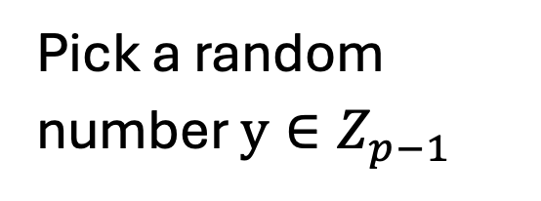
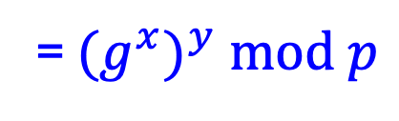
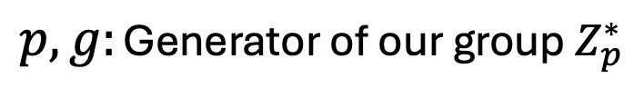
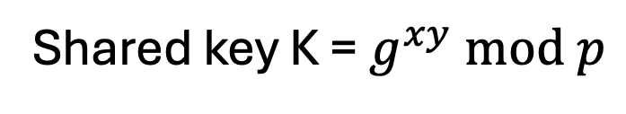
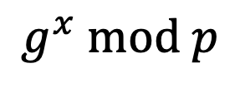
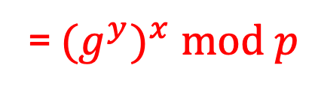
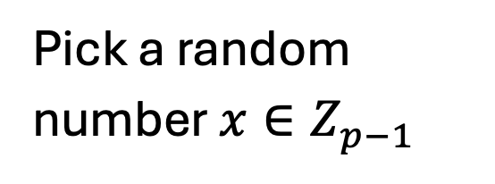
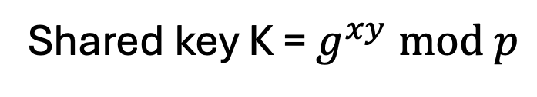
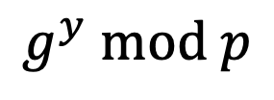
Diffie-Hellman Key Exchange
$p,g:$ Generator of our group $Z_{p}^{∗}$
$$g^{x} mod p$$
$$g^{y} mod p$$
Pick a random number $x∈Z_{p−1}^{}$
Pick a random number $y∈Z_{p−1}^{}$
Shared key K = $g^{xy} mod p$
Shared key K = $g^{xy} mod p$
= ${(g}^{y})^{x} mod p$
= ${(g}^{x})^{y} mod p$

Slide 34
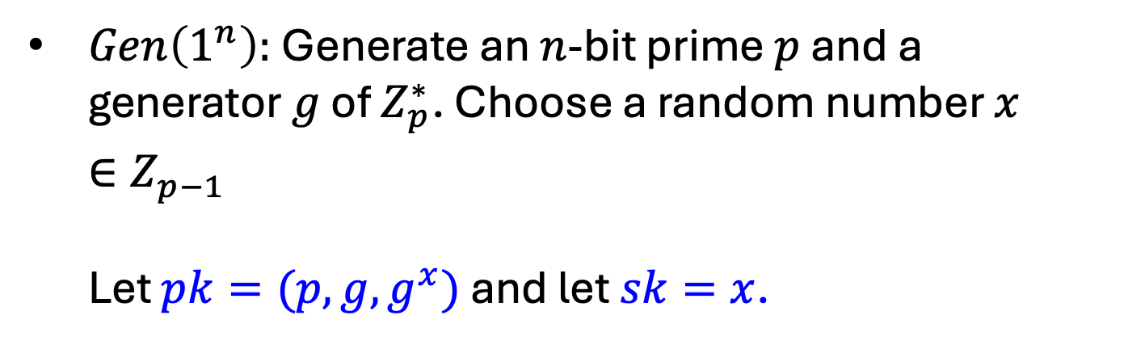
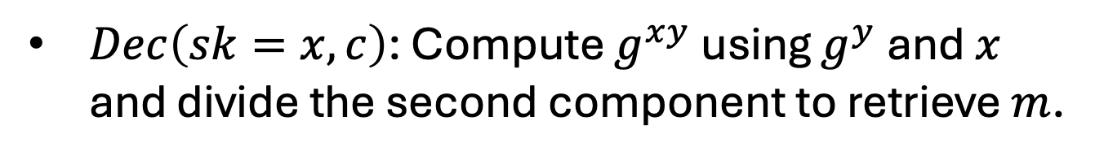
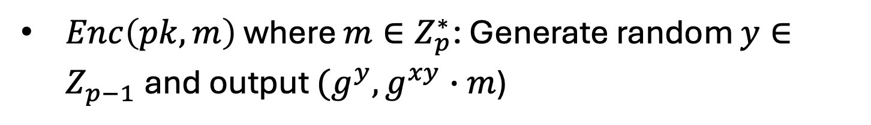
Diffie-Hellman/El Gamal Encryption
$Gen\left(1^{n}\right):$Generate an $n$-bit prime $p$ and a generator $g$ of $Z_{p}^{∗}$. Choose a random number $x∈Z_{p−1}^{}$ Let $pk=(p,g,g^{x})$ and let $sk=x$.
$Enc\left(pk,m\right)$ where $m∈Z_{p}^{∗}$: Generate random $y∈Z_{p−1}^{}$and output $(g^{y},g^{xy}∙m$)
$Dec\left(sk=x,c\right)$: Compute $g^{xy}$ using $g^{y}$ and $x$ and divide the second component to retrieve $m$.
How to make this really work?
Is this Secure?

Slide 35
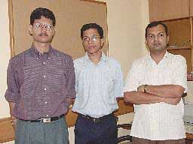
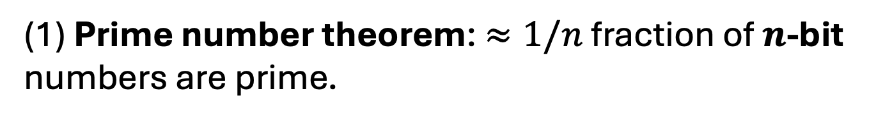

How to come up with a prime p
(1) Prime number theorem: $≈1/n$ fraction of $n$-bit numbers are prime.
(2) Primality tests [Miller’76, Rabin’80, Agrawal-Kayal-Saxena’02] Can test in time $poly(n)$ if a given $n$-bit number is prime.
OPEN: Deterministically come up with an n-bit prime?
EXCITING NEW RESULT (TOC Colloq. Oct 3): Pseudo-deterministic poly-time algorithm!

Slide 36


How to come up with a generator g
(1) There are lots of generators: $≈1/\log{n}$ fraction of $ℤ_{p}^{∗}$ are generators (where p is an n-bit prime).
(2) Testing if $g$ is a generator:
Theorem: let $q_{1},…,q_{k}$ be the prime factors of $p−1$. Then, g is a generator of $ℤ_{p}^{∗}$ if and only if $g^{(p−1)/q_{i}}≠1 (mod p)$ for all i.
OPEN: Can you test if g is a generator without knowing the prime factorization of p-1?
OPEN: Deterministically come up with a generator?

Slide 37


To Summarize
Pick a random safe prime $p.$ Therefore, I know the factorization of $p−1=2q$ automatically!
Pick a random element of $ℤ_{p}^{∗}$ and test if it is a generator (using theorem from last slide).
Continue step 2 until you hit a generator.

Slide 38

Squares mod P
Let P be prime. $x∈Z_{P}^{∗}$ is a squares mod P (also called a “quadratic residue”) if there is a $y∈Z_{P}^{∗}$ s.t.
$x=y^{2} mod P$.
Theorem: Exactly half of $Z_{P}^{∗}$ are squares mod P.

Slide 39



Squares mod P: A Characterization
Claim: Fix any generator $g$. Then, $x∈ℤ_{P}^{∗}$ is a square iff ${DLOG}_{g}(x)$ mod $p−1$ is even.
Proof (if)
If $x=g^{a} mod P$ and $a$ is even, then $g^{a/2} mod P$ is a square root of $x$.
Proof (iff)
If $x=g^{a}={(g^{b})}^{2} mod P$, then $a=2b (mod P−1)$. So, $a$ is even.

Slide 40

Now, an Efficient Characterization…
Claim: $x$ mod P is a square iff $x^{(P−1)/2}=1 mod P$
Proof (iff) If $x=y^{2} mod P,x^{(P−1)/2}=y^{(P−1)}=1 mod P.$
Proof (if) Show that the discrete log of $x$ has to be even and therefore (by previous slide) $x$ is a square.
So, it is easy to detect whether a number mod P is a square.

Slide 41
Computing Square Roots mod P
Let P be prime. Exactly half of $Z_{P}^{∗}$ are squares mod P.
It is easy to compute square roots mod P. We will show it for the case where P = 3 (mod 4).
Claim: The square roots of $x$ mod P are ${± x}^{(P+1)/4}$
Proof: $({± x}^{(P+1)/4})^{2}$ $=x^{(P+1)/2}={x∙x}^{(P−1)/2}=x mod P$

Slide 42

The Problem
Claim: Given $p,g, g^{x} mod p and$ $g^{y} mod p,$ adversary can
compute some information about $g^{xy} mod p.$
Corollary: Therefore, additionally given $g^{xy}∙m mod p$, the adversary can determine whether $m$ is a square mod $p$, violating “IND-CPA security”.

Slide 43
The Problem
Claim: Given $p,g, g^{x} mod p and$ $g^{y} mod p,$ adversary can
determine if $g^{xy} mod p$ is a square $mod p$.
Corollary: Therefore, additionally given $g^{xy}∙m mod p$, the adversary can determine whether $m$ is a square mod $p$, violating “IND-CPA security”.

Slide 44


The Problem
Claim: Given $p,g, g^{x} mod p and$ $g^{y} mod p,$ adversary can
determine if $g^{xy} mod p$ is a square $mod p$.
$g^{xy} mod p$ is a square $⟺xy (mod p−1)$ is even
$⟺$ $xy$is even
$⟺$ $x$is even or $y$ is even
$⟺$ $x (mod p−1)$is even or $y (mod p−1)$is even
$⟺$ $g^{x} mod p$ or $g^{y} mod p$is a square
This can be checked in poly time!

Slide 45

Diffie-Hellman/El Gamal Encryption
Claim: Given $p,g, g^{x} mod p and$ $g^{y} mod p,$ adversary can
determine if $g^{xy} mod p$ is a square $mod p$.
More generally, dangerous to work with groups that have non-trivial subgroups (in our case, the subgroup of all squares mod p)
Lesson: Best to work over a group of prime order. Such groups have no non-trivial subgroups.
An Example: Let $p=2q+1$ where $q$ is a prime itself. Then, the group of squares mod $p$ has order $\frac{\left(p−1\right)}{2}=q$.

Slide 46



Diffie-Hellman/El Gamal Encryption
$Gen\left(1^{n}\right):$Generate an $n$-bit safe prime $p=2q+1$ and a generator $g$ of $Z_{p}^{∗}$ and let $h=g^{2}mod p$ be a generator of ${QR}_{p}^{}$. Choose a random number $x∈Z_{q}^{}$.
Let $pk=(p,h,h^{x})$ and let $sk=x$.
$Enc\left(pk,m\right)$ where $m∈{QR}_{p}^{}$: Generate random $y∈Z_{q}^{}$and output $(g^{y},g^{xy}∙m$)
$Dec\left(sk=x,c\right)$: Compute $g^{xy}$ using $g^{y}$ and $x$ and divide the second component to retrieve $m$.

Slide 47

Decisional Diffie-Hellman Assumption
Decisional Diffie-Hellman Assumption (DDHA):
Hard to distinguish between $g^{xy}$ and a uniformly random group element, given ${g,g}^{x}$ and $g^{y}$
That is, the following two distributions are computationally indistinguishable:
$$(g,g^{x},g^{y},g^{xy})≈(g,g^{x},g^{y},u)$$
DH/El Gamal is IND-secure under the DDH assumption on the given group.
Notes:
Pf: QNR*QNR = QR.

Slide 48



Which Group to Use?
$(1)$ ${QR}_{P}$ for a safe prime $P=2Q+1$ where $Q$ is prime. The order of the group is Q.
Discrete log can be broken in sub-exponential time $2^{\sqrt{\log{P\log{\log{P}}}}}$ (better than $poly(P)$ but worse than $poly(\log{P).)}$
$\left(2\right)$ Elliptic Curve Groups. The set of solutions $(x,y)$ to the equation $y^{2}=x^{3}+ax+b$ (mod P) together with a very cool group addition law.
Best known Discrete log algorithm: $O(\sqrt{P})$ time!
Much smaller keys: 160-bit P suffices for “80-bit security”.
Notes:
Pf: QNR*QNR = QR.

