Slide 1
Purdue CS555: Cryptography Lecture 17
Instructor: Hanshen Xiao
Teaching Assistant: Justin He
course website: https://cs55500.github.io/

Slide 2


NP Proofs
For the NP-complete problem of graph 3-coloring
Proof =
Verifier V checks: (a) only 3 colors are used & (b) any two vertices connected by an edge are colored differently.
Prover P has a witness, the 3-coloring of G

Slide 3

Zero-Knowledge (Interactive) Proof
Because NP proofs reveal too much
Commitments
$$e←E$$

Slide 4
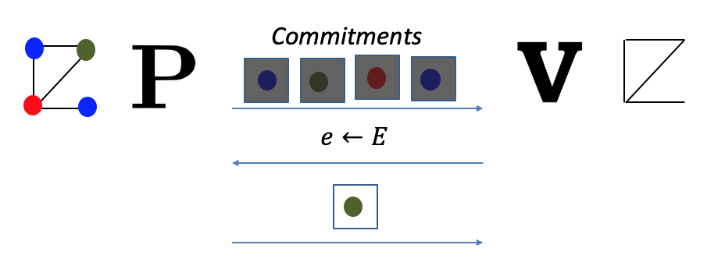
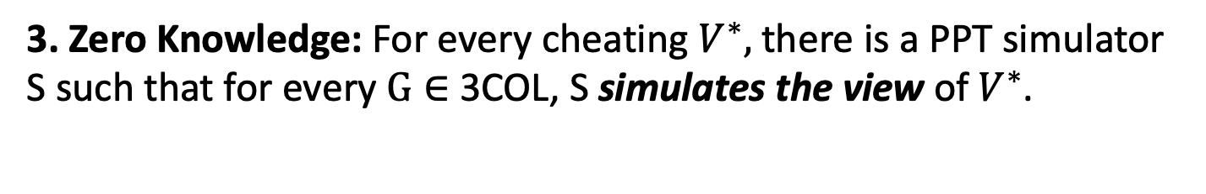
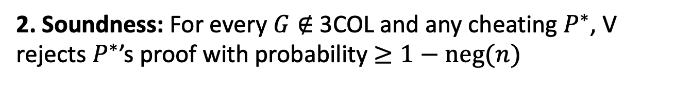
Zero-Knowledge (Interactive) Proof
Because NP proofs reveal too much
1. Completeness: For every $G∈$3COL, V accepts P’s proof.
2. Soundness: For every $G∉$3COL and any cheating $P^{∗}$, V rejects $P^{∗}$’s proof with probability $≥1−neg(n)$
3. Zero Knowledge: For every cheating $V^{∗},$there is a PPT simulator S such that for every $G∈$ 3COL, S simulates the view of $V^{∗}$.

Slide 5
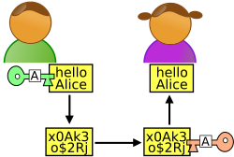
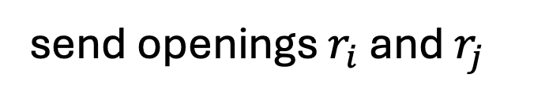


ZK Proof for 3COL
1
2
1
2
Graph G
=(V,E)
Graph G
4
3
4
3
$$\{Com\left(ρ\left(k\right);r_{k}\right)\}_{k=1}^{n}$$
random edge $(i,j)$
send openings $r_{i}$ and $r_{j}$

Slide 6

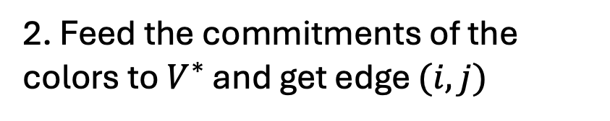
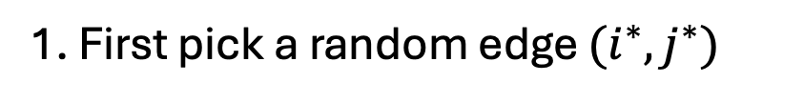
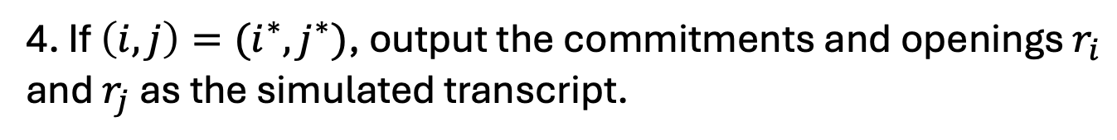

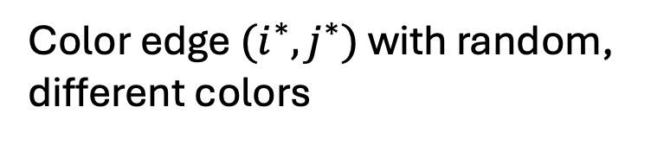

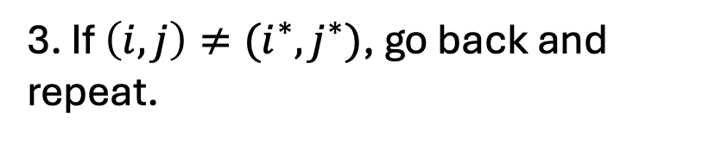

Why is this zero-knowledge?
Simulator S works as follows:
1. First pick a random edge $(i^{∗},j^{∗})$
Color edge $(i^{∗},j^{∗})$ with random, different colors
$$\{Com\left(ρ\left(k\right);r_{k}\right)\}_{k=1}^{n}$$
Color all other edges red.
edge $(i,j)$
2. Feed the commitments of the colors to $V^{∗}$ and get edge $(i,j)$
3. If $\left(i,j\right)≠(i^{∗},j^{∗})$, go back and repeat.
send openings $r_{i}$ and $r_{j}$
4. If $\left(i,j\right)=(i^{∗},j^{∗})$, output the commitments and openings $r_{i}$ and $r_{j}$ as the simulated transcript.

Slide 7
Why is this zero-knowledge?
Simulator S works as follows (call this Hybrid 0)
1. First pick a random edge $(i^{∗},j^{∗})$
Color edge $(i^{∗},j^{∗})$ with random, different colors
$$\{Com\left(ρ\left(k\right);r_{k}\right)\}_{k=1}^{n}$$
Color all other edges red.
edge $(i,j)$
2. Feed the commitments of the colors to $V^{∗}$ and get edge $(i,j)$
3. If $\left(i,j\right)≠(i^{∗},j^{∗})$, go back and repeat.
send openings $r_{i}$ and $r_{j}$
4. If $\left(i,j\right)=(i^{∗},j^{∗})$, output the commitments and openings $r_{i}$ and $r_{j}$ as the simulated transcript.

Slide 8
Why is this zero-knowledge?
Not-a-Simulator S works as follows (call this Hybrid 1)
1. First pick a random edge $(i^{∗},j^{∗})$
Permute a legal coloring and color all edges correctly.
$$\{Com\left(ρ\left(k\right);r_{k}\right)\}_{k=1}^{n}$$
edge $(i,j)$
2. Feed the commitments of the colors to $V^{∗}$ and get edge $(i,j)$
3. If $\left(i,j\right)≠(i^{∗},j^{∗})$, go back and repeat.
send openings $r_{i}$ and $r_{j}$
4. If $\left(i,j\right)=(i^{∗},j^{∗})$, output the commitments and openings $r_{i}$ and $r_{j}$ as the simulated transcript.

Slide 9
Why is this zero-knowledge?
Claim: Hybrids 0 and 1 are computationally indistinguishable, assuming the commitment scheme is computationally hiding.
Proof: By contradiction. Show a reduction that breaks the hiding property of the commitment scheme, assuming there is a distinguisher between hybrids 0 and 1. (More on the board)

Slide 10
Why is this zero-knowledge?
Not-a-Simulator S works as follows (call this Hybrid 1)
1. First pick a random edge $(i^{∗},j^{∗})$
Permute a legal coloring and color all edges correctly.
$$\{Com\left(ρ\left(k\right);r_{k}\right)\}_{k=1}^{n}$$
edge $(i,j)$
2. Feed the commitments of the colors to $V^{∗}$ and get edge $(i,j)$
3. If $\left(i,j\right)≠(i^{∗},j^{∗})$, go back and repeat.
send openings $r_{i}$ and $r_{j}$
4. If $\left(i,j\right)=(i^{∗},j^{∗})$, output the commitments and openings $r_{i}$ and $r_{j}$ as the simulated transcript.

Slide 11
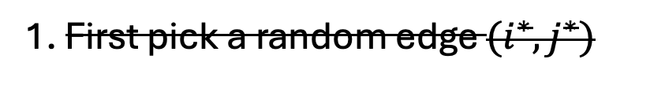
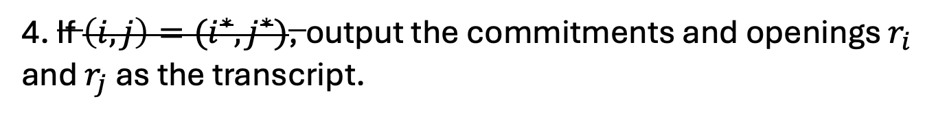
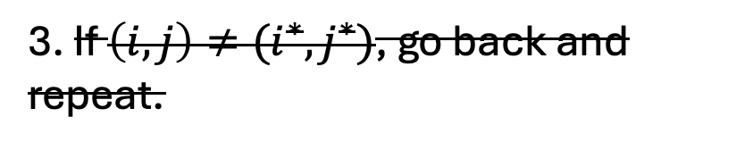
Why is this zero-knowledge?
Here is the real view of V* (Hybrid 2)
1. First pick a random edge $(i^{∗},j^{∗})$
Permute a legal coloring and color all edges correctly.
$$\{Com\left(ρ\left(k\right);r_{k}\right)\}_{k=1}^{n}$$
edge $(i,j)$
2. Feed the commitments of the colors to $V^{∗}$ and get edge $(i,j)$
3. If $\left(i,j\right)≠(i^{∗},j^{∗})$, go back and repeat.
send openings $r_{i}$ and $r_{j}$
4. If $\left(i,j\right)=(i^{∗},j^{∗})$, output the commitments and openings $r_{i}$ and $r_{j}$ as the transcript.

Slide 12
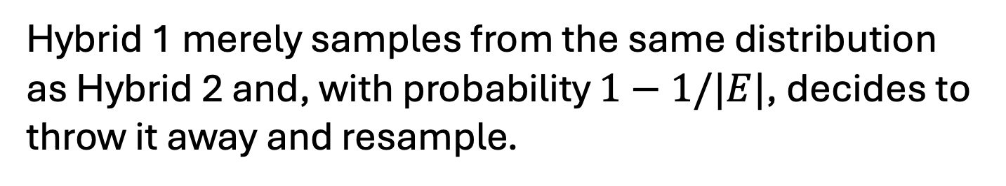
Why is this zero-knowledge?
Claim: Hybrids 1 and 2 are identical.
Hybrid 1 merely samples from the same distribution as Hybrid 2 and, with probability $1−1/|E|$, decides to throw it away and resample.

Slide 13
Put together:
Theorem: The 3COL protocol is zero knowledge.

Slide 14
Sequential vs Parallel Repetition

Slide 15
Reducing Soundness Error
The 3COL protocol has a large soundness error of $1−1/|E|$
(probability that $V$ accepts even though $G∉3COL$)
Theorem: Sequential Repetition reduces soundness error for interactive proofs (and preserves the ZK property.)
Problem: Lots of rounds
Theorem: Parallel Repetition also reduces soundness error for interactive proofs. It is also honest-verifier ZK (but does not, in general, preserve the ZK property.)

Slide 16
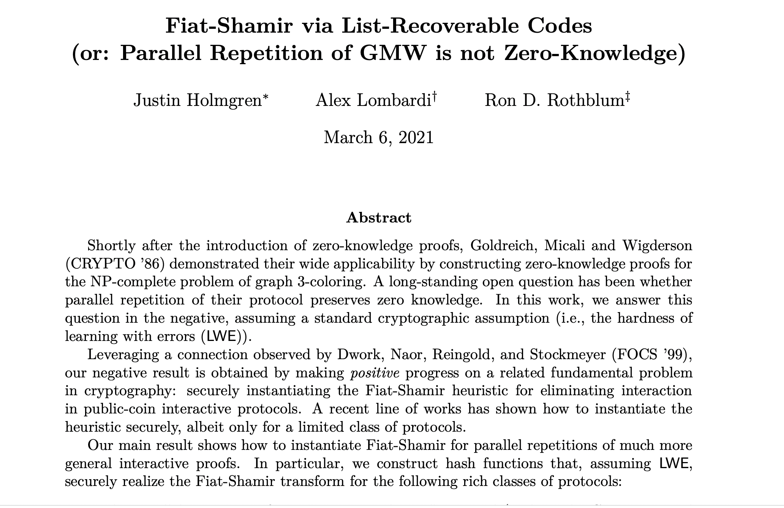
Theorem [Goldreich-Krawczyk’90] Parallel Repetition also reduces soundness error for interactive proofs (but does not, in general, preserve the ZK property.)
Theorem [Holmgren-Lombardi-Rothblum’21] Parallel Repetition of the (Goldreich-Micali-Wigderson) 3COL protocol is not zero-knowledge.

Slide 17
Reducing Soundness Error
Fortunately, we have:
Theorem [Goldreich-Kahan’95] There is a constant-round ZK proof system for 3COL (with exponentially small soundness error), assuming discrete logarithms are hard.

Slide 18
Proofs of Knowledge

Slide 19
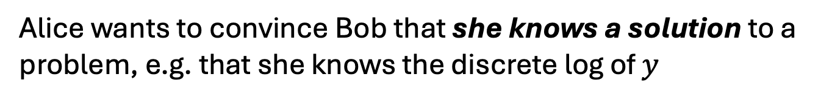
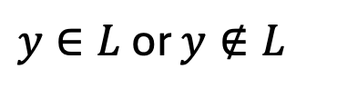


So far: Decision Problems
$y∈L$ or $y∉L$
(e.g. $y$ is a quadratic residue mod $N$ or it is not)
Here is a different scenario:
$$x$$
$${y=g}^{x} (mod p)$$
Discrete log of $y$ always exists (assuming $g$ is a generator)…
Alice wants to convince Bob that she knows a solution to a problem, e.g. that she knows the discrete log of $y$

Slide 20
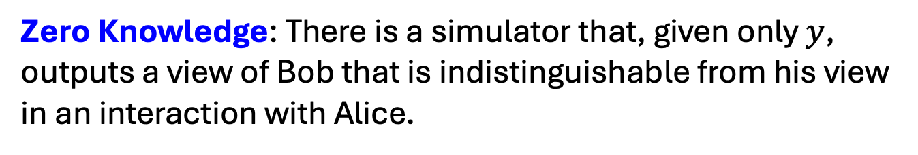
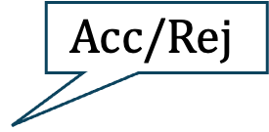
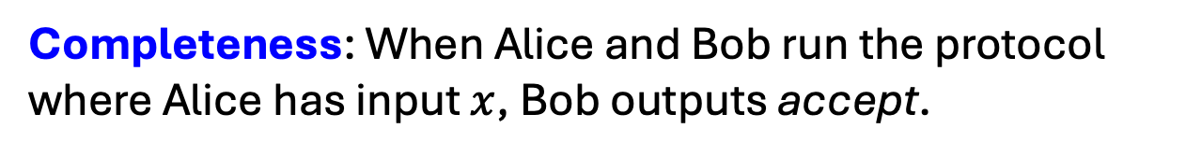


So far: Decision Problems
$$x$$
$$Acc/Rej$$
$${y=g}^{x} (mod p)$$
Completeness: When Alice and Bob run the protocol where Alice has input $x$, Bob outputs accept.
Soundness? How to define it?
Zero Knowledge: There is a simulator that, given only $y$, outputs a view of Bob that is indistinguishable from his view in an interaction with Alice.

Slide 21
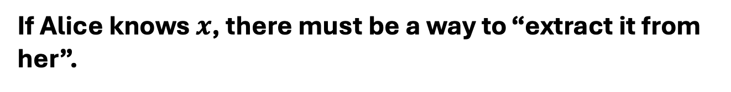
Proof of Knowledge
$$x$$
$$Acc/Rej$$
$${y=g}^{x} (mod p)$$
If Alice knows $x$, there must be a way to “extract it from her”.
I will not define an extractor formally but will show you an example (see Goldreich’s book for more)

Slide 22


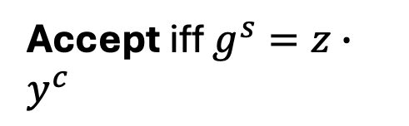


ZK Proof of Knowledge of Discrete Log
$$p=2q+1$$
$$x$$
$$Acc/Rej$$
$${y=g}^{x} (mod p)$$
$${z=g}^{r} (mod p)$$
$$c←\{0,1\}$$
$$s=r+cx (mod q)$$
Accept iff $g^{s}=z∙y^{c}$
Completeness and Zero Knowledge: Exercise.

Slide 23

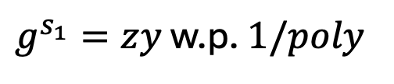


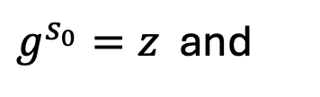
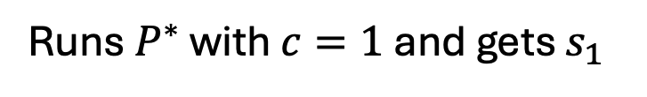

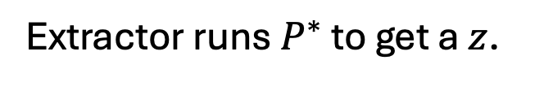



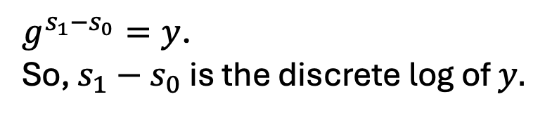

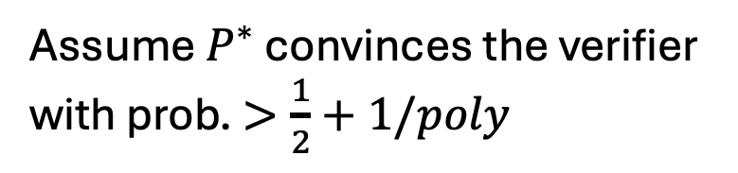
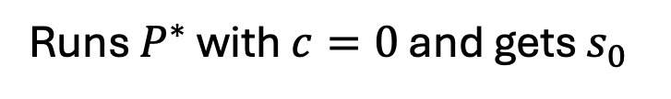
Proof of Knowledge: Extractor
Assume $P^{∗}$ convinces the verifier with prob. $>\frac{1}{2}+1/poly$
$${y=g}^{x} (mod p)$$
$${z=g}^{r} (mod p)$$
Extractor runs $P^{∗}$ to get a $z$.
$P^{∗}$
Runs $P^{∗}$ with $c=0$ and gets $s_{0}$
$$c=0$$
$$c=1$$
Rewinds $P^{∗}$ to the first message.
Runs $P^{∗}$ with $c=1$ and gets $s_{1}$
$$s_{0}$$
$$s_{1}$$
$g^{s_{0}}=z$ and
$g^{s_{1}}=zy$ w.p. $1/poly$
$g^{s_{1}−s_{0}}=y$. So, $s_{1}−s_{0}$ is the discrete log of $y.$

Slide 24
Next Topic:
Can we make proofs non-interactive again?
Why?
V does not need to be online during the proof process.
Proofs are not ephemeral, can stay into the future.

Slide 25
Next Topic:
Can we make proofs non-interactive again?
NO!
YES, WE CAN!

Slide 26
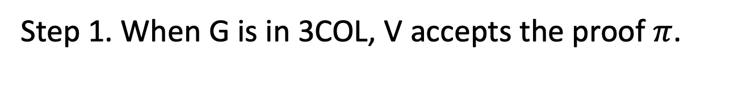

Non-Interactive ZK is Impossible
Suppose there were an NIZK proof system for 3COL.
Graph G
Graph G
$$π$$
Step 1. When G is in 3COL, V accepts the proof $π$.
(Completeness)

Slide 27

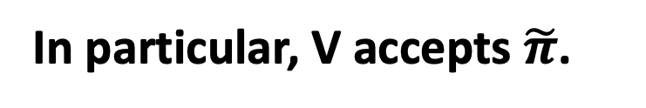
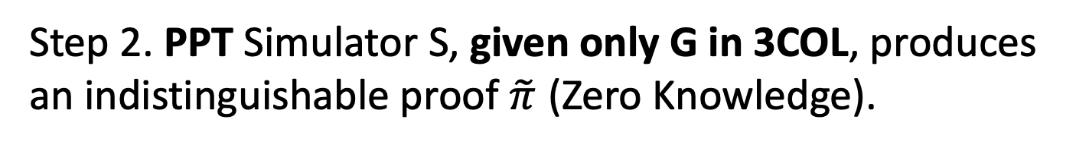
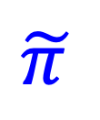
Non-Interactive ZK is Impossible
Suppose there were an NIZK proof system for 3COL.
Graph G
Graph G
$$\tilde{π }$$
Step 2. PPT Simulator S, given only G in 3COL, produces an indistinguishable proof $\tilde{π}$ (Zero Knowledge).
In particular, V accepts $\tilde{π}$.

Slide 28
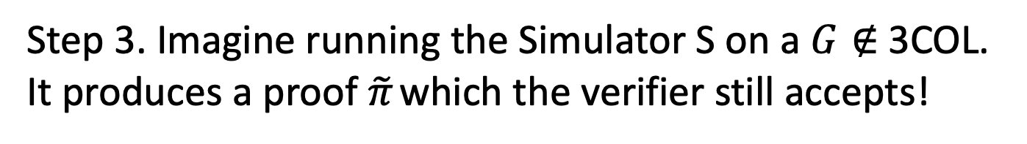
Non-Interactive ZK is Impossible
Suppose there were an NIZK proof system for 3COL.
Graph G
Graph G
$$\tilde{π }$$
Step 3. Imagine running the Simulator S on a $G∉$3COL. It produces a proof $\tilde{π}$ which the verifier still accepts!
(WHY?! Because S and V are PPT. They together cannot tell if the input graph is 3COL or not)

Slide 29
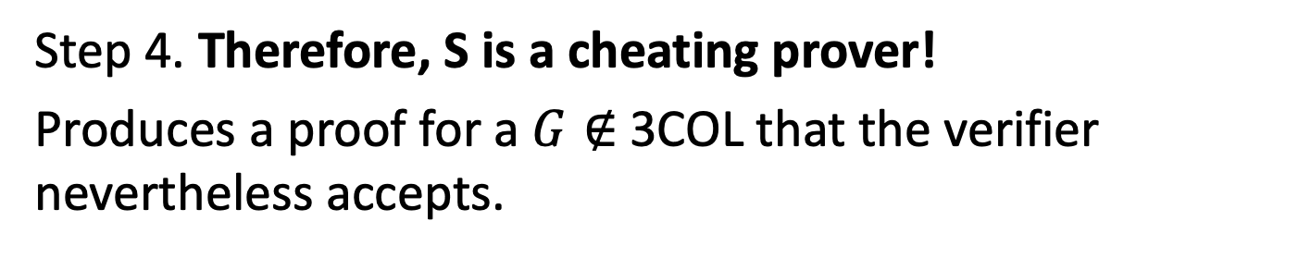
Non-Interactive ZK is Impossible
Suppose there were an NIZK proof system for 3COL.
Graph G
Graph G
$$π$$
Step 4. Therefore, S is a cheating prover!
Produces a proof for a $G∉$3COL that the verifier nevertheless accepts.
Ergo, the proof system is NOT SOUND!

Slide 30
THE END
Or, is it?

Slide 31

Two Roads to Non-Interactive ZK (NIZK)
1. Random Oracle Model & Fiat-Shamir Transform.
Random Oracle
Graph G
Graph G
$$π$$
2. Common Random String Model.

Slide 32
NIZK Proof for 3COL
1
2
1
2
Graph G
=(V,E)
Graph G
4
3
4
3
random challenge c
Start with the parallel repetition of the 3COL protocol.
Recall: it is complete, has exponentially small soundness error, and is HVZK.

Slide 33
NIZK Proof for 3COL
1
2
Random Oracle
1
2
Graph G
=(V,E)
H
Graph G
4
3
4
3
a
a, c=H(a), z
random challenge c
z
Fiat and Shamir 1986: Let c = H(a). Now the prover can compute the challenge herself!
Potentially harmful for soundness. But in the random oracle model for H, can prove soundness.

