Slide 1
Purdue CS555: Cryptography Lecture 6
Instructor: Hanshen Xiao
Teaching Assistant: Justin He
course website: https://cs55500.github.io/

Slide 2
Recap
Implication of One-way Function
Construction of PRG
Construction of Hardcore Bit (Goldreich-Levin (GL) Theorem)

Slide 3
Today
Continuing: Proof of Goldreich-Levin (GL) Theorem
Stateless Encryption
Pseudorandom Functions

Slide 4

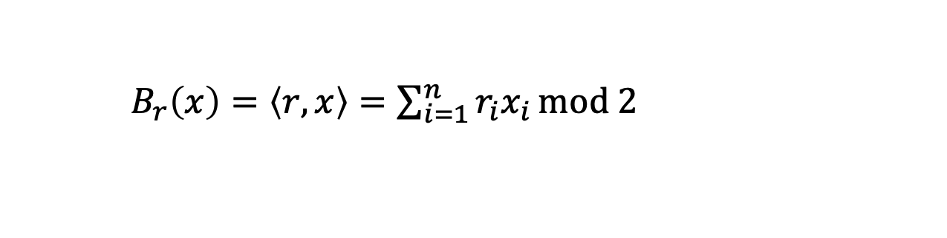
Goldreich-Levin (GL) Theorem
Let ${\{B}_{r}:{\{0,1\}}^{n}→\{0,1\}\}$ where
$B_{r}\left(x\right)=\left\langle r,x\right\rangle =\sum_{i=1}^{n}{r_{i}x_{i}}mod 2$
be a collection of predicates (one for each $r$). Then, a random $B_{r}$is hardcore for every one-way function $F$. That is, for every one-way function $F$, every PPT $A$, there is a negligible function $μ$ s.t.
$$\operatorname{Pr}\left[x←{\left\{0,1\right\}}^{n};r←{\left\{0,1\right\}}^{n}:A\left(F\left(x\right),r\right)=B_{r}(x)\right]≤\frac{1}{2}+μ(n)$$

Slide 5

GL Theorem: Alternative Interpretation
For every one-way function/permutation $F$, there is a related one-way function/permutation
$F^{′}\left(x,r\right)=(F\left(x\right),r)$
which has a deterministic hardcore predicate. In particular, the predicate $B\left(x,r\right)=$ $\left\langle r,x\right\rangle mod 2$ is hardcore for $F^{′}$.
$$\operatorname{Pr}\left[x←{\left\{0,1\right\}}^{n};r←{\left\{0,1\right\}}^{n}:A\left(F′\left(x,r\right)\right)=\left\langle r,x\right\rangle \right]≤\frac{1}{2}+μ(n)$$
This statement is sufficient to construct PRGs from any OWP.

Slide 6
Proof of GL Theorem
Assume for contradiction there is a predictor $P$
$$\operatorname{Pr}\left[x←{\left\{0,1\right\}}^{n};r←{\left\{0,1\right\}}^{n}:P\left(F\left(x\right),r\right)=\left\langle r,x\right\rangle \right]≥\frac{1}{2}+1/p(n)$$
We will need to show an inverter $A$ for $F$
$$\operatorname{Pr}\left[x←{\left\{0,1\right\}}^{n} :A\left(F\left(x\right)\right)=x^{′}:F\left(x^{′}\right)=F(x)\right]≥1/p′(n)$$

Slide 7
Proof of GL Theorem
Let’s make our lives easier: assume a perfect predictor $P$
Assume for contradiction there is a predictor $P$
$$\operatorname{Pr}\left[x←{\left\{0,1\right\}}^{n};r←{\left\{0,1\right\}}^{n}:P\left(F\left(x\right),r\right)=\left\langle r,x\right\rangle \right]=1$$
We will need to show an inverter $A$ for $F$
$$\operatorname{Pr}\left[x←{\left\{0,1\right\}}^{n} :A\left(F\left(x\right)\right)=x^{′}:F\left(x^{′}\right)=F(x)\right]≥1/p′(n)$$

Slide 8
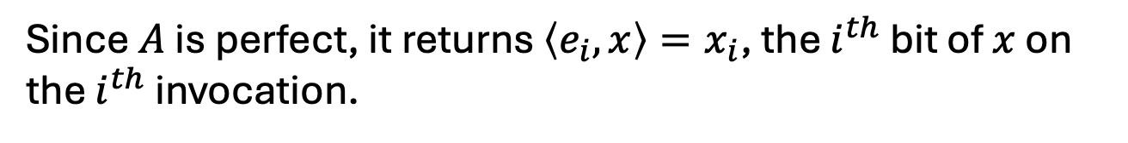
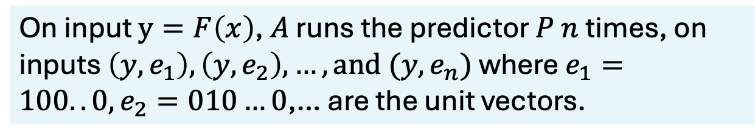
Proof of GL Theorem
Let’s make our lives easier: assume a perfect predictor $P$
Assume for contradiction there is a predictor $P$
$$\operatorname{Pr}\left[x←{\left\{0,1\right\}}^{n};r←{\left\{0,1\right\}}^{n}:P\left(F\left(x\right),r\right)=\left\langle r,x\right\rangle \right]=1$$
The inverter $A$ works as follows:
On input $y=F\left(x\right)$, $A$ runs the predictor $P$ $n$ times, on inputs $\left(y,e_{1}\right), \left(y,e_{2}\right),…, and (y,e_{n})$ where $e_{1}=100..0, e_{2}=010…0$,… are the unit vectors.
Since $A$ is perfect, it returns $\left\langle e_{i},x\right\rangle =x_{i}$, the $i^{th}$ bit of $x$ on the $i^{th}$ invocation.

Slide 9
Proof of GL Theorem
OK, now let’s assume less: assume a pretty good predictor $P$
Assume for contradiction there is a predictor $P$
$$\operatorname{Pr}\left[x←{\left\{0,1\right\}}^{n};r←{\left\{0,1\right\}}^{n}:P\left(F\left(x\right),r\right)=\left\langle r,x\right\rangle \right]≥\frac{3}{4}+1/p(n)$$
First, we need an averaging argument.
Claim: For at least a $1/2p(n)$ fraction of the $x$,
$$\operatorname{Pr}\left[r←{\left\{0,1\right\}}^{n}:P\left(F\left(x\right),r\right)=\left\langle r,x\right\rangle \right]≥\frac{3}{4}+1/2p(n)$$
Proof: Exercise in counting.
Call these the good $x.$

Slide 10
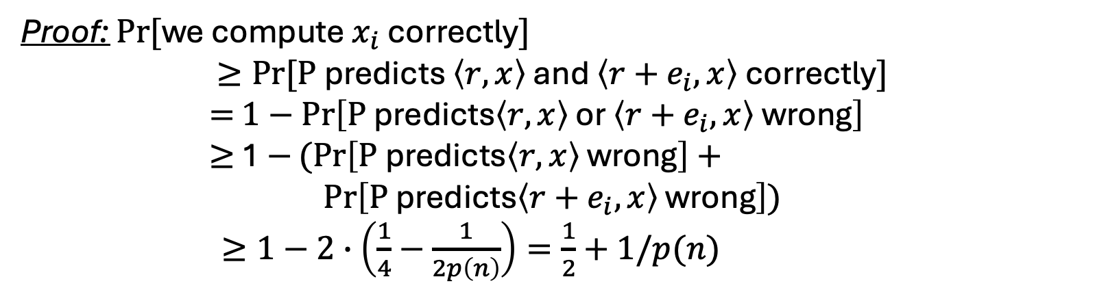
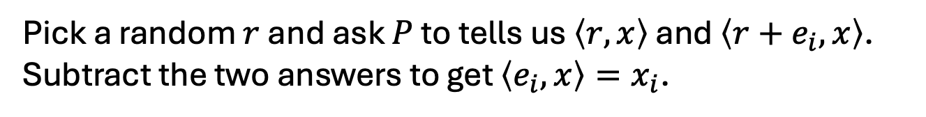
Proof of GL Theorem
For at least a $1/2p(n)$ fraction of the $x$,
$$\operatorname{Pr}\left[r←{\left\{0,1\right\}}^{n}:P\left(F\left(x\right),r\right)=\left\langle r,x\right\rangle \right]≥\frac{3}{4}+1/2p(n)$$
Key Idea: Linearity
Pick a random $r$ and ask $P$ to tells us $\left\langle r,x\right\rangle$ and $\left\langle r+e_{i},x\right\rangle$. Subtract the two answers to get $\left\langle e_{i},x\right\rangle =x_{i}$.
Proof: $Pr⁡[$we compute $x_{i}$ correctly$]$
$$≥Pr⁡[\text{P} \text{predicts} \left\langle r,x\right\rangle \text{and} \left\langle r+e_{i},x\right\rangle \text{correctly}]$$
$=$ $1−\operatorname{Pr}\left[\text{P} \text{predicts}\left\langle r,x\right\rangle \text{or} \left\langle r+e_{i},x\right\rangle \text{wrong}\right]$
$≥$ 1 $−(Pr\left[\text{P} \text{predicts}\left\langle r,x\right\rangle \text{wrong}\right]+$
$$\operatorname{Pr}\left[\text{P} \text{predicts}\left\langle r+e_{i},x\right\rangle \text{wrong}\right])$$
$≥1−2∙\left(\frac{1}{4}−\frac{1}{2p\left(n\right)}\right)=\frac{1}{2}+1/p(n)$
(by union bound)

Slide 11
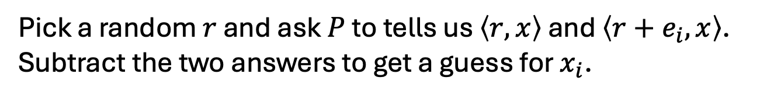
Proof of GL Theorem
For at least a $1/2p(n)$ fraction of the $x$,
$$\operatorname{Pr}\left[r←{\left\{0,1\right\}}^{n}:P\left(F\left(x\right),r\right)=\left\langle r,x\right\rangle \right]≥\frac{3}{4}+1/2p(n)$$
Inverter A:
Repeat for each $i∈\left\{1,2,…,n\right\}$:
Repeat $\log{n}∗p(n)$ times:
Pick a random $r$ and ask $P$ to tells us $\left\langle r,x\right\rangle$ and $\left\langle r+e_{i},x\right\rangle$. Subtract the two answers to get a guess for $x_{i}$.
Compute the majority of all such guesses and set the bit as $x_{i}$
Output the concatenation of all $x_{i}$ as $x.$
Analysis: Chernoff + Union Bound

Slide 12
Now the real Proof…
Assume (after averaging) that for $≥1/2p(n)$ fraction of the $x$,
$$\operatorname{Pr}\left[r←{\left\{0,1\right\}}^{n}:P\left(F\left(x\right),r\right)=\left\langle r,x\right\rangle \right]≥\frac{1}{2}+1/2p(n)$$

Slide 13
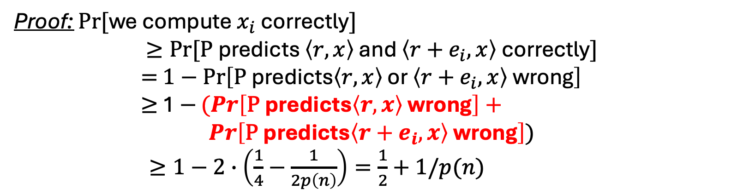
Who’s the culprit here?
For at least a $1/2p(n)$ fraction of the $x$,
$$\operatorname{Pr}\left[r←{\left\{0,1\right\}}^{n}:P\left(F\left(x\right),r\right)=\left\langle r,x\right\rangle \right]≥\frac{3}{4}+1/2p(n)$$
Pick a random $r$ and ask $P$ to tells us $\left\langle r,x\right\rangle$ and $\left\langle r+e_{i},x\right\rangle$. Subtract the two answers to get $\left\langle e_{i},x\right\rangle =x_{i}$.
Proof: $Pr⁡[$we compute $x_{i}$ correctly$]$
$$≥Pr⁡[\text{P} \text{predicts} \left\langle r,x\right\rangle \text{and} \left\langle r+e_{i},x\right\rangle \text{correctly}]$$
$=$ $1−\operatorname{Pr}\left[\text{P} \text{predicts}\left\langle r,x\right\rangle \text{or} \left\langle r+e_{i},x\right\rangle \text{wrong}\right]$
$≥$ 1 $−(Pr\left[\text{P} \text{predicts}\left\langle r,x\right\rangle \text{wrong}\right]+$
$$\operatorname{Pr}\left[\text{P} \text{predicts}\left\langle r+e_{i},x\right\rangle \text{wrong}\right])$$
$≥1−2∙\left(\frac{1}{4}−\frac{1}{2p\left(n\right)}\right)=\frac{1}{2}+1/p(n)$
We need a more careful analysis on their correlation
(by union bound)

Slide 14
Now on to the Real Proof
Assume (after averaging) that for $≥1/2p(n)$ fraction of the $x$,
$$\operatorname{Pr}\left[r←{\left\{0,1\right\}}^{n}:P\left(F\left(x\right),r\right)=\left\langle r,x\right\rangle \right]≥\frac{1}{2}+1/2p(n)$$
Key Idea: Pairwise independence

Slide 15


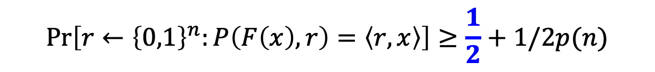
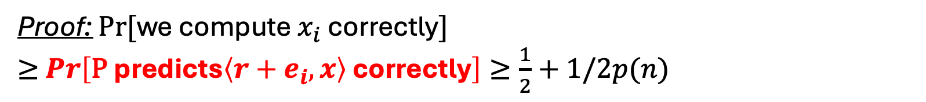
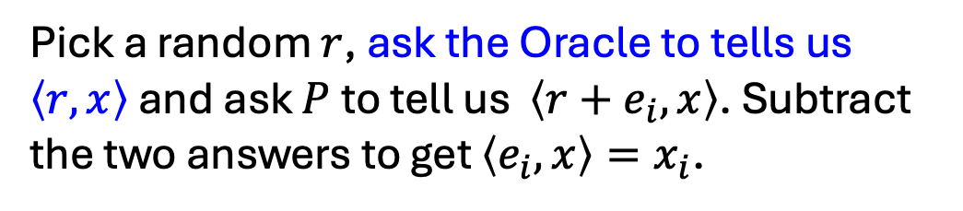
A Proof of the GL Theorem
(attributed to Charlie Rackoff)
Assume (after averaging) that for $≥1/2p(n)$ fraction of the $x$,
$$\operatorname{Pr}\left[r←{\left\{0,1\right\}}^{n}:P\left(F\left(x\right),r\right)=\left\langle r,x\right\rangle \right]≥\frac{1}{2}+1/2p(n)$$
For a minute, assume we have a bit of help/advice.
Pick a random $r$, ask the Oracle to tells us $\left\langle r,x\right\rangle$ and ask $P$ to tell us $\left\langle r+e_{i},x\right\rangle$. Subtract the two answers to get $\left\langle e_{i},x\right\rangle =x_{i}$.
Proof: $Pr⁡[$we compute $x_{i}$ correctly$]$
$≥$ $\operatorname{Pr}\left[\text{P} \text{predicts}\left\langle r+e_{i},x\right\rangle \text{correctly}\right]≥\frac{1}{2}+1/2p(n)$

Slide 16

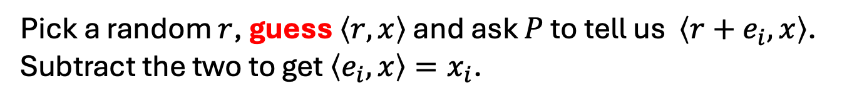
A Proof of the GL Theorem
(attributed to Charlie Rackoff)
Assume (after averaging) that for $≥1/2p(n)$ fraction of the $x$,
$$\operatorname{Pr}\left[r←{\left\{0,1\right\}}^{n}:P\left(F\left(x\right),r\right)=\left\langle r,x\right\rangle \right]≥\frac{1}{2}+1/2p(n)$$
Pick a random $r$, guess $\left\langle r,x\right\rangle$ and ask $P$ to tell us $\left\langle r+e_{i},x\right\rangle$. Subtract the two to get $\left\langle e_{i},x\right\rangle =x_{i}$.
If our guesses are all correct, then the analysis works out just as before.
But what’s the chance…?
Let’s focus on $m= O(n log{n}{(p(n))}^{2})$ possibility of $r$

Slide 17
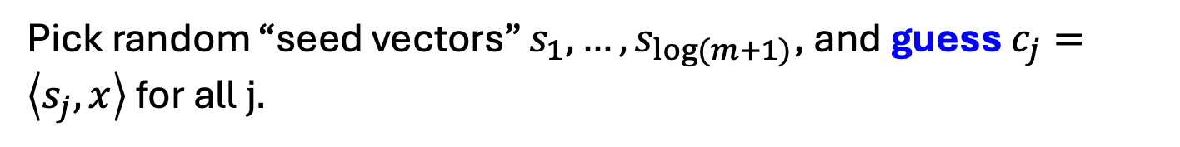

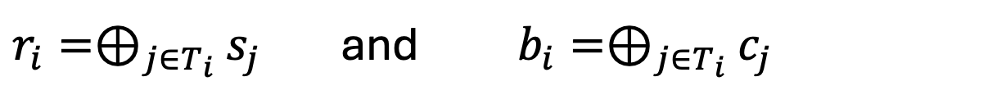
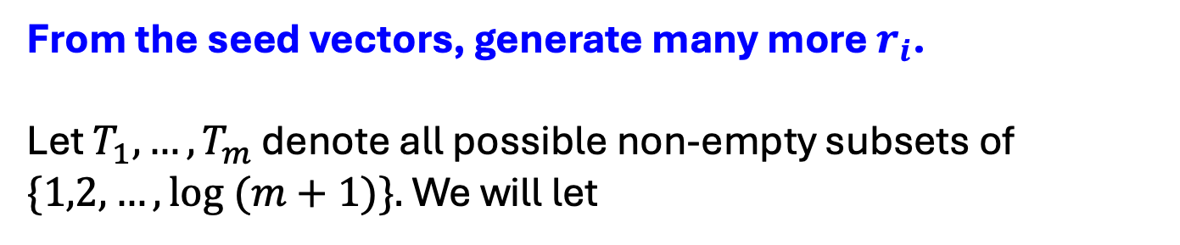
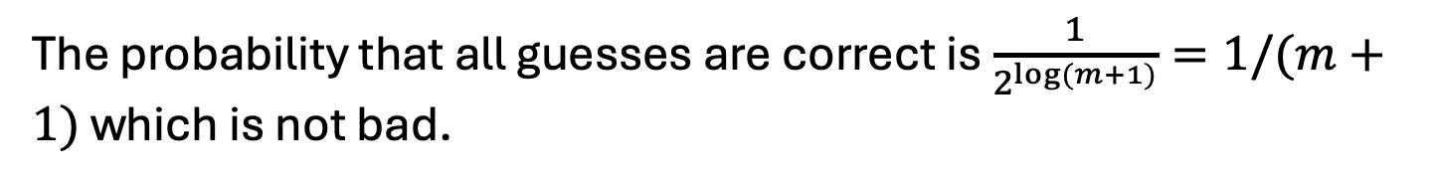
Parsimony in Guessing
Pick random “seed vectors” $s_{1},…,s_{\log{(m+1)}}$, and guess $c_{j}=\left\langle s_{j},x\right\rangle$ for all$j.$
The probability that all guesses are correct is $\frac{1}{2^{\log{(m+1)}}}=1/(m+1)$ which is not bad.
From the seed vectors, generate many more $r_{i}$.
Let $T_{1},…,T_{m}$ denote all possible non-empty subsets of $\{1,2,…,\log{(m+1)\}.}$ We will let
$r_{i}=⊕_{j∈T_{i}}$ $s_{j}$ and $b_{i}=⊕_{j∈T_{i}}$ $c_{j}$
Key Observation: If the guesses $c_{1},…,c_{\log{(m+1)}}$ are all correct, then so are the $b_{1},…,b_{m}.$

Slide 18
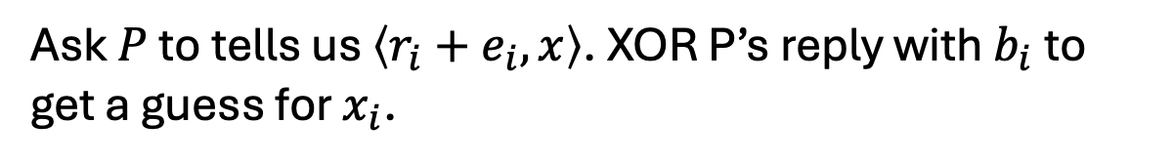

The OWF Inverter
Generate random $s_{1},…,s_{log⁡(m+1)}$ and bits $c_{1},…,c_{log⁡(m+1)}$.
From them, derive $r_{1},…,r_{log⁡(m+1)}$ and bits $b_{1},…,b_{m}$ as in the previous slide.
Repeat for each $i∈\left\{1,2,…,n\right\}$:
Repeat $100n{(p(n))}^{2}$ times:
Ask $P$ to tells us $\left\langle r_{i}+e_{i},x\right\rangle$. XOR P’s reply with $b_{i}$to get a guess for $x_{i}$.
Compute the majority of all such guesses and set the bit as $x_{i}$
Output the concatenation of all $x_{i}$ as $x.$

Slide 19

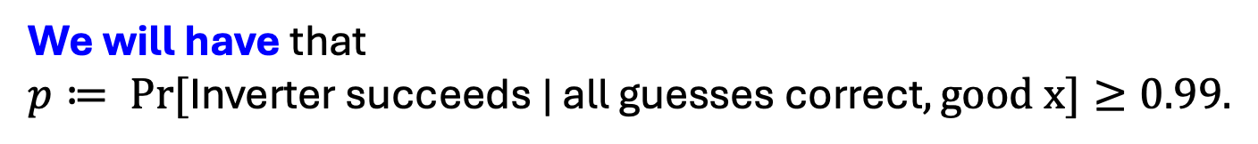

Analysis of the Inverter
Let’s condition on the guesses $c_{1},…,c_{log⁡(m+1)}$ being all correct.
The main issue: The $r_{i}$ are not independent (can’t do Chernoff)
Key Observation: The $r_{i}$ are pairwise independent.
Therefore, can apply Chebyshev!
We will have that
$p≔ Pr⁡[\text{Inverter} \text{succeeds}\text{ | }\text{all} \text{guesses} \text{correct}, good x]≥0.99.$

Slide 20


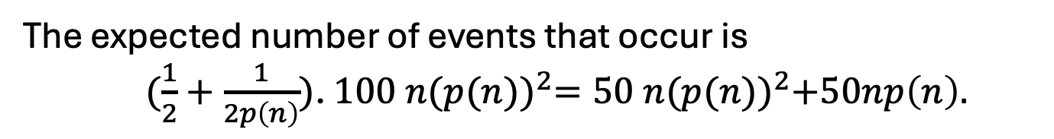
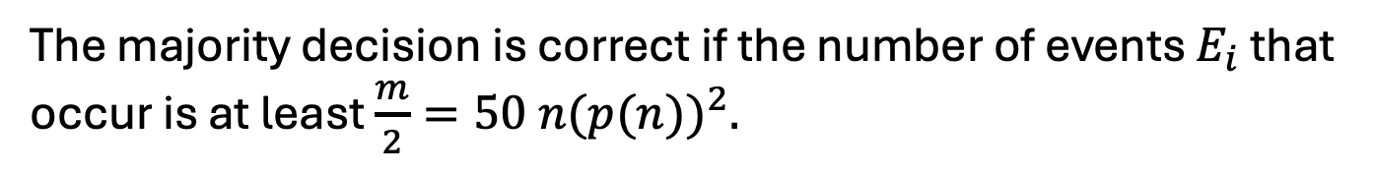

Analysis of the Inverter
The probability that a single iteration of the inner loop gives the correct $x_{i}$ is at least $\frac{1}{2}+1/2p(n)$.
Let this be the good event $E_{i}$ (for the $i^{th}$ iteration of the inner loop).
The majority decision is correct if the number of events $E_{i}$ that occur is at least $\frac{m}{2}=50 n{(p(n))}^{2}.$
The expected number of events that occur is
$(\frac{1}{2}+\frac{1}{2p\left(n\right)})$. $100 n{(p(n))}^{2}=50 n{(p(n))}^{2}+50np\left(n\right).$
The variance (independent sum) is
$≈\frac{1}{4}∙100 n{\left(p\left(n\right)\right)}^{2}=25n{\left(p\left(n\right)\right)}^{2}$

Slide 21
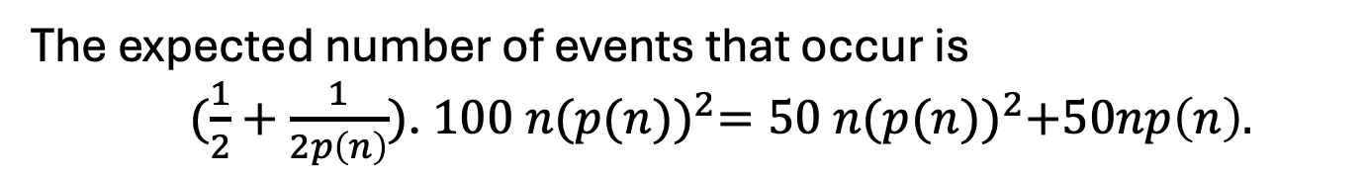
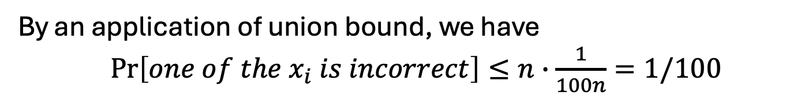
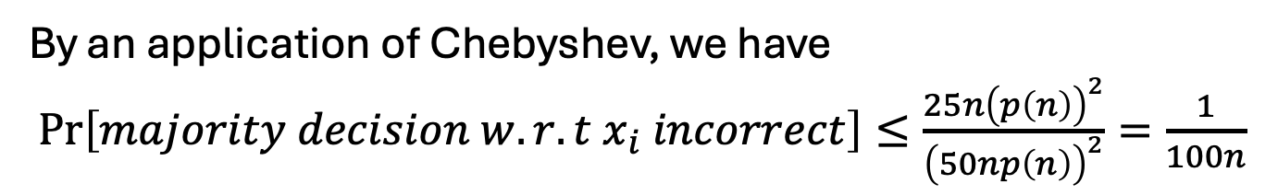
Analysis of the Inverter
The expected number of events that occur is
$(\frac{1}{2}+\frac{1}{2p\left(n\right)})$. $100 n{(p(n))}^{2}=50 n{(p(n))}^{2}+50np\left(n\right).$
The variance is $≈\frac{1}{4}∙100 n{\left(p\left(n\right)\right)}^{2}=25n{\left(p\left(n\right)\right)}^{2}$
By an application of Chebyshev, we have
$\operatorname{Pr}\left[majority decision w.r.t x_{i} incorrect\right]≤\frac{25n{\left(p\left(n\right)\right)}^{2}}{{\left(50np\left(n\right)\right)}^{2}}=\frac{1}{100n}$
By an application of union bound, we have
$\operatorname{Pr}\left[one of the x_{i} is incorrect\right]≤n∙\frac{1}{100n}=1/100$
$∴$ The inverter outputs the correct inverse w.p. $p≥0.99.$

Slide 22
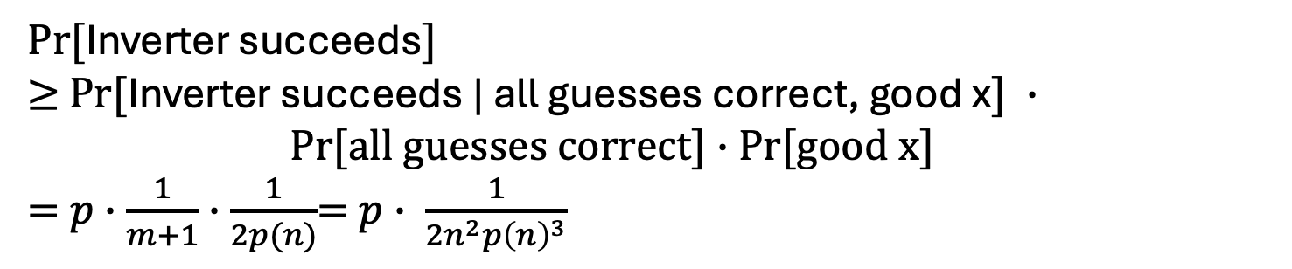
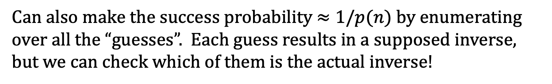
Putting it all together
$Pr⁡[$Inverter succeeds$]$
$≥$ $Pr⁡[$Inverter succeeds | all guesses correct, good x$] ∙$ $Pr[all guesses correct]∙$ Pr[good x]
= $p∙\frac{1}{m+1}∙\frac{1}{2p(n)}$= $p∙ \frac{1}{{2n}^{2}{p\left(n\right)}^{3}}$
So, it suffices to show that $p$is large.
By our calculation (last two slides), $p≥0.99$, so we are done.
Can also make the success probability $≈1/p(n)$ by enumerating over all the “guesses”. Each guess results in a supposed inverse, but we can check which of them is the actual inverse!

Slide 23
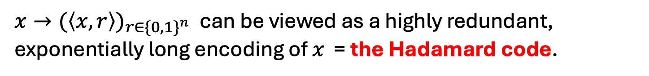
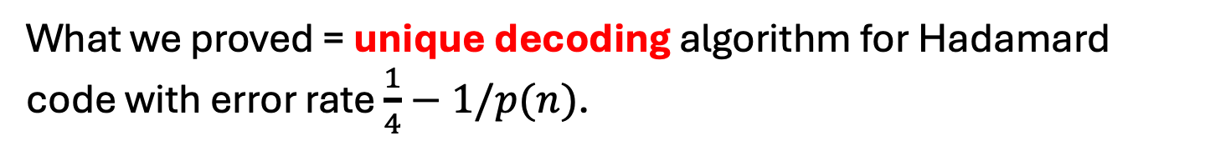
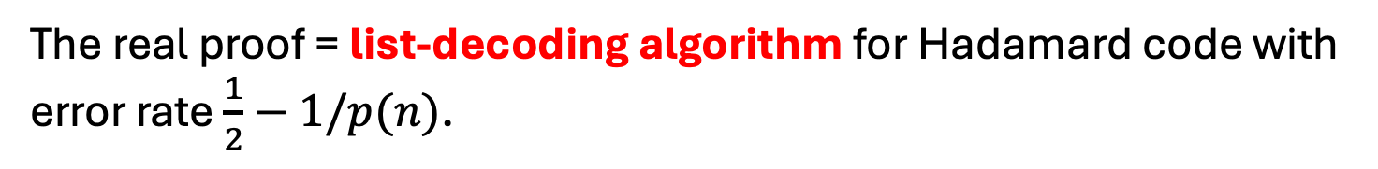
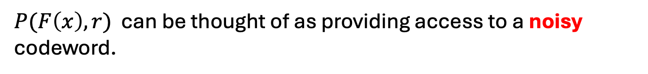
The Coding-Theoretic View of GL
$x→{(\left\langle x,r\right\rangle )}_{r∈{\{0,1\}}^{n}}$ can be viewed as a highly redundant, exponentially long encoding of $x$ = the Hadamard code.
$P(F\left(x\right),r)$ can be thought of as providing access to a noisy codeword.
What we proved = unique decoding algorithm for Hadamard code with error rate $\frac{1}{4}−1/p(n)$.
The real proof = list-decoding algorithm for Hadamard code with error rate $\frac{1}{2}−1/p(n)$.

Slide 24

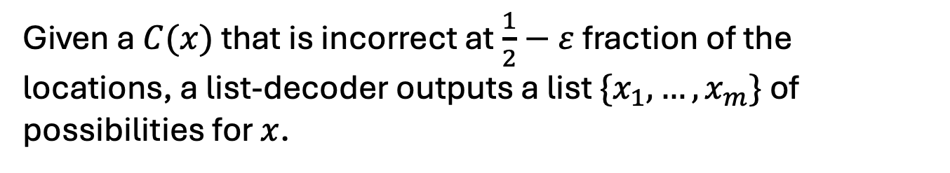
Hardcore Predicates from any
List-Decodable Code
(due to Impagliazzo and Sudan)
$x→C(x)$ is the encoding.
Given a $C(x)$ that is incorrect at $\frac{1}{2}−ε$ fraction of the locations, a list-decoder outputs a list $\{x_{1},…,x_{m}\}$ of possibilities for $x$.
The hardcore predicate is
$$B_{i}\left(x\right)= {C(x)}_{i}.$$
A hardcore-bit predictor gives us access to a corrupted codeword. Running the list-decoder on it gives us the list of possible inverses. The fact that the OWF is easy to compute means that we can filter out the bogus (non-)inverses.

Slide 25
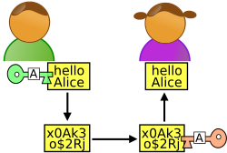
















Stateful Encryption of Many Messages
1-bit m
${m⊕b}_{1}$
Alice
Bob
Initial state ${=s}_{0}$
Initial state ${=s}_{0}$
S$tate{=s}_{1}$
State ${=s}_{1}$
$$s_{0}$$
$$s_{1}$$
$$s_{2}$$
$$s_{3}$$
$$s_{4}$$
$$s_{5}$$
G
G
G
G
G
$$b_{1}$$
$$b_{2}$$
$$b_{3}$$
$$b_{4}$$
$$b_{5}$$

Slide 26





Stateful Encryption of Many Messages
3-bit m’
$${m′⊕b}_{2}b_{3}b_{4}$$
Alice
Bob
S$tate{=s}_{4}$
State ${=s}_{4}$
S$tate{=s}_{1}$
State ${=s}_{1}$
$$s_{0}$$
$$s_{1}$$
$$s_{2}$$
$$s_{3}$$
$$s_{4}$$
$$s_{5}$$
G
G
G
G
G
$$b_{1}$$
$$b_{2}$$
$$b_{3}$$
$$b_{4}$$
$$b_{5}$$

Slide 27





Stateful Encryption of Many Messages
1-bit m’’
$${m′′⊕b}_{5}$$
Alice
Bob
S$tate{=s}_{5}$
State ${=s}_{5}$
S$tate{=s}_{4}$
State ${=s}_{4}$
$$s_{0}$$
$$s_{1}$$
$$s_{2}$$
$$s_{3}$$
$$s_{4}$$
$$s_{5}$$
G
G
G
G
G
$$b_{1}$$
$$b_{2}$$
$$b_{3}$$
$$b_{4}$$
$$b_{5}$$

Slide 28
Stateful Encryption of Many Messages
PLUS: Alice and Bob can keep encrypting as many bits as they wish.
MINUS: Alice and Bob have to keep their states in perfect synchrony. They cannot transmit simultaneously.
IF NOT: Correctness goes down the drain, so does security.

Slide 29















How to be Stateless? Here is an idea…
1-bit m
pick a random index, say 5
(5,${m⊕b}_{5})$
Alice
Bob
Key k ${=s}_{0}$
Key k ${=s}_{0}$
${ b}_{1}$
${ b}_{2}$
${ b}_{3}$
${ b}_{4}$
${ b}_{5}$
$$…$$
${ b}_{n^{100}−1}$
${ b}_{n^{100}}$
${ b}_{1}$
${ b}_{2}$
${ b}_{3}$
${ b}_{4}$
${ b}_{5}$
$$…$$
${ b}_{n^{100}−1}$
${ b}_{n^{100}}$
DOES THIS WORK?
Collisions! Pr[Alice’s first two indices collide] $≥1/n^{100}$
$⟹$Alice is using the same one-time pad bit twice!

Slide 30






Here is another idea…
1-bit m
pick a random index, say 5
(5,${m⊕b}_{5})$
Alice
Bob
Key k ${=s}_{0}$
Key k ${=s}_{0}$
${ b}_{1}$
${ b}_{2}$
${ b}_{3}$
${ b}_{4}$
${ b}_{5}$
$$…$$
${ b}_{2^{n}−1}$
${ b}_{2^{n}}$
${ b}_{1}$
${ b}_{2}$
${ b}_{3}$
${ b}_{4}$
${ b}_{5}$
$$…$$
${ b}_{2^{n}−1}$
${ b}_{2^{n}}$
Pr[$∃$ collision in $t=poly(n)$ indices] $≤t^{2}/2^{n}=negl(n)$
BUT: Alice and Bob are not poly-time!

Slide 31




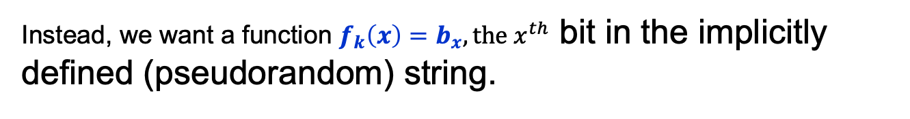
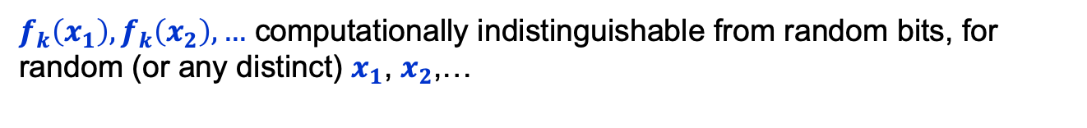







Pseudorandom Functions
But these are good bad ideas…
Key k ${=s}_{0}$
$$x$$
${ b}_{1}$
${ b}_{2}$
${ b}_{3}$
$$…$$
${ b}_{x}$
$$…$$
${ b}_{2^{n}−1}$
${ b}_{2^{n}}$
Goal: Never compute this exponentially long string explicitly!
Instead, we want a function $f_{k}\left(x\right)=b_{x}, the x^{th}$ bit in the implicitly defined (pseudorandom) string.
Computable in time $poly\left(\left|x\right|\right)=poly(n)$.
$f_{k}\left(x_{1}\right),f_{k}\left(x_{2}\right),…$ computationally indistinguishable from random bits, for random (or any distinct) $x_{1}$, $x_{2}$,…
|$x|$ = $n$ = length of the string $x$.

Slide 32
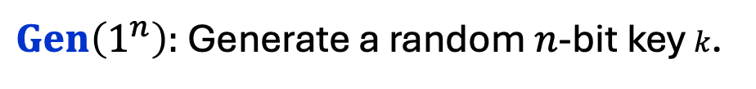
Pseudorandom Functions
Collection of functions $ℱ_{ℓ}=\{f_{k}:\{0,1\}^{ℓ}→\{0,1\}^{m}\}_{k∈\{0,1\}^{n}}$
indexed by a (private) key/seed $k$
$n$: key length, $ℓ$: input length, $m:$ output length.
Independent parameters, all poly(sec-param) = poly($n$)
#functions in $ℱ_{ℓ}$ $≤$ $2^{n}$ (singly exponential in $n$)
$Gen\left(1^{n}\right):$ Generate a random $n$-bit key $k$.
$Eval\left(k,x\right)$ is a poly-time algorithm that outputs $f_{k}\left(x\right).$

Slide 33


Pseudorandom Functions
Collection of functions $ℱ_{ℓ}=\{f_{k}:\{0,1\}^{ℓ}→\{0,1\}^{m}\}_{k∈\{0,1\}^{n}}$
indexed by a (private) key $k$
$n$: key length, $ℓ$: input length, $m:$ output length.
Independent parameters, all poly(sec-param) = poly($n$)
#functions in $ℱ_{ℓ}$ $≤$ $2^{n}$ (singly exponential in $n$)
$$≈$$
Collection of ALL functions ${ALL}_{ℓ}=\{f:\{0,1\}^{ℓ}→\{0,1\}^{m}\}$
#functions in ${ALL}_{ℓ}$ $≤$ $2^{m2^{ℓ}}$ (doubly exponential in $ℓ$)

Slide 34





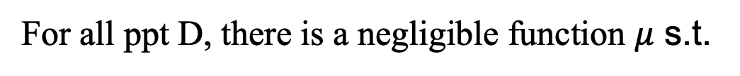








Pseudorandom Functions should be “indistinguishable” from random
The pseudorandom world
The random world
$f_{k}←$ $ℱ_{ℓ}$
$f←$ ${ALL}_{ℓ}$
$$f_{k}(x)$$
$$x$$
$$f(x)$$
$$x$$
Distinguisher D
Distinguisher D
$$0/1$$
$$0/1$$
For all ppt D, there is a negligible function $μ$ s.t.
$$|$$
$$−$$
$$|$$
$$≤μ(n)$$
$$Pr⁡[{f← ℱ_{ℓ}\text{:} D}^{f}\left(1^{n}\right)=1]$$
$$Pr⁡[{f← {ALL}_{ℓ}\text{:} D}^{f}\left(1^{n}\right)=1]$$

Slide 35


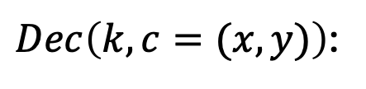

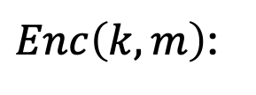

PRF $⟹$ Stateless Secret-key Encryption
$Gen\left(1^{n}\right):$ Generate a random $n$-bit key k that defines
$$f_{k}:\{0,1\}^{ℓ}→\{0,1\}^{m}$$
(the domain size, $2^{ℓ}$, had better be super-polynomially large in n)
$Enc\left(k,m\right)$:
Pick a random $x$ and let the ciphertext $c$be the pair $(x,{y=f}_{k}\left(x\right)⨁m).$
$Dec\left(k,c=(x,y)\right)$:
O$utput f_{k}\left(x\right)⨁y.$
$$Correctness:$$
$Dec\left(k,c\right)$ outputs $f_{k}\left(x\right)⨁y=f_{k}\left(x\right)⨁f_{k}\left(x\right)⨁m=m.$

