Slide 1
Purdue CS555: Cryptography Lecture 2
Instructor: Hanshen Xiao
Teaching Assistant: Justin He
course website: https://cs55500.github.io/

Slide 2
Recap
Information leakage model
Privacy risk in an adversarial inference form
From posterior success rate to belief and posterior advantage
Perfect secrecy and its equivalence to input-independent indistinguishability

Slide 3
Today
Types of leakage
One-time pad and symmetric encryption
Limitation of perfect secrecy
Computational indistinguishability (a game description)
Initialization Vector

Slide 4

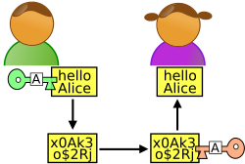


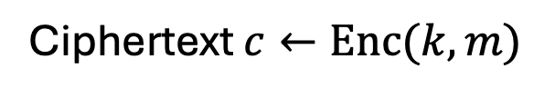
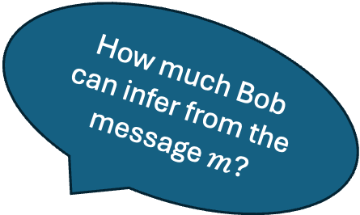
Two Types of Leakage
Private Communication against outside adversary
How much Bob can infer from the message $m$?
$m$
Ciphertext $c←Enc(k,m)$
$$m←Dec(k,c)$$
Key k
Key k
Alice
Bob

Slide 5
Two Types of Leakage
Private Communication against outside adversary
-- intermediate secrecy
Public Release
-- output secrecy
-- tradeoff between information propagation and obfuscation
U.S. Census releases average salaries and population ages in Indiana
ChatGPT responses
Side-channel leakage

Slide 6
Intermediate Secrecy
(Cryptography)
Free lunch in terms of accuracy/utility is possible under additional assumptions
Two main research problems
Weaker assumptions: reduction to more fundamental hard problems
Computational efficiency: efficient primitives and protocols
Perfect indistinguishability
Output Secrecy
(Information Theory and Statistic)
No free lunch in terms of accuracy/utility
Key research problem: optimal utility-privacy tradeoff (e.g., minimal noise/randomization for required privacy guarantees)
Non-zero posterior advantage

Slide 7
Intermediate Secrecy
(Cryptography)
Free lunch in terms of accuracy/utility is possible under additional assumptions
Two main research problems
Weaker assumptions: reduction to more fundamental hard problems
Computational efficiency: efficient primitives and protocols
Perfect indistinguishability
Output Secrecy
(Information Theory and Statistic)
No free lunch in terms of accuracy/utility
Key research problem: optimal utility-privacy tradeoff (e.g., minimal noise/randomization for required privacy guarantees)
Non-zero posterior advantage
Users can leverage some “trapdoor” only known to “key holders”

Slide 8
Secret/Symmetric Key Encryption
m
Key k
Key k
Eavesdropper “Eve”
Setup: Alice and Bob meet beforehand to agree on a secret key k.

Slide 9


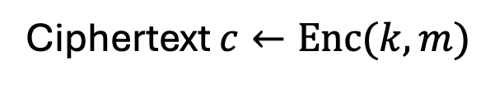
Secret/Symmetric Key Encryption
$m$
Ciphertext $c←Enc(k,m)$
$$m←Dec(k,c)$$
Key k
Key k
Three (possibly probabilistic) components:
Key Generation Algorithm Gen: $k←Gen(θ)$
Encryption Algorithm Enc: $c←Enc(k,m)$
Decryption Algorithm Dec: $m←Dec(k,c)$

Slide 10
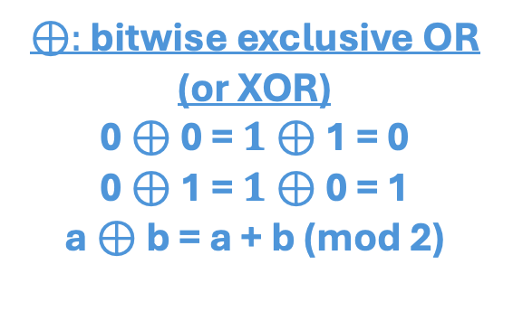

Secret/Symmetric Key Encryption -- One-time Pad Construction
$m$
Ciphertext $c←Enc(k,m)$
$$m←Dec(k,c)$$
Key k
Key k
Three (possibly probabilistic) components:
Key Generation Algorithm Gen: $k←{\{0,1\}}^{l}$
$l$-bit string randomly selected
$⊕:$ bitwise exclusive OR (or XOR)
0 $⊕$ 0 = $1⊕$ 1 = 0
0 $⊕$ 1 = $1⊕$ 0 = 1
a $⊕$ b = a + b (mod 2)
Encryption Algorithm Enc: $c←Enc\left(k,m\right)=m⨁k$
Decryption Algorithm Dec: $m←Dec\left(k,c\right)=c⨁k$

Slide 11
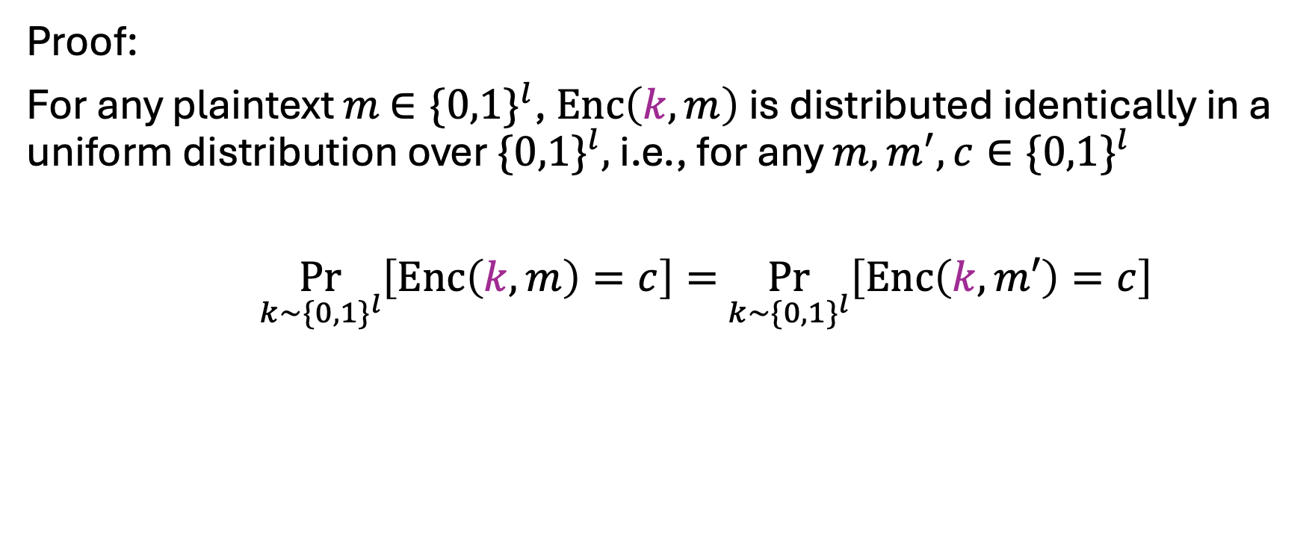
One-time Pad Satisfies Perfect Secrecy
Proof:
For any plaintext $m$ $∈\{0,1\}^{l}$, $Enc\left(k,m\right)$ is distributed identically in a uniform distribution over $\{0,1\}^{l},$ i.e., for any $m,m^{′},c∈\{0,1\}^{l}$
$\underset{k∼\{0,1\}^{l}}{Pr}\left[Enc\left(k,m\right)=c\right]=$ $\underset{k∼\{0,1\}^{l}}{Pr}\left[Enc\left(k,m′\right)=c\right]$

Slide 12






Is One-time Pad Reusable?
$$m_{0}$$
$$c_{0}=m_{0}⊕k$$
Key $k$
A week later:
$$m_{1}$$
$$c_{1}=m_{1}⊕k$$
Key $k$
Is this still perfectly secret?

Slide 13

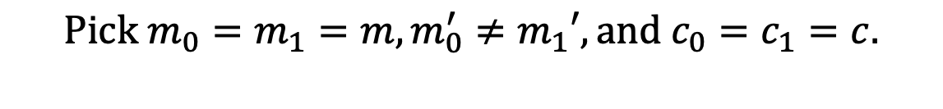
Reused One-time Pad is NOT Perfectly Secure
Claim: Two-time Pad does not achieve Perfect Indistinguishability (and therefore not perfect secrecy).
Proof:
We want to pick $\left(m_{0},m_{1}\right),{(m_{0}}^{′},m_{1}′),(c_{0},c_{1})∈\{0,1\}^{2l}$ s.t.
$$Pr[Enc\left(k,m_{0})=c_{0} and Enc(k,m_{1}\right)=c_{1}]$$
$$≠Pr[Enc\left(k,m_{0}′)=c_{0} and Enc(k,m_{1}′\right)=c_{1}]$$
$$Pick m_{0}=m_{1}=m,m_{0}^{′}≠m_{1}′, and c_{0}=c_{1}=c.$$
$$Pr[Enc\left(k,m_{0})=c= Enc(k,m_{1}\right)]=1/2^{l}$$
$$Pr[Enc\left(k,m_{0}′)=c=Enc(k,m_{1}′\right)]=0$$

Slide 14
Reused One-time Pad is NOT Perfectly Secure
Claim: Two-time Pad does not achieve Perfect Indistinguishability (and therefore not perfect secrecy).
Proof:
We want to pick $\left(m_{0},m_{1}\right),{(m_{0}}^{′},m_{1}′),(c_{0},c_{1})∈\{0,1\}^{2l}$ s.t.
$$Pr[Enc\left(k,m_{0})=c_{0} and Enc(k,m_{1}\right)=c_{1}]$$
$$≠Pr[Enc\left(k,m_{0}′)=c_{0} and Enc(k,m_{1}′\right)=c_{1}]$$
Generalization to any deterministic encryption
$$Pick m_{0}=m_{1}=m,m_{0}^{′}≠m_{1}′, and c_{0}=c_{1}=c.$$
$$Pr[Enc\left(k,m_{0})=c= Enc(k,m_{1}\right)]=1/2^{l}$$
$$Pr[Enc\left(k,m_{0}′)=c=Enc(k,m_{1}′\right)]=0$$

Slide 15
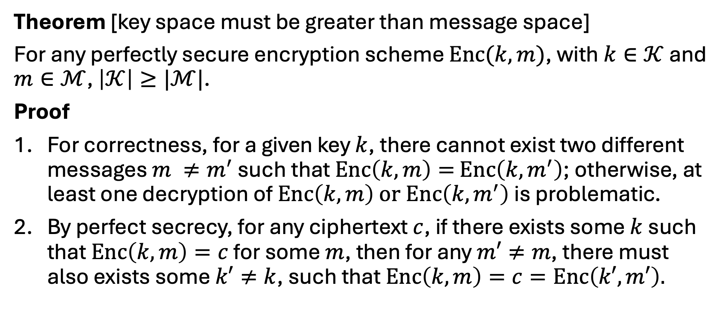
A Shorter Key?
Theorem [key space must be greater than message space]
For any perfectly secure encryption scheme $Enc(k,m)$, with $k∈𝒦$ and $m∈ℳ$, $\left|𝒦\right|≥|ℳ|$.
Proof
For correctness, for a given key $k$, there cannot exist two different messages $m {≠m}^{′}$ such that $Enc\left(k,m\right)=$ $Enc\left(k,m^{′}\right)$; otherwise, at least one decryption of $Enc\left(k,m\right) or Enc\left(k,m^{′}\right)$ is problematic.
By perfect secrecy, for any ciphertext $c$, if there exists some $k$ such that $Enc\left(k,m\right)=c$ for some $m$, then for any $m′≠m$, there must also exists some $k′≠k$, such that $Enc\left(k,m\right)=c=Enc\left(k′,m′\right).$

Slide 16













A Shorter Key?
Theorem [key space must be greater than message space]
For any perfectly secure encryption scheme $Enc(k,m)$, with $k∈𝒦$ and $m∈ℳ$, $\left|𝒦\right|≥|ℳ|$.
Proof
$$ℳ$$
$$𝒞$$
$$k$$
$$m$$
$$c$$
$$k′$$
$$m′$$
$$k′′$$
$$m′′$$
$$k′′′$$
$$≤\left|𝓚\right|<|𝓜|$$
$$\tilde{m}$$

Slide 17
Perfect Secrecy Has Its Price
Consensus on fresh key (padding) for every message
More random bits are required compared to the length of your message
Communication Inefficient

Slide 18
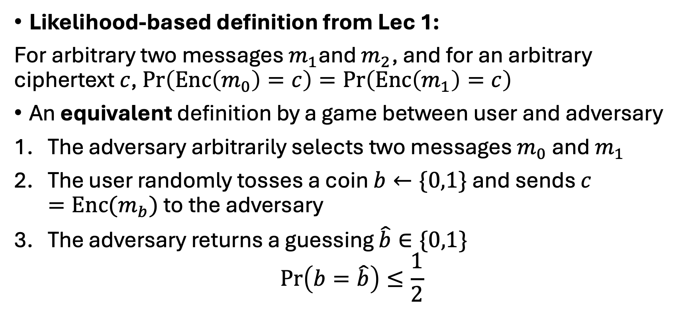
Indistinguishability (between Ciphertexts)
Likelihood-based definition from Lec 1:
For arbitrary two messages $m_{1}$and $m_{2}$, and for an arbitrary ciphertext $c$, $\operatorname{Pr}\left(Enc\left(m_{0}\right)=c\right)=\operatorname{Pr}\left(Enc\left(m_{1}\right)=c\right)$
An equivalent definition by a game between user and adversary
The adversary arbitrarily selects two messages $m_{0}$ and $m_{1}$
The user randomly tosses a coin $b←\{0,1\}$ and sends $c=Enc(m_{b})$ to the adversary
The adversary returns a guessing $\hat{b}∈\{0,1\}$
$$\operatorname{Pr}\left(b=\hat{b}\right)≤\frac{1}{2}$$

Slide 19
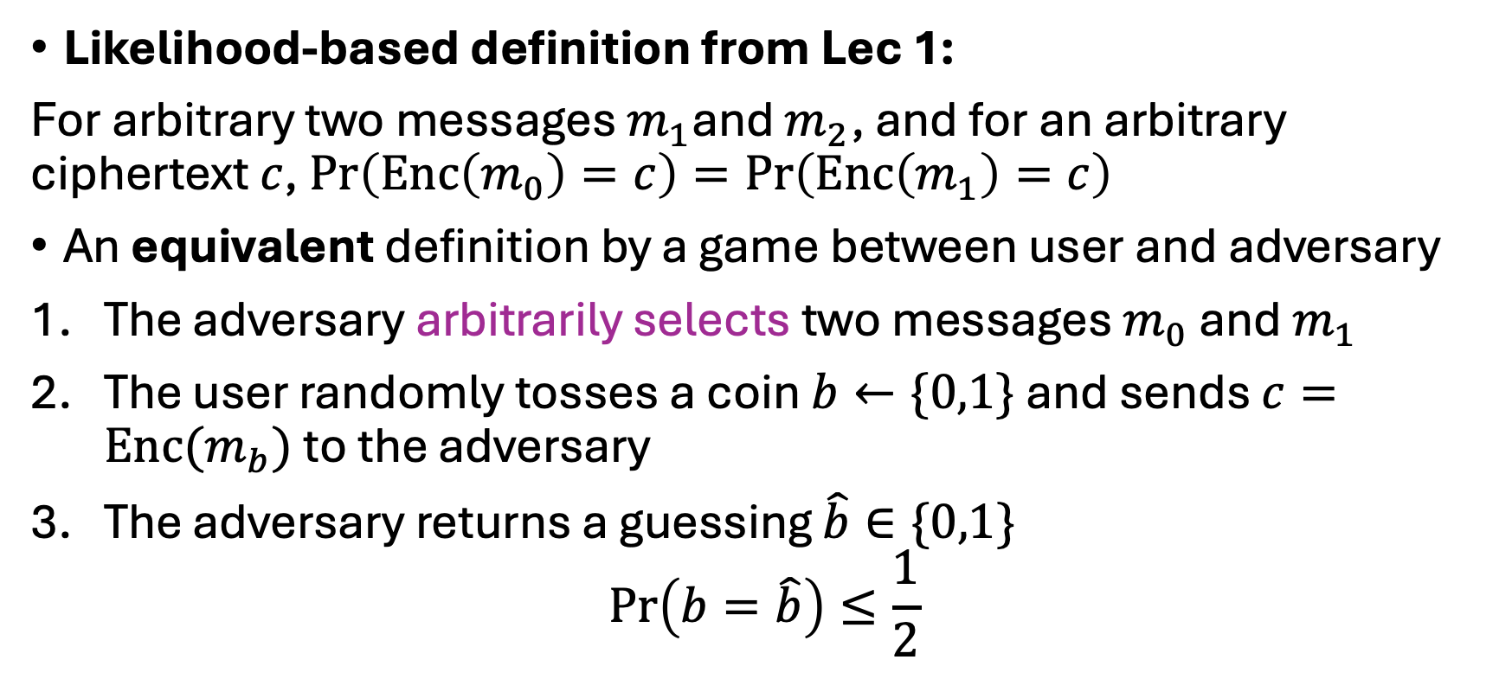
Indistinguishability (between Ciphertexts)
Likelihood-based definition from Lec 1:
For arbitrary two messages $m_{1}$and $m_{2}$, and for an arbitrary ciphertext $c$, $\operatorname{Pr}\left(Enc\left(m_{0}\right)=c\right)=\operatorname{Pr}\left(Enc\left(m_{1}\right)=c\right)$
An equivalent definition by a game between user and adversary
The adversary arbitrarily selects two messages $m_{0}$ and $m_{1}$
The user randomly tosses a coin $b←\{0,1\}$ and sends $c=Enc(m_{b})$ to the adversary
The adversary returns a guessing $\hat{b}∈\{0,1\}$
$$\operatorname{Pr}\left(b=\hat{b}\right)≤\frac{1}{2}$$
Chosen-Plaintext Attack
(IND-CPA)

Slide 20
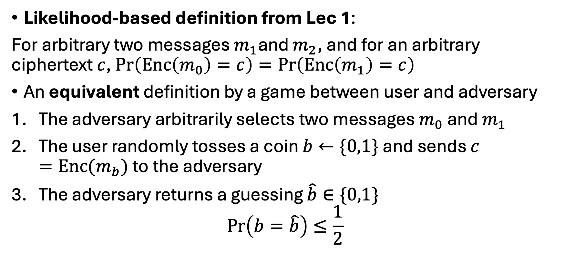
Indistinguishability (between Ciphertexts)
Likelihood-based definition from Lec 1:
For arbitrary two messages $m_{1}$and $m_{2}$, and for an arbitrary ciphertext $c$, $\operatorname{Pr}\left(Enc\left(m_{0}\right)=c\right)=\operatorname{Pr}\left(Enc\left(m_{1}\right)=c\right)$
An equivalent definition by a game between user and adversary
The adversary arbitrarily selects two messages $m_{0}$ and $m_{1}$
The user randomly tosses a coin $b←\{0,1\}$ and sends $c=Enc(m_{b})$ to the adversary
The adversary returns a guessing $\hat{b}∈\{0,1\}$
$$\operatorname{Pr}\left(b=\hat{b}\right)≤\frac{1}{2}$$
For an arbitrary adversarial strategy, it cannot be better than random guessing

Slide 21
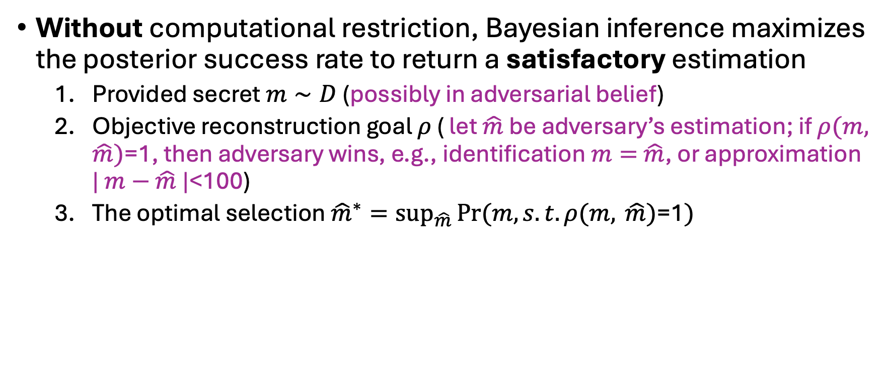
Optimal Adversarial Strategy
Without computational restriction, Bayesian inference maximizes the posterior success rate to return a satisfactory estimation
Provided secret $m∼D$ (possibly in adversarial belief)
Objective reconstruction goal $ρ$ ( let $\hat{m}$ be adversary’s estimation; if $ρ(m,$ $\hat{m})$=1, then adversary wins, e.g., identification $m=$ $\hat{m}$, or approximation | $m−$ $\hat{m}$|<100)
The optimal selection ${\hat{m}}^{∗}=\sup_{\hat{m}}\operatorname{Pr}{(m, s.t. ρ(m, \hat{m})\text{=1})}$

Slide 22
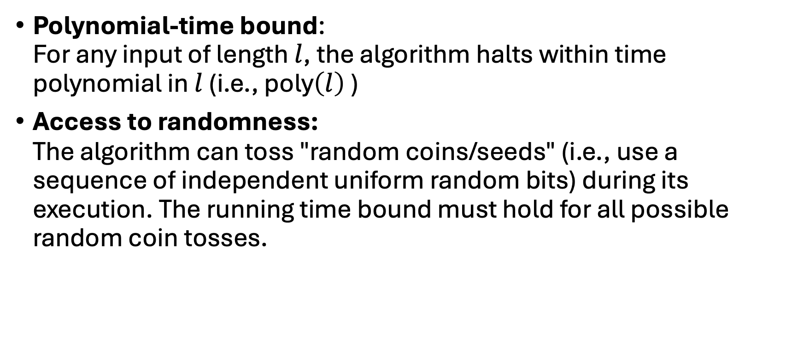
Probabilistic Polynomial-Time (P.P.T) -- Efficiency Standard
Polynomial-time bound: For any input of length $l$, the algorithm halts within time polynomial in $l$ (i.e., $\text{poly}\left(l\right)$ )
Access to randomness: The algorithm can toss "random coins/seeds" (i.e., use a sequence of independent uniform random bits) during its execution. The running time bound must hold for all possible random coin tosses.

Slide 23
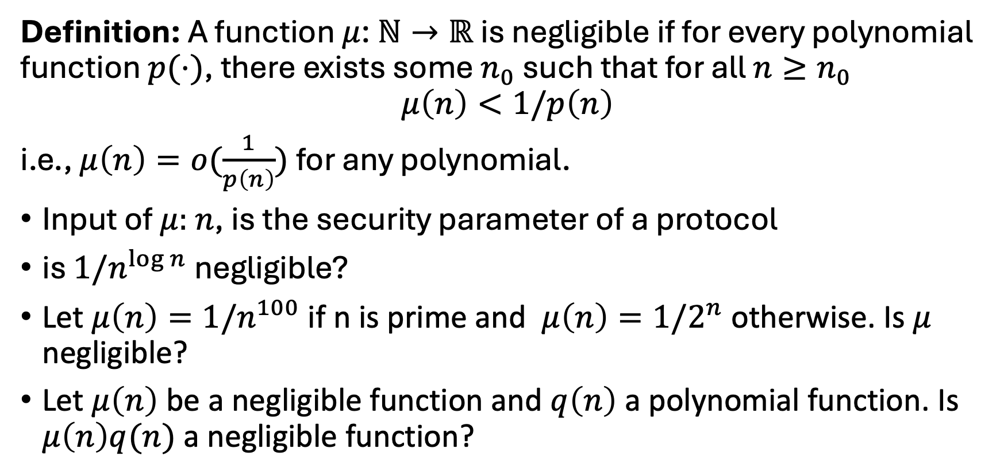
Negligible Function -- Significance Standard
Definition: A function $μ$: $ℕ→ℝ$ is negligible if for every polynomial function $p(⋅)$, there exists some $n_{0}$ such that for all $n≥n_{0}$
$$μ\left(n\right)<1/p\left(n\right)$$
i.e., $μ\left(n\right)=o(\frac{1}{p\left(n\right)})$ for any polynomial.
Input of $μ:$ $n$, is the security parameter of a protocol
is $1/n^{\log{n}}$ negligible?
Let $μ\left(n\right)=1/n^{100}$ if n is prime and $μ\left(n\right)=1/2^{n}$ otherwise. Is $μ$ negligible?
Let $μ\left(n\right)$ be a negligible function and $q\left(n\right)$ a polynomial function. Is $μ\left(n\right)q(n)$ a negligible function?

Slide 24
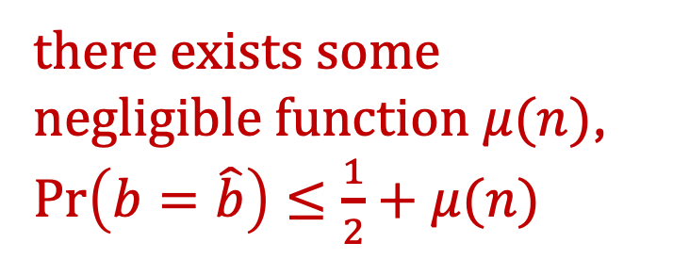
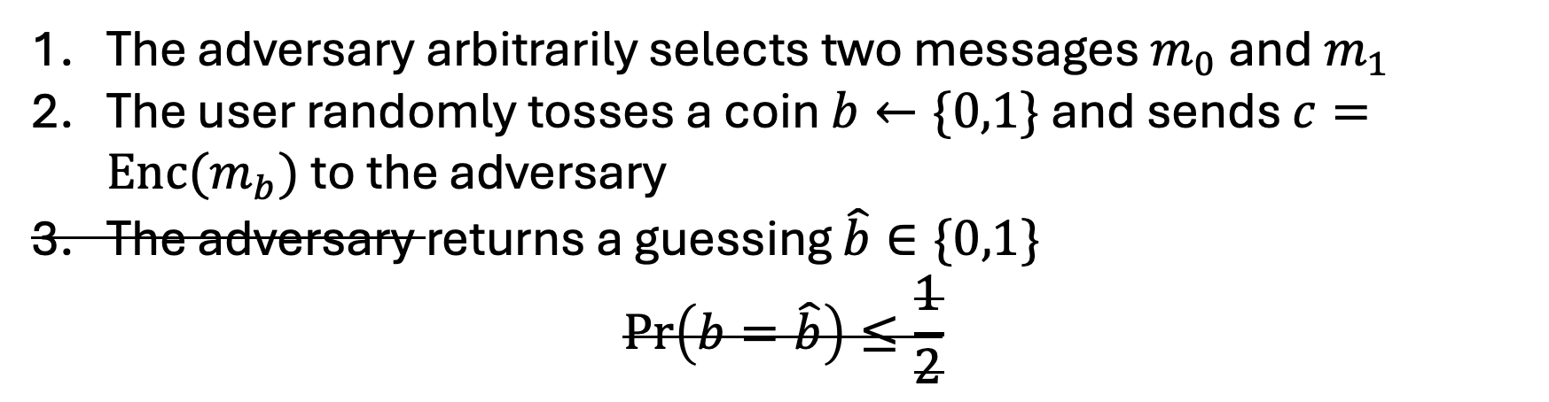
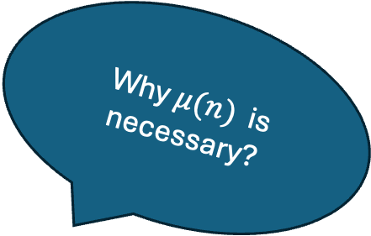
Computational Indistinguishability
For all P.P.T algorithms (EVE)
The adversary arbitrarily selects two messages $m_{0}$ and $m_{1}$
The user randomly tosses a coin $b←\{0,1\}$ and sends $c=Enc(m_{b})$ to the adversary
The adversary returns a guessing $\hat{b}∈\{0,1\}$
$$\operatorname{Pr}\left(b=\hat{b}\right)≤\frac{1}{2}$$
Why $μ(n)$ is necessary?
there exists some negligible function $μ(n)$,
$\operatorname{Pr}\left(b=\hat{b}\right)≤\frac{1}{2}+μ(n)$
Pseudorandomness
-- indistinguishable from true randomness

Slide 25
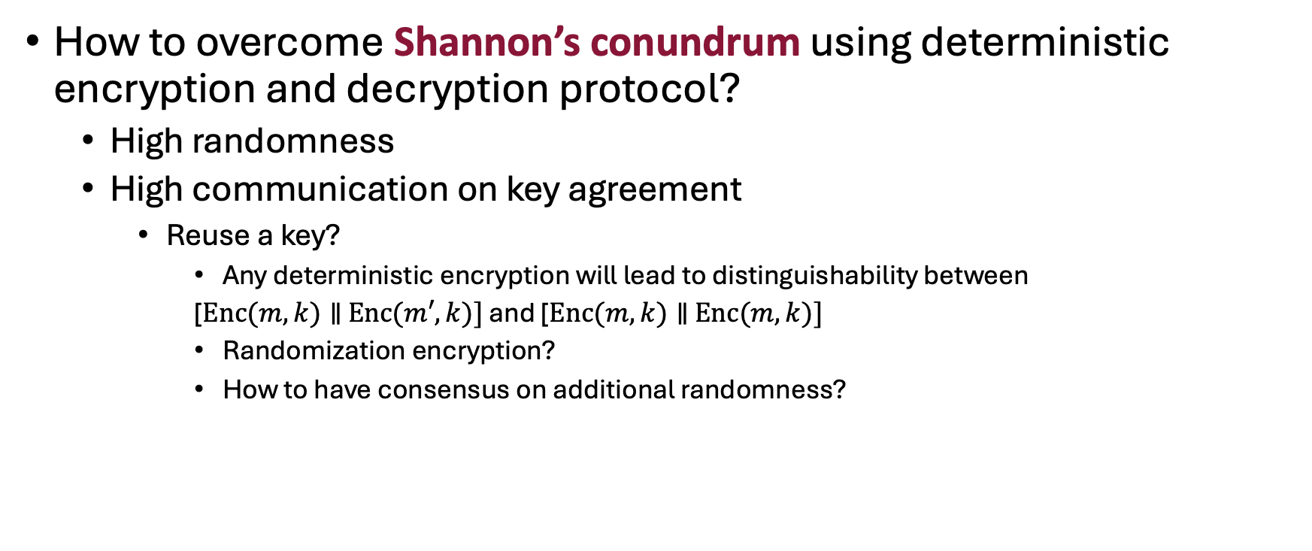
Initialization Vector and One-time Padding
How to overcome Shannon’s conundrum using deterministic encryption and decryption protocol?
High randomness
High communication on key agreement
Reuse a key?
Any deterministic encryption will lead to distinguishability between
[$Enc(m,k)∥$ $Enc(m′,k)]$ and [$Enc(m,k)∥$ $Enc(m,k)]$
Randomization encryption?
How to have consensus on additional randomness?
pseudorandom generator

Slide 26
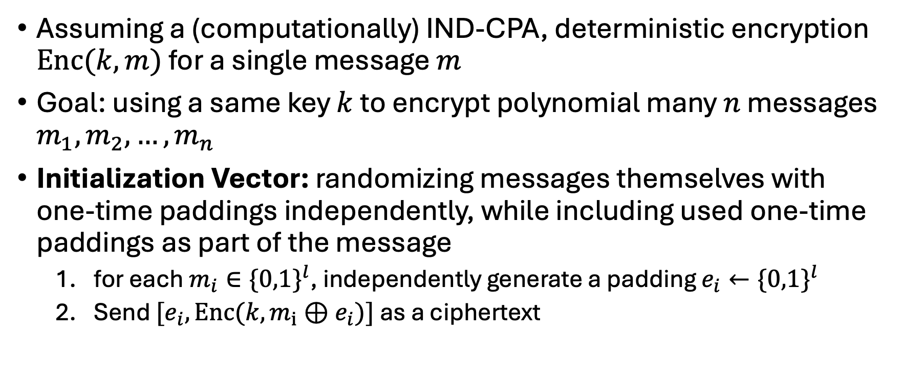
Initialization Vector and One-time Padding
Assuming a (computationally) IND-CPA, deterministic encryption $Enc(k,m)$ for a single message $m$
Goal: using a same key $k$ to encrypt polynomial many $n$ messages $m_{1},m_{2},…,m_{n}$
Initialization Vector: randomizing messages themselves with one-time paddings independently, while including used one-time paddings as part of the message
for each $m_{i}∈{\{0,1\}}^{l}$, independently generate a padding $e_{i}←{\{0,1\}}^{l}$
Send ${[e}_{i},Enc(k,m_{i}⊕e_{i})]$ as a ciphertext

Slide 27
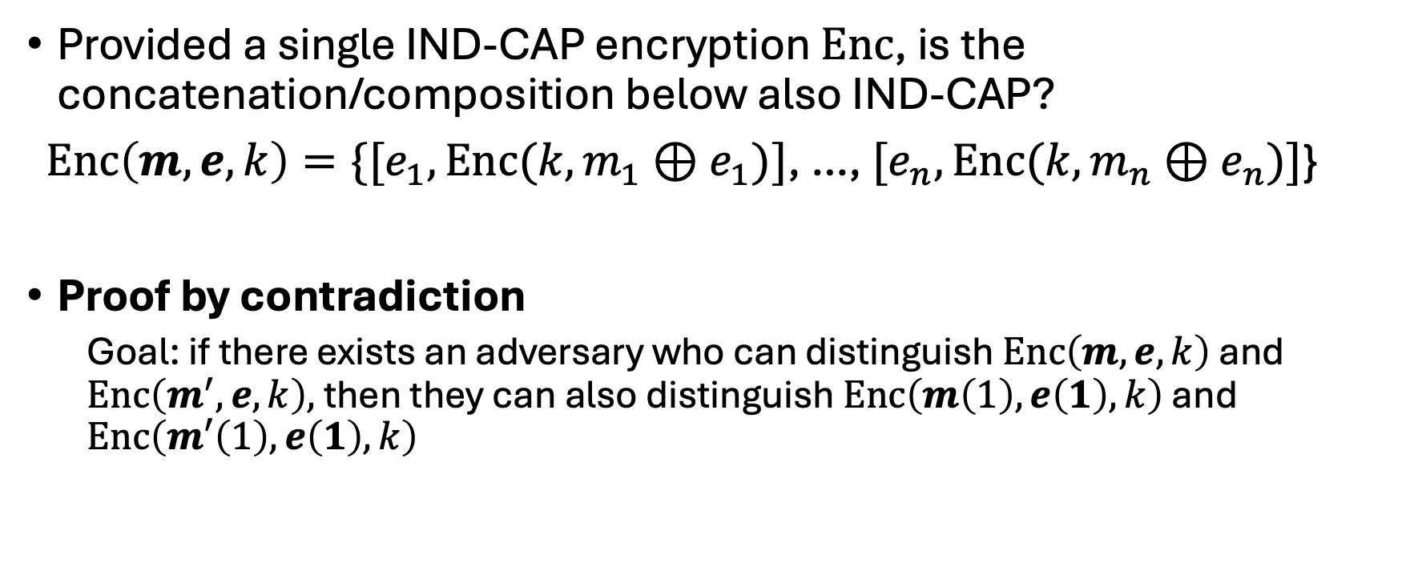
Initialization Vector and One-time Padding
Provided a single IND-CAP encryption $Enc$, is the concatenation/composition below also IND-CAP?
$Enc\left(m,e,k\right)=\{{[e}_{1},Enc(k,m_{1}⊕e_{1})]$, …, ${[e}_{n},Enc(k,m_{n}⊕e_{n})]$}
Proof by contradiction
Goal: if there exists an adversary who can distinguish $Enc\left(m,e,k\right)$ and $Enc\left(m^{′},e,k\right),$ then they can also distinguish $Enc\left(m\left(1\right),e\left(1\right),k\right)$ and $Enc\left(m′\left(1\right),e\left(1\right),k\right)$

