Slide 1
Purdue CS555: Cryptography Lecture 3
Instructor: Hanshen Xiao
Teaching Assistant: Justin He
course website: https://cs55500.github.io/

Slide 2
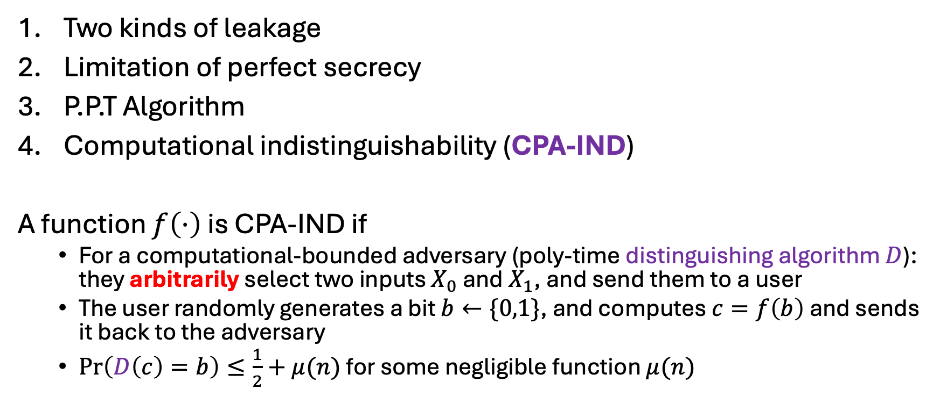
Recap
Two kinds of leakage
Limitation of perfect secrecy
P.P.T Algorithm
Computational indistinguishability (CPA-IND)
A function $f\left(⋅\right)$ is CPA-IND if
For a computational-bounded adversary (poly-time distinguishing algorithm $D$): they arbitrarily select two inputs $X_{0}$ and $X_{1}$, and send them to a user
The user randomly generates a bit $b←\{0,1\}$, and computes $c=f\left(b\right)$ and sends it back to the adversary
$\operatorname{Pr}\left(D\left(c\right)=b\right)≤\frac{1}{2}+μ(n)$ for some negligible function $μ(n)$

Slide 3
Recap
3. One-time pad
4. Initial Vector Technique – encrypting multiple messages with deterministic IND-CPA function with a same key:
Randomizing secret massages with fresh one-time pad and including one-time pad in the message to enable decryption

Slide 4
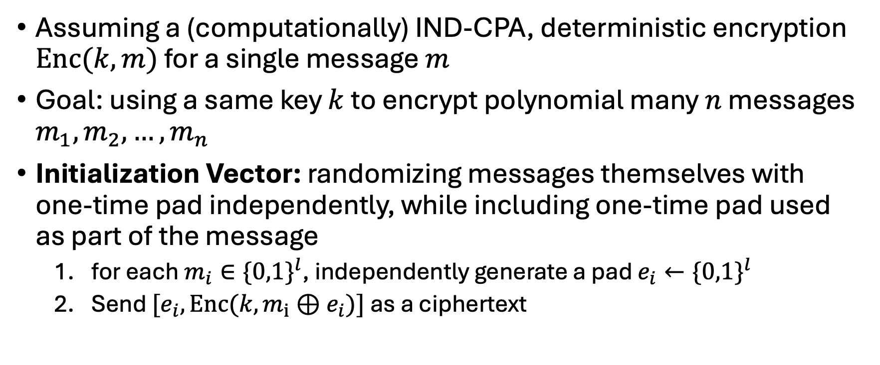
Initialization Vector and One-time Padding
Assuming a (computationally) IND-CPA, deterministic encryption $Enc(k,m)$ for a single message $m$
Goal: using a same key $k$ to encrypt polynomial many $n$ messages $m_{1},m_{2},…,m_{n}$
Initialization Vector: randomizing messages themselves with one-time pad independently, while including one-time pad used as part of the message
for each $m_{i}∈{\{0,1\}}^{l}$, independently generate a pad $e_{i}←{\{0,1\}}^{l}$
Send ${[e}_{i},Enc(k,m_{i}⊕e_{i})]$ as a ciphertext

Slide 5
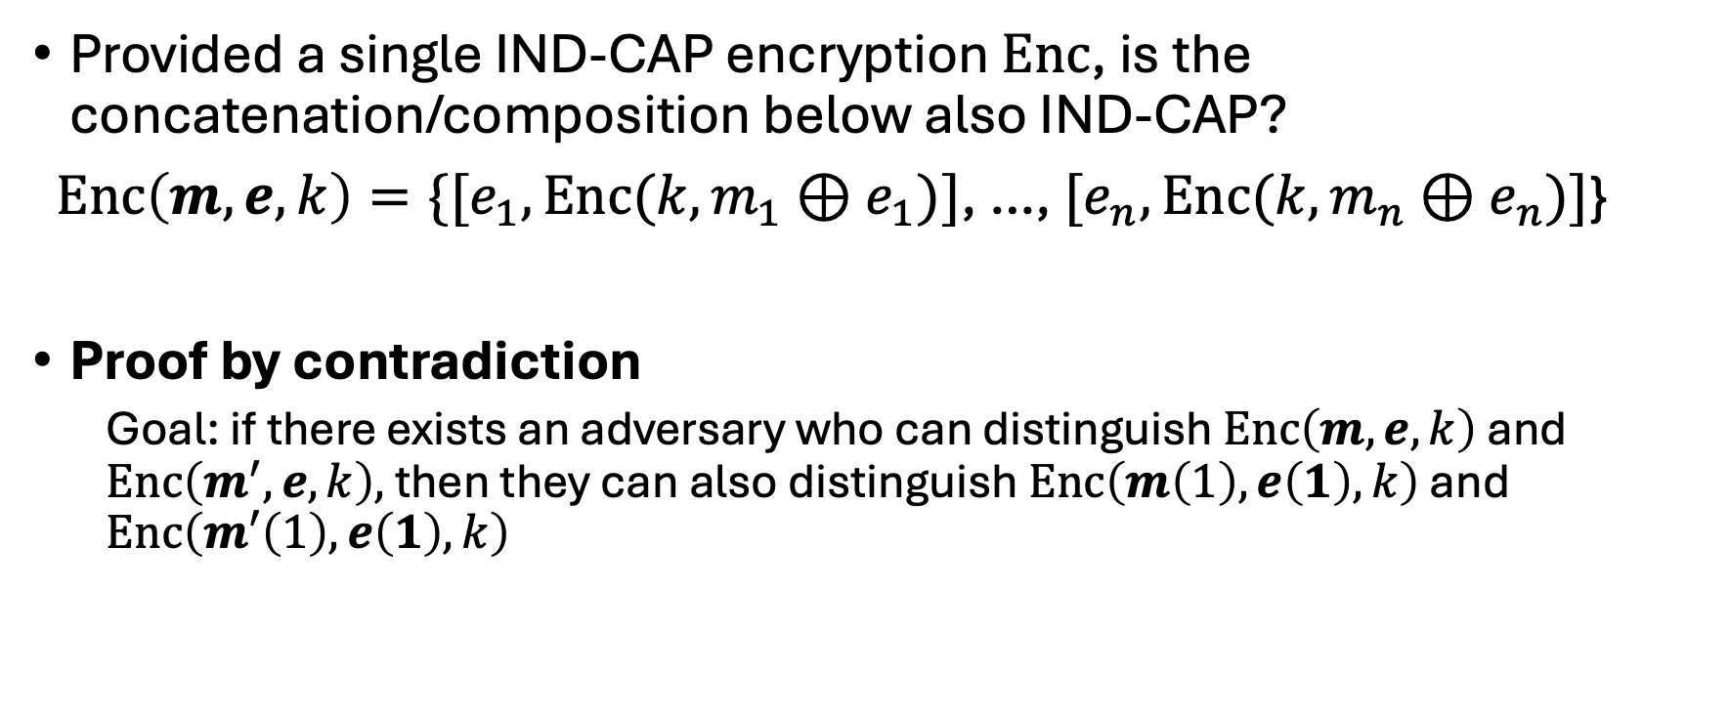
Initialization Vector and One-time Padding
Provided a single IND-CAP encryption $Enc$, is the concatenation/composition below also IND-CAP?
$Enc\left(m,e,k\right)=\{{[e}_{1},Enc(k,m_{1}⊕e_{1})]$, …, ${[e}_{n},Enc(k,m_{n}⊕e_{n})]$}
Proof by contradiction
Goal: if there exists an adversary who can distinguish $Enc\left(m,e,k\right)$ and $Enc\left(m^{′},e,k\right),$ then they can also distinguish $Enc\left(m\left(1\right),e\left(1\right),k\right)$ and $Enc\left(m′\left(1\right),e\left(1\right),k\right)$

Slide 6
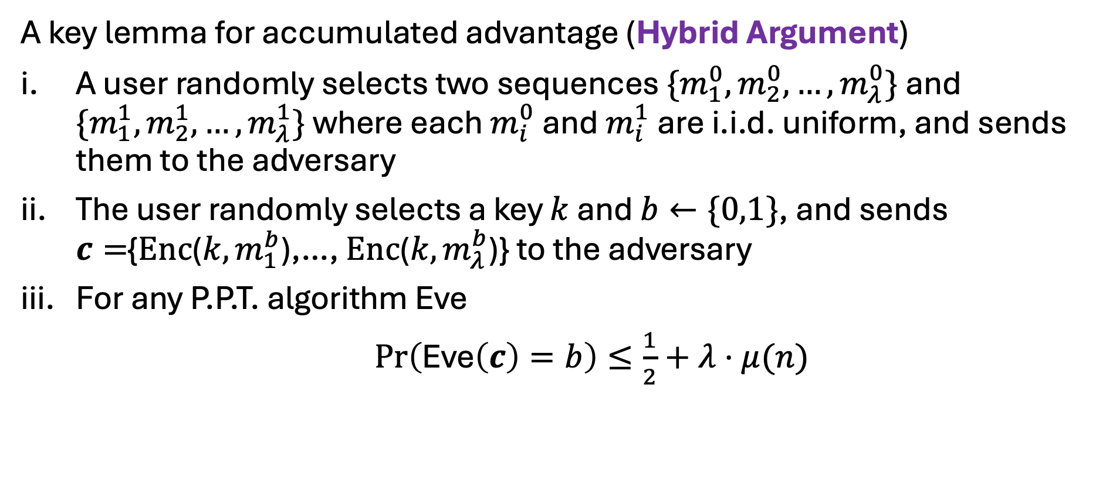
Initialization Vector and One-time Padding
A key lemma for accumulated advantage (Hybrid Argument)
A user randomly selects two sequences $\{m_{1}^{0},m_{2}^{0},…,m_{λ}^{0}\}$ and $\{m_{1}^{1},m_{2}^{1},…,m_{λ}^{1}\}$ where each $m_{i}^{0}$ and $m_{i}^{1}$ are i.i.d. uniform, and sends them to the adversary
The user randomly selects a key $k$ and $b←\{0,1\}$, and sends $c=${$Enc$($k,m_{1}^{b}$),…, $Enc$($k,m_{λ}^{b}$)} to the adversary
For any P.P.T. algorithm Eve
$\operatorname{Pr}\left(\text{Eve}\left(c\right)=b\right)≤\frac{1}{2}+λ⋅μ(n)$

Slide 7
Today
Pseudorandom Generator (PRG)
One bit to (poly) many bits
Equivalence to Next-bit Unpredictability (UBN)
Hybrid Argument

Slide 8

Pseudorandom Generators (PRG) -- Our first cryptographic tool
Deterministic programs that stretch a “truly random” seed into a (much) longer sequence of “seemingly random” bits.
Given $l$ true random bits, they can extend them to Poly($l$) bits
Indistinguishable from the true randomness

Slide 9




Pseudorandom Generators (PRG) -- Our first cryptographic tool
WORLD 1: The Pseudorandom World
WORLD 2: The Truly Random World
$$y←G\left(1^{n}\right)$$
$$y←1^{m}$$
PPT Distinguisher gets $y$ but cannot tell which world she is in
Notation: $1^{n}$ (resp. $1^{m}$) denotes the random distribution on n-bit (resp. m-bit) strings; m is shorthand for m (n).

Slide 10
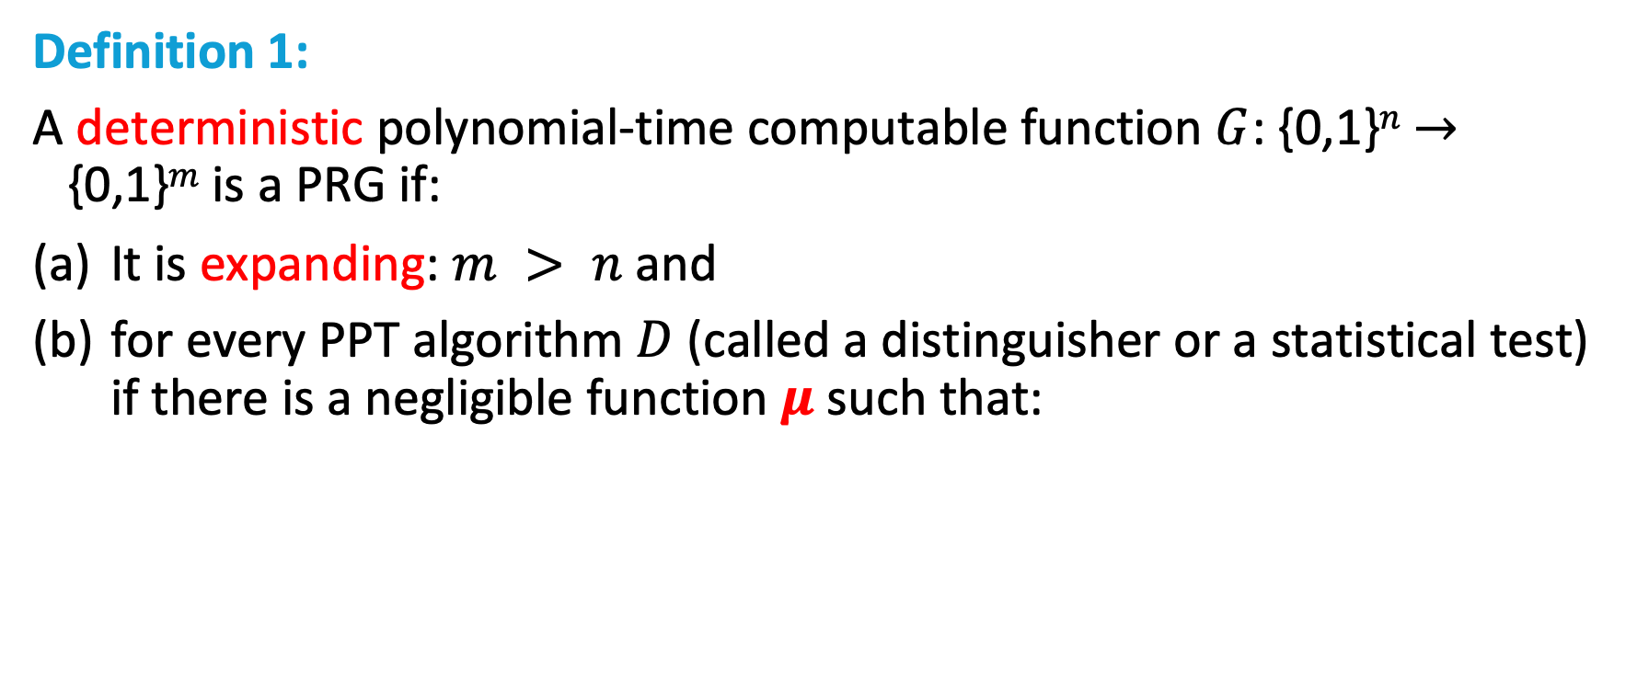
PRG Def 1 (Indistinguishability)
Definition 1:
A deterministic polynomial-time computable function $G$: {0,1}$n$ $→$ {0,1}$m$ is a PRG if:
It is expanding: $m > n$and
for every PPT algorithm $D$ (called a distinguisher or a statistical test) if there is a negligible function $μ$ such that:
$$| Pr⁡[ D(G(1^{n})) = 1 ] – Pr⁡[ D(1^{m}) = 1 ] | =μ(n)$$

Slide 11

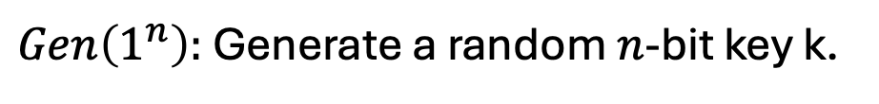
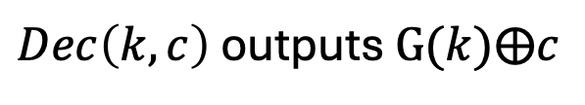

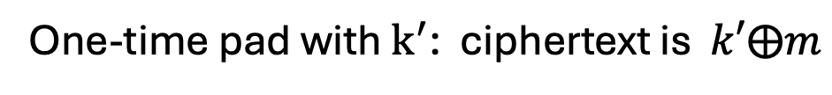
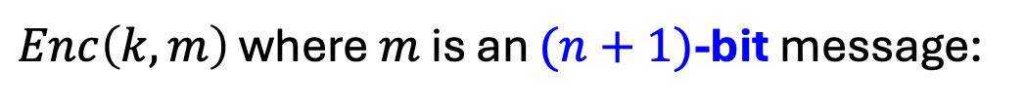
Overcoming Shannon’s Conundrum -- Encrypting $(n+1)$-bit with $n$-bit key
$Gen\left(1^{n}\right):$ Generate a random $n$-bit key k.
$Enc\left(k,m\right)$ where $m$ is an $(n+1)$-bit message:
Expand k into a $(n+1)$-bit pseudorandom string $k^{′}= G(k)$
One-time pad with $k^{′}$: ciphertext is $k′⨁m$
$Dec\left(k,c\right)$ outputs $G(k)⨁c$
$$Correctness:$$
$Dec\left(k,c\right)$ outputs $G\left(k\right)⨁c=G\left(k\right)⨁G\left(k\right)⨁m=m$

Slide 12

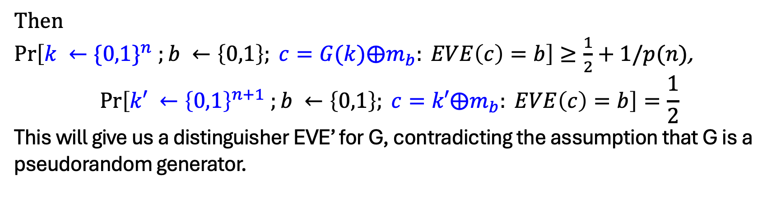
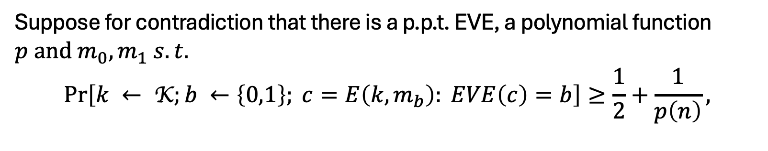
Overcoming Shannon’s Conundrum -- Encrypting $(n+1)$-bit with $n$-bit key
$$Security (Your First Reduction):$$
Suppose for contradiction that there is a p.p.t. EVE, a polynomial function $p and m_{0},m_{1} s.t.$
$$\operatorname{Pr}\left[k ← \text{K};b ←\left\{0,1\right\}; c=E\left(k,m_{b}\right): EVE\left(c\right)=b\right]≥\frac{1}{2}+\frac{1}{p\left(n\right)},$$
Then
$\operatorname{Pr}\left[k ←{\{0,1\}}^{n} ;b ←\left\{0,1\right\}; c=G(k)⨁m_{b}: EVE\left(c\right)=b\right]≥\frac{1}{2}+1/p(n)$,
$$\operatorname{Pr}\left[k′ ←{\left\{0,1\right\}}^{n+1} ;b ←\left\{0,1\right\}; c=k′⨁m_{b}: EVE\left(c\right)=b\right]=\frac{1}{2}$$
This will give us a distinguisher EVE’ for G, contradicting the assumption that G is a pseudorandom generator.

Slide 13
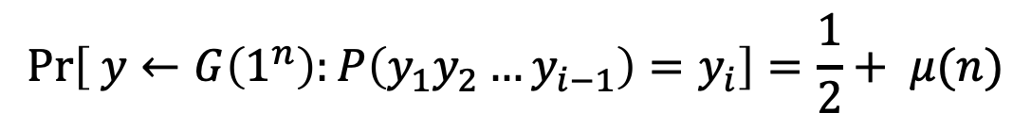
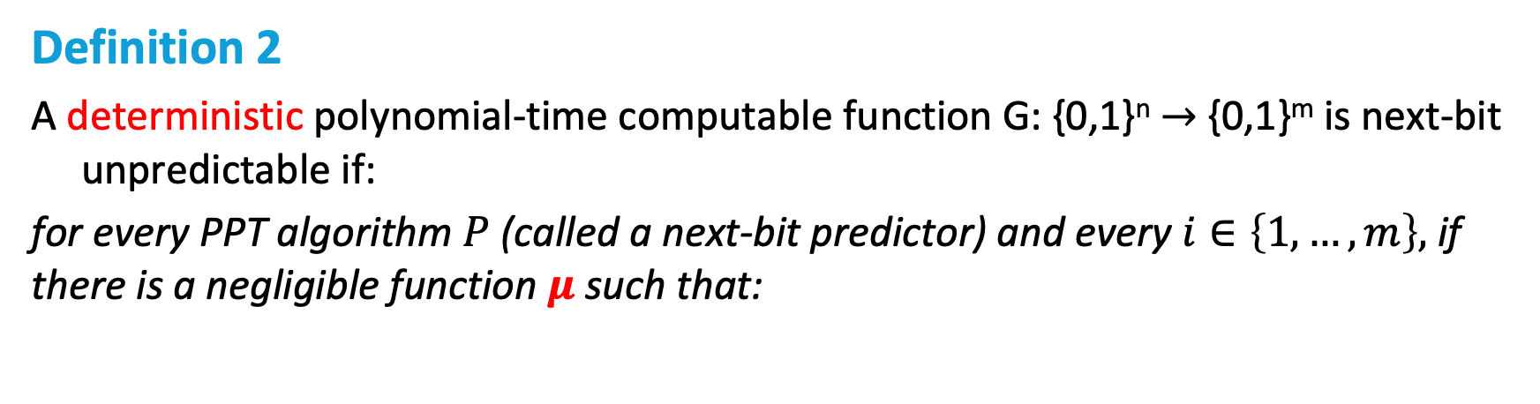
PRG Def 1 (Next-bit Unpredictability)
Definition 2
A deterministic polynomial-time computable function G: {0,1}^{n} $→$ {0,1}^{m} is next-bit unpredictable if:
for every PPT algorithm $P$ (called a next-bit predictor) and every $i∈\left\{1,…,m\right\},$ if there is a negligible function $μ$ such that:
$$\operatorname{Pr}\left[ y←G\left(1^{n}\right):P\left(y_{1}y_{2}…y_{i−1}\right)=y_{i}\right]=\frac{1}{2}+ μ(n)$$

Slide 14
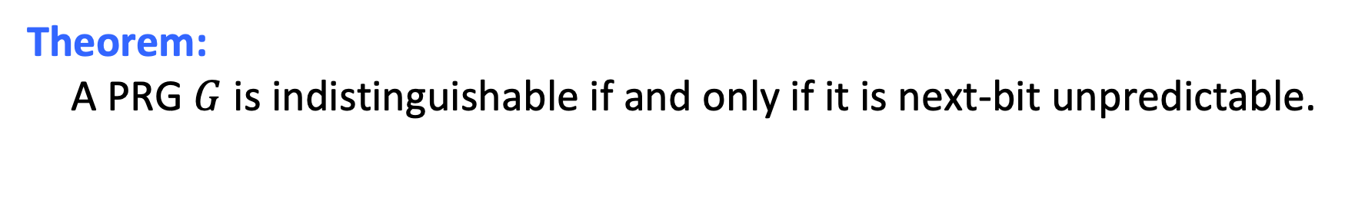
Def 1 and Def 2 are Equivalent
Theorem: A PRG $G$ is indistinguishable if and only if it is next-bit unpredictable.
Next-bit Unpredictability (NBU): Seemingly much weaker requirement. Only says that next bit predictors, a particular type of distinguishers, cannot succeed. Yet, surprisingly, Next-bit Unpredictability (NBU) = Indistinguishability.
NBU often much easier to use.

Slide 15
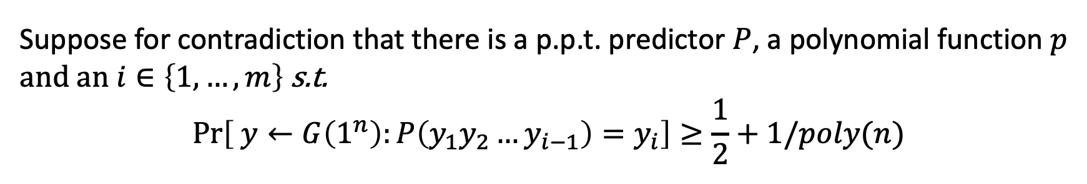

Indistinguishability $⟹$ NBU
Proof: by contradiction.
Suppose for contradiction that there is a p.p.t. predictor $P$, a polynomial function $p$ and an $i∈\left\{1,…,m\right\}$ s.t.
$$\operatorname{Pr}\left[ y←G\left(1^{n}\right):P\left(y_{1}y_{2}…y_{i−1}\right)=y_{i}\right]≥\frac{1}{2}+1/poly(n)$$
Then, I claim that $P$ essentially gives us a distinguisher $D$!
Consider $D$ which gets an m-bit string $y$ and does the following:
1. Run $P$ on the $(i−1)$-bit prefix $y_{1}y_{2}…y_{i−1}$.
2. If $P$ returns the $i$-th bit $y_{i}$, then output 1 (“PRG”) else output 0 (“Random”).
If $P$ is p.p.t. so is $D$.

Slide 16
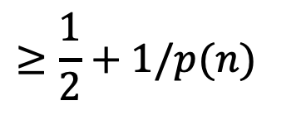
Indistinguishability $⟹$ NBU
Proof: by contradiction.
Suppose for contradiction that there is a p.p.t. predictor $P$, a polynomial function $p$ and an $i∈\left\{1,…,m\right\}$ s.t.
$$\operatorname{Pr}\left[ y←G\left(1^{n}\right):P\left(y_{1}y_{2}…y_{i−1}\right)=y_{i}\right]≥\frac{1}{2}+1/poly(n)$$
$$= Pr⁡[y←G\left(1^{n}\right): P\left(y_{1}y_{2}…y_{i−1}\right)=y_{i}]$$
Then, $Pr⁡[y←G\left(1^{n}\right): D(y) =1 ]$
$$≥\frac{1}{2}+1/p(n)$$
(by assumption on P)
$\operatorname{Pr}\left[y←1^{m} : D\left(y\right)=1 \right]=\frac{1}{2}$, a non-negligible gap!

Slide 17


NBU $⟹$Indistinguishability
Proof: by contradiction (again!)
Suppose for contradiction that there is a distinguisher $D$, and a polynomial function $p$ s.t.
$| Pr⁡[y←G\left(1^{n}\right): D(y) =1 ]$ $– Pr⁡[y←1^{m}: D(y) =1 ] |≥\frac{1}{p^{′}\left(n\right)}=ε$
I want to construct a next bit predictor $P$ out of $D$.
TWO STEPS:
STEP 1: HYBRID ARGUMENT
STEP 2: From Distinguishing to Predicting

Slide 18


Averaging Argument (Pigeonhole Lemma)
Lemma: Let $p_{0},p_{1},p_{2},…,p_{m}$ be real numbers s.t.
$$p_{m}−p_{0}≥ε.$$
Then, there is an index $i$ such that $p_{i}−p_{i−1}$ $≥ε/m$.
Proof:
$p_{m}−p_{0}=\left(p_{m}−p_{m−1}\right)+\left(p_{m−1}−p_{m−2}\right)+…+(p_{1}−p_{0}$)
$$≥ε$$
At least one of the $m$ terms has to be at least $ε/m$ (averaging).

Slide 19
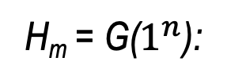
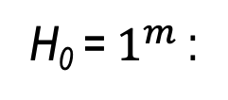
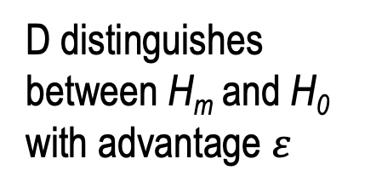
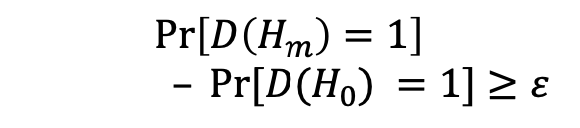
Define Hybrid Distributions
random
pseudorandom
H₀ = $1^{m}$:
...
...
H_{i-1}:
D distinguishes between H_{m} and H₀ with advantage $ε$
H_{i}:
...
$$\operatorname{Pr}\left[D\left(H_{m}\right)=1\right]$$
$– Pr⁡[D(H_{0}) =1]≥ε$
...
H_{m-1}:
H_{m} = G($1^{n}$):

Slide 20
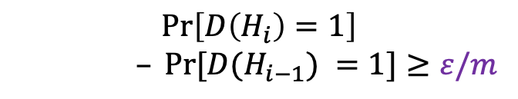

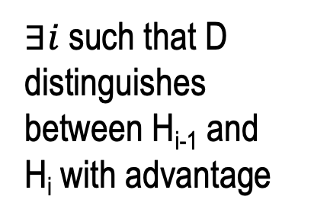
Define Hybrid Distributions
random
pseudorandom
H₀ = $1^{m}$:
$∃i$such that D distinguishes between H_{i-1} and H_{i} with advantage
...
...
H_{i-1}:
$$≥ε/m$$
H_{i}:
$$\operatorname{Pr}\left[D\left(H_{i}\right)=1\right]$$
$– Pr⁡[D(H_{i−1}) =1]≥ε/m$
...
...
H_{m-1}:
H_{m} = G($1^{n}$):

Slide 21
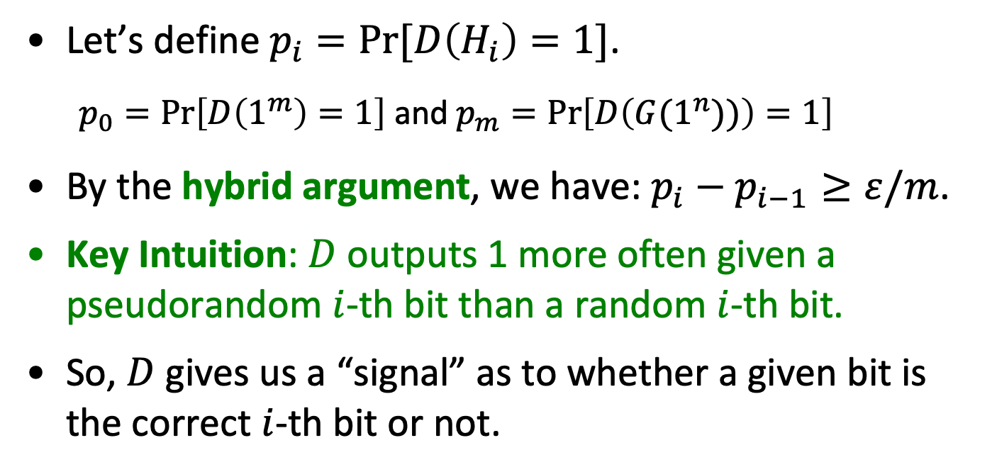

random
pseudorandom
H_{i-1}:
$≥$ $ε/m$
H_{i}:
Let’s define $p_{i}=Pr⁡[D\left(H_{i}\right)=1]$.
$p_{0}=\operatorname{Pr}\left[D\left(1^{m}\right)=1\right]$ and $p_{m}=\operatorname{Pr}\left[D\left(G(1^{n}))\right)=1\right]$
By the hybrid argument, we have: $p_{i}−p_{i−1}≥ε/m$.
Key Intuition: $D$ outputs 1 more often given a pseudorandom $i$-th bit than a random $i$-th bit.
So, $D$ gives us a “signal” as to whether a given bit is the correct $i$-th bit or not.

Slide 22







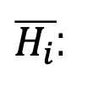





random
We know: $p_{i}−p_{i−1}≥ε/m$.
pseudorandom
$$\overline{p_{i}}$$
H_{i-1}:
$$u$$
$p_{i−1}$
$$p:Pr⁡[D\left(H\right)=1]$$
H_{i}:
$$y_{i}$$
$p_{i}$
Claim: $p_{i−1}=(p_{i}+\overline{p_{i}})/2$
Define
Corollary (*): $p_{i}−\overline{p_{i}}≥2ε/m$.
$\overline{H_{i}}$:
$$\overline{y_{i} }$$
$u:$ random bit
So, Takeaway: D says “1” more often when fed with the “right bit” than the “wrong bit”.
$y_{i}:$ i-th pseudorandom bit
$$\overline{p_{i}}=Pr[D\left(\overline{H_{i}}\right)=1]$$
$$\overline{y_{i} }=1−y_{i}$$

Slide 23

Predictor P
Idea: The predictor is given the first $i−1$ pseudorandom bits (call it $y_{1}y_{2}…y_{i−1}$) and needs to guess the $i$-th bit.
The Predictor P works as follows:
1. Pick a random bit $b;$
2. $F$eed $D$ with input$y_{1}y_{2}…y_{i−1}\left| b \right| u_{i+1}$… $u_{m}$ ($u$’s are random)
3. If $D$ says “1”, output $b$ as the prediction for $y_{i}$and if $D$ says “0”, output $\overline{b} \text{as} \text{the} \text{prediction} \text{for} y_{i}$

Slide 24
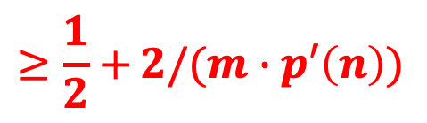
Predictor P
$$\operatorname{Pr}\left[x←{\left\{0,1\right\}}^{n};y=G(x):P\left(y_{1}y_{2}…y_{i−1}\right)=y_{i}\right]$$
$$=\operatorname{Pr}\left[D\left(y_{1}y_{2}…y_{i−1}b…\right)=1| b=y_{i}\right]\operatorname{Pr}\left[b=y_{i}\right]+$$
$$Pr⁡\left[D\left(y_{1}y_{2}…y_{i−1}b…\right)=0| b≠y_{i}\right]\operatorname{Pr}\left[b≠y_{i}\right]$$
$$=\frac{1}{2}(Pr{[D\left(y_{1}y_{2}…y_{i−1}b…\right)=1| b=y_{i}]+ }Pr⁡\left[D\left(y_{1}y_{2}…y_{i−1}b…\right)=0| b≠y_{i}\right])$$
$$=\frac{1}{2}(Pr\left[D\left(y_{1}y_{2}…y_{i−1}y_{i}…\right)=1\right]+ Pr⁡\left[D\left(y_{1}y_{2}…y_{i−1}\overline{y_{i}}…\right)=0\right])$$
$$=\frac{1}{2}(Pr\left[D\left(y_{1}y_{2}…y_{i−1}y_{i}…\right)=1\right]+1− Pr⁡\left[D\left(y_{1}y_{2}…y_{i−1}\overline{y_{i}}…\right)=1\right])$$
$$≥\frac{1}{2}+{2/(m∙p′\left(n\right))}$$

Slide 25

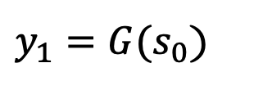

From 1-bit to Many-bit Extension
Let $G$: ${\{0,1\}}^{n} →{\{0,1\}}^{n+1}$ be a pseudorandom generator.
Goal: use $G$ to generate poly many pseudorandom bits.
Construction of G’($s_{0}$)
$${seed=s}_{0}$$
$y_{1}=G(s_{0}$)
G

Slide 26

From 1-bit to Many-bit Extension
Let $G$: ${\{0,1\}}^{n} →{\{0,1\}}^{n+1}$ be a pseudorandom generator.
Goal: use $G$ to generate poly many pseudorandom bits.
Construction of G’($s_{0}$)
$${seed=s}_{0}$$
$$y_{1}{=G(s_{0}\text{)}=b}_{1}||{ s}_{1}$$
G

Slide 27









From 1-bit to Many-bit Extension
Let $G$: ${\{0,1\}}^{n} →{\{0,1\}}^{n+1}$ be a pseudorandom generator.
Goal: use $G$ to generate poly many pseudorandom bits.
Construction of G’($s_{0}$)
Output $b_{1}$ $b_{2}$ $b_{3}$ $b_{4}$ $b_{5}$ $…s_{L}.$
$${seed=s}_{0}$$
$$s_{1}$$
$$s_{2}$$
$$s_{L−1}$$
$$s_{L}$$
$$…$$
G
G
G
G
$$b_{1}$$
$$b_{2}$$
$$b_{L−1}$$
$$b_{L}$$

Slide 28
From 1-bit to Many-bit Extension
Proof of Security:
next-bit unpredictability + hybrid argument
Construction of G’($s_{0}$)
Output $b_{1}$ $b_{2}$ $b_{3}$ $b_{4}$ $b_{5}$ $…s_{L}.$
$${seed=s}_{0}$$
$$s_{1}$$
$$s_{2}$$
$$s_{L−1}$$
$$s_{L}$$
$$…$$
G
G
G
G
$$b_{1}$$
$$b_{2}$$
$$b_{L−1}$$
$$b_{L}$$

