Slide 1
Purdue CS555: Cryptography Lecture 14
Instructor: Hanshen Xiao
Teaching Assistant: Justin He
course website: https://cs55500.github.io/

Slide 2
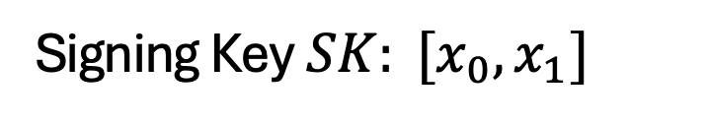
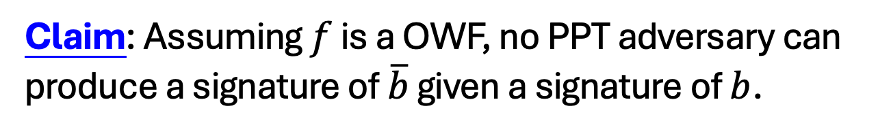

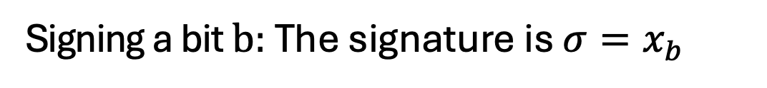
Lamport (One-time) Signatures
How to sign a bit
Signing Key $SK: [x_{0},x_{1}]$
Verification Key $VK: [y_{0}=f(x_{0}),{y_{1}=f(x}_{1})]$
Signing a bit $b:$ The signature is ${σ=x}_{b}$
?
Verifying $(b,σ):$ Check if $f\left(σ\right)=y_{b}$
Claim: Assuming $f$ is a OWF, no PPT adversary can produce a signature of $\overline{b}$ given a signature of $b$.
Notes:
No proof here because we will prove the stronger statement in a few slides

Slide 3
Constructing a Signature Scheme
Step 0. Still one-time, but arbitrarily long messages.
Step 1. Many-time: Stateful, Growing Signatures.
Step 2. How to Shrink the signatures.
Step 3. How to Shrink Alice’s storage.
Step 4. How to make Alice stateless.
Step 5 (optional). How to make Alice stateless and deterministic.

Slide 4
Step 0: How to Sign Polynomially Many Bits
(with a fixed verification key)

Slide 5
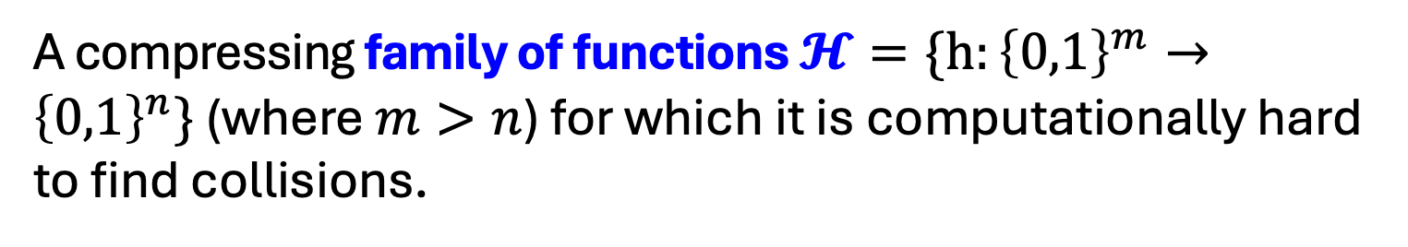
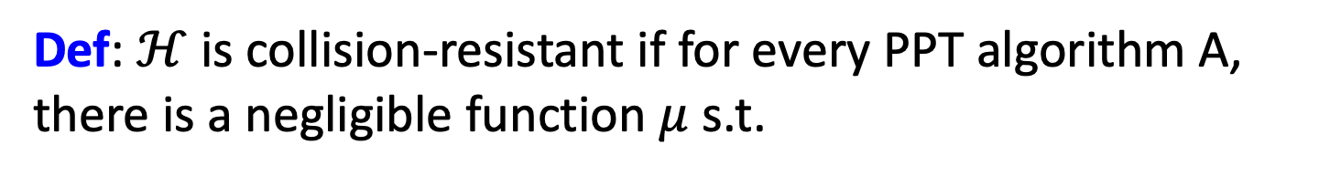
Detour: Collision-Resistant Hash Functions
A compressing family of functions $𝓗=\{h:{\left\{0,1\right\}}^{m}→{\left\{0,1\right\}}^{n}\}$ (where $m>n$) for which it is computationally hard to find collisions.
Def: $ℋ$ is collision-resistant if for every PPT algorithm A, there is a negligible function $μ$ s.t.
$${Pr}_{h←ℋ}\left[A\left(1^{n},h\right)=\left(x,y\right):x≠y, h\left(x\right)=h\left(y\right)\right]=μ(n)$$

Slide 6
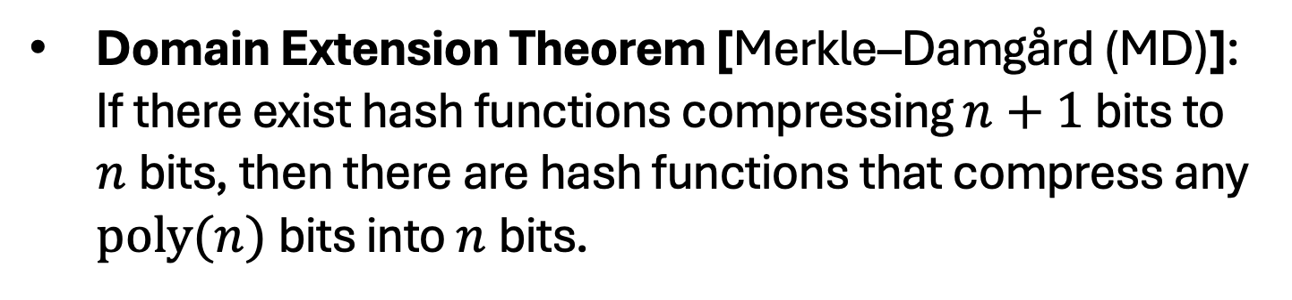
Do CRHFs exist?
Theoretical Constructions: assuming discrete logarithms (as well as under several other number-theoretic assumptions)
Practical Constructions: SHA3.
Domain Extension Theorem [Merkle–Damgård (MD)]: If there exist hash functions compressing $n+1$ bits to $n$bits, then there are hash functions that compress any $poly(n)$bits into $n$bits.

Slide 7

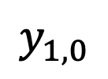
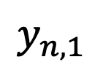
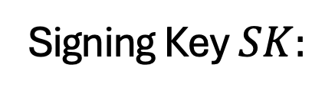






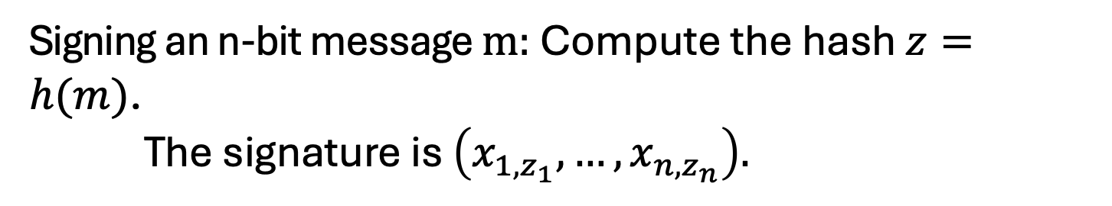



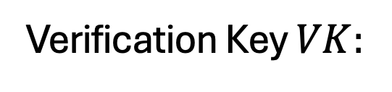


How to Sign Polynomially Many Bits
(with a fixed verification key)
Idea: Hash the message into n bits and sign the hash.
$$x_{1,0}$$
$$x_{2,0}$$
$$x_{n,0}$$
Signing Key $SK:$
$$x_{1,1}$$
$$x_{2,1}$$
$$x_{n,1}$$
$$y_{1,0}$$
$$y_{2,0}$$
$$y_{n,0}$$
Verification Key $VK:$
and $h←𝓗$.
$$y_{1,1}$$
$$y_{2,1}$$
$$y_{n,1}$$
Signing an n-bit message $m:$ Compute the hash $z=h(m)$. The signature is $\left(x_{1,z_{1}},…,x_{n,z_{n}}\right).$
Verifying $(m,σ):$ Recompute the hash $z=h(m)$.
Check if $∀i:f\left(σ_{i}\right)=y_{i,z_{i}}$

Slide 8
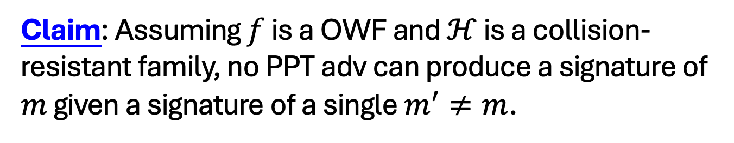
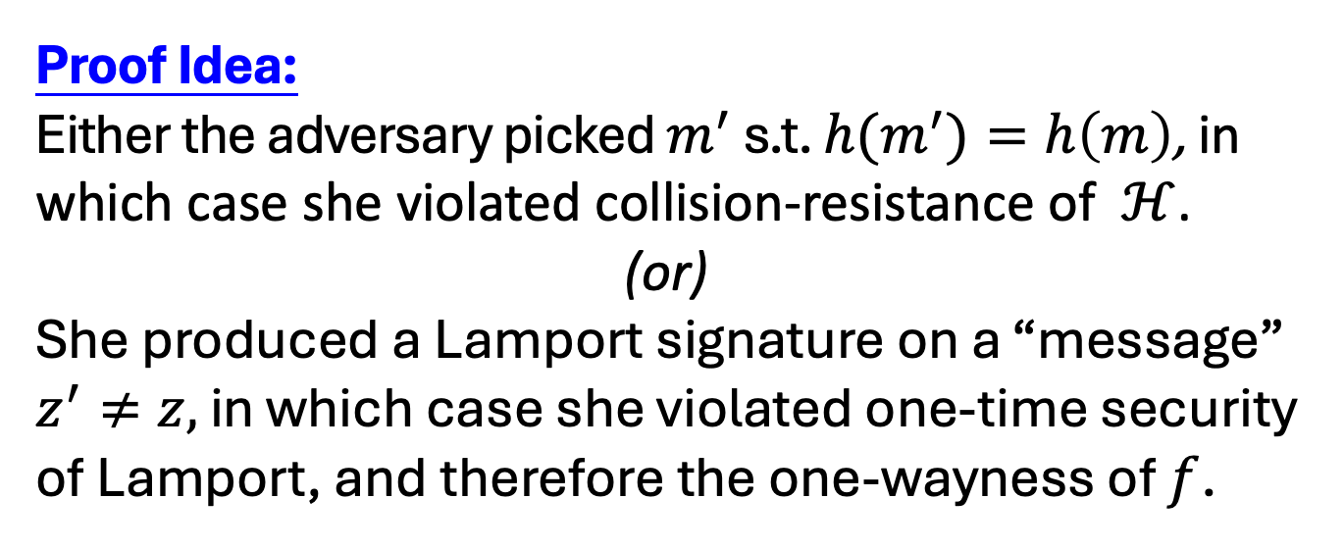
How to Sign Polynomially Many Bits
(with a fixed verification key)
Claim: Assuming $f$ is a OWF and $ℋ$ is a collision-resistant family, no PPT adv can produce a signature of $m$ given a signature of a single $m^{′}≠m$.
Proof Idea:
Either the adversary picked $m^{′}$ s.t. ${h(m}^{′})=h\left(m\right)$, in which case she violated collision-resistance of $ℋ$.
(or)
She produced a Lamport signature on a “message” $z^{′}≠z,$ in which case she violated one-time security of Lamport, and therefore the one-wayness of $f$.

Slide 9
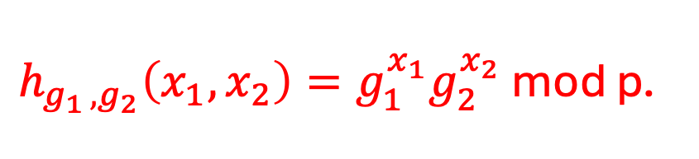
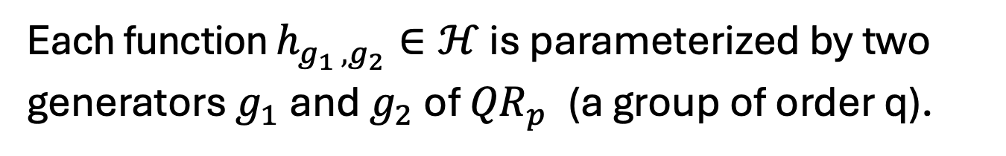
Let’s go back to CRHFs…
$p=2q+1$ is a “safe” prime.
$$ℋ=\{h:{(ℤ_{q})}^{2}→{QR}_{p}^{}\}$$
Each function $h_{g_{1 },g_{2}}∈ℋ$ is parameterized by two generators $g_{1}$ and $g_{2}$ of ${QR}_{p}^{}$ (a group of order q).
$h_{g_{1 },g_{2}}\left(x_{1},x_{2}\right)=g_{1}^{x_{1}}g_{2}^{x_{2}}$ mod p.
This compresses 2 log q bits into log p $≈$ log q + 1 bits.

Slide 10
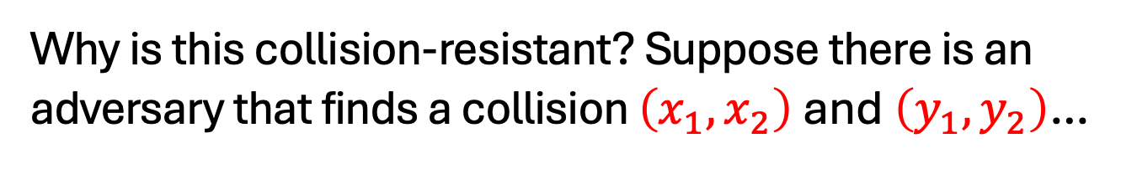
Let’s go back to CRHFs…
$p=2q+1$ is a “safe” prime.
$$ℋ=\{h:{(ℤ_{q})}^{2}→{QR}_{p}^{}\}$$
Each function $h_{g_{1 },g_{2}}∈ℋ$ is parameterized by two generators $g_{1}$ and $g_{2}$ of ${QR}_{p}^{}$ (a group of order q).
$h_{g_{1 },g_{2}}\left(x_{1},x_{2}\right)=g_{1}^{x_{1}}g_{2}^{x_{2}}$ mod p.
Why is this collision-resistant? Suppose there is an adversary that finds a collision $\left(x_{1},x_{2}\right)$ and $\left(y_{1},y_{2}\right)$…

Slide 11
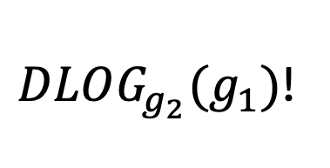
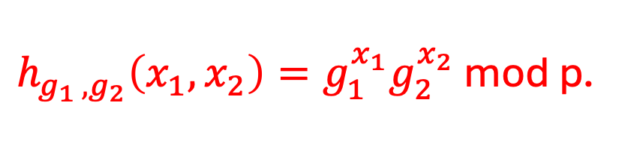
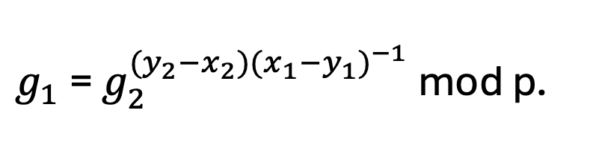
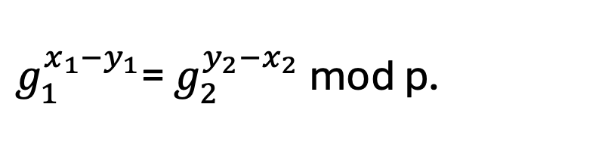
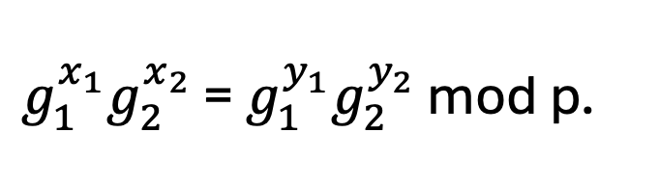

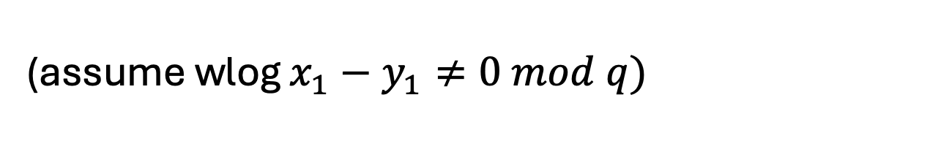
Let’s go back to CRHFs…
$h_{g_{1 },g_{2}}\left(x_{1},x_{2}\right)=g_{1}^{x_{1}}g_{2}^{x_{2}}$ mod p.
Why is this collision-resistant? Suppose there is an adversary that finds a collision $\left(x_{1},x_{2}\right)$ and $\left(y_{1},y_{2}\right)$…
$g_{1}^{x_{1}}g_{2}^{x_{2}}$ = $g_{1}^{y_{1}}g_{2}^{y_{2}}$ mod p.
$g_{1}^{x_{1}−y_{1}}$= $g_{2}^{y_{2}−x_{2}}$ mod p.
(assume wlog $x_{1}−y_{1}≠0 mod q)$
$g_{1}$= $g_{2}^{{(y}_{2}−x_{2}){(x_{1}−y_{1})}^{−1}}$ mod p.
$DLOG_{g_{2}}(g_{1})$!

Slide 12
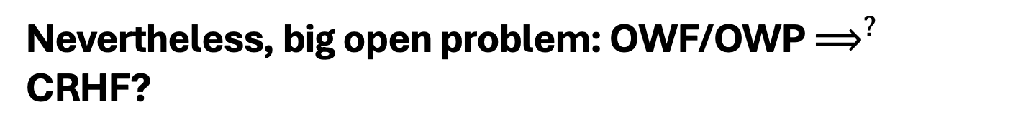
Other Constructions of CRHFs
From the hardness of factoring, lattice problems etc.
Not known to follow from the existence of one-way functions or even one-way permutations…
“Black-box separations”: Certain ways of constructing CRHF from OWF/OWP cannot work.
“Finding collisions on a one-way street”, Daniel Simon, Eurocrypt 1998.
Nevertheless, big open problem: OWF/OWP $⟹^{?}$ CRHF?

Slide 13
So far, only one-time security…

Slide 14
Constructing a Signature Scheme
Theorem [Naor-Yung’89, Rompel’90] (EUF-CMA-secure) Signature schemes exist assuming that one-way functions exist.
TODAY: (EUF-CMA-secure) Signature schemes exist assuming that collision-resistant hash functions exist.

Slide 15
(Many-time) Signature Scheme
In four+ steps
Step 1. Stateful, Growing Signatures. Idea: Signature Chains
Step 2. How to Shrink the signatures. Idea: Signature Trees
Step 3. How to Shrink Alice’s storage. Idea: Pseudorandom Trees
Step 4. How to make Alice stateless. Idea: Randomization
Step 5 (optional). How to make Alice stateless and deterministic. Idea: PRFs.

Slide 16
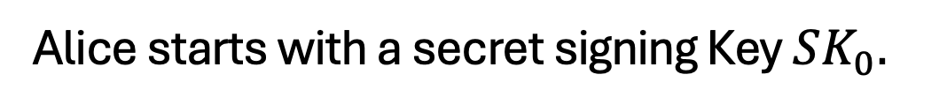


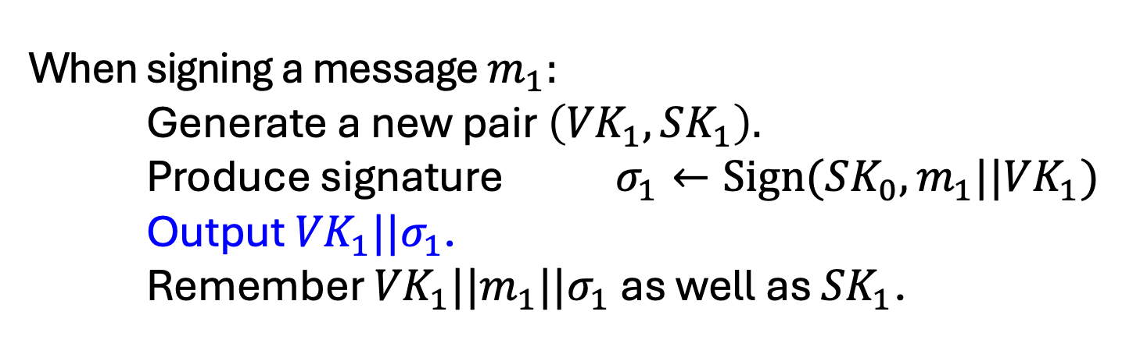
Step 1: Stateful Many-time Signatures
Idea: Signature Chains.
Alice
$$VK_{0}$$
Alice starts with a secret signing Key $SK_{0}.$
When signing a message $m_{1}:$ Generate a new pair $\left({VK}_{1},SK_{1}\right).$
Produce signature $σ_{1}←Sign({SK_{0},m_{1}||VK}_{1})$
Output ${VK}_{1}||σ_{1}$. Remember ${VK}_{1}||{m_{1}||σ}_{1}$ as well as ${SK}_{1}$.
To verify a signature ${VK}_{1}||σ_{1}$ for message $m_{1}:$
Run Verify(${VK}_{0}{,m_{1}||VK}_{1},σ_{1}$)

Slide 17




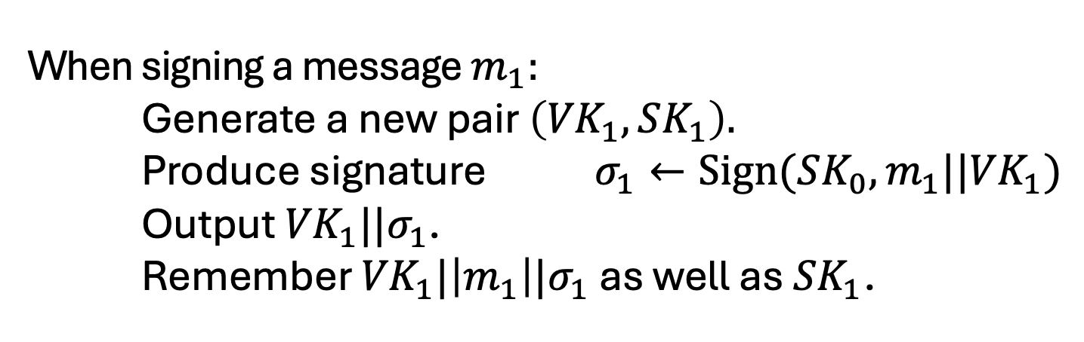
Step 1: Stateful Many-time Signatures
Idea: Signature Chains.
Alice
$$VK_{0}$$
Alice starts with a secret signing Key $SK_{0}.$
When signing a message $m_{1}:$ Generate a new pair $\left({VK}_{1},SK_{1}\right).$
Produce signature $σ_{1}←Sign({SK_{0},m_{1}||VK}_{1})$
Output ${VK}_{1}||σ_{1}$. Remember ${VK}_{1}|\left|m_{1}\right||σ_{1}$ as well as ${SK}_{1}$.
$$m_{1}$$
$$σ_{1}$$
$${VK}_{0}$$
$${VK}_{1}$$

Slide 18
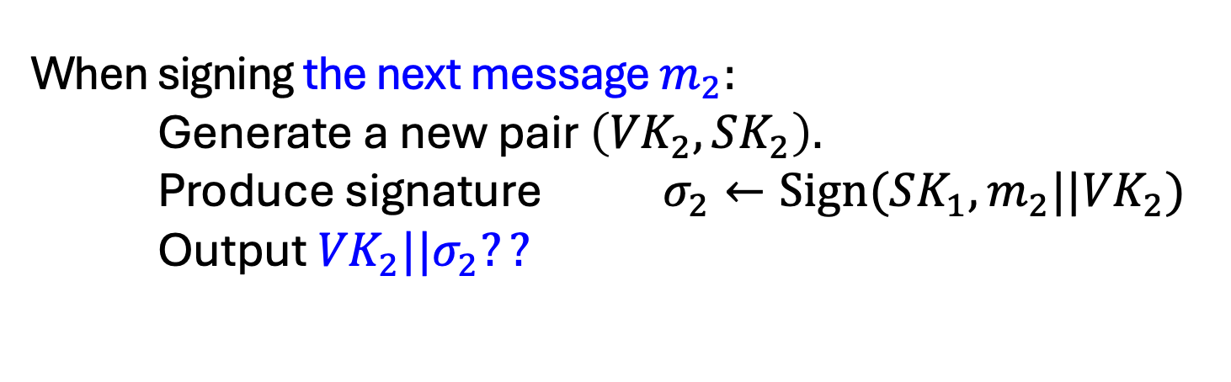
Step 1: Stateful Many-time Signatures
Idea: Signature Chains.
Alice
$$VK_{0}$$
Alice starts with a secret signing Key $SK_{0}.$
When signing the next message $m_{2}:$ Generate a new pair $\left({VK}_{2},SK_{2}\right).$
Produce signature $σ_{2}←Sign({SK_{1},m_{2}||VK}_{2})$
Output ${VK}_{2}||σ_{2}??$
$$m_{1}$$
$$σ_{1}$$
$${VK}_{0}$$
$${VK}_{1}$$

Slide 19
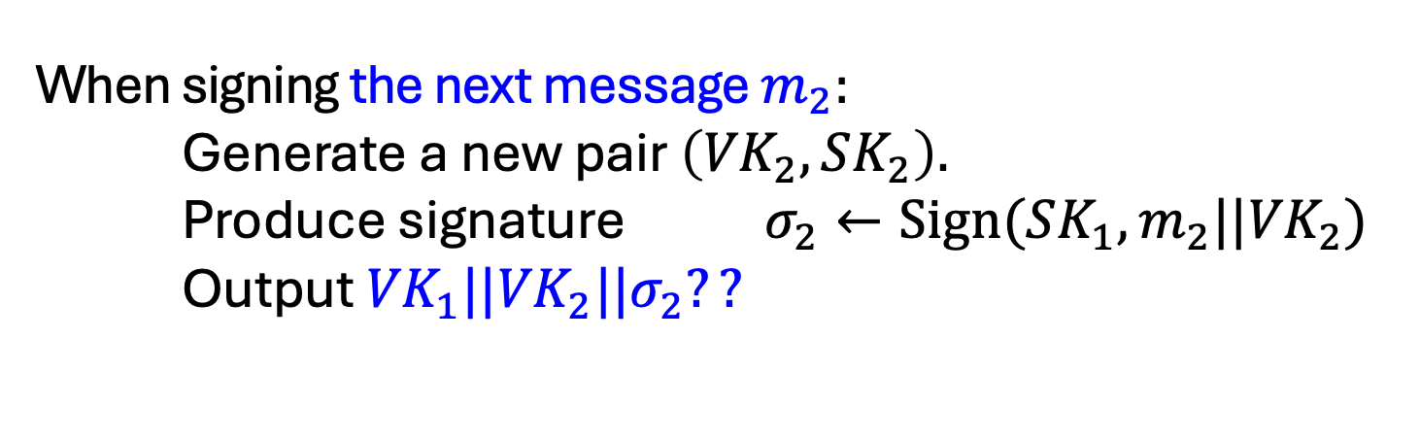
Step 1: Stateful Many-time Signatures
Idea: Signature Chains.
Alice
$$VK_{0}$$
Alice starts with a secret signing Key $SK_{0}.$
When signing the next message $m_{2}:$ Generate a new pair $\left({VK}_{2},SK_{2}\right).$
Produce signature $σ_{2}←Sign({SK_{1},m_{2}||VK}_{2})$
Output ${{VK}_{1}||VK}_{2}||σ_{2}??$
$$m_{1}$$
$$σ_{1}$$
$${VK}_{0}$$
$${VK}_{1}$$

Slide 20








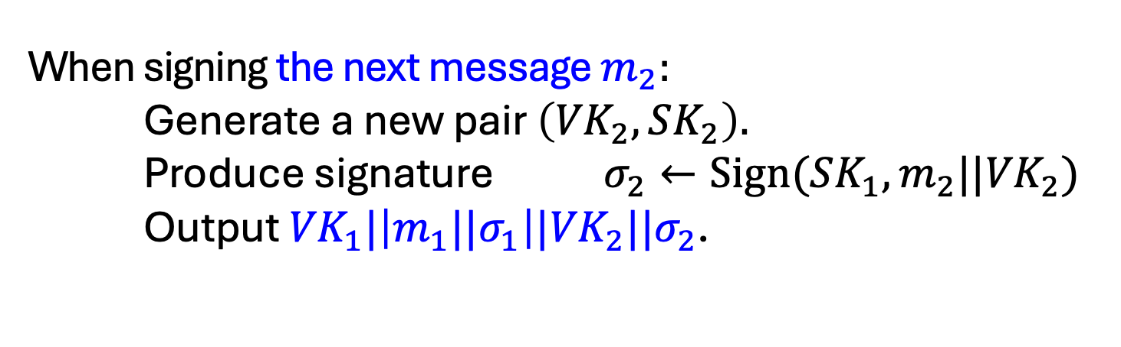


Step 1: Stateful Many-time Signatures
Idea: Signature Chains.
Alice
$$VK_{0}$$
Alice starts with a secret signing Key $SK_{0}.$
When signing the next message $m_{2}:$ Generate a new pair $\left({VK}_{2},SK_{2}\right).$
Produce signature $σ_{2}←Sign({SK_{1},m_{2}||VK}_{2})$
Output ${{VK}_{1}|\left|{m_{1}||σ}_{1}\right||VK}_{2}||σ_{2}$.
$$m_{1}$$
$$m_{2}$$
$$m_{3}$$
$$m_{4}$$
$$σ_{1}$$
$$σ_{2}$$
$$σ_{3}$$
$$σ_{4}$$
$$…$$
$${VK}_{0}$$
$${VK}_{1}$$
$${VK}_{2}$$
$${VK}_{3}$$
$${VK}_{4}$$

Slide 21
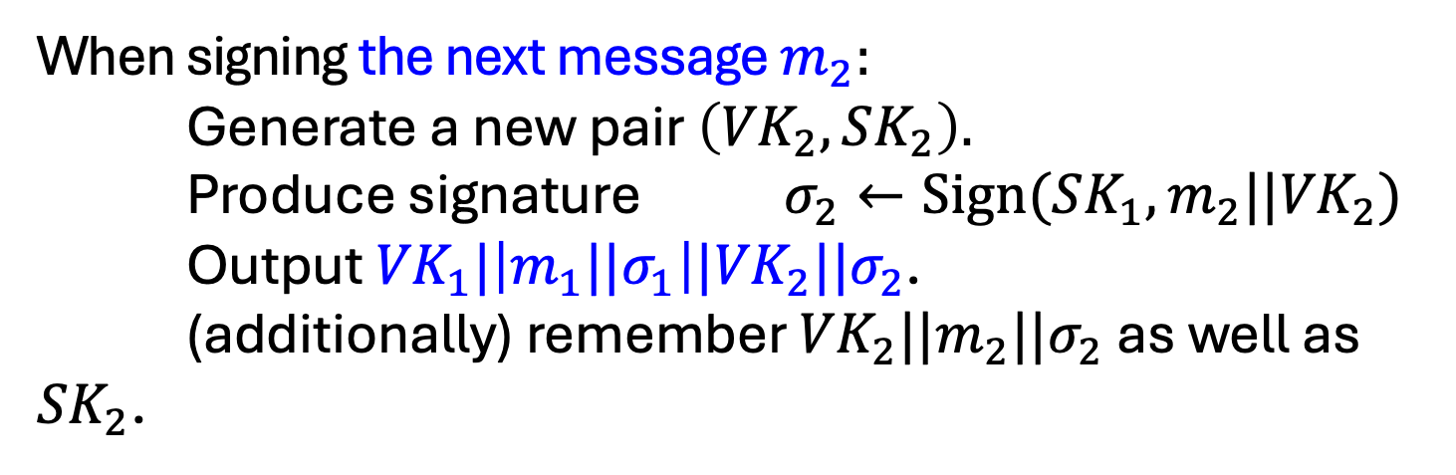
Step 1: Stateful Many-time Signatures
Idea: Signature Chains.
Alice
$$VK_{0}$$
Alice starts with a secret signing Key $SK_{0}.$
When signing the next message $m_{2}:$ Generate a new pair $\left({VK}_{2},SK_{2}\right).$
Produce signature $σ_{2}←Sign({SK_{1},m_{2}||VK}_{2})$
Output ${{VK}_{1}|\left|{m_{1}||σ}_{1}\right||VK}_{2}||σ_{2}$. (additionally) remember ${VK}_{2}||{m_{2}||σ}_{2}$ as well as ${SK}_{2}$.
$$m_{1}$$
$$m_{2}$$
$$m_{3}$$
$$m_{4}$$
$$σ_{1}$$
$$σ_{2}$$
$$σ_{3}$$
$$σ_{4}$$
$$…$$
$${VK}_{0}$$
$${VK}_{1}$$
$${VK}_{2}$$
$${VK}_{3}$$
$${VK}_{4}$$

Slide 22









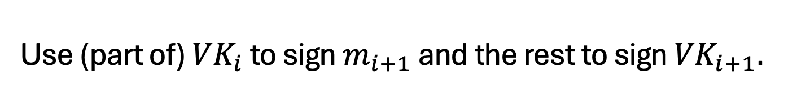
Step 1: Stateful Many-time Signatures
Idea: Signature Chains.
An optimization: Need to remember only the past verification keys, not the past messages.
Use (part of) ${VK}_{i}$ to sign $m_{i+1}$ and the rest to sign ${VK}_{i+1}.$
$$τ_{1}$$
$$m_{1}$$
$$τ_{2}$$
$$m_{2}$$
$$τ_{3}$$
$$m_{3}$$
$$τ_{4}$$
$$m_{4}$$
$$…$$
$$σ_{1}$$
$$σ_{2}$$
$$σ_{3}$$
$$σ_{4}$$
$$…$$
$${VK}_{0}$$
$${VK}_{1}$$
$${VK}_{2}$$
$${VK}_{3}$$
$${VK}_{4}$$

Slide 23
(Many-time) Signature Scheme
In four+ steps
Step 1. Stateful, Growing Signatures. Idea: Signature Chains
Step 2. How to Shrink the signatures. Idea: Signature Trees

Slide 24


Alice
$$VK_{ε}$$
Step 2.
How to Shrink the signatures.
$${VK}_{ε}$$

Slide 25


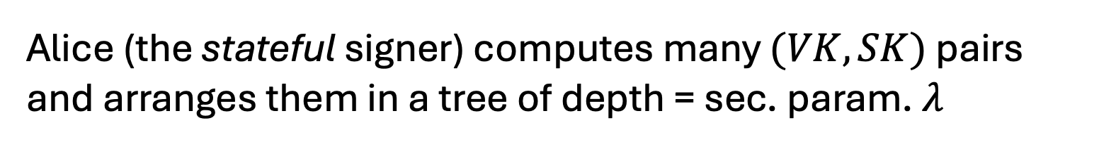












Alice
$$VK_{ε}$$
Step 2.
How to Shrink the signatures.
$${VK}_{ε}$$
$${VK}_{0}$$
$${VK}_{1}$$
$${VK}_{00}$$
$${VK}_{01}$$
$${VK}_{10}$$
$${VK}_{11}$$
$${VK}_{000}$$
$${VK}_{001}$$
$${VK}_{010}$$
$${VK}_{011}$$
$${VK}_{100}$$
$${VK}_{101}$$
$${VK}_{110}$$
$${VK}_{111}$$
Alice (the stateful signer) computes many $(VK,SK)$ pairs and arranges them in a tree of depth = sec. param. $λ$

Slide 26
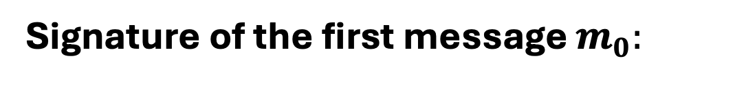






Step 2.
How to Shrink the signatures.
$${VK}_{ε}$$
$${VK}_{0}$$
$$σ_{ε}$$
$${VK}_{1}$$
$$σ_{0}$$
$${VK}_{00}$$
$${VK}_{01}$$
$${VK}_{10}$$
$${VK}_{11}$$
$$σ_{00}$$
$${VK}_{000}$$
$${VK}_{001}$$
$${VK}_{010}$$
$${VK}_{011}$$
$${VK}_{100}$$
$${VK}_{101}$$
$${VK}_{110}$$
$${VK}_{111}$$
$$τ_{0}$$
$$m_{0}$$
Signature of the first message $m_{0}:$
Use ${VK}_{000}$ to sign $m_{0}$.
“Authenticate” ${VK}_{000}$ using the “signature path”.

Slide 27
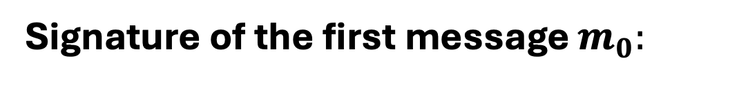
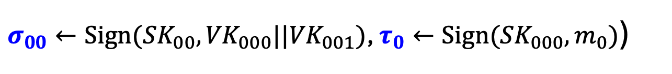
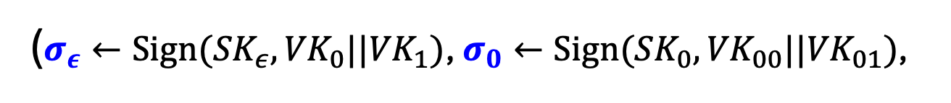
Step 2.
How to Shrink the signatures.
$${VK}_{ε}$$
$${VK}_{0}$$
$$σ_{ε}$$
$${VK}_{1}$$
$$σ_{0}$$
$${VK}_{00}$$
$${VK}_{01}$$
$${VK}_{10}$$
$${VK}_{11}$$
$$σ_{00}$$
$${VK}_{000}$$
$${VK}_{001}$$
$${VK}_{010}$$
$${VK}_{011}$$
$${VK}_{100}$$
$${VK}_{101}$$
$${VK}_{110}$$
$${VK}_{111}$$
$$τ_{0}$$
$$m_{0}$$
Signature of the first message $m_{0}:$
($σ_{ε}←Sign({SK}_{ε},{VK}_{0}||{VK}_{1})$, $σ_{0}←Sign({SK}_{0},{VK}_{00}||{VK}_{01})$,
$σ_{00}←Sign({SK}_{00},{VK}_{000}||{VK}_{001})$, $τ_{0}←Sign({SK}_{000},m_{0})$)

Slide 28

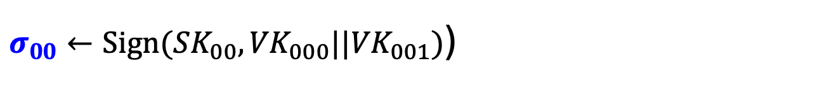
Step 2.
How to Shrink the signatures.
$${VK}_{ε}$$
$${VK}_{0}$$
$$σ_{ε}$$
$${VK}_{1}$$
$$σ_{0}$$
$${VK}_{00}$$
$${VK}_{01}$$
$${VK}_{10}$$
$${VK}_{11}$$
$$σ_{00}$$
$${VK}_{000}$$
$${VK}_{001}$$
$${VK}_{010}$$
$${VK}_{011}$$
$${VK}_{100}$$
$${VK}_{101}$$
$${VK}_{110}$$
$${VK}_{111}$$
$$τ_{0}$$
$$m_{0}$$
Authentication Path for ${VK}_{000}$:
($σ_{ε}←Sign({SK}_{ε},{VK}_{0}||{VK}_{1})$, $σ_{0}←Sign({SK}_{0},{VK}_{00}||{VK}_{01})$,
$σ_{00}←Sign({SK}_{00},{VK}_{000}||{VK}_{001})$)

Slide 29
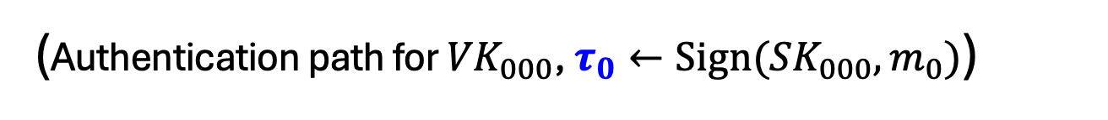
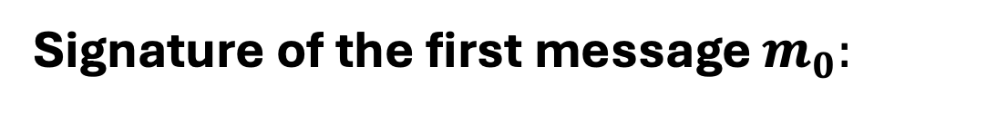
Step 2.
How to Shrink the signatures.
$${VK}_{ε}$$
$${VK}_{0}$$
$$σ_{ε}$$
$${VK}_{1}$$
$$σ_{0}$$
$${VK}_{00}$$
$${VK}_{01}$$
$${VK}_{10}$$
$${VK}_{11}$$
$$σ_{00}$$
$${VK}_{000}$$
$${VK}_{001}$$
$${VK}_{010}$$
$${VK}_{011}$$
$${VK}_{100}$$
$${VK}_{101}$$
$${VK}_{110}$$
$${VK}_{111}$$
$$τ_{0}$$
$$m_{0}$$
Signature of the first message $m_{0}:$
(Authentication path for ${VK}_{000}$, $τ_{0}←Sign({SK}_{000},m_{0})$)

Slide 30


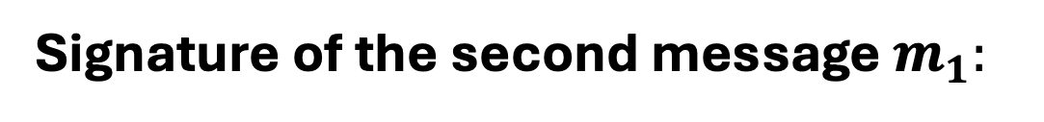

Step 2.
How to Shrink the signatures.
$${VK}_{ε}$$
$${VK}_{0}$$
$$σ_{ε}$$
$${VK}_{1}$$
$$σ_{0}$$
$${VK}_{00}$$
$${VK}_{01}$$
$${VK}_{10}$$
$${VK}_{11}$$
$$σ_{00}$$
$${VK}_{000}$$
$${VK}_{001}$$
$${VK}_{010}$$
$${VK}_{011}$$
$${VK}_{100}$$
$${VK}_{101}$$
$${VK}_{110}$$
$${VK}_{111}$$
$$τ_{1}$$
$$m_{1}$$
Signature of the second message $m_{1}:$
(Authentication path for ${VK}_{001}$, $τ_{0}←Sign({SK}_{001},m_{1})$)

Slide 31


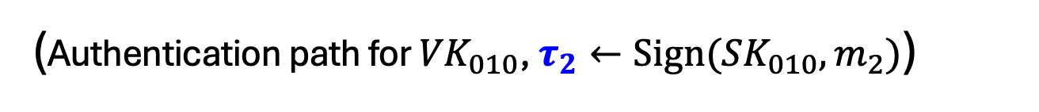
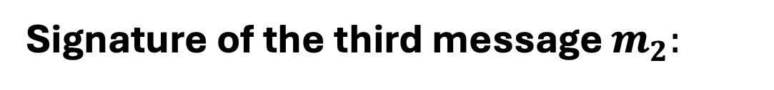

Step 2.
How to Shrink the signatures.
$${VK}_{ε}$$
$${VK}_{0}$$
$$σ_{ε}$$
$${VK}_{1}$$
$$σ_{0}$$
$${VK}_{00}$$
$${VK}_{01}$$
$${VK}_{10}$$
$${VK}_{11}$$
$$σ_{01}$$
$${VK}_{000}$$
$${VK}_{001}$$
$${VK}_{010}$$
$${VK}_{011}$$
$${VK}_{100}$$
$${VK}_{101}$$
$${VK}_{110}$$
$${VK}_{111}$$
$$τ_{2}$$
$$m_{2}$$
Signature of the third message $m_{2}:$
(Authentication path for ${VK}_{010}$, $τ_{2}←Sign({SK}_{010},m_{2})$)

Slide 32

Step 2.
How to Shrink the signatures.
$${VK}_{ε}$$
$${VK}_{0}$$
$$σ_{ε}$$
$${VK}_{1}$$
$$σ_{0}$$
$${VK}_{00}$$
$${VK}_{01}$$
$${VK}_{10}$$
$${VK}_{11}$$
$$σ_{01}$$
$${VK}_{000}$$
$${VK}_{001}$$
$${VK}_{010}$$
$${VK}_{011}$$
$${VK}_{100}$$
$${VK}_{101}$$
$${VK}_{110}$$
$${VK}_{111}$$
$$τ_{2}$$
$$m_{2}$$
GOOD NEWS:
Each verification key (incl. at the leaves) is used only once, so one-time security suffices!

Slide 33
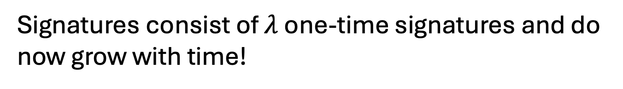
Step 2.
How to Shrink the signatures.
$${VK}_{ε}$$
$${VK}_{0}$$
$$σ_{ε}$$
$${VK}_{1}$$
$$σ_{0}$$
$${VK}_{00}$$
$${VK}_{01}$$
$${VK}_{10}$$
$${VK}_{11}$$
$$σ_{01}$$
$${VK}_{000}$$
$${VK}_{001}$$
$${VK}_{010}$$
$${VK}_{011}$$
$${VK}_{100}$$
$${VK}_{101}$$
$${VK}_{110}$$
$${VK}_{111}$$
$$τ_{2}$$
$$m_{2}$$
GOOD NEWS:
Signatures consist of $λ$ one-time signatures and do now grow with time!

Slide 34

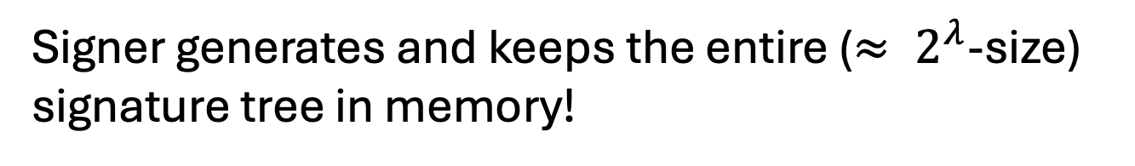
Step 2.
How to Shrink the signatures.
$${VK}_{ε}$$
$${VK}_{0}$$
$$σ_{ε}$$
$${VK}_{1}$$
$$σ_{0}$$
$${VK}_{00}$$
$${VK}_{01}$$
$${VK}_{10}$$
$${VK}_{11}$$
$$σ_{01}$$
$${VK}_{000}$$
$${VK}_{001}$$
$${VK}_{010}$$
$${VK}_{011}$$
$${VK}_{100}$$
$${VK}_{101}$$
$${VK}_{110}$$
$${VK}_{111}$$
$$τ_{2}$$
$$m_{2}$$
BAD NEWS:
Signer generates and keeps the entire ($≈ 2^{λ}$-size) signature tree in memory!

Slide 35
(Many-time) Signature Scheme
In four+ steps
Step 1. Stateful, Growing Signatures. Idea: Signature Chains
Step 2. How to Shrink the signatures. Idea: Signature Trees
Step 3. How to Shrink Alice’s storage. Idea: Pseudorandom Trees

Slide 36



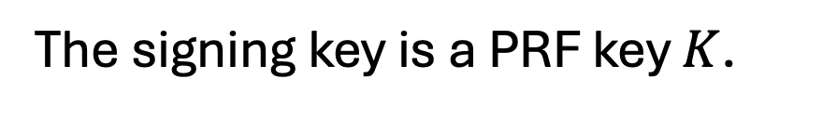
Step 3.
Pseudorandom Signature Trees.
$$r_{ε}$$
$({VK}_{ε}$,${SK}_{ε})$
$$r_{0}$$
$$r_{1}$$
$({VK}_{1}$,${SK}_{1})$
$({VK}_{0}$,${SK}_{0})$
$$r_{00}$$
$$…$$
$$r_{01}$$
$$…$$
$$r_{10}$$
$$…$$
$$r_{11}$$
$$…$$
$$r_{000}$$
$$r_{001}$$
$$r_{010}$$
$$r_{011}$$
$$r_{100}$$
$$r_{101}$$
$$r_{110}$$
$$r_{111}$$
Tree of pseudorandom values:
The signing key is a PRF key $K$.
Populate the nodes with $r_{x}=PRF(K,x)$.
Use $r_{x}$ to derive the keys $({VK}_{x},{SK}_{x})←Gen(1^{λ};r_{x})$.

Slide 37
Step 3.
Pseudorandom Signature Trees.
$${VK}_{ε}$$
$${VK}_{0}$$
$${VK}_{1}$$
$${VK}_{00}$$
$${VK}_{01}$$
$${VK}_{10}$$
$${VK}_{11}$$
$${VK}_{000}$$
$${VK}_{001}$$
$${VK}_{010}$$
$${VK}_{011}$$
$${VK}_{100}$$
$${VK}_{101}$$
$${VK}_{110}$$
$${VK}_{111}$$
GOOD NEWS:
Short signatures and small storage for the signer

Slide 38
Step 3.
Pseudorandom Signature Trees.
$${VK}_{ε}$$
$${VK}_{0}$$
$${VK}_{1}$$
$${VK}_{00}$$
$${VK}_{01}$$
$${VK}_{10}$$
$${VK}_{11}$$
$${VK}_{000}$$
$${VK}_{001}$$
$${VK}_{010}$$
$${VK}_{011}$$
$${VK}_{100}$$
$${VK}_{101}$$
$${VK}_{110}$$
$${VK}_{111}$$
$$τ_{2}$$
$$m_{2}$$
BAD NEWS:
Signer needs to keep a counter indicating which leaf (which tells her which secret key) to use next.

Slide 39
(Many-time) Signature Scheme
In four+ steps
Step 1. Stateful, Growing Signatures. Idea: Signature Chains
Step 2. How to Shrink the signatures. Idea: Signature Trees
Step 3. How to Shrink Alice’s storage. Idea: Pseudorandom Trees
Step 4. How to make Alice stateless. Idea: Randomization

Slide 40
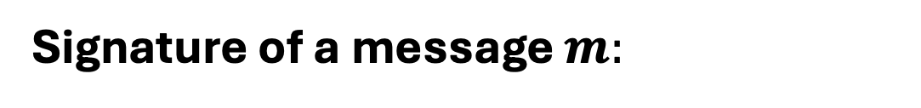




Step 4.
Statelessness via Randomization
$${VK}_{ε}$$
$$σ_{ε}$$
$${VK}_{0}$$
$$σ_{ε}$$
$${VK}_{1}$$
$$σ_{0}$$
$$σ_{1}$$
$${VK}_{00}$$
$${VK}_{01}$$
$${VK}_{10}$$
$${VK}_{11}$$
$$σ_{01}$$
$$σ_{10}$$
$${VK}_{000}$$
$${VK}_{001}$$
$${VK}_{010}$$
$${VK}_{011}$$
$${VK}_{010}$$
$${VK}_{100}$$
$${VK}_{101}$$
$${VK}_{101}$$
$${VK}_{110}$$
$${VK}_{111}$$
Signature of a message $m:$
Pick a random leaf $r$. Use ${VK}_{r}$ to sign $m$.
$$σ_{r}←Sign({SK}_{r},m)$$
Output $(r, σ_{r},$ authentication path for ${VK}_{r})$

Slide 41
Step 4.
Statelessness via Randomization
$${VK}_{ε}$$
$${VK}_{0}$$
$$σ_{ε}$$
$${VK}_{1}$$
$$σ_{0}$$
$${VK}_{00}$$
$${VK}_{01}$$
$${VK}_{10}$$
$${VK}_{11}$$
$$σ_{01}$$
$${VK}_{000}$$
$${VK}_{001}$$
$${VK}_{010}$$
$${VK}_{011}$$
$${VK}_{010}$$
$${VK}_{100}$$
$${VK}_{101}$$
$${VK}_{110}$$
$${VK}_{111}$$
GOOD NEWS:
No need to keep state.

Slide 42
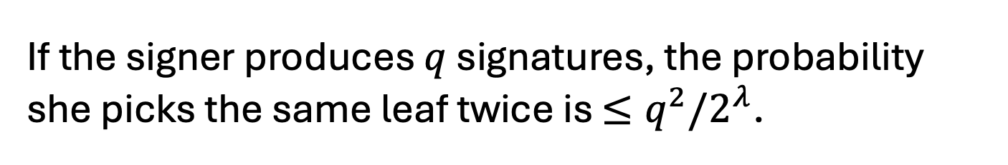
Step 4.
Statelessness via Randomization
$${VK}_{ε}$$
$${VK}_{0}$$
$$σ_{ε}$$
$${VK}_{1}$$
$$σ_{0}$$
$${VK}_{00}$$
$${VK}_{01}$$
$${VK}_{10}$$
$${VK}_{11}$$
$$σ_{01}$$
$${VK}_{000}$$
$${VK}_{001}$$
$${VK}_{010}$$
$${VK}_{011}$$
$${VK}_{010}$$
$${VK}_{100}$$
$${VK}_{101}$$
$${VK}_{110}$$
$${VK}_{111}$$
Key Idea:
If the signer produces $q$ signatures, the probability she picks the same leaf twice is ${≤q}^{2}/2^{λ}$.

Slide 43
(Many-time) Signature Scheme
In four+ steps
Step 1. Stateful, Growing Signatures. Idea: Signature Chains
Step 2. How to Shrink the signatures. Idea: Signature Trees
Step 3. How to Shrink Alice’s storage. Idea: Pseudorandom Trees
Step 4. How to make Alice stateless. Idea: Randomization
Step 5 (optional). How to make Alice stateless and deterministic. Idea: PRFs.

Slide 44
Step 5.
Making the Signer Deterministic.
$${VK}_{ε}$$
$${VK}_{0}$$
$$σ_{ε}$$
$${VK}_{1}$$
$$σ_{0}$$
$${VK}_{00}$$
$${VK}_{01}$$
$${VK}_{10}$$
$${VK}_{11}$$
$$σ_{01}$$
$${VK}_{000}$$
$${VK}_{001}$$
$${VK}_{010}$$
$${VK}_{011}$$
$${VK}_{010}$$
$${VK}_{100}$$
$${VK}_{101}$$
$${VK}_{110}$$
$${VK}_{111}$$
Key Idea:
Generate $r$ pseudo-randomly.
Have another PRF key $K′$ and let $r=PRF(K^{′},m)$

Slide 45
That’s it for the construction.

Slide 46
Digital Signatures
We showed:
Theorem: Assuming the existence of one-way functions and collision-resistant hash function families, there are digital signature schemes.

Slide 47
Digital Signatures
It turns out that collision-resistant hashing is not necessary.
Theorem: Digital Signature schemes exist if and only if one-way functions exist.

Slide 48
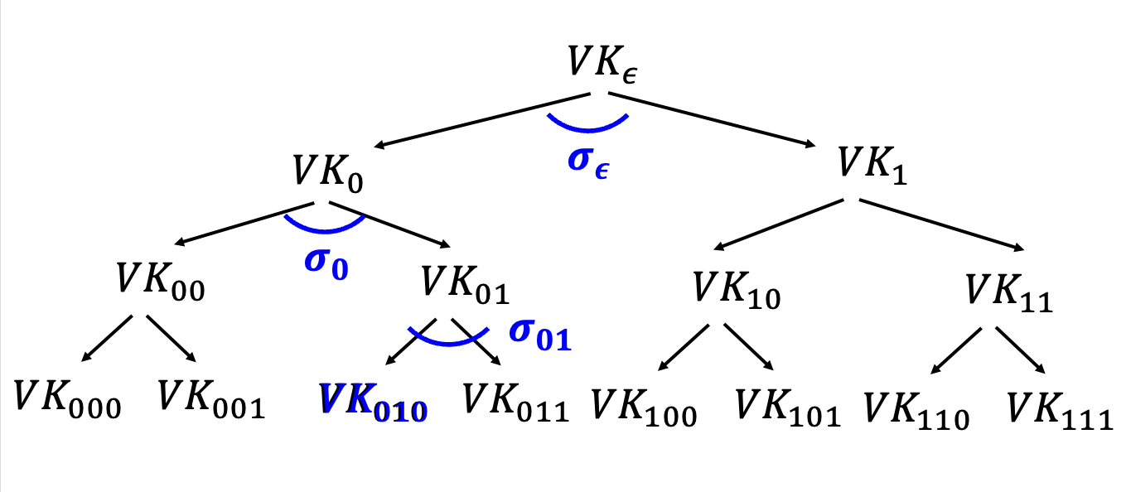
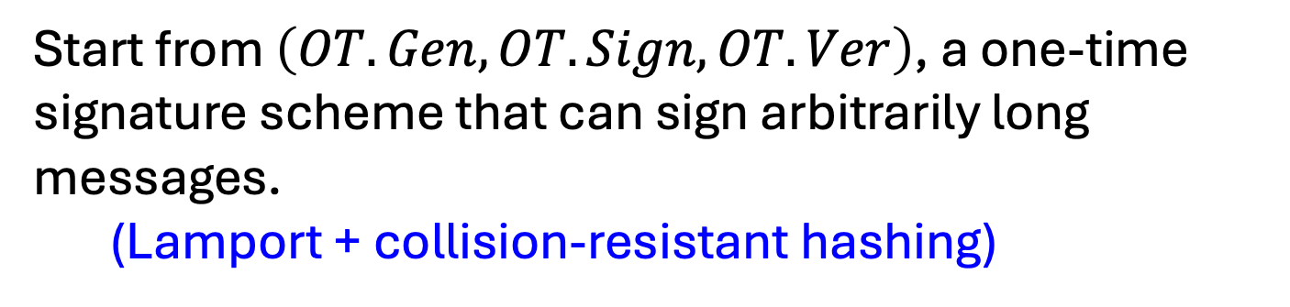
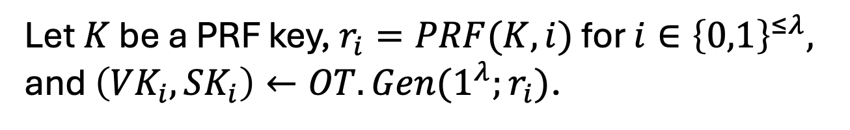
Digital Signature Construction
Start from $\left(OT.Gen, OT.Sign, OT.Ver\right)$, a one-time signature scheme that can sign arbitrarily long messages. (Lamport + collision-resistant hashing)
Build a (virtual) tree of depth $λ$ = security param.
Let $K$ be a PRF key, $r_{i}=PRF(K,i)$ for $i∈{\left\{0,1\right\}}^{≤λ},$ and $\left({VK}_{i},{SK}_{i}\right)←OT.Gen(1^{λ};r_{i})$.

Slide 49



Digital Signature Construction
Signature keys: $SK=K$ and $VK={OTVK}_{ε}$.
Signing Algorithm:
Pick a random leaf $r∈{\left\{0,1\right\}}^{λ},$
Generate the authentication path $σ_{ε}$, $σ_{r_{1}},σ_{r_{2}},…,σ_{r}$ & $σ^{∗}$
$$σ_{x}←OT.Sign\left({SK}_{x},{VK}_{x0}||{VK}_{x1}\right)$$
$$σ^{∗}←OT.Sign\left({SK}_{r},m\right)$$
The signature is $(r,σ_{ε}$, $σ_{r_{1}},σ_{r_{2}},…,σ_{r},$ $σ^{∗})$.

Slide 50
Digital Signature Construction
Historically regarded as inefficient; therefore, never used in practice.
However, this signature scheme (or variants thereof) are now called “hash-based signatures” and seeing a re-emergence as a candidate post-quantum secure signature scheme. E.g. https://sphincs.org/

Slide 51
Direct Constructions
“Hash-and-Sign”: Secure in the “random oracle model”.

Slide 52


“Vanilla” RSA Signatures
Start with any trapdoor permutation, e.g. RSA.
Gen($1^{λ}$): Pick primes $\left(P,Q\right)$ and let $N=PQ.$ Pick $e$ relatively prime to $φ\left(N\right)$ and let $d=e^{−1} (mod$ $φ\left(N\right)).$
SK = $\left(N,d\right)$ and VK = $\left(N,e\right)$
Sign($SK,m$): Output signature $σ=m^{d} \left(mod N\right).$
Verify($VK,m,σ$): Check if $σ^{e}=m \left(mod N\right).$
Problem: Existentially forgeable!

Slide 53


“Vanilla” RSA Signatures
Sign($SK,m$): Output signature $σ=m^{d} \left(mod N\right).$
Verify($VK,m,σ$): Check if $σ^{e}=m \left(mod N\right).$
Problem: Existentially forgeable!
Attack: Pick a random $σ$ and output (${m=σ}^{e}$, $σ$) as the forgery.
Problem: Malleable!
Attack: Given a signature of $m$, you can produce a signature of $2^{e}∗m,3^{e}∗m,…,m^{2},m^{3},…$

Slide 54
“Vanilla” RSA Signatures
Sign($SK,m$): Output signature $σ=m^{d} \left(mod N\right).$
Verify($VK,m,σ$): Check if $σ^{e}=m \left(mod N\right).$
Fundamental Issues:
1. Can ”reverse-engineer” the message starting from the signature (Attack 1)
2. Algebraic structure allows malleability (Attack 2)

Slide 55

How to Fix Vanilla RSA
Start with any trapdoor permutation, e.g. RSA.
Gen($1^{λ}$): Pick primes $\left(P,Q\right)$ and let $N=PQ.$ Pick $e$ relatively prime to $φ\left(N\right)$ and let $d=e^{−1} (mod$ $φ\left(N\right)).$
SK = $\left(N,d\right)$ and VK = $\left(N,e,H\right)$
Sign($SK,m$): Output signature $σ={H(m)}^{d} \left(mod N\right).$
Verify($VK,m,σ$): Check if $σ^{e}=H(m) \left(mod N\right).$
So, what is H? Some very complicated “hash” function.

Slide 56
How to Fix Vanilla RSA
Start with any trapdoor permutation, e.g. RSA.
Gen($1^{λ}$): Pick primes $\left(P,Q\right)$ and let $N=PQ.$ Pick $e$ relatively prime to $φ\left(N\right)$ and let $d=e^{−1} (mod$ $φ\left(N\right)).$
SK = $\left(N,d\right)$ and VK = $\left(N,e,H\right)$
Sign($SK,m$): Output signature $σ={H(m)}^{d} \left(mod N\right).$
Verify($VK,m,σ$): Check if $σ^{e}=H(m) \left(mod N\right).$
H should be at least one-way to prevent Attack #1.

Slide 57
How to Fix Vanilla RSA
Start with any trapdoor permutation, e.g. RSA.
Gen($1^{λ}$): Pick primes $\left(P,Q\right)$ and let $N=PQ.$ Pick $e$ relatively prime to $φ\left(N\right)$ and let $d=e^{−1} (mod$ $φ\left(N\right)).$
SK = $\left(N,d\right)$ and VK = $\left(N,e,H\right)$
Sign($SK,m$): Output signature $σ={H(m)}^{d} \left(mod N\right).$
Verify($VK,m,σ$): Check if $σ^{e}=H(m) \left(mod N\right).$
Hard to “algebraically manipulate” H(m) into H(related m’).
(to prevent Attack #2.)

Slide 58
How to Fix Vanilla RSA
Start with any trapdoor permutation, e.g. RSA.
Gen($1^{λ}$): Pick primes $\left(P,Q\right)$ and let $N=PQ.$ Pick $e$ relatively prime to $φ\left(N\right)$ and let $d=e^{−1} (mod$ $φ\left(N\right)).$
SK = $\left(N,d\right)$ and VK = $\left(N,e,H\right)$
Sign($SK,m$): Output signature $σ={H(m)}^{d} \left(mod N\right).$
Verify($VK,m,σ$): Check if $σ^{e}=H(m) \left(mod N\right).$
Collision-resistance does not seem to be enough. (Given a CRHF h(m), you may be able to produce h(m’) for related m’.)

Slide 59



The Random Oracle Heuristic
Want: A public H that is “non-malleable”.
Given H(m), it is hard to produce H(m’) for any non-trivially related m’.
For every PPT adv $A$and “every non-trivial relation” $R$,
$\operatorname{Pr}\left[A\left(H\left(m\right)\right)=H\left(m^{′}\right):R\left(m,m^{′}\right)=1\right]=negl(λ)$
How about the relation $R$ where $R\left(x,y\right)=1$ if and only if $y=H\left(x\right)$?

Slide 60





The Random Oracle Heuristic
Proxy: A public H that “behaves like a random function”
(A PRF also behaves like a random function, but ${PRF}_{K}$ is not publicly computable.)
Reality:
Random Oracle Heuristic:
$𝒜$(
)
$$𝒜$$
($1^{λ}$)
H
H
H is virtually a black box.
The only way to compute H is by calling the oracle.

Slide 61












Proof
Claim: To produce a successful forgery, $𝒜$ must have queried the hash oracle on $m^{∗}$. W.p. $1/Q$, $m^{∗}$ is the trap.
$$ℬ$$
$$VK=(N,e)$$
$$(N,e,y)$$
$$𝒜$$
Hash Query: m
$H\left(\tilde{m}\right)=y$
o.w., $H\left(m\right)=x^{e}$
Sign Query: m
$m=\tilde{m}?$ !abort!
o.w., $σ=x$
$$y^{1/e}$$
“trap”
If $m^{∗}=\tilde{m}$, yay!
Forgery: $m^{∗},σ^{∗}$

Slide 62


Bottomline: Hashed RSA
(PKCS Standard, used everywhere)
In practice, we let $H$ be the SHA-3 hash function.
… and believe that SHA-3 ”acts like a random function”. That’s the heuristic. On the one hand, it doesn’t make any sense, but on the other, it has served us well so far. No attacks against RSA + SHA-3, for example.

