Slide 1
Purdue CS555: Cryptography Lecture 13
Instructor: Hanshen Xiao
Teaching Assistant: Justin He
course website: https://cs55500.github.io/

Slide 2
Digital Signature

Slide 3




Message Authentication Codes
m
$$m, t=MAC(sk,m)$$
sk
sk
$$Verify(sk,m,t)$$
Authenticity: Bob wants to ensure that the message came from Alice.
Needs Bob and Alice to share a secret key beforehand.

Slide 4


Digital Signatures: Public-key Analog of MACs
Alice
vk
m
$$m, σ←Sign(sk,m)$$
sk
$$Verify(vk,m,σ)$$
(Public) verification keys are stored in a “directory”.
Only Alice can produce signatures; but Bob (or indeed, anyone else) can verify them.

Slide 5
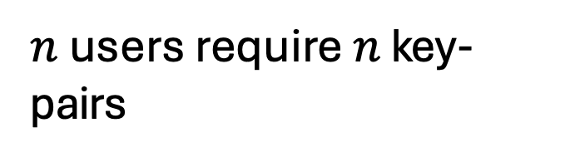
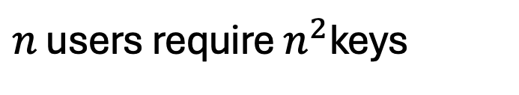
Digital Signatures vs. MACs
Signatures
MACs
$n$ users require $n$ key-pairs
$n$ users require $n^{2}$keys
Publicly Verifiable
Privately Verifiable
Transferable
Not Transferable
Provides Non-Repudiation
Does not provide Non-Rep.
(is this a good thing or a bad thing?)
Notes:
MAC -> secret key -> only shared by sender and verifier

Slide 6
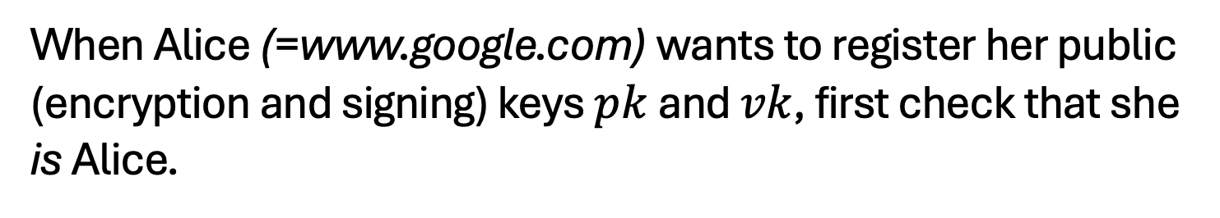

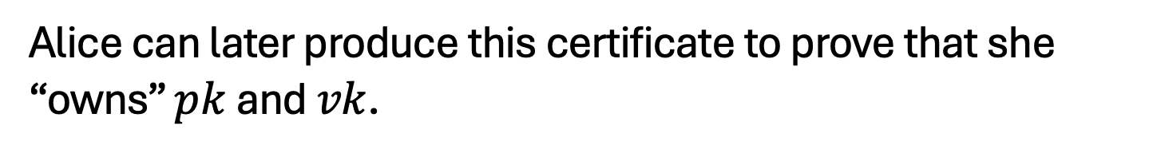
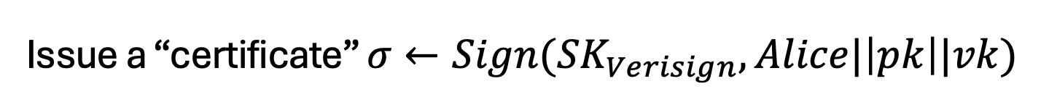
Alice
pk,vk
Other Applications
1. Certificates, or a public-key directory in practice:
Trusted Certificate Authority, e.g. Verisign, Let’s Encrypt.
When Alice (=www.google.com) wants to register her public (encryption and signing) keys $pk$ and $vk$, first check that she is Alice.
Issue a “certificate” $σ←Sign({SK}_{Verisign},Alice|\left|pk\right||vk)$
Alice can later produce this certificate to prove that she “owns” $pk$ and $vk$.
Browsers store ${VK}_{Verisign}$ and check the certificate.

Slide 7
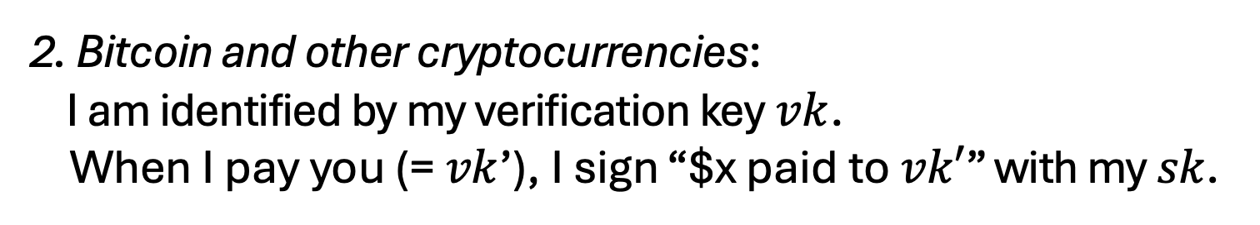
Other Applications
2. Bitcoin and other cryptocurrencies:
I am identified by my verification key $vk$. When I pay you (= $vk$’), I sign “$x paid to $vk′$” with my $sk$.

Slide 8

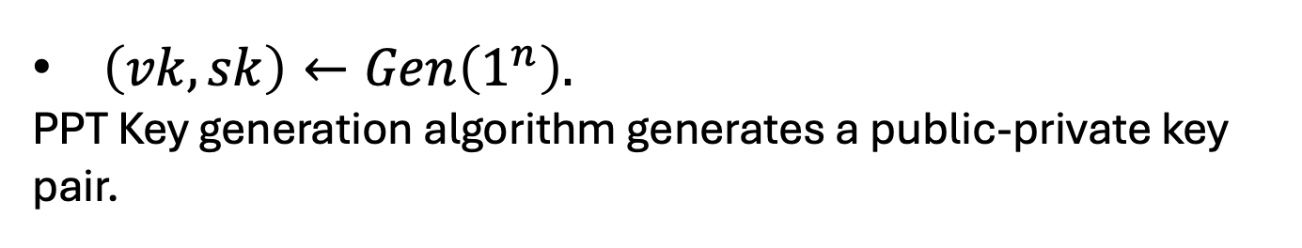
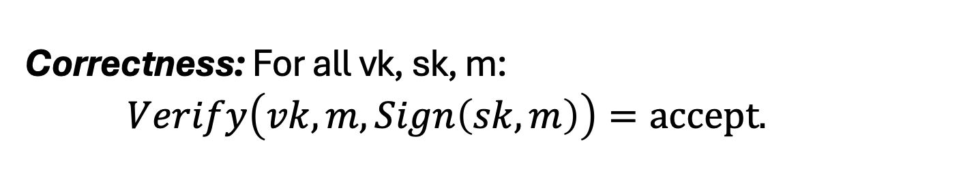
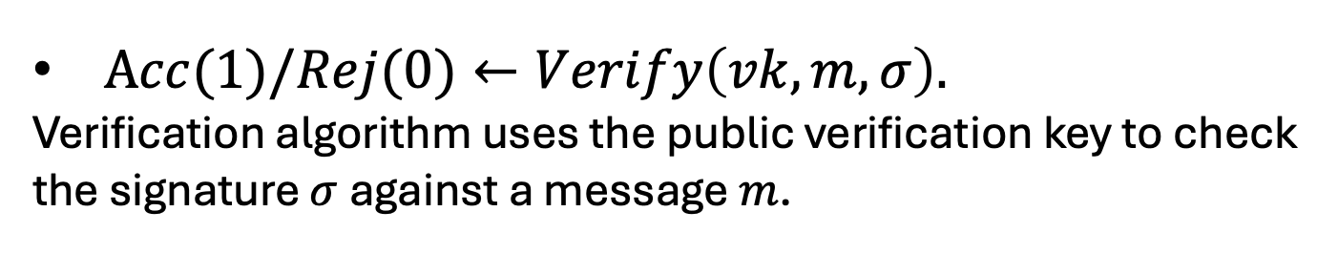
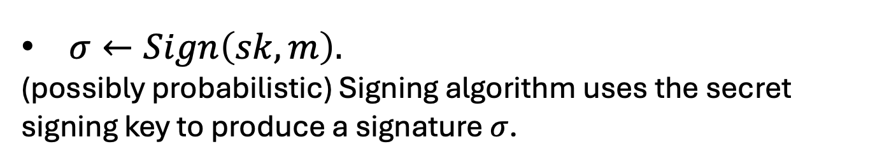
Digital Signatures: Definition
A triple of PPT algorithms $(Gen,Sign,Verify)$ s.t.
$\left(vk,sk\right)←Gen\left(1^{n}\right).$
PPT Key generation algorithm generates a public-private key pair.
$σ←Sign\left(sk,m\right).$
(possibly probabilistic) Signing algorithm uses the secret signing key to produce a signature $σ$.
$Acc(1)/Rej(0)←Verify\left(vk,m,σ\right).$
Verification algorithm uses the public verification key to check the signature $σ$against a message $m$.
Correctness: For all vk, sk, m: $Verify\left(vk,m,Sign\left(sk,m\right)\right)=accept.$

Slide 9
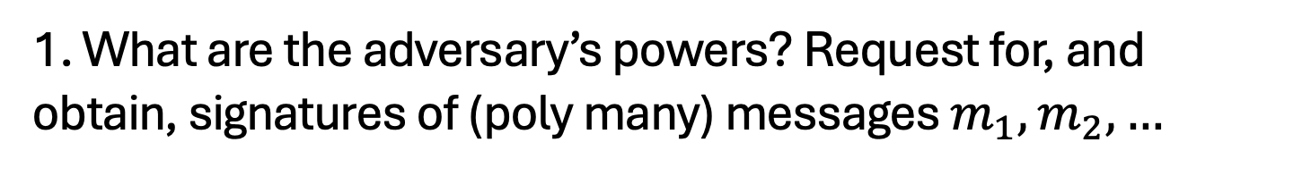
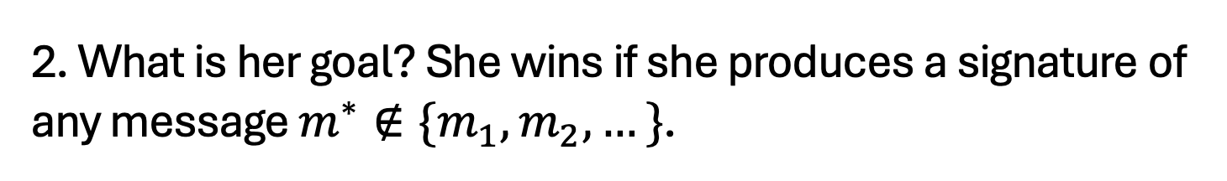
Digital Signatures: Security
“The adversary after seeing signatures of many msgs, should not be able to produce a signature of any new msg.”
1. What are the adversary’s powers? Request for, and obtain, signatures of (poly many) messages $m_{1},m_{2},…$
Chosen-message attack
2. What is her goal? She wins if she produces a signature of any message $m^{∗}∉\{m_{1},m_{2},…\}$.
Existential Forgery

Slide 10





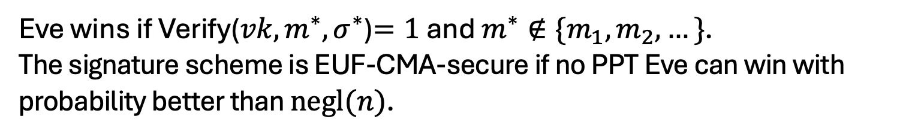



EUF-CMA Security
(Existentially Unforgeable against a Chosen Message Attack)
Challenger
Eve
$$\left(vk,sk\right)←Gen\left(1^{n}\right)$$
$$vk$$
$$m_{i}$$
poly many times
$$σ_{i}$$
$$σ_{i}←Sign(sk,m_{i})$$
$$m^{∗},σ^{∗}$$
Eve wins if Verify(${vk,m}^{∗},σ^{∗}$)$=1$ and $m^{∗}∉\{m_{1},m_{2},…\}$. The signature scheme is EUF-CMA-secure if no PPT Eve can win with probability better than $negl(n)$.
Notes:
Encryption has to be probabilistic.

Slide 11
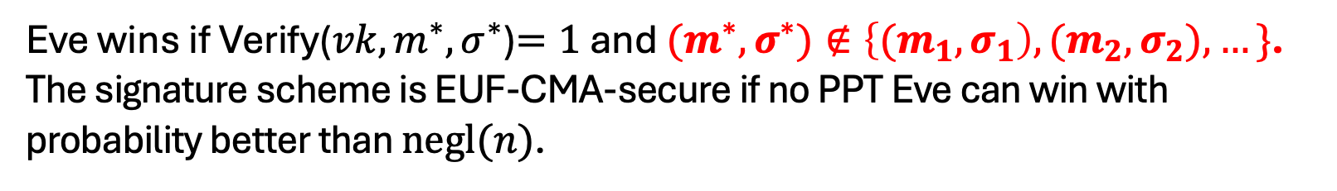
Strong EUF-CMA Security
(Existentially Unforgeable against a Chosen Message Attack)
Challenger
Eve
$$\left(vk,sk\right)←Gen\left(1^{n}\right)$$
$$vk$$
$$m_{i}$$
poly many times
$$σ_{i}$$
$$σ_{i}←Sign(sk,m_{i})$$
$$m^{∗},σ^{∗}$$
Eve wins if Verify(${vk,m}^{∗},σ^{∗}$)$=1$ and ${(m}^{∗},σ^{∗})∉\left\{{(m}_{1},σ_{1}\right),{(m}_{2},σ_{2}),…\}$. The signature scheme is EUF-CMA-secure if no PPT Eve can win with probability better than $negl(n)$.
Notes:
Encryption has to be probabilistic.

Slide 12
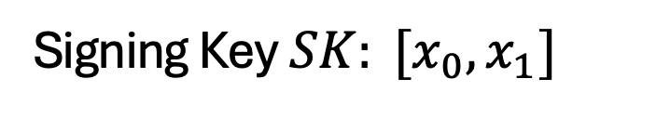
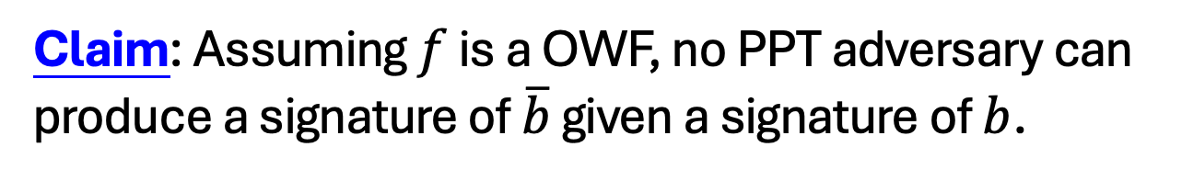

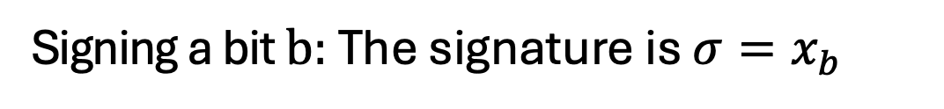
Lamport (One-time) Signatures
How to sign a bit
Signing Key $SK: [x_{0},x_{1}]$
Verification Key $VK: [y_{0}=f(x_{0}),{y_{1}=f(x}_{1})]$
Signing a bit $b:$ The signature is ${σ=x}_{b}$
?
Verifying $(b,σ):$ Check if $f\left(σ\right)=y_{b}$
Claim: Assuming $f$ is a OWF, no PPT adversary can produce a signature of $\overline{b}$ given a signature of $b$.
Notes:
No proof here because we will prove the stronger statement in a few slides

Slide 13
Constructing a Signature Scheme
Step 0. Still one-time, but arbitrarily long messages.
Step 1. Many-time: Stateful, Growing Signatures.
Step 2. How to Shrink the signatures.
Step 3. How to Shrink Alice’s storage.
Step 4. How to make Alice stateless.
Step 5 (optional). How to make Alice stateless and deterministic.

Slide 14
Step 0: How to Sign Polynomially Many Bits
(with a fixed verification key)

Slide 15
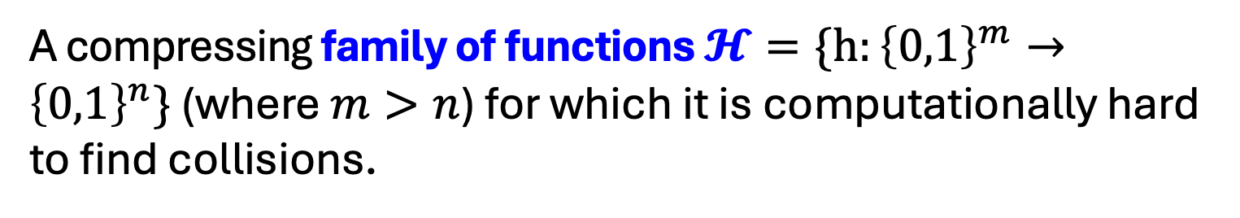
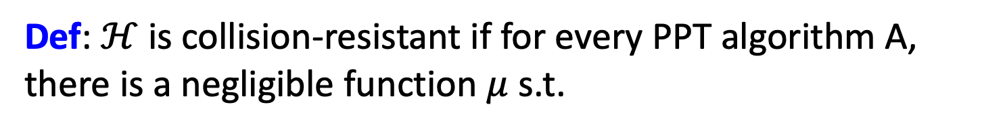
Detour: Collision-Resistant Hash Functions
A compressing family of functions $𝓗=\{h:{\left\{0,1\right\}}^{m}→{\left\{0,1\right\}}^{n}\}$ (where $m>n$) for which it is computationally hard to find collisions.
Def: $ℋ$ is collision-resistant if for every PPT algorithm A, there is a negligible function $μ$ s.t.
$${Pr}_{h←ℋ}\left[A\left(1^{n},h\right)=\left(x,y\right):x≠y, h\left(x\right)=h\left(y\right)\right]=μ(n)$$

Slide 16
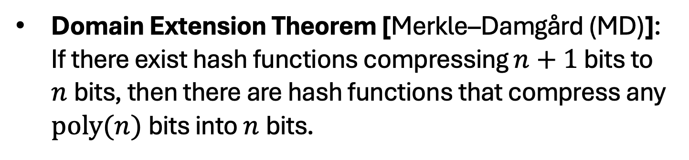
Do CRHFs exist?
Theoretical Constructions: assuming discrete logarithms (as well as under several other number-theoretic assumptions)
Practical Constructions: SHA3.
Domain Extension Theorem [Merkle–Damgård (MD)]: If there exist hash functions compressing $n+1$ bits to $n$bits, then there are hash functions that compress any $poly(n)$bits into $n$bits.

Slide 17

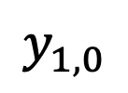
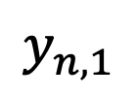
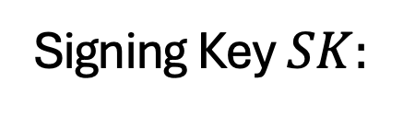






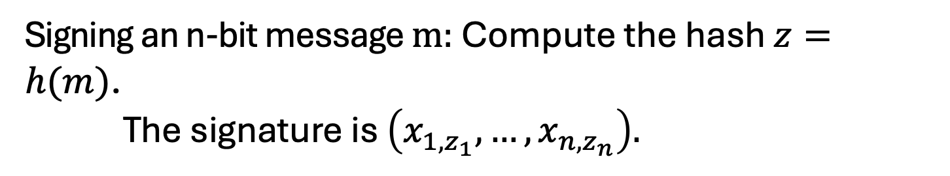



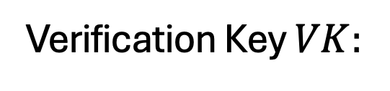


How to Sign Polynomially Many Bits
(with a fixed verification key)
Idea: Hash the message into n bits and sign the hash.
$$x_{1,0}$$
$$x_{2,0}$$
$$x_{n,0}$$
Signing Key $SK:$
$$x_{1,1}$$
$$x_{2,1}$$
$$x_{n,1}$$
$$y_{1,0}$$
$$y_{2,0}$$
$$y_{n,0}$$
Verification Key $VK:$
and $h←𝓗$.
$$y_{1,1}$$
$$y_{2,1}$$
$$y_{n,1}$$
Signing an n-bit message $m:$ Compute the hash $z=h(m)$. The signature is $\left(x_{1,z_{1}},…,x_{n,z_{n}}\right).$
Verifying $(m,σ):$ Recompute the hash $z=h(m)$.
Check if $∀i:f\left(σ_{i}\right)=y_{i,z_{i}}$

Slide 18
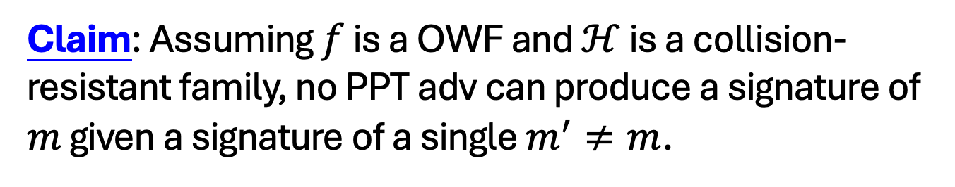
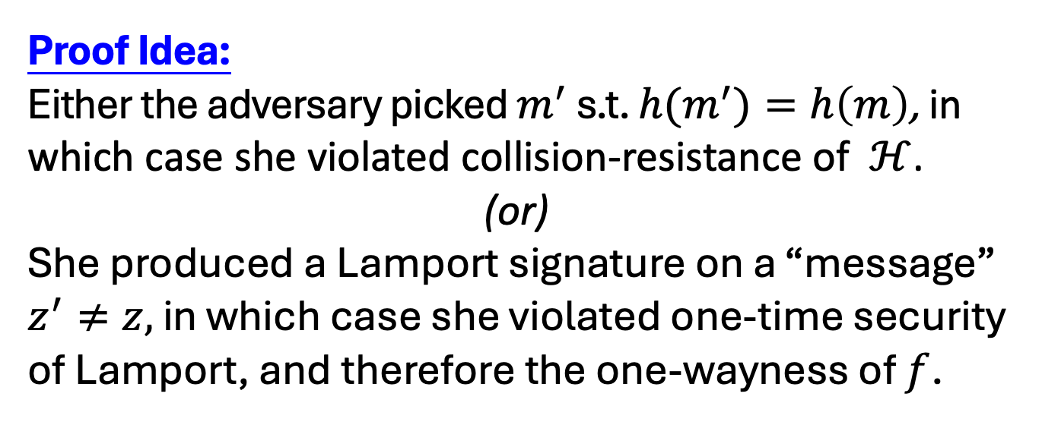
How to Sign Polynomially Many Bits
(with a fixed verification key)
Claim: Assuming $f$ is a OWF and $ℋ$ is a collision-resistant family, no PPT adv can produce a signature of $m$ given a signature of a single $m^{′}≠m$.
Proof Idea:
Either the adversary picked $m^{′}$ s.t. ${h(m}^{′})=h\left(m\right)$, in which case she violated collision-resistance of $ℋ$.
(or)
She produced a Lamport signature on a “message” $z^{′}≠z,$ in which case she violated one-time security of Lamport, and therefore the one-wayness of $f$.

Slide 19
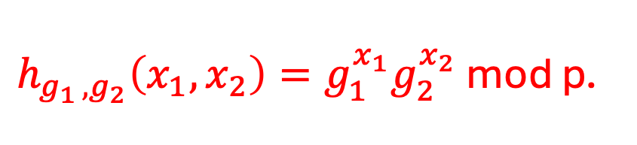
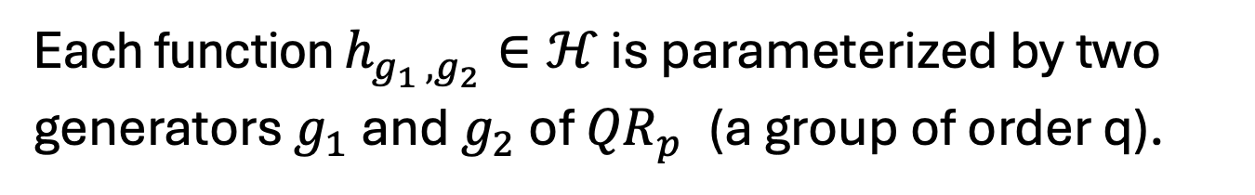
Let’s go back to CRHFs…
$p=2q+1$ is a “safe” prime.
$$ℋ=\{h:{(ℤ_{q})}^{2}→{QR}_{p}^{}\}$$
Each function $h_{g_{1 },g_{2}}∈ℋ$ is parameterized by two generators $g_{1}$ and $g_{2}$ of ${QR}_{p}^{}$ (a group of order q).
$h_{g_{1 },g_{2}}\left(x_{1},x_{2}\right)=g_{1}^{x_{1}}g_{2}^{x_{2}}$ mod p.
This compresses 2 log q bits into log p $≈$ log q + 1 bits.

Slide 20
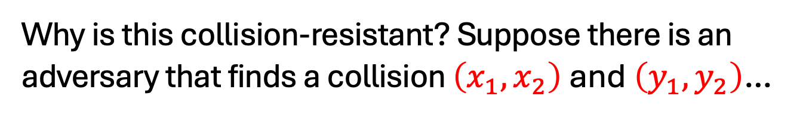
Let’s go back to CRHFs…
$p=2q+1$ is a “safe” prime.
$$ℋ=\{h:{(ℤ_{q})}^{2}→{QR}_{p}^{}\}$$
Each function $h_{g_{1 },g_{2}}∈ℋ$ is parameterized by two generators $g_{1}$ and $g_{2}$ of ${QR}_{p}^{}$ (a group of order q).
$h_{g_{1 },g_{2}}\left(x_{1},x_{2}\right)=g_{1}^{x_{1}}g_{2}^{x_{2}}$ mod p.
Why is this collision-resistant? Suppose there is an adversary that finds a collision $\left(x_{1},x_{2}\right)$ and $\left(y_{1},y_{2}\right)$…

Slide 21
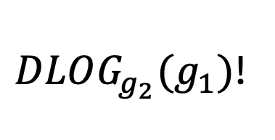
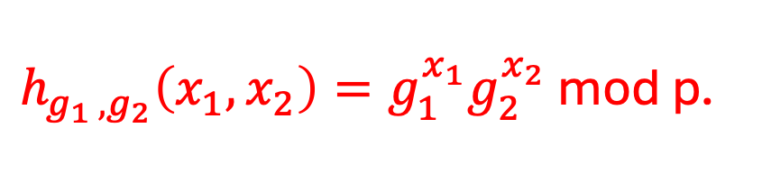
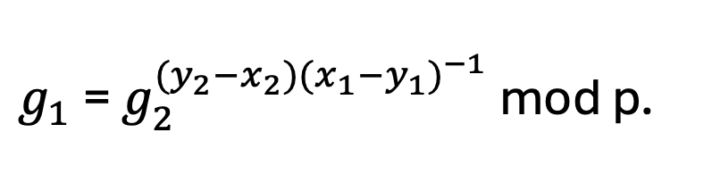
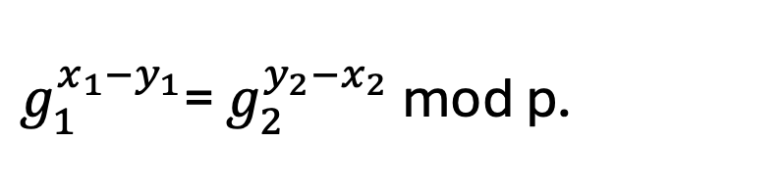
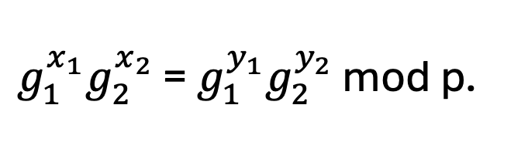

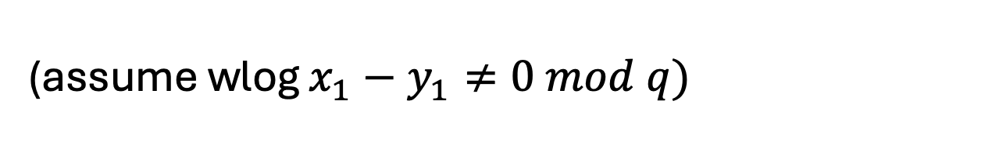
Let’s go back to CRHFs…
$h_{g_{1 },g_{2}}\left(x_{1},x_{2}\right)=g_{1}^{x_{1}}g_{2}^{x_{2}}$ mod p.
Why is this collision-resistant? Suppose there is an adversary that finds a collision $\left(x_{1},x_{2}\right)$ and $\left(y_{1},y_{2}\right)$…
$g_{1}^{x_{1}}g_{2}^{x_{2}}$ = $g_{1}^{y_{1}}g_{2}^{y_{2}}$ mod p.
$g_{1}^{x_{1}−y_{1}}$= $g_{2}^{y_{2}−x_{2}}$ mod p.
(assume wlog $x_{1}−y_{1}≠0 mod q)$
$g_{1}$= $g_{2}^{{(y}_{2}−x_{2}){(x_{1}−y_{1})}^{−1}}$ mod p.
$DLOG_{g_{2}}(g_{1})$!

Slide 22
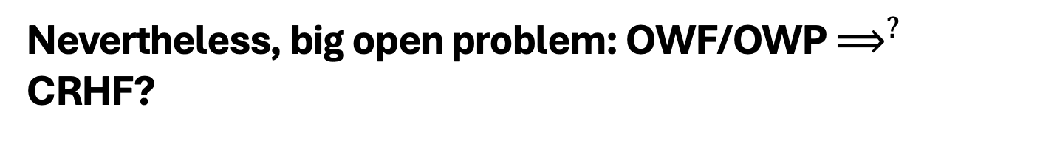
Other Constructions of CRHFs
From the hardness of factoring, lattice problems etc.
Not known to follow from the existence of one-way functions or even one-way permutations…
“Black-box separations”: Certain ways of constructing CRHF from OWF/OWP cannot work.
“Finding collisions on a one-way street”, Daniel Simon, Eurocrypt 1998.
Nevertheless, big open problem: OWF/OWP $⟹^{?}$ CRHF?

Slide 23
So far, only one-time security…

Slide 24
Constructing a Signature Scheme
Theorem [Naor-Yung’89, Rompel’90] (EUF-CMA-secure) Signature schemes exist assuming that one-way functions exist.
TODAY: (EUF-CMA-secure) Signature schemes exist assuming that collision-resistant hash functions exist.

Slide 25
(Many-time) Signature Scheme
In four+ steps
Step 1. Stateful, Growing Signatures. Idea: Signature Chains
Step 2. How to Shrink the signatures. Idea: Signature Trees
Step 3. How to Shrink Alice’s storage. Idea: Pseudorandom Trees
Step 4. How to make Alice stateless. Idea: Randomization
Step 5 (optional). How to make Alice stateless and deterministic. Idea: PRFs.

Slide 26
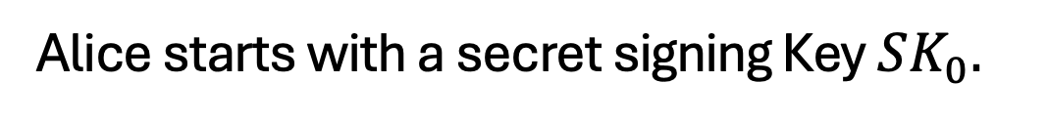


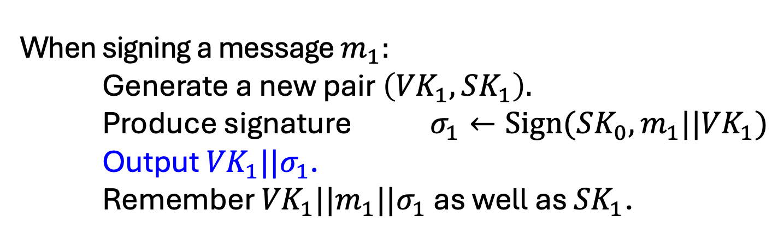
Step 1: Stateful Many-time Signatures
Idea: Signature Chains.
Alice
$$VK_{0}$$
Alice starts with a secret signing Key $SK_{0}.$
When signing a message $m_{1}:$ Generate a new pair $\left({VK}_{1},SK_{1}\right).$
Produce signature $σ_{1}←Sign({SK_{0},m_{1}||VK}_{1})$
Output ${VK}_{1}||σ_{1}$. Remember ${VK}_{1}||{m_{1}||σ}_{1}$ as well as ${SK}_{1}$.
To verify a signature ${VK}_{1}||σ_{1}$ for message $m_{1}:$
Run Verify(${VK}_{0}{,m_{1}||VK}_{1},σ_{1}$)

Slide 27




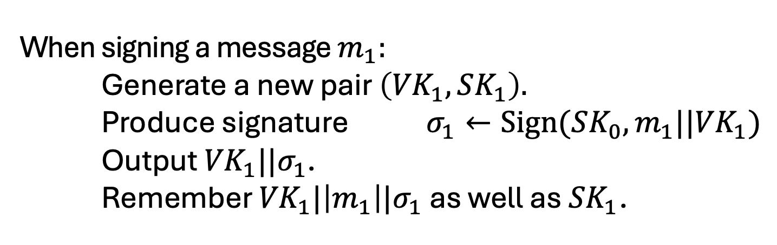
Step 1: Stateful Many-time Signatures
Idea: Signature Chains.
Alice
$$VK_{0}$$
Alice starts with a secret signing Key $SK_{0}.$
When signing a message $m_{1}:$ Generate a new pair $\left({VK}_{1},SK_{1}\right).$
Produce signature $σ_{1}←Sign({SK_{0},m_{1}||VK}_{1})$
Output ${VK}_{1}||σ_{1}$. Remember ${VK}_{1}|\left|m_{1}\right||σ_{1}$ as well as ${SK}_{1}$.
$$m_{1}$$
$$σ_{1}$$
$${VK}_{0}$$
$${VK}_{1}$$

Slide 28
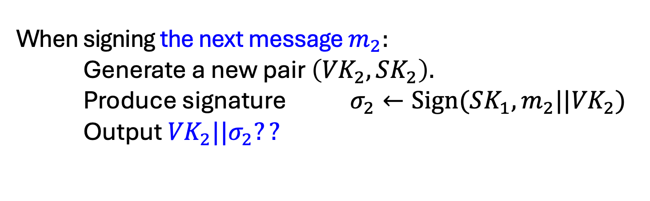
Step 1: Stateful Many-time Signatures
Idea: Signature Chains.
Alice
$$VK_{0}$$
Alice starts with a secret signing Key $SK_{0}.$
When signing the next message $m_{2}:$ Generate a new pair $\left({VK}_{2},SK_{2}\right).$
Produce signature $σ_{2}←Sign({SK_{1},m_{2}||VK}_{2})$
Output ${VK}_{2}||σ_{2}??$
$$m_{1}$$
$$σ_{1}$$
$${VK}_{0}$$
$${VK}_{1}$$

Slide 29
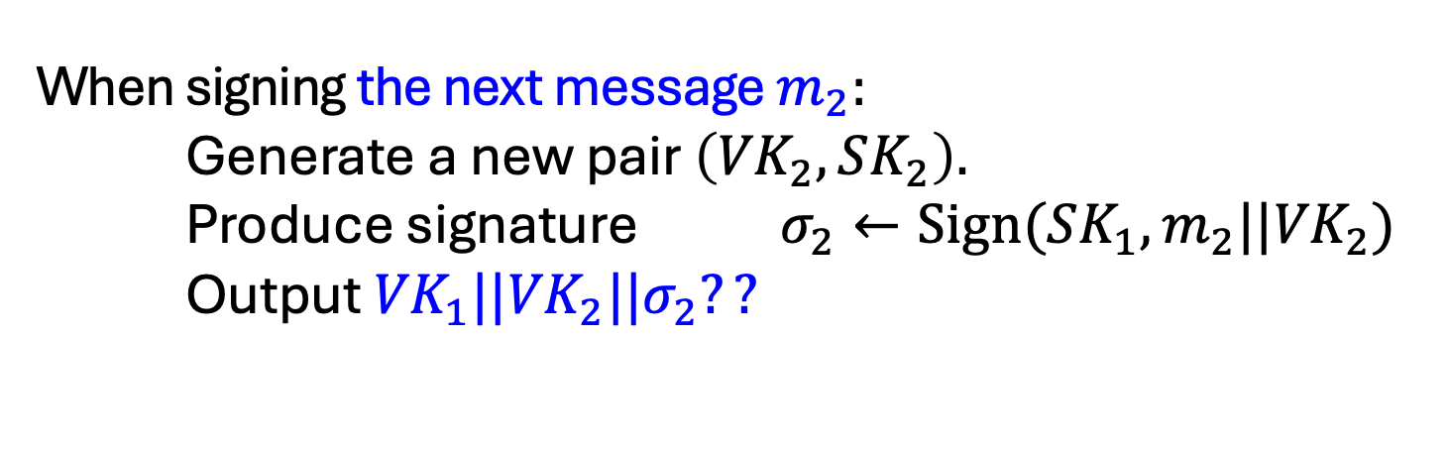
Step 1: Stateful Many-time Signatures
Idea: Signature Chains.
Alice
$$VK_{0}$$
Alice starts with a secret signing Key $SK_{0}.$
When signing the next message $m_{2}:$ Generate a new pair $\left({VK}_{2},SK_{2}\right).$
Produce signature $σ_{2}←Sign({SK_{1},m_{2}||VK}_{2})$
Output ${{VK}_{1}||VK}_{2}||σ_{2}??$
$$m_{1}$$
$$σ_{1}$$
$${VK}_{0}$$
$${VK}_{1}$$

Slide 30








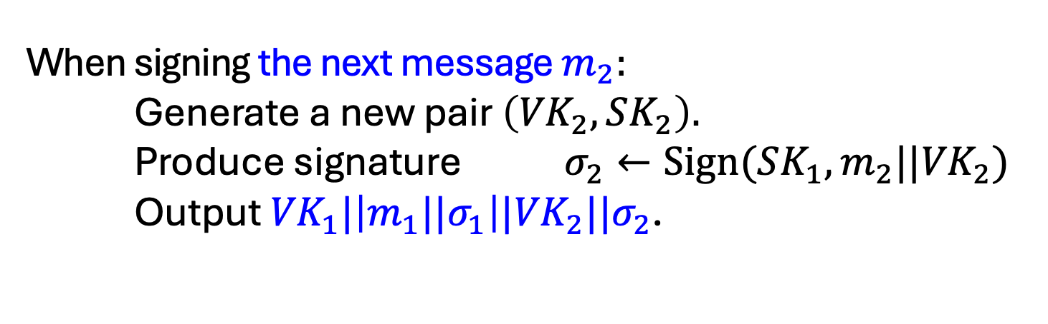


Step 1: Stateful Many-time Signatures
Idea: Signature Chains.
Alice
$$VK_{0}$$
Alice starts with a secret signing Key $SK_{0}.$
When signing the next message $m_{2}:$ Generate a new pair $\left({VK}_{2},SK_{2}\right).$
Produce signature $σ_{2}←Sign({SK_{1},m_{2}||VK}_{2})$
Output ${{VK}_{1}|\left|{m_{1}||σ}_{1}\right||VK}_{2}||σ_{2}$.
$$m_{1}$$
$$m_{2}$$
$$m_{3}$$
$$m_{4}$$
$$σ_{1}$$
$$σ_{2}$$
$$σ_{3}$$
$$σ_{4}$$
$$…$$
$${VK}_{0}$$
$${VK}_{1}$$
$${VK}_{2}$$
$${VK}_{3}$$
$${VK}_{4}$$

Slide 31
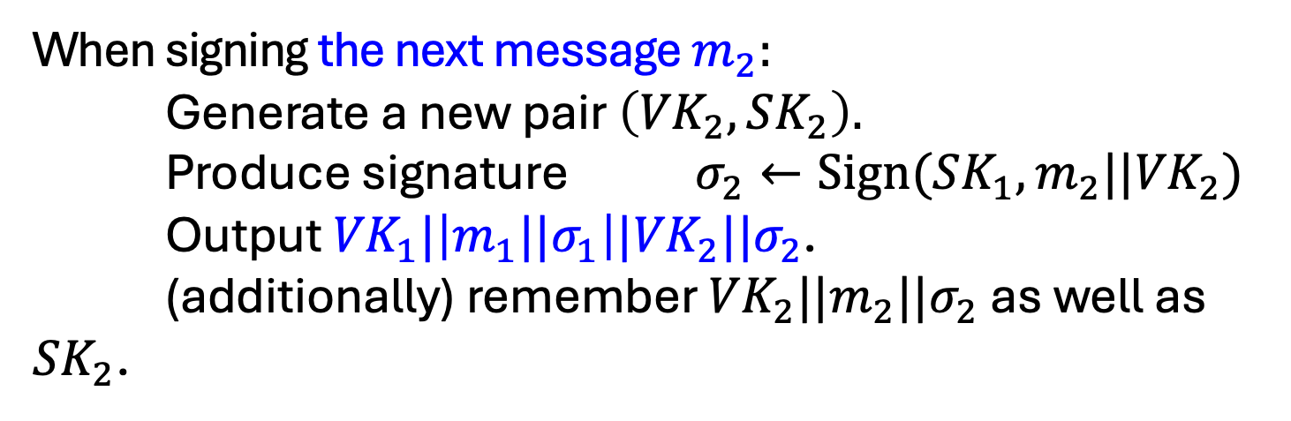
Step 1: Stateful Many-time Signatures
Idea: Signature Chains.
Alice
$$VK_{0}$$
Alice starts with a secret signing Key $SK_{0}.$
When signing the next message $m_{2}:$ Generate a new pair $\left({VK}_{2},SK_{2}\right).$
Produce signature $σ_{2}←Sign({SK_{1},m_{2}||VK}_{2})$
Output ${{VK}_{1}|\left|{m_{1}||σ}_{1}\right||VK}_{2}||σ_{2}$. (additionally) remember ${VK}_{2}||{m_{2}||σ}_{2}$ as well as ${SK}_{2}$.
$$m_{1}$$
$$m_{2}$$
$$m_{3}$$
$$m_{4}$$
$$σ_{1}$$
$$σ_{2}$$
$$σ_{3}$$
$$σ_{4}$$
$$…$$
$${VK}_{0}$$
$${VK}_{1}$$
$${VK}_{2}$$
$${VK}_{3}$$
$${VK}_{4}$$

Slide 32









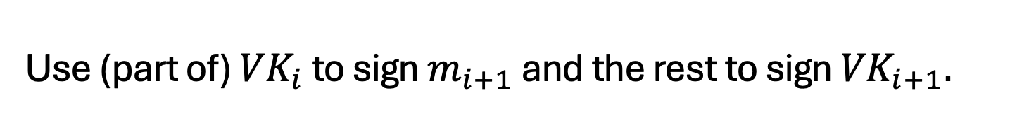
Step 1: Stateful Many-time Signatures
Idea: Signature Chains.
An optimization: Need to remember only the past verification keys, not the past messages.
Use (part of) ${VK}_{i}$ to sign $m_{i+1}$ and the rest to sign ${VK}_{i+1}.$
$$τ_{1}$$
$$m_{1}$$
$$τ_{2}$$
$$m_{2}$$
$$τ_{3}$$
$$m_{3}$$
$$τ_{4}$$
$$m_{4}$$
$$…$$
$$σ_{1}$$
$$σ_{2}$$
$$σ_{3}$$
$$σ_{4}$$
$$…$$
$${VK}_{0}$$
$${VK}_{1}$$
$${VK}_{2}$$
$${VK}_{3}$$
$${VK}_{4}$$

Slide 33
(Many-time) Signature Scheme
In four+ steps
Step 1. Stateful, Growing Signatures. Idea: Signature Chains
Step 2. How to Shrink the signatures. Idea: Signature Trees

Slide 34


Alice
$$VK_{ε}$$
Step 2.
How to Shrink the signatures.
$${VK}_{ε}$$

Slide 35


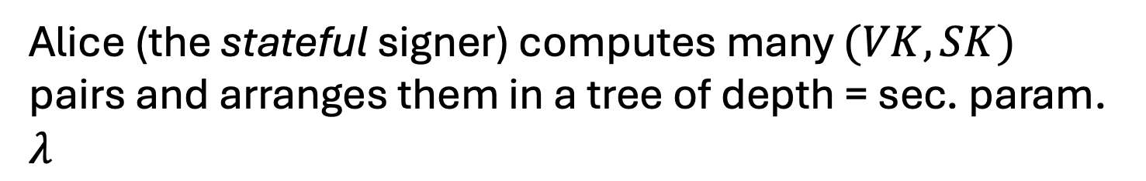












Alice
$$VK_{ε}$$
Step 2.
How to Shrink the signatures.
$${VK}_{ε}$$
$${VK}_{0}$$
$${VK}_{1}$$
$${VK}_{00}$$
$${VK}_{01}$$
$${VK}_{10}$$
$${VK}_{11}$$
$${VK}_{000}$$
$${VK}_{001}$$
$${VK}_{010}$$
$${VK}_{011}$$
$${VK}_{100}$$
$${VK}_{101}$$
$${VK}_{110}$$
$${VK}_{111}$$
Alice (the stateful signer) computes many $(VK,SK)$ pairs and arranges them in a tree of depth = sec. param. $λ$

Slide 36
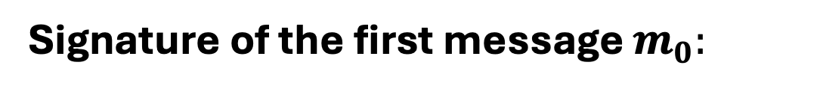

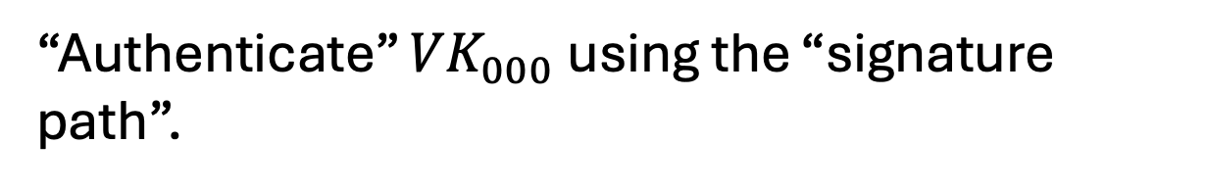





Step 2.
How to Shrink the signatures.
$${VK}_{ε}$$
$${VK}_{0}$$
$$σ_{ε}$$
$${VK}_{1}$$
$$σ_{0}$$
$${VK}_{00}$$
$${VK}_{01}$$
$${VK}_{10}$$
$${VK}_{11}$$
$$σ_{00}$$
$${VK}_{000}$$
$${VK}_{001}$$
$${VK}_{010}$$
$${VK}_{011}$$
$${VK}_{100}$$
$${VK}_{101}$$
$${VK}_{110}$$
$${VK}_{111}$$
$$τ_{0}$$
$$m_{0}$$
Signature of the first message $m_{0}:$
Use ${VK}_{000}$ to sign $m_{0}$.
“Authenticate” ${VK}_{000}$ using the “signature path”.

Slide 37
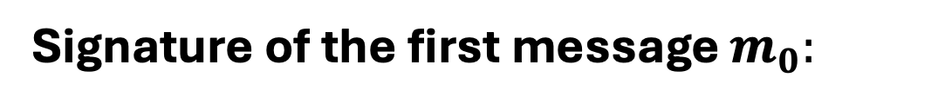
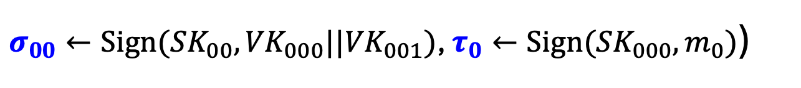

Step 2.
How to Shrink the signatures.
$${VK}_{ε}$$
$${VK}_{0}$$
$$σ_{ε}$$
$${VK}_{1}$$
$$σ_{0}$$
$${VK}_{00}$$
$${VK}_{01}$$
$${VK}_{10}$$
$${VK}_{11}$$
$$σ_{00}$$
$${VK}_{000}$$
$${VK}_{001}$$
$${VK}_{010}$$
$${VK}_{011}$$
$${VK}_{100}$$
$${VK}_{101}$$
$${VK}_{110}$$
$${VK}_{111}$$
$$τ_{0}$$
$$m_{0}$$
Signature of the first message $m_{0}:$
($σ_{ε}←Sign({SK}_{ε},{VK}_{0}||{VK}_{1})$, $σ_{0}←Sign({SK}_{0},{VK}_{00}||{VK}_{01})$,
$σ_{00}←Sign({SK}_{00},{VK}_{000}||{VK}_{001})$, $τ_{0}←Sign({SK}_{000},m_{0})$)

Slide 38


Step 2.
How to Shrink the signatures.
$${VK}_{ε}$$
$${VK}_{0}$$
$$σ_{ε}$$
$${VK}_{1}$$
$$σ_{0}$$
$${VK}_{00}$$
$${VK}_{01}$$
$${VK}_{10}$$
$${VK}_{11}$$
$$σ_{00}$$
$${VK}_{000}$$
$${VK}_{001}$$
$${VK}_{010}$$
$${VK}_{011}$$
$${VK}_{100}$$
$${VK}_{101}$$
$${VK}_{110}$$
$${VK}_{111}$$
$$τ_{0}$$
$$m_{0}$$
Authentication Path for ${VK}_{000}$:
($σ_{ε}←Sign({SK}_{ε},{VK}_{0}||{VK}_{1})$, $σ_{0}←Sign({SK}_{0},{VK}_{00}||{VK}_{01})$,
$σ_{00}←Sign({SK}_{00},{VK}_{000}||{VK}_{001})$)

Slide 39


Step 2.
How to Shrink the signatures.
$${VK}_{ε}$$
$${VK}_{0}$$
$$σ_{ε}$$
$${VK}_{1}$$
$$σ_{0}$$
$${VK}_{00}$$
$${VK}_{01}$$
$${VK}_{10}$$
$${VK}_{11}$$
$$σ_{00}$$
$${VK}_{000}$$
$${VK}_{001}$$
$${VK}_{010}$$
$${VK}_{011}$$
$${VK}_{100}$$
$${VK}_{101}$$
$${VK}_{110}$$
$${VK}_{111}$$
$$τ_{0}$$
$$m_{0}$$
Signature of the first message $m_{0}:$
(Authentication path for ${VK}_{000}$, $τ_{0}←Sign({SK}_{000},m_{0})$)

Slide 40




Step 2.
How to Shrink the signatures.
$${VK}_{ε}$$
$${VK}_{0}$$
$$σ_{ε}$$
$${VK}_{1}$$
$$σ_{0}$$
$${VK}_{00}$$
$${VK}_{01}$$
$${VK}_{10}$$
$${VK}_{11}$$
$$σ_{00}$$
$${VK}_{000}$$
$${VK}_{001}$$
$${VK}_{010}$$
$${VK}_{011}$$
$${VK}_{100}$$
$${VK}_{101}$$
$${VK}_{110}$$
$${VK}_{111}$$
$$τ_{1}$$
$$m_{1}$$
Signature of the second message $m_{1}:$
(Authentication path for ${VK}_{001}$, $τ_{0}←Sign({SK}_{001},m_{1})$)

Slide 41





Step 2.
How to Shrink the signatures.
$${VK}_{ε}$$
$${VK}_{0}$$
$$σ_{ε}$$
$${VK}_{1}$$
$$σ_{0}$$
$${VK}_{00}$$
$${VK}_{01}$$
$${VK}_{10}$$
$${VK}_{11}$$
$$σ_{01}$$
$${VK}_{000}$$
$${VK}_{001}$$
$${VK}_{010}$$
$${VK}_{011}$$
$${VK}_{100}$$
$${VK}_{101}$$
$${VK}_{110}$$
$${VK}_{111}$$
$$τ_{2}$$
$$m_{2}$$
Signature of the third message $m_{2}:$
(Authentication path for ${VK}_{010}$, $τ_{2}←Sign({SK}_{010},m_{2})$)

Slide 42

Step 2.
How to Shrink the signatures.
$${VK}_{ε}$$
$${VK}_{0}$$
$$σ_{ε}$$
$${VK}_{1}$$
$$σ_{0}$$
$${VK}_{00}$$
$${VK}_{01}$$
$${VK}_{10}$$
$${VK}_{11}$$
$$σ_{01}$$
$${VK}_{000}$$
$${VK}_{001}$$
$${VK}_{010}$$
$${VK}_{011}$$
$${VK}_{100}$$
$${VK}_{101}$$
$${VK}_{110}$$
$${VK}_{111}$$
$$τ_{2}$$
$$m_{2}$$
GOOD NEWS:
Each verification key (incl. at the leaves) is used only once, so one-time security suffices!

Slide 43

Step 2.
How to Shrink the signatures.
$${VK}_{ε}$$
$${VK}_{0}$$
$$σ_{ε}$$
$${VK}_{1}$$
$$σ_{0}$$
$${VK}_{00}$$
$${VK}_{01}$$
$${VK}_{10}$$
$${VK}_{11}$$
$$σ_{01}$$
$${VK}_{000}$$
$${VK}_{001}$$
$${VK}_{010}$$
$${VK}_{011}$$
$${VK}_{100}$$
$${VK}_{101}$$
$${VK}_{110}$$
$${VK}_{111}$$
$$τ_{2}$$
$$m_{2}$$
GOOD NEWS:
Signatures consist of $λ$ one-time signatures and do now grow with time!

Slide 44


Step 2.
How to Shrink the signatures.
$${VK}_{ε}$$
$${VK}_{0}$$
$$σ_{ε}$$
$${VK}_{1}$$
$$σ_{0}$$
$${VK}_{00}$$
$${VK}_{01}$$
$${VK}_{10}$$
$${VK}_{11}$$
$$σ_{01}$$
$${VK}_{000}$$
$${VK}_{001}$$
$${VK}_{010}$$
$${VK}_{011}$$
$${VK}_{100}$$
$${VK}_{101}$$
$${VK}_{110}$$
$${VK}_{111}$$
$$τ_{2}$$
$$m_{2}$$
BAD NEWS:
Signer generates and keeps the entire ($≈ 2^{λ}$-size) signature tree in memory!

